Slide 1
Introduction to Deep Learning for Natural Language Processing

Slide 2
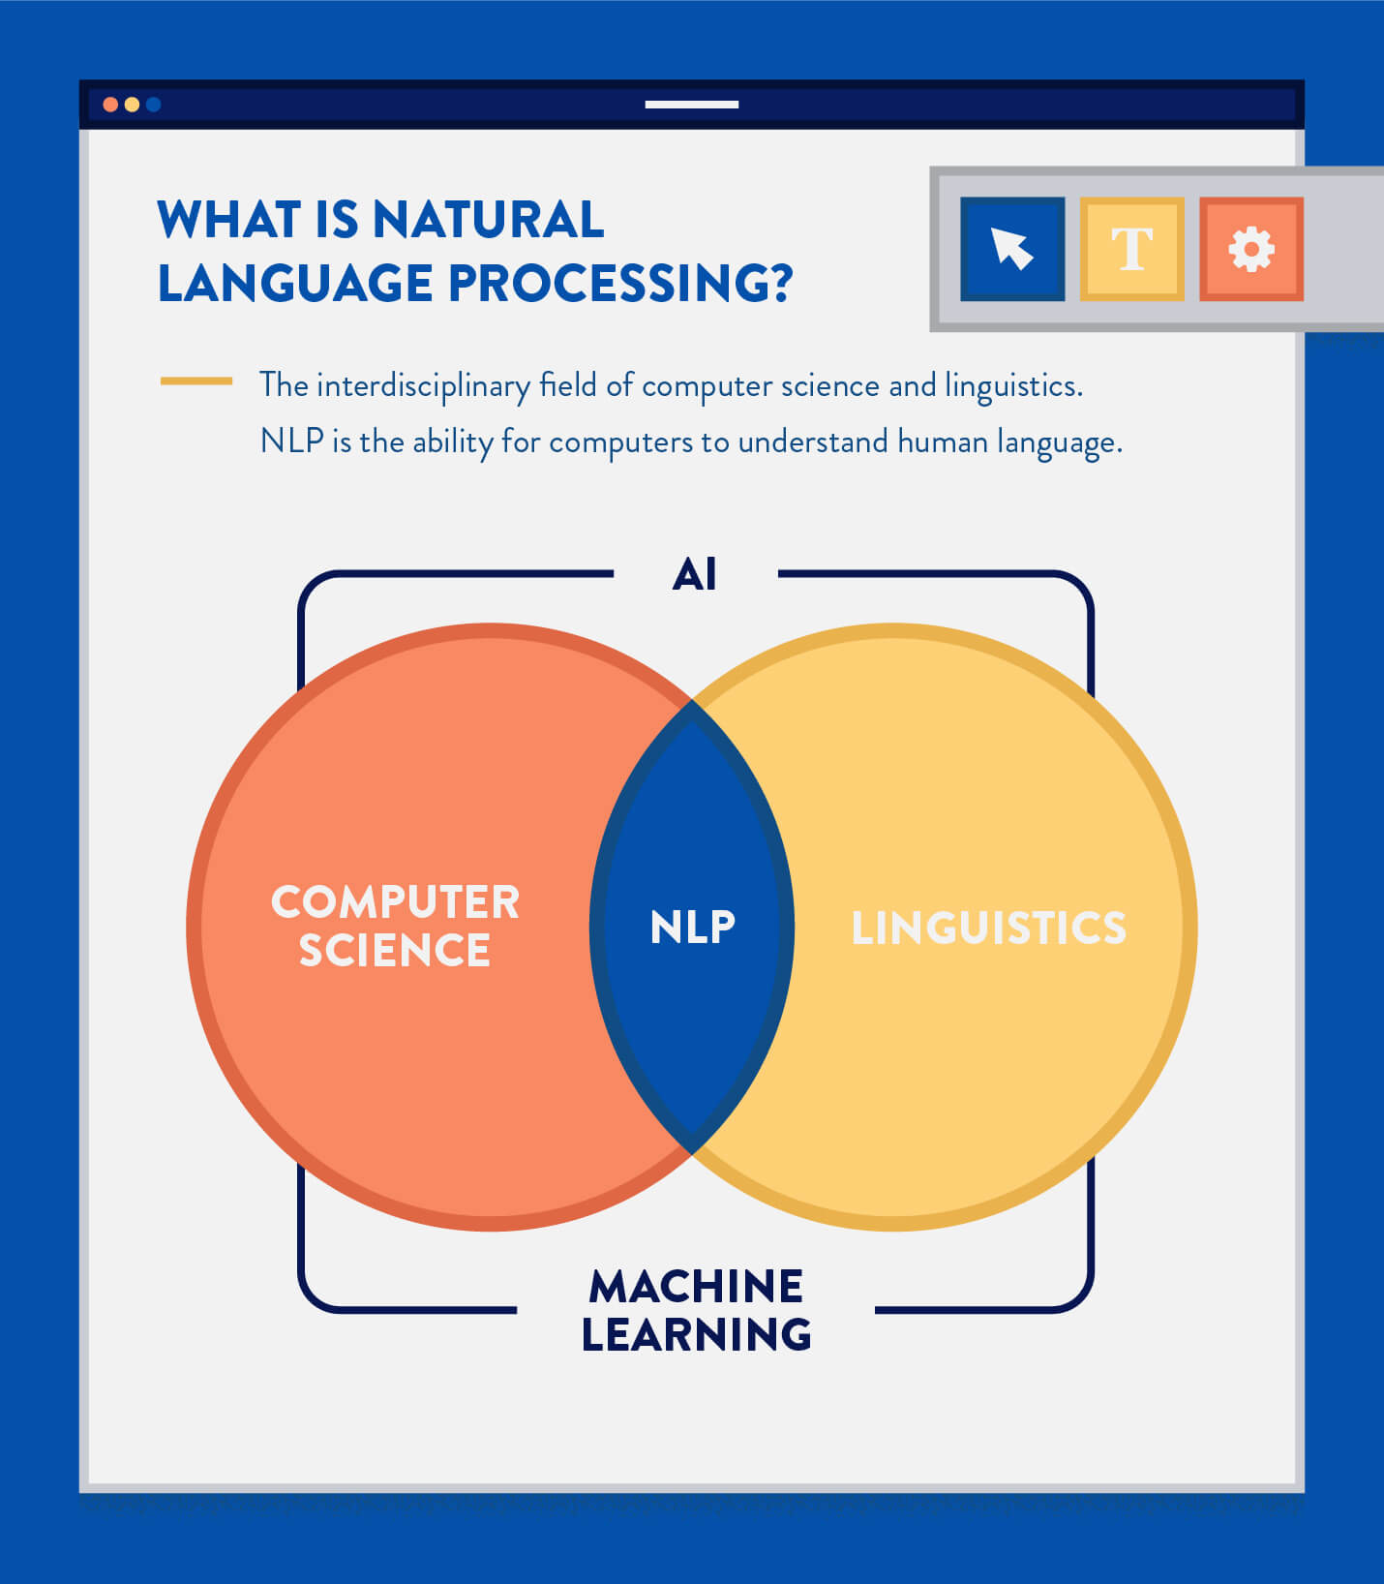
Natural Language Processing
NLP is the ability to automatically receive, understand, and operate on human language in the raw written or spoken form.
Ref: https://clevertap.com/blog/natural-language-processing/

Slide 3
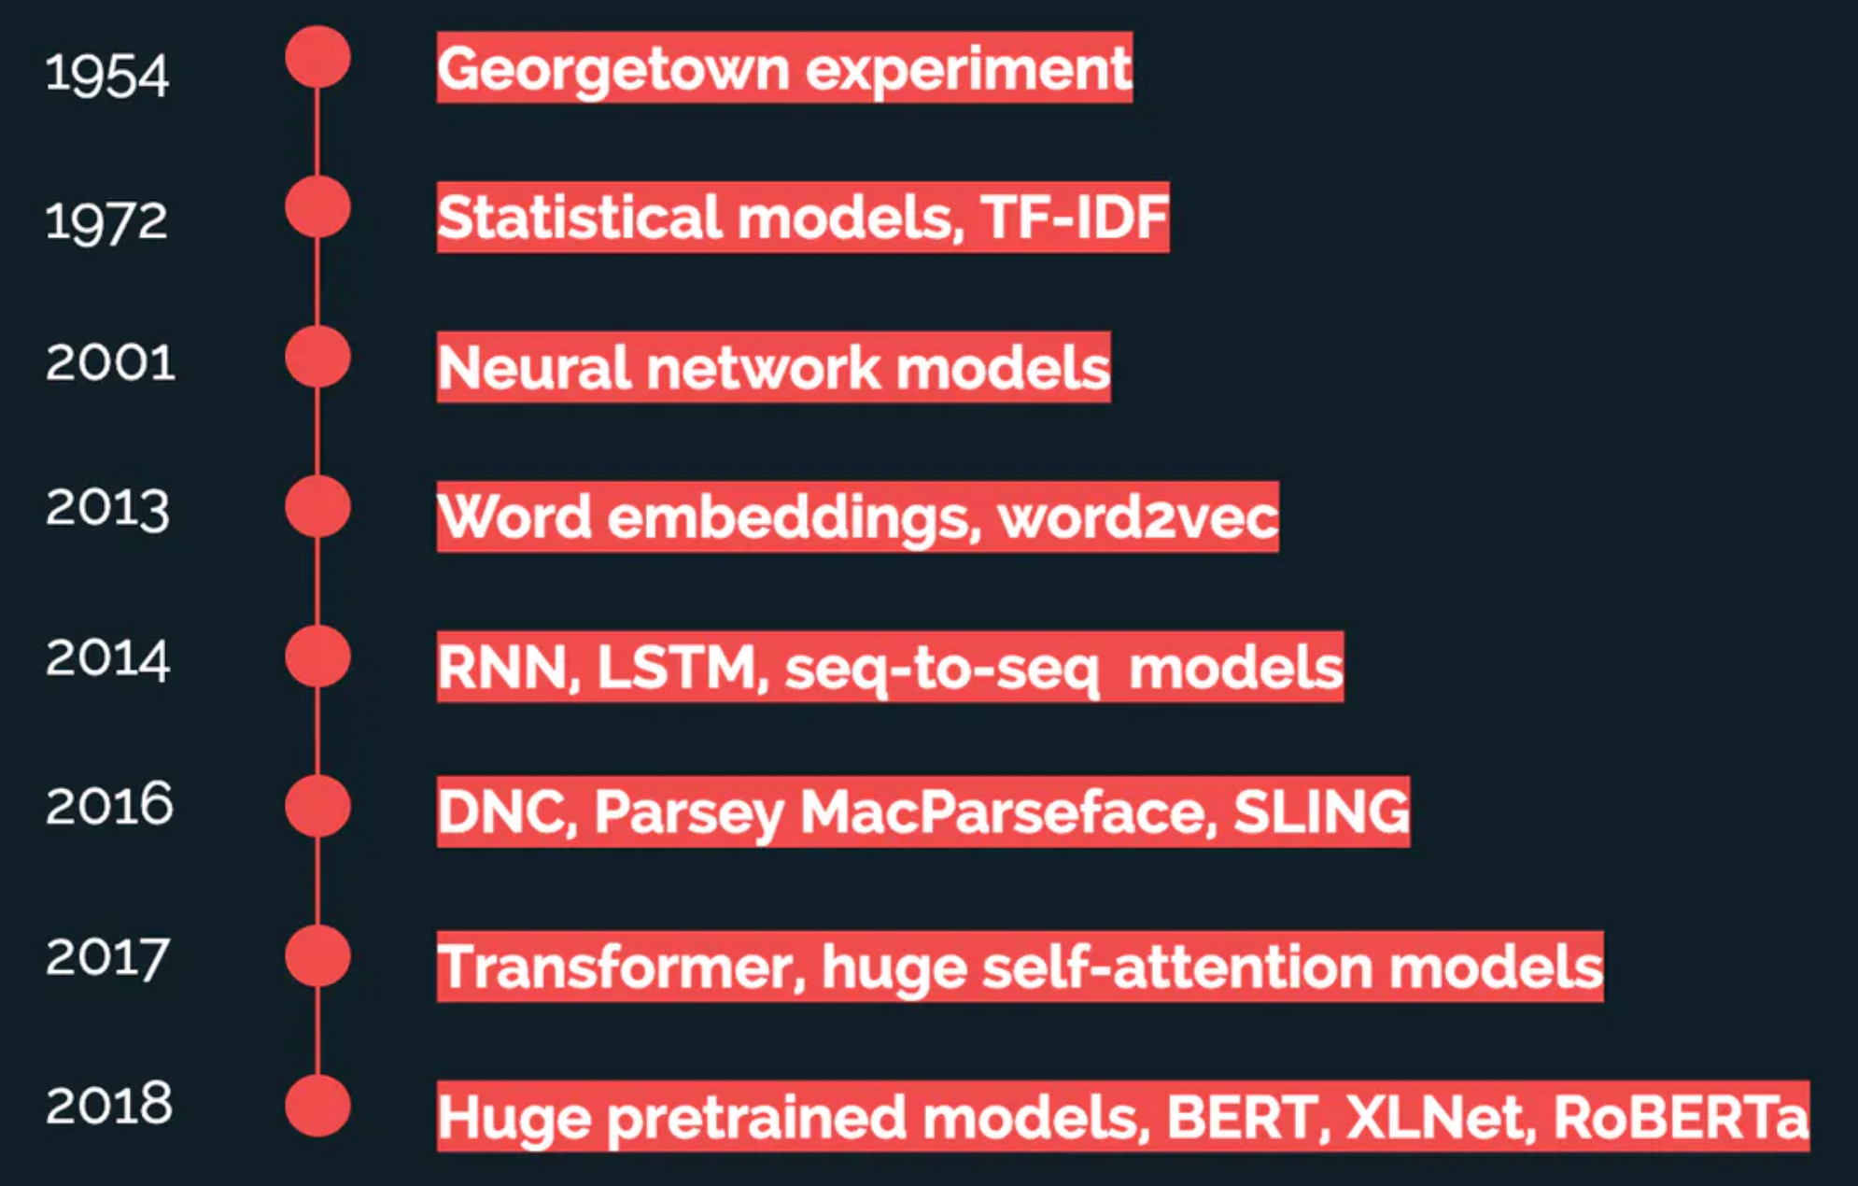
Natural Language Processing
NLP is one of the most well-known applications of AI.
Georgetown experiment (1954): when a group of scientists was able to program a computer to translate 60 sentences from Russian into English.
https://peltarion.com/blog/data-science/a-year-in-review-nlp-in-2019

Slide 4
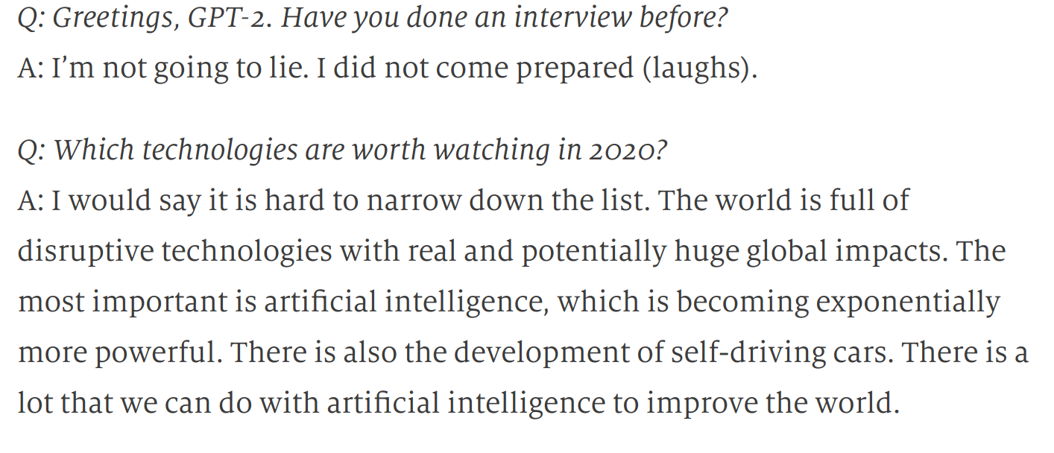
Natural Language Processing
An artificial intelligence predicts the future
https://worldin.economist.com/article/17521/edition2020artificial-intelligence-predicts-future

Slide 5
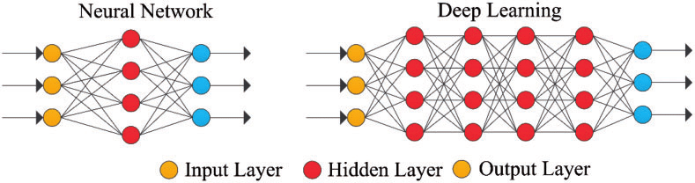
Deep Learning
Notes:
Deep Learning – Basics
Slide no: 21-29 from REF: https://www.slideshare.net/LuMa921/deep-learning-a-visual-introduction
<number>

Slide 6
Quick review – Deep Learning Topics
Neurons
Input layer
Hidden layer
Output layer
Values from one layer to other layer are being transferred through function
Connection between layer - weights
Weights are learned during training
Training through back propagation
REF: https://www.slideshare.net/LuMa921/deep-learning-a-visual-introduction
For more in-depth – join next workshop by Vincent
Notes:
<number>

Slide 7
Sequence Classification
Sequence to Sequence
Others
Use Cases
https://github.com/ravikg/deep-learning-nlp-kaggle-toxic-comment/blob/master/notebooks/USECASES.md
Notes:
Look into examples in next slides
<number>

Slide 8
Sequence Classification
Given a sequence classify:
Language detection
Sentiment analysis
Topics detection
Keyword classification
SPAM detection
Movie reviews
Notes:
<number>

Slide 9
Sequence to sequence
Given a sequence generate another sequence:
Machine translation
Smart replies (in e-mails, messages)
Auto response (chat-bots, personal ai agents)
Question-answering

Slide 10
Other Use cases
Sequence generator: name, story etc.
Image captioning
Part of speech (PoS) tagging
Name entity recognition (NER): names, places, brands etc.

Slide 11
IMDB review dataset
Ubuntu dialog corpora
Translation dataset
Other datasets
Kaggle challenge: Toxic comment classification (Wikipedia comment dataset)
Datasets
https://github.com/ravikg/deep-learning-nlp-kaggle-toxic-comment/blob/master/notebooks/DATASET.md
Notes:
We will explore the Kaggle challenge dataset
<number>

Slide 12
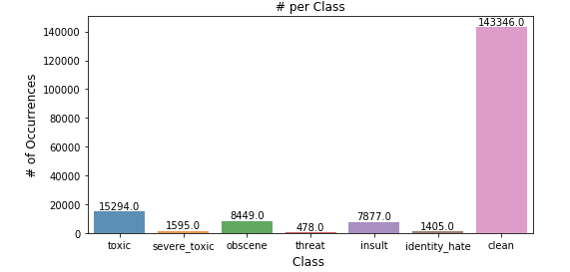
Toxic comment classification
Kaggle challenge: https://www.kaggle.com/c/jigsaw-toxic-comment-classification-challenge
Identify and classify toxic online comments
Multi class classification

Slide 13
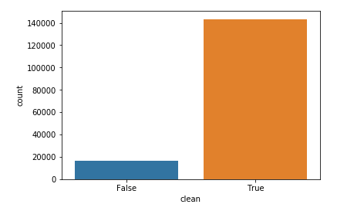
Toxic comment classification
Simplified to 2 class problem for the workshop

Slide 14
System Setup
docker-compose up
Python 3.6
pip
Virtualenv
Libraries:
Keras
Tensorflow
Jupyter
matplotlib
https://github.com/ravikg/deep-learning-nlp-kaggle-toxic-comment/blob/master/notebooks/SETUP.md
Notes:
Official jupyter provides multiple docker images for data science. Will use one of those
<number>

Slide 15
NLP Stages
Text representation
Tokenization
Word embedding
Batching & Padding
Notes:
Official jupyter provides multiple docker images for data science. Will use one of those
<number>

Slide 16

Text(Sequence) Representation
All algorithm needs numerical tensor
Generating numerical tensor in following steps:
Tokenization:
Sequence of characters
Sequence of words
Sequence of n-grams
Vector representation
One Hot Encoding
Word Embedding
Other representation
Bag of words
Notes:
Algorithms needs numerical tensor (multi dimensional vectors) to work on.
Tokenization: split using e.g. punctuation marks = Seq of words is most common. e.g. 2-gram = 2 words is a single element of sequence
Interpret word/element in sequence as pixel from an image in Image processing
<number>

Slide 17
Tokenization
Sample text: This is a car
Seq of char:
Tokens: {t, h, i, s, a, c, r}
Seq of words:
Tokens: {this, is, a, car}
Seq of n-grams:
Tokens(bi-gram): {this is, is a, a car}
We will use words as our token
Notes:
Official jupyter provides multiple docker images for data science. Will use one of those
<number>

Slide 18
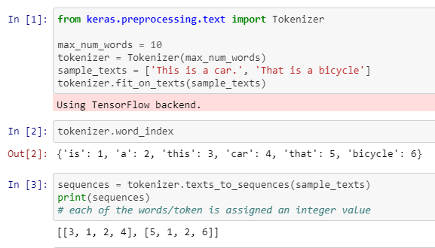
Tokenization

Slide 19
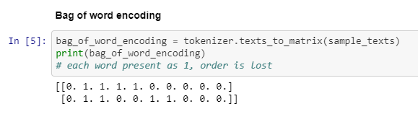
Bag of words
Collect of index for the tokens present in a text
Binary vector with 0, 1 entries
Order of tokens is lost

Slide 20
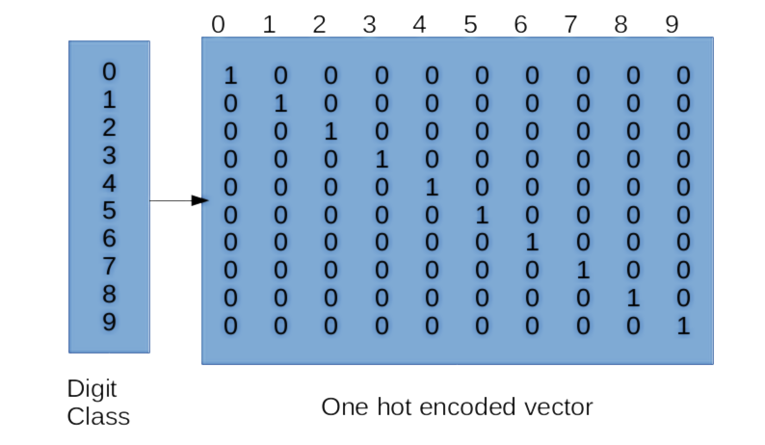
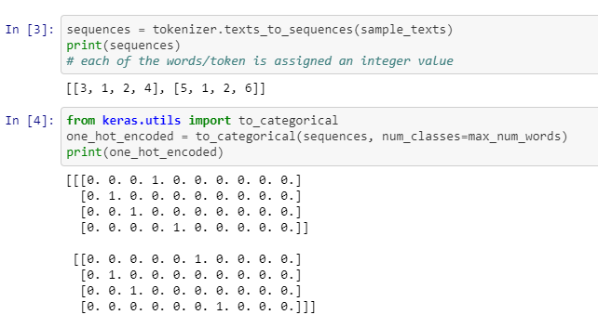
One hot encoding
https://app.pluralsight.com/guides/getting-started-tensorflow
Notes:
A token which is represented as an integer is transformed into a vector
So the sequence of integer becomes a seq of vector which can be processed
Total no. of dimension = no. of unique tokens in vocabulary
Sparse Matrix
<number>

Slide 21
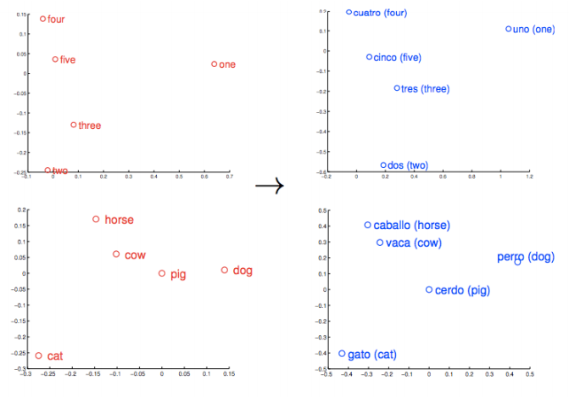
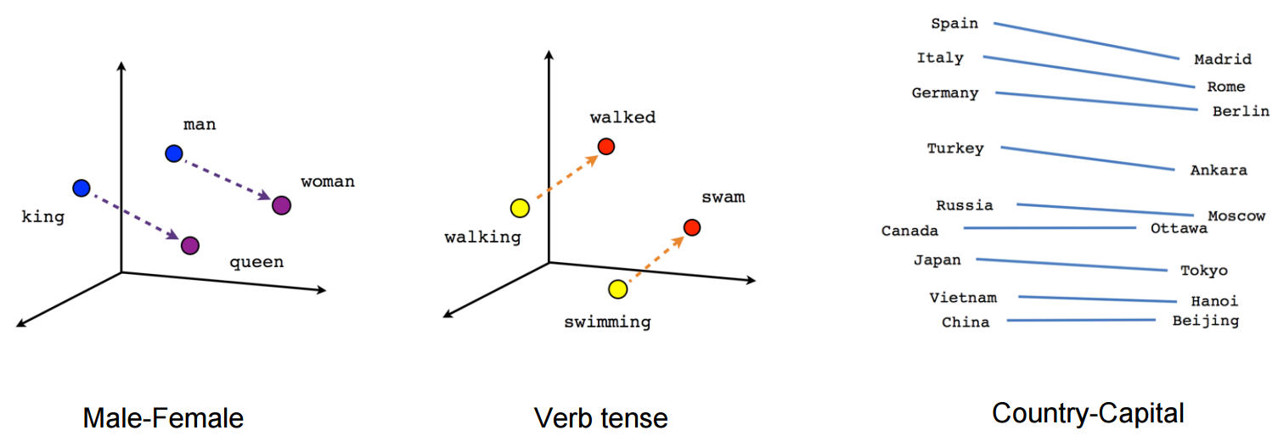
Word Embeddings
https://skymind.ai/wiki/word2vec
https://towardsdatascience.com/deep-learning-4-embedding-layers-f9a02d55ac12

Slide 22
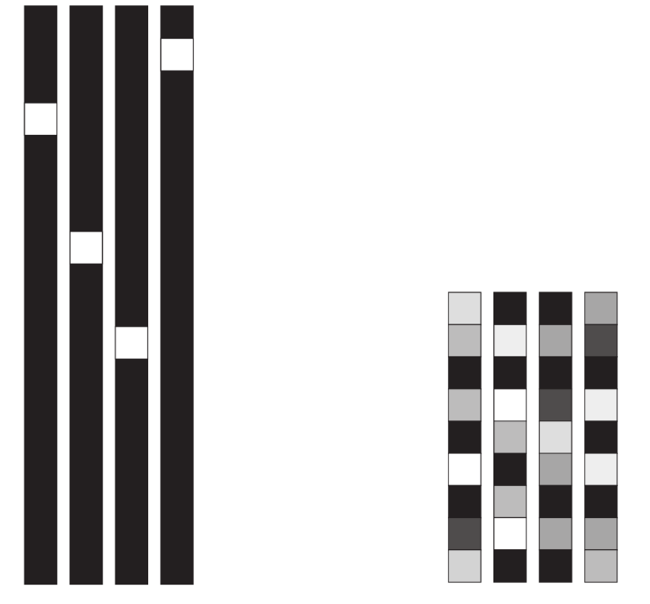
Word Embeddings
One hot encoding:
High dimensional
Sparse matrix, mostly made of zero
Does not capture relations between words
Independent of data
Word embedding:
Low dimensional
Learn from data
Vector with floating values
Learns relationship between words
Deep Learning with Python by Francois Chollet, Book
Notes:
<number>

Slide 23
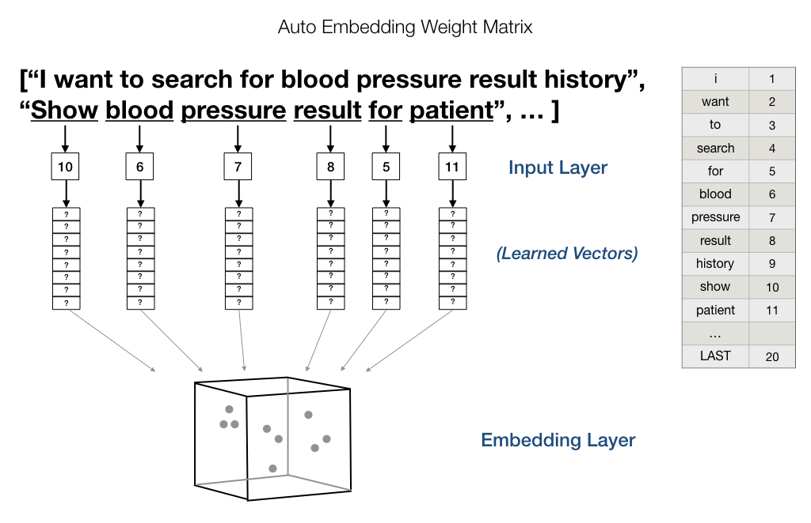
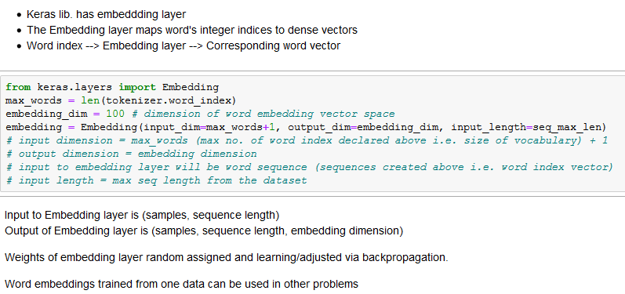
Embedding Layer
Notes:
<number>

Slide 24
Pre trained word embeddings
Word2Vec: which captures specific semantic structure https://code.google.com/archive/p/word2vec
GloVe: which captures co-occurrence statistics for millions of English tokens from Wikipedia and Common Crawl data. https://nlp.stanford.edu/projects/glove
Notes:
One can learn from the training data also or use pre trained ones
Some training data does not have enough data to learn word embeding
There are many pretrained word embeddings.
<number>

Slide 25
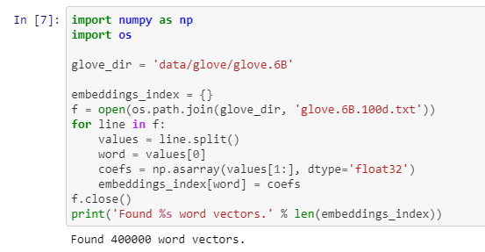
Load pre trained word embedding
Step 1: Load the map

Slide 26
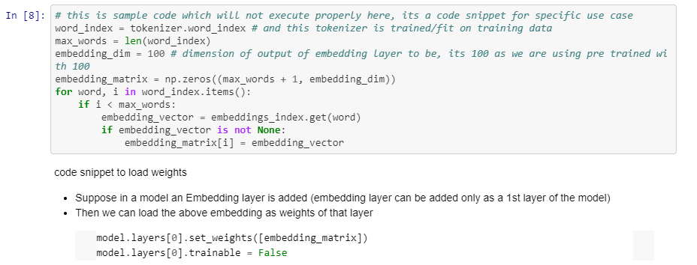
Load pre trained word embedding
Step 2: Generate the Embedding layer weights
Notes:
For our use case we will learn the embedding layer
<number>

Slide 27
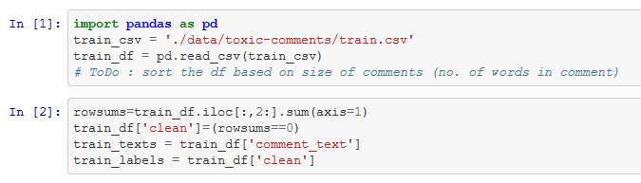
Preprocessing
Convert multi-class to 2-class label

Slide 28
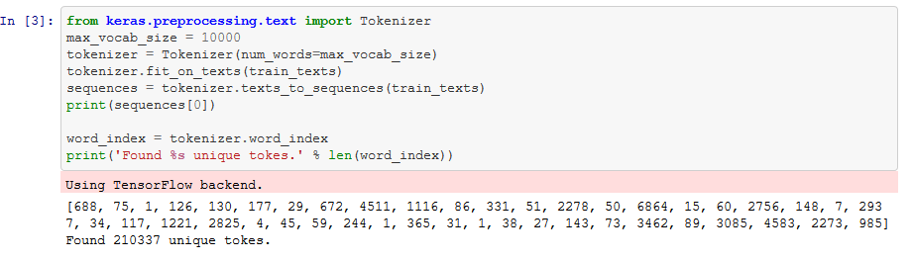
Preprocessing
Tokenization

Slide 29
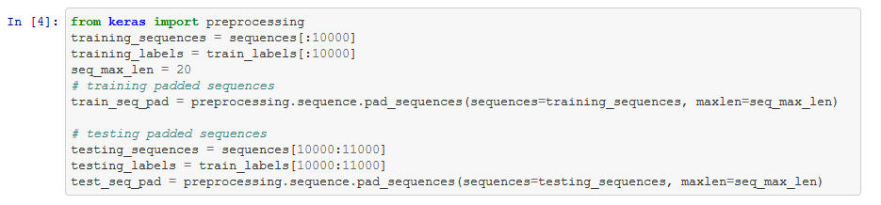
Preprocessing
Batch and Padding

Slide 30
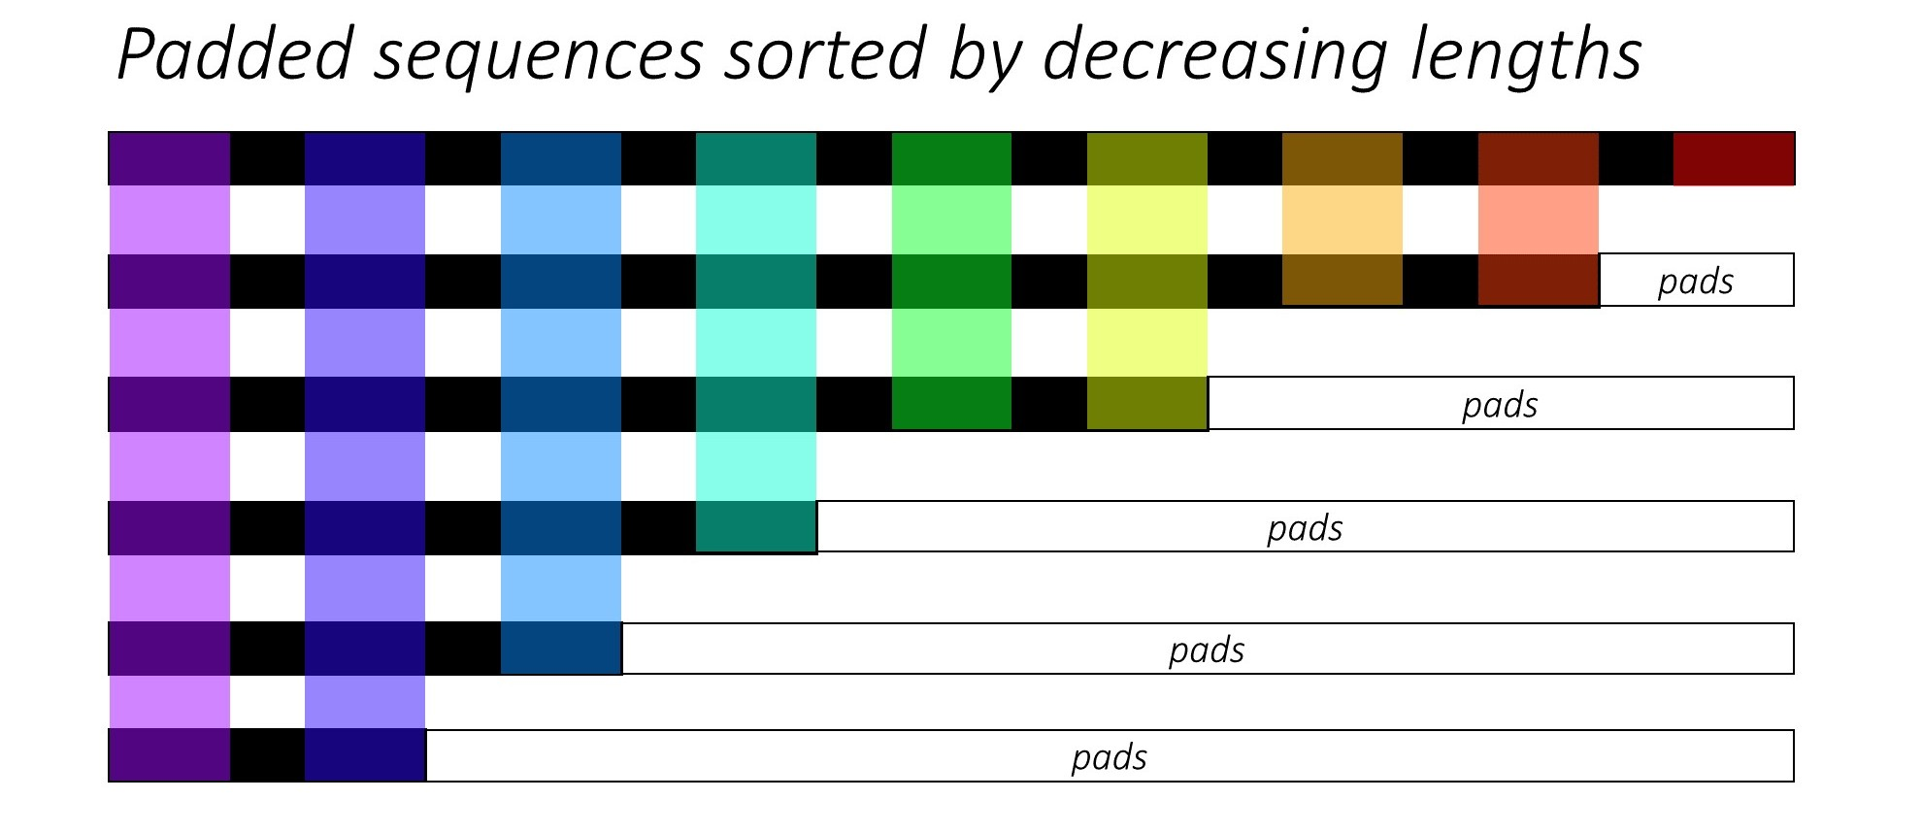
Padding
https://stackoverflow.com/a/56211056

Slide 31
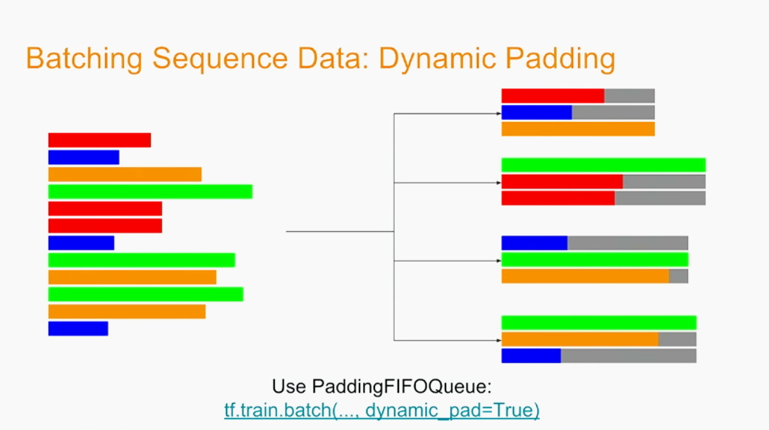
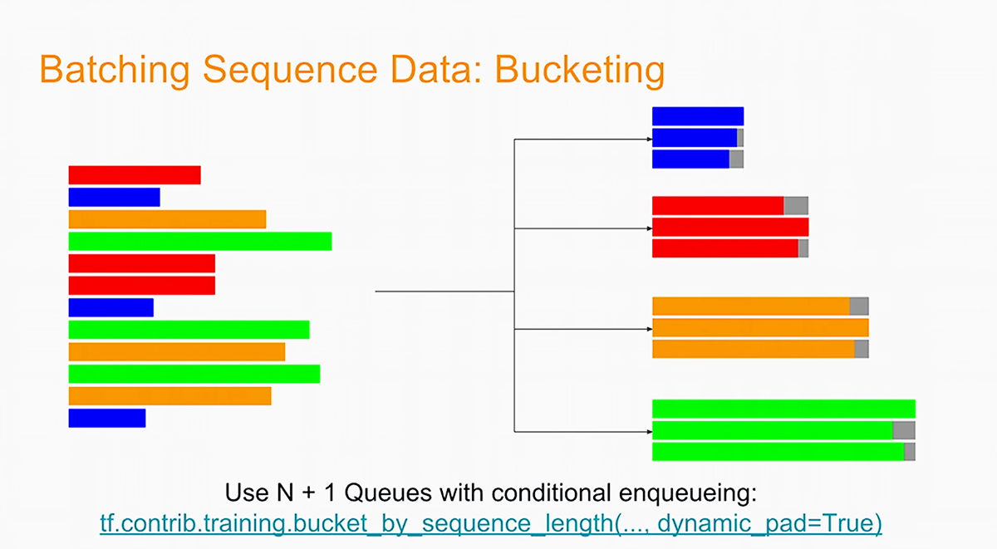
Batch & Padding
https://www.altoros.com/blog/the-magic-behind-google-translate-sequence-to-sequence-models-and-tensorflow/

Slide 32
Models
Embedding => Class
Embedding => Simple RNN => Class
Embedding => RNN => … => RNN => Class
Embedding => Bi-RNN(Bi-directional RNN)
Notes:
<number>

Slide 33
Model 1 : Embedding => Class
Model 1 is made of 4 layers:
Layer 0 is input layer
Layer 1 is Embedding layer (Hidden Layer)
Layer 2 is Flatten Layer (Flattens the embedding layer)
Layer 3 is Dense Layer (output layer)
Go to jupyter notebook

Slide 34
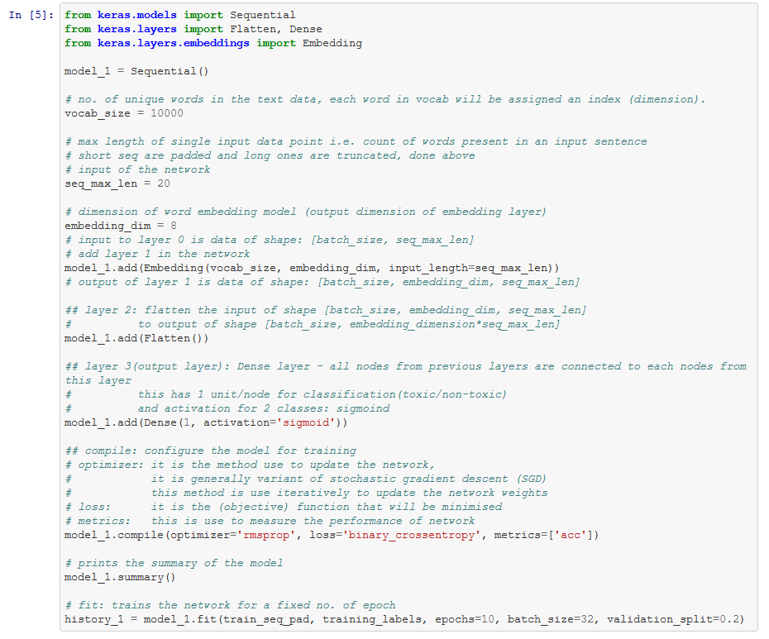
Model 1 : Embedding => Class
Various Parameters
Notes:
<number>

Slide 35
Model 1 : Embedding => Class
Adding layers

Slide 36
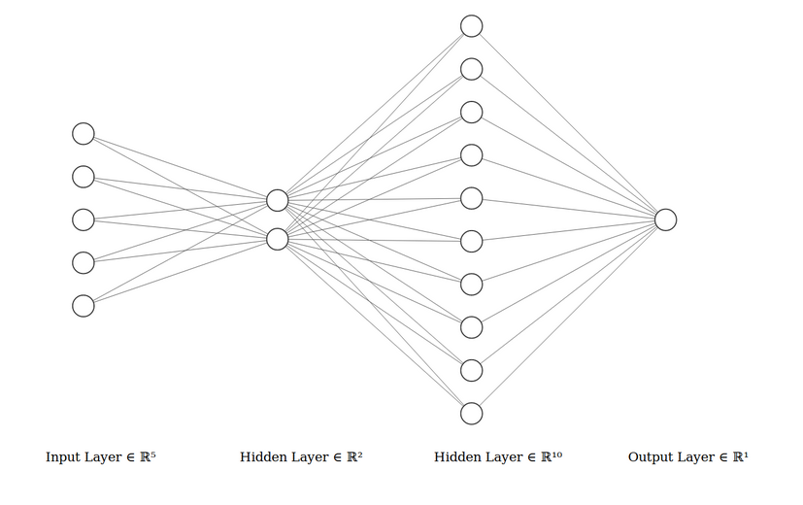
Model 1 : Embedding => Class
For the diagram, following configs are used(1/4th of the ones used in code):
seq_max_len = 5
embedding_dim = 2
flatten layer = 5x2 = 10
desnse output layer = 1
Notes:
<number>

Slide 37
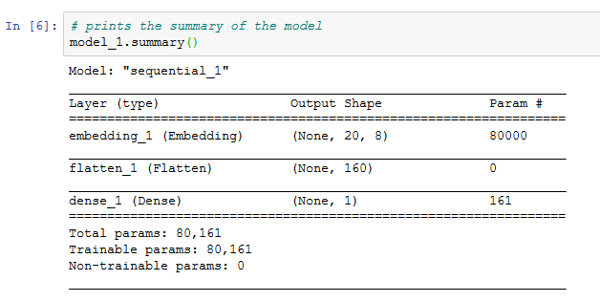
Model 1 : Embedding => Class
Model Summary

Slide 38
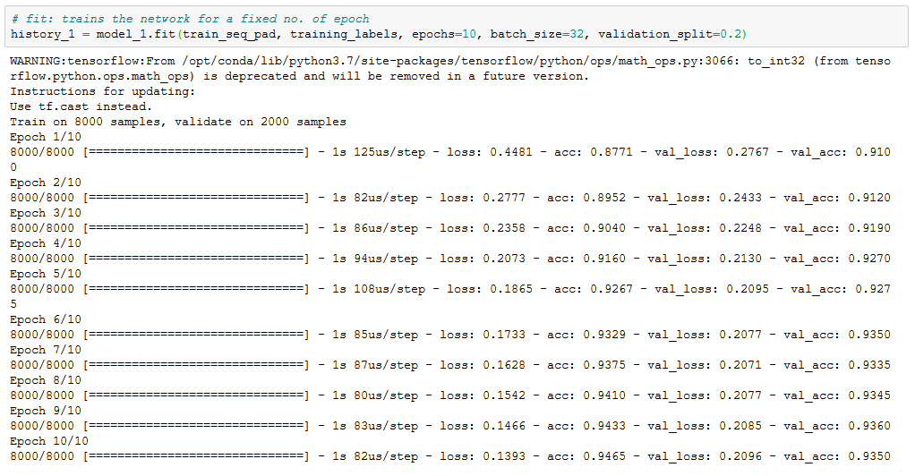
Model 1 : Embedding => Class
Model Training

Slide 39
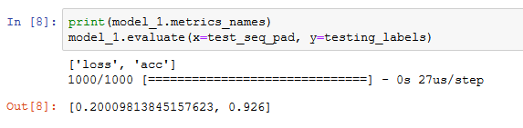
Model 1 : Embedding => Class
Model Evaluation

Slide 40
Excercise

Slide 41
Model 2 : Embedding => RNN => Class
Model 2 is made of 4 layers:
Layer 0 is input layer
Layer 1 is Embedding layer (Hidden Layer)
Layer 2 is RNN Layer (return last output)
Layer 3 is Dense Layer (output layer)
Go to jupyter notebook

Slide 42
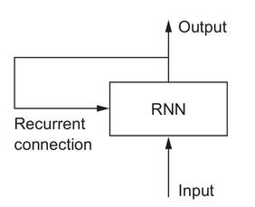
RNN : Recurrent Neural Network
RNN is a neural network with following properties
Processes each element (word) of a sequence (sentence) one by one
And output of intermediate element is fed back together with the next element
The state of RNN is reset between two independent sequence
Deep Learning with Python by Francois Chollet, Book
Notes:
<number>

Slide 43
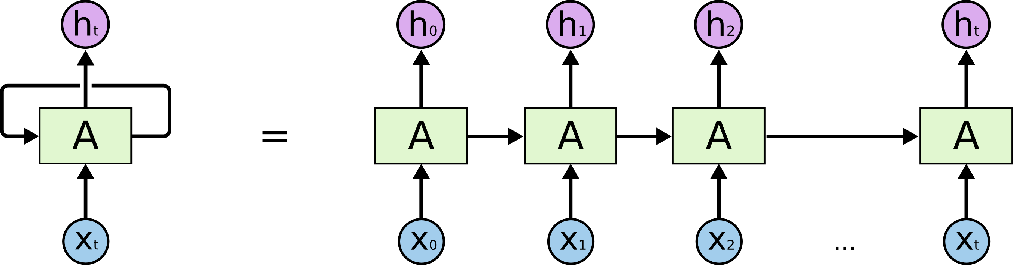
Unrolled RNN
http://colah.github.io/posts/2015-08-Understanding-LSTMs/

Slide 44
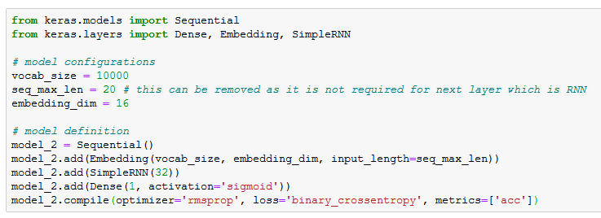
Model 2 : Embedding => RNN => Class
Model Definition

Slide 45
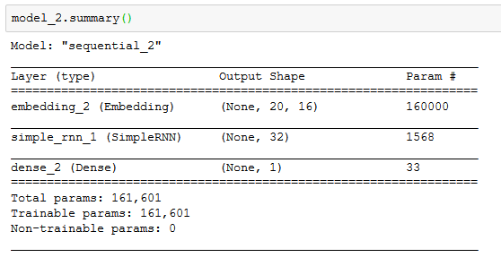
Model 2 : Embedding => RNN => Class
Model Summary

Slide 46
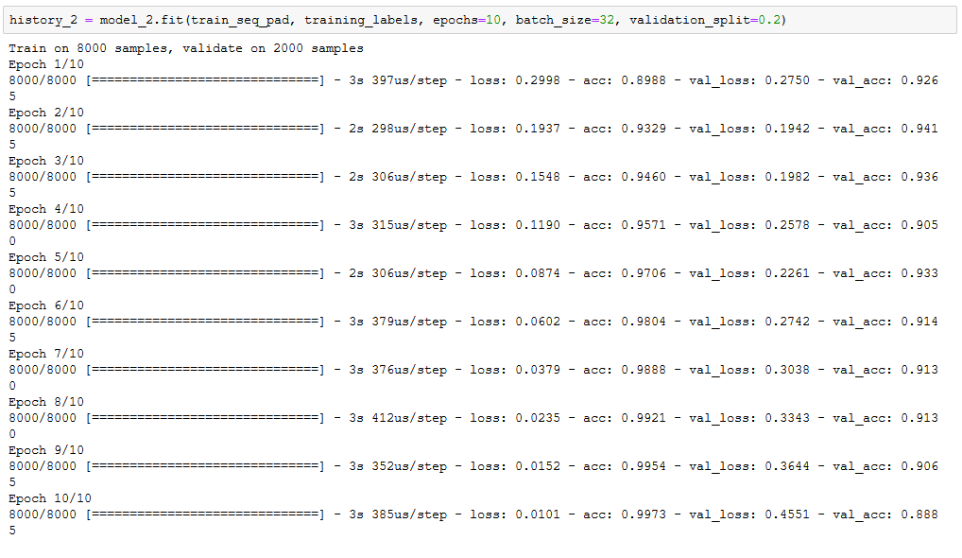
Model 2 : Embedding => RNN => Class
Model Training
Notes:
Accuracy is decreasing
<number>

Slide 47
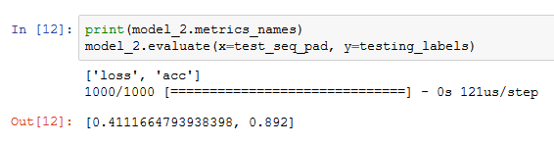
Model 2 : Embedding => RNN => Class
Model Evaluation

Slide 48
Excercise

Slide 49
Model 2Ext : Embedding => (RNN)^n => Class
Model 2Ext is made of 6 layers:
Layer 0 is input layer
Layer 1 is Embedding layer (Hidden Layer)
Layer 2 is RNN Layer (return full sequence)
Layer 3 is RNN Layer (return full sequence)
Layer 4 is RNN Layer (return last output)
Layer 5 is Dense Layer (output layer)
Go to jupyter notebook

Slide 50
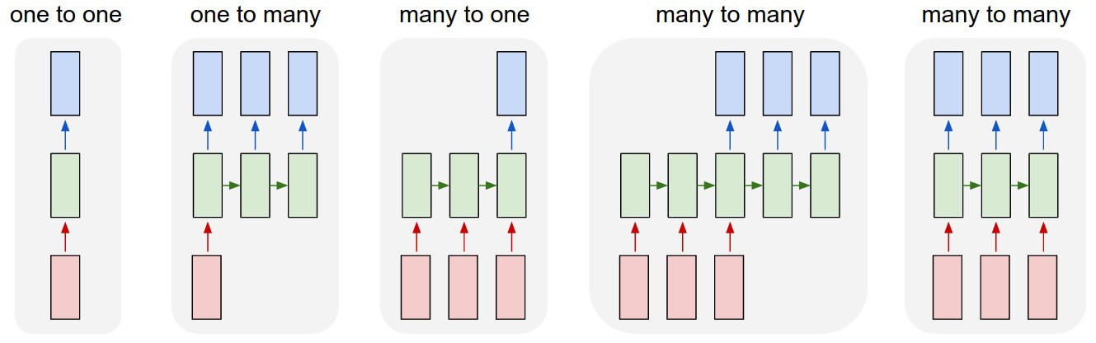
Model 2Ext : Embedding => (RNN)^n => Class
Layer 2 & 3: many to many; Layer 4: many to one

Slide 51
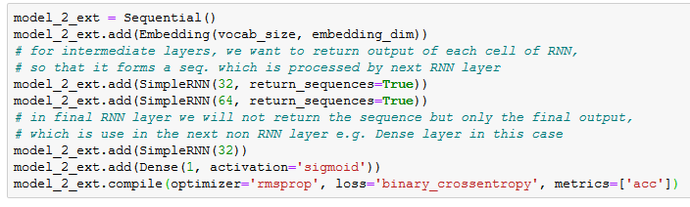
Model 2Ext : Embedding => (RNN)^n => Class
Model Definition

Slide 52
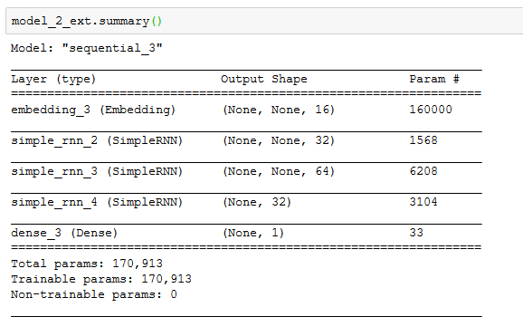
Model 2Ext : Embedding => (RNN)^n => Class
Model Summary

Slide 53
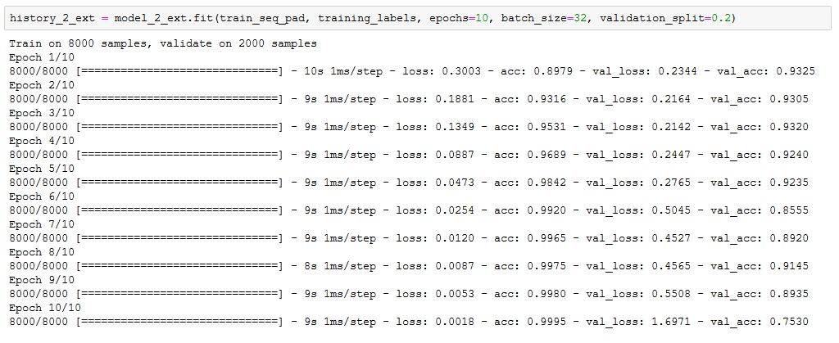
Model 2Ext : Embedding => (RNN)^n => Class
Model Training

Slide 54
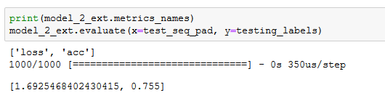
Model 2Ext : Embedding => (RNN)^n => Class
Model Evaluation

Slide 55
Excercise

Slide 56
Model 3 : Embedding => Bidirectional RNN => Class
Model 2 is made of 4 layers and uses a new type of layer:
Layer 0 is input layer
Layer 1 is Embedding layer (Hidden Layer)
Layer 2 is Bidirectional RNN Layer (return last output)
Layer 3 is Dense Layer (output layer)
Go to jupyter notebook

Slide 57
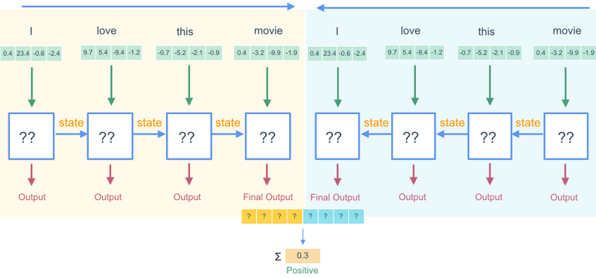
Model 3 : Embedding => Bidirectional RNN => Class
https://www.wandb.com/classes/intro/class-9-notes

Slide 58
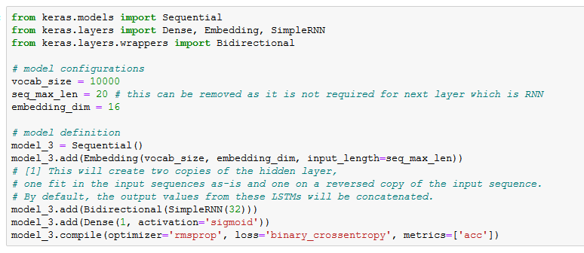
Model 3 : Embedding => Bidirectional RNN => Class
Model Definition

Slide 59
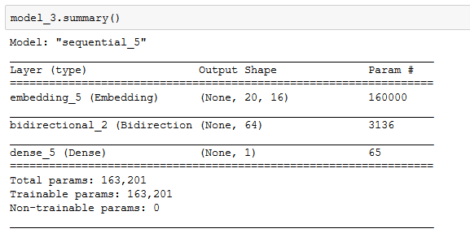
Model 3 : Embedding => Bidirectional RNN => Class
Model Summary

Slide 60
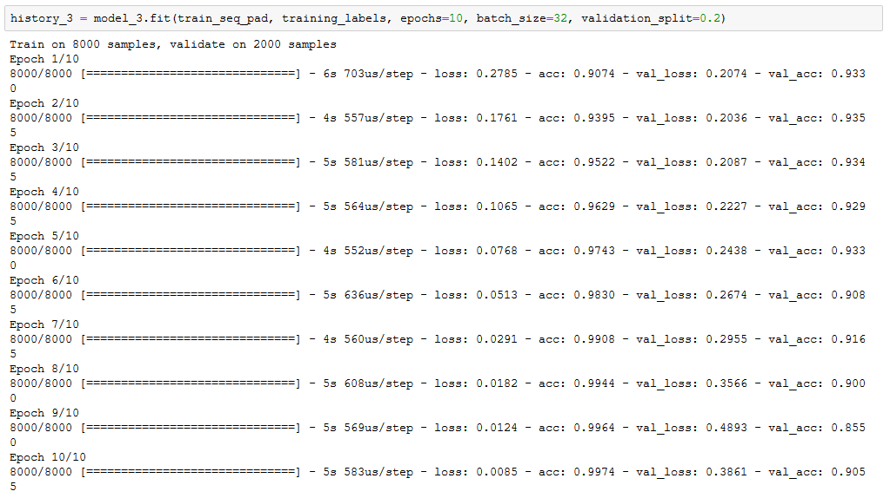
Model 3 : Embedding => Bidirectional RNN => Class
Model Training

Slide 61
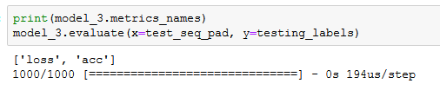
Model 3 : Embedding => Bidirectional RNN => Class
Model Evaluation

Slide 62
Excercise

