Slide 1
SPREADSHEET PROJECT
IT Ticket Analysis
Agent performance, resolution efficiency and where the next rupee should go
RAVIKIRAN GOUD
30 September 2026
97,498 tickets · 50 IT agents · 2016 – 2020
Notes:
Good morning. Over the next fifteen minutes I'll take you through an analysis of 97,498 IT support tickets raised between 2016 and 2020 and handled by 50 agents. The question I was asked to answer is where the next investment should go - more agents, better training, or new software. The data gives a clear answer, and it isn't the one most people expect.

Slide 2
SLIDE 2
Problem Statement
The objective is to analyze the IT support ticket management system to understand the performance of IT agents, the efficiency of ticket resolution, and the satisfaction levels of employees. The analysis aims to identify high and low performers among IT agents, assess the overall effectiveness of the team, and pinpoint areas for improvement in the ticket resolution process. The ultimate goal is to make informed staffing decisions, including hiring, firing, and training, to enhance overall service quality and team performance.
— as set out in the project brief
Why it matters — what the data showed on arrival
The four questions this project answers
Ticket volume has more than doubled in five years and is still accelerating.
Resolution time is reported only as one company-wide average, hiding a 25-fold gap between categories.
Agent performance had never been compared like-for-like, so nobody knew who was genuinely struggling.
Nearly a third of tickets are logged with no priority, so the queue cannot be sequenced.
1
Is this a capacity problem?
Do we need more agents, or is the existing team under-used?
2
Where is the time actually lost?
Severity, priority, or request category — which really drives delay?
3
Who needs support, and who should mentor?
Which agents underperform once workload is held constant?
4
Where should the next rupee go?
Hire, train, or upgrade the ticket management software?
Notes:
This is the problem statement as set out in the project brief: analyse the ticket management system to understand agent performance, resolution efficiency and employee satisfaction, identify high and low performers, and ultimately make informed staffing decisions on hiring, firing and training. On the left is what the data looked like on arrival, and on the right are the four questions I turned that objective into. Everything in this deck answers one of those four.

Slide 3
SLIDE 3
Introduction and Objectives
Every single day for five years, this organisation logged 53 new IT tickets — and the daily rate is still climbing.
97,498
50
TICKETS ANALYSED
IT AGENTS
The IT support function handles every technical issue and service request raised inside the business. Five years of its ticket history was analysed to understand how well it performs, where it loses time, and what management should fund next.
5
16
What this project sets out to achieve
YEARS OF HISTORY
ATTRIBUTES
1
Measure agent performance
Identify the strongest and weakest performers on comparable workloads
The decision on the table:
2
Assess resolution efficiency
Hire more IT agents?
Improve training programmes?
Upgrade the ticket management software?
Find where time is lost and which factors actually drive delay
3
Understand employee satisfaction
Establish what moves the satisfaction score, and what does not
4
Guide the investment decision
Hire more agents, improve training, or upgrade the software?
Notes:
The hook is that this organisation logs 53 tickets every single day, and that rate is still rising. The project set out to measure agent performance, find where resolution time is lost, understand what drives satisfaction, and ultimately answer one investment question: hire, train, or upgrade the software.

Slide 4
SLIDE 4
Data Overview
Two source sheets, 16 attributes, a complete gap-free daily history
What the dataset contains
Data cleaning and preprocessing
Tickets sheet (10 attributes)
ID Ticket · Fecha · Employee ID · Agent ID · Request Category · Issue Type · Severity · Priority · Resolution Time (Days) · Satisfaction Rate
IT Agents sheet (6 attributes)
Agent ID · Full Name · Email · Year of Birth · Month of Birth · Day of Birth
No missing values and no duplicates anywhere — the problems were subtler, and all would have skewed the analysis.
3
Spelling errors — 34,602 records
“3 - Mayor”, “0 - Unclasified”, “0 - Unassiged” corrected in Severity and Priority
14
Malformed agent names
7 incomplete (A. Trejo, Javier D., Lorena…) and 7 reversed — rebuilt from the email address
Coverage
01-Jan-2016 to 31-Dec-2020 — 1,827 consecutive days
4 request categories, 2 issue types, 5 severities, 4 priorities
Satisfaction captured on a 1–5 scale for every ticket
0
Blanks, duplicates, orphan IDs
Verified with COUNTBLANK, COUNTIF and a referential-integrity check
Why it matters: the agent-name column contains no blanks, so a standard null check passes it clean. Every name was rebuilt before any agent-level comparison was made.
Notes:
The dataset is 97,498 tickets across two sheets with sixteen attributes, covering every day for five years with no gaps. Cleaning found two things: three spelling errors affecting nearly 35,000 records, and - less obviously - fourteen of the fifty agent names were malformed. That second one matters because the column has no blanks, so a standard null check passes it clean.

Slide 5
SLIDE 5
Methodology
Built entirely in Excel — cleaned tables, pivot analysis, and an interactive dashboard
1
Data cleaning
COUNTIF, COUNTBLANK, SUBSTITUTE, TRIM and PROPER to correct labels and rebuild names
What was built
2
Data enrichment
22
worksheets
VLOOKUP to join agents to tickets; MID with FIND to extract email domains
3
Derived features
28
pivot tables
DATE and DATEDIF for agent age and seniority bands; resolution-speed buckets
4
Statistical testing
27
charts
CORREL to test whether severity genuinely drives resolution time
5
Summarisation
3
linked slicers
Pivot tables on a single shared cache, one sheet per question
6
Visualisation & interactivity
Charts plus slicers on Year, Request Category and Priority
One sheet per question, so every figure quoted in this deck can be traced back to its own pivot table.
Notes:
Everything is native Excel. Cleaning with text functions, enrichment with VLOOKUP, derived age fields with DATEDIF, a correlation test with CORREL, and then pivot tables and charts feeding a slicer-driven dashboard. The workbook has one sheet per question so every number in this deck is traceable.

Slide 6
SLIDE 6 · OBJECTIVE ANALYSIS
Demand has more than doubled in five years
+122.9%
TICKET GROWTH 2016 → 2020
13,051 rising to 29,088 a year
Key takeaways
Every single year is higher than the one before — no year of decline.
2020 accelerated hardest at +35.4% on 2019.
December 2020 is the busiest month on record.
Average daily volume is 53 tickets across 1,827 days.
This is structural growth, not a seasonal spike — whatever we fund has to scale.
Notes:
The first objective finding: demand is growing relentlessly. Volume rose from just over thirteen thousand tickets in 2016 to twenty-nine thousand in 2020 - up 123 percent. No year fell, and 2020 was the steepest of all. This is the backdrop to every recommendation that follows.

Slide 7
SLIDE 7 · OBJECTIVE ANALYSIS
Category — not severity — decides how long a ticket takes
25×
SLOWEST vs FASTEST
Hardware 7.63 d
Login Access 0.31 d
Key takeaways
System is 40% of all volume at 6.62 days — the largest pool of recoverable delay.
Login Access proves automation works: 29,193 tickets at a third of a day.
Hardware is slowest but smallest — a logistics problem, not a skills one.
Ticket volume by category
Avg resolution time (days)
Notes:
The second finding. System carries forty percent of the workload at six and a half days, while Login Access handles nearly thirty thousand tickets in a third of a day. That twenty-five fold gap is driven by category, not by how urgent the ticket is - which brings me to the next slide.

Slide 8
SLIDE 8 · OBJECTIVE ANALYSIS
Triage is inverted: Urgent is fast, Normal is slowest
−0.0405
CORRELATION · SEVERITY vs RESOLUTION TIME
Effectively zero — severity does not drive speed
Key takeaways
Tested with =CORREL() against a derived numeric Severity Level.
In a healthy process this number would be strongly negative — severe work resolved fastest.
Instead ordinary Normal tickets — 88,656 of them — are the slowest of all at 4.66 days.
Urgent tickets close in 2.00 days and Major in 3.91 — both faster than Normal.
Either the routing rules are misconfigured, or agents are bypassing them.
Notes:
The third objective finding, and the one that should worry us. Severity is supposed to govern urgency. I tested it directly: the correlation between severity and resolution time is minus zero point zero four - effectively zero. Worse, it runs the wrong way. Urgent tickets close in two days but ordinary Normal tickets take four and a half. Triage is not working.

Slide 9
SLIDE 9 · SUBJECTIVE INSIGHT
Identical workloads, very different outcomes
1.55
POINT GAP · WORST TO BEST AGENT
On caseloads within 9% of each other
Why this is the key insight
All 50 agents handled 1,856–2,027 tickets — a spread of only 9%.
So there is no capacity bottleneck, and performance gaps are genuine, not workload artefacts.
Seniority explains almost none of it — the variation is individual, so coaching can close it.
The five slowest and the five least-liked are different people — but at agent level satisfaction and speed correlate −0.40, so the problems are related, not independent.
Notes:
Now the subjective insights. This is the most important slide in the deck. On caseloads within nine percent of each other, one agent averages three point zero four out of five and another averages four point six. That gap is not workload and it is not seniority - it is individual, which means training can close it.

Slide 10
SLIDE 10 · SUBJECTIVE INSIGHT
A third of tickets enter the queue with no priority
30.2%
LOGGED WITH NO PRIORITY
29,410 of 97,498 tickets
How the current tool is failing
PRIORITISATION — severity does not drive sequencing (correlation −0.04).
DATA CAPTURE — the tool allows a ticket to be created with no priority at all.
COMPLEXITY — no evidence of escalation routing; Hardware and System never speed up.
What does work: routine automation. Login Access closes in 0.31 days at high volume.
Notes:
The second subjective insight. Twenty-nine thousand four hundred tickets - thirty percent of everything logged - were never given a priority. Combined with the inverted triage from slide seven, that is a configuration failure in the ticketing tool, not an agent failure. And it is the cheapest thing on the list to fix.

Slide 11
SLIDE 11 · SUBJECTIVE INSIGHT
Quality held as demand doubled — but speed doesn't buy satisfaction
4.5
−0.004
DAYS — FLAT ALL 5 YEARS
SPEED vs SATISFACTION
Two findings that change the recommendation
Resolution time moved only 4.52–4.59 days while volume rose 123%, and satisfaction rose every year to 4.16.
So there is no service emergency — we are investing from strength, not firefighting.
But satisfaction is insensitive to speed: it sits at 4.09–4.11 across categories ranging from 0.31 to 7.63 days.
Technology buys throughput and scale. Training buys satisfaction. Different levers, different outcomes.
Notes:
The third insight has two halves, and I want to be straight about the second. The good news: resolution time stayed flat at about four and a half days while volume doubled, and satisfaction rose every year. The caution: satisfaction barely responds to speed - the correlation is minus zero point zero zero four. So technology buys us throughput, but training is what buys satisfaction.

Slide 12
SLIDE 12 · STRATEGIC RECOMMENDATION
1. Invest in training first
Reasoning: the data shows a consistency problem, not a capacity problem — so the fastest, cheapest return is closing the gap between agents.
1–3
1.55
Balanced training priority — combined metric
Ranked on a combined metric — Avg Satisfaction ÷ Avg Resolution Time — so both dimensions count.
MONTHS TO IMPACT
POINT GAP TO CLOSE
1
Priority 5 — by combined ratio
Alfonso Barraza 0.609 · Lorena Leon 0.658 · Nurio Zepeda 0.668 · Elena Velez 0.672 · Alberto Trejo 0.675
Step-by-step reasoning
Workload per agent varies by only 9% → hiring removes no bottleneck.
Satisfaction varies 3.04 to 4.60 on the same caseload → the gap is skill, not load.
Satisfaction and speed correlate −0.40 at agent level → a combined ratio ranks candidates fairly.
Skill gaps close with coaching, at one-off rather than recurring cost.
Expected impact: lifting the weakest quartile to the team median is free capacity at the same headcount.
2
Split by cause
Soft skills where satisfaction is weak; technical and process training where speed is — aimed at Hardware and System
3
Mentors & target
Diana Rojo (1.264) and Jesus Grajeda (1.244) mentor; re-measure in a quarter and target every agent above 0.75
Notes:
Recommendation one: fund training now. The reasoning is a chain - workload is even, so hiring removes no bottleneck; satisfaction varies by one and a half points on the same caseload, so the gap is skill; and skill gaps close with coaching at one-off cost. Note we need two different programmes, because the least-liked agents and the slowest agents are completely different people.

Slide 13
SLIDE 13 · STRATEGIC RECOMMENDATION
2. Then upgrade the ticket management software
Reasoning: training cannot fix a tool that lets 30% of tickets through with no priority and resolves Urgent work faster than Normal work.
1
2
3
4
Make priority mandatory
Rebuild prioritisation rules
Automate routing & escalation
Self-service for Login Access
No ticket creatable without one. Addresses 30.2% of the queue — the cheapest fix on this list.
So severity genuinely drives sequencing. Track the severity–resolution correlation as a health metric.
Send Hardware and System tickets to specialists automatically, with triggers on ageing tickets.
29,193 tickets a year that could leave the queue entirely — password resets and account unlocks.
Expected impact: closing even a third of the System gap — 6.62 days down to about 4.4 — pulls the company-wide average from 4.55 to roughly 3.7 days. A 19% improvement with no additional headcount.
Notes:
Recommendation two: the software upgrade, phased in after training. Four concrete fixes, starting with the cheapest - make the priority field mandatory. And to size the prize: closing even a third of the System gap takes the company-wide average from four and a half days to under four, without hiring anyone.

Slide 14
SLIDE 14 · STRATEGIC RECOMMENDATION
3. Hold on hiring — and dismiss no one
Do not hire yet
No agent should be dismissed
All 50 agents carry within 9% of the same caseload — there is no queue bottleneck to relieve.
Resolution time stayed flat while volume grew 123%, so the team is not yet at its limit.
Hiring adds permanent cost to solve a problem the data does not show.
Revisit once training and the tooling fixes are done, and if volume per agent genuinely exceeds capacity.
Every agent handled 1,856–2,027 tickets — nobody is failing to do the work.
The weakest satisfaction score, 3.04, is still above the mid-point of the scale.
The slowest agent at 5.55 days is under one day off the team average of 4.55.
This is a tightly clustered team with a coaching gap, not a performance crisis.
Dismissal would remove ~2,000 tickets a year of capacity to solve what training fixes far more cheaply.
Sequencing: train now (1–3 months) → upgrade the tool (6–18 months) → only then revisit headcount.
Notes:
Recommendation three is about what not to do. Don't hire yet - there's no bottleneck. And on whether anyone should be let go: no. Every agent is doing the work, the weakest score is above the middle of the scale, and the slowest agent is less than a day off the average. This is a coaching gap, not a performance crisis.

Slide 15
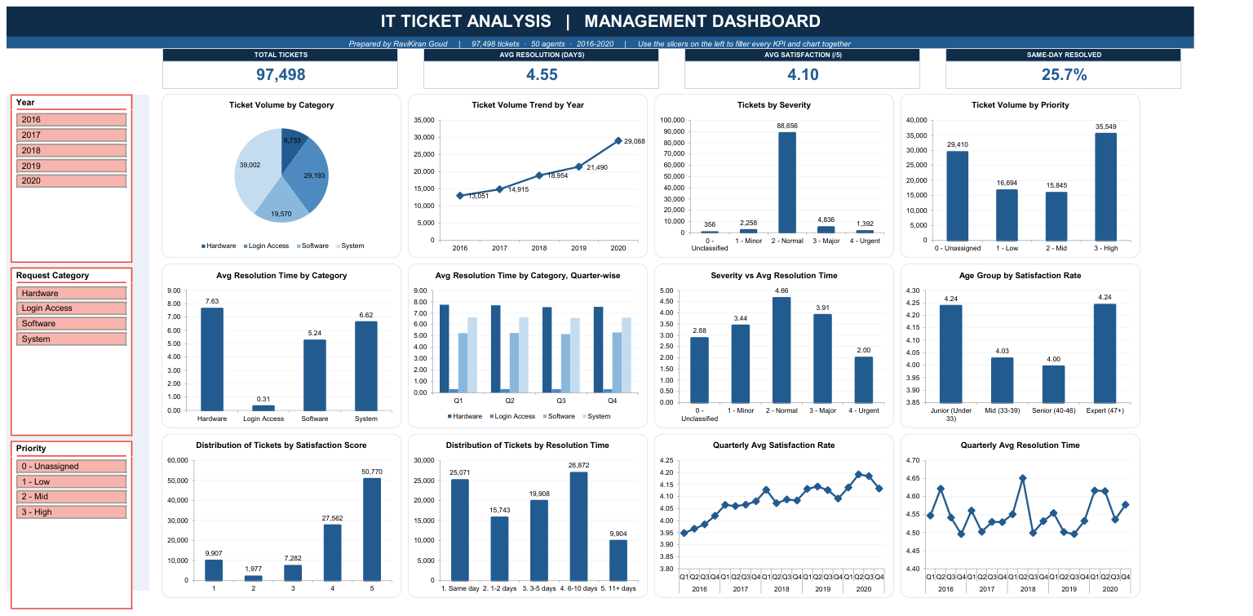
SLIDE 15
Dashboard and Visualizations
Four KPI cards · three linked slicers · twelve charts · one uniform colour scheme
How to read it: the three slicers on the left — Year, Request Category and Priority — are connected to all 13 pivot tables on the sheet, so selecting any combination (for example 2020 + Hardware + Unassigned) filters all four KPI cards and all twelve charts together. The next six slides walk through every chart with its key insights.
Notes:
This is the dashboard. Four KPI cards across the top, three slicers down the left, and twelve charts covering scale, classification, efficiency, triage health, distribution and trend. The slicers are connected to every pivot table, so you can interrogate any combination live - for example 2020 plus Hardware plus Unassigned isolates the slowest, least-governed part of the queue instantly.

Slide 16
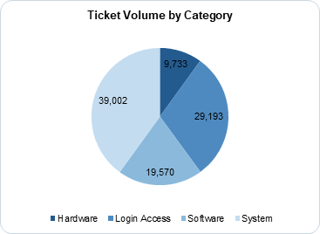
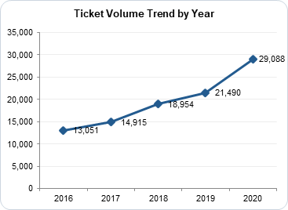
DASHBOARD WALKTHROUGH · 1 OF 6
Scale and mix: where the workload actually sits
Ticket Volume by Category
Ticket Volume Trend by Year
System alone is 39,002 tickets — 40% of everything logged.
Login Access is a close second at 29,193 (30%), but as the next slides show it costs almost no time.
Hardware is the smallest category at 9,733 (10%) — and the slowest to resolve.
Volume rose from 13,051 to 29,088 a year — up 122.9% with no year of decline.
2020 accelerated hardest at +35.4% on 2019.
Whatever we fund has to scale with this curve, not just clear today's queue.
Notes:
Starting the dashboard walkthrough. These two charts set the scale: System is forty percent of the workload, and total volume has more than doubled with no sign of levelling off.

Slide 17
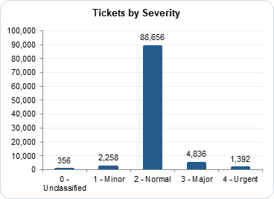
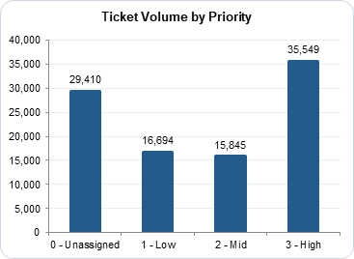
DASHBOARD WALKTHROUGH · 2 OF 6
Classification: how tickets are labelled on intake
Tickets by Severity
Ticket Volume by Priority
88,656 of 97,498 tickets — 91% — are logged as '2 - Normal'.
Only 1,392 are Urgent and 356 are left Unclassified.
Severity is barely being used as a discriminator, which is why it fails to predict resolution time.
29,410 tickets (30.2%) carry no priority at all.
High is the largest assigned band at 35,549, but Unassigned outranks both Low and Mid.
A ticket with no priority cannot be sequenced — this is a tool configuration fault, not an agent fault.
Notes:
These two charts show how tickets are classified on the way in. Ninety-one percent are logged as Normal, so severity barely discriminates at all. And thirty percent never get a priority. Together these explain why the queue cannot be sequenced properly.

Slide 18
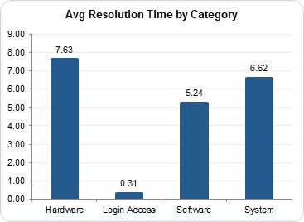
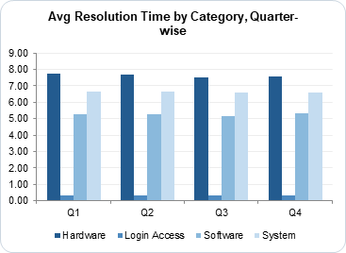
DASHBOARD WALKTHROUGH · 3 OF 6
Efficiency: where the time is actually lost
Avg Resolution Time by Category
Avg Resolution Time by Category, Quarter-wise
Hardware averages 7.63 days against Login Access at 0.31 — a 25-fold gap.
System at 6.62 days across 39,002 tickets is the largest recoverable pool of delay.
Login Access proves automation works here: high volume, near-instant resolution.
The gap is structural, not seasonal: Hardware sits at 7.53–7.74 days in every quarter.
System holds 6.58–6.64 and Login Access 0.31–0.32 in all four quarters.
Because the pattern never varies, the cause is process and logistics — not a busy period.
Notes:
Now efficiency. Hardware takes over seven and a half days, Login Access a third of a day. And the quarter-wise view on the right is important: that gap holds in every single quarter, which tells us it is structural, not a seasonal blip.

Slide 19
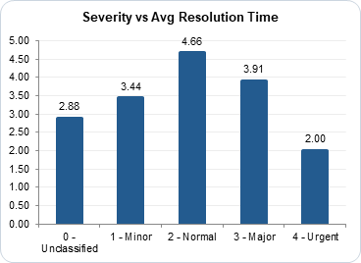
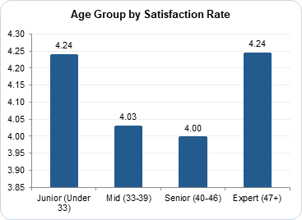
DASHBOARD WALKTHROUGH · 4 OF 6
Triage health: does urgency actually drive speed?
Severity vs Avg Resolution Time
Age Group by Satisfaction Rate
Urgent tickets close fastest at 2.00 days — but Normal tickets are slowest at 4.66.
Major (3.91) is also resolved faster than Normal, so the ordering is inverted.
CORREL confirms it: severity to resolution time is −0.0405, effectively zero.
Satisfaction by age band spans only 0.25 of a point (4.00 to 4.24).
Individual agents span 1.55 points — about six times wider, so demographics explain little.
So coaching should target named individuals on measured performance, not an age group.
Notes:
Triage health. On the left, the inversion - Urgent resolves fastest but Normal is slowest, and the correlation is effectively zero. On the right, a question the agent ranking alone cannot settle: age explains almost none of the variation, so the performance gap is individual.

Slide 20
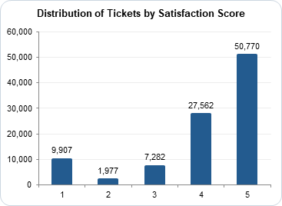
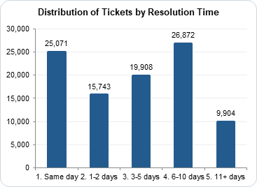
DASHBOARD WALKTHROUGH · 5 OF 6
Distribution: the shape behind the averages
Distribution of Tickets by Satisfaction Score
Distribution of Tickets by Resolution Time
The 4.10 average hides a bimodal picture: 50,770 tickets score 5, but 9,907 score 1.
Only 1,977 tickets score 2 — users rate strongly positive or strongly negative, rarely in between.
That 9,907-ticket tail is the real target, and an average will never show it moving.
25,071 tickets close the same day, but 9,904 take 11 days or more.
The largest single band is 6–10 days at 26,872 tickets.
Success for the tech investment looks like the 11+ day bar shrinking — not the mean ticking down.
Notes:
These two distribution charts are the most revealing on the dashboard. Both headline averages hide heavily skewed data. Satisfaction is bimodal - fifty thousand fives against ten thousand ones. And resolution time has a long tail: nearly ten thousand tickets take more than eleven days. Watch those tails, not the averages.

Slide 21
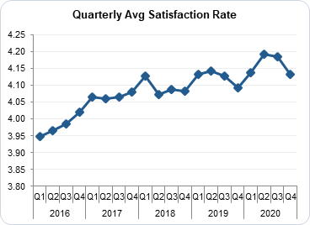
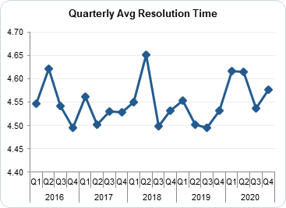
DASHBOARD WALKTHROUGH · 6 OF 6
Trend: is quality holding as demand grows?
Quarterly Avg Satisfaction Rate
Quarterly Avg Resolution Time
Satisfaction climbed steadily from 3.95 to about 4.16 across the twenty quarters.
It rose in every single year: 3.98, 4.07, 4.09, 4.12, 4.16.
Service quality improved while volume more than doubled.
Resolution time oscillates in a narrow band — roughly 4.5 to 4.65 days — with no upward drift.
Yearly averages moved only between 4.52 and 4.59 days across the whole period.
The team absorbed 123% more work without slowing down: there is no performance emergency to fund.
Notes:
Finally the trend view. Satisfaction rose every year and resolution time stayed flat while volume doubled. That matters for the investment case: we are funding improvement from a position of strength, not firefighting a crisis.

Slide 22
SLIDE 22 · CONCLUSION
A team performing well, with three fixable weaknesses
1
Performance varies by individual, not by workload
All 50 agents carry within 9% of the same caseload, yet satisfaction ranges 3.04 to 4.60. Coaching closes that — not recruitment.
2
Delay is driven by category, not severity
Hardware 7.63 days against Login Access 0.31. Severity correlates with resolution time at just −0.04.
3
Triage is broken
30.2% of tickets logged with no priority, and Urgent tickets resolved faster than Normal ones.
Train first. Upgrade the tooling next. Hold on hiring. Dismiss no one.
This analysis turns a growing but reactive IT function into a proactive, scalable one — and every rupee of the recommendation is tied to a number in the workbook.
Notes:
To summarise. This team absorbed a doubling of demand without dropping speed or satisfaction. The weaknesses are specific and fixable, and none of them are about headcount. Train first, because it's the fastest and cheapest return. Upgrade the tooling next, because that's what makes this scale. Hold on hiring until both are done. And on this evidence, no one should be dismissed.

Slide 23
SLIDE 23
Acknowledgements and References
Data sources
Tools and acknowledgements
IT Tickets Analysis dataset — Tickets sheet (97,498 records) and IT Agents sheet (50 records), supplied with the project brief.
Period covered: 01-Jan-2016 to 31-Dec-2020.
Agent email domain: fp20analytics.com (source of the cleaned agent names).
No external or third-party data was used; every figure is derived from the supplied dataset.
Microsoft Excel — tables, pivot tables, slicers and charts.
Functions used: VLOOKUP, MID, FIND, LEN, DATE, DATEDIF, CORREL, COUNTIF, COUNTBLANK, AVERAGE, MEDIAN, ROUND, SUMPRODUCT.
Project brief, submission guidelines and document/spreadsheet templates provided by the course team.
Thanks to the course team and mentors for the project brief and the sample approach guidelines followed in this deck.
Accompanying submission: IT_Tickets_Analysis_RaviKiranGoud.xlsx · IT_Tickets_Analysis_Answers_RaviKiranGoud.docx
Prepared by RaviKiran Goud · 30 September 2026
Notes:
Finally, sources and acknowledgements. Everything here comes from the supplied dataset - no external data. Built entirely in Excel using the functions listed. Thank you, and I'm happy to take questions.

