Slide 1

SOLVING: FINANCIAL INSTRUMENTS IDENTIFIERS FRAGMENTATION
Ravi Patel
Presales Director
18th August 2025
Confidential & Proprietary. Not for Distribution

Slide 2


AGENDA
Introductions
The Operating Model – Trade Life Cycle
Fragmented Instrument Identifiers
Operational Impact
Proposed Solution - OPENFIGI
Solution Demonstration
Key Features & Benefits
Q&A / Next Steps
THE GREEN EARTH
GLOBAL SOVEREIGN WEALTH FUND
Confidential & Proprietary. Not for Distribution
Notes:
Let me start with an introduction…..thank you for having us at The Green Earth SWF….We Understand….Mission, Vision, Values We will start by confirming your Op Model & understanding the challenges
Ask you to help us measure operational impacts
Then provide an overview of our proposed solution,
Which will allow us to discuss if there are any benefits or advantages to adopting it
Then Q&A and Next Steps

Slide 3


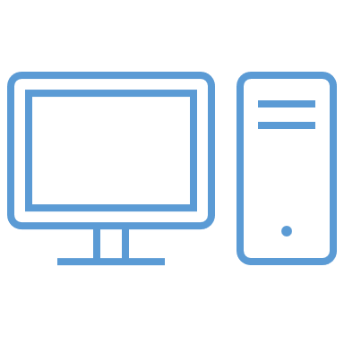













OPERATING MODEL: The Trade Life Cycle
THE GREEN EARTH
GLOBAL SOVEREIGN WEALTH FUND
Trades, Positions, Performance, Other Data/Reports….
REPORTS
STATEMENTS
Multiple
External Mandates
Research Management
Portfolio & Risk Management
Order & Execution Management
Compliance & Risk Oversight
Accounting & Reconciliations
Content Creation
Custom Data
Consumption & Collaboration
Research Analytics
ESG Management
Portfolio Analytics
Risk Management
Performance Attribution
Modelling & Construction
Monitoring & Reporting
Rebalancing & Order Management
Execution Management
Transaction Cost Analytics
Post Trade – Matching & Settlements
Investment & Trade Compliance
Best Execution Oversight
Ex-Post Compliance
Regulatory & Risk Reporting
IBOR / ABOR
Corporate Actions Processing
Custody Reconciliations
Reporting & Statements
Models, Orders, Trades
Investment Committee
Internal PMs Desks
Positions, Cash, Others…
Internal Stakeholders
Positions, Cash, NAV, GL
Trades, Cash Movements
External Stakeholders
Multiple
Custodians / Admins
Technology & Infrastructure
OTHER
SYSTEMS
Sec Masters,
Prices, Rates, Curves, Indices, Benchmarks Constituents
Terminals
OMS
EMS
PMS
EDM
WAREHOUSE
RECON
Regulators
Multiple
Data Vendors
SUPPORTS DECISION MAKING & PROCESSING
Confidential & Proprietary. Not for Distribution

Slide 4
OPERATING MODEL: Operational Impact
THE GREEN EARTH
GLOBAL SOVEREIGN WEALTH FUND
Tickers, ISINs
DELAYS
INCONSISTENCIES
PENALTIES
Multiple
External Mandates
Research Management
Portfolio & Risk Management
Order & Execution Management
Compliance & Risk Oversight
Accounting & Reconciliations
Content Creation
Custom Data
Consumption & Collaboration
Research Analytics
ESG Management
Portfolio Analytics
Risk Management
Performance Attribution
Modelling & Construction
Monitoring & Reporting
Rebalancing & Order Management
Execution Management
Transaction Cost Analytics
Post Trade – Matching & Settlements
Investment & Trade Compliance
Best Execution Oversight
Ex-Post Compliance
Regulatory & Risk Reporting
IBOR / ABOR
Corporate Actions Processing
Custody Reconciliations
Reporting & Statements
CUSIPs , SEDOLs
Investment Committee
Internal PMs Desks
Internal Stakeholders
Tickers
CUSIPs
SEDOLs
ISINs, etc.…
External Stakeholders
Multiple
Custodians /
Admins
Technology & Infrastructure
OTHER
SYSTEMS
RIC Code
BBG Tickers
VALORs,
ICE ICFs
SEDOL
LinIDs
LoanXIDs
Terminals
OMS
EMS
PMS
EDM
WAREHOUSE
RECON
Regulators
Multiple
Data Vendors
Processing Issues
Data Discrepancies
Mapping Maintenance
Recon Breaks
POOR
QUALITY DATA
Confidential & Proprietary. Not for Distribution

Slide 5
Buy-side firms often face significant challenges due to fragmentation in financial instrument identifiers
Service Providers
Counterparties
Vendors
Internal
Systems
Identifier | Scope / Coverage | Limitations / Problems
Ticker | Exchange-specific (equities, ETFs) | Not globally unique; duplicated across exchanges; changes with corporate actions; doesn’t cover bonds/derivatives
CUSIP | US & Canada (equities, bonds, funds) | Regional only; proprietary & licensed; changes with corporate actions; sometimes recycled
SEDOL | UK origin, extended globally (equities, bonds, funds) | Proprietary & licensed; incomplete OTC coverage; legacy inconsistencies
ISIN | Global standard (ISO 6166) | Same ISIN can trade on multiple venues (not unique per listing); no exchange/currency; issuance lag; limited derivatives coverage
RIC Code | Refinitiv ecosystem (multi-asset) | Proprietary/vendor lock-in; licensing fees; not portable outside Refinitiv
Valor / WKN | Switzerland / Germany | Proprietary / Local focus, not globally recognized
Custodians
Fund Administrators
Brokers
Depositories
CCPs / ICSDs
Execution Venues
Data Vendors
Exchanges
Regulators
External Mandates
Transfer Agents
TICKER
CUSIP
SEDOL
ISIN
RIC
Order Management
Execution Management
Settlements
Portfolio Management
Risk Engine
Compliance & Surveillance
Positions Keeping
Accounting
Performance & Attribution
Reconciliations
Collateral & Margin
Tax & Reg Reporting
Enterprise Data Management
Client Reporting
Confidential & Proprietary. Not for Distribution

Slide 6
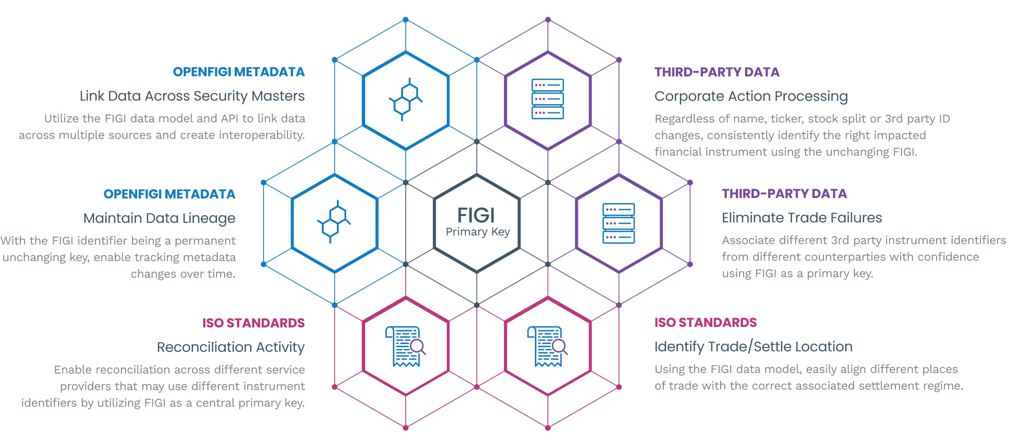
PROPOSED SOLUTION : FIGI (The Financial Global Identifier)
Unlock the Power of Efficiency with OpenFIGI
Established global standard issued under The Object Management Group (OMG.org)
Free globally unique URI - 12 character, alphanumeric, randomly generated ID
300 trillion potential IDs available across all global asset classes
Total 1.4 billion FIGIs already assigned (100m+ since beginning of 2025)
Open API - 17,000 users | 81.7 billion API jobs 2025 |13.6 billion jobs per month
Confidential & Proprietary. Not for Distribution
Notes:
Free, Scalable, RESTful, Open

Slide 7
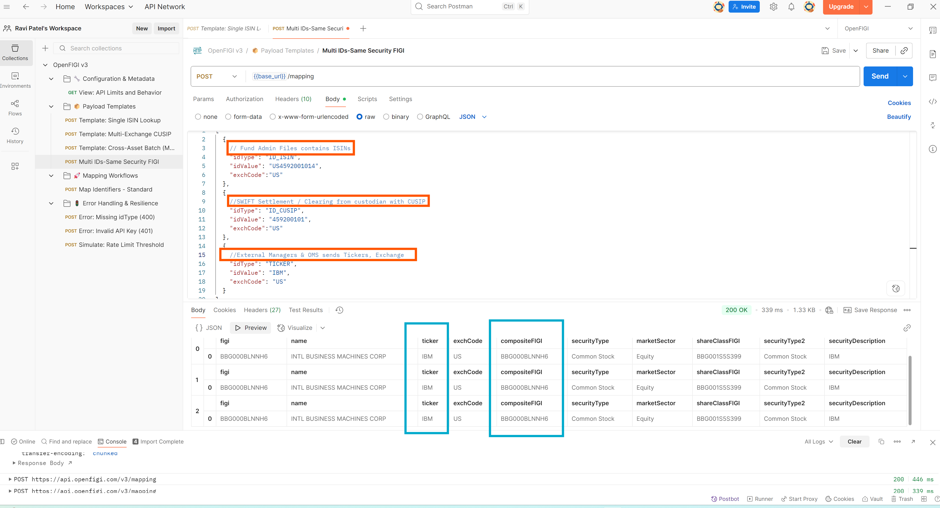
Solution Demonstration: FIGI (The Financial Global Identifier)
Example: Map third-party identifiers to globally unique FIGIs
Postman
Confidential & Proprietary. Not for Distribution

Slide 8
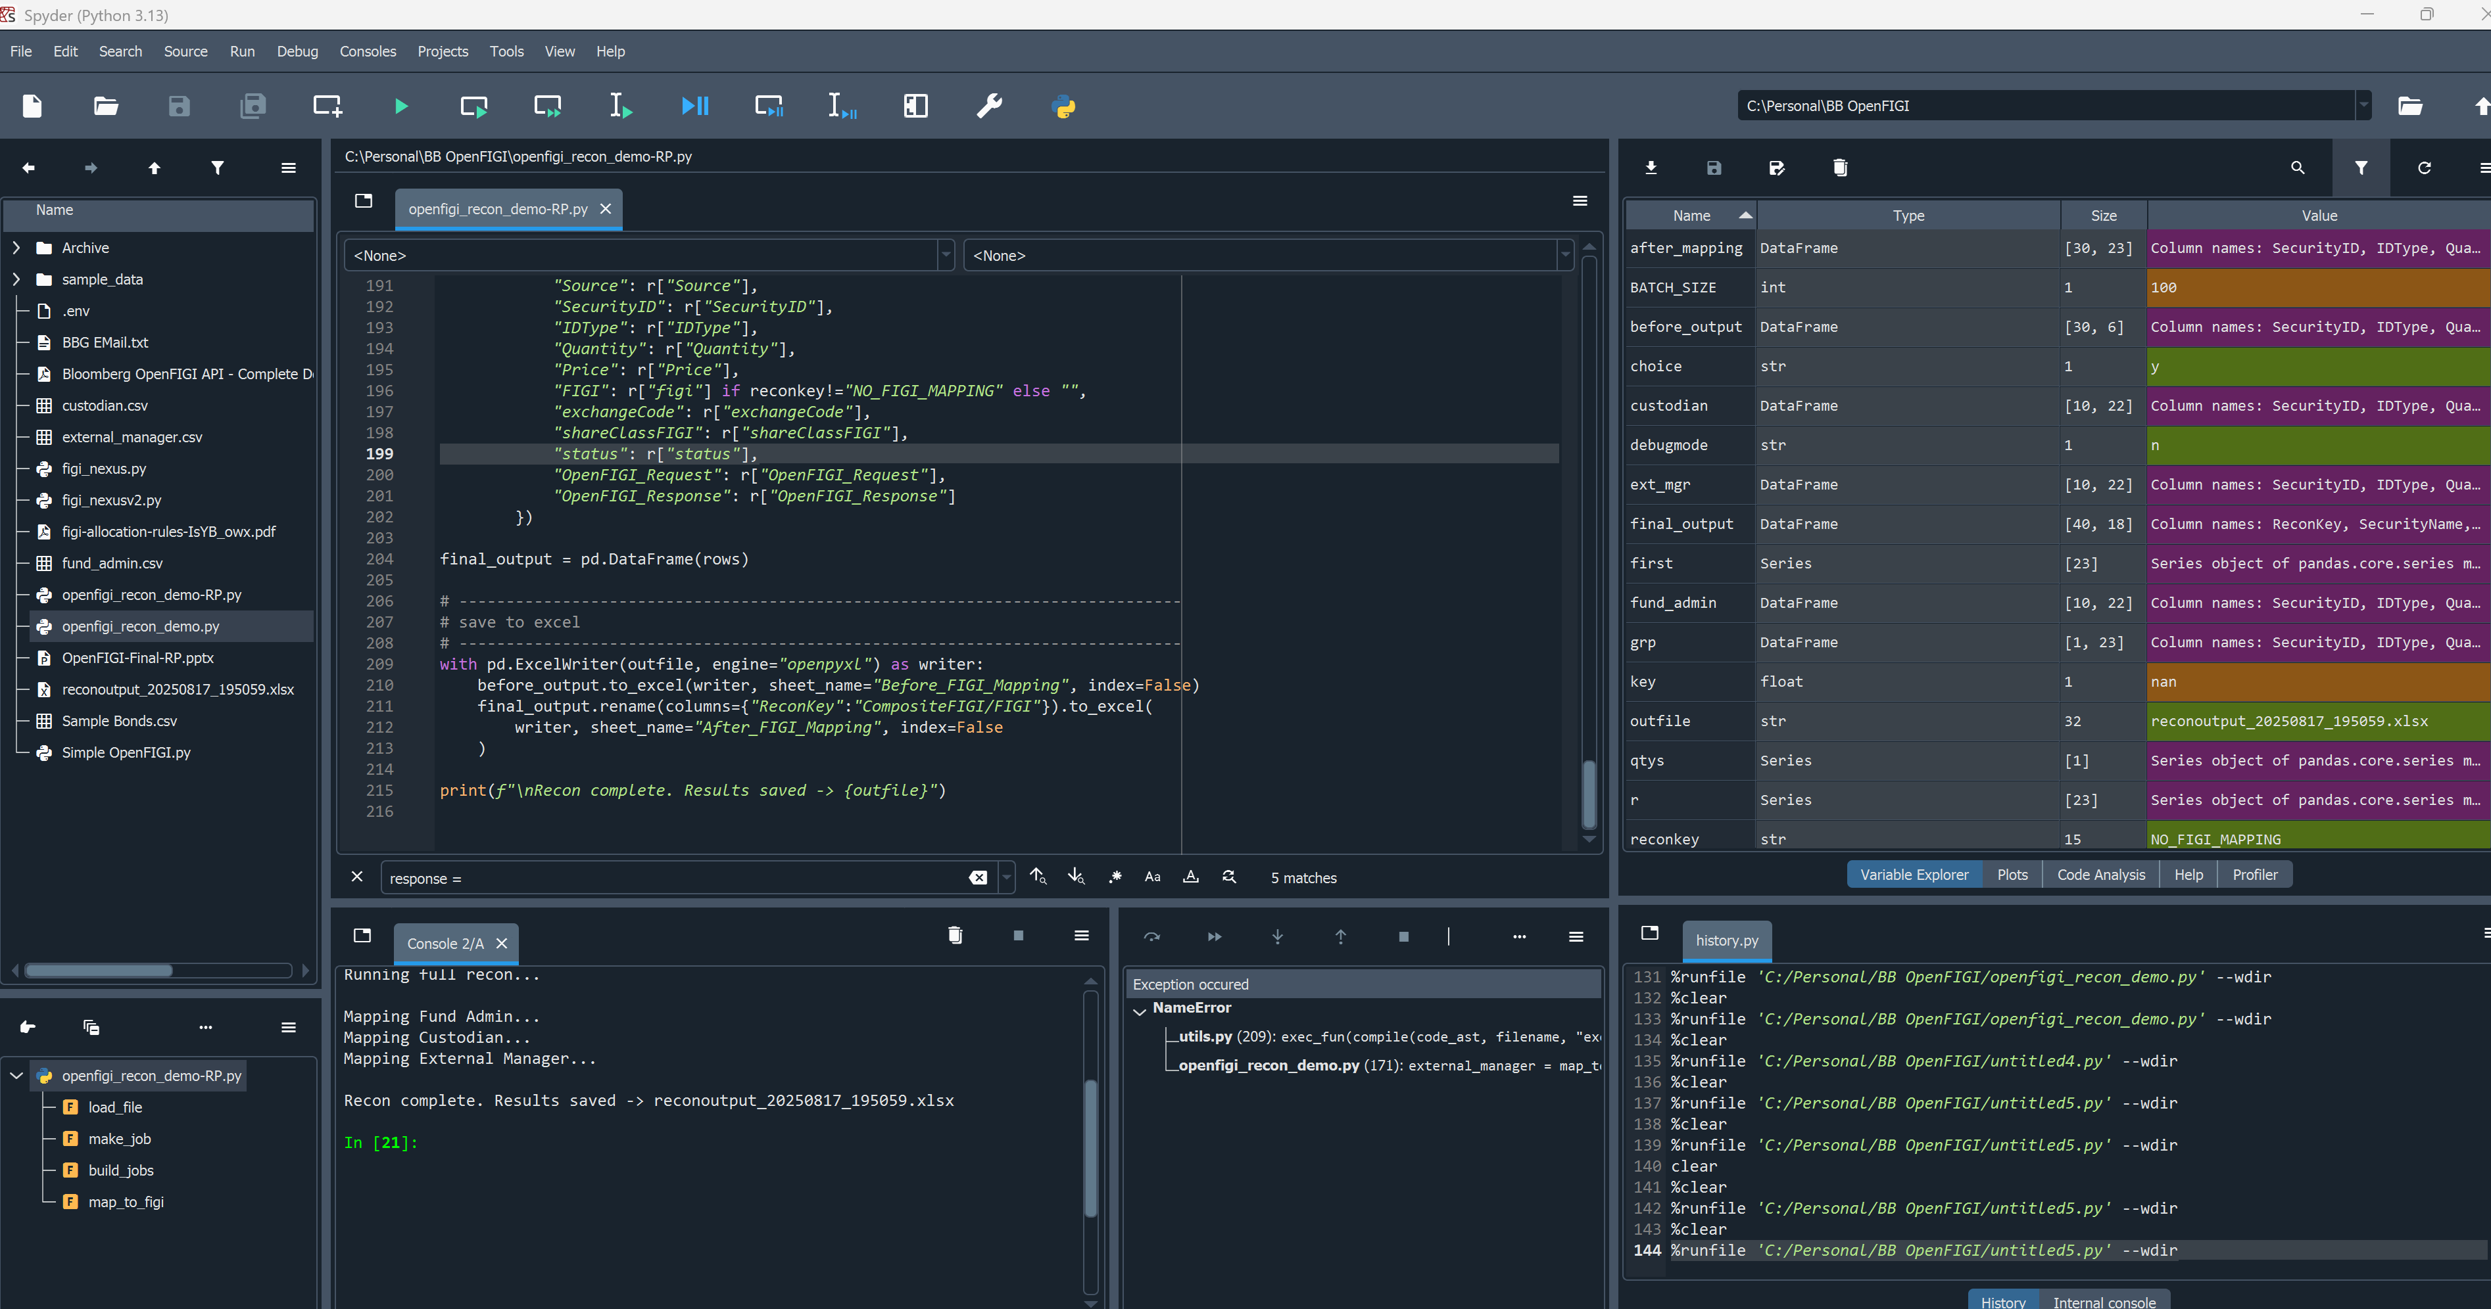
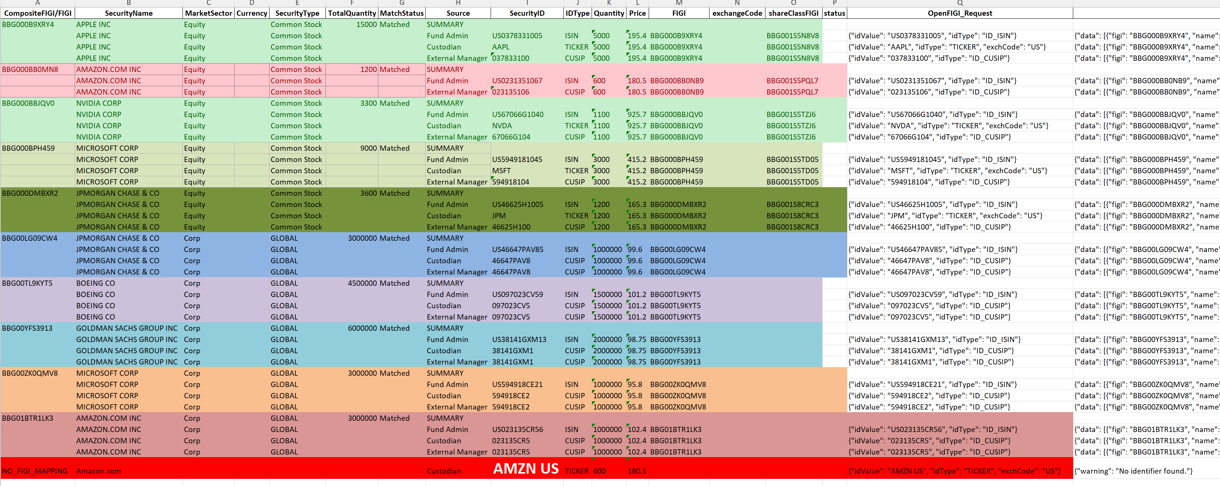
Solution Demonstration: FIGI (The Financial Global Identifier)
Confidential & Proprietary. Not for Distribution

Slide 9


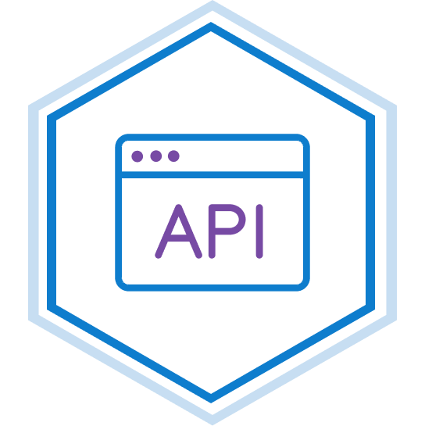

Key Features & Benefits: FIGI (The Financial Global Identifier)
Coverage
Global coverage of the financial markets. The ID will be invaluable for loans, cryptocurrency pairs, futures and options that lack an identifier.
Consistency
Based on the same identifiers used in the Bloomberg Professional® service and Bloomberg's Enterprise Solutions, but now declared as an Open Standard, and further enhanced by additional Certified Providers like Kaiko, providing enhanced coverage in newer assets like cryptocurrencies.
Delivery
Submission form via dedicated portal OpenFIGI.com and the OpenFIGI API allows mapping from alternative symbologies, or perform searches using over 100 fields as variable inputs.
Access
FIGI identifiers are available through the OpenFIGI website with no material impediments on use, or barriers to access.
Usage
FIGIs can be used for a variety of purposes, including trading, research, and database mapping.
Uniqueness
Unique, non-changing identifier that covers all financial instruments globally with no restrictions on usage or distribution.
Confidential & Proprietary. Not for Distribution

