Slide 1
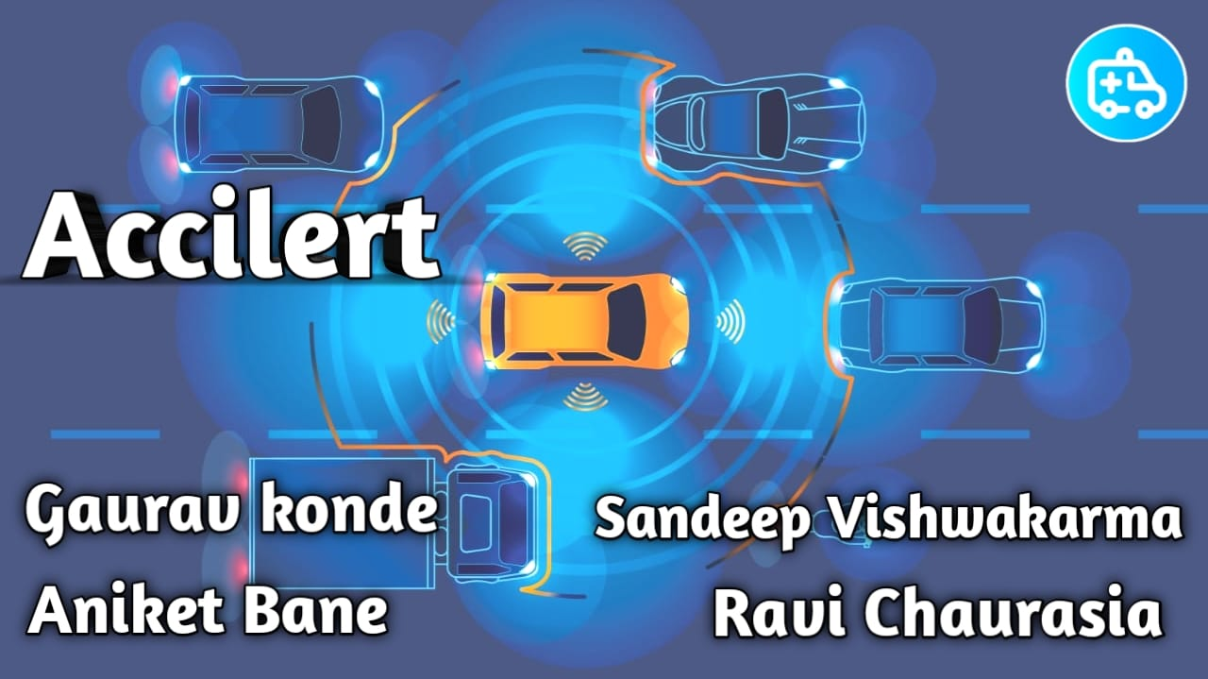

Slide 2
Inspiration & Problem Statement
As long as there have been roads there have been crashes. As vehicle technology improved and speeds increased, these crashes became more and more destructive.
While the implementation of crumple zones, driver cages, steel bar doors, and airbags have served to lower the cost in human loss to these crashes, a more comprehensive vision is needed, to solve this problem.
Almost 467,044 road accidents have been reported in 2018 and has been increasing.
Major reasons for the deaths is due to the lack of critical medical support .
So, to solve this up I have come up with this “AcciLERT 3.0”

Slide 3
Solution
AcciLERT notify about the accident to the nearest hospital located with the accident location with direction with the driver's medical data to save the critical time of life and death.
It also provides the hospital with the drivers relatives contact detail and could contact them immediately.
It notifies to the relatives about the current status of the accident and the hospital location to the relatives were the patient must have been admitted.
It performs the alcohol detection and warns the driver and also performs engine lock system

Slide 4
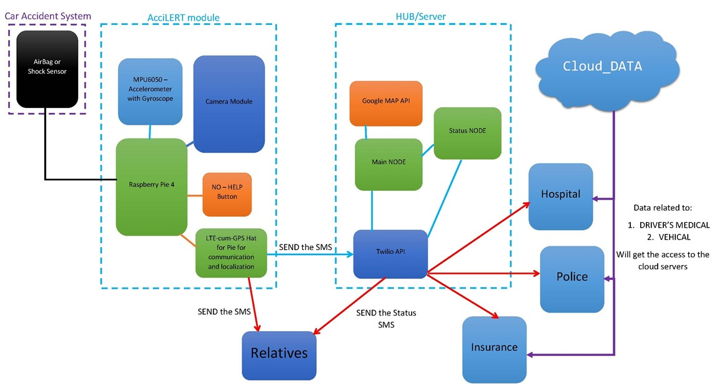
Block Diagram

Slide 5
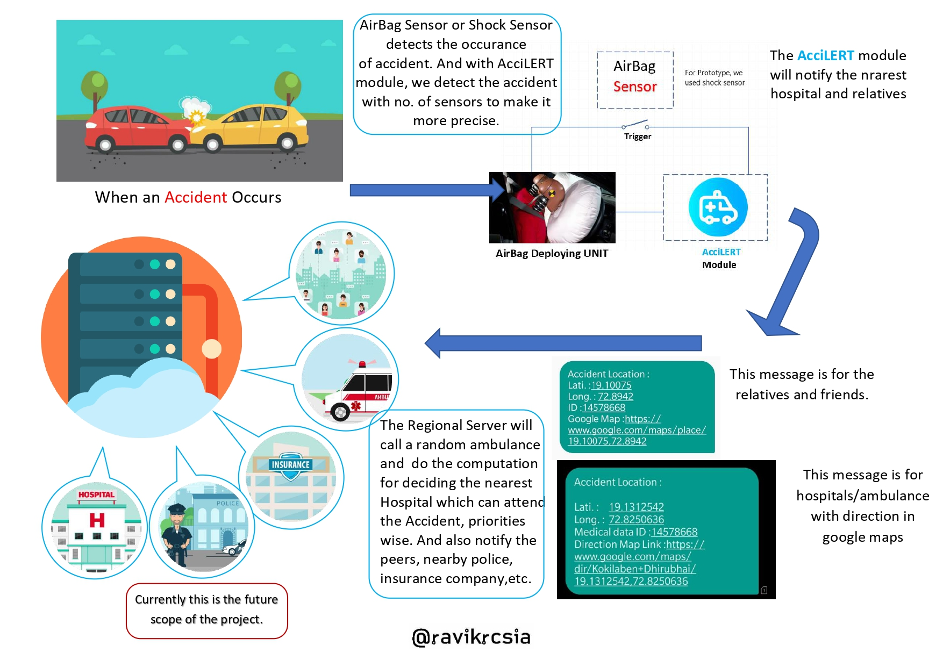
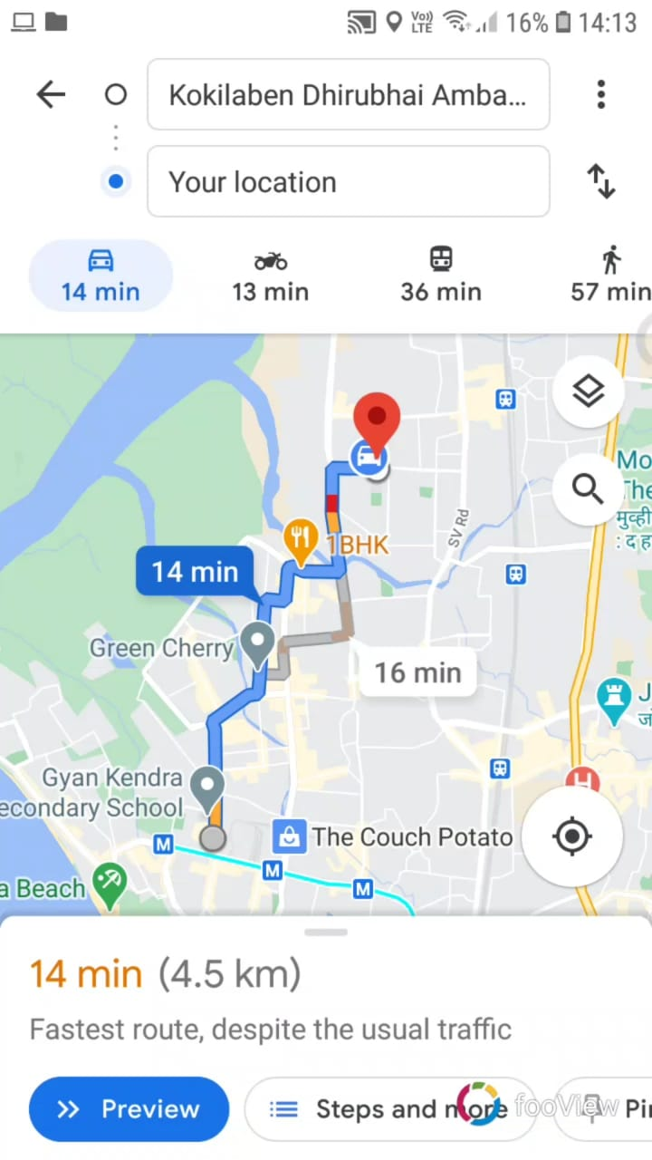
Concept

Slide 6
Working
AcciLERT is a integrated module with sensors to detect the accident precisely when the accident takes place.
When suddenly an accident takes place, the air bag gets triggered it initializes the module.
After in few seconds the main working begins where we catch the current location and the message is passed on to the server
From there the main working begins. It Finds the nearest reachable hospital. Notify the hospital with victim’s current location with direction on google maps and even provides the hospital with victim’s medical data .
Using the sensors we also detect if the driver is drunken or not, with that we also keep a track of the areas where accidents place, also detect the impact of accident that took place

Slide 7
Output
https://youtu.be/TgpUlmdOAMU

Slide 8
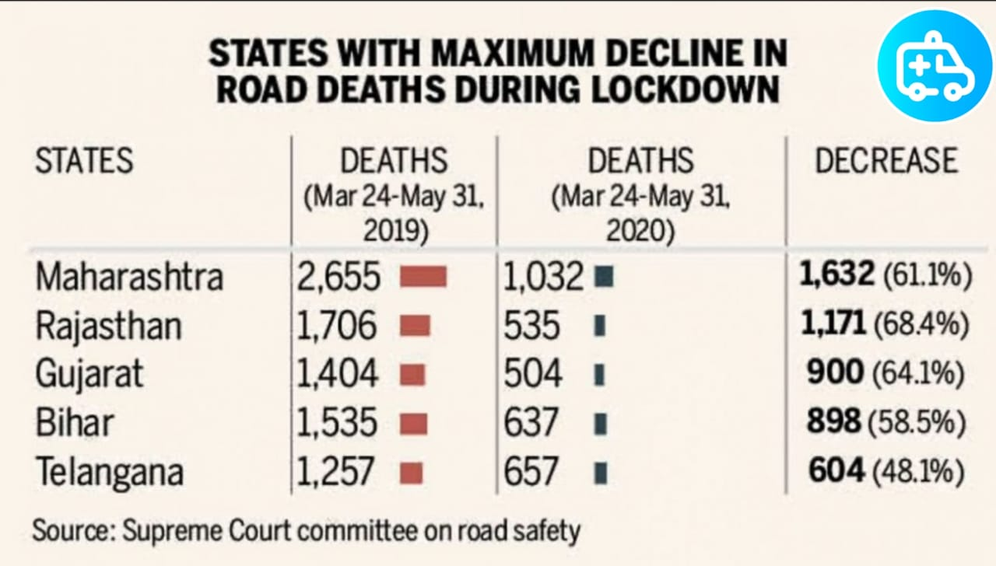
Report And Analysis
Such kind of identical features are available in some premium cars which aren’t affordable by normal people.
They just notify to there relatives.
As well as they don’t provide with some sort of these features.

Slide 9
Future Scope
Similar concept can be implemented for bike accidents.
Creating servers as per area with more computation power.
Accident prediction using rear and front camera.
Accident Recording in 3D model

Slide 10
Team Contribution
Aniket Bane – Video Editing & Documentation
Gaurav Konde – Code Integration & Server Hosting
Ravikumar Chaurasia – Scripting & planner

Slide 11

Thank
You

