Slide 1
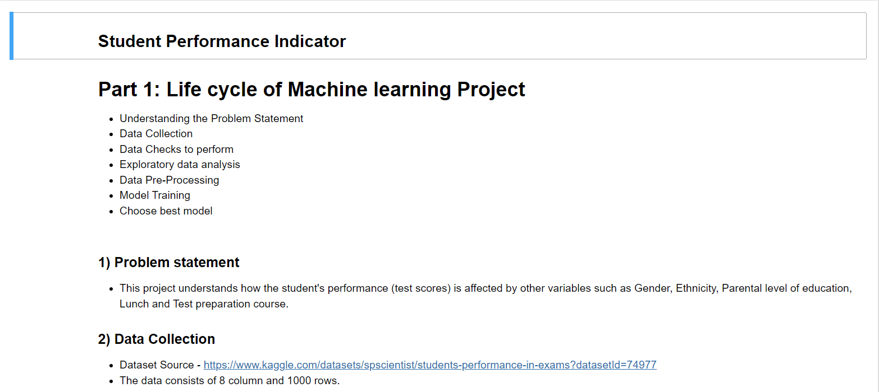

Slide 2
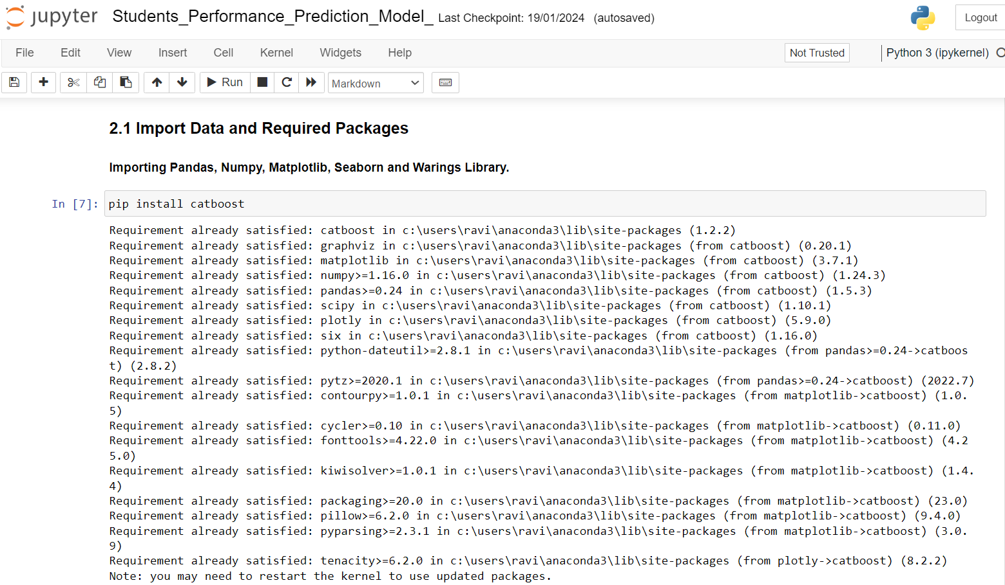

Slide 3
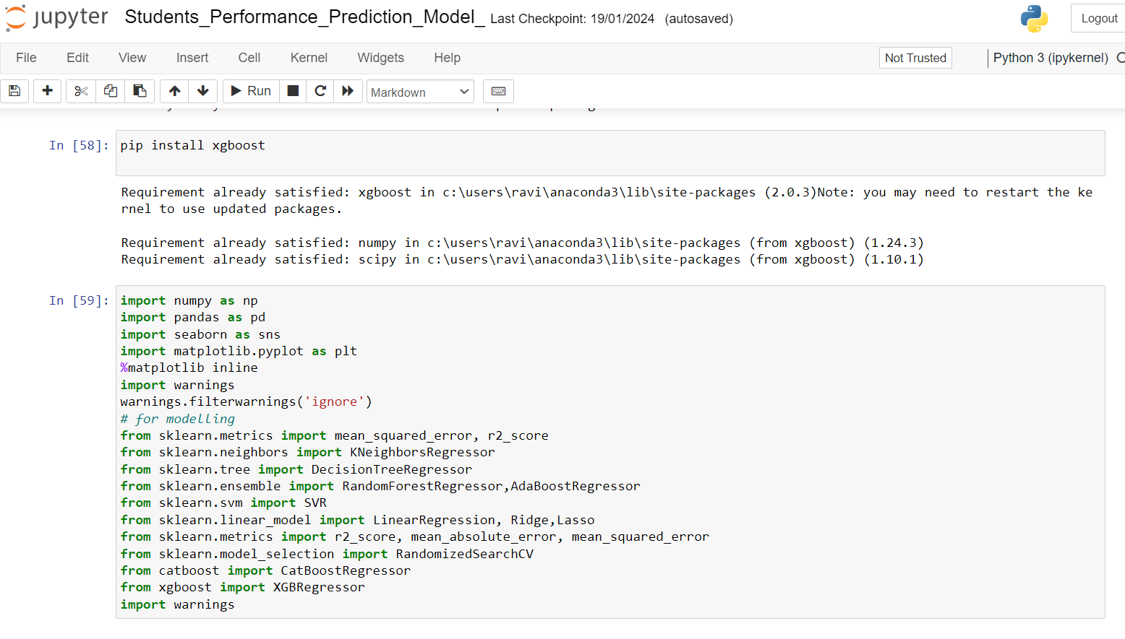

Slide 4
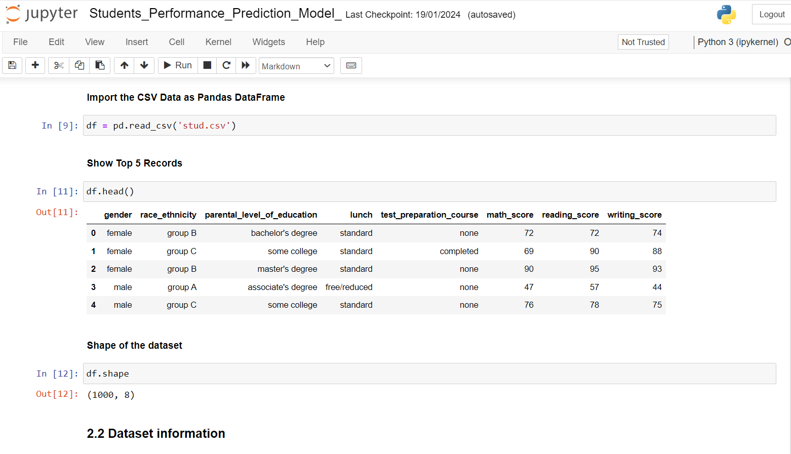

Slide 5
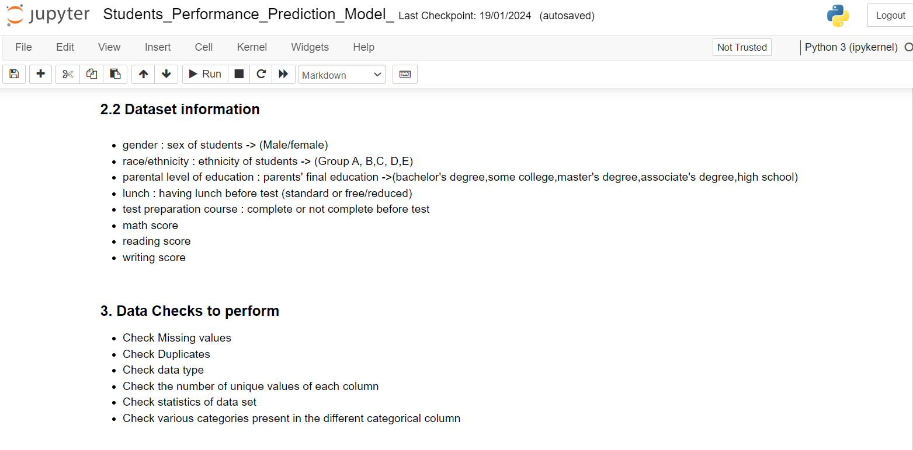

Slide 6
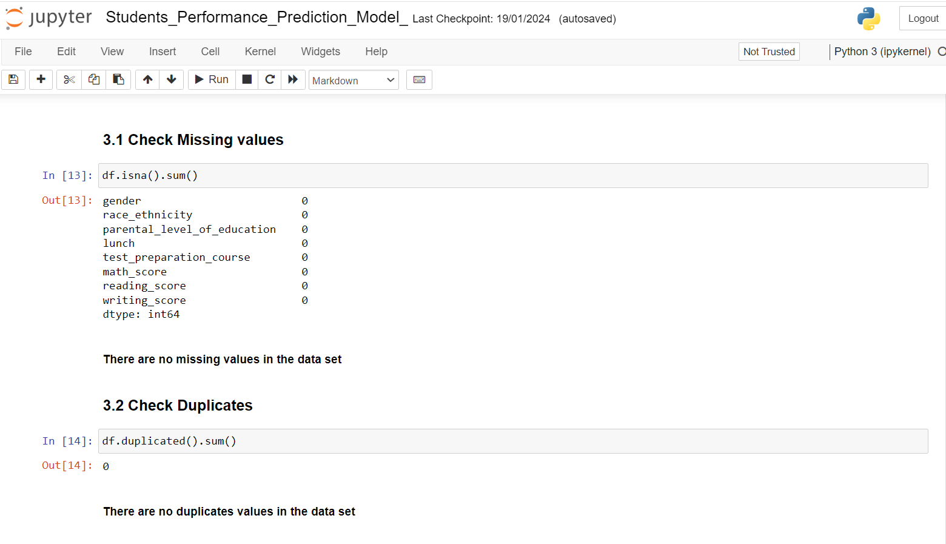

Slide 7
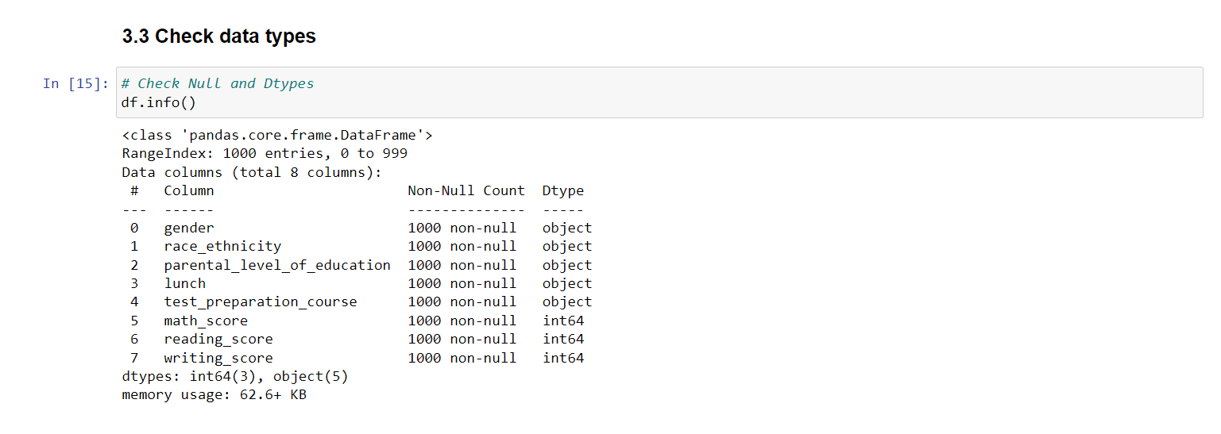

Slide 8
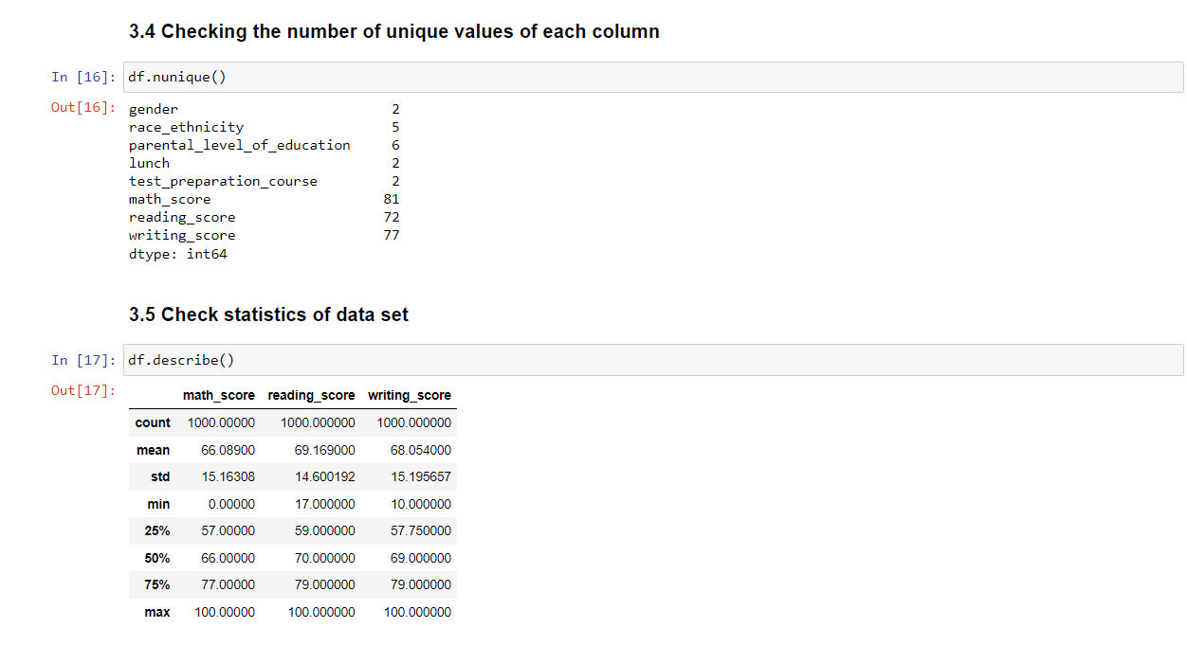

Slide 9
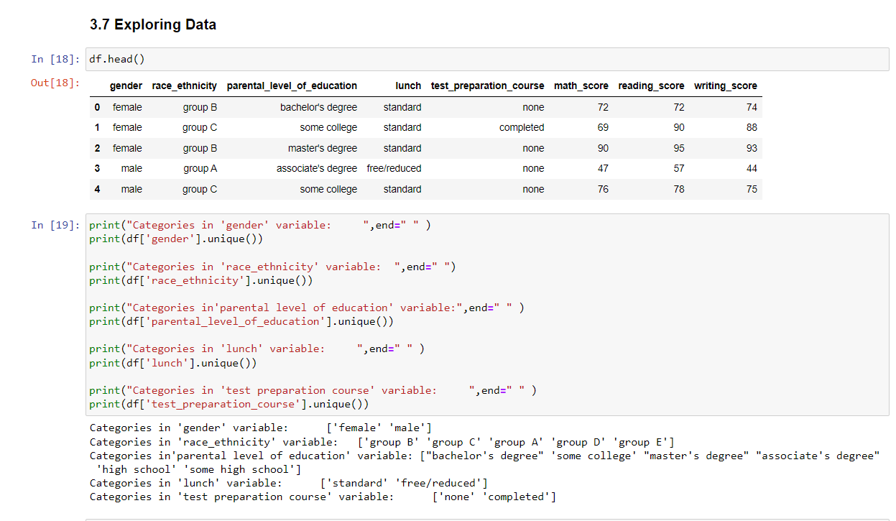

Slide 10
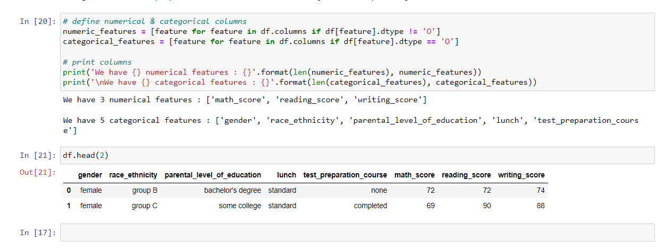

Slide 11

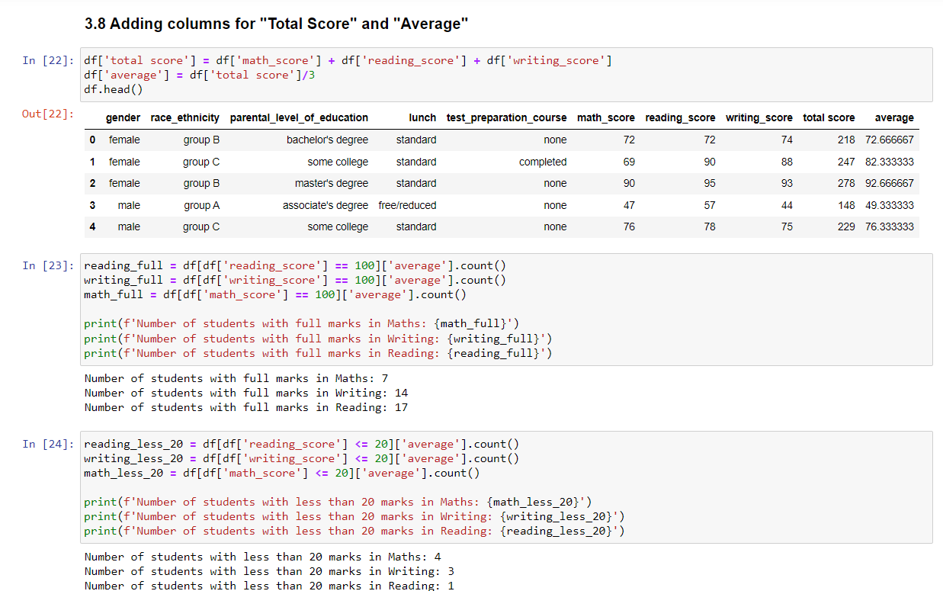

Slide 12
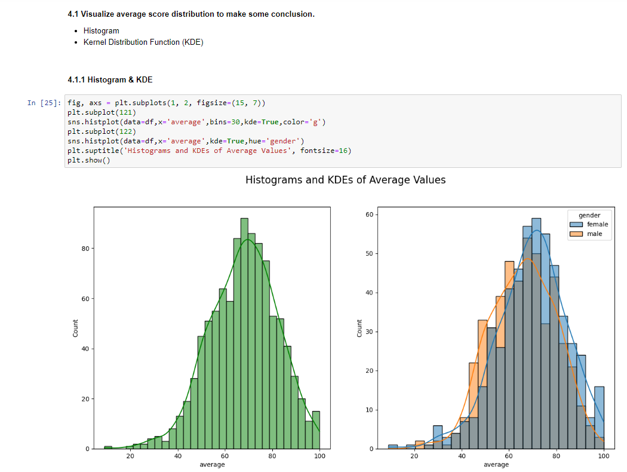

Slide 13
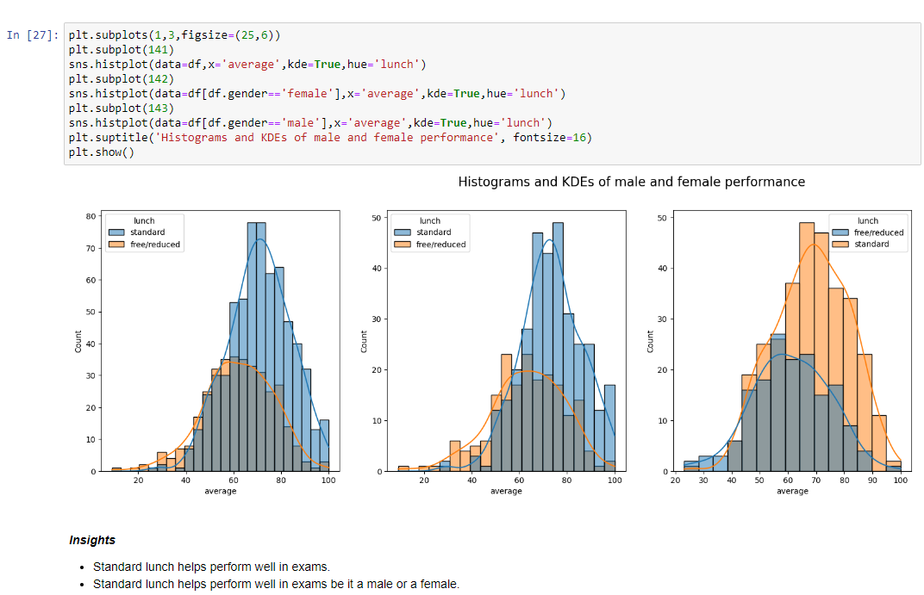

Slide 14
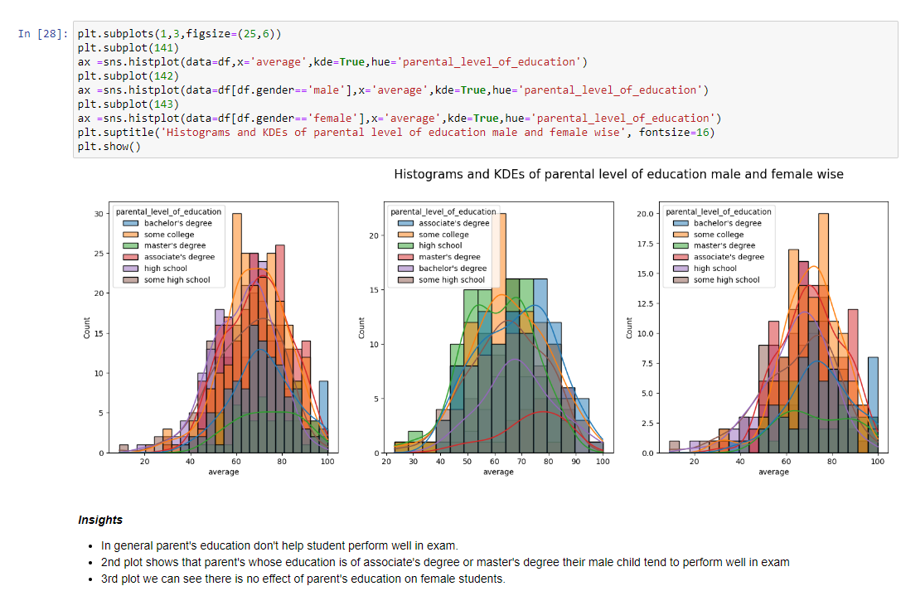

Slide 15
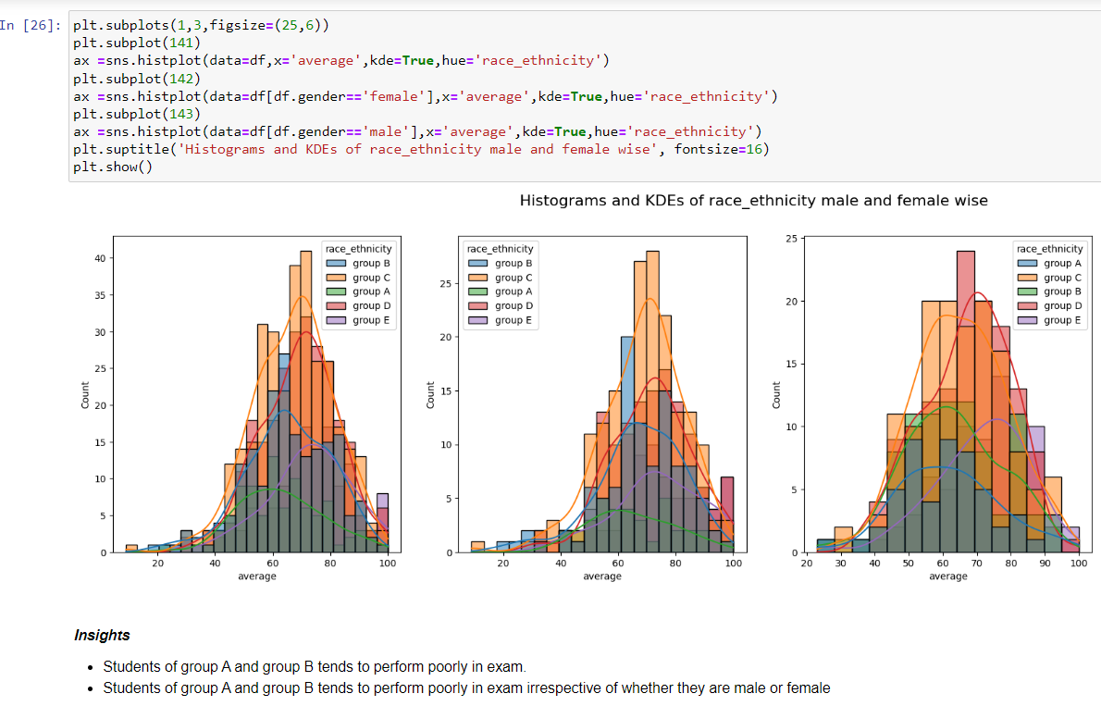

Slide 16
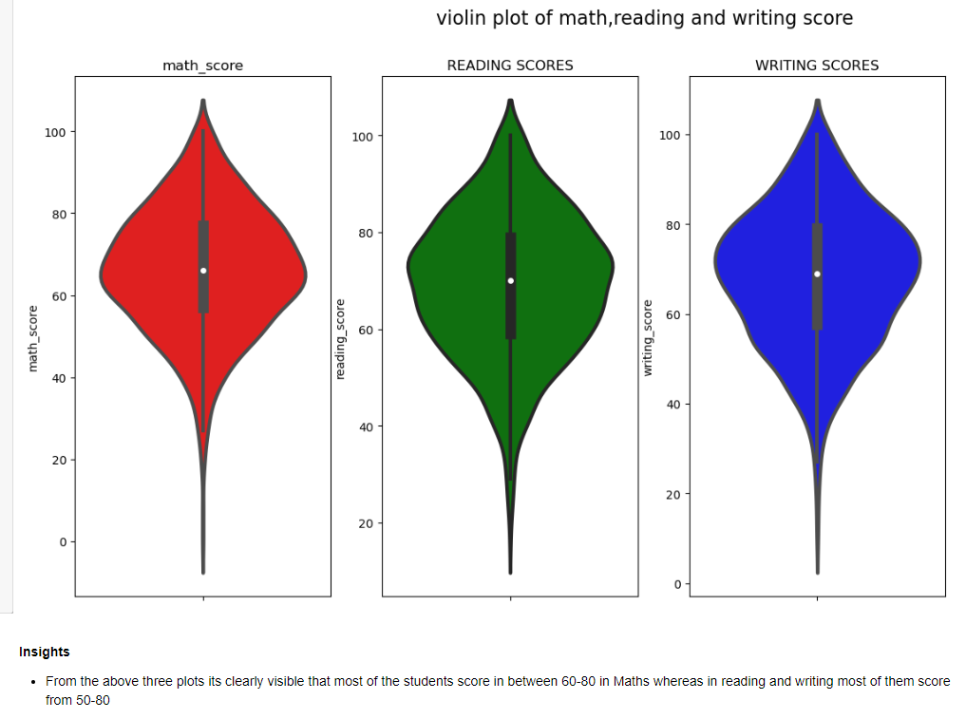
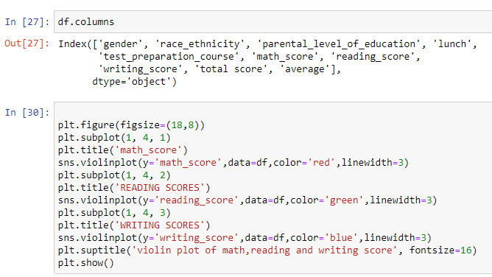

Slide 17
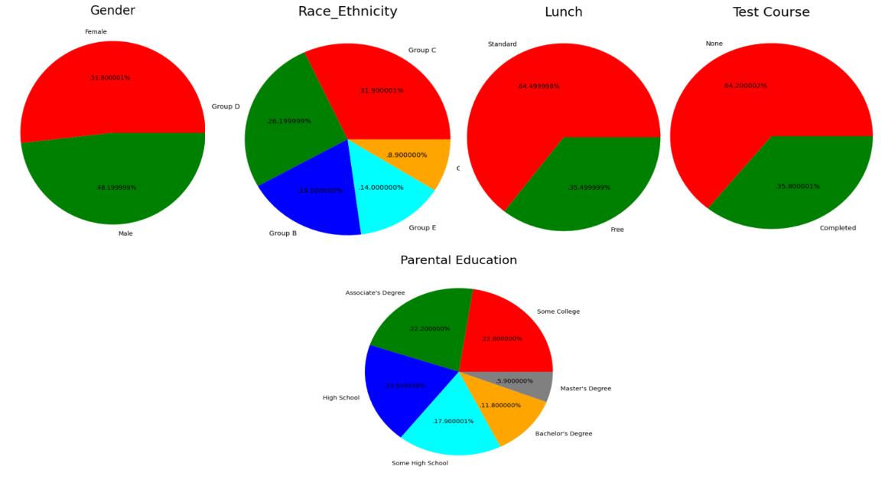

Slide 18
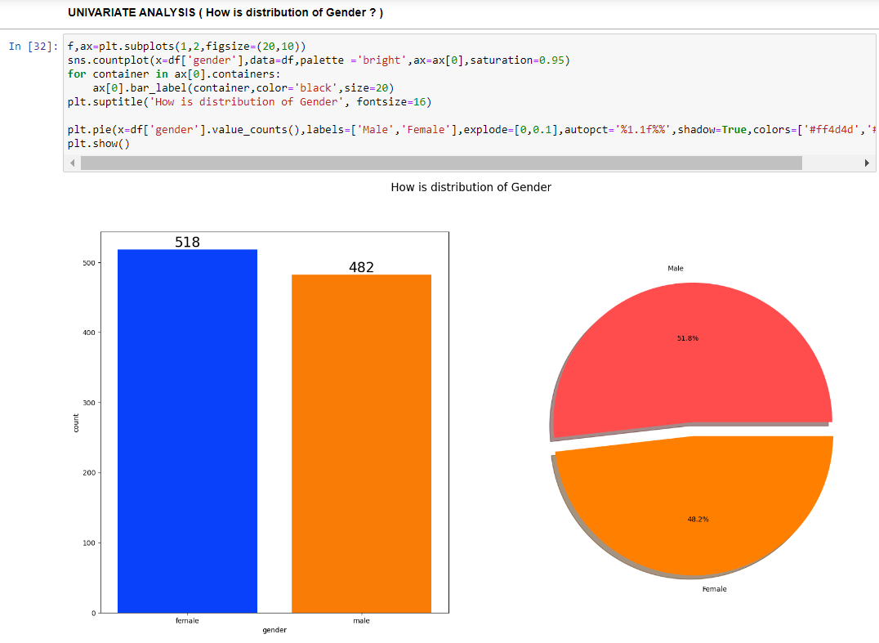

Slide 19
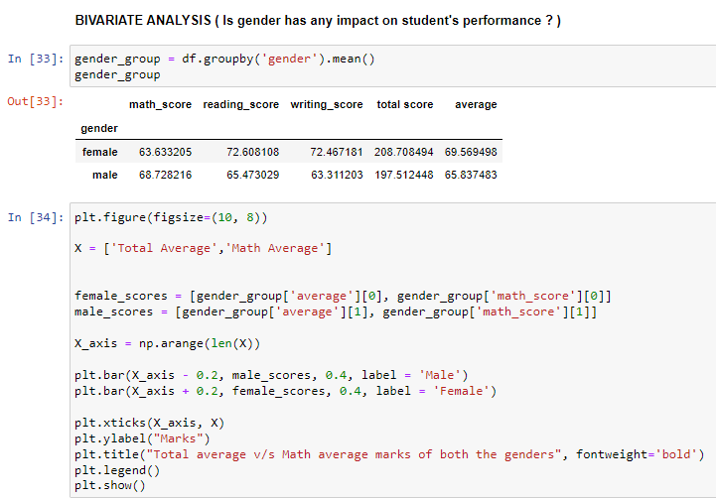
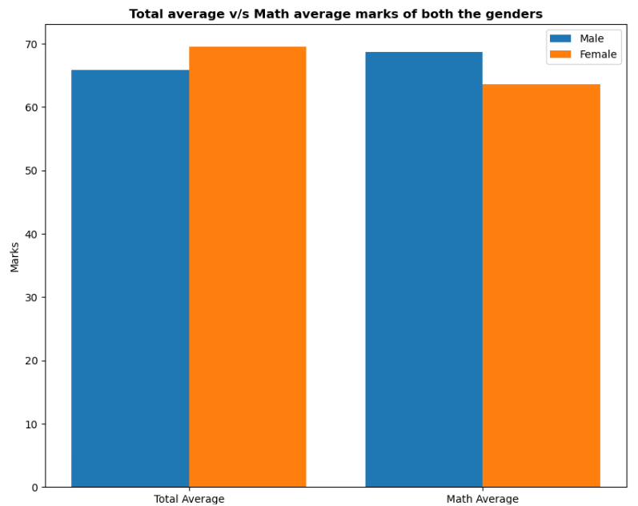

Slide 20
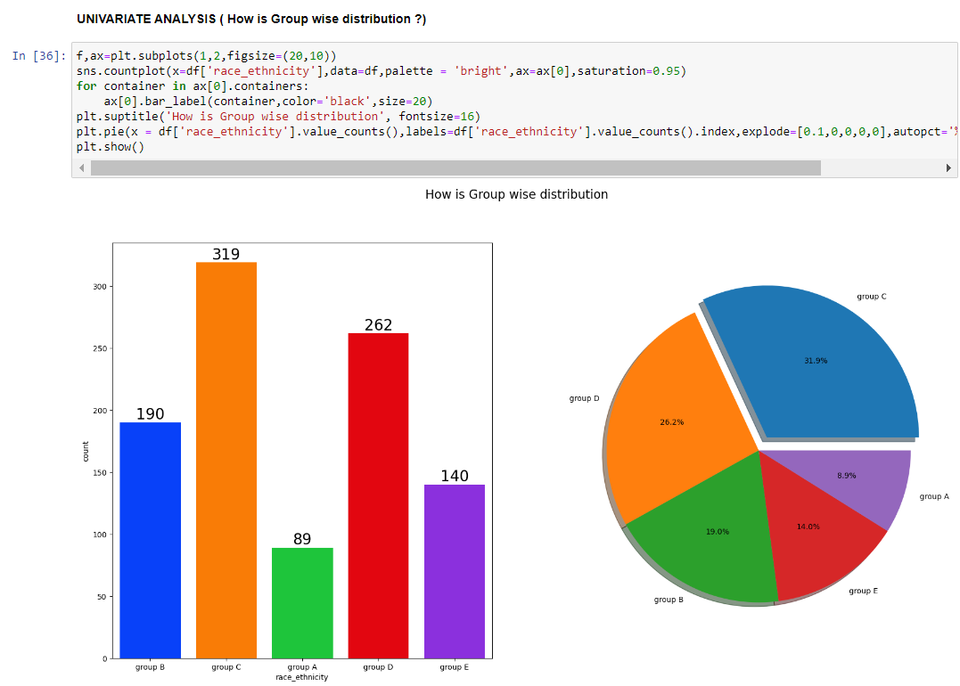

Slide 21
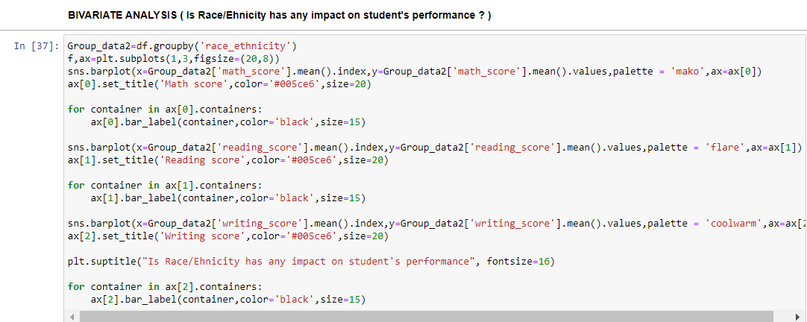
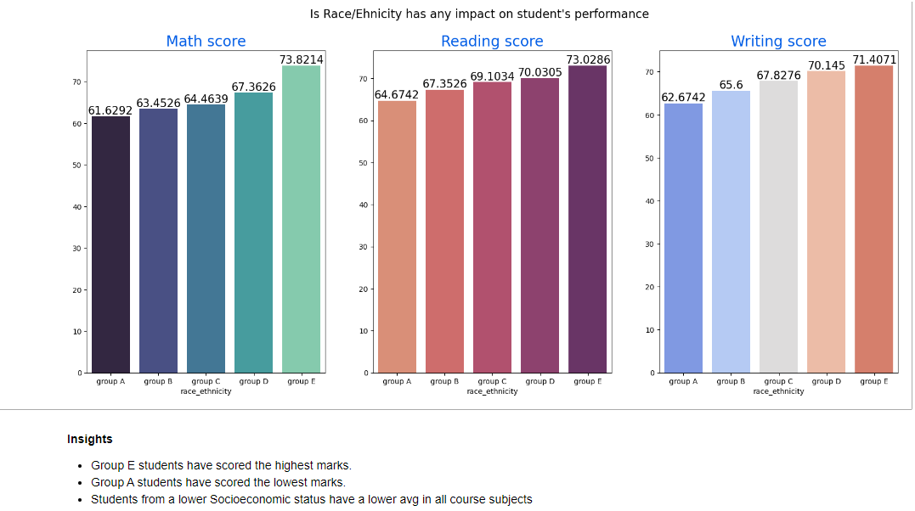

Slide 22
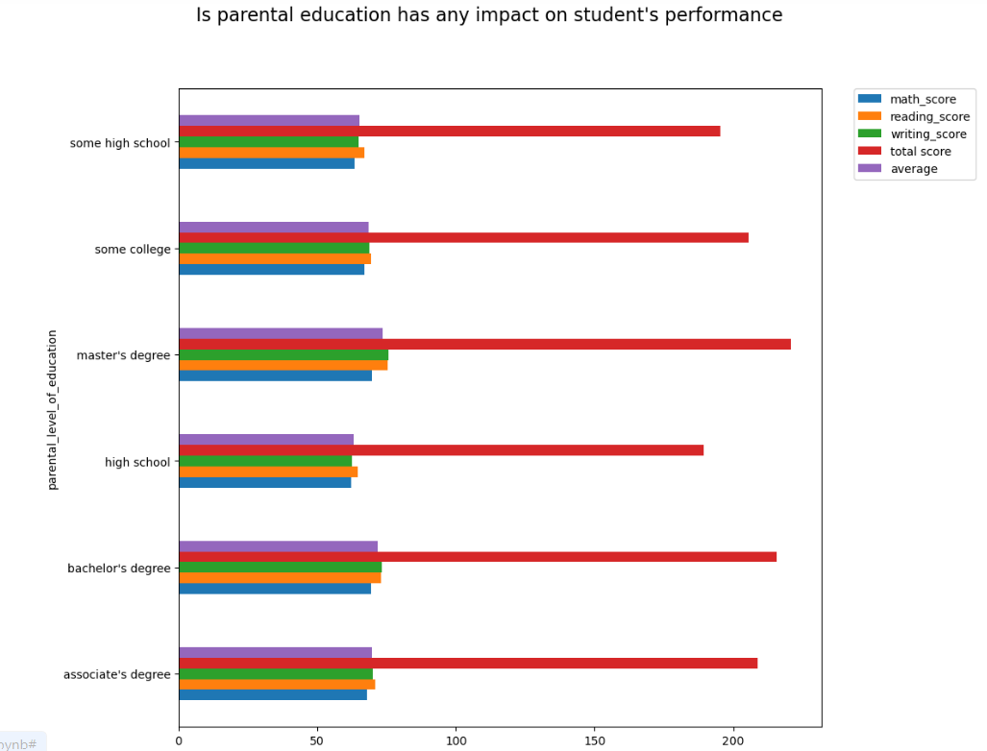

Slide 23
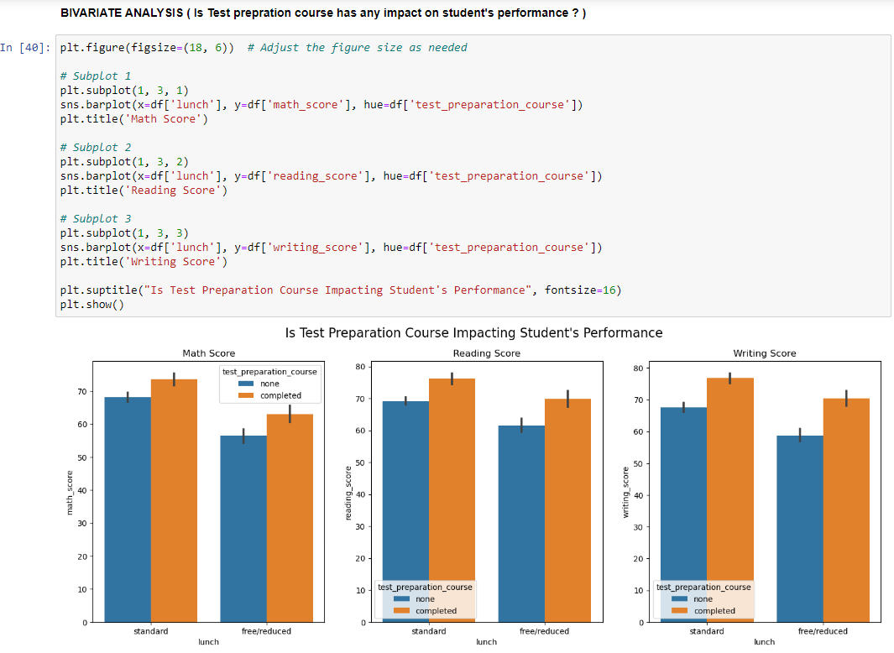

Slide 24
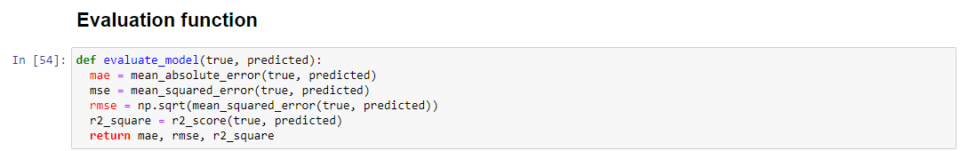
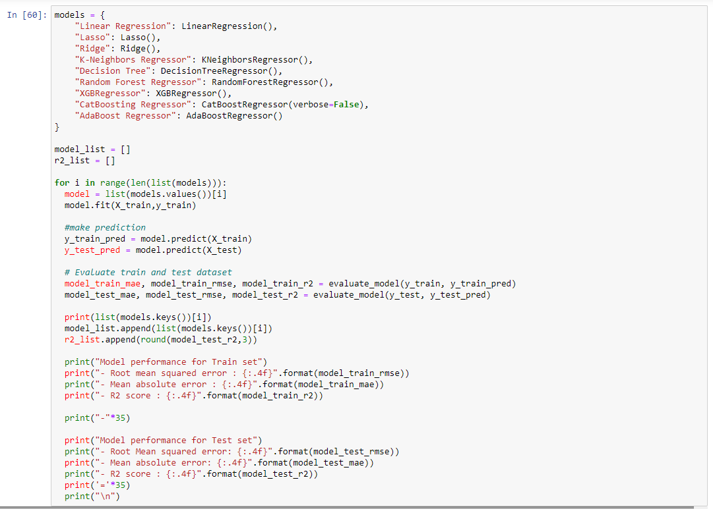

Slide 25
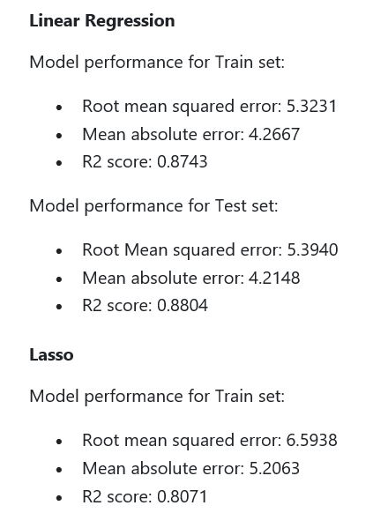
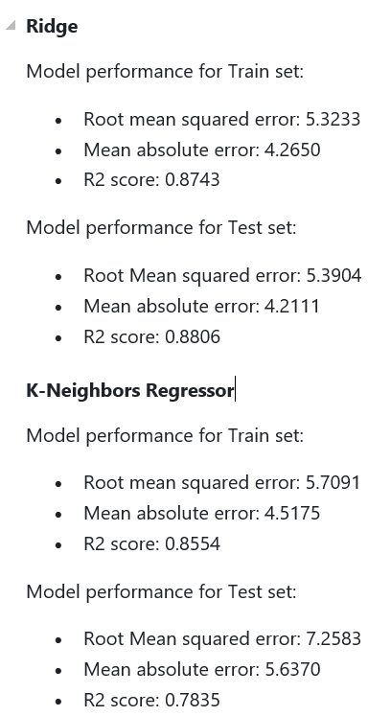
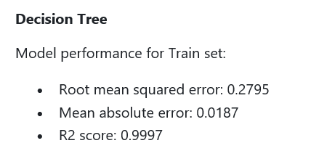
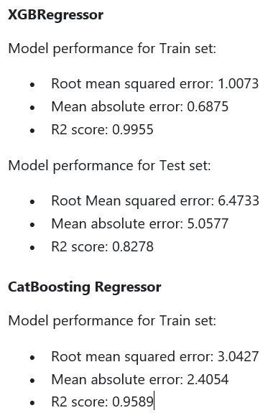
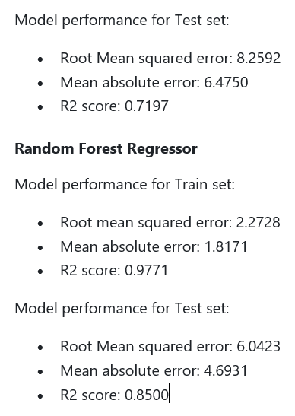
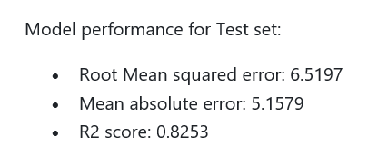
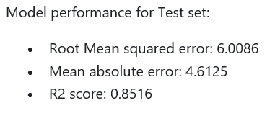

Slide 26
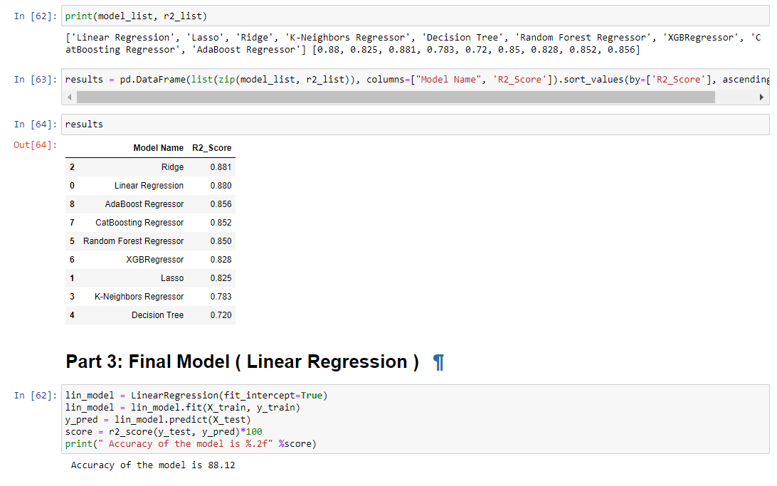

Slide 27
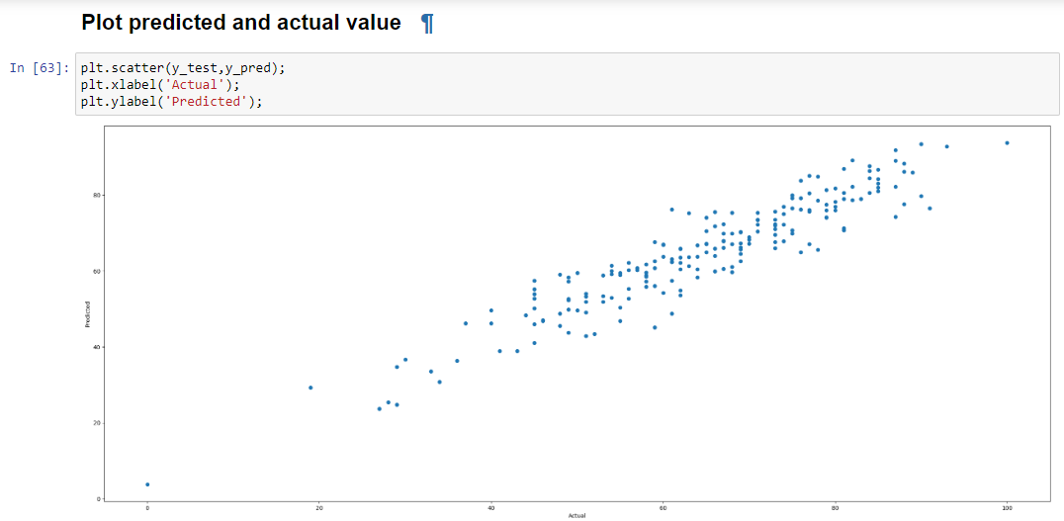
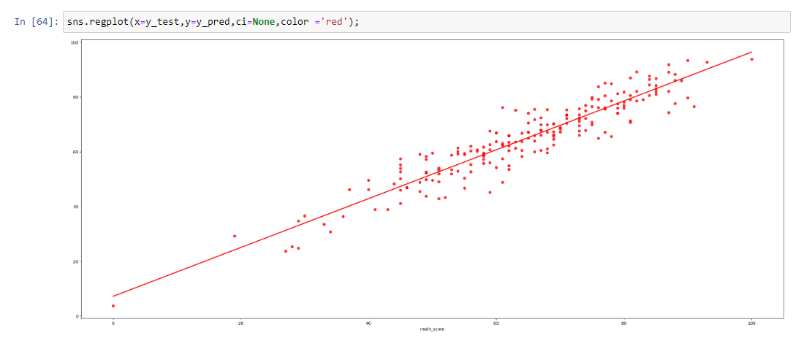

Slide 28
References
EDUCAUSE Research: http://net.educause.edu/ir/library/pdf/ERB1210.pdf
Z. Yue and Y. Jin, "The Development and Design of the Student Management System Based on the Network Environment," 2010 International Conference on Multimedia Communications, Hong Kong, 2010, pp. 5-8. doi: 10.1109/MEDIACOM.2010.23
S. A. M. Noor, N. Zaini, M. F. A. Latip and N. Hamzah, "Android-based attendance management system," 2015 IEEE Conference on Systems, Process and Control (ICSPC),
Bandar Sunway, 2015, pp. 118-122. doi: 10.1109/SPC.2015.7473570
J. Mei-shan, Q. Chang-li and L. Jing, "The designment of student information management system based on B/S architecture," 2012 2nd International Conference on Consumer Electronics, Communications and Networks (CECNet), Yichang, 2012, pp. 2153-2155. doi: 10.1109/CECNet.2012.6201529
Y. Shulin and H. Jieping, "Research and implementation of Web Services in Android network communication framework Volley," 2014 11th International Conference on Service Systems and Service Management (ICSSSM), Beijing, 2014, pp. 1-3. doi: 10.1109/ICSSSM.2014.6943373
F. Yue, "A study of student information management software," 2016 IEEE International Conference of Online Analysis and Computing Science (ICOACS),
Chongqing, 2016, pp. 393-396. doi: 10.1109/ICOACS.2016.7563123
L. Meng, "College Student Management System Design Using Computer Aided System," 2015 International Conference on Intelligent Transportation, Big Data and Smart City, Halong Bay, 2015, pp. 212-215. doi: 10.1109/ICITBS.2015.59
A. Alshareef, A. Alkilany, M. Alweshah and A. A. Bakar, "Toward a student information system for Sebha University, Libya," Fifth International Conference on the Innovative Computing Technology (INTECH 2015), Pontevedra, 2015, pp. 34-39. doi: 10.1109/INTECH.2015.7173362

