Slide 1
UNIT 1: single dimension arrays
CAP770| Ms Deepika | Programming Domain

Slide 2
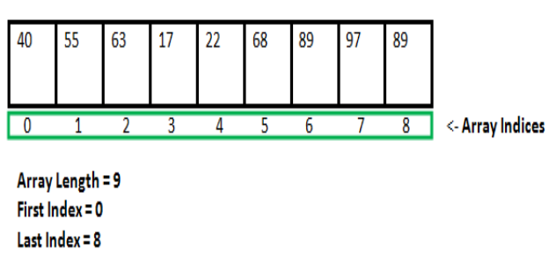
arrays
It is a collection of similar data items stored at contiguous memory locations and elements can be accessed randomly using indices of an array.
They can be used to store collection of primitive data types such as int, float, double, char, etc of any particular type.
Notes:
Insert a map of your country.

Slide 3
Properties of Array
Each element of an array is of same data type and carries the same size, i.e., int = 4 bytes.
Elements of the array are stored at contiguous memory locations where the first element is stored at the smallest memory location.
Elements of the array can be randomly accessed since we can calculate the address of each element of the array with the given base address and the size of the data element
Notes:
Insert a map of your country.

Slide 4
Advantages of arrays
1) Code Optimization: Less code to the access the data.
2) Ease of traversing: By using the for loop, we can retrieve the elements of an array easily.
3) Ease of sorting: To sort the elements of the array, we need a few lines of code only.
4) Random Access: We can access any element randomly using the array.
Notes:
Insert a map of your country.

Slide 5
Declaration of C Array
SYNTAX
data_type array_name[array_size];
int marks[5];
Notes:
Insert a map of your country.

Slide 6
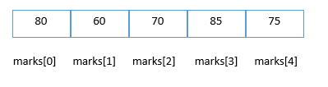
Initialization of C Array
marks[0]=80;//initialization of array
marks[1]=60;
marks[2]=70;
marks[3]=85;
marks[4]=75;
Notes:
Insert a map of your country.

Slide 7
#include<stdio.h>
int main(){
int i=0;
int marks[5];//declaration of array
marks[0]=80;//initialization of array
marks[1]=60;
marks[2]=70;
marks[3]=85;
marks[4]=75;
for(i=0;i<5;i++){
printf("%d \n",marks[i]);
}
}
Notes:
Insert a map of your country.

Slide 8
Declaration with Initialization
int marks[5]={20,30,40,50,60};
In some case, there is no requirement to define the size
int marks[]={20,30,40,50,60};
Notes:
Insert a map of your country.

Slide 9
two dimension arrays
CAP770| Ms Deepika | Programming Domain

Slide 10
The two-dimensional array can be defined as an array of arrays.
The 2D array is organized as matrices which can be represented as the collection of rows and columns.
Notes:
Insert a map of your country.

Slide 11
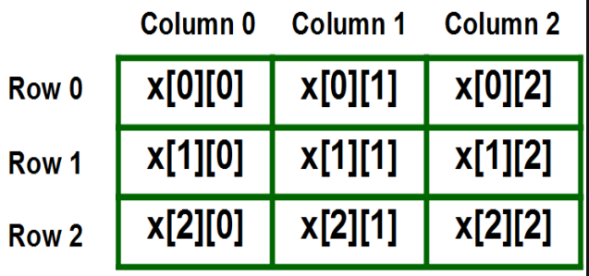
Declaration
We can declare a two-dimensional integer array say ‘x’ of size 3 rows and 4 columns as
int x[3][4];
Notes:
Insert a map of your country.

Slide 12
Initializing Two – Dimensional Arrays:
int x[3][2] = {{0,1}, {2,3}, {4,5}};
Notes:
Insert a map of your country.

Slide 13
#include<stdio.h>
main()
{ int x[3][2] = {{0,1}, {2,3}, {4,5}};
for (int i = 0; i < 3; i++)
{
for (int j = 0; j < 2; j++)
{
printf(" %d ", x[i][j]);
}
}
}
Notes:
Insert a map of your country.

Slide 14
operations on arrays
CAP770

Slide 15
Searching an element in array
#include<stdio.h>
int main()
{ int a[5]={ 22,55,66,22};
int n, element=55, pos=0,i
for(i=0; i<4; i++)
{
if(a[i]==element)
{
printf("%d found at position %d", element, i+1);
return 0;
}
}
printf("%d not found.", element);
return 0;
}
Notes:
Insert a map of your country.

Slide 16
Inserting an element in array
#include <stdio.h>
int main()
{ int arr[5]={ 33,55,77,88,22};
int i, x=99, pos=3,n=5;
for (i = 0; i < n; i++)
printf(" %d \n ", arr[i]);
n++;
for (i = n-1; i >= pos; i--)
arr[i] = arr[i - 1];
arr[pos - 1] = x;
printf(" array after insertion \n");
for (i = 0; i < n; i++)
printf(" %d \n ", arr[i]);
}
Notes:
Insert a map of your country.

Slide 17
Inserting an element in array
{ int arr[6]={ 33,55,77,88,22};
int i, x=99, pos=3,n=5;
for (i = 0; i < n; i++)
printf(" %d \n ", arr[i]);
for (i = n; i >= pos; i--)
arr[i] = arr[i - 1];
arr[pos - 1] = x;
printf(" array after insertion \n");
for (i = 0; i < n+1; i++)
printf(" %d \n ", arr[i]);
}
Notes:
Insert a map of your country.

Slide 18
Deleting an element in array
#include <stdio.h>
int main()
{ int size=5;
int arr[5]={ 33,55,77,88,22};
int i, x=99, pos=3;
for (i = 0; i < size; i++)
printf(" %d \n ", arr[i]);
for(i=pos-1; i<size-1; i++)
{
arr[i] = arr[i + 1];
}
size--;
printf(" array after deletion \n");
for (i = 0; i < size; i++)
printf(" %d \n ", arr[i]);
}
Notes:
Insert a map of your country.

Slide 19
Merging tw0 arrays
#include <stdio.h>
int main()
{ int size1=5,i,size2=5,size3;
int arr1[size1]={ 33,55,77,88,22};
int arr2[size2]={ 3,5,7,8,2};
printf("1st array \n");
for (i = 0; i < size1; i++)
printf(" %d \n ", arr1[i]);
printf("2nd array \n");
for (i = 0; i < size2; i++)
printf(" %d \n ", arr2[i]);
size3=size1+size2;
int arr3[size3];
for(i=0;i<size1;i++)
arr3[i]=arr1[i];
for(i=0;i<size2;i++)
arr3[size1+i]=arr2[i];
printf("3rd array \n");
for (i = 0; i < size3; i++)
printf(" %d \n ", arr3[i]);
}
Notes:
Insert a map of your country.

Slide 20
concatenating tw0 arrays
#include <stdio.h>
int main()
{ int size1=5,i,size2=5,size3;
int arr1[size1]={ 33,55,77,88,22};
int arr2[size2]={ 3,5,7,8,2};
printf("1st array \n");
for (i = 0; i < size1; i++)
printf(" %d \n ", arr1[i]);
printf("2nd array \n");
for (i = 0; i < size2; i++)
printf(" %d \n ", arr2[i]);
size3=size1+size2;
for(i=0;i<size2;i++)
arr1[size1+i]=arr2[i];
printf("concat array \n");
for (i = 0; i < size3; i++)
printf(" %d \n ", arr1[i]);
}}
Notes:
Insert a map of your country.

Slide 21
APPLICATIONS OF arrays
CAP770 | Programming Domain

Slide 22
An array is used in solving matrix problems.
Database records are also implemented by an array.
It helps in implementing a sorting algorithm.
It is also used to implement other data structures like Stacks, Queues, Heaps, Hash tables, etc.
An array can be used for CPU scheduling.Can be applied as a lookup table in computers
Arrays can be used in speech processing where every speech signal is an array.
Notes:
Insert a map of your country.

Slide 23
The screen of the computer is also displayed by an array. Here we use a multidimensional array.
The array is used in many management systems like a library, students, parliament, etc.
The array is used in the online ticket booking system.
Contacts on a cell phone are displayed by this array.
In games like online chess, where the player can store his past moves as well as current moves. It indicates a hint of position.
Notes:
Insert a map of your country.

Slide 24
REAL LIFE APPLICATIONS OF arrays
CAP770| MS deepika | Programming Domain

Slide 25
An array is frequently used to store data for mathematical computations.
It is used in image processing.
It is also used in record management.
Book pages are also real-life examples of an array.
It is used in ordering boxes as well.
Notes:
Insert a map of your country.

Slide 26
Binary search tree
. Construct a binary search tree with the below information. The preorder traversal of a binary search tree 10, 4, 3, 5, 11, 12.

