Slide 1
HTML
Introduction

Slide 2
The most popular mark-up language among the developers HTML was started at CERN in 1989 with the idea of creating a hypertext system for the internet by Sir Tim Berners-Lee.
HTML was first launched in 1991 with the first version of the language, HTML 1.0, which was released in the same year. The first version of HTML was called HTML 1.0 Strict and was released in 1993.
HTML was then released in 1994 with the second version of the language, HTML 2.0, which was released in 1995. The second version of HTML was called HTML 2.0 Transitional and was released in 1997.

Slide 3
What Is HTML?
The full form of HTML is Hypertext Markup Language. It is a mark-up language that is used to create web pages. HTML is a subset of the XHTML language, which is used to create XML documents that are valid and well-formed.
You can think of HTML as the skeleton, structure, or layout of a web page. Everything on a webpage is built using components of HTML.
The smallest unit of HTML is called a tag. A tag is a piece of code that tells the browser how to display a certain part of the page. For example, the <h1> tag tells the browser to display the text inside the tag as a heading.

Slide 4
The Story behind HTML
In the year 1980, a physicist named Tim Berners-Lee come up with an idea of a system in which documents could be stored and shared with the researchers at CERN.
The idea was to create a system where researchers could create documents and share them with other researchers. The documents would be stored on a server and the researchers could access them through a web browser.
Then in 1989, he composed an update proposing an Internet-based Hypertext System for global computers. Tim Berners-Lee's idea was a model in which users can navigate from one set of information on a computer to another set of information on another computer.
Note: A hypertext system is a network of text documents connected using a hyperlink and can be jumped from one document to another using some action like a mouse click.

Slide 5
Tim Berners-Lee wrote the browser and server software for HTML in 1990.
Berners-Lee and another data system engineer collaborated in 1990 to request funding but CERN rejected the project.
In late 1991 Tim Berner-Lee publicly posted the description of HTML in a document called HTML Tags.

Slide 6
Versions of HTML
Let's see the list of different versions of HTML with their timeline and features.
1991 - Tim Berners-Lee created HTML 1.0
1993:-
HTML 1.0 was first released in 1993 for developers
back then not many developers were creating websites so it was evolving slowly during those time
This version only had basic tags like text, even tables and fonts were not available in this version
Nov 24, 1995 - This year HTML 2.0 was published. All the features of HTML 1.0 were inherited in HTML 2.0 plus new features were added. Until the release of HTML 3.0, it remains the standard markup language for creating websites.

Slide 7
Jan 14, 1997:-
HTML 3.2 was published in 1997 as W3C Recommendation
It was the first version of HTML which was developed by W3C
In this version, there was good support for form elements
One most important thing that was added in this version was the support of CSS
1999:-
HTML 4.01 was published as W3C Recommendation on Dec 14, 1999
This version was the most successful of all previous HTML released versions
In this version features like multimedia, scripting, better printing features and more were added.
After the release of HTML 4.01, no newer version of HTML was released for many years because W3C's HTML working group were busy building the language XHTML
2014:-
HTML5 (the latest version of HTML) was released on Oct 28, 2014 as W3C Recommendation
It was an extended version of HTML 4.01 published in 2012
Many new tags were added in this version like <header>, <footer>, <main>, <video>, etc

Slide 8
Future of HTML
HTML has covered a long journey from a simple idea of document sharing among different computers to becoming part of almost everything we do on the internet.
HTML has always changed with the world with new demands and technology and will keep changing and adding new features. A most recent update in HTML5 was the addition of canvas which was really awesome, you can use canvas to draw shapes, images, text, animations, and even an entire game upon it.
As the technology has become more complex to fulfill the increasing demand for more reliable devices, the future of HTML lies in adaptability to change, operationality for different devices, and new features for developers and users.

Slide 9
Here is some key information to easily describe HTML:
HTML (Hypertext Markup Language) is a language for publishing text-based and multimedia information on the World Wide Web.
HTML is a straightforward Computer Coding Language. It was developed in the 90s. HTML is the basis of a web page, and the web page is the basis of a website. HTML uses 'tags' to create web documents.
HTML is a hypertext markup language, a predetermined set of markup tags used to design web pages.
HTML is the first language of web designing. CSS is also used along with HTML to improve web page design further. JavaScript is used with HTML to make web pages dynamic.
HTML is relatively easy to learn because every tag is predefined, so only we need to know the work of tags and their attributes.
Web browsers (Chrome, Internet Explorer, Firefox, Safari, and other web browsers) are software' to read HTML and display web page design as output.
You can write HTML in any simple editor, such as Notepad. And other software, such as Adobe Dreamweaver, Sublime, NetBeans, Notepad ++, etc., are mainly used for writing and editing HTML.
".html" or ".htm" are the two extensions used to write and save HTML files; we can write HTML code in any text editor and save it as "filename.html" or "filename.htm".

Slide 10
What is HTML DOCTYPE?
HTML Doctype Declaration refers to a Document Type Definition (DTD). A DTD refers to an XML document format representing allowed elements in a web page. Every HTML document requires a document type declaration. It is a directive that tells the web browser about the HTML version and standard in which the current page is written; this helps different web browsers parse the web page correctly. Technically the Doctype declaration does not belong to the category of tag or element in HTML. It is just a directive to the web browser about the type of HTML document. It is a null element with no closing tag.

Slide 11
These are some of the points which are essential to know for the Doctype Declaration:
The doctype declaration should be on the first line at the top of all other content on the web page.
The Doctype declaration was long for earlier versions of HTML because the HTML language was SGML-based and therefore required reference to DTDs, but they are now obsolete.
The HTML5 doctype declaration is concise, easy to use, reliable, and case-insensitive.
In HTML5, only the doctype declaration is required to enable standards mode for web pages.
Doctype declaration differs in different HTML versions.

Slide 12
example template of HTML 5 doctype declaration:
<!DOCTYPE Root element Publicity "Registration//Organization//Type Name//Language" "URL">
<!DOCTYPE html>
<html lang="en-US">
<head> <title>Example of HTML5 Doctype declaration</title>
</head>
<body>
The body of the web page.
</body>
</html>

Slide 13
In earlier versions of HTML, some parameters are attached to the doctype:
Root element: It represents the root element of the document. <HTML> for HTML or XHTML.
Publicity: The Publicity parameter can be either PUBLIC or SYSTEM. For HTML or XHTML, the DOCTYPE value is PUBLIC.
Registration: It can hold two values, namely plus (+), which lists the International Organization for Standardization (ISO) developer, and minus (-), not registering the International Organization for Standardization (ISO) developer.
Organization: It is the name of the DTD developer. W3C for HTML or XHTML.
Type: It declares the document type. DTD for HTML or XHTML.
Name: It defines the unique identifier illustrating DTD.
Language: The HTML document with the language type, two letters in uppercase. For HTML or XHTML, English (EN) is the language.
URL: It defines the Document Type Description URL (for example, https://www.w3.org/TR/html4/strict.dtd).

Slide 14
SGML
SGML (standard generalized markup language) is an international standard for the definition of markup languages; that is, it is a metalanguage. Markup consists of notations called tags that specify the function of a piece of text or how it is to be displayed. SGML emphasizes descriptive markup, in which a tag might be “<emphasis>.” Such a markup denotes the document function, and it could be interpreted as reverse video on a computer screen, underlining by a typewriter, or italics in typeset text.
SGML is used to specify DTDs (document type definitions). A DTD defines a kind of document, such as a report, by specifying what elements must appear in the document—e.g., <Title>—and giving rules for the use of document elements, such as that a paragraph may appear within a table entry but a table may not appear within a paragraph. A marked-up text may be analyzed by a parsing program to determine if it conforms to a DTD. Another program may read the markups to prepare an index or to translate the document into PostScript for printing. Yet another might generate large type or audio for readers with visual or hearing disabilities.

Slide 15
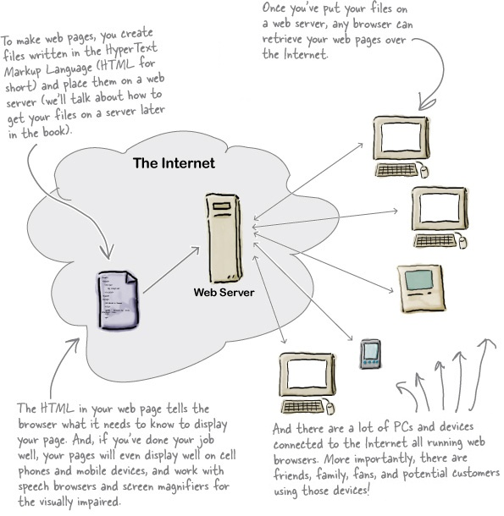

Slide 16
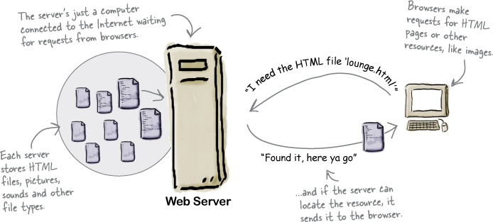
What does the web server do?

Slide 17
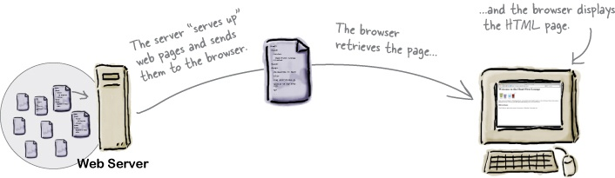
What does the web browser do?

