Slide 1

Online Study Room Booking System
Team - 01 Ignite

Slide 2

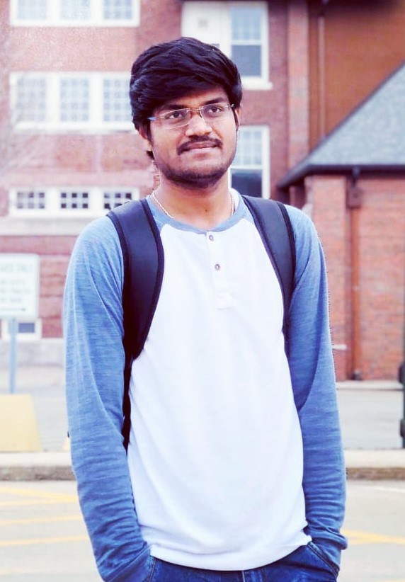
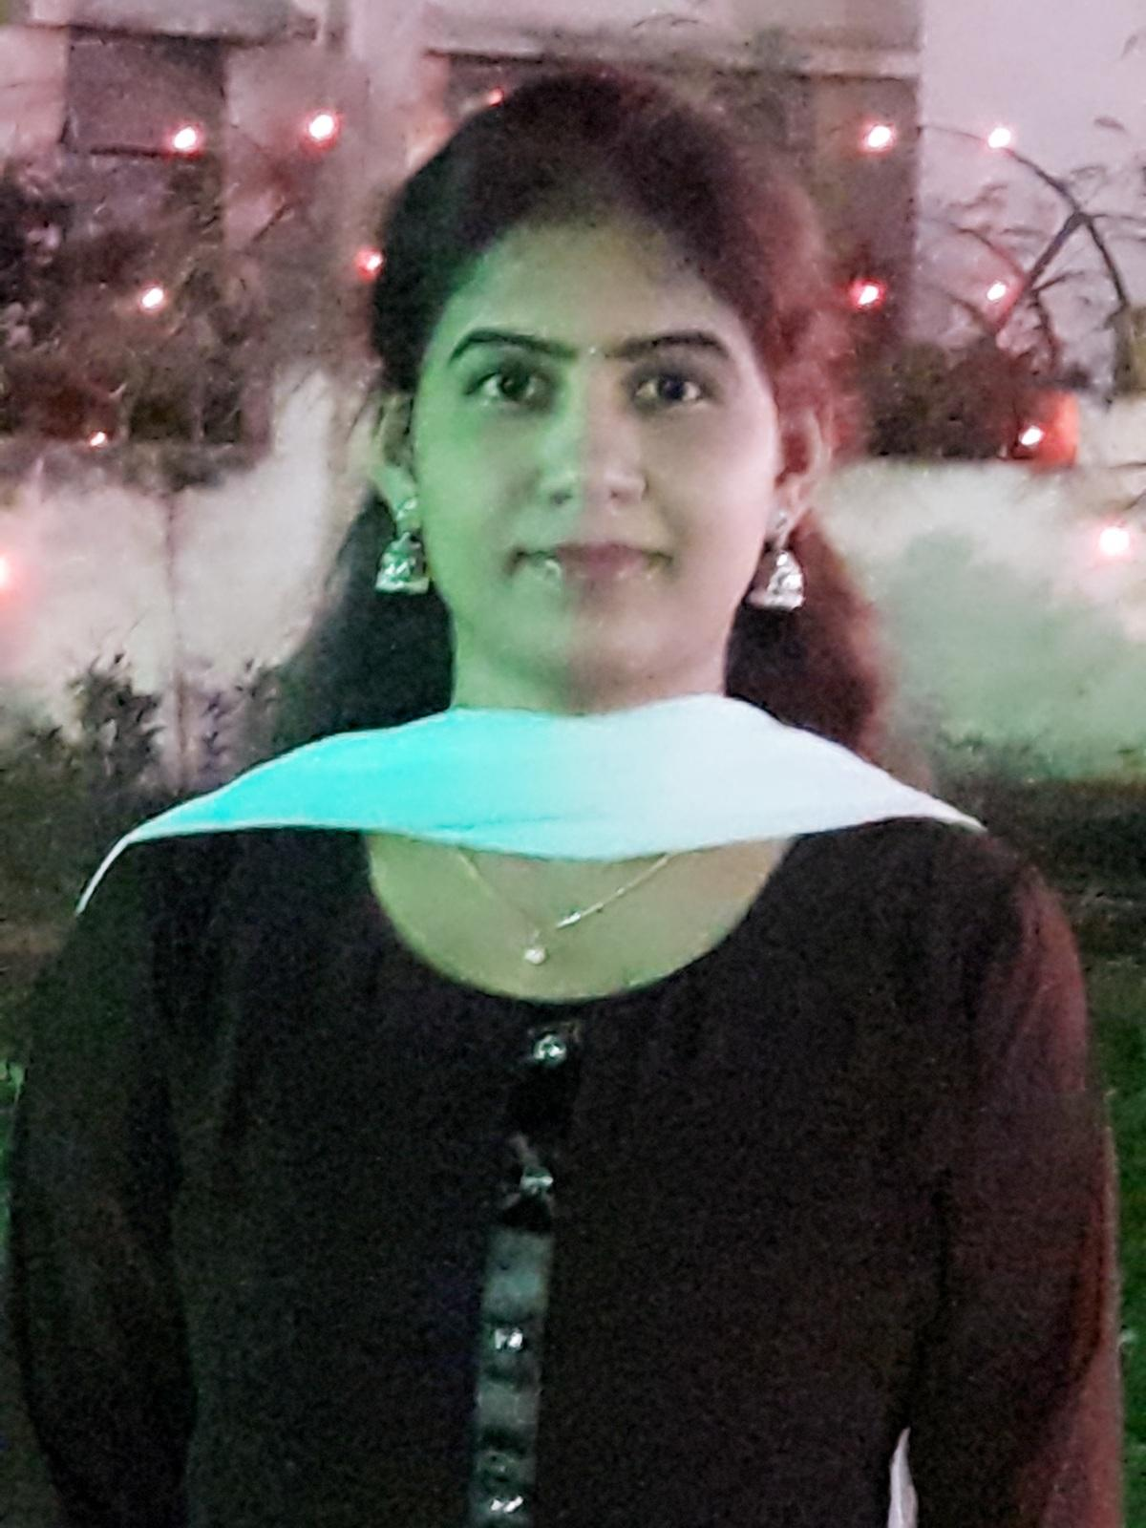
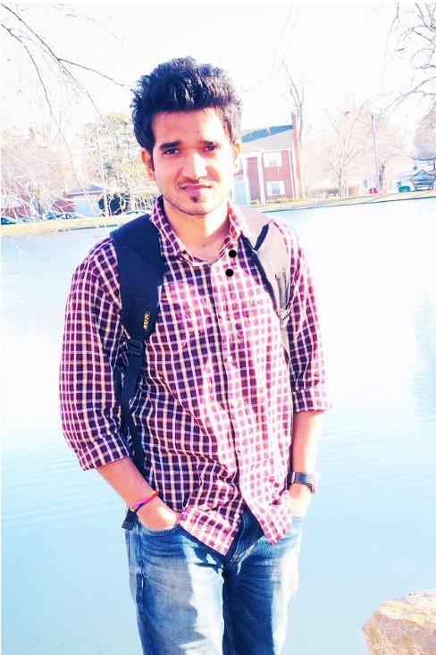
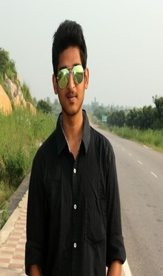
Team
Harsha Bollam
Ravi Atluri
Chitralekha Chikku
Satish Gadge
Nishanth

Slide 3
Contents
Introduction
Functional Requirements
ER Diagram
Tools & Technologies
List of Tasks
Demo
Usability Logs
Lessons Learnt
Acknowledgement

Slide 4
Introduction
In this application, the user/students can check the availability of the room and book the room in the library for a specific period by using the valid Bearcat email account and Bearcat ID.
It is a reliable website in which the personal details of the user/students is kept private and it also works on diverse platforms.
Satish

Slide 5
Functional Requirements
The user/student are able to open the website by using a valid Bearcat email account and Bearcat ID.
The user is able to login to the home page of the Online Study Room Booking by using the above credentials.
The user is able to view the number of available rooms on the floor.
The user is able to book the time slot from the available slot.
The user is given a unique ID for the blocking of the room, which is generated automatically by the application.
Satish

Slide 6
Functional Requirements
The user is able to cancel or reschedule the blocking only before three hours of blocked time.
After completing the booking, the user is able to view their reservation for the confirmation.
Admin is able to add and remove the rooms.
Admin is be able to add and remove the user.
Admin also have access to create /update and delete the bookings.
Satish

Slide 7
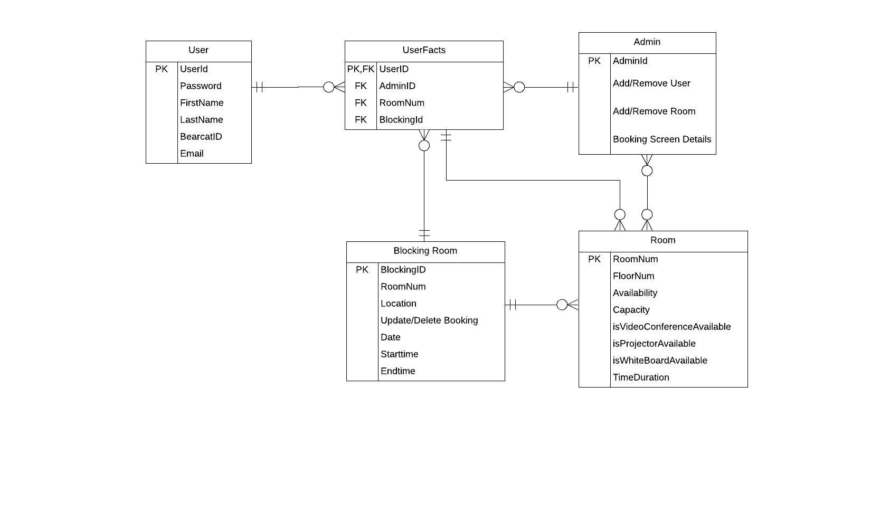
ER Diagram
Harsha Bollam

Slide 8
Tools & Technologies
Technologies:
HTML
CSS
Java Script
Bootstrap
Mongodb
Tools:
VS Code
Lucid Chart
Git Hub
Harsha Bollam

Slide 9
List of Tasks
Home Screen Portal
Registering to website
Log in Website
Room Searching
Booking Room
Reschedule Booking
Cancel Booking
About Us and Contact Us
Log Out
Harsha Bollam

Slide 10
Demo
https://github.com/bollamharshavardhanreddy/UXD
Ravi Atluri & Nishanth

Slide 11
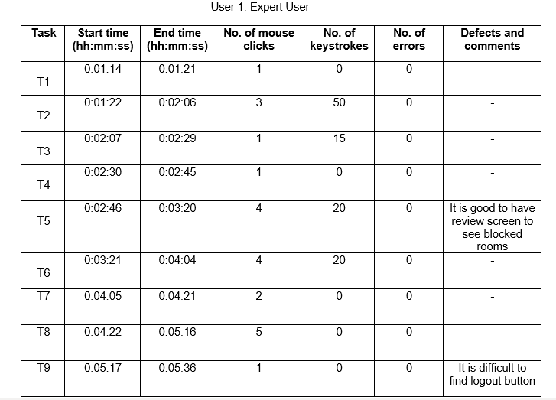
Usability Logs
ChitraLekha

Slide 12
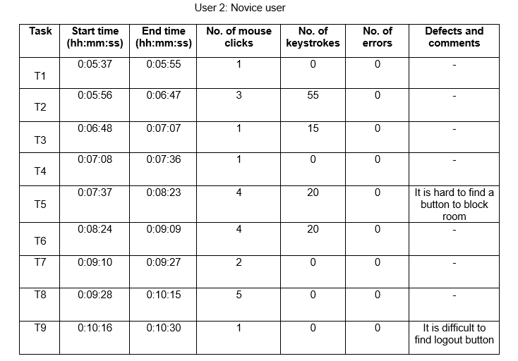
Usability Logs
ChitraLekha

Slide 13
Lessons Learned
Creating a good user interface.
Universal Usability.
Using 8 golden rules for designing a website.
Learnt different technologies.
Team Coordination and Communication.
ChitraLekha

Slide 14
Acknowledgement
We would like say thank you to Dr. Charitha Hettiarachchi for assisting in our Human Computer Interaction course.
We would also like to thank our GA, Pradeep Kolli for helping us throughout the course duration.

Slide 15
Queries ?

Slide 16
Thank you!

