Slide 1
E-Hospital
By:-manoj

Slide 2


Introduction
What is E-Hospital Management?
Demands of patients…
How to get E-appointment?
3G Help…
Advantage – Disadvantage
Conclusion
Thank You…

Slide 3



Demands Of patients
Instant Appointment…
Good & qualified Doctors…
Many Specialties…like,
ENT Surgeon
Dentists
Neurologist
Physician
General Surgeon
Blood Bank , Medical Store , laboratory…
Good Facilities…

Slide 4


How to get e-appointment???
Find Hospital Site…
Fill Patient’s Data in Appointment Form…
Fix Appointment With Doctor on your time…
3G Help…
SMS Help…

Slide 5
Find Hospital’s site
Just Google it…
Find Doctor By…
Specialty
Problem
Doctor’s Name
Peak Specialty
Select City
Select Area

Slide 6


Fill patient’s Data…
Name:-
Address:-
Age:-
Gender:-
Problem:-
Previous Treatment:-
Email & cont.no.:-
Which Doctor:-
Ex:
9.Do you need ambulance???
On Which time?
From where?
Dr. Name | Qualification | Time
Heom | M.C.H. | 9.00am To11.00am
Priyank | M.S. | 4.00pm To 6.00pm

Slide 7

After Fix Appointment
Site Creates 3 copies of case register
Personal
Hospital Record
Government Record
Once your treatment is started
Your account will be created
For next three months you will be considered under old case.
You can get updates about absence of your Doctor in case your appointment time is changed.

Slide 8
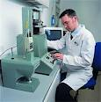
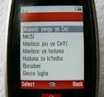
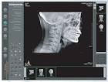
3G & SMS help
3G Help
You can get Primary Treatment…
You can contact foreign doctors as reference…
SMS / Email Help
Final appointment time on your phone…
Reports by Email
Remainder of next check-up & medicine time

Slide 9



Advantages
Appointment 24/7 from anywhere…
No More long waits…
Know doctor before visiting…
Get information about blood bank, medical store’s stoke , laboratory…
Save transportation expenses…
It don’t create black money…

Slide 10


Disadvantages
Server down
Not useful for uneducated people
For emergency this system is not useful
Without appointment you can’t meet Doctor

Slide 11



Conclusion
With the help of IT Sector this technology will be developed in future .
It saves your time & money.
You can easily get the best Doctor & Hospital near by.

Slide 12


Doctor house
Right Doctor, Right Place,Right Time
Book your Appointment instant & Free with a top Doctor near by …..
Do You want to fix appointment???
For any help call:
8374837407
Doctors
Schedule
Blood Bank
Laboratory
Click Here…
Medical store
For Reference:
www.healthavail.com

Slide 13
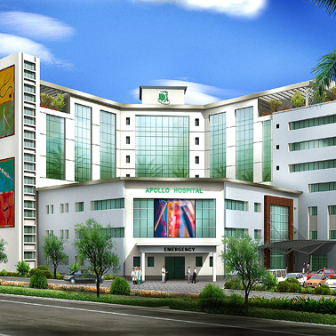
Future Hospital
Where no wait, Fast Treatment , Doctors on Your Time

Slide 14
Thank You…

