Slide 1
PATISSERIE
PREPARED BY:R.dileep

Slide 2
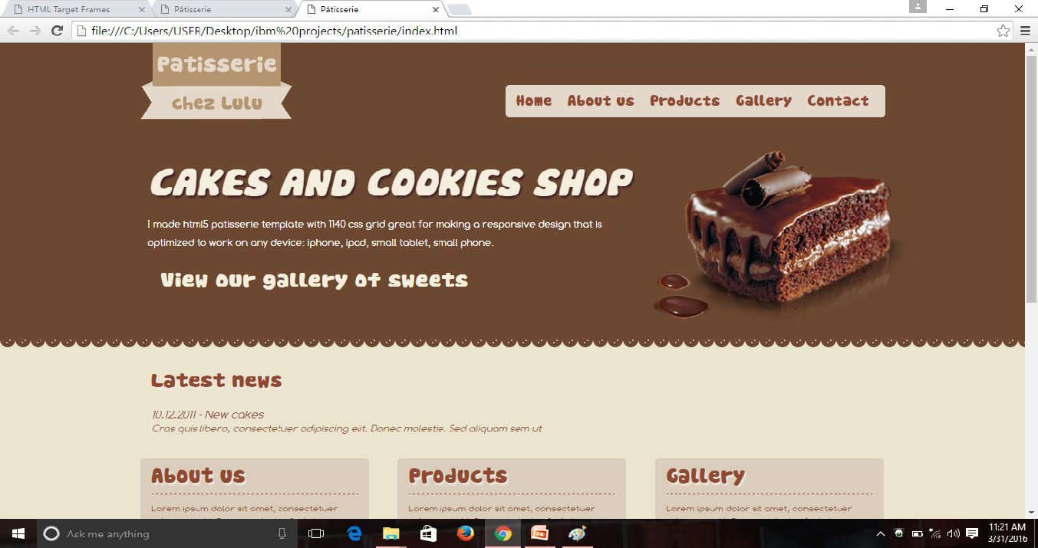
Open delicious cakes click read more and buy it

Slide 3
you click read more than go to website

