Slide 1
ShopOnline
New year bonanza
Items for sale!!!

Slide 2
online shopping in this technological world now-a-days man was so busy so we save the time for us so we started shop online in this you can shop what ever you want you can buy in this it can be useful for future generation also….some of the categories listen below

Slide 3
Shopping Categories
Books, DVD’s & Music
CD’s, Magazine Subscriptions, 300: The Movie, & more..
Books, DVD’s & Music
CD’s, Magazine Subscriptions, 300: The Movie, & more..
Books, DVD’s & Music
CD’s, Magazine Subscriptions, 300: The Movie, & more..
Books, DVD’s & Music
CD’s, Magazine Subscriptions, 300: The Movie, & more..
Books, DVD’s & Music
CD’s, Magazine Subscriptions, 300: The Movie, & more..
Books, DVD’s & Music
CD’s, Magazine Subscriptions, 300: The Movie, & more..
Notes:
online shopping in this technological world now-a-days man was so busy so we save the time for us so we started shop online in this you can shop what ever you want you can buy in this it can be useful for future generation also….

Slide 4


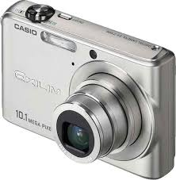
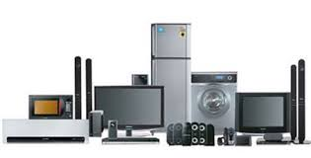
Notes:
Shopping Categories
Books, DVD’s & Music
CD’s, Magazine Subscriptions, 300: The Movie, & more..
Books, DVD’s & Music
CD’s, Magazine Subscriptions, 300: The Movie, & more..
Books, DVD’s & Music
CD’s, Magazine Subscriptions, 300: The Movie, & more..
Books, DVD’s & Music
CD’s, Magazine Subscriptions, 300: The Movie, & more..
Books, DVD’s & Music
CD’s, Magazine Subscriptions, 300: The Movie, & more..
Books, DVD’s & Music
CD’s, Magazine Subscriptions, 300: The Movie, & more..

Slide 5
Thank you
Notes:
Thank you

