Slide 1
Solution Blueprint
Service workflow
Service Lifecycle
Application Modules
Data Entities
Technologies
Technical Architecture

Slide 2
Document history
Version | Modified by | Modified date | Reviewed by | Review date
0.1 | Devaraja Murthy | 15-sep-2015
1.0 | Devaraja Murthy | 30-sep-2015
1.1 | Devaraja Murthy | 5-oct-2015

Slide 3
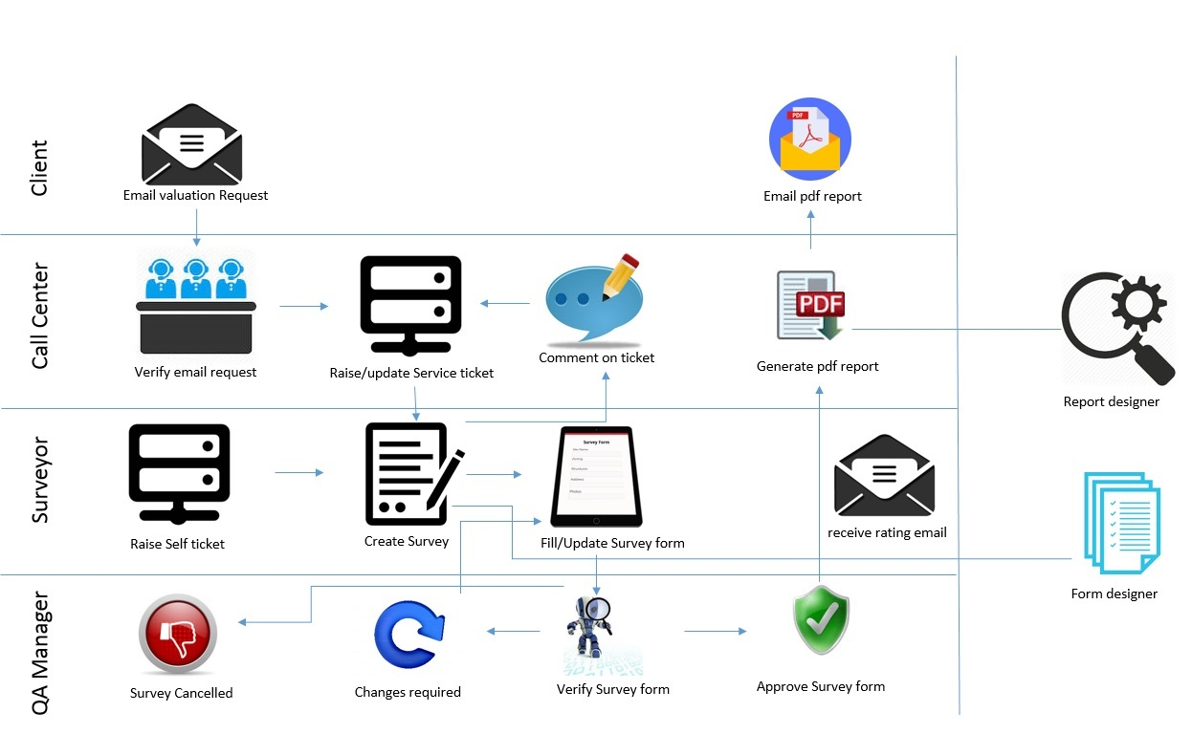
Service Workflow
Service request workflow
Client send email to Call center desk
Call center staff verify the email and raise service ticket and assign to surveyor
Surveyor creates survey
  If any issues comment on ticket.
  Call center staff take action on comment and update ticket.
Surveyor completes the survey on field visit with iPad.
QA manager verifies the survey information.
  If changes required open the survey again
  Again surveyor take up the survey to update
  If verification fails survey is cancelled
  If rating is not normal send email.
Call center staff generate pdf report on the survey.
Update and close the service ticket
Send the pdf report to client

Slide 4
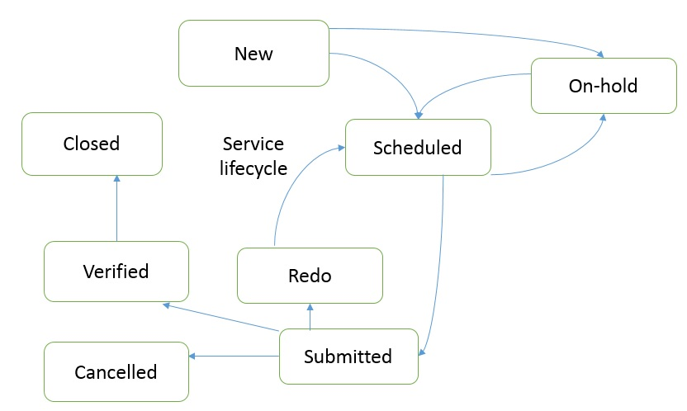
Service lifecycle
Service follows below status
New – Call center staff create service ticket
Scheduled – Survey is open to execute
Redo – Assigned back for redo after verification
Incomplete – Assigned back by QA manager to redo.
Submitted – Survey is submitted
  Cancelled – Verification not fulfilled and survey cancelled.
Verified – QA verified
Closed – Service fulfilled and closed
On-hold – If any issues comment on ticket item and keep on Hold.

Slide 5
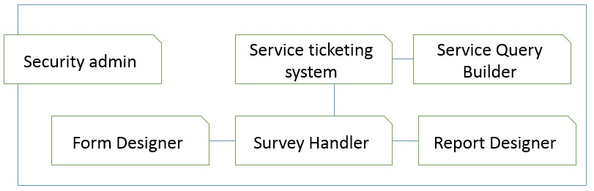
Application Modules
Service ticketing system
  Facilitates service ticketing
Survey handler
  Facilitates survey execution
Form designer
  Define form templates for given survey type
Report designer
  Define Report format for given survey type
Service query builder
  Query on service ticketing system to get custom information
Security administration
  Manage security and permissions of system users

Slide 6
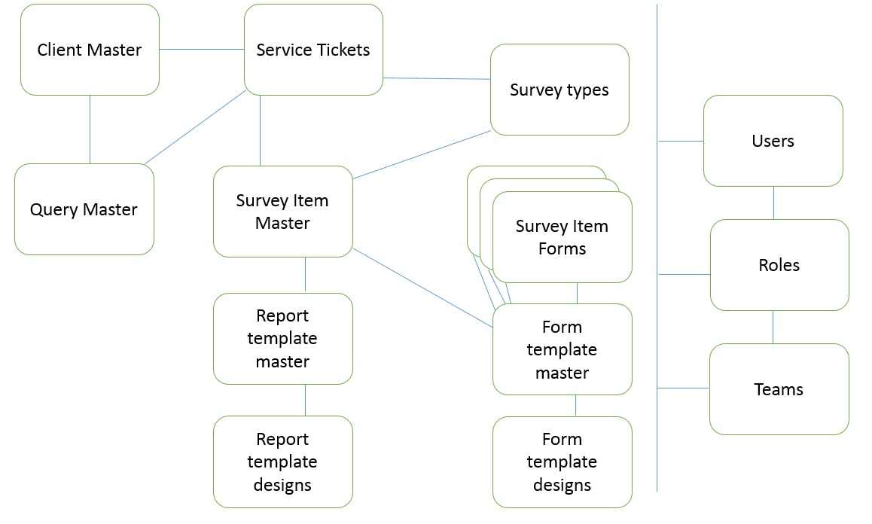
Data Entities
Client master ( Bank details )
Service tickets (service lifecycle)
Survey types
Survey item master (Survey lifecycle)
  Survey item form values are filled in this referenced entity
  Survey item form fields to be filled are selected as per form template design
Survey item forms
  For each basic survey type survey item form entity created dynamically through form template designer.
  Form entity fields are defined as per form template design of given survey type.
Form template master
  For each survey type one form template item defined.
  Each Form template record contains reference to basic survey type form entity name
Form template designs
  For given form template several form field items are defined with datatype and other properties.
Report template master
  For each survey type one report template item defined.
Report template designs
  For given report template several report display items are defined with display style and other properties.
Users
Roles
Teams

Slide 7
Technologies
.Net Framework 4.5.1 or later
Asp.net MVC framework
Web Api
Internet Information Services (IIS 7 or later)
SQL server 2014
JSReport.MVC
HTML5, Jquery, Javascript, AngularJS
iPad Native Application

Slide 8
Technical architecture
Asp.net MVC Web application hosted on IIS will serve the client applications on desktop and iPad devices.
Secured protocol (HTTPS) used for communication between client and server.
Web Api will serve to provide REST services for client applications through IIS.
SQL server serves the purpose of data storage.

Slide 9
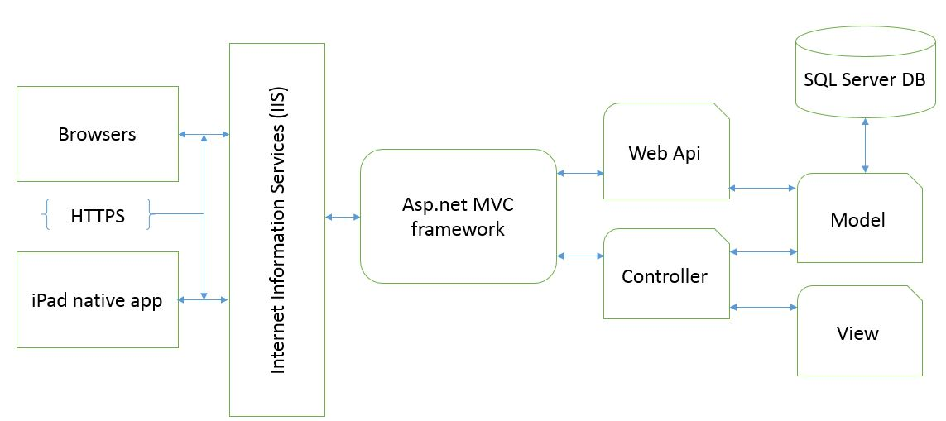
Technical architecture

