Slide 1
TECHNICAL ASSESSMENT
Enterprise-Grade
Reconciliation Platform
Principal Engineer / Architect assessment demonstrating production Java engineering, IBM MQ messaging, Kubernetes deployment, resiliency patterns and observability.
Enterprise Reconciliation Platform | Principal Engineer / Architect Assessment
1

Slide 2
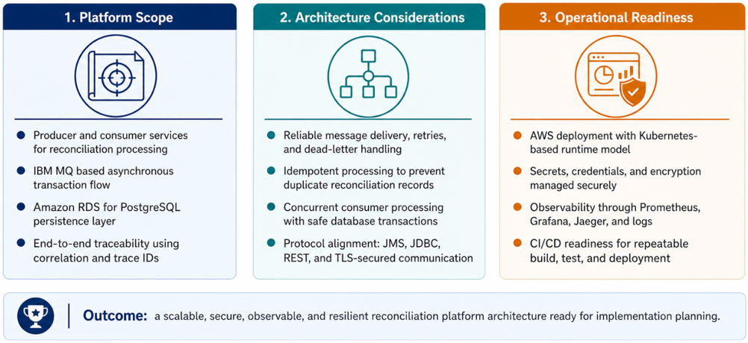
Executive Summary
This assessment defines the target architecture, integration flow, infrastructure model, and operational controls required to build a production-grade reconciliation platform.
Enterprise Reconciliation Platform | Principal Engineer / Architect Assessment
2

Slide 3
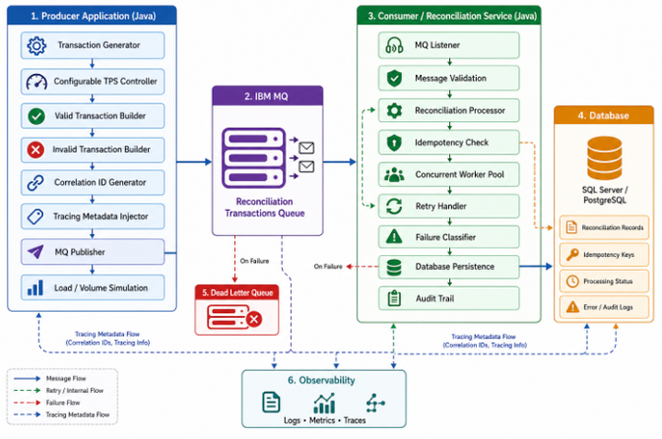
High Level Functional Architecture
Producer Application generates valid and invalid reconciliation transactions, controls transaction volume using configurable TPS, and enriches every message with correlation and tracing metadata.
IBM MQ decouples producer and consumer processing, buffers reconciliation messages reliably, and routes failed or unprocessable messages to the Dead Letter Queue.
Consumer / Reconciliation Service validates messages, performs reconciliation logic, checks idempotency, processes messages concurrently, retries transient failures, and classifies permanent failures.
Database stores reconciliation records, idempotency keys, processing status, and audit/error details for traceability and reporting.
Observability captures logs, metrics, and traces across the full flow to support monitoring, troubleshooting, and end-to-end transaction tracking.
Enterprise Reconciliation Platform | Principal Engineer / Architect Assessment
3

Slide 4
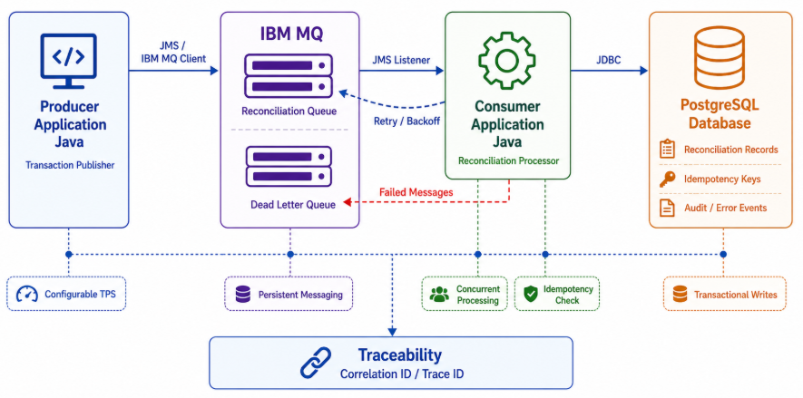
High Level Technical Architecture
The architecture separates transaction publishing, message buffering, reconciliation processing, and database persistence into clear runtime components.
IBM MQ provides reliable decoupling between producer and consumer, while correlation IDs help trace each reconciliation transaction end to end.
Enterprise Reconciliation Platform | Principal Engineer / Architect Assessment
4

Slide 5
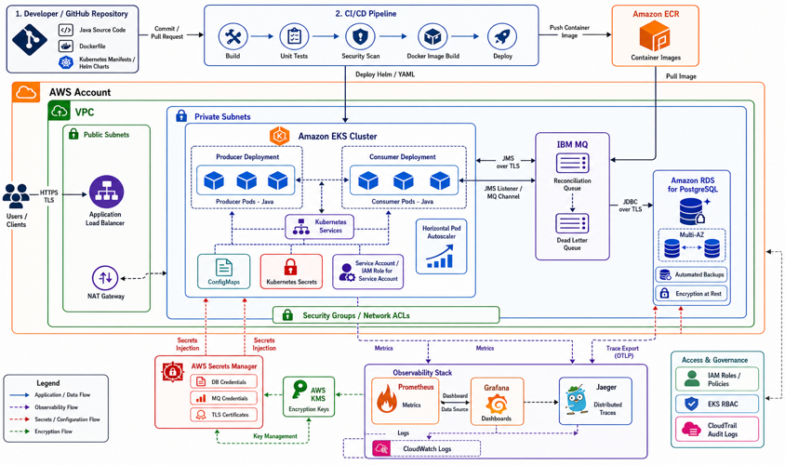
High Level Infra Architecture
AWS EKS runs the producer, consumer, and dashboard services as scalable Kubernetes deployments.
IBM MQ and PostgreSQL provide reliable messaging and durable reconciliation storage with persistent volumes/backups.
AWS Secrets Manager, IAM roles, security groups, and observability tools secure and monitor the platform end to end.
Enterprise Reconciliation Platform | Principal Engineer / Architect Assessment
5

Slide 6
End-to-End Message Flow
The message is the contract boundary: JSON TextMessage plus JMSCorrelationID and W3C tracing headers.
IBM MQ
RECON.IN
Persistent message
PostgreSQL
reconciliation_record
Status + audit
Producer
Java 17
Random transactions
Consumer
Concurrent JMS
Reconcile
Retry / Backout
DLQ paths
Replay support
Dashboard API
Status / failed
Queue / replay
- Business invalid transactions are persisted as INVALID, not silently dropped
- Retryable technical failures follow retry/backout/DLQ paths
- Dashboard can prove current status and replay recoverable failures
Enterprise Reconciliation Platform | Principal Engineer / Architect Assessment
6

Slide 7
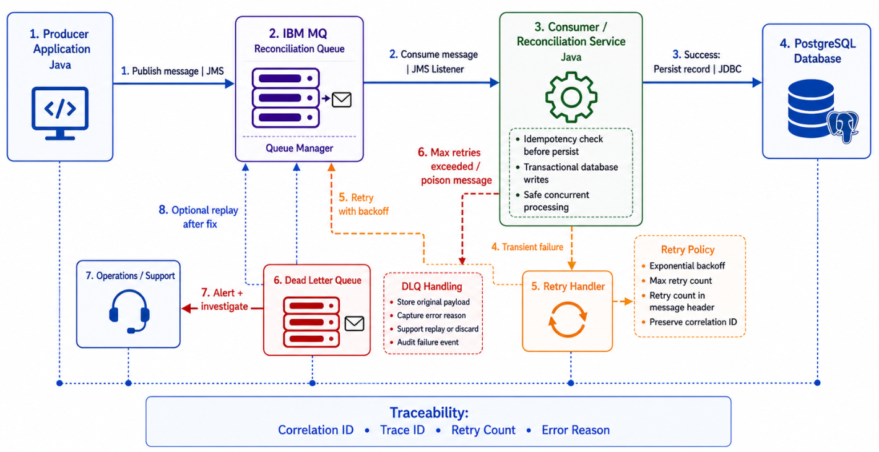
Retry and DLQ Architecture
Enterprise Reconciliation Platform | Principal Engineer / Architect Assessment
6

Slide 8
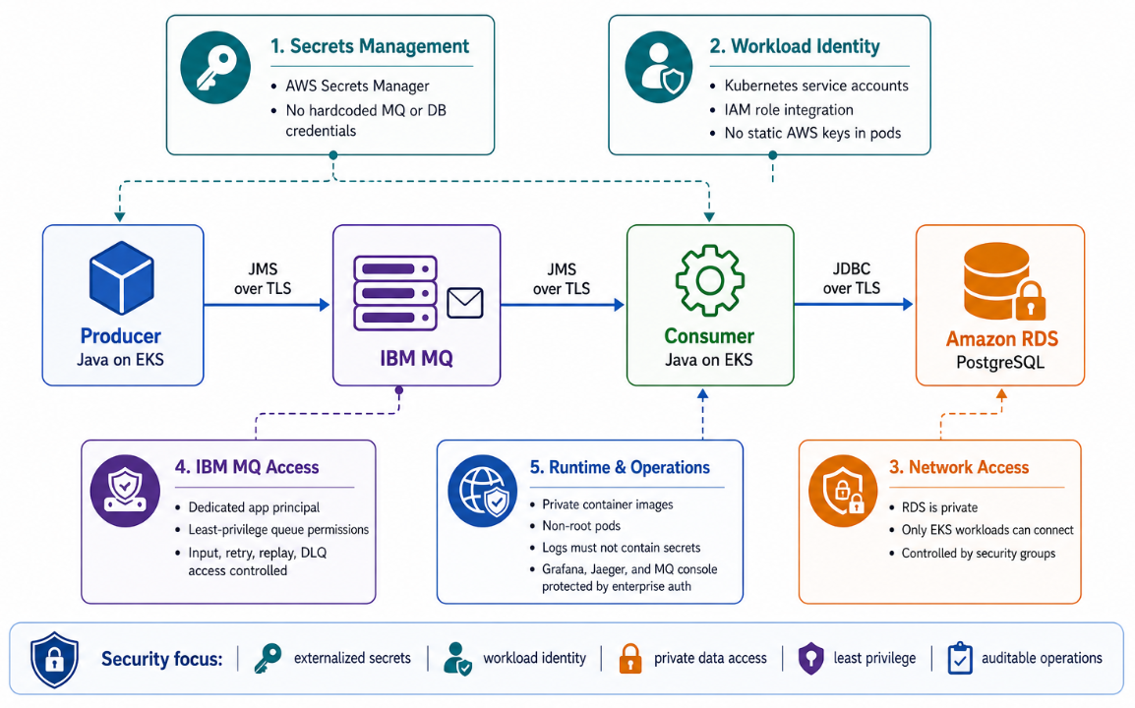
Key Security Considerations
Secrets are externalized using AWS Secrets Manager, MQ, DB, and runtime credentials are not hardcoded in source code or property files.
Workload identity is controlled through Kubernetes service accounts and AWS IAM role integration, avoiding static AWS credentials inside pods.
Network access is restricted by keeping PostgreSQL/RDS private and allowing access only through VPC security groups from the EKS workload network.
IBM MQ access is least-privilege based using a dedicated app principal with explicit OAM permissions for input, retry, backout, replay, and DLQ queues.
Container and Kubernetes security controls include private ECR images, non-root pod execution, restricted container privileges, readiness/liveness probes, and ConfigMaps for non-sensitive config only.
Operational security is considered through structured logging without secrets, trace/correlation IDs for auditability, and the recommendation to protect Grafana, Jaeger, MQ console, and dashboard APIs with enterprise authentication in production.
Enterprise Reconciliation Platform | Principal Engineer / Architect Assessment
7

Slide 9
Producer Engineering Design
Capabilities
Production controls
- Configurable TPS using PRODUCER_TPS and PRODUCER_INTERVAL_MS
- Random valid and invalid transaction generation
- Correlation metadata: correlationId, traceId and traceparent
- Backpressure guard reads queue depth before publishing
- Structured logging and Micrometer counters
- No secrets in source code or properties
- AWS Secrets Manager loaded at startup
- MQRC 2035 is logged clearly without exposing credentials
- Queue-depth cap prevents uncontrolled message growth
- Prometheus metric: recon_producer_messages_total
Enterprise Reconciliation Platform | Principal Engineer / Architect Assessment
7

Slide 10
Consumer / Reconciliation Engineering Design
Core Processing
Reliability controls
- JMS listener consumes RECON.IN and RECON.RETRY
- Business validation marks records RECONCILED or INVALID
- PostgreSQL persistence with unique transaction/correlation keys
- Idempotency prevents duplicate processing side effects
- Concurrent processing controlled through configuration
- Deadlock retry with exponential backoff
- Circuit breaker around database calls
- Bulkhead isolation protects worker threads
- Poison messages move to RECON.BACKOUT
- Prometheus counters for retries, failures and deadlocks
Enterprise Reconciliation Platform | Principal Engineer / Architect Assessment
8

Slide 11
Dashboard/API Engineering Design
API Surface
Operational value
- GET /api/reconciliation/status
- GET /api/reconciliation/failed
- GET /api/reconciliation/queues
- POST /api/reconciliation/replay
- Actuator liveness and readiness probes
- Shows total, reconciled, invalid, failed and DLQ counts
- Exposes queue backlog visibility
- Provides controlled replay mechanism
- Supports live demo and recovery walkthrough
- Feeds Prometheus queue-depth metrics
Enterprise Reconciliation Platform | Principal Engineer / Architect Assessment
9

Slide 12
IBM MQ Topology and Recovery Paths
RECON.IN
Primary input
RECON.RETRY
Retry queue
RECON.BACKOUT
Poison/exhausted
SYSTEM.DLQ
Undeliverable
MQ features demonstrated
- Retry queues
- Backout queue
- Dead-letter queue handling
- MQRC 2035 diagnosis and correction
- Poison message handling
- Message replay through dashboard
Recovery behavior
- Retryable failures are isolated
- Poison messages stop blocking the main queue
- DLQ is visible and measurable
- Replay path is explicit and auditable
- Correlation metadata is preserved
Operational evidence
- MQRC 2035 failure runbook
- OAM authority script
- Queue depth metrics
- Logs with correlationId
- Dashboard status confirms DB results
Enterprise Reconciliation Platform | Principal Engineer / Architect Assessment
10

Slide 13
Kubernetes Objects Implemented
Raw manifests
Operational behavior
- Deployments for producer, consumer and dashboard
- StatefulSet for IBM MQ
- Services for app access and MQ internal routing
- ConfigMaps for runtime configuration and MQSC setup
- Secrets and IRSA for runtime credentials
- HPAs, PDBs, liveness and readiness probes
- RollingUpdate deployments with controlled availability
- Persistent storage through gp3 StorageClass
- Auto-recovery when pods crash
- Consumer scaling controlled through HPA and concurrency settings
- GitHub Actions builds and deploys container images to EKS
Enterprise Reconciliation Platform | Principal Engineer / Architect Assessment
11

Slide 14
CI/CD: GitHub to AWS
GitHub Actions
Build
Unit tests
Containerize
Amazon EKS
kubectl apply
rollout status
Developer Push
main branch
Amazon ECR
Versioned images
Deploy role pattern
GitHub assumes an AWS IAM role through OIDC. The workflow builds all three services, pushes images to ECR, applies raw Kubernetes manifests, and waits for rollout completion. Kubernetes access still depends on EKS access entry or aws-auth mapping.
Enterprise Reconciliation Platform | Principal Engineer / Architect Assessment
12

Slide 15
Testing and Code Quality
Unit and integration focus
Production code practices
- Producer tests validate generation, scheduling and publish behavior
- Consumer tests validate reconciliation, retry, idempotency and failure paths
- Dashboard tests validate API status, failed view, replay and queue visibility
- Exception handling paths are covered explicitly
- Target coverage: 80 percent or higher
- Java 17 and Spring Boot conventions
- No credential hardcoding
- Structured exceptions and domain-specific failure types
- ObjectMapper configured for Java time serialization
- Clean separation of app responsibilities
Enterprise Reconciliation Platform | Principal Engineer / Architect Assessment
13

Slide 16
Troubleshooting Case Study: MQRC 2035
Symptom
Producer and consumer started but failed to open MQ queues.
IBM MQ returned MQRC 2035 authorization failure.
Diagnosis
Logs showed authorization failure, not network or credential parsing issue.
Queue manager and queue OAM were inspected.
Correction
Applied OAM authorities for app principal on QM1 and queues using documented script.
Why this matters
This is the kind of real production issue the assessment is asking for: a cloud deployment worked at the platform layer, but MQ object authorization blocked message flow. The recovery was diagnosed, fixed through MQ authority commands, documented, and validated by end-to-end transaction processing.
Enterprise Reconciliation Platform | Principal Engineer / Architect Assessment
14

Slide 17
AI-Assisted Engineering Workflow
How AI was used
Engineering judgement applied
- Clarified the assessment into phased engineering deliverables
- Generated initial scaffolding for Java services and Kubernetes manifests
- Produced architecture documentation, Draw.io structure and prompt packs
- Assisted troubleshooting of AWS, EKS, MQ, Grafana and serialization issues
- Prepared demo scripts and validation commands
- Validated generated code with unit tests and live deployments
- Corrected secret handling to use AWS Secrets Manager instead of properties
- Fixed ObjectMapper Java time serialization in JMS converter
- Added queue backpressure to avoid unbounded MQ growth
- Separated TPS panels from cumulative total panels in Grafana
Enterprise Reconciliation Platform | Principal Engineer / Architect Assessment
16

Slide 18
Prompt Engineering Examples and Corrections
Example prompts used
- Build three independent Java 17 services for producer, consumer and dashboard.
- Add IBM MQ retry, backout, DLQ and replay patterns.
- Move confidential runtime config to AWS Secrets Manager.
- Create Kubernetes manifests for EKS with HPA, probes and persistent MQ storage.
- Generate architecture diagrams and SRE walkthrough.
AI-generated sections
- Spring Boot project structure
- JMS configuration
- Reconciliation service skeleton
- Kubernetes Deployment/StatefulSet YAML
- Prometheus/Grafana manifests
- Runbook and architecture documentation
Manual corrections
- Removed property-file secrets and used Secrets Manager
- Added exception handling and production logging
- Fixed MQ OAM authorization and documented MQRC 2035
- Added JavaTime ObjectMapper support
- Added total processed Grafana panels
- Tuned TPS/backpressure for cloud cost and stability
Enterprise Reconciliation Platform | Principal Engineer / Architect Assessment
17

Slide 19
Architecture Decisions and Trade-Offs
Decisions
Trade-offs
- IBM MQ selected for durable enterprise messaging and MQ-specific assessment coverage
- PostgreSQL selected for transactional reconciliation state
- Three services selected for independent scaling and failure isolation
- Raw Kubernetes manifests selected for transparent operational assessment
- In-cluster Prometheus/Grafana selected for portable demo evidence
- Single MQ StatefulSet is cost-effective for assessment, but production HA should use replicated MQ pattern
- Dashboard LoadBalancer is simple for demo, but production should use TLS, SSO and WAF
- HPA on CPU is simple, but queue-depth based scaling would be stronger for production
- RDS single instance is cost-conscious; production should use Multi-AZ
- Raw YAML is explicit; Helm/Terraform improves repeatability at scale
Enterprise Reconciliation Platform | Principal Engineer / Architect Assessment
18

Slide 20
HA/DR, Capacity and Cost Strategy
Production HA/DR path
Capacity and cost management
- Run EKS worker nodes across multiple availability zones
- Use RDS Multi-AZ and automated backups/PITR
- Adopt replicated IBM MQ / native HA queue manager pattern
- Version all container images in ECR
- Recreate infrastructure from manifests and future Terraform
- Keep consumer capacity greater than producer TPS
- Monitor RECON.IN queue depth slope and p95 DB latency
- Tune JMS concurrency, DB pool and RDS instance class
- Scale workloads to zero when idle for assessment cost control
- Right-size EKS node groups after observing real metrics
Enterprise Reconciliation Platform | Principal Engineer / Architect Assessment
19

Slide 21
Assessment Coverage and Evidence Map
Implemented Evidence
Evaluation Area
Where Demonstrated Demonstrated
Enterprise-grade design
Separated producer, consumer and dashboard; MQ topology; security; HA/DR; capacity planning
Architecture docs + PPTX
Hands-on production code
Java 17 Spring Boot apps, tests, exception handling, idempotency, Dockerfiles
GitHub repository
Messaging and resiliency
Retry queues, backout, DLQ, replay, MQRC 2035 runbook, poison handling
Phase 2 docs and code
Cloud-native deployment
AWS EKS, ECR, RDS PostgreSQL, Secrets Manager, raw Kubernetes manifests
aws-kubernetes folder
SRE and observability
Prometheus, Grafana, Jaeger, OpenTelemetry, queue depth, TPS, alerts
Phase 6 docs + dashboard
AI-assisted workflow
Prompting, generated-code validation, troubleshooting corrections, architecture prompt pack
Phase 5 slides
Enterprise Reconciliation Platform | Principal Engineer / Architect Assessment
20

Slide 22
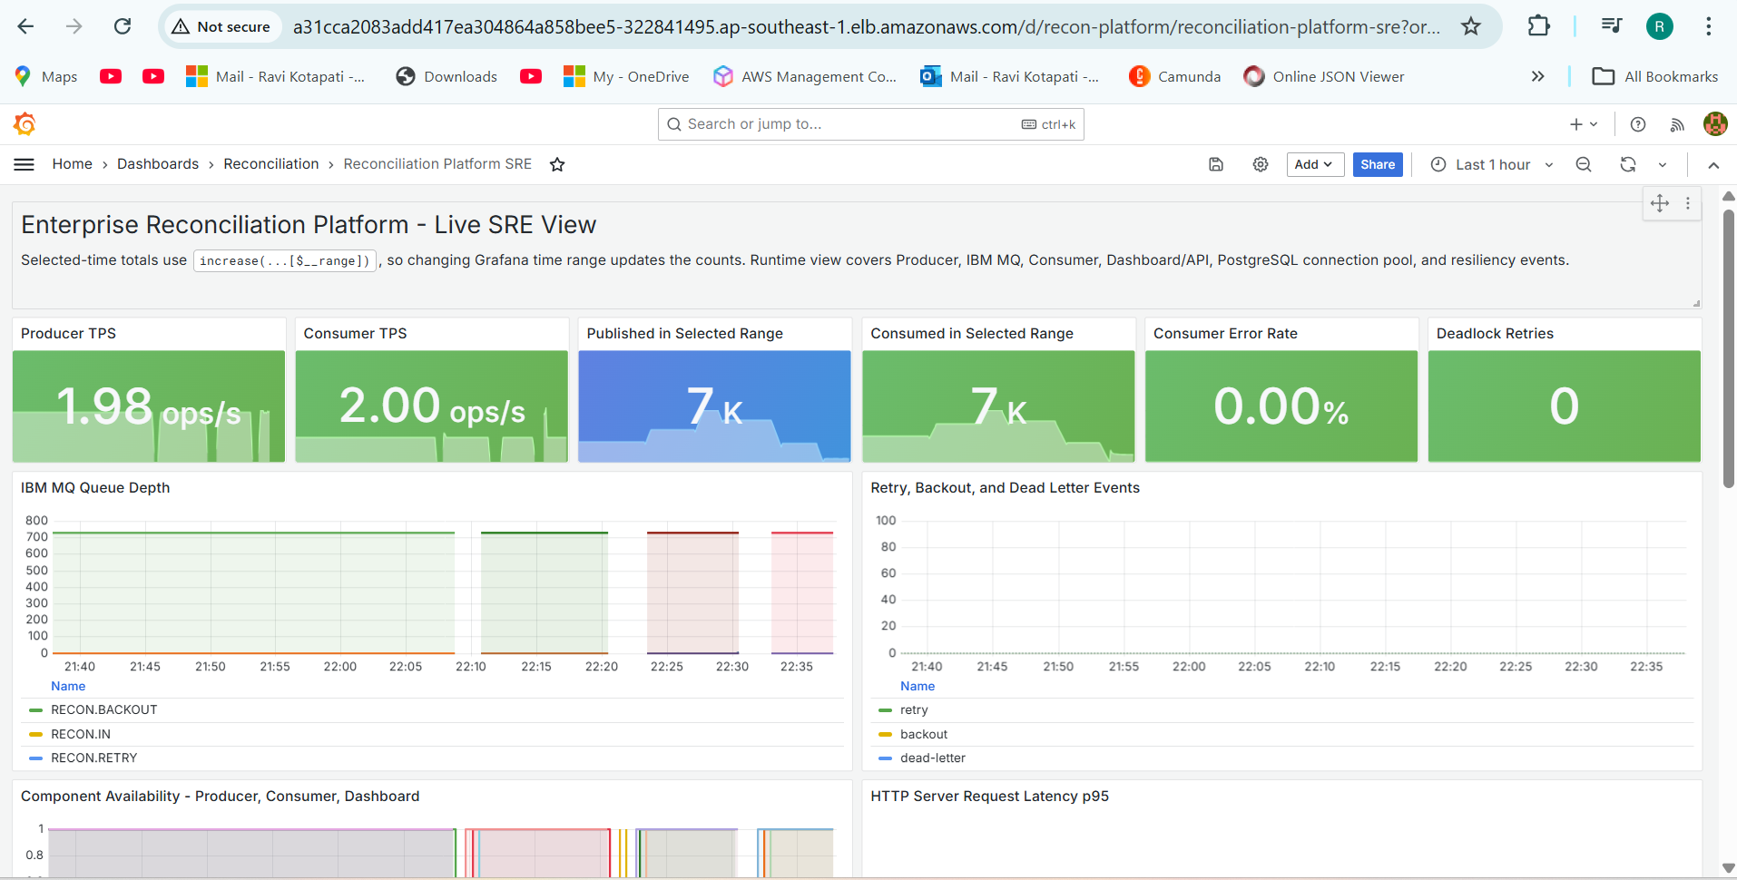
Grafana Dashboard
Enterprise Reconciliation Platform | Principal Engineer / Architect Assessment
20

Slide 23
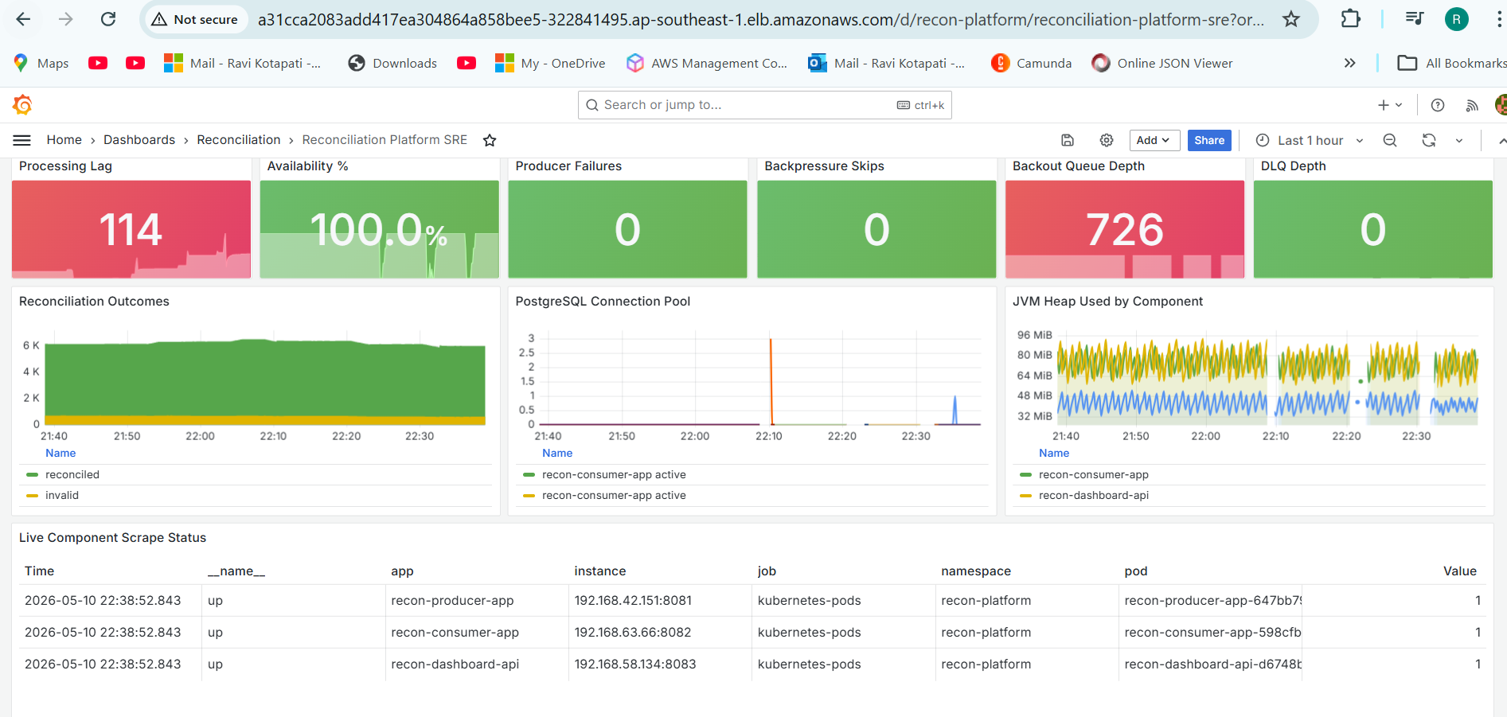
Grafana Dashboard
Enterprise Reconciliation Platform | Principal Engineer / Architect Assessment
20

Slide 24
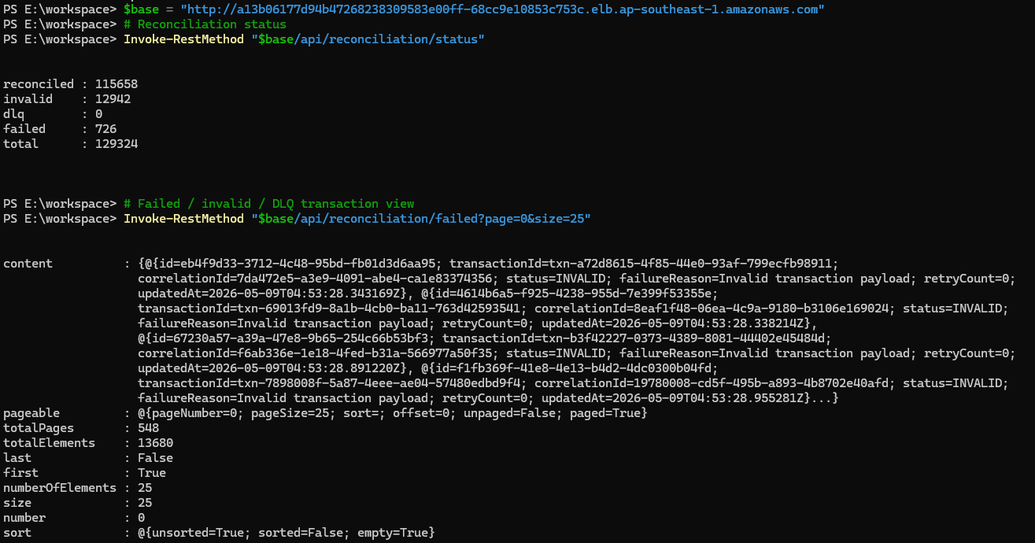
Dashboard/API
Enterprise Reconciliation Platform | Principal Engineer / Architect Assessment
20

Slide 25
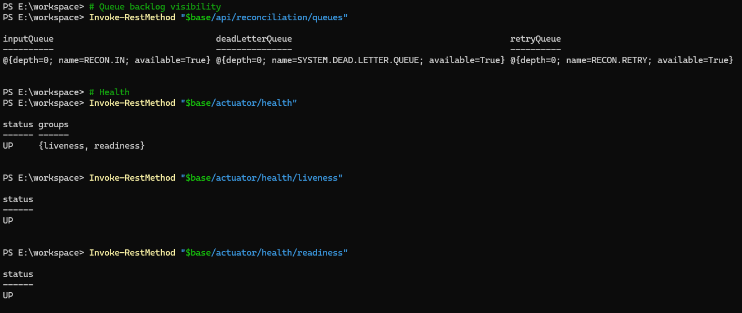
Dashboard/API
Enterprise Reconciliation Platform | Principal Engineer / Architect Assessment
20

Slide 26
Thank You
Enterprise Reconciliation Platform | Principal Engineer / Architect Assessment
21

