Slide 1


Object Oriented Programming 01CE0307 4 Credits MU - CE – 3rd Sem
Prepared By
Prof. Ravikumar R Natarajan
Assistant Professor, CE Dept.

Slide 2
Unit – 1 Introduction to Java

Slide 3
Contents
History & Features of Java
Java Virtual Machine
Java Runtime Environment
Bytecode
Objected Oriented principles
Datatypes
Variables
Final keyword
Operators & precedence
Scanner class for input
Type conversion

Slide 4
History of Java
Java is a high-level, class-based, object-oriented programming language that is designed to have as few implementation dependencies as possible. It is a general-purpose programming language intended to let programmers write once, run anywhere (WORA), meaning that compiled Java code can run on all platforms that support Java without the need to recompile.
B led to C, C evolved into C++, and C++ set the stage for Java.
James Gosling, Mike Sheridan, and Patrick Naughton initiated the Java language project in June 1991. The language was initially called Oak after an oak tree that stood outside Gosling's office.

Slide 5
Introduction
Java syntax is defined in the Java language specification, and the Java library is defined in the Java application program interface (API). The JDK (Java Development Kit) is the software for compiling and running Java programs. An IDE (Integrated Development Environment) is for rapidly developing programs.
Computer languages have strict rules of usage. If you do not follow the rules when writing a program, the computer will not be able to understand it. The Java language specification and the Java API define the Java standards.

Slide 6
Language Specification
The Java language specification is a technical definition of the Java programming language’s syntax and semantics. You can find the complete Java language specification at https://docs.oracle.com/javase/specs/ (Accessed on 21-Jan-22)

Slide 7
API
The application program interface (API), also known as library, contains predefined classes and interfaces for developing Java programs.
The API is still expanding. You can view and download the latest version of the Java API at https://www.oracle.com/in/java/technologies/javase-jdk8-doc-downloads.html (Accessed on 21-Jan-22)

Slide 8
Java Editions
Java is a full-fledged and powerful language that can be used in many ways. It comes in three editions:
Java Standard Edition (Java SE) to develop client-side applications. the applications can run on desktop.
Java Enterprise Edition (Java EE) to develop server-side applications, such as Java servlets, JavaServer Pages (JSP), and JavaServer Faces (JSF).
Java Micro Edition (Java ME) to develop applications for mobile devices, such as cell phones.

Slide 9
JDK & JRE
The JDK consists of a set of separate programs, each invoked from a command line, for compiling, running, and testing Java programs.
The program for running Java programs is known as JRE.
Instead of using the JDK, you can use a Java development tool (e.g., NetBeans, Eclipse, and TextPad)—software that provides an integrated development environment (IDE) for developing Java programs quickly.
Editing, compiling, building, debugging, and online help are integrated in one graphical user interface (GUI). You simply enter source code in one window or open an existing file in a window, and then click a button or menu item or press a function key to compile and run the program.

Slide 10

Questions
What is the Java language specification?
What does JDK stand for? What does JRE stand for?
What does IDE stand for?
Are tools like NetBeans and Eclipse are different languages from Java, or are they dialects or extensions of Java?

Slide 11
First Java Program
// Your First Program HelloWorld.java
class HelloWorld {
public static void main(String[] args) {
System.out.println("Hello, World!");
}
}
Output
Hello, World!
Note: You need to give the name of the class and file name same in Java.

Slide 12
How Java "Hello, World!"
Program Works?
// Your First Program
In Java, any line starting with// is a comment. Comments are intended for users reading the code to better understand the intent and functionality of the program. It is completely ignored by the Java compiler.
class HelloWorld { ... }
In Java, every application begins with a class definition. In the program, HelloWorld is the name of the class, and the class definition is:
class HelloWorld {
... .. ...
}

Slide 13
How Java "Hello, World!"
Program Works?
public static void main(String[] args) { ... }
This is the main method. Every application in Java must contain the main method.
The Java compiler starts executing the code from the main method.
4. System.out.println("Hello, World!");
The code above is a print statement. It prints the text Hello, World! to standard
output (your screen). The text inside the quotation marks is called String in Java.
Notice the print statement is inside the main function, which is inside the class definition.

Slide 14
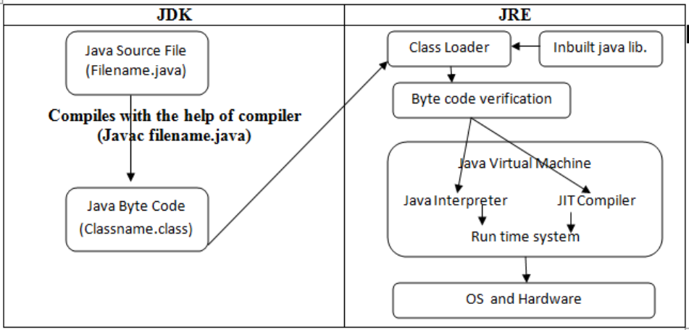
Compiling & Executing Java Program

Slide 15
Compiling & Executing Java Program
Java Program can be compiled using below command:
javac filename.java
And can be executed using below mentioned command:
java file-name

Slide 16


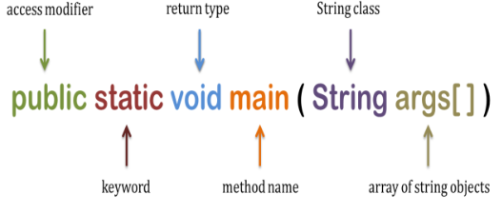
Main method in Java
Public class class-name {
Public static void main ( String[ ] agrs)
{
--- Your code---
}
}
Every word in the public static void main statement has got a meaning to the JVM.
1. Public: It is an Access modifier, which specifies from where and who can access the method. Making the main() method public makes it globally available. It is made public so that JVM can invoke it from outside the class as it is not present in the current class.
2. Static: It is a keyword which is when associated with a method, makes it a class related method. The main() method is static so that JVM can invoke it without instantiating the class. This also saves the unnecessary wastage of memory which would have been used by the object declared only for calling the main() method by the JVM.

Slide 17
Main method in Java
Every word in the public static void main statement has got a meaning to the JVM.
Public: It is an Access modifier, which specifies from where and who can access the method. Making the main() method public makes it globally available. It is made public so that JVM can invoke it from outside the class as it is not present in the current class.
Static: It is a keyword which is when associated with a method, makes it a class related method. The main() method is static so that JVM can invoke it without instantiating the class. This also saves the unnecessary wastage of memory which would have been used by the object declared only for calling the main() method by the JVM.
Public class class-name {
Public static void main ( String[ ] agrs)
{
--- Your code---
}
}
Every word in the public static void main statement has got a meaning to the JVM.
1. Public: It is an Access modifier, which specifies from where and who can access the method. Making the main() method public makes it globally available. It is made public so that JVM can invoke it from outside the class as it is not present in the current class.
2. Static: It is a keyword which is when associated with a method, makes it a class related method. The main() method is static so that JVM can invoke it without instantiating the class. This also saves the unnecessary wastage of memory which would have been used by the object declared only for calling the main() method by the JVM.

Slide 18
Main method in Java
3. Void: It is a keyword and used to specify that a method doesn’t return anything. As main() method doesn’t return anything, its return type is void. As soon as the main() method terminates, the java program terminates too. Hence, it doesn’t make any sense to return from main() method as JVM can’t do anything with the return value of it.
. main: It is the name of Java main method. It is the identifier that the JVM looks for as the starting point of the java program. It’s not a keyword.
. String[] args: It stores Java command line arguments and is an array of type java.lang.String class. Here, the name of the String array is args but it is not fixed and user can use any name in place of it.

Slide 19
Questions
Which file consists of Byte codes?
What is JVM?
What is JIT?
Is java a compiled or interpreted language?
Are tools like NetBeans and Eclipse are different languages from Java, or are they dialects or extensions of Java?

Slide 20
Objected Oriented Principles
1. Object – Instance of class | - Run time entities which occupies memory
2. Classes – Collection of attributes, methods.
3. Instance – Obj. created at run time
4. Inheritance – Provides reusability |
5. Data abstraction – Information hiding | refers to particular feature and hiding its background details | used in s/w design phase.
6. Encapsulation – Binding data and method together | used in s/w implementation | Inherited
7. Polymorphism –Ability to take more than one form | Types: compile time & run time
8. Message passing – An object sends data to another obj.

Slide 21
Java Buzz Words
Simple
Secure
Portable
Object-oriented
Robust
Multithreaded
Architecture-neutral
Interpreted
High performance
Distributed
Dynamic

Slide 22
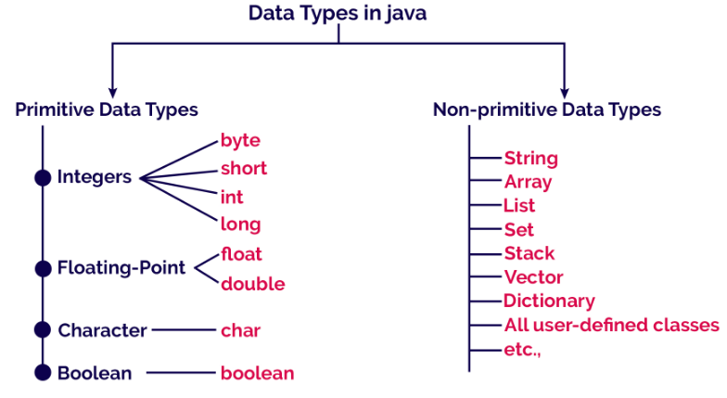
Java Data types

Slide 23
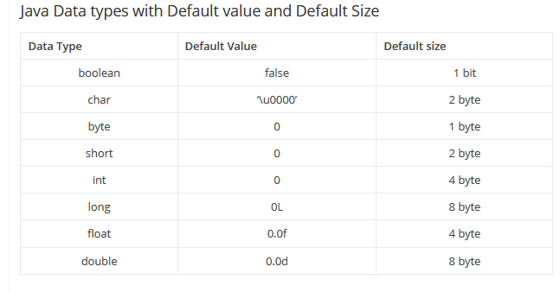
Java Data types

Slide 24
Java Data types
Character Data Type
A character data type represents a single character.
Unicode and ASCII code
Java supports Unicode, an encoding scheme to support the interchange, processing, and display of written texts in the world’s diverse languages.
65,536 characters possible in a 16-bit encoding are not sufficient to represent all the characters in the world.
The Unicode standard therefore has been extended to allow up to 1,112,064 characters. Those characters that go beyond the original 16- bit limit are called supplementary characters.

Slide 25
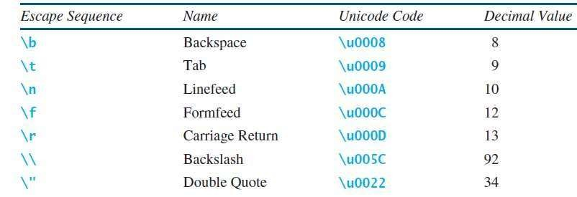
Escape Sequence for special
characters
System.out.println("He said \"Java is fun\"");
output: He said "Java is fun"
System.out.println("\\t is a tab character");
output: \t is a tab character

Slide 26

Java Identifiers
Identifiers are the names of variables, methods, classes, packages and interfaces.
Unlike literals they are not the things themselves, just ways of referring to them.
Literals are the values that are assigned to Identifiers. Ex: int count = 0;
In the HelloWorld program, HelloWorld, String, args, main and println are identifiers. The general rules for constructing names (naming conventions) for variables are:
› Names can contain letters, digits, underscores, and dollar signs
› Names must begin with a letter and it cannot contain whitespace
› Names can also begin with $ and _
› Names are case sensitive ("myVar" and "myvar" are different variables)
› Reserved words cannot be used as names

Slide 27
Variables in Java
› Variables are containers for storing data values.
int - stores integers (whole numbers), without decimals, such as 123 or -123
float - stores floating point numbers, with decimals, such as 12.34 or -12.34
char - stores single characters, such as 'a' or ‘A'.
boolean - stores values with two states: true or false
String - stores text, such as "Hello".
› Syntax: Data-type variable-name = variable-value;
› Example: String name = "John";

Slide 28
Final Variables
You can add the final keyword if you don't want others (or yourself) to overwrite existing values.
› This will declare the variable as "final" or "constant", which means unchangeable and read-only.
› Example:
final float interest_rate = 7.85;
interst_rate = 8.23; /* will generate an error: cannot assign a value to a final variable */

Slide 29
Java Naming conventions
Java naming convention is a rule to follow as you decide what to name your identifiers such as class, package, variable, constant, method, etc.
But, it is not forced to follow. So, it is known as convention not rule. These conventions are suggested by several Java communities such as Sun Microsystems and Netscape.
All the classes, interfaces, packages, methods and fields of Java programming language are given according to the Java naming convention. If you fail to follow these conventions, it may generate confusion or erroneous code.

Slide 30
Java Naming conventions
By using standard Java naming conventions, you make your code easier to read for yourself and other programmers. Readability of Java program is very important. It indicates that less time is spent to figure out what the code does.
Class
It should start with the uppercase letter.
It should be a noun such as Color, Button, System, Thread, etc. Use appropriate words, instead of acronyms.
Interface
It should start with the uppercase letter.
It should be an adjective such as Runnable, Remote, ActionListener. Use appropriate words, instead of acronyms.
public class Employee { //code snippet }
interface Printable { //code snippet }

Slide 31
Java Naming conventions
class Employee { // method void draw() { //code snippet } }
Method
It should start with lowercase letter.
It should be a verb such as main(), print(), println().
If the name contains multiple words, start it with
a lowercase letter followed by an
uppercase letter such as actionPerform
Variable
It should start with a lowercase letter such as id, name.
It should not start with the special characters like
& (ampersand), $ (dollar), _ (underscore). If the name contains
multiple words, start it with the lowercase letter followed by an
uppercase letter such as firstName, lastName.
Avoid using one-character variables such as x, y, z.
class Employee { // variable int id; //code snippet }

Slide 32
Java Naming conventions
Package
It should be a lowercase letter such as java, lang.
If the name contains multiple words, it should be
separated by dots (.) such as java.util, java.lang.
Constant
It should be in uppercase letters such as RED, YELLOW.
If the name contains multiple words, it should be
separated by an underscore(_) such as MAX_PRIORITY.
It may contain digits but not as the first letter.
//package package javaAppln01 class Employee { //code snippet }
class Employee { //constant static final int MIN_AGE = 18; //code snippet }

Slide 33
Java Naming conventions
Using the right letter case is the key to following a naming convention:
Lowercase is where all the letters in a word are written without any capitalization (e.g., while, if, mypackage).
Uppercase is where all the letters in a word are written in capitals. When there are more than two words in the name use underscores to separate them (e.g., MAX_HOURS)
CamelCase (also known as Upper CamelCase) is where each new word begins with a capital letter (e.g., ActionListener)
Mixed case (also known as Lower CamelCase) is the same as CamelCase except the first letter of the name is in lowercase (e.g., hasChildren, customerFirstName, customerLastName).

Slide 34
Java literals
Java Literals are syntactic representations of boolean, character, numeric, or string data. Literals provide a means of expressing specific values in your program.
For example, in the following statement, an integer variable named count is declared and
assigned an integer value.
Literal: Any constant value which can be assigned to the variable is called as literal/constant.
// Here 100 is a constant/literal.
int x = 100; String s = "Hello"; float a = 101.230; char ch = 'a';

Slide 35
Taking input from the console
There are 3 ways to get input from the console:-
Using Buffered Reader Class
Using Scanner Class
Using Console Class

Slide 36
1. Using Buffered Reader Class
This is the Java classical method to take input, Introduced in JDK1.0. This method is used by wrapping the System.in (standard input stream) in an InputStreamReader which is wrapped in a BufferedReader, we can read input from the user in the command line.
Advantages
The input is buffered for efficient reading.
Drawback:
The wrapping code is hard to remember.
Check program: BufferReaderDemo.java

Slide 37
1. Using Buffered Reader Class
import java.io.BufferedReader; import java.io.IOException; import java.io.InputStreamReader; public class BufferedReaderDemo { public static void main(String args[]) throws IOException{ InputStreamReader reader = new InputStreamReader(System.in); BufferedReader br = new BufferedReader(reader); System.out.println("What is your name?"); String name=br.readLine(); System.out.println("Welcome "+name); }}

Slide 38
2. Using Scanner Class
This is probably the most preferred method to take input. The main purpose of the Scanner class is to parse primitive types and strings using regular expressions, however it is also can be used to read input from the user in the command line.
Advantages:
- Convenient methods for parsing primitives (nextInt(), nextFloat(), …) from the tokenized input.
- Regular expressions can be used to find tokens.
Disadvantages :
- The reading methods are not synchronized

Slide 39
2. Using Scanner Class
import java.util.Scanner; /*package whatever //do not write package name here */ class ScannerDemo { public static void main (String[] args) { Scanner sc = new Scanner(System.in); System.out.println("Enter your number"); int t = sc.nextInt(); System.out.println("Number you entered is: " + t); }}

Slide 40
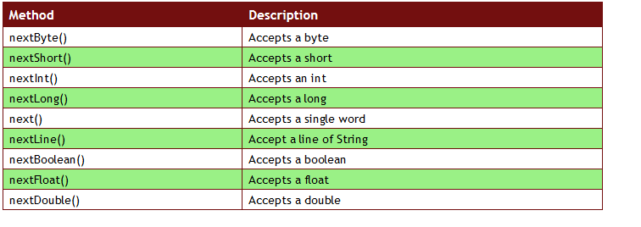
2. Using Scanner Class
Check program: ScannerClassDemo.java

Slide 41
3. Using Console Class
It has been becoming a preferred way for reading user’s input from the command line. In addition, it can be used for reading password-like input without echoing the characters entered by the user; the format string syntax can also be used (like System.out.printf()).
Advantages:
Reading password without echoing the entered characters.
Reading methods are synchronized.
Format string syntax can be used.
Drawback:
Does not work in non-interactive environment (such as in an IDE).
Check program: ConsoleClassDemo.java

Slide 42
3. Using Console Class
public class Main{
public static void main(String[] args)
{
// Using Console to input data from user
System.out.println("Enter your data");
String name = System.console().readLine();
System.out.println("You entered: "+name);
}}

Slide 43
Operators in Java
Operator in Java is a symbol which is used to perform operations.
For example: +, -, *, / etc.
There are many types of operators in Java which are given below:
Arithmetic operators (+,-,*,/,%,++,--)
Assignment operators (=,+=,=,*=,/=,%=,&=,|=,^=,>>=,<<=)
Comparison operators (==,!=,>,<,>=,<=)
Short Circuit Logical operators (&&,||,!)
Bitwise operators (&,|,^,~,<<,>>,>>>)
Ternary Operator (?:)

Slide 44
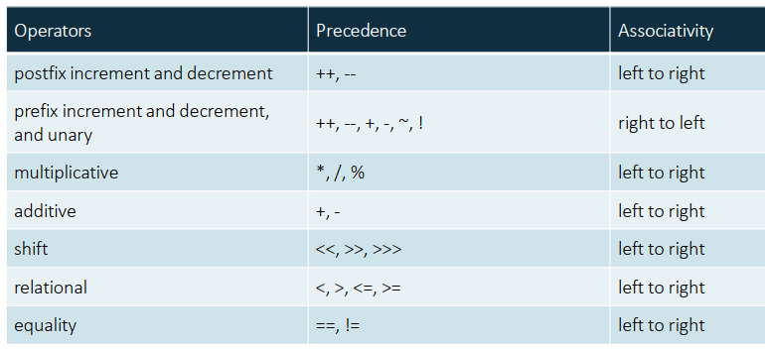
Operators Precedence & Associativity

Slide 45
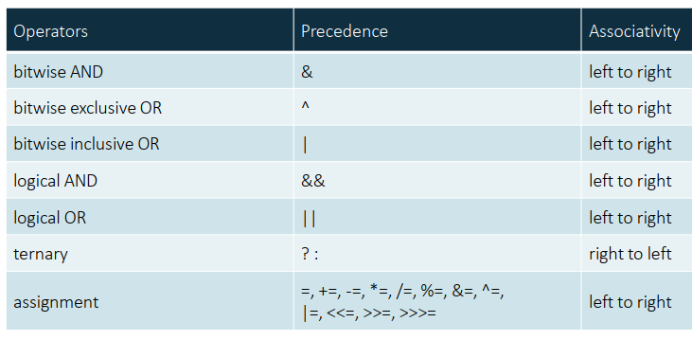
Operators Precedence & Associativity

Slide 46
Java Unary Operator
The Java unary operators require only one operand. Unary operators are used to perform
various operations i.e.:
incrementing/decrementing a value by one
negating an expression
inverting the value of a boolean
postfix prefix
expr++ expr--
++expr --expr +expr -expr ~ !

Slide 47
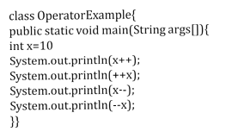
Java Unary Operator
Output:
10
12
12
10

Slide 48
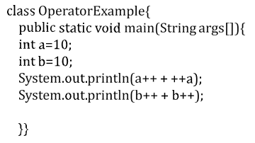
Java Unary Operator
Output:
22
21

Slide 49
Java Arithmetic Operators
Java arithmatic operators are used to perform addition, subtraction, multiplication, and division. They act as basic mathematical operations.
class OperatorExample{ public static void main(String args[]) |  | Output:
int a=10; |  | 15
int b=5; |  | 5
System.out.println(a+b); |  | 50
System.out.println(a-b); |  | 2
System.out.println(a*b); |  | 0
System.out.println(a/b);
System.out.println(a%b);
}}

Slide 50
Java Arithmetic Operators
class OperatorExample{
public static void main(String args[]){
System.out.println(10*10/5+3-1*4/2);
}}
Output:
21

Slide 51
Java Left Shift Operator
The Java left shift operator << is used to shift all of the bits in a value to the left side of a specified number of times.
class OperatorExample{
public static void main(String args[]){
System.out.println(10<<2); System.out.println(10<<3); System.out.println(20<<2); System.out.println(15<<4);
}}
Output:
40
80
80
240

Slide 52
Java Right Shift Operator
The Java right shift operator >> is used to move left operands value to right by the number of bits specified by the right operand.
class OperatorExample{
public static void main(String args[]){ System.out.println(10>>2); System.out.println(20>>2); System.out.println(20>>3);
}}
Output:
2
5
2

Slide 53
Java AND operator
Example: Logical && and Bitwise &
The logical && operator doesn't check second condition if first condition is false. It checks second condition only if first one is true.
The bitwise & operator always checks both conditions whether first condition is true or false.
Output:
class OperatorExample{
public static void main(String args[]){
int a=10; int b=5; int c=20;
System.out.println(a<b&&a<c);
System.out.println(a<b&a<c);
}}
false
false
Notes:
&& operates Boolean, & is a bitwise operator and compares each operand bitwise

Slide 54
Java OR operator
Example: Logical || and Bitwise |
The logical || operator doesn't check second condition if first condition is true. It checks second condition only if first one is false.
The bitwise | operator always checks both conditions whether first condition
is true or false.
Output:
class OperatorExample{
public static void main(String args[]){
int a=10; int b=5; int c=20; System.out.println(a>b||a<c); System.out.println(a>b|a<c); System.out.println(a>b||a++<c); System.out.println(a); System.out.println(a>b|a++<c); System.out.println(a);
}}
true true true 10
true 11

Slide 55
Java Ternary operator
Java Ternary operator is used as one liner replacement for if-then-else statement and used a lot in Java programming. It is the only conditional operator which takes three operands.
variable = (condition) ? expression1 : expression2
The above statement states that if the condition returns true, expression1 gets executed, else the expression2 gets executed and the final result stored in a variable.
class OperatorExample{
public static void main(String args[]){
int a=2; int b=5;
int min=(a<b)?a:b;
System.out.println(min);
}}
Output: 2

Slide 56
Java Assignment operators
Java assignment operator is one of the most common operator. It is used to assign the value on its right to the operand on its left.
class OperatorExample{
public static void main(String args[]){
int a=10; int b=20; a+=4;
b-=4;
System.out.println(a);
System.out.println(b);
}}
Output:
14
16

Slide 57
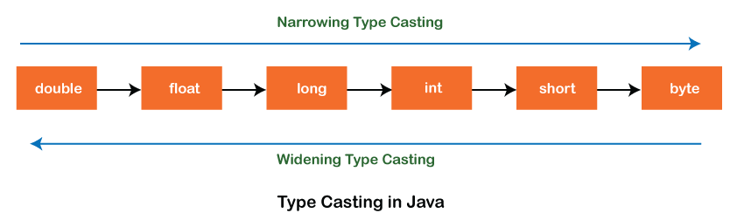
Casting in Java
There are two types of type casting:
Widening Type Casting
Converting a lower data type into a higher one is called widening type casting. It is also known as implicit conversion or casting down. It is done automatically. It is safe because there is no chance to lose data.
Narrowing Type Casting
Converting a higher data type into a lower one is called narrowing type casting. It is also known as explicit conversion or casting up. It is done manually by the programmer.

Slide 58
Casting between char and
numeric types
When a floating-point value is cast into a char, the floating-point value is first
cast into an int, which is then cast into a char.
- char ch = (char)65.25; // Decimal 65 is assigned to ch
System.out.println(ch); // ch is character A
When a char is cast into a numeric type, the character’s Unicode is cast into the
specified numeric type.
int i = (int)'A'; // The Unicode of character A is assigned to i
System.out.println(i); // i is 65
Implicit casting can be used if the result of a casting fits into the target variable.
Otherwise, explicit casting must be used.
byte b = 'a';
int i = 'a';

Slide 59
Casting between char and
numeric types
2
▶ int i = '2' + '3';
▶ System.out.println("i is " + i);
▶ int j = 2 + 'a';
▶ System.out.println("j is " + j);
// (int)'2' is 50 and (int)'3' is 51
// i is 101
// (int)'a' is 97
// j is 99
▶ System.out.println(j + " is the Unicode for character “ + (char)j);
// 99 is the Unicode for character c
▶ System.out.println("Chapter " + '2');
▶ OUTPUT : i is 101
j is 99
99 is the Unicode for characterc
Chapter 2

Slide 60
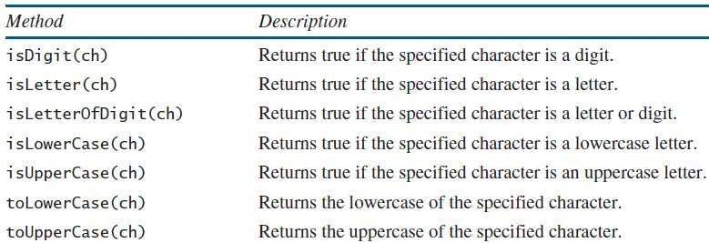
Casting between char and
numeric types
System.out.println("isDigit('a') is " + Character.isDigit('a')); //false
System.out.println("isLetter('a') is " + Character.isLetter('a')); //true
System.out.println("isLowerCase('a') is "+ Character.isLowerCase('a')); //true

Slide 61
Casting in Java
class Main {
public static void main(String[] args) {
// create int type variable
int num = 10;
System.out.println("The integer value: " + num);
// convert into double type - Implicit
double data = num;
System.out.println("The double value: " + data);
}
}

Slide 62
Casting in Java
class Main {
public static void main(String[] args) {
// create double type variable
double num = 10.99;
System.out.println("The double value: " + num);
// convert into int type - Explicit
int data = (int)num;
System.out.println("The integer value: " + data);
}
}

Slide 63
Activity
www.menti.com
7700 9039

Slide 64
Summary
History & Features of Java
Java Virtual Machine
Java Runtime Environment
Bytecode
Objected Oriented principles
Datatypes
Variables
Final keyword
Operators & precedence
Scanner class for input
Type conversion

Slide 65
END OF UNIT - 1

