Slide 1


Unit – 2 Selection, Iteration and Array
Prepared By
Prof. Ravikumar R N
Assistant Professor, CE Dept.

Slide 2
Contents
If statements
Switch statement
While statement
For statement
Do-while statement
Break and continue keywords
One dimensional and multidimensional arrays
Jagged array
Methods to copy array

Slide 3
Selections
If Statement
Two way if-else statement
Nested if and multi-way if else statement
Switch statement
Conditional Expression (Ternary)

Slide 4
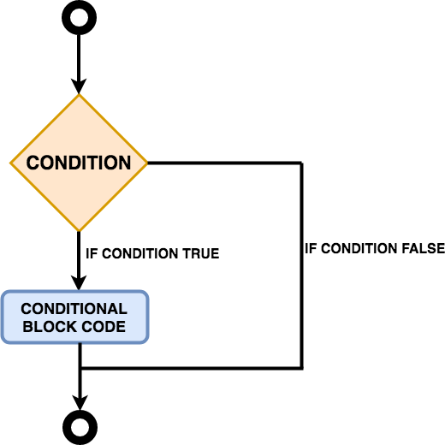
If Statement
The Java if statement tests the condition. It executes the if block if condition is true.
Syntax:
if(condition){
//code to be executed
}
Check Program: Unit – 2 → IfDemo.java

Slide 5
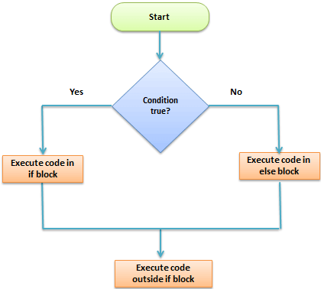
Two way If ( if.. else Statement )
The Java if-else statement also tests the condition. It executes the if block if condition
is true otherwise else block is executed.
Syntax:
if(condition){
//code if condition is true
}else{
//code if condition is false
}
Check Program: Unit – 2 → IfElseDemo.java

Slide 6
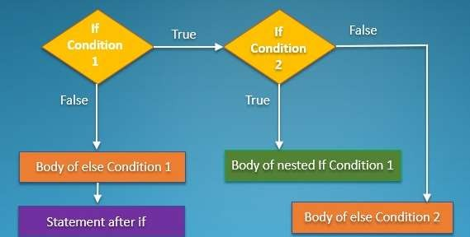
Nested if statement
The nested if statement represents the if block within another if block. Here, the
inner if block condition executes only when outer if block condition is true.
Syntax:
if(condition){
//code to be executed
if(condition){
//code to be executed
}
}
Check Program: Unit – 2 → NestedIfDemo.java

Slide 7
Multi way if… ladder if
The if-else-if ladder statement executes one condition from multiple statements.
Syntax:
if(condition1){
//code to be executed if condition1 is true
}else if(condition2){
//code to be executed if condition2 is true
}
else if(condition3){
//code to be executed if condition3 is true
}
...
else{
//code to be executed if all the conditions are false
}

Slide 8
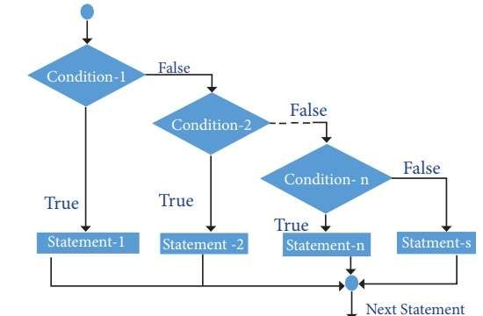
Multi way if… ladder if
The if-else-if ladder statement executes one condition from multiple statements.
Check Program: Unit – 2 → LadderIfDemo.java

Slide 9
Multi way if… ladder if
class IfElseLadder{
public static void main(String[] args)
{
// initializing expression
int i = 20;
// condition 1
if (i == 10)
System.out.println("i is 10\n");
// condition 2
else if (i == 15)
System.out.println("i is 15\n");
// condition 3
else if (i == 20)
System.out.println("i is 20\n");
else
System.out.println("i is not present\n");
System.out.println("Outside if-else-if");
}
}

Slide 10
Java Switch Statement
The Java switch statement executes one statement from multiple conditions. It is like if-else-if ladder statement. The switch statement works with byte, short, int, long, enum types, String and some wrapper types like Byte, Short, Int, and Long. Since Java 7, you can use strings in the switch statement.
In other words, the switch statement tests the equality of a variable against multiple values.
There can be one or N number of case values for a switch expression.
The case value must be of switch expression type only. The case value must be literal or constant. It doesn't
allow variables.
The case values must be unique. In case of duplicate value, it renders compile-time error.
The Java switch expression must be of byte, short, int, long (with its Wrapper type), enums and string.
Each case statement can have a break statement which is optional. When control reaches to the break statement, it jumps the control after the switch expression. If a break statement is not found, it executes the next case.
The case value can have a default label which is optional.
Check Program: Unit – 2 → SwitchDemo.java

Slide 11
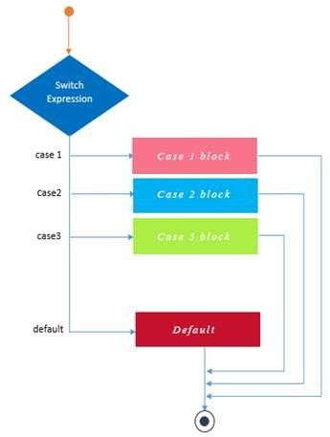
Java Switch Statement
Check Program: Unit – 2 → SwitchDemo.java

Slide 12
Java Switch Statement
public class SwitchDemo{
public static void main(String[] args)
{
int day = 5;
String dayString;
// switch statement with int data type
switch (day) {
case 1:
dayString = "Monday";
break;
case 2:
dayString = "Tuesday";
break;
case 3:
dayString = "Wednesday";
break;
default:
dayString = "Invalid day";
}
System.out.println(dayString);
}
}

Slide 13
Loops in Java
Loops can execute a block of code as long as a specified condition is reached.
Loops are handy because they save time, reduce errors, and they make code more
readable.
Java Supports :-
While loop
Do-while loop
for loop

Slide 14
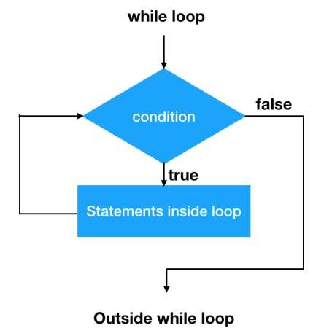
Java While Loop
The while loop loops through a block of code as long as a specified condition is true:
Syntax
while (condition) {
// code block to be executed
}
Check Program: Unit – 2 → WhileDemo.java

Slide 15
Java While Loop
public class WhileExample {
public static void main(String[] args) {
int i=1;
while(i<=10){
System.out.println(i);
i++;
}
}
}
class whileLoopDemo {
public static void main(String args[])
{
// initialization expression
int i = 1;
// test expression
while (i < 6) {
System.out.println("Hello World");
// update expression
i++;
}
}
}

Slide 16
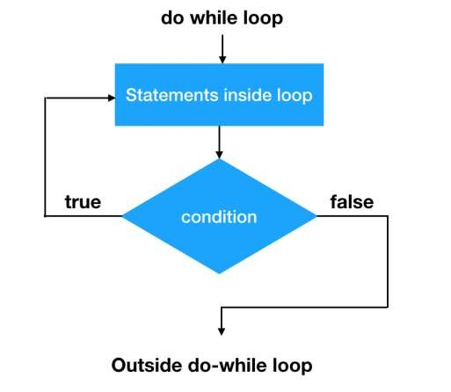
Java do.. While Loop
The do/while loop is a variant of the while loop. This loop will execute the code block once, before checking if the condition is true, then it will repeat the loop as long as the condition is true.
Syntax
do {
// code block to be executed
}
while (condition);
Check Program: Unit – 2 → DoWhileDemo.jav
a

Slide 17
Java do.. While Loop
public class DoWhileExample {
public static void main(String[] args) {
int i=1;
do{
System.out.println(i);
i++;
}while(i<=10);
}
}
public class DoWhileExample2 {
public static void main(String[] args) {
do{
System.out.println("infinitive do while loop");
}while(true);
}
}
Check Program: Unit – 2 → DoWhileDemo.jav
a

Slide 18
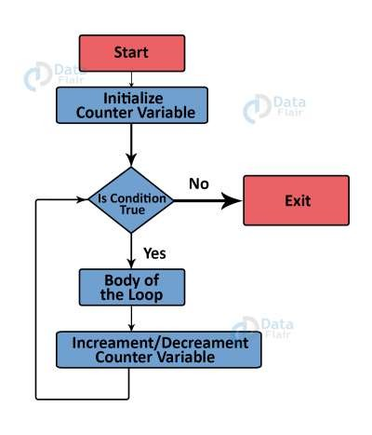
Java for Loop
When you know exactly how many times you want to loop through a block of code, use the for loop instead of a while loop:
Syntax
for (statement 1; statement 2; statement 3) {
// code block to be executed
}
Statement 1 is executed (one time) before the
execution of the code block.
Statement 2 defines the condition for
executing the code block.
Statement 3 is executed (every time) after
the code block has been executed.
Check Program: Unit – 2 → ForDemo.java

Slide 19
Java for Loop
class Test {
public static void main(String[] args) {
// for loop
for (int i = 1; i <= 10; ++i) {
// if the value of i is 5 the loop terminates
if (i == 5) {
break;
}
System.out.println(i);
}
}
}
Check Program: Unit – 2 → ForDemo.java

Slide 20
Java Scanner, If, While
import java.util.Scanner;
class UserInputSum {
public static void main(String[] args) {
Double number, sum = 0.0;
// create an object of Scanner
Scanner input = new Scanner(System.in);
while (true) {
System.out.print("Enter a number: ");
// takes double input from user
number = input.nextDouble();
// if number is negative the loop terminates
if (number < 0.0) {
break;
}
sum += number;
}
System.out.println("Sum = " + sum);
}
}
Check Program: Unit – 2 → ForDemo.java

Slide 21
Java Break statement
hen a break statement is encountered inside a loop, the loop is immediately terminated and the program control resumes at the next statement following the loop.
The Java break statement is used to break loop or switch statement. It breaks the current flow of the program at specified condition. In case of inner loop, it breaks only inner loop.
We can use Java break statement in all types of loops such as for loop,
while loop and do-while loop.
Check Program: Unit – 2 → BreakDemo.java

Slide 22
Java Break statement
public class BreakExample {
public static void main(String[] args) {
//using for loop
for(int i=1;i<=10;i++){
if(i==5){
//breaking the loop
break;
}
System.out.println(i);
}
}
}
1
2
3
4

Slide 23
Java continue statement
The continue statement is used in loop control structure when you need to jump/skip to the next iteration of the loop immediately. It can be used with for loop or while loop.
The Java continue statement is used to continue the loop. It continues the current flow of the program and skips the remaining code at the specified condition. In case of an inner loop, it continues the inner loop only.
We can use Java continue statement in all types of loops such as for loop,
while loop and do-while loop.
Cannot be used with Switch Statement
Check Program: Unit – 2 → ContinueDemo.java

Slide 24
Java continue statement
public class ContinueExample {
public static void main(String[] args) {
//for loop
for(int i=1;i<=10;i++){
if(i==5){
//using continue statement
continue;//it will skip the particular statement
}
System.out.println(i);
}
}
}
1
2
3
4
6
7
8
9
10

Slide 25
Break | Continue
The break statement is used to terminate the loop immediately. | The continue statement is used to skip the current iteration of the loop.
break keyword is used to indicate break statements in java programming. | continue keyword is used to indicate continue statement in java programming.
We can use a break with the switch statement. | We can not use a continue with the switch statement.
The break statement terminates the whole loop early. | The continue statement brings the next iteration early.
It stops the execution of the loop. | It does not stop the execution of the loop.

Slide 26
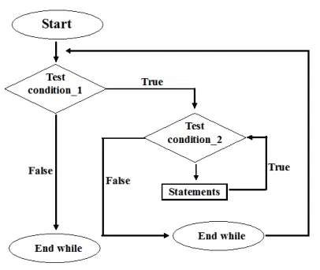
Java Nested Loop
If a loop exists inside the body of another loop, it's called a nested loop. Here's an example of the nested for loop.
int row,column;
// outer loop row = 1; while(row <= 3) { column=1;
// inner loop while(column <=row) {
System.out.println(row + “ “);
Column++;
}
System.out.println(“\n”);
row++;
} OUTPUT:- 1
2 2
3 3 3
Check Program: Unit – 2 → NestedForDemo.java

Slide 27
Java Nested Loop
class Main {
public static void main(String[] args) {
int rows = 5;
for (int i = 1; i <= rows; ++i) {
for (int j = 1; j <= i; ++j) {
System.out.print(j + " ");
}
System.out.println("");
}
}
}

Slide 28
Questions
Will the Switch statement work without using Break?
Do while vs while?
For vs for each?
Is it a good idea to use Continue statement in Switch case?
“If” and multiple “else if” works without “else” part or not?
Break statement is used to jump/skip statements?
Inner “if” block condition executes only when outer if block condition is true?

Slide 29
Common mathematical methods
The java.lang.Math class contains various methods for performing basic numeric operations such as the logarithm, cube root, and trigonometric functions etc.
Min, Max, abs , log, sqrt method
Ex. Math.max(2.5, 3) returns 3.0
Math.min(2.5, 4.6) returns 2.5
Math.abs(-2) returns 2
Math.abs(-2.1) returns 2.1
Check Program : Unit – 2 → MathRandomDemo1.java

Slide 30
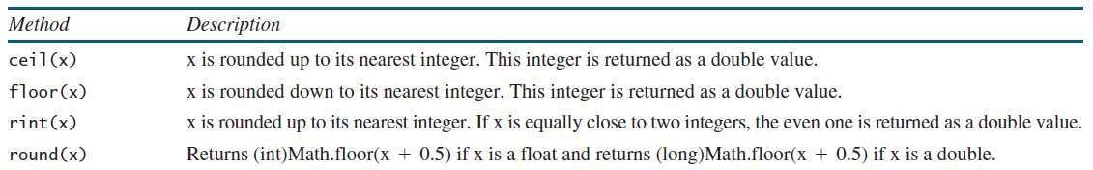
Common mathematical methods
Rounding methods
Ex. Math.ceil(2.1) returns 3.0
Math.floor(2.8) returns 2.0
Math.rint(2.5) returns 2.0
Math.round(2.6f) returns 3
Check Program : Unit – 2 → MathRandomDemo3.java

Slide 31
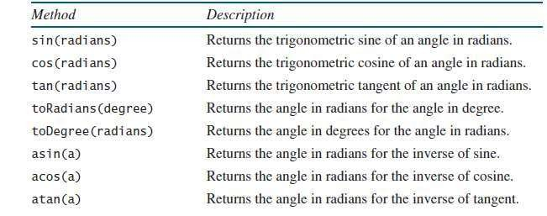
Common mathematical methods
Trigonometric methods in Math class
Ex. Math.toDegrees(Math.PI / 2) returns 90.0 Math.toRadians(30) returns 0.5236 (same as π/6) Math.atan(1.0) returns 0.785398 (same as π/4)
Check Program : Unit – 2 → MathRandomDemo2.java

Slide 32
Common mathematical methods
public class MathRandomDemo1
{
public static void main(String[] args)
{
double x = 28;
double y = 4;
// return the maximum of two numbers
System.out.println("Maximum number of x
and y is: " +Math.max(x, y));
// return the square root of y
System.out.println("Square root of y is: " + Math.sqrt(y));
//returns 28 power of 4 i.e. 28*28*28*28
System.out.println("Power of x and y is: " + Math.pow(x, y));
// return the logarithm of given value
System.out.println("Logarithm of x is: " + Math.log(x));
System.out.println("Logarithm of y is: " + Math.log(y));
// return the logarithm of given value when base is 10
System.out.println("log10 of x is: " + Math.log10(x));
System.out.println("log10 of y is: " + Math.log10(y));
// return the log of x + 1
System.out.println("log1p of x is: " +Math.log1p(x));
// return a power of 2
System.out.println("exp of a is: " +Math.exp(x));
// return (a power of 2)-1
System.out.println("expm1 of a is: " +Math.expm1(x));
}
}
Check Program : Unit – 2 → MathRandomDemo1.java

Slide 33
Common mathematical methods
public class JavaMathExample2
{
public static void main(String[] args)
{
double a = 30;
// converting values to radian
double b = Math.toRadians(a);
// return the trigonometric sine of a
System.out.println("Sine value of a is: " +Math.sin(a));
// return the trigonometric cosine value of a
System.out.println("Cosine value of a is: " +Math.cos(a));
// return the trigonometric tangent value of a
System.out.println("Tangent value of a is: " +Math.tan(a));
// return the trigonometric arc sine of a
System.out.println("Sine value of a is: " +Math.asin(a));
// return the trigonometric arc cosine value of a
System.out.println("Cosine value of a is: " +Math.acos(a));
// return the trigonometric arc tangent value of a
System.out.println("Tangent value of a is: " +Math.atan(a));
// return the hyperbolic sine of a
System.out.println("Sine value of a is: " +Math.sinh(a));
// return the hyperbolic cosine value of a
System.out.println("Cosine value of a is: " +Math.cosh(a));
// return the hyperbolic tangent value of a
System.out.println("Tangent value of a is: " +Math.tanh(a));
}
}
Check Program : Unit – 2 → MathRandomDemo2.java

Slide 34
Common mathematical methods
public class MathRandomDemo3 {
public static void main(String args[]) {
int i1 = 27;
int i2 = -45;
System.out.println("Absolute value of i1: " + Math.abs(i1));
System.out.println("Absolute value of i2: " + Math.abs(i2));
double d1 = 84.6;
double d2 = 0.45;
System.out.println("Round off for d1: " + Math.round(d1));
System.out.println("Round off for d2: " + Math.round(d2));
System.out.println("Ceiling of '" + d1 + "' = " + Math.ceil(d1));
System.out.println("Ceiling of '" + d2 + "' = " + Math.ceil(d2));
System.out.println("Minimum out of '" + i1 + "' and '" + i2 + "' = " + Math.min(i1, i2));
System.out.println("Maximum out of '" + i1 + "' and '" + i2 + "' = " + Math.max(i1, i2));
System.out.println("Floor of '" + d1 + "' = " + Math.floor(d1));
System.out.println("Floor of '" + d1 + "' = " + Math.floor(d2));
System.out.println("exp(" + d2 + ") = " + Math.exp(d2));
System.out.println("log(" + d2 + ") = " + Math.log(d2));
System.out.println("pow(5, 3) = " + Math.pow(5.0, 3.0));
System.out.println("sqrt(16) = " + Math.sqrt(16));
}
Check Program : Unit – 2 → MathRandomDemo3.java

Slide 35
Array
An array is a container object that holds a fixed number of values of a single type. The length of an array is established when the array is created. After creation, its length is fixed.
Java array is an object which contains elements of a similar data type.
Benefits
Code Optimization. Easier access to any element using the index.
Random access.
Disadvantages
Fixed size. Can not be increased or decrease once declared.
Can store a single type of primitives only.
To delete an element in an array we need to traverse through out the array so this will reduce performance.

Slide 36
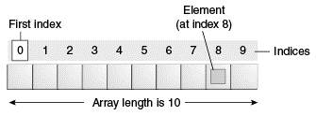
Array

Slide 37
Single Dimensional Array
A single array variable can reference a large collection of data.
Once an array is created, its size is fixed. An array reference variable is used to access the elements in an array using an index.
Instead of declaring individual variables, such as number0, number1, . . . , and number99, you declare one array variable such as numbers and use numbers[0], numbers[1], . . . , and numbers[99] to represent individual variables.

Slide 38
Declaring 1-D Array Variables
Syntax:
datatype[ ] arr_ref_var;
OR
datatype arr_ref_var[ ]; OR datatype [ ]arr_ref_var;
Ex. double myList[ ];
Unlike declarations for primitive data type variables, the declaration of an array variable does not allocate any space in memory for the array. It creates only a storage location for the reference to an array.
you can create an array by using the new operator and assign its reference to the variable.
Syntax:
Arr_ref_var = new datatype [ size ];

Slide 39
Declaring 1-D Array Variables
Declaring an array variable, creating an array, and assigning the reference of the array to the variable can be combined in one statement as:
datatype[ ] arr_ref_var = new datatype [ Size ];
OR
datatype arr_ref_var[ ] = new datatype [ Size ];
Ex. double[] myList = new double[10];

Slide 40
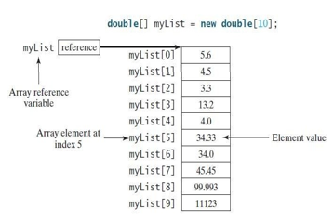
Assign values to Array
Ex.
myList[0] = 5.6;
myList[1] = 4.5;
myList[2] = 3.3;
myList[3] = 13.2;
myList[4] = 4.0;
myList[5] = 34.33;
myList[6] = 34.0;
myList[7] = 45.45;
myList[8] = 99.993;
myList[9] = 11123;

Slide 41
Array size and default values
The size of an array cannot be changed after the array is created.
Size can be obtained using arr_ref_var.length.
For example, myList.length is 10.
myList holds 10 double values, and the indices are from 0 to 9.
For example, myList[9] represents the last element in the array myList.
Array Initializer:
Syntax: elementType[] arrayRefVar = {value0, value1, ..., valuek}; Example: double[] myList = {1.9, 2.9, 3.4, 3.5};

Slide 42
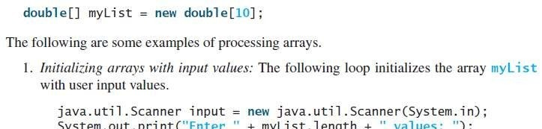
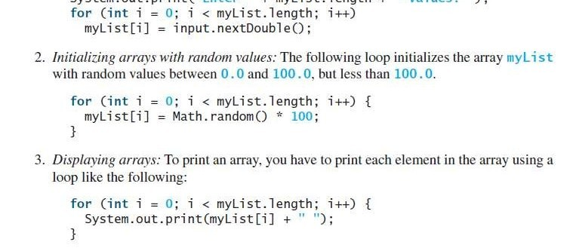
Processing Array

Slide 43

1D – Array Example
public class Array1D{
public static void main(String args[])
{
double[ ] mylist = new double[10]; // Array declaration
java.util.Scanner sc = new java.util.Scanner(System.in);
System.out.println("Enter " + mylist.length + " values ");
//intialization array with input values
for(int i=0;i<mylist.length;i++)
mylist[i] = sc.nextInt();
//Display Array
for(int i=0;i<mylist.length;i++)
System.out.print((int)mylist[i] + " ");
}
}

Slide 44
For each Loop
For Java supports a convenient for loop, known as a foreach loop, which enables you to traverse the array sequentially without using an index variable.
Syntax:
for (elementType element: arrayRefVar)
{
// Process the element
}
You can read the code as “for each element e in myList, do the following.” If you wish to traverse in different order then you need index variable.
Ex.
for(double e : myList)
{
System.out.println(e);
}

Slide 45
Two-Dimensional Array
Data in a table or a matrix can be represented using a two- dimensional array.
An element in a two-dimensional array is accessed through a row and column index.
Syntax:
elementType[ ][ ] arrayRefVar;
OR
elementType arrayRefVar[ ][ ]; OR elementType [ ][ ]arrayRefVar;
Ex:
int[ ][ ] matrix;
OR
int matrix[ ][ ];

Slide 46
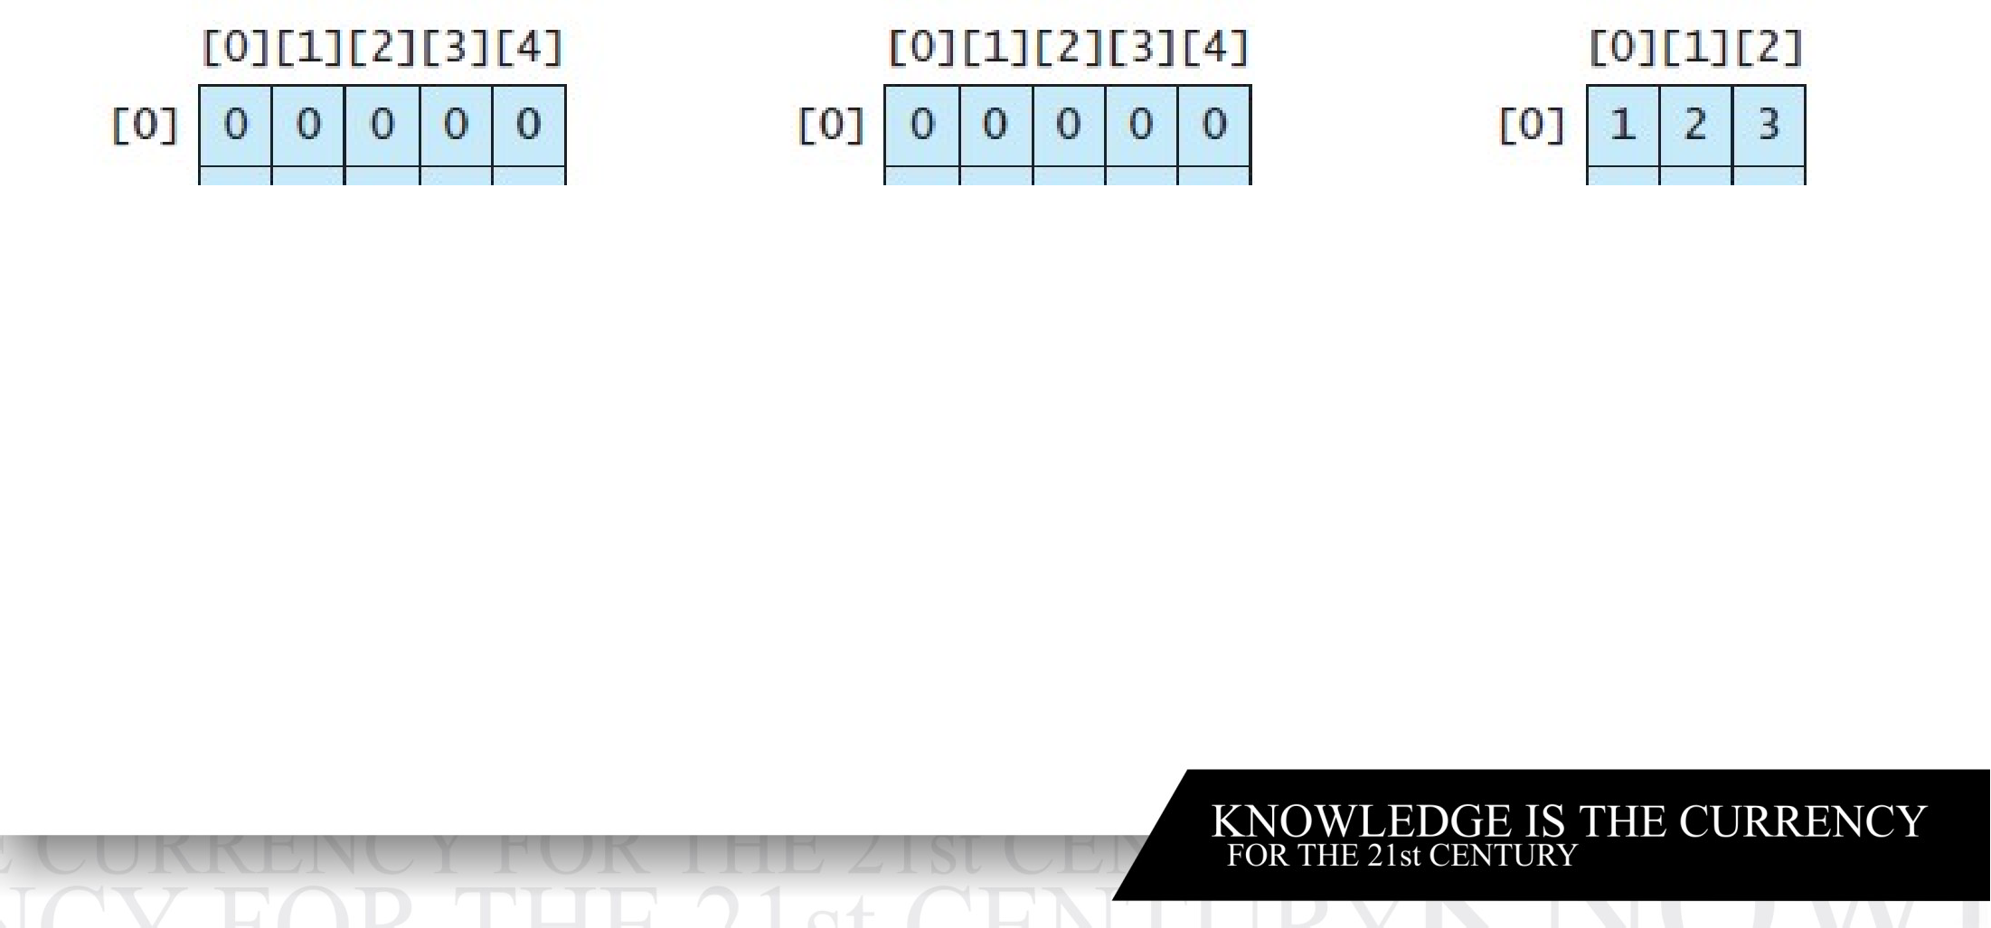
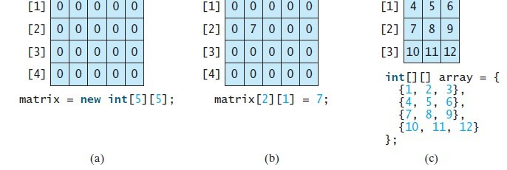
Two-Dimensional Array
matrix = new int[5][5];

Slide 47
Two-Dimensional Array
class Main
{
public static void main(String args[])
{
int[][] a={{10,20},{30,40}};//declaration and initialization
System.out.println("Two dimensional array elements are");
System.out.println(a[0][0]);
System.out.println(a[0][1]);
System.out.println(a[1][0]);
System.out.println(a[1][1]);
}
}

Slide 48
Two-Dimensional Array

Slide 49
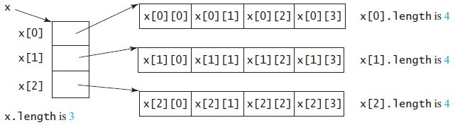
Obtaining length of 2-D Array
Example:
x = new int[3][4], x[0], x[1], and x[2] are one-dimensional arrays and each contains four elements. So, x.length is 3, and x[0].length, x[1].length, and x[2].length are 4.

Slide 50
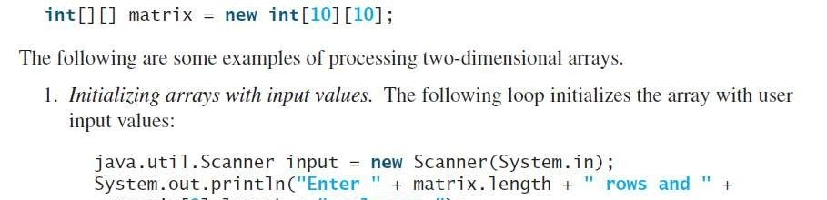
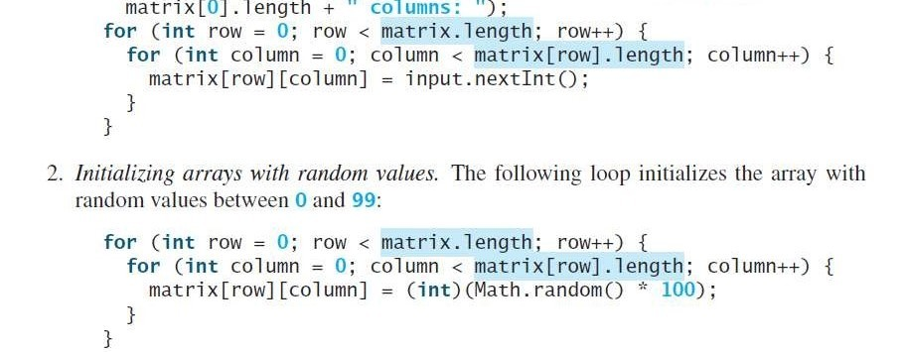
Processing 2-D Arrays

Slide 51
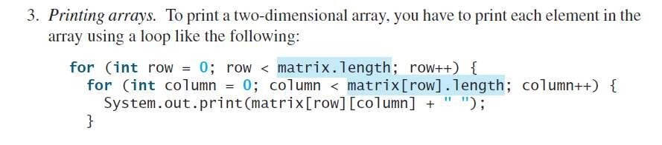

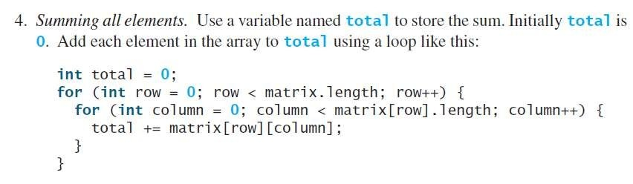
Processing 2-D Arrays

Slide 52
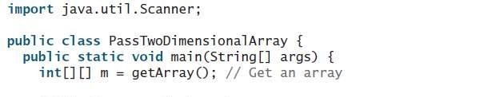
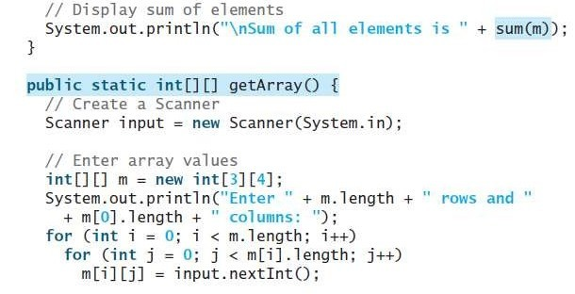
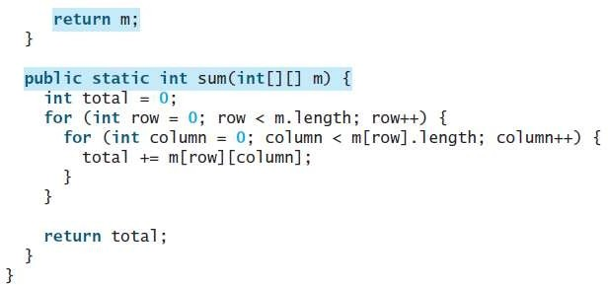
Passing 2-D Array to methods
When passing a two-dimensional array to a method, the reference of the array is passed to the method.

Slide 53
2-D Array Example
class Main
{
public static void main(String args[])
{
int[][] a={{10,20},{30,40},{50,60}};//declaration and initialization
System.out.println("Two dimensional array elements are");
for (int i = 0; i < 3; i++)
{
for (int j = 0; j < 2; j++)
{
System.out.println(a[i][j]);
}
}
}
}

Slide 54
2-D Array to Method Example
public class Main {
public static void main(String[] args) {
int[][] a = { { 1, 2, 3 }, { 4, 5, 6 }, { 7, 8, 9 } };
arr2method(a); // pass it to the method
}
public static void arr2method(int[][] a) {
System.out.println("Elements are :");
for (int i = 0; i < a.length; i++) {
for (int j = 0; j < a[i].length; j++) {
System.out.print(a[i][j] + "\t");
}
System.out.println("");
}
} }

Slide 55
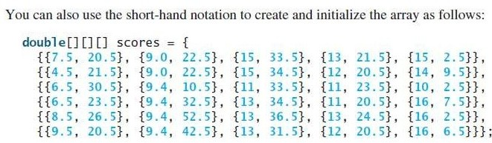
Multi Dimensional Array
A two-dimensional array consists of an array of one-dimensional arrays and a three dimensional array consists of an array of two- dimensional arrays.

Slide 56
Multi Dimensional Array
Data_Type[][][] Name = new int[Tables][Row_Size][Column_Size];
Int [] [] [] sum = new int [2] [3] [4]
Tables: Total number of tables it can accept. 2D Array is always a single table with rows and columns. In contrast, Multi Dimensional array in Java is more than one table with rows and columns.
Row_Size: Number of Row elements. For example, Row_Size = 3, then the 3D array holds 3 rows.
Column_Size: Column elements it can store. Column_Size = 4, then the 3D array holds 4 Columns.

Slide 57
Multi Dimensional Array
public class Main
{
public static void main(String[] args) {
//initialize 3-d array
int[][][] intArray = { { { 1, 2, 3}, { 4, 5, 6 } , { 7, 8, 9 } } };
System.out.println ("3-d array is given below :");
//print the elements of array
for (int i = 0; i < 1; i++)
for (int j = 0; j < 3; j++)
for (int z = 0; z < 3; z++)
System.out.println (intArray [i][j][z]);
}
}

Slide 58
Multi Dimensional Array
public class Main {
public static void main(String[] args) {
//initialize 3-d array
int[][][] myArray = { { { 1, 2, 3 }, { 4, 5, 6 } }, { { 1, 4, 9 }, { 16, 25, 36 } },
{ { 1, 8, 27 }, { 64, 125, 216 } } };
System.out.println("3x2x3 array is given below:");
//print the 3-d array
for (int i = 0; i < 3; i++) {
for (int j = 0; j < 2; j++) {
for (int k = 0; k < 3; k++) {
System.out.print(myArray[i][j][k] + "\t");
}
System.out.println();
}
System.out.println();
} } }

Slide 59
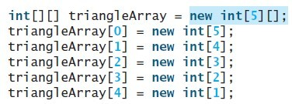
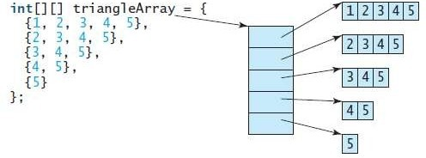

Jagged Array
Each row in a two-dimensional array is itself an array. Thus, the rows can have different lengths. An array of this kind is known as a jagged array.
If you don’t know the values in a jagged array in advance, but do know the sizes.

Slide 60
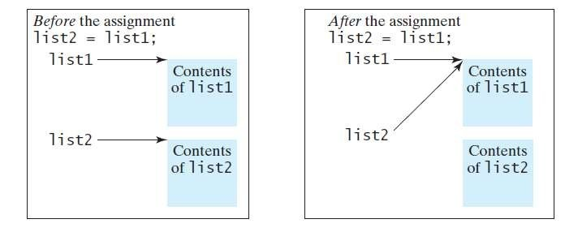
Copying Array
To copy the contents of one array into another, you have to copy the array’s individual elements into the other array.
Method : 1
list2 = list1;
This statement does not copy the contents of the array referenced by list1 to list2, but instead it copies the reference value from list1 to list2.

Slide 61
Copying Array
The other 3 ways to copy Array:
Method 2: Use a loop to copy individual elements one by one.
Method 3: Use the static arraycopy method in the System class.
Method 4: Use the clone method to copy arrays
Method 2: Loop to copy individual element
int[] sourceArray = {2, 3, 1, 5, 10};
int[] targetArray = new int[sourceArray . length];
for (int i = 0; i < sourceArray.length; i++)
{
targetArray[i] = sourceArray[i];
}

Slide 62
Copying Array – Method 1
class Main {
public static void main(String[] args) {
int [] arr1 = {1, 2, 3, 4, 5, 6};
int [] arr2 = arr1; // copying arrays
// change value of first array
arr1[0] = -1;
// printing the second array
for (int x: arr2) {
System.out.print(x + ", ");
// Check hashCode for arr1 and arr2 it must be same.
}
} }

Slide 63
Copying Array – Method 2
class Main {
public static void main(String[] args) {
int [] source = {1, 2, 3, 4, 5, 6};
int [] destination = new int[6];
for (int i = 0; i < source.length; ++i) {
destination[i] = source[i];
}
destination[0]= -1;
for(int a: source) {System.out.print(a + " " ); }//Actual array
System.out.println();
for(int x: destination) { System.out.print(x + " "); }//Copied
System.out.println("\n" + source.hashCode());
System.out.println(destination.hashCode());
}}

Slide 64
Copying Array
Method 3: Another approach is to use the arraycopy method in the
java.lang.System class to copy arrays instead of using a loop.
Syntax: arraycopy(sourceArray, srcPos, targetArray, tarPos, length);
Ex: System.arraycopy(sourceArray, 0, targetArray, 0, sourceArray.length);
Method 4: Another approach is to use the clone method in the

Slide 65
Copying Array – Method 3
//arraycopy
import java.util.Arrays;
class Main {
public static void main(String[] args) {
int[] n1 = {2, 3, 12, 4, 12, -2};
// Creating n2 array of having length of n1 array
int[] n2 = new int[n1.length];
// copying entire n1 array to n2
System.arraycopy(n1, 0, n2, 0, n1.length);
System.out.println("n2 = " + Arrays.toString(n2));
}
}

Slide 66
Copying Array – Method 4
class Main {
public static void main(String args[]) {
int num_Array[] = {5,10,15,20,25,30};
int clone_Array[] = num_Array.clone();
System.out.println("Original num_Array:");
for (int i = 0; i <num_Array.length; i++) {
System.out.print(num_Array[i]+" ");
}
System.out.println();
System.out.println("Cloned num_Array:");
for (int i = 0; i <clone_Array.length; i++) {
System.out.print(clone_Array[i]+" ");
} } }

Slide 67
Jagged Array Example
//Java Program to illustrate the jagged array
class JaggedArrayDemo{
public static void main(String[] args){
//declaring a 2D array with odd columns
int arr[][] = new int[3][];
arr[0] = new int[3];
arr[1] = new int[4];
arr[2] = new int[2];
//initializing a jagged array
int count = 0;
for (int i=0; i<arr.length; i++)
for(int j=0; j<arr[i].length; j++)
arr[i][j] = count++;
//printing the data of a jagged array
for (int i=0; i<arr.length; i++){
for (int j=0; j<arr[i].length; j++){
System.out.print(arr[i][j]+" ");
}
System.out.println();//new line
}
}
}

Slide 68
Jagged Array Example
class Main
{
public static void main(String[] args)
{
// Declare a 2-D array with 3 rows
int myarray[][] = new int[3][];
// define and initialize jagged array
myarray[0] = new int[]{1,2,3};
myarray[1] = new int[]{4,5};
myarray[2] = new int[]{6,7,8,9,10};
// display the jagged array
System.out.println("Two dimensional Jagged Array:");
for (int i=0; i<myarray.length; i++)
{
for (int j=0; j<myarray[i].length; j++)
System.out.print(myarray[i][j] + " ");
System.out.println();
}
}
}

Slide 69
Command-Line Argument
Can a main method receive arguments?
Yes
The main method can receive string arguments from the command line.
Write a program to make calculator using Command Line argument.
class Main{
public static void main(String args[]){
System.out.println("Your first argument is: "+args[0]);
}
}

Slide 70
Summary
If statements
Switch statement
While statement
For statement
Do-while statement
Break and continue keywords
One dimensional and multidimensional arrays
Jagged array
Methods to copy array

Slide 71
END OF UNIT - 2

