Slide 1



Unit – 4 Inheritance, Interface and Packages
Prepared By
Prof. Ravikumar Natarajan
Assistant Professor, CE Dept.

Slide 2
Contents
Inheritance basics
Super keyword
Multilevel hierarchy
Overriding methods
Dynamic method dispatch
Abstract class
Using final with inheritance
Object class
Interfaces
Packages: defining and importing
Access protection

Slide 3
Inheritance basics
It is defined as the process where derived class can borrow the properties of base class.
Inheritance can be achieved by using the “extends” keyword.
Inheritance in Java is a mechanism in which one object acquires all the properties and behaviors of a parent object.
Advantages:
i. Code reusability
ii. Extensibility
iii. Data hiding
iv. Overriding

Slide 4
Inheritance basics
Inheritance represents the IS-A relationship which is also known as a parent-child relationship.
Example:
class A //Base class //Super class // Parent class
{
}
class B extends A //Derived class //Sub class //Child class
{
..//Use of class A properties
}

Slide 5
Inheritance Types
Single inheritance - It has one parent per derived class. | Whenever a class inherits another class, it is called single inheritance.
2. Multilevel inheritance – when a derived class is derived from base class which itself is derived again is called multilevel inheritance. | Multilevel inheritance is a part of single inheritance where more than two classes are in the sequence.
3. Hierarchical inheritance - If a class has more than one derived classes This is known as hierarchal inheritance.
4. Multiple inheritance - If a class inherits the data member and member function from more than one base class, then this type of inheritance is called multiple inheritance. (Java will not support directly but it is possible using “interface”)
5. Hybrid inheritance – when two or more types of inheritances (Single and multiple inheritance) are combined together then it is called hybrid inheritance.

Slide 6
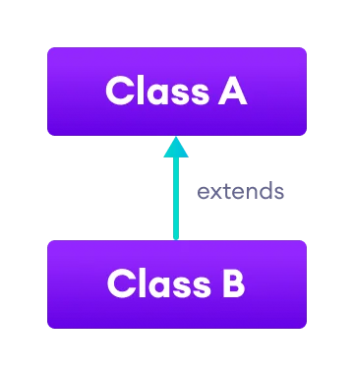
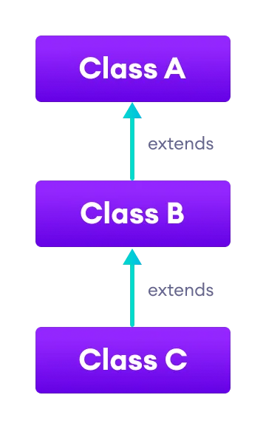
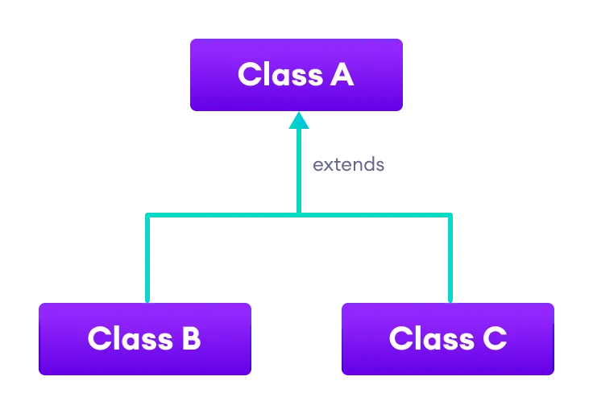
Inheritance Types
Hierarchical
Single
Multilevel

Slide 7
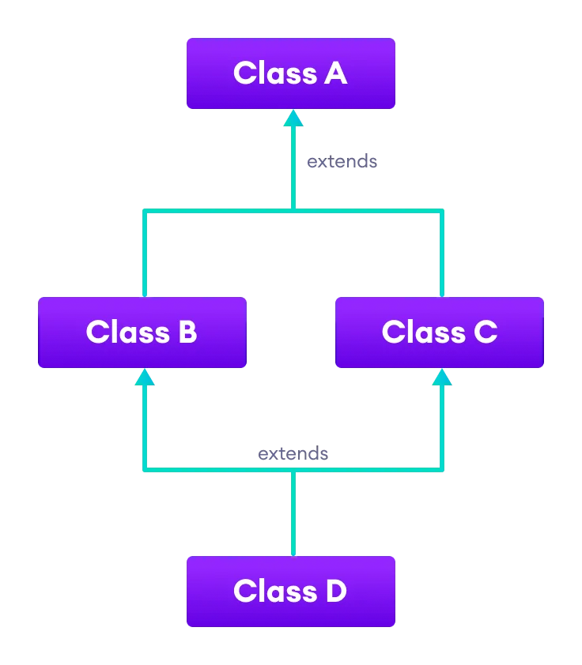
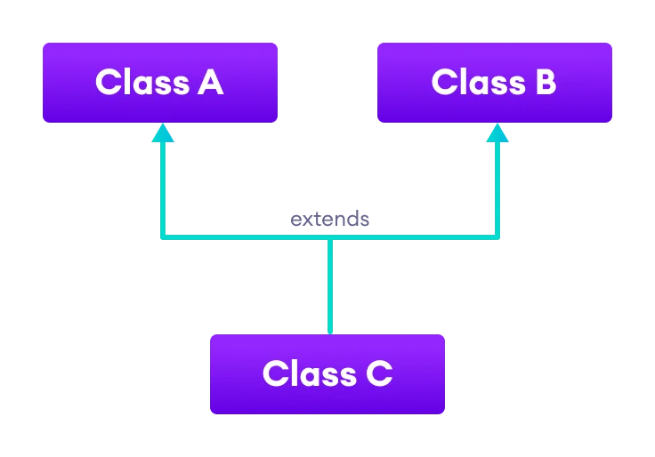
Inheritance Types
Multiple
Hybrid

Slide 8
Single Inheritance
//Single inheritance – Example
class a //base class
{ void disp() //method 1
{
System.out.println("Hello"); }}
class b extends a //derived class
{ void disp1() //method 2
{
System.out.println(" Good morning"); }}
class singleinh //main class
{ public static void main(String args[]) //main function
{
b B1 = new b(); // reference variable B1, Creating object to allocate memory space
B1.disp1(); //calling method
B1.disp(); }}

Slide 9
Multilevel Inheritance
//Multilevel inheritance – Example
class a
{ void disp() { System.out.println("Helllo"); }}
class b extends a
{ void disp1() { System.out.println("Good morning"); } }
class c extends b
{ void disp2() { System.out.println("Welcome to MU"); } }
class multilevelinh{
public static void main(String args[]) {
c C1 = new c();
C1.disp2();
C1.disp1();
C1.disp();
}}

Slide 10
Hierarchical Inheritance
//Hierarchical inheritance – Example
class a
{ void disp() { System.out.println("Helllo"); }}
class b extends a
{ void disp1() { System.out.println("Good morning"); } }
class c extends a
{ void disp2() { System.out.println("Welcome to MU"); } }
class hierarInh{
public static void main(String args[]) {
c C1 = new c();
C1.disp2();
C1.disp1();// Question?
C1.disp();
}}

Slide 11
Multiple Inheritance
Why Interface should be used in multiple inheritance? Consider the example
class A {
void msg()
{ System.out.println("Hello"); } }
class B {
void msg()
{ System.out.println("Welcome"); } }
class C extends A,B //suppose if it were
{ public static void main(String args[]) {
C obj=new C();
obj.msg();//Now which msg() method would be invoked?
} }
Compile time error occurs

Slide 12
Interface
Since abstract class allows concrete methods as well, it does not provide 100% abstraction.
You can say that it provides partial abstraction.
Interfaces are used for 100% abstraction (full abstraction)
Syntax:
modifier interface InterfaceName {
/** Constant declarations */
/** Abstract method signatures */
}

Slide 13
Multiple Inheritance
//Multiple inheritance example
interface mobileFeature1 {
int pixel=720;
public void camera();
}
interface mobileFeature2 {
int color=200;
public void design();
}
class Mobile implements mobileFeature1, mobileFeature2 //two interfaces
{ public void camera() {
int color=pixel*200;
System.out.println(“Suported Colors: "+color);
}
public void design() {
int pixel=color*300;
System.out.println(“Supported Pixel "+pixel);
}
}
class MultipleInterface{
public static void main(String args[]){
Mobile obj = new Mobile();
obj.camera();
obj.design();
} }
Notes:
Interfaces specify what a class must do and not how. It is the blueprint of the class.

Slide 14
Hybrid Inheritance
class D extends C //Single inh.
{void sum() //method2
{ System.out.println("Adding all 3 variables");
int d=a+b+mul(); //Calc
System.out.println(d);
}}
class hybridinh //main class
{
public static void main(String[] args) //main fun.
{ C obj1 = new C(); //Obj. creation
D obj2 = new D();
System.out.println("Multiplying two variables");
System.out.println(obj1.mul()); //Print stmt
obj2.sum(); //Calling method
}}
class A //class
{ int a=10; //variable with value assigned
}
interface B //Interface
{int b=20;
}
//Multiple inh.
class C extends A implements B {
int c;
int mul() //method1
{ c=a*b;
return c;
}
}

Slide 15
Using Super Keyword
The super keyword in Java is a reference variable which is used to refer immediate parent class object.
Conditions where super key word used:
1. Only used in subclass constructor and methods.
2. Call to super must first statement in subclass constructor.
3. Parameters must be in same order.
Super keyword can be used for the following:
Use of super with variables
Use of super with methods
Use of super with constructors

Slide 16
Using Super Keyword
//Use of super with variables:
class Vehicle
{ int maxSpeed = 120; }
class Car extends Vehicle
{ int maxSpeed = 180;
void display() {
System.out.println("Maximum Speed: " + super.maxSpeed);
}}
class Test
{ public static void main(String[] args) {
Car small = new Car();
small.display();
} }

Slide 17
Using Super Keyword
//Use of super with methods
class Person
{ void message() {
System.out.println("This is person class");
} }
class Student extends Person
{ void message()
{ System.out.println("This is student class"); }
void display()
{ super.message();
message(); }}
class Test
{ public static void main(String args[]) {
Student s = new Student();
s.display(); }}

Slide 18
Using Super Keyword
//Use of super with constructors
class Person {
Person() {
System.out.println("Person class Constructor"); }
Person(int i) { System.out.println("Person class Const. with param:”+i);
}}
class Student extends Person {
Student() { System.out.println("Student class Constructor"); }
Student(int i) {
super(i);
System.out.println("Student class Const. with param");
}}
class Main {
public static void main(String[] args) {
Student s = new Student(5); } }

Slide 19
Overriding Methods
Discussed in unit 3

Slide 20
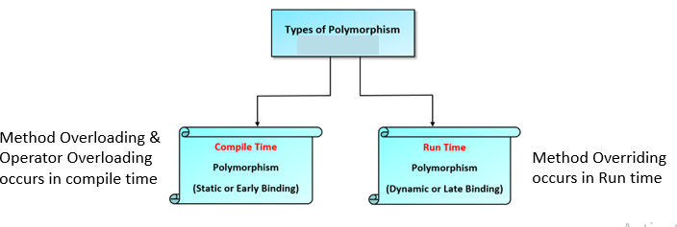
Dynamic Method Dispatch
Discussed in unit 3

Slide 21
Abstraction
Class abstraction is the separation of class implementation from
the use of a class.
The details of implementation are encapsulated and hidden from
the user, which is called as class encapsulation.
Ways to achieve Abstraction
There are two ways to achieve abstraction in java
Abstract class (0 to 100%)
Interface (100%)

Slide 22
Abstract Class
Hiding the internal implementation of the feature and only showing the functionality to the users. i.e. what it works (showing), how it works (hiding). Both abstract class and interface are used for abstraction.
Rules:
1. Abstract method must present in abstract class only.
2. Cannot be instantiated i.e not allowed to create object.
3. Method must be overridden.
4. It can have constructors & final and static methods

Slide 23
Abstract Class
Example for abstract class and method:
abstract class Animal //abstract parent class
{
public abstract void sound();//abstract method
// public abstract void disp();//if this method is not overridden class error occurs
}
public class Dog extends Animal{
public void sound()
{
System.out.println(“Bowww..");
}
public static void main(String args[])
{
Animal obj = new Dog();
obj.sound();
}}

Slide 24
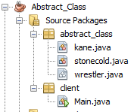
Abstract Class – Case Study

Slide 25
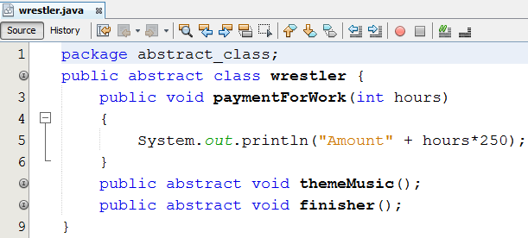
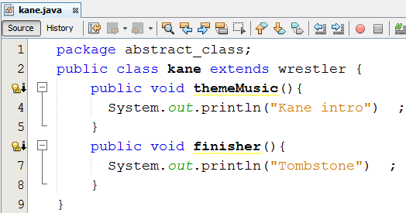
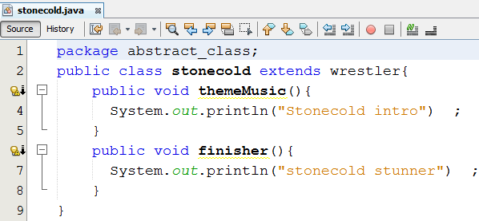
Abstract Class – Case Study

Slide 26
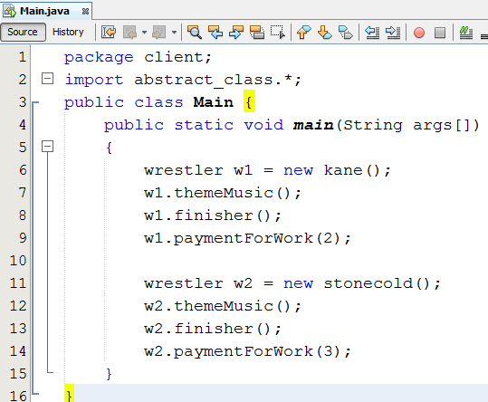
Abstract Class – Case Study

Slide 27
Interface vs Abstract Class
Parameters | Interface | Abstract class
Speed | Slow | Fast
Multiple Inheritances | Implement several Interfaces | Only one abstract class
Structure | Abstract methods | Abstract & concrete methods
When to use | Future enhancement | To avoid independence
Inheritance/ Implementation | A Class can implement multiple interfaces | The class can inherit only one Abstract Class
Data fields | the interface cannot contain data fields. | the class can have data fields.
Abstract keyword | “interface” keyword used | “abstract” keyword used
Hiding | 100% abstraction | 0 to 100% abstraction
Instantiation | Object cannot be created | Object cannot be created
Methods | Methods in interface are abstract by default & compulsory to override. | Both abstract & non abstract methods can be used.

Slide 28
Encapsulation
Encapsulation in Java is a mechanism of wrapping the data (variables) and code acting on the data (methods) together as a single unit.
In encapsulation, the variables of a class will be hidden from other classes, and can be accessed only through the methods of their current class.

Slide 29
Encapsulation
class Encapsulate {
private String Name;
public String getName()
{ return Name; }
public void setName(String newName)
{
Name = newName;
}
public class Main{
public static void main(String[] args) {
Encapsulate obj = new Encapsulate();
obj.setName("Harsh");
System.out.println("name: " + obj.getName());
//System.out.println("name: " + obj.Name);
}}

Slide 30
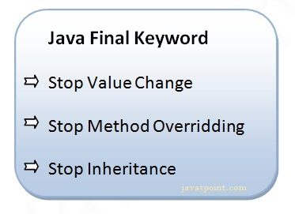
Using Final with Inheritance
The final keyword in java is used to restrict the user.
The java final keyword can be used in many context. Final can be:
Variable
Method
Class

Slide 31
Using Final with Inheritance
Java final variable
If you make any variable as final, you cannot change the value of final variable(It will be constant).
class A{
final int speedlimit=90;//final variable
void run(){
speedlimit=400;
}
public static void main(String args[]){
Aobj=new A();
obj.run();
}
Output: Compile Time Error

Slide 32
Using Final with Inheritance
Java final method
If you make any method as final, you cannot override it.
class A{
final void run(){System.out.println(“From Class A");}
}
class B extends A{
void run(){System.out.println(“From Class B");}
public static void main(String args[]){
B b1= new B();
b1.run();
}
}
Output: Compile Time Error

Slide 33
Using Final with Inheritance
Java final class
If you make any class as final, you cannot extend it.
final class B{}
class H extends B{
void run(){System.out.println(“From class H");}
public static void main(String args[]){
H h1= new H();
h1.run();
}
}
Output: Compile Time Error

Slide 34
Using Final with Inheritance
Is final method inherited?
Yes, final method is inherited but you cannot override it.
class B{
final void run(){System.out.println(“B class");}
}
class H extends B{
public static void main(String args[]){
H h1 = new H() ////new H().run();
h1.run();
}
}
Output: Compile Time Error

Slide 35
Object Class
The Object class is the parent class of all the classes in java by default. In other words, it is the topmost class of java.
Object class is present in java.lang package.
Object class methods:
toString()
hashCode()
Equals()
getClass()
Finalize()
Clone()

Slide 36
Object Class
class Object { }
public class Main {
public static void main(String[] args)
{
String obj = new String("Hi");
Class c = obj.getClass();
System.out.println("Class of Object obj is: "+ c.getName());
}
}

Slide 37
Object Class
class Main{
int rollno;
String name;
Main(int rollno, String name){
this.rollno=rollno;
this.name=name;
}
public String toString(){//overriding the toString() method
return rollno+" "+name;
}
public static void main(String args[]){
Main s1=new Main(101,"Raj");
Main s2=new Main(102,"Vijay");
System.out.println(s1);//compiler writes here s1.toString()
System.out.println(s2);//compiler writes here s2.toString() } }

Slide 38
Packages: Defining and Importing
Packages is a mechanism in which variety of classes and interfaces can be grouped together.
Advantages:
i. Code reused – from other package
ii. Same name – two classes from two different packages
iii. Possible to hide the classes
iv. Name of the directory becomes the package name.
Two types:
i. Built-in packages
Ex: java.lang, java.util, java.io, java.awt, java.applet
ii. User defined packages

Slide 39
Packages: Defining and Importing
Syntax to create package:
package package_name;
package abc;
Syntax to Import package:
import abc.*;

Slide 40
Packages: Defining and Importing
STEP 1: Create a folder p1 and follow the below code,
package p1;
public class testpackage
{
public void display()
{
System.out.println("Hi");
}
}
Save the file in p1 folder as “testpackage” and compile it.

Slide 41
Packages: Defining and Importing
STEP 2: Come out from the folder p1 and save the below code as “test”.
import p2.*;
public class test
{
public static void main(String args[])
{
testpackage tp = new testpackage();
tp.display();
}
}
Now compile and run the “test” file

Slide 42
Access Protection
The access modifiers in Java specifies the accessibility or scope of a field, method, constructor, or class.
We can change the access level of fields, constructors, methods, and class by applying the access modifier on it.
Four types:
Public
Protected
Default
Private
Access Location | Access Modifier
 | Public | Protected | Default | Private
Same class | Yes | Yes | Yes | Yes
Sub class in same package | Yes | Yes | Yes | No
Other classes in same package | Yes | Yes | Yes | No
Subclass in other packages | Yes | Yes | No | No
Non-subclass in other package | Yes | No | No | No

Slide 43
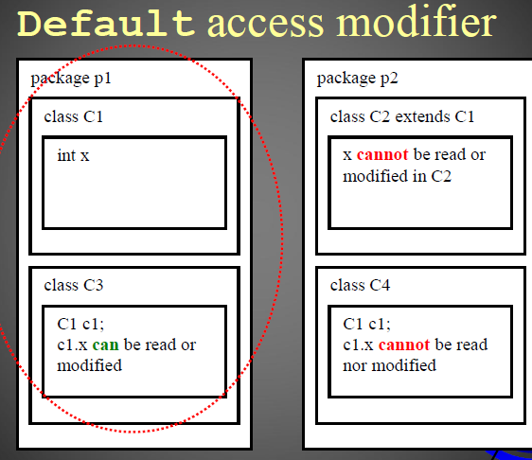
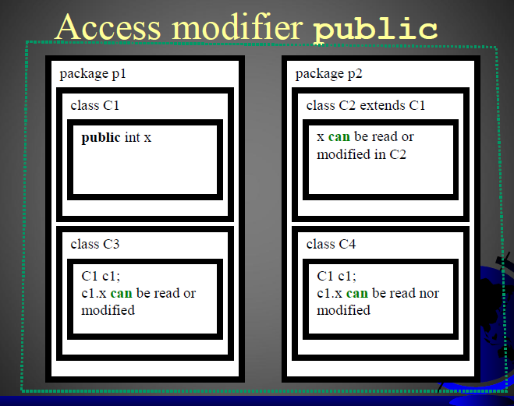
Access Protection

Slide 44
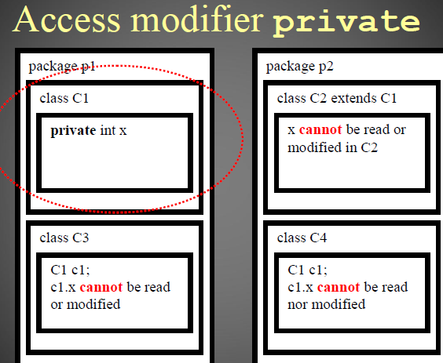
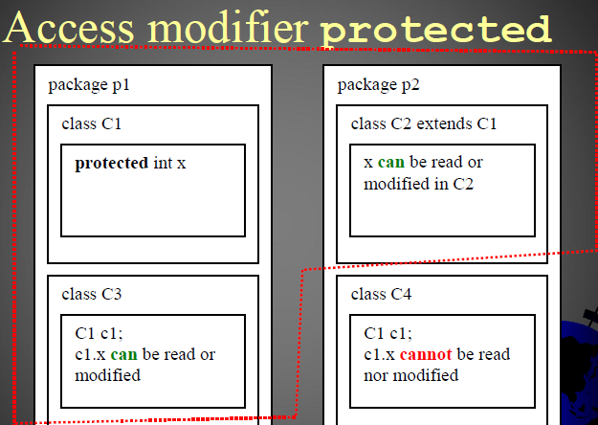
Access Protection

Slide 45
Summary
Inheritance basics
Super keyword
Multilevel hierarchy
Overriding methods
Dynamic method dispatch
Abstract class
Using final with inheritance
Object class
Interfaces
Packages: defining and importing
Access protection

Slide 46
Next
Exception handling overview
Types of exception
Using try
Catch and finally clauses
Multiple catch clauses
Throw and throws keyword
Custom exception class

Slide 47
END OF UNIT - 4

