Slide 1



Unit – 5 Exception Handling
Prepared By
Prof. Ravikumar Natarajan
Assistant Professor, CE Dept.

Slide 2
Contents
Exception Handling Overview
Types of Exception
Using Try
Catch and Finally Clauses
Multiple Catch Clauses
Throw and Throws Keyword
Custom Exception Class

Slide 3
Error vs Exception
In java, both Errors and Exceptions are the subclasses of java.lang.Throwable class.
Error refers to an illegal operation performed by the user which results in the abnormal working of the program.
Recovering from error is difficult.
Ex: java.lang.OutOfMemoryError
Exceptions in java refer to an unwanted or unexpected event, which occurs during the execution of a program i.e at run time & compile time, that disrupts the normal flow of the program’s instructions.
Recovering from exception is possible by using try, catch, or throwing exceptions.
Ex: Checked and Unchecked Exceptions

Slide 4
Exception Handling
Exception handling enables a program to deal with exceptional situations and continue its normal execution.
Handles runtime & compile time errors.
Ex. You divide a number with ‘0’. Division by 0 exception will occur and program will be terminated.
If you can handle this kind of exceptions then your program will continue its normal execution.

Slide 5
What Happens During Exception?
Exception is an unwanted or unexpected event, which occurs during the execution of a program, i.e. at run time, that disrupts the normal flow of the program’s instructions.
Exceptions can be caught and handled by the program. When an exception occurs within a method, it creates an object. This object is called the exception object.
It contains information about the exception, such as the name and description of the exception and the state of the program when the exception occurred.

Slide 6
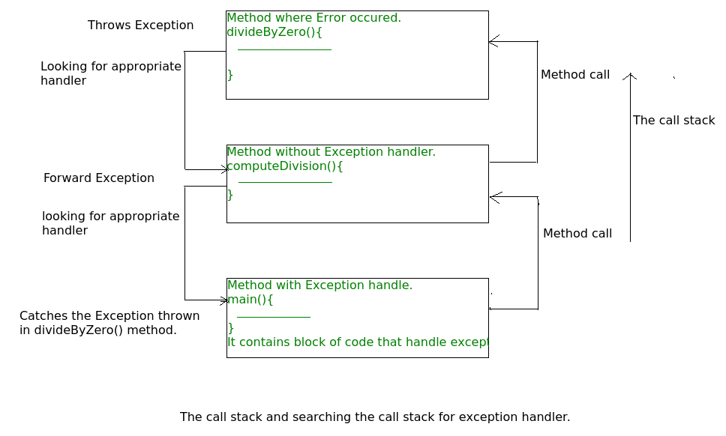
What is Call Stack?
Creating the Exception Object and handling it in the run-time system is called throwing an Exception. There might be a list of the methods that had been called to get to the method where an exception occurred. This ordered list of the methods is called Call Stack.

Slide 7
Exception-Handling Overview
Java’s exception-handling model is based on three operations:
Declaring an exception,
Throwing an exception, and
Catching an exception.
Exceptions are thrown from a method. The caller of the method can catch and handle the exception.

Slide 8
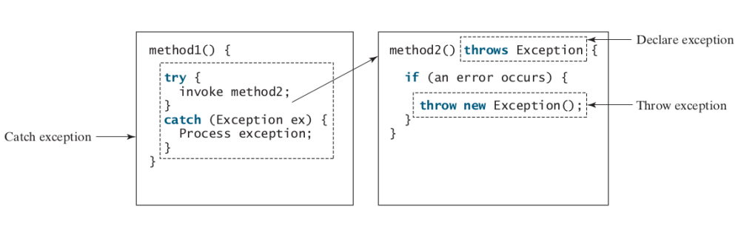
Exception-Handling Overview

Slide 9
Exception Types
Three types,
1. Checked Exception (Compile time)
These exceptions checked by the code itself. Using try-catch or throws i.e compiler will check these exceptions. From java.lang.Exception class.
Ex: IOException
2. Unchecked Exception (Run time)
These exceptions are not checked by compiler. JVM will check these exceptions. From java.lang.RuntimeException class.
Ex: ArrayIndexOutOfBounds, RunTimeException.
3. System Errors
System errors are thrown by the JVM and are represented in the
Error class. The Error class describes internal system errors, though such errors rarely occur.
Ex: LinkageError, VirtualMachineError

Slide 10
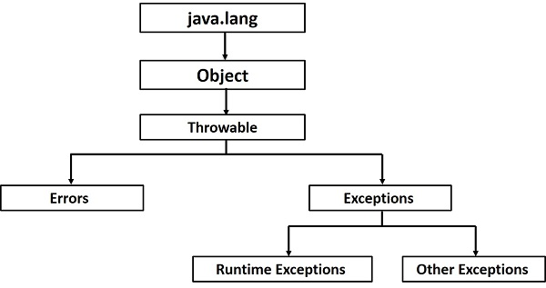
Exception Types

Slide 11
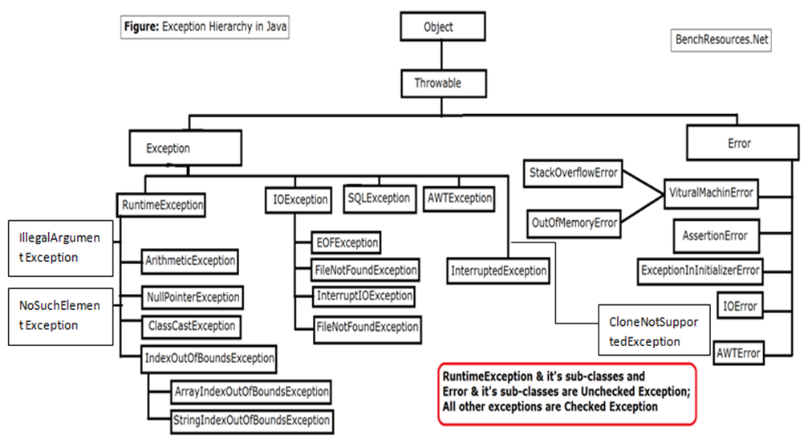
Exception Types

Slide 12
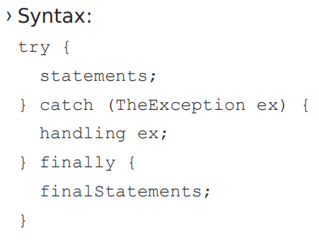
The finally Clause
The finally clause is always executed regardless whether an exception occurred or not.
You may want some code to be executed regardless of whether an
exception occurs or is caught.
Java has a finally clause that can be used to accomplish this objective.

Slide 13
Throwing and Catching Exceptions
Five keywords to handle exception,
1. Try – to monitor exception | to try critical block
2. Catch – handles specific exception with try block
3. Finally – code executed even exception may or may not occur. Denotes end of the program. | optional to use
4. Throw – used to throw specific exception
5. Throws - used to throw specific exception by a particular method.

Slide 14
Throwing and Catching Exceptions
try-catch-finally keyword
class myExeption
{ public static void main(String s[]){
int i=5, j=0;
System.out.println("Try started");
try
{
int temp = i/j;
System.out.println("Inside try");
}
catch(Exception e)
{
System.out.println("Inside catch");
System.out.println("Divide by 0");
}
finally
{
System.out.println("Finally block");
} } }
Output: try started
Inside catch
Divide by 0
Finally block

Slide 15
Throwing and Catching Exceptions
Using Multiple Catch Clauses
To catch different types of exceptions multiple catch clause can be used.
Example:
public class TestMultipleCatchBlock{
public static void main(String args[]){
try{
int a[]=new int[5];
a[5]=30/0;
}
catch(ArithmeticException e){
System.out.println("task1 is completed");}
catch(ArrayIndexOutOfBoundsException e){
System.out.println("task 2 completed");}
catch(Exception e){
System.out.println("common task completed");}
System.out.println("rest of the code...");
} }
Output:task1 completed
rest of the code...

Slide 16
Throwing and Catching Exceptions
Try block can be nested
A try, catch or finally block can contain another set of try catch and finally sequence.
class Excep6{
public static void main(String args[]){
try{
try{
System.out.println("going to divide");
int b =39/0;
}catch(ArithmeticException e) {System.out.println(e);}
try{
int a[]=new int[5];
a[5]=4;
}catch(ArrayIndexOutOfBoundsException e) {System.out.println(e);}
System.out.println("other statement");
}catch(Exception e)
{System.out.println("handeled");} System.out.println("normal flow.."); }
Output:
going to divide
Java.lang. ArithmeticException: /by zero
Java.lang. ArrayIndexOutOfBoundsException: 5
Other statement
Normal flow..

Slide 17
Methods to Print the Exception Information
printStackTrace()
toString()
getMessage()
import java.io.*;
class Main {
public static void main (String[] args) {
int a=5;
int b=0;
try{
System.out.println(a/b);
}
catch(ArithmeticException e){
e.printStackTrace();
System.out.println(e.toString());
System.out.println(e.getMessage());
}
}
}

Slide 18
Activity
Go to www.menti.com
36983345

Slide 19
Throwing and Catching Exceptions
Using throw #UserDefined Exception #Explicit
public class Main
{
void checkAge(int age)
{ if(age<18)
throw new ArithmeticException("Not Eligible for voting"); //inside Method UserDefined
else
System.out.println("Eligible for voting");
}
public static void main(String args[])
{
Main obj = new Main();
obj.checkAge(13);
System.out.println("End Of Program");
}
}
Output:
Exception in thread "main" java.lang.ArithmeticException:
Not Eligible for voting
at Example1.checkAge(Example1.java:4)
at Example1.main(Example1.java:10)

Slide 20
Throwing and Catching Exceptions
Example using throws
public class Example1
{
int division(int a, int b) throws ArithmeticException //Method signature, Supports Multiple Exception
{ int t = a/b;
return t;
}
public static void main(String args[])
{
Example1 obj = new Example1();
try{
System.out.println(obj.division(15,0));
}
catch(ArithmeticException e)
{
System.out.println("You shouldn't divide number by zero");
}
}
}
Output:
You shouldn't divide number by zero

Slide 21
Rethrowing Exception
Sometimes we may need to rethrow an exception in Java. If a catch block cannot handle the particular exception it has caught, we can rethrow the exception. The rethrow expression causes the originally thrown object to be rethrown.
Java allows an exception handler to rethrow the exception if the handler cannot process the exception or simply wants to let its caller be notified of the exception.
The syntax for rethrowing an exception may look like this:
try {
statements;
} catch (TheException ex) {
perform operations before exits;
throw ex;
}

Slide 22

Rethrowing Exception
public class RethrowingExceptions
{ static void divide() {
int x,y,z;
try {
x = 6 ;
y = 0 ;
z = x/y ;
System.out.println(x + "/"+ y +" = " + z);
}
catch(ArithmeticException e)
{
System.out.println("Exception Caught in Divide()");
System.out.println("Cannot Divide by Zero in Integer Division");
throw e; // Rethrows an exception
}
}
public static void main(String[] args)
{
System.out.println("Start of main()");
try
{
divide();
}
catch(ArithmeticException e)
{
System.out.println("Rethrown Exception Caught in Main()");
System.out.println(e);
}
}
}

Slide 23
Chained Exception
Throwing an exception along with another exception forms a chained exception.
Example
// the catch block of method1
catch (Exception ex) { ex.printStackTrace(); }
// the catch block of method2
catch (Exception ex) {
throw new Exception("New info from method1", ex);
}

Slide 24
Chained Exception
The Throwable class has methods which support exception chaining −
Method | Description
getCause() | Returns the original cause of the exception
initCause(Throwable cause) | Sets the cause for invoking the exception
public class Example {
public static void main(String[] args) {
try {
// creating an exception
ArithmeticException e = new ArithmeticException("Apparent cause");
// set the cause of an exception
e.initCause(new NullPointerException("Actual cause"));
// throwing the exception
throw e;
} catch(ArithmeticException e) {
// Getting the actual cause of the exception
System.out.println(e.getCause()); } } }

Slide 25
Defining Custom Exception Classes
You can define a custom exception class by extending the java.lang.Exception class.
You can use exception classes provided by Java, whenever it is appropriate.
If you run into a problem that cannot be adequately described by the predefined exception classes, you can create your own exception class.
Custom Exception Class must be derived from Exception or from a subclass of Exception, such as IOException.

Slide 26
Defining Custom Exception Classes
class CustomException extends Exception {
String message;
CustomException(String str) {
message = str;
}
public String toString() {
return ("Custom Exception Occurred : " + message);
}
}
public class MainException {
public static void main(String args[]) {
try {
throw new CustomException(“Hello!! this my message”);
} catch(CustomException e) {
System.out.println(e); } } }

Slide 27
Questions?
When to use throws throw VS try-catch in Java?
The “throws” keyword is used to declare the exception with the method signature.
The throw keyword is used to explicitly throw the exception.
The try statement defines the code block to run (to try).
The catch statement defines a code block to handle any error.
What do you know about finally block?
The finally statement defines a code block to run regardless of the result.
Which can handle multiple exceptions throw or throws?
Throws

Slide 28
Summary
Exception Handling Overview
Types of Exception
Using Try
Catch and Finally Clauses
Multiple Catch Clauses
Throw and Throws Keyword
Custom Exception Class

Slide 29
Next
Multithreading
Thread Model
Creating Threads
Thread Priorities
Synchronization
Inter-thread Communication

Slide 30
END OF UNIT - 5

