Slide 1



Unit – 06 Multithreading
Prepared By
Prof. Ravikumar Natarajan
Assistant Professor, CE Dept.

Slide 2
Contents
Thread model,
Creating threads
Thread priorities
Synchronization
Inter-thread communication

Slide 3
Concurrency
Concurrency is the ability to run several programs or several parts of a program in parallel.
If a time consuming task can be performed asynchronously or in parallel, this improves the throughput and the interactivity of the program.
A modern computer has several CPU's or several cores within one CPU.
Two basic units of execution,
Processes – it has self contained execution environment. Has its own memory space.
Threads – Threads exist within process – every process has at least one. Threads share process’s resources including memory and open files.

Slide 4
What is Thread?
Thread is a tiny program running continuously. It is called as light weight process. Any single path of execution is called thread.
A thread is also called flow of execution.
Switching between threads automatically done by JVM
S.No | Thread | Process
1. | It is a light-weight process | It is a heavy-weight process
2 | Threads do not require separate address space. It runs in the address space of process to which it belongs to. | Each process requires separate address space to execute.

Slide 5
Multithreading vs Multitasking
S.No | Multithreading | Multitasking
1. | Thread is a fundamental unit of multithreading. | Process is a fundamental unit of multiprocessing environment.
2. | Multiple parts of a single program gets executed in multithreading envi. | Multiple programs get executed in multiprocessing envi.
3. | During multithreading the processor switches b/w multiple threads of the program. | During multiprocessing the processor switches b/w multiple programs.
4. | It is cost effective bcz cpu can be shared among multiple threads at a time. | It is expensive because when a particular process uses cpu other processes has to wait.
5. | Highly efficient | Less efficient
6. | It helps in developing application programs. | It helps in developing OS programs.

Slide 6
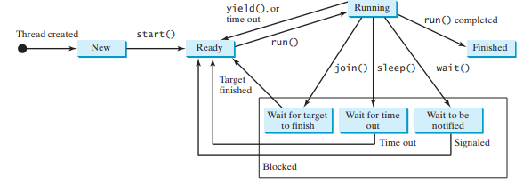
Thread states and life cycle
A thread state indicates the status of thread.
Tasks are executed in threads. Threads can be in one of five states: New, Ready, Running, Blocked, or Finished

Slide 7
Thread states and life cycle
When a thread is newly created, it enters the New state. After a thread is started by calling its start() method, it enters the Ready state. A ready thread is runnable but may not be running yet. The operating system has to allocate CPU time to it.
When a ready thread begins executing, it enters the Running state. A running thread can enter the Ready state if its given CPU time expires or its yield() method is called.
A thread can enter the Blocked state (i.e., become inactive) for several reasons. It may have invoked the join(), sleep(), or wait() method. It may be waiting for an I/O operation to finish. A blocked thread may be reactivated when the action inactivating it is reversed. For
example, if a thread has been put to sleep and the sleep time has expired, the thread is reactivated and enters the Ready state.
Finally, a thread is Finished if it completes the execution of its run() method.
The isAlive() method is used to find out the state of a thread. It returns true if a thread is in the Ready, Blocked, or Running state; it returns false if a thread is new and has not started or if it is finished.
The interrupt() method interrupts a thread in the following way: If a thread is currently in the Ready or Running state, its interrupted flag is set; if a thread is currently blocked, it is awakened and enters the Ready state, and a java.lang.InterruptedException is thrown.

Slide 8
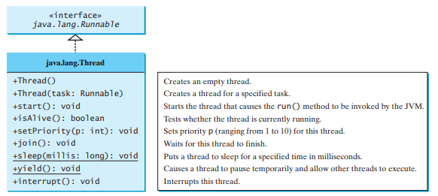
The Thread Class
The Thread class contains the constructors for creating threads for tasks and the methods for controlling threads.

Slide 9
Creating Threads
Two approaches,
1. Using Thread class
2. Using Runnable interface
The run() method is the most important method in any thread programming. Using this method thread behavior can be implemented.
Syntax:
public void run()
{
//statements
}

Slide 10
Creating Threads
//Example using Thread class
class mythread extends Thread
{
public void run()
{
System.out.println("Thread is created!!");
}
}
class threaddemo
{
public static void main(String args[])
{
mythread t= new mythread();
t.start();
}
}
//Example using Runnable interface
class mythread implements Runnable
{
public void run()
{
System.out.println("Thread is created!!");
}
}
class Main extends mythread
{
public static void main(String args[])
{
Main obj = new Main();
Thread t= new Thread(obj);
t.start();
}
}

Slide 11
Thread Synchronization
Java Synchronization allows only one thread to access the shared resource. This will overcome problems like i) Thread interference and ii) Memory consistency errors. iii) Inconsistency problems.
The synchronization concept is based on monitor, which is lock and unlock. When a thread owns this monitor other thread cannot access the resources. Other threads will be in waiting state.
Two ways to achieve synchronization,
1) Using synchronized methods
2) Using synchronized blocks or statements
Rules:
1. Constructors, Classes and variables cannot be synchronized
2. Each object has one lock
3. A thread can acquire more than one lock.
4. When synchronization applied it is called critical section (one thread process can access resource at a time).

Slide 12
Thread Synchronization
class Table{
synchronized void printTable(int n) {
for(int i=1;i<=5;i++){
System.out.println(n*i);
try{
Thread.sleep(400);
}catch(Exception e) {System.out.println(e);}
} } }
class MyThread1 extends Thread{
Table t;
MyThread1(Table t)
{ this.t=t; }
public void run() {
t.printTable(5);
} }
class MyThread2 extends Thread{
Table t;
MyThread2(Table t){
this.t=t;
}
public void run(){
t.printTable(100);
}
}
class Main{
public static void main(String args[]){
Table obj = new Table();//only one object
MyThread1 t1=new MyThread1(obj);
MyThread2 t2=new MyThread2(obj);
t1.start();
t2.start();
} }

Slide 13
Thread Priorities
Priority of a thread describes how early it gets execution and selected by the thread scheduler. In Java, when we create a thread, always a priority is assigned to it.
In a Multithreading environment, the processor assigns a priority to a thread scheduler. The priority is given by the JVM or by the programmer itself explicitly.
The range of the priority is between 1 to 10 and there are three constant variables which are static and used to fetch priority of a Thread.

Slide 14
Thread Priorities
1. public static int MIN_PRIORITY
It holds the minimum priority that can be given to a thread. The value for this is 1.
2. public static int NORM_PRIORITY
It is the default priority that is given to a thread if it is not defined. The value for this is 0.
3. public static int MAX_PRIORITY
It is the maximum priority that can be given to a thread. The value for this is 10.

Slide 15
Thread Priorities
class MyThread extends Thread
{
public void run()
{
System.out.println("Thread Running...");
}
public static void main(String[]args)
{
MyThread p1 = new MyThread();
MyThread p2 = new MyThread();
MyThread p3 = new MyThread();
p1.start();
System.out.println("P1 thread priority : " + p1.getPriority());
System.out.println("P2 thread priority : " + p2.getPriority());
System.out.println("P3 thread priority : " + p3.getPriority());
}
}
P1 thread priority : 5
Thread Running...
P2 thread priority : 5
P3 thread priority : 5

Slide 16
Thread Priorities
class MyThread extends Thread
{
public void run()
{
System.out.println("Thread Running...");
}
public static void main(String[]args)
{
MyThread p1 = new MyThread();
p1.start();
System.out.println("max thread priority : " + p1.MAX_PRIORITY);
System.out.println("min thread priority : " + p1.MIN_PRIORITY);
System.out.println("normal thread priority : " + p1.NORM_PRIORITY);
}
}
Thread Running...
max thread priority : 10
min thread priority : 1
normal thread priority : 5

Slide 17
Thread Priorities
class MyThread extends Thread
{
public void run()
{
System.out.println("Thread Running... "+Thread.currentThread().getName());
}
public static void main(String[]args)
{
MyThread p1 = new MyThread();
MyThread p2 = new MyThread();
// Starting thread
p1.start();
p2.start();
// Setting priority
p1.setPriority(2);
// Getting -priority
p2.setPriority(1);
int p = p1.getPriority();
int p22 = p2.getPriority();
System.out.println("first thread priority : " + p);
System.out.println("second thread priority : " + p22);
} }
Thread Running... Thread-0
first thread priority : 5
second thread priority : 1
Thread Running... Thread-1

Slide 18
Inter-Thread Communication – Cooperation among Threads – Producer-Consumer Problem
Inter-thread communication or Co-operation is all about allowing synchronized threads to communicate with each other.
Cooperation (Inter-thread communication) is a mechanism in which a thread is paused running in its critical section and another thread is allowed to enter (or lock) in the same critical section to be executed.
It is implemented by following methods of Object class:
wait()
notify()
notifyAll()

Slide 19
Inter-Thread Communication – Cooperation among Threads – Producer-Consumer Problem
class Customer
{
int amount=100;
synchronized void withdraw(int amount)
{
System.out.println("Going to withdraw...");
if(this.amount<amount){
System.out.println("Less balance; waiting for deposit...");
try{wait();}catch(Exception e){}
}
this.amount-=amount;
System.out.println("Withdraw of " +amount+" completed...");
}
synchronized void deposit(int amount)
{
System.out.println("going to deposit...");
this.amount+=amount;
System.out.println("Deposit of " + amount+ " completed... ");
notify();
}
}
class InterThread
{
public static void main(String args[]){
final Customer c=new Customer();
new Thread(){
public void run(){c.withdraw(500);}
}.start();
new Thread(){
public void run(){c.deposit(12000);}
}.start(); } }

Slide 20
Deadlock and Semaphore
//For your reference
Semaphores can be used to restrict the number of threads that access a shared resource.
Deadlocks can be avoided by using a proper resource ordering

Slide 21
Creating and Executing threads with the Executor Framework
Server Programs such as database and web servers repeatedly execute requests from multiple clients and these are oriented around processing a large number of short tasks.
In server application, it creates a new thread each time a request arrives and service this new request in the newly created thread.
Disadvantage: A server that creates a new thread for every request would spend more time and consume more system resources in creating and destroying threads than processing actual requests.

Slide 22
Creating and Executing threads with the Executor Framework
As active threads consume system resources, a JVM creating too many threads at the same time can cause the system to run out of memory.
This necessitates the need to limit the number of threads being created.
Solution: ThreadPool
A thread pool reuses previously created threads to execute current tasks and offers a solution to the problem of thread cycle overhead and resource thrashing.
Since the thread is already existing when the request arrives, the delay introduced by thread creation is eliminated, making the application more responsive.

Slide 23
Creating and Executing threads with the Executor Framework
Java provides the Executor framework which is centered around the
Executorinterface, its sub-interface–ExecutorService and the class ThreadPoolExecutor, which implements both of these interfaces.
By using the executor, one only has to implement the Runnable objects and send them to the executor to execute.
To use thread pools, we first create a object of Executor Service and pass a set of tasks to it. ThreadPoolExecutor class allows to set the core and maximum pool size. The runnables that are run by a particular thread are executed sequentially.

Slide 24
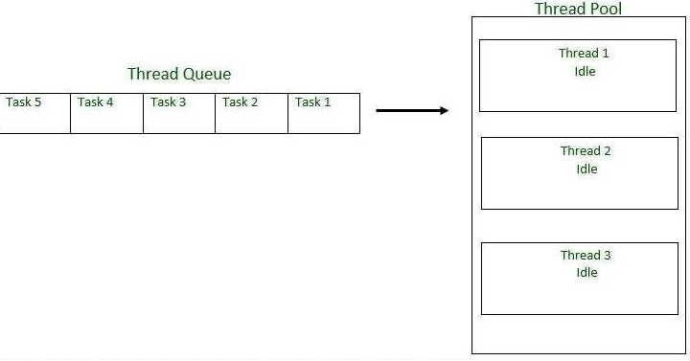
Creating and Executing threads with the Executor Framework
Some types of Java Executors are listed below:
SingleThreadExecutor – For sequential execution
FixedThreadPool(n)+ - Fixed no. of threads
CachedThreadPool – reuse previously constructed
ScheduledExecutor – to run at regular interval
Syntax: ExecutorService executor = Executors.new SingleThreadExecutor();

Slide 25
Creating and Executing threads with the Executor Framework
One of the main advantages of using this approach is when you want to process 100 requests at a time, but do not want to create 100 Threads for the same, so as to reduce JVM overload.
You can use this approach to create a ThreadPool of 10 Threads and you can submit 100 requests to this ThreadPool. ThreadPool will create maximum of 10 threads to process 10 requests at a time.
After process completion of any single Thread, ThreadPool will internally allocate the 11th request to this Thread and will keep on doing the same to all the remaining requests.

Slide 26
Questions?
5 states in Thread model?
Two ways to Create threads ?
Methods in Thread priorities?
Use of Synchronization?
What is Inter-thread communication?

Slide 27
Summary
Thread model,
Creating threads
Thread priorities
Synchronization
Inter-thread communication

Slide 28
Queries???

Slide 29

END OF UNIT - 06

