Slide 1



Unit – 7 Input and Output
Prepared By
Prof. Ravikumar Natarajan
Assistant Professor, CE Dept.

Slide 2
Contents
File
Stream Classes
Byte Stream Classes
Character Stream Classes

Slide 3
File Handling
A file is a sequence of records stored in binary format. A disk drive is formatted into several blocks that can store records. File records are mapped onto those disk blocks.
A file is an object on a computer that stores data, information, settings, or commands used with a computer program.
To obtain properties of file/directory.
To delete file/directory.
To rename file/directory.
To create directory.
To read File.
To write File.
Absolute vs. Relative File Name

Slide 4
Absolute vs Relative File Name
An absolute file name (or full name) contains a file name with its
complete path.
Absolute file names are machine dependent.
For example,
Windows: D:\MEFGI\Oop1.java
directory path: D:\MEFGI, file name: Oop1.java
UNIX: /home/MEFGI/Oop1.java
directory path: /home/MEFGI, file name: Oop1.java
A relative file name is in relation to the current working directory.
The complete directory path for a relative file name is omitted.
For example, Oop1.java is a relative file name.

Slide 5
File Handling
Use the File class to obtain file/directory properties, to delete and
rename files/directories, and to create directories.
Use the Scanner class for reading text data from a file.
Use the PrintWriter class for writing text data to a file.

Slide 6
File Class
File class is in java.io package.
The File class is intended to provide an abstraction that deals with most of the machine-dependent complexities of files and path names in a machine-independent fashion.
The File class contains the methods for obtaining the properties of a file/directory and for renaming and deleting a file/directory.
However, the File class does not contain the methods for reading and writing file contents.

Slide 7
The File Class
› File Constructors
› exists() method
› canRead() method
› isDirectory() method
› isFile() mthod
› isAbsolute() method
› isHidden() method
› getAbsolutePath() method
› getName() method
› getPath() method
› getParent() method
› lastModified() method
› length() method
› listFile() method
› delete() method
› renameTo() method
› mkdir() method

Slide 8
The Scanner Class
› Scanner(source: File) // Creates a Scanner that scans tokens from the specified file.
› Scanner(source: String) // Creates a Scanner that scans tokens from the specified string.
› close() // Closes this scanner.
› hasNext(): boolean // Returns true if this scanner has more data to be read.
› next(): String // Returns next token as a string from this scanner.
› nextLine(): String // Returns a line ending with the line separator from this scanner.

Slide 9
The Scanner Class
› nextByte(): byte // Returns next token as a byte from this scanner.
› nextShort(): short // Returns next token as a short from this scanner.
› nextInt(): int // Returns next token as an int from this scanner.
› nextLong(): long // Returns next token as a long from this scanner.
› nextFloat(): float // Returns next token as a float from this scanner.
› nextDouble(): double // Returns next token as a double from this scanner

Slide 10
Byte Streams and Character Streams
Stream is a channel in which data flow from sender to receiver.
Sequence of objects and methods pipelined together to produce results.
An input object reads the stream of data from a file is called input stream.
The output object writes the stream of data to a file is called output stream.
These classes are found in java.IO package.

Slide 11
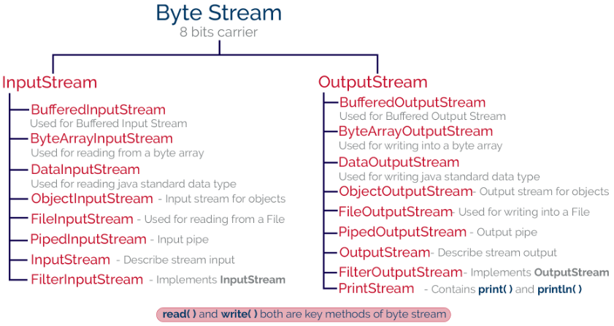
Byte Stream

Slide 12
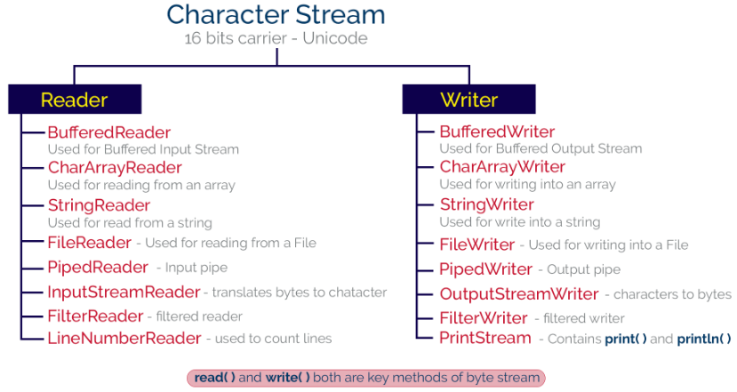
Character Stream

Slide 13
ByteStream VS CharacterStream
Character streams
Byte streams
Meant for reading or writing to character- or text-based I/O such as text files, text documents, XML, and HTML files.
Data dealt with is 16-bit Unicode characters.
Input and output character streams are called readers and writers, respectively.
The abstract classes of Reader and Writer and their derived classes in the java.io package provide support for character streams.
Meant for reading or writing to binary data I/O such as executable files, image files, and files in low-level file formats such as .zip, .class, .obj and .exe.
Data dealt with is bytes (i.e., units of 8-bit data).
Input and output byte streams are simply called input streams and output streams, respectively.
The abstract classes of Input Stream and Output Stream and their derived classes in the java.io package provide support for byte streams.

Slide 14
Read and write operations on file using InputStream and OutputStream
//To write into a file using byte stream
import java.io.*;
class output
{public static void main(String args[])
{ String s ="This is my file";
int a=5;
Double d=5.35;
try
{
FileOutputStream fos= new FileOutputStream("abcd.txt");
DataOutputStream dos = new DataOutputStream(fos);
dos.writeBytes(s);
dos.writeInt(a);
dos.writeDouble(d);
dos.close();
}
catch(IOException ex)
{ex.printStackTrace();}
}}

Slide 15
Read and write operations on file using InputStream and OutputStream
//To read from a file using byte stream
import java.io.*;
class input
{public static void main(String args[])
{
try
{ FileInputStream fin= new FileInputStream("abcd.txt"); //to read data from a file in bytes
DataInputStream din = new DataInputStream(fin); // read primitive Java data types
String line=null;
while((line =din.readLine())!=null)
{
System.out.println(line);
}
din.close();
}
catch(Exception ex)
{ex.printStackTrace();}
}}

Slide 16
FileWriter and FileReader
//To read from a file using character stream
import java.io.*;
class readerDemo
{
public static void main(String[] args)
{
try{
File f1= new File("abc.txt");
FileReader fr = new FileReader(f1);
BufferedReader br=new BufferedReader(fr); //chaining
String line=null;
while((line=br.readLine()) !=null)
{
System.out.println(line);
}
br.close();
}
catch(Exception ex)
{ex.printStackTrace();} }}
//To write into a file using character stream
import java.io.*;
class writerDemo
{
public static void main(String[] args)
{
try
{
FileWriter fw = new FileWriter("abc.txt");
fw.write("Hello, Good Morning"); // fw.write("123");
fw.close();
}
catch(IOException ex)
{ex.printStackTrace();}
}}

Slide 17
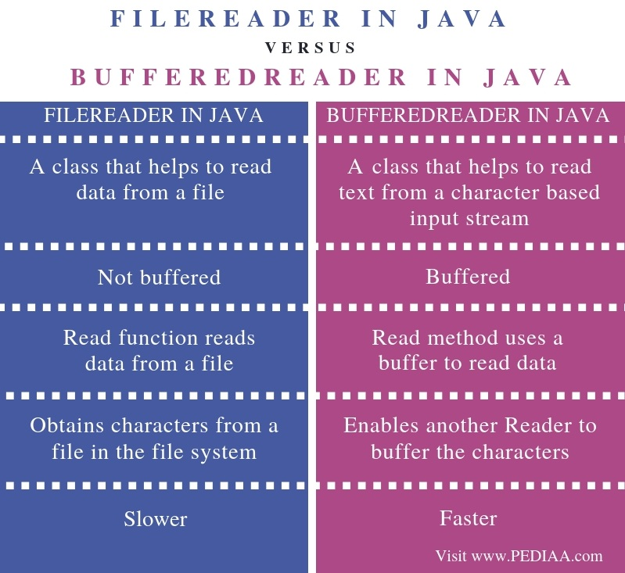
FileReader vs BufferedReader
FileReader reads file path and returns data in byte format. FileReader class has the following two methods: read() and close().
BufferedReader reads characters using another Reader.
Methods: read(), readLine(), close().

Slide 18
Questions
File?
What is a Stream?
Two types of Streams?
Byte Stream Classes used for?
Character Stream Classes used for?

Slide 19
Summary
File
Stream Classes
Byte Stream Classes
Character Stream Classes

Slide 20
Next
String class
Character class
StringBuffer class
StringBuilder class
Primitive type Wrapper classes
Collections overview
Collection interfaces
Collection classes
Maps
Comparators
Lists
Vector class
Stack class
Scanner
Formatter

Slide 21

END OF UNIT - 7

Slide 22
REFERENCE PURPOSE Example 2
REFERENCE PURPOSE

Slide 23
PrintWriter and Reader
import java.io.PrintWriter;
class Main {
public static void main(String[] args) {
String data = "This is a text inside the file.";
try {
PrintWriter output = new PrintWriter(“PQR.txt");
output.print(data);
output.close();
}
catch(Exception e) {
e.getStackTrace();
}
}
}
import java.io.*;
public class ReaderExample {
public static void main(String[] args) {
try {
Reader reader = new FileReader(“PQR.txt");
int data = reader.read();
while (data != -1) {
System.out.print((char) data);
data = reader.read();
}
reader.close();
} catch (Exception ex) {
System.out.println(ex.getMessage());
}
}
}

Slide 24
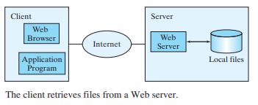
Reading Data from the Web
Just like you can read data from a file on your computer, you can read data from a file on the Web.
You can also access data from a file that is on the Web if you know the file’s URL (Uniform Resource Locator—the unique address for a file on the Web).
For example, www.google.com/index.html is the URL for the file index.html located on the Google Web server.

Slide 25
Reading Data from the Web
For an application program to read data from a URL, you first need to create a URL object using the java.net.URL class with this constructor:
public URL(String spec) throws MalformedURLException
try {
URL url = new URL("http://www.google.com/index.html");
}
catch (MalformedURLException ex)
{ ex.printStackTrace();
}

Slide 26
Reading Data from the Web
For an application program to read data from a URL, you first need to create a URL object using the java.net.URL class with this constructor:
public URL(String spec) throws MalformedURLException
try {
URL url = new URL("http://www.google.com/index.html");
}
catch (MalformedURLException ex)
{ ex.printStackTrace();
}

Slide 27
Reading Data from the Web
import java.net.*;
import java.io.*;
public class ReadURL {
public static void main(String[] args) throws Exception {
URL url = new URL("http://www.google.com/index.html");
BufferedReader read = new BufferedReader(
new InputStreamReader(url.openStream()));
String i;
while ((i = read.readLine()) != null)
System.out.println(i);
read.close();
}}

Slide 28
Abstract Class VS Interface
Refer previous unit for examples.
Parameters | Interface | Abstract class
Speed | Slow | Fast
Multiple Inheritances | Implement several Interfaces | Only one abstract class
Structure | Abstract methods | Abstract & concrete methods
When to use | Future enhancement | To avoid independence
Inheritance/ Implementation | A Class can implement multiple interfaces | The class can inherit only one Abstract Class
Data fields | the interface cannot contain data fields. | the class can have data fields.
Abstract keyword | In an abstract interface keyword, is optional for declaring a method as an abstract. | In an abstract class, the abstract keyword is compulsory for declaring a method as an abstract.

Slide 29
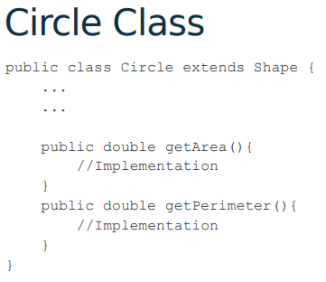
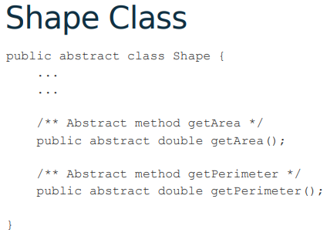
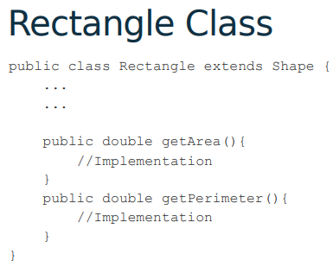
Abstract Class Example
Ex.: Shape (superclass), Circle and Rectangle (subclass)
Main Class
Class main{
Circle c = new circle();
Rectangle r = new Rectangle(); }

Slide 30
Interface
Since abstract class allows concrete methods as well, it does not provide 100% abstraction.
You can say that it provides partial abstraction.
Interfaces are used for 100% abstraction (full abstraction)
Syntax:
modifier interface InterfaceName {
/** Constant declarations */
/** Abstract method signatures */
}

Slide 31
The Comparable Interface
Suppose you want to design a generic method to find the larger of two objects of the same type, such as two students / dates / circles / rectangles / etc.
In order to accomplish this, the two objects must be comparable, so the common behavior for the objects must be comparable.
Java provides the Comparable interface for this purpose.
The Comparable interface defines the compareTo method for comparing objects.
The interface is defined as follows:
package java.lang;
public interface Comparable<E> {
public int compareTo(E o);
}

Slide 32
The Comparable Interface
The Comparable interface is a generic interface.
The generic type E [Comparable<E>] is replaced by a concrete type when implementing this interface.
class circle implements Comparable<Circle> {
public int compareTo(Circle o){
...
}
}

Slide 33
The Comparable Interface SortComparableObjects
import java.math.*;
public class Main {
public static void main(String[] args) {
String[] cities = {"Savannah", "Boston", "Atlanta", "Tampa"};
java.util.Arrays.sort(cities);
for (String city: cities)
System.out.print(city + " ");
System.out.println();
BigInteger[] hugeNumbers = {new BigInteger("2323231092923992"),
new BigInteger("432232323239292"),
new BigInteger("54623239292")};
java.util.Arrays.sort(hugeNumbers);
for (BigInteger number: hugeNumbers)
System.out.print(number + " ");
} }
Output:
Atlanta Boston Savannah Tampa
54623239292 432232323239292 2323231092923992

Slide 34
The Comparable Interface
class Student implements Comparable<Student>{
int rollno;
String name;
int age;
Student(int rollno,String name,int age){
this.rollno=rollno;
this.name=name;
this.age=age;
}
public int compareTo(Student st){
if(age==st.age)
return 0;
else if(age>st.age)
return 1;
else
return -1;
}
}
import java.util.*;
public class TestSort2{
public static void main(String args[]){
ArrayList<Student> al=new ArrayList<Student>();
al.add(new Student(101,"Vijay",23));
al.add(new Student(106,"Ajay",27));
al.add(new Student(105,"Jai",21));
Collections.sort(al);
for(Student st:al){
System.out.println(st.rollno+" "+st.name+" "+st.age);
}
}
}

Slide 35
The Cloneable Interface
Often it is desirable to create a copy of an object. To do this, you need to use the clone method and understand the Cloneable interface.
The Cloneable interface specifies that an object can be cloned.
An interface contains constants and abstract methods, but the Cloneable interface is a special case. The Cloneable interface in the java.lang package is defined as follows:
package java.lang;
public interface Cloneable {
}
This interface is empty. An interface with an empty body is referred to as a marker interface. A marker interface does not contain constants or methods. It is used to denote that a class possesses certain desirable properties. A class that implements the Cloneable interface is marked cloneable, and its objects can be cloned using the clone() method defined in the Object class.

Slide 36
The Cloneable Interface
package java.lang;
public interface Cloneable {
}
This interface is empty. An interface with an empty body is referred to as a marker interface.
A marker interface does not contain constants or methods. It is used to denote that a class possesses certain desirable properties.
A class that implements the Cloneable interface is marked cloneable, and its objects can be cloned using the clone() method defined in the Object class.
Many classes in the Java library (e.g., Date, Calendar, ArrayList etc.) implement Cloneable. Thus, the instances of these classes can be cloned.

Slide 37
The Cloneable Interface
Creating Copy of Java Object
We can create a replica or copy of java object by
Creating a copy of object in a different memory location. This is called a Deep copy.
Creating a new reference that points to the same memory location. This is also called a Shallow copy.

Slide 38
The Cloneable Interface
//DeepCopy
class Main implements Cloneable
{
public int x = 30;
public static void main(String args[])
{
Main obj1 = new Main();
// it will copy the reference, not value
//SCopy obj2 = obj1;
try{
Main obj2 = (Main)obj1.clone();
obj2.x = 6;
System.out.println("The value of x is: " + obj1.x);
System.out.println("The value of x is: " + obj2.x);
}
catch(Exception e){System.out.println(e);}
} }
//ShallowCopy
class Main
{
int x = 30;
public static void main(String args[])
{
Main obj1 = new Main();
// it will copy the reference, not value
Main obj2 = obj1;
obj2.x = 6;
System.out.println("The value of x is: " + obj1.x);
} }

Slide 39
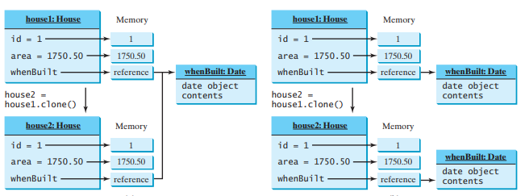
The Cloneable Interface
Shallow Copy
Deep Copy

Slide 40
Reference Programs

Slide 41
Reading Data from the Web
import java.util.Scanner;
public class ReadFileFromURL {
public static void main(String[] args) {
System.out.print("Enter a URL: ");
String URLString = new Scanner(System.in).next();
try {
java.net.URL url = new java.net.URL(URLString);
int count = 0;
Scanner input = new Scanner(url.openStream());
while (input.hasNext()) {
String line = input.nextLine();
count += line.length();
}
System.out.println("The file size is " + count + " characters");
}
catch (java.net.MalformedURLException ex) {
System.out.println("Invalid URL");
}
catch (java.io.IOException ex) {
System.out.println("I/O Errors: no such file");
}
}
}

Slide 42
ByteStream VS CharacterStream
import java.io.*;
class CopyFile
{
public static void main(String args[])
{
try
{
FileInputStream fr = new FileInputStream("photo.jpg");
FileOutputStream fw = new FileOutputStream(“copy.jpg");
int i =0;
while ((i=fr.read())!=-1){
fw.write(i);
}
fw.flush();
fw.close();
fr.close();
System.out.println("File copied successfully.......");
}
catch(Exception e)
{
System.out.println(e);
}
}
}
First place the image in the proper folder.
This program will copy the picture as it is in the name of “copy”.
This will work fine.

Slide 43
ByteStream VS CharacterStream
import java.io.*;
class CopyFile
{
public static void main(String args[])
{
try
{
FileReader fr = new FileReader("Data.txt");
FileWriter fw = new FileWriter("Copy.txt");
int i =0;
while ((i=fr.read())!=-1){
fw.write(i);
}
fw.flush();
fw.close();
fr.close();
System.out.println("File copied successfully.......");
}
catch(Exception e)
{
System.out.println(e); } } }
TRY
First place the image in the proper folder.
Try to create a copy as like previous program it will not copy the image.
The copied image will be corrupted.
This will work fine for the text.

Slide 44
ByteStream VS CharacterStream
Figure out the reasons for the previous two programs.

Slide 45
Thank you End of Unit 7

