Slide 1



Unit – 8 Language and Utility Framework
Prepared By
Prof. Ravikumar Natarajan
Assistant Professor, CE Dept.

Slide 2
Contents
String class
Character class
StringBuffer class
StringBuilder class
Primitive type Wrapper classes
Collections overview
Collection interfaces
Collection classes
Maps
Comparators
Lists
Vector class
Stack class
Scanner
Formatter

Slide 3
String Class
In Java, string is basically an object that represents sequence of char values. An array of characters works same as Java string.
For example:
char[] ch={'j','a','v','a'};
String s=new String(ch);
is same as:
String s="java";

Slide 4
String Class
String is a collection of characters. In Java, string is an object that represents a sequence of characters.
The Java String is immutable which means it cannot be changed. Whenever we change any string, a new instance is created.
Java String class provides a lot of methods to perform operations on strings such as compare(), concat(), equals(), split(), length(), replace(), compareTo(), intern(), substring() etc.
The java.lang.String class implements Serializable, Comparable and CharSequence interfaces.
The CharSequence interface is used to represent the sequence of characters. String, StringBuffer and StringBuilder classes implement it. It means, we can create strings in Java by using these three classes.

Slide 5
How to create a string object?
There are two ways to create String object:
By string literal
By new keyword
Method 1: Java String literal is created by using double quotes. For Example: String s="welcome";
Each time you create a string literal, the JVM checks the "string constant pool" first. If the string already exists in the pool, a reference to the pooled instance is returned. If the string doesn't exist in the pool, a new string instance is created and placed in the pool. For example:
String s1="Welcome";
String s2="Welcome";//It doesn't create a new instance

Slide 6
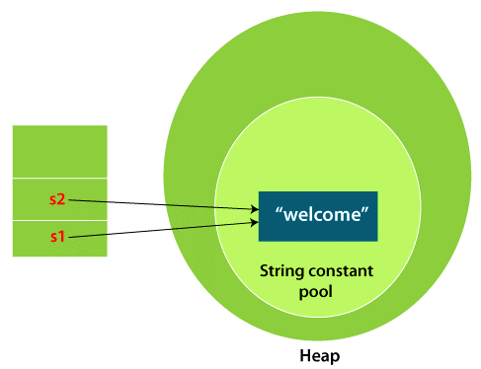
How to create a string object?
In the above example, only one object will be created.

Slide 7
How to create a string object?
Why Java uses the concept of String literal?
To make Java more memory efficient (because no new objects are created if it exists already in the string constant pool).
Method 2: By new keyword
String s=new String("Welcome"); //creates two objects and one reference variable
In such case, JVM will create a new string object in normal (non-pool) heap memory, and the literal "Welcome" will be placed in the string constant pool. The variable s will refer to the object in a heap (non-pool).

Slide 8
How to create a string object?
public class Main{
public static void main(String args[]){
String s1="java";
char ch[]={'s','t','r','i','n','g','s'};
String s2=new String(ch);
String s3=new String("example");
System.out.println(s1);
System.out.println(s2);
System.out.println(s3);
}}

Slide 9
Immutable string (Cannot change object)
String class represents immutable string that means once one has created a string object it cannot be changed.
If want to modify string object need to use StringBuffer class.
class a
{
public static void main (String[] args) {
{
String s = “Hi”;
s.concat(“Hello”); //appends string at end
System.out.println(s); //prints only Hi because strings are immutable.
}}

Slide 10
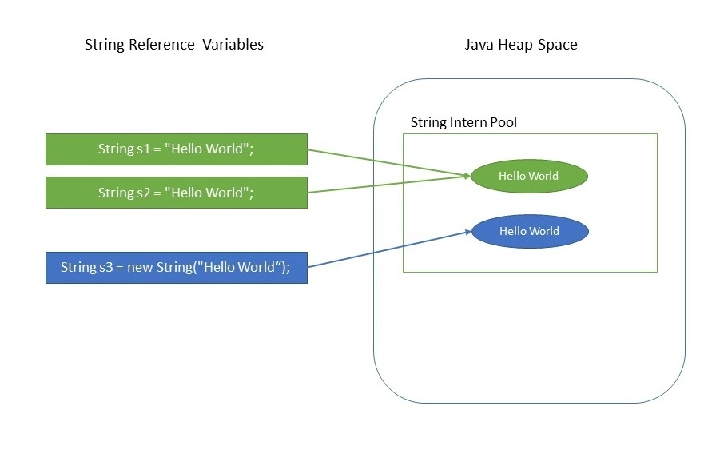
Advantages of Immutable String
The key benefits of keeping this class as immutable are caching, security, synchronization, and performance.
What is Java String Pool?
Java String Pool is the special memory region where Strings are stored by the JVM. Since Strings are immutable in Java, the JVM optimizes the amount of memory allocated for them by storing only one copy of each literal String in the pool. This process is called interning.

Slide 11

Advantages of Immutable String
String Pool example
class Main{
public static void main (String[] args) {
{
String s1 = "Hello World";
String s2 = "Hello World";
String s3 = "Hello";
String s4 = new String("Hello World");
System.out.println(s1.equals(s2));
System.out.println(s1.hashCode());
System.out.println(s2.hashCode());
System.out.println(s3.hashCode());
System.out.println(s4.hashCode());
System.out.println(s1==s2); //true
System.out.println(s2==s4); //false
} } }
//s4 hashCode ll be same as s1 and s2. Because new object is created in non heap but as the literal is same it ll be placed in constant pool.
To justify check the reference of s1 = = s2 and s2 == s4. Here s2==s4 will be false. It shows s4 is from different address.

Slide 12
Advantages of Immutable String
String Pool example
class Main{
public static void main (String[] args) {
{
String s1 = "Hello World";
String s2 = "Hello World";
String s3 = "Hello";
String s4 = new String("Hello World").intern();
System.out.println(s1.equals(s2));
System.out.println(s1.hashCode());
System.out.println(s2.hashCode());
System.out.println(s3.hashCode());
System.out.println(s4.hashCode());
System.out.println(s1==s2); //true
System.out.println(s2==s4); //Now this will be true, because intern means it will create a copy of the object, not the new object.
} } }

Slide 13
String Class
class Main
{
public static void main(String args[])
{
String s ="Hello";
System.out.println(s.length());
char ch;
ch =s.charAt(2);
System.out.println(ch);
//substring
System.out.println("Substring:" +s.substring(2,5));
//replace
String str;
str=s.replace('H','Y');
System.out.println(str);
//Upper
String str1 = s.toUpperCase();
System.out.println(str1);
//Lower
String str2 = s.toLowerCase();
System.out.println(str2);
} }

Slide 14
String Class
› String Constructor
› String Concatenation
› length() method
› charAt() method
› getChars() method
› Equals() mthod
› equalsIgnoreCase() method
› startsWith() method
› endsWith() method
› compareTo() method
› indexOf() method with char
› indexOf() method with substring
› substring() method
› concat() method
› replace() method
› trim() method
› Changing the case

Slide 15
Overriding toString() method
The default toString() method from object class prints “Class name @ hashcode”.
Default toString() method can be overridden
class Main
{
int rollno;
String sname;
Main(int rollno, String sname)
{
this.rollno=rollno;
this.sname=sname;
}
public String toString() //override
{
return rollno + " " +sname;
}
public static void main(String args[])
{
Main x1 = new Main(101,"Ram");
System.out.println(x1); //xxx@3e25a5
}}

Slide 16
Java StringBuffer Class
Java StringBuffer class is used to create mutable (modifiable) String objects.
The StringBuffer class in Java is the same as String class except it is mutable i.e. it can be changed.
StringBuffer and StringBuilder classes are used for creating mutable strings.
class Main{
public static void main(String args[]){
StringBuffer sb=new StringBuffer("Hello ");
sb.append("Java");//now original string is changed
System.out.println(sb);//prints Hello Java
}
}

Slide 17
Java StringBuffer Class
class Main{
public static void main(String args[]){
StringBuffer sb=new StringBuffer("Hello");
sb.reverse();
System.out.println(sb);//prints olleH
}
}

Slide 18
Java StringBuilder Class
class Main{
public static void main(String args[]){
StringBuilder sb=new StringBuilder("Hello ");
sb.insert(1,"Java");//now original string is changed
System.out.println(sb);//prints HJavaello } }
No. | StringBuffer | StringBuilder
1) | StringBuffer is synchronized i.e. thread safe. It means two threads can't call the methods of StringBuffer simultaneously. | StringBuilder is non-synchronized i.e. not thread safe. It means two threads can call the methods of StringBuilder simultaneously.
2) | StringBuffer is less efficient than StringBuilder. | StringBuilder is more efficient than StringBuffer.
3) | StringBuffer was introduced in Java 1.0 | StringBuilder was introduced in Java 1.5

Slide 19
Java StringBuilder Class
› StringBuilder()
› StringBuilder(capacity)
› StringBuilder(str)
› append(data)
› append(data,offset,len)
› append(val)
› append(str)
› delete(startIndex,endIndex)
› deleteCharAt(index)
› insert(index,data,offset,len)
› insert(offset, data)
› insert(offset,val)
› insert(offset,str)
› replace(startIndex,endIndex,str)
› reverse()
› setCharAt(index,ch)
› toString()
› capacity()
› charAt(index)
› length()
› setLength(newLength)
› substring(startIndex)
› substring(startIndex,endIndex)
› trimToSize()

Slide 20
Primitive Data Type and Wrapper Class Types
A primitive type value is not an object, but it can be wrapped in an object using a wrapper class in the Java API.
Java offers a convenient way to incorporate, or wrap, a primitive data type into an object.
e.g. wrapping int into the Integer class, wrapping double into the Double class, and wrapping char into the Character class etc.
Java provides Boolean, Character, Double, Float, Byte, Short, Integer, and Long wrapper classes in the java.lang package for primitive data types.

Slide 21
Wrapper Classes
The wrapper class in Java provides the mechanism to convert primitive into object and object into primitive.
Since J2SE 5.0, autoboxing and unboxing feature convert primitives into objects and objects into primitives automatically. The automatic conversion of primitive into an object is known as autoboxing and vice-versa unboxing.

Slide 22
Use of Wrapper classes in Java
Change the value in Method: Java supports only call by value. So, if we pass a primitive value, it will not change the original value. But, if we convert the primitive value in an object, it will change the original value.
Serialization: We need to convert the objects into streams to perform the serialization. If we have a primitive value, we can convert it in objects through the wrapper classes.
Synchronization: Java synchronization works with objects in Multithreading.
java.util package: The java.util package provides the utility classes to deal with objects.
Collection Framework: Java collection framework works with objects only. All classes of the collection framework (ArrayList, LinkedList, Vector, HashSet, LinkedHashSet, TreeSet, PriorityQueue, ArrayDeque, etc.) deal with objects only.

Slide 23
Use of Wrapper classes in Java
The eight classes of the java.lang package are known as wrapper classes in Java. The list of eight wrapper classes are given below:
Primitive Type | Wrapper class
boolean | Boolean
char | Character
byte | Byte
short | Short
int | Integer
long | Long
float | Float
double | Double

Slide 24
Use of Wrapper classes in Java
//Java program to convert primitive into objects
//Autoboxing example of int to Integer
public class WrapperExample1{
public static void main(String args[]){
//Converting int into Integer
int a=20;
Integer i=Integer.valueOf(a); //converting int into Integer explicitly
Integer j=a; //autoboxing, now compiler will write Integer.valueOf(a) internally
System.out.println(a+" "+i+" "+j);
}}

Slide 25
Use of Wrapper classes in Java
//Java program to convert object into primitives
//Unboxing example of Integer to int
public class WrapperExample2{
public static void main(String args[]){
//Converting Integer to int
Integer a=new Integer(3);
int i=a.intValue();//converting Integer to int explicitly
int j=a; //unboxing, now compiler will write a.intValue() internally
System.out.println(a+" "+i+" "+j);
}}

Slide 26
Big integer and Big decimal class
The BigInteger and BigDecimal classes can be used to represent integers or decimal numbers of any size and precision.
If you need to compute with very large integers or high-precision floating-point values, you can use the BigInteger and BigDecimal classes in the java.math package.
Both are immutable.

Slide 27
Big Integer
import java.math.*;
public class Main{
public static void main(String[] args) {
int aa = 9223372036854775807;
int bb = 2 ;
int cc = aa*bb;
System.out.println(cc); //Will not work
BigInteger a = new BigInteger("9223372036854775807");
BigInteger b = new BigInteger("2");
BigInteger c = a.multiply(b); // 9223372036854775807 * 2 System.out.println(c); //This will work
}}

Slide 28
Big Decimal
import java.math.*;
public class Main{
public static void main(String[] args) {
BigDecimal bd1 = new BigDecimal("124567890.0987654321");
BigDecimal bd2 = new BigDecimal("987654321.123456789");
bd1 = bd1.add(bd2);
System.out.println("BigDecimal1 = " + bd1);
bd1 = bd1.multiply(bd2);
System.out.println("BigDecimal1 = " + bd1);
}}

Slide 29
Character Class
Java provides a wrapper class Character in java.lang package. An object of type Character contains a single field, whose type is char. The Character class offers a number of useful class (i.e., static) methods for manipulating characters. You can create a Character object with the Character constructor.
Creating a Character object:
Character ch = new Character('a');
Methods in Character Class
boolean isLetter(char ch)
boolean isDigit(char ch)
boolean isWhitespace(char ch), etc

Slide 30
Character Class
public class Test {
public static void main(String[] args)
{
System.out.println(Character.isLetter('A'));
System.out.println(Character.isLetter('0'));
System.out.println(Character.isDigit('A'));
System.out.println(Character.isDigit('0'));
System.out.println(Character.isWhitespace('A'));
System.out.println(Character.isWhitespace(' '));
}
}

Slide 31
Next
Collections overview,
Collection interfaces,
Collection classes,
Maps
Comparators
Lists
Vector class
Stack class
Scanner
Formatter

Slide 32
Collections
A Collection represents a single unit of objects, i.e., a group.
The Collection in Java is a framework that provides an architecture to store and manipulate the group of objects.
Java Collections can achieve all the operations that you perform on a data such as searching, sorting, insertion, manipulation, and deletion.
Java Collection means a single unit of objects. Java Collection framework provides many interfaces (Set, List, Queue, Deque) and classes (ArrayList, Vector, LinkedList, PriorityQueue, HashSet, LinkedHashSet, TreeSet).

Slide 33
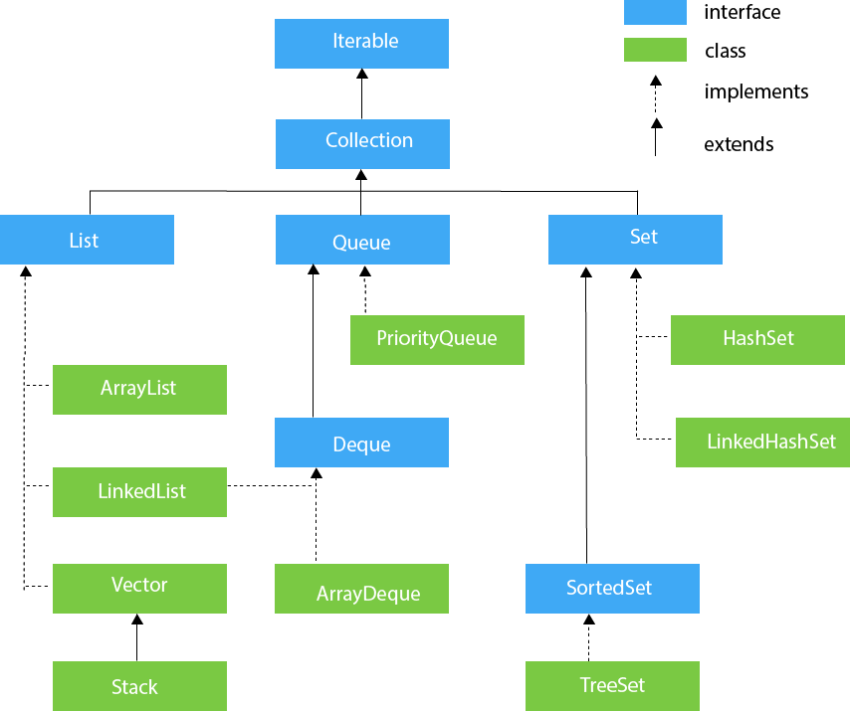
Collection Interface and Classes

Slide 34
Iterators
Iterator is a classic design pattern for walking through a data structure without having to expose the details of how data is stored in the data structure.
The Collection interface extends the Iterable interface.
The Iterable interface defines the iterator method, which returns an iterator.
The Collection interface contains the methods for manipulating the elements in a collection, and you can obtain an iterator object for traversing elements in the collection.

Slide 35
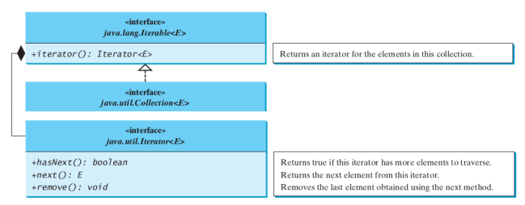
Iterators

Slide 36
Iterators
import java.util.*;
public class Main {
public static void main(String[] args) {
Collection<String> collection = new ArrayList<>();
collection.add("New York");
collection.add("Atlanta");
collection.add("Dallas");
collection.add("Madison");
Iterator<String> iterator = collection.iterator();
while (iterator.hasNext()) {
System.out.print(iterator.next().toUpperCase() + " ");
}
System.out.println(); } }
Output:
NEW YORK ATLANTA DALLAS MADISON

Slide 37
Lists
The List interface extends the Collection interface and defines a collection for storing elements in a sequential order.
To create a list, use one of its two concrete classes: ArrayList or LinkedList.
The List interface adds position-oriented operations, as well as a new list iterator that enables the user to traverse the list bidirectionally.

Slide 38
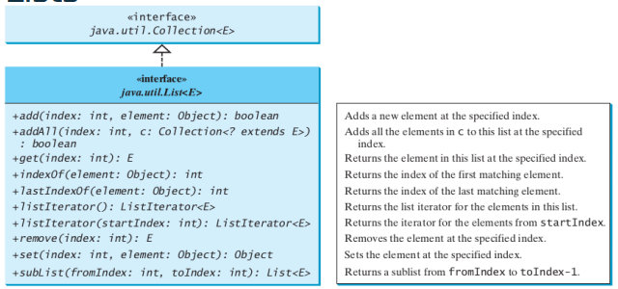
Lists

Slide 39
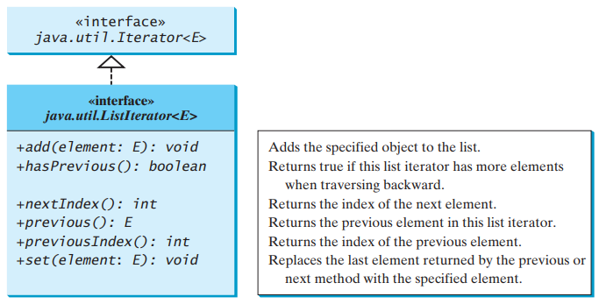
List Iterator
The listIterator() or listIterator(startIndex) method returns an instance of ListIterator.
The ListIterator interface extends the Iterator interface to add bidirectional traversal of the list.

Slide 40
Iterator vs List Iterator
Iterator can traverse only in forward direction whereas ListIterator traverses both in forward and backward directions.
Using Iterator we cannot modify or replace elements present in Collection. But, ListIterator can modify or replace elements with the help of set(E e).
Iterator methods are next(), remove(), hasNext() whereas ListIterator methods are next(), previous(), hasNext(), hasPrevious(), add(E e).

Slide 41
ArrayList
Java ArrayList class uses a dynamic array for storing the elements. It is like an array, but there is no size limit. We can add or remove elements anytime. So, it is much more flexible than the traditional array. It is found in the java.util package.
Java ArrayList class can contain duplicate elements.
Java ArrayList class maintains insertion order.
Java ArrayList class is non synchronized.
Java ArrayList allows random access because the array works on an index basis.
In ArrayList, manipulation is a little bit slower than the LinkedList in Java because a lot of shifting needs to occur if any element is removed from the array list.
We can not create an array list of the primitive types, such as int, float, char, etc. It is required to use the required wrapper class in such cases. For example: ArrayList<Integer> al = new ArrayList<Integer>();

Slide 42
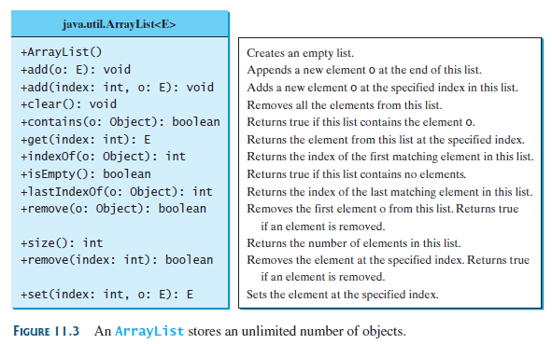
ArrayList

Slide 43
ArrayList
import java.util.*;
public class Main{
public static void main(String args[]){
ArrayList<String> al=new ArrayList<String>(); //ArrayList al = new ArrayList();
al.add("Ravi");
al.add("Vijay");
al.add("Aarav");
al.add("Ajay");
for(String s2:al)
System.out.println("Elements:"+s2);
al.remove("Ravi");
for(String s:al)
System.out.println("After remove:"+s);
al.clear();
System.out.println(al.size());
} }

Slide 44
LinkedList
Java LinkedList class uses a doubly linked list to store the elements.
It provides a linked-list data structure.
It inherits the AbstractList class and implements List and Deque interfaces.
The important points about Java LinkedList are:
Java LinkedList class can contain duplicate elements.
Java LinkedList class maintains insertion order.
Java LinkedList class is non synchronized.
In Java LinkedList class, manipulation is fast because no shifting needs to occur.
Java LinkedList class can be used as a list, stack or queue.

Slide 45
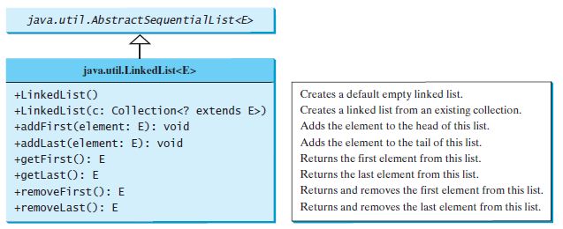
LinkedList

Slide 46
LinkedList
import java.util.*;
public class Main{
public static void main(String args[]){
LinkedList<String> al=new LinkedList<String>();
al.add("Ravi");
al.add("Vijay");
System.out.println(al);
al.addFirst("Zumba");
System.out.println("After addFirst:"+al);
al.removeFirst();
System.out.println("After removeFirst:"+al);
} }

Slide 47
The ArrayList and LinkedList Classes
The ArrayList class and the LinkedList class are two concrete implementations of the List interface.
ArrayList stores elements in an array. The array is dynamically created.
If the capacity of the array is exceeded, a larger new array is created and all the elements from the current array are copied to the new array.
LinkedList stores elements in a linked list. A list can grow or shrink dynamically.
Use of these depends on your specific needs.
List or ArrayList when to choose?
If you need to support random access through an index without inserting or removing elements at the beginning of the list, ArrayList offers the most efficient collection.
If your application requires the insertion or deletion of elements at the beginning of the list, you should choose LinkedList.

Slide 48
The ArrayList and LinkedList Classes
import java.util.*;
public class Main {
public static void main(String[] args) {
List<Integer> arrayList = new ArrayList<>();
arrayList.add(1); // 1 is autoboxed to new Integer(1)
arrayList.add(2);
arrayList.add(3);
arrayList.add(1);
arrayList.add(4);
arrayList.add(0, 10);
arrayList.add(3, 30);
System.out.println("A list of integers in the array list:");
System.out.println(arrayList);
LinkedList<Object> linkedList = new LinkedList<>(arrayList);
linkedList.add(1, "red");
linkedList.removeLast();
linkedList.addFirst("green");
System.out.println("Display the linked list forward:");
ListIterator<Object> listIterator = linkedList.listIterator();
while (listIterator.hasNext()) {
System.out.print(listIterator.next() + " ");
}
System.out.println();
System.out.println("Display the linked list backward:");
listIterator = linkedList.listIterator(linkedList.size());
while (listIterator.hasPrevious()) {
System.out.print(listIterator.previous() + " ");
}
}
}
Extra Example for reference

Slide 49
Vector and Stack Classes
The Collections class contains static methods to perform common operations in a collection and a list.
The Collections class contains the sort, binarySearch, reverse, shuffle, copy, and fill methods for lists, and max, min, disjoint, and frequency methods for collections.
Vector is a subclass of AbstractList, and Stack is a subclass of Vector in the Java API.
Vector is the same as ArrayList, except that it contains synchronized methods for accessing and modifying the vector. Synchronized methods can prevent data corruption when a vector is accessed and modified by two or more threads concurrently.

Slide 50
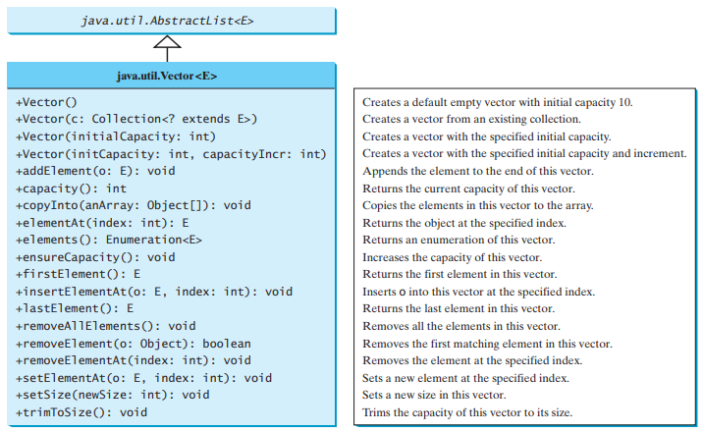
Vector Classes

Slide 51
Vector Classes
// Java Program to Add Elements in Vector Class
import java.util.*;
class Main {
public static void main(String[] arg)
{
Vector v1 = new Vector();
//Vector<Integer> v2 = new Vector<Integer>();
v1.add(1);
v1.add(2);
v1.add("Hi");
v1.add("Hello");
v1.add(3);
System.out.println("Vector v1 is " + v1);
}
}

Slide 52
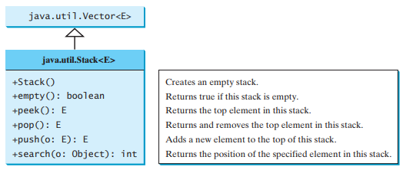
Stack Classes
In the Java Collections Framework, Stack is implemented as an extension of Vector.
Stack follows LIFO

Slide 53
Stack Classes
// Java program to add & remove the elements in the stack
import java.util.*;
class Main {
public static void main(String[] args)
{
Stack stack1 = new Stack();
stack1.push(4);
stack1.push("All");
stack1.push(“Hello");
System.out.println(stack1);
stack1.pop();
System.out.println(stack1);
System.out.println(stack1.peek());
} }

Slide 54
Scanner Classes
Already discussed

Slide 55
Formatter Class
The Formatter is a built-in class in java used for layout justification and alignment, common formats for numeric, string, and date/time data, and locale-specific output in java programming.
The Formatter class is defined as final class inside the java.util package.
import java.util.*;
public class Main {
public static void main(String[] args) {
Formatter f = new Formatter();
f.format("%s age is %d", "MU", 22);
System.out.println(f);
}}

Slide 56
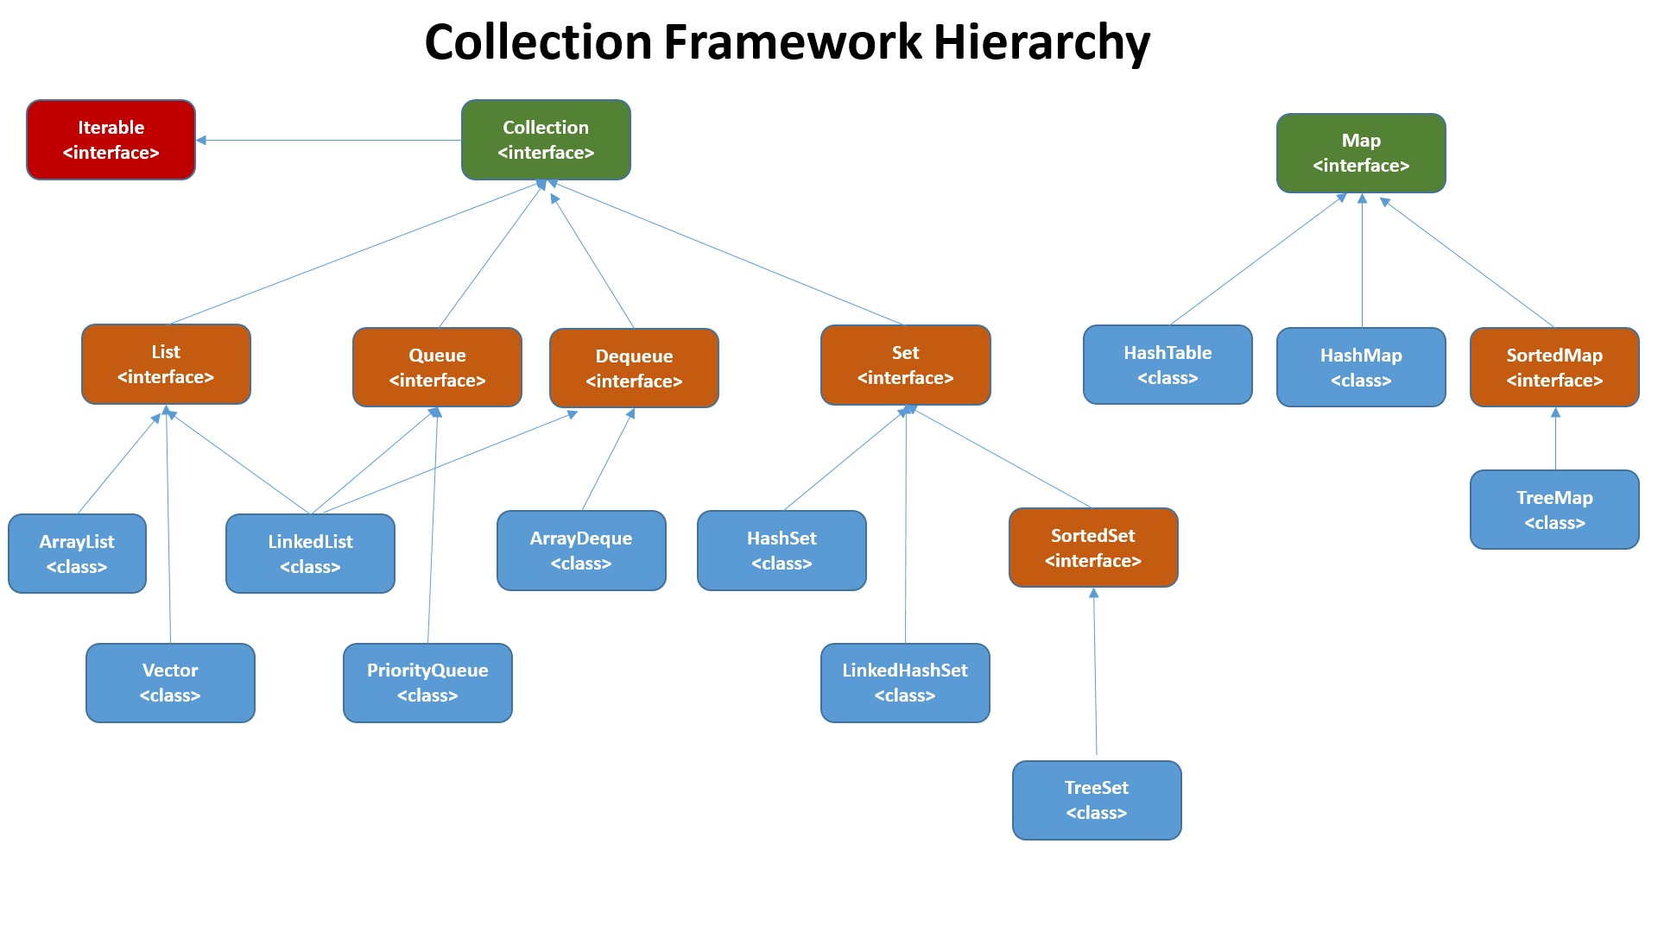
The ArrayList and LinkedList Classes

Slide 57
Maps
You can create a map using one of its three concrete classes: HashMap, LinkedHashMap, or TreeMap.
A map is a container object that stores a collection of key/value pairs. It enables fast retrieval, deletion, and updating of the pair through the key.
A map stores the values along with the keys. The keys are like indexes.
In List, the indexes are integers. In Map, the keys can be any objects.
A map cannot contain duplicate keys.
Each key maps to one value. A key and its corresponding value form an entry stored in a map.

Slide 58
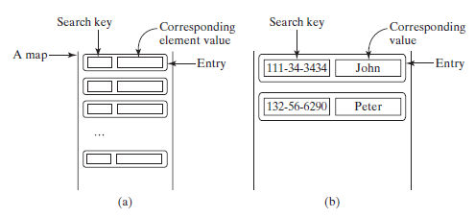
Maps
The entries consisting of key/value pairs are stored in a map.

Slide 59
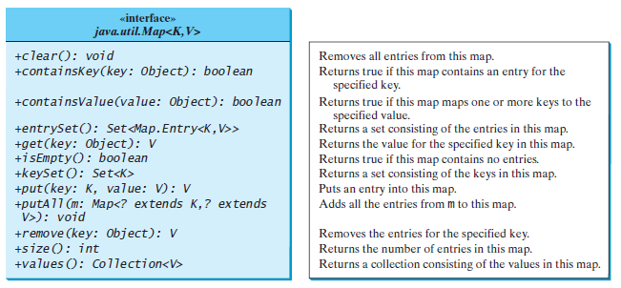
Maps

Slide 60
Maps
import java.util.*;
public class Main {
public static void main(String[] args) {
Map<String, String, String> map = new LinkedHashMap<>();
map.put("123", "John Smith", "a");
map.put("111", "George Smith", "b");
map.put("123", "Steve Yao", " ");
map.put("222", "Steve Yao", " ");
System.out.println(map);
System.out.println(map.get("222"));
map.clear();
System.out.println("Size:"+map.size());
} }
{123=Steve Yao, 111=George Smith, 222=Steve Yao}
Steve Yao
Size:0

Slide 61
Multiple values in Maps?
import java.util.*; //Reference
public class Main {
public static void main(String[] args) {
Map<String, ArrayList<String>> map = new HashMap<String, ArrayList<String>>();
map.put("Ford", new ArrayList<String>());
map.get("Ford").add("GT");
map.get("Ford").add("Mustang Mach-E");
map.get("Ford").add("Pantera");
map.put("Maruti", new ArrayList<String>());
map.get("Maruti").add("Swift");
map.get("Maruti").add("Dzire");
map.get("Maruti").add("Alto");
System.out.println(map);
System.out.println(map.get("Ford"));
map.clear();
System.out.println("Size:"+map.size()); }}
{Ford=[GT, Mustang Mach-E, Pantera], Maruti=[Swift, Dzire, Alto]}
[GT, Mustang Mach-E, Pantera]
Size:0

Slide 62
Comparator Interface
A comparator interface is used to order the objects of user-defined classes. A comparator object is capable of comparing two objects of the same class.
import java.util.*;
public class Main {
public static void main(String[] args) {
String[] cities = {"Savannah", "Boston", "Atlanta", "Tampa"};
Arrays.sort(cities);
for (String city: cities)
System.out.print(city + " ");
System.out.println();
}}

Slide 63
Queries??

Slide 64
END OF UNIT – 8

