Slide 1


PLEDGE TO PROGRESS Sustainability Hackathon
Sponsored By
Your Team Name : Matrix 4 Robots
Your team bio : we are building a software solution to various problem definition by developing a software in the form of Artificial Intelligence / Machine Learning Algorithm that is intelligent enough in detecting carbon emission or carbon content in air after the release of carbon from industries needs to be calculated by capturing an image of industry emission.
Date : 22-04-2023

Slide 2
Problem Statement?
Why did you decide to solve this Problem statement?
The main objective behind this solution to problem statement is by incorporating this Green Software into an Electronics, we may be able to use these products in real-time for detection and prediction of carbon particles. Thereby, the prototype model may be extended to be used in place to assess the percentage of carbon particles present in an emitted carbon dioxide. This paves an important benchmark solution as an alternative to the existing conventional approach

Slide 3
User Segment & Pain Points
Which user /advertiser segment would be early adopter of your product & why?
The user segment is vide various applications ranging from manufacturing sectors to service oriented sectors.
1. Detection of carbon particles from air, where the release of carbon-dioxide may be detected and carbon emission percentage may be predicted.
2. Service Oriented Sectors may also use these products deployed with an efficient AI/ML based code.

Slide 4
Pre-Requisite
What are the alternatives/competitive products for the problem you are solving?
We are in the process of developing a product that are useful for carbon particle percentage detection and suitable actions may be initiated, if an carbon particles released into an environment is beyond the threshold level of carbon emission content into an air.

Slide 5
Tools or resources
Azure tools or resources which are likely to be used by you for the prototype, if your idea gets selected we are interested to use our innavative AI/ML algorithm, instead of pre-built Azure prototype, as it will pave a path for us to comeup with a solution to changes and research for improvising the code written python is possible with our innovative coding strategies

Slide 6
Any Supporting Functional Documents
Present your solution, talk about methodology, architecture & scalability
Solution:
An Image Processing techniques are used for pre-processing an image. Pattern Classification approach is used for predicting any carbon particles present in a captured image. Wayforward, we deploy these AI/ML Algorithms into prototype electronics products, which may be used for a specific purpose.
Methodology:
Pre-processing
Proposed descriptions or Descriptors are used
Classification of described information into various classes of carbon particle content present in air
Deployment of these AI/ML based code into an Electronics Product

Slide 7
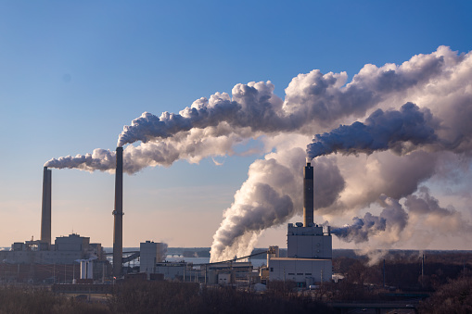
Any Supporting Functional Documents
Architecture:
Testing
Pre-processing
Image Descriptors
Post-processing
Camera
Training
Pre-processing
Image Descriptors
Post-processing
Classification

Slide 8
Any Supporting Functional Documents
Architecture: Second Phase of this Solution
This may be embedded into any Electronics products with micro-controllers for use in industry for Green revolution

Slide 9
Any Supporting Functional Documents
Scalability:
This may be extended to use at government offices for assessment of industry air pollution
Release into air.

Slide 10
Key Differentiators & Adoption Plan
How is your solution better than alternatives and how do you plan to build adoption?
This solution provides a state-of-the art solution from existing approaches.

Slide 11
GitHub Repository Link & supporting diagrams, screenshots, if any
How far it can go?
This becomes a benchmark capsule for implementation at various level of AI based Green Revolution.

Slide 12
Thank You
Team member names
Dr Ravi Kumar Y B

