Slide 1
Mumbai: The financial capital?
A Coursera Capstone Project
By Ravi Lakhlan

Slide 2
Introduction
Ideally development in a city should take place uniformly across all parts. But the reality is often different and some areas are left behind whereas other areas are developed at faster pace. This creates a sense of inequity among the residents of the city. Mumbai is one of the most developed cities in India and it is often called the financial capital of India. Whereas the large part of Mumbai is filled with skyscrappers, there are still a big part which even lacks the most basic developmental needs. In this case study we will try to find and highlight such differences on an aggregate scale.

Slide 3
Data
For this case study, we will be using the following data:
1. Zip code data for Mumbai
2. Geolocation data for the zip codes
3. Infrastructure details using Foursquare API

Slide 4
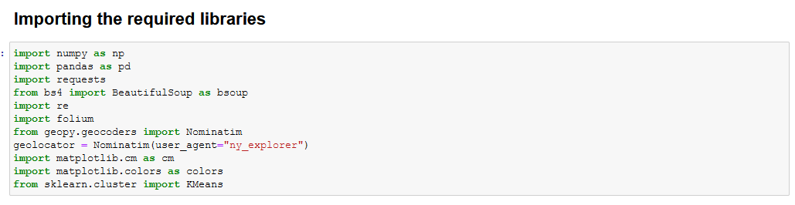
Methodology
Libraries used

Slide 5
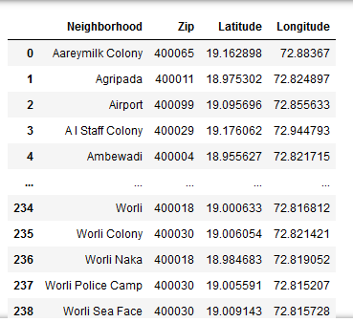
Data scrapping

Slide 6
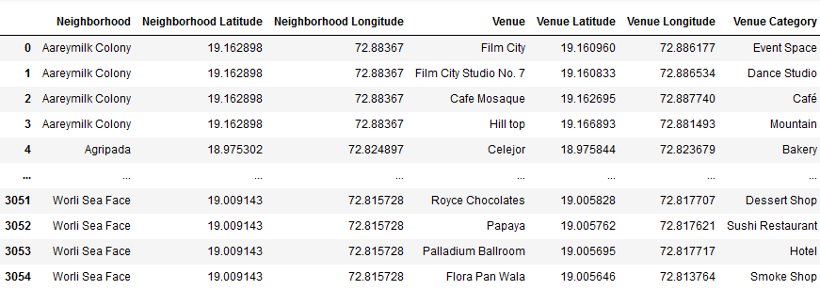
Getting venues

Slide 7
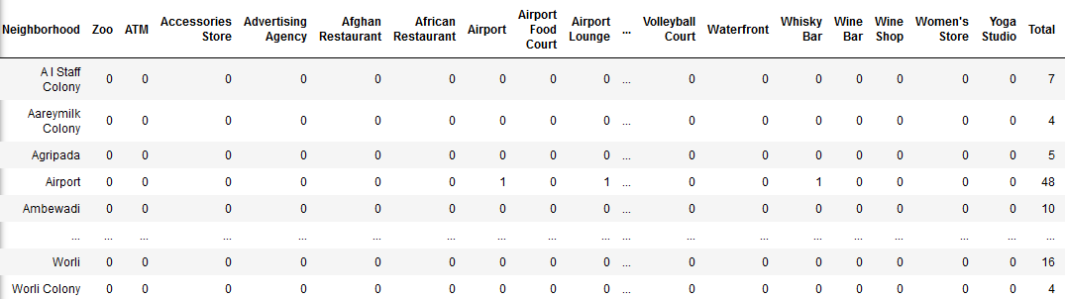
Transformed data

Slide 8
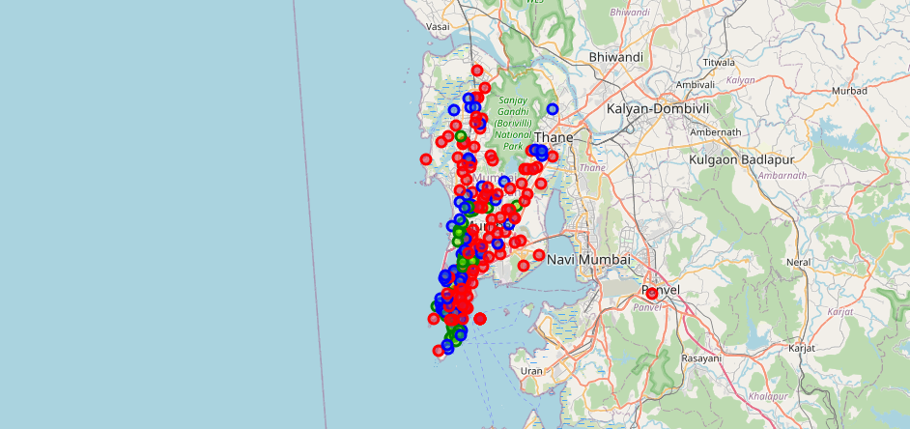
Mapped result

Slide 9
Result
Out of 225 areas for which the venue data was available:
129 were identified as underdeveloped areas.
61 were identified as developing areas.
35 were identified as developed areas.

Slide 10
Conclusion
Despite Mumbai being hailed as the financial capital of India, it can be seen that a large portion of its area is underdeveloped and only a very small portion of its area can be considered as developed.
This points to a large inequality in distribution of resources where a small portion of population enjoys majority of the resources and a large portion gets only small amount of resources.

