Slide 1

Baby Monitoring System

Slide 2
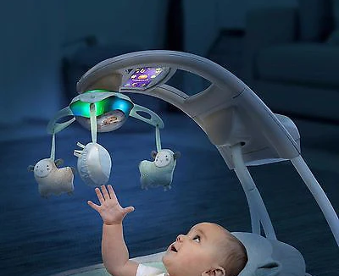
Abstract
This paper presents an idea to design a Smart Cradle System using IoT which will help the parents to monitor their child even if they are away from home & detect every activity of the Baby from any distant corner of the world. It is an innovative , smart & protective Cradle System to nurture an infant in an efficient way. This system considers all the minute details required for the care & protection of the Baby in the cradle.

Slide 3
Introduction
As we are very well familiar with the hurdles faced by Parents to nurture their infants and especially in case both the parents are working. To give 24 hours of time in such cases is next to impossible. Thus, we need to develop something unique that can help Parents to have continuous surveillance/watch on the Baby/Infant and can notify about the same.
Thus, we have come up with an idea to design a Smart Cradle System using IoT which will help the parents to monitor their child even if they are away from home & detect every activity of the Baby from any distant corner of the world.

Slide 4
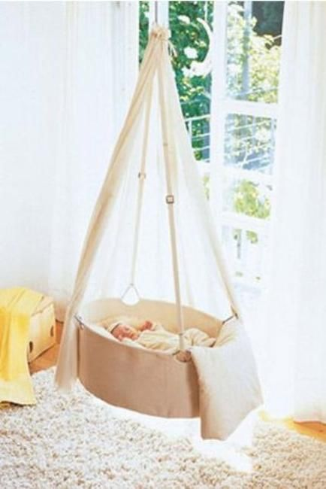
Components
Hardware Requirements
Software Requirements

Slide 5
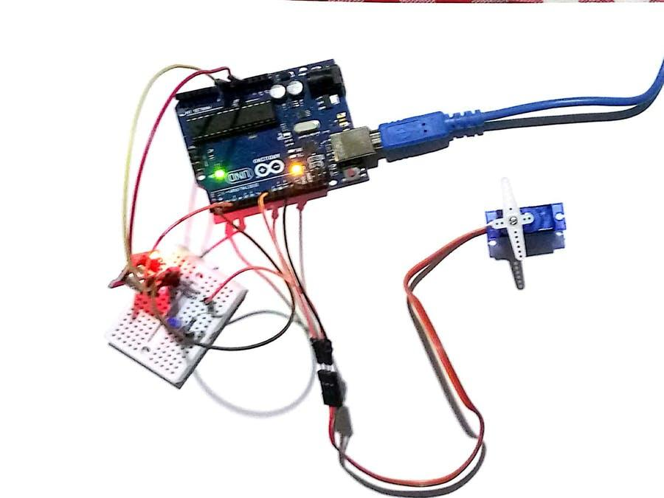
Hardware Requirements
Arduino UNO
Sound Sensor
Servo Motor
LM-35

Slide 6
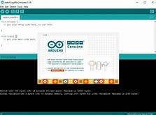
Software Requirements
Arduino IDE
The open-source Arduino Software (IDE) makes it easy to write code and upload it to the board. This software can be used with any Arduino board. Add transitions, animations, and motion.
Language-Embedded C
Embedded C is most popular programming language in software field for developing electronic gadgets. Each processor used in electronic system is associated with embedded software.

Slide 7
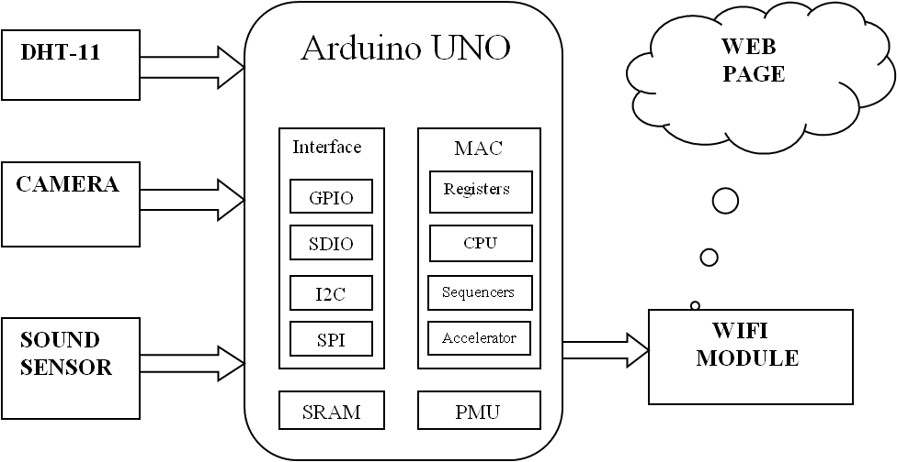
Block Diagram

Slide 8
Proposed Work
The working of child support is structured like there are four modules which highlights comparing work in the plan like 5v apparatus servo motor , sound sensor, temperature sensor and wet sensor are going to be depicted with highlights and the technique for working.
When baby cries, automatically the cradle will swing & toys placed in cradle rotates simultaneously till baby stops crying.
A wet sensor continuously keeps on checking whether the baby’s mattress is wet or not. When the wetness is sensed the parents are intimated by sending SMS. This system helps in keeping the baby in a hygienic environment.

Slide 9

Working parents struggle in childcare
Childcare is difficult for parents even when they are not working . But working parents need to balance their work and life balance.
But that is not the case in daily life , they struggle a lot even hardly finding time for themselves.
This system helps them monitor their child while working

Slide 10
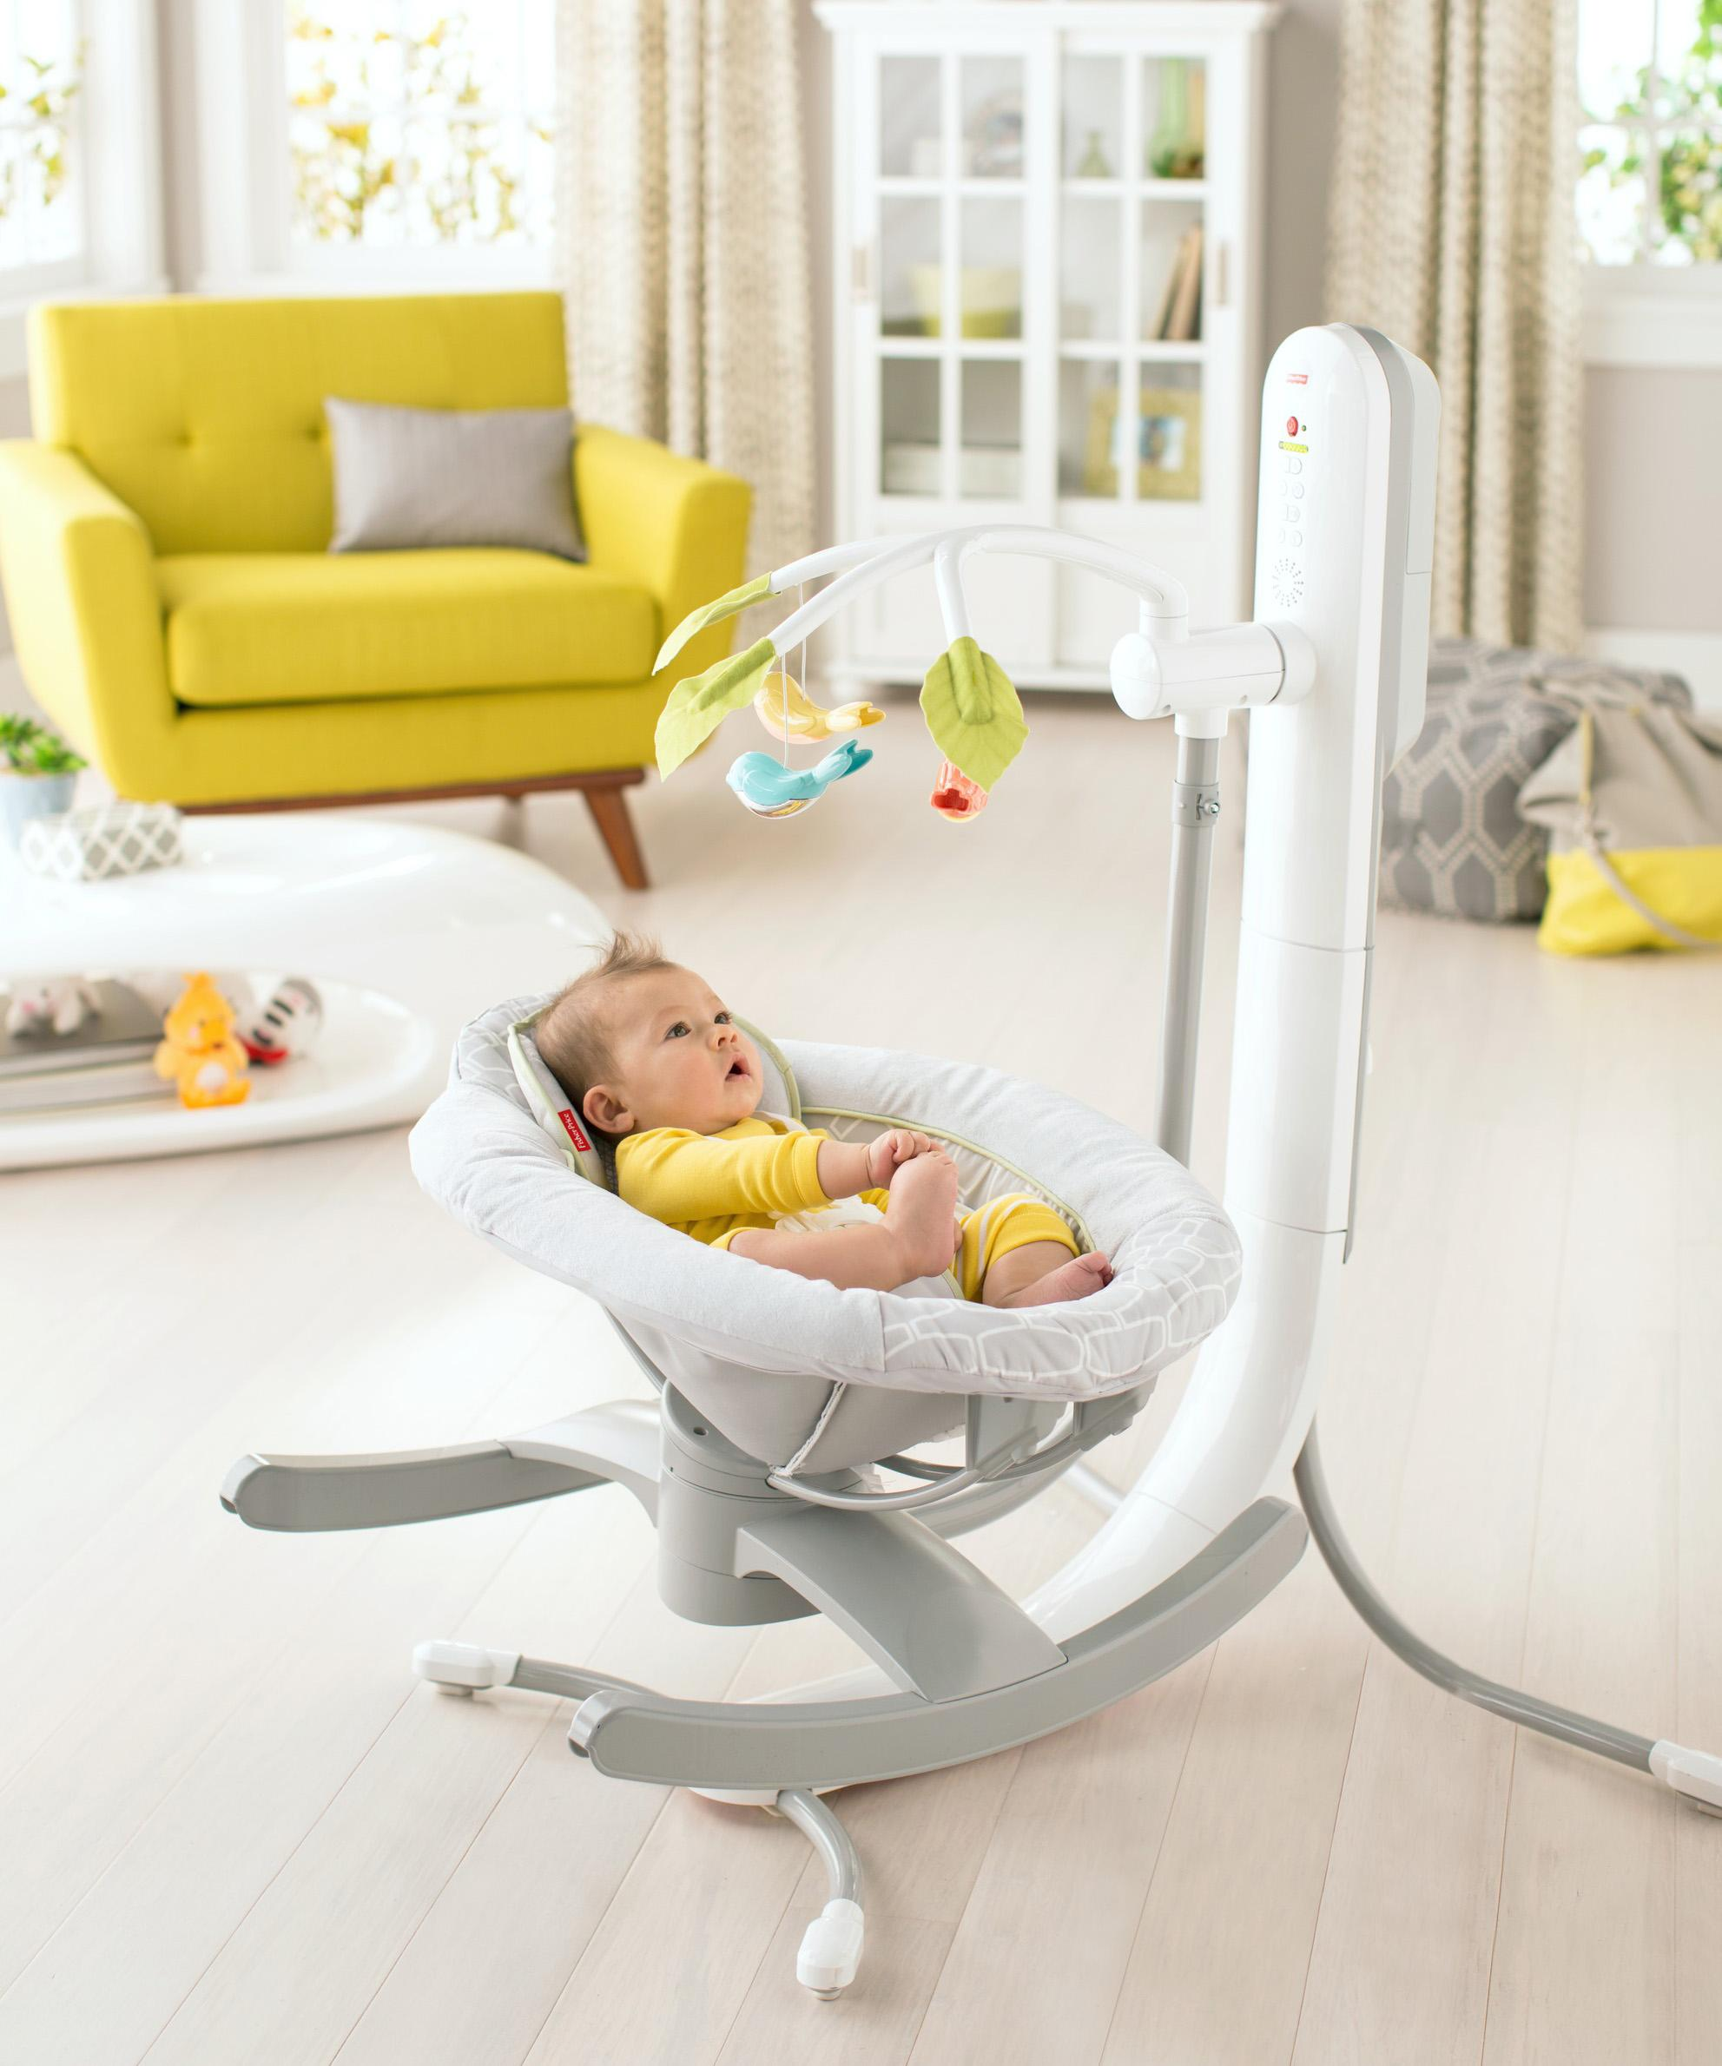
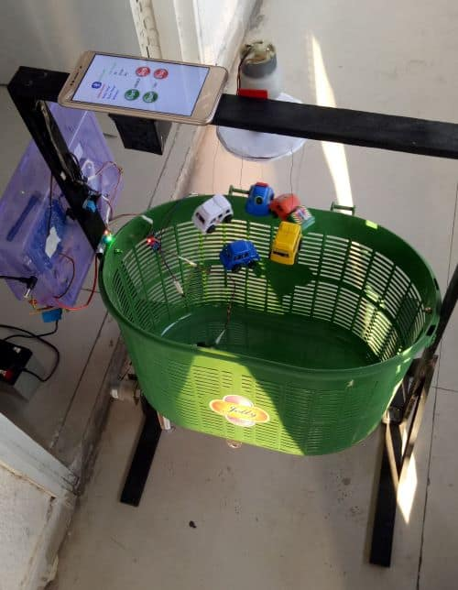
Summary
Innovation has been created incredibly that its makes human work less complex. This programmed infant support would let the working mother to do family works other than dealing with infant in the meantime. It is conservative and easy to understand. The programmed child support can be utilized in clinics and home.

Slide 11

Thank You

