Slide 1
Containerization && Dockers

Slide 2


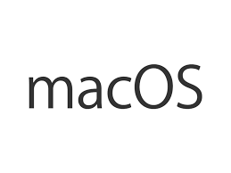
Application Development
Application
{ # }

Slide 3
Application Development
7.x, 8.x,10.x
Application
{ # }
14.x, 16.x, 20.x

Slide 4
What is Containerization?
App
Container
BIN/LIBS
OS
LxC
Container Engine (Docker)
Host Operating System
Infrastructure- CPU, Memory, HDD

Slide 5
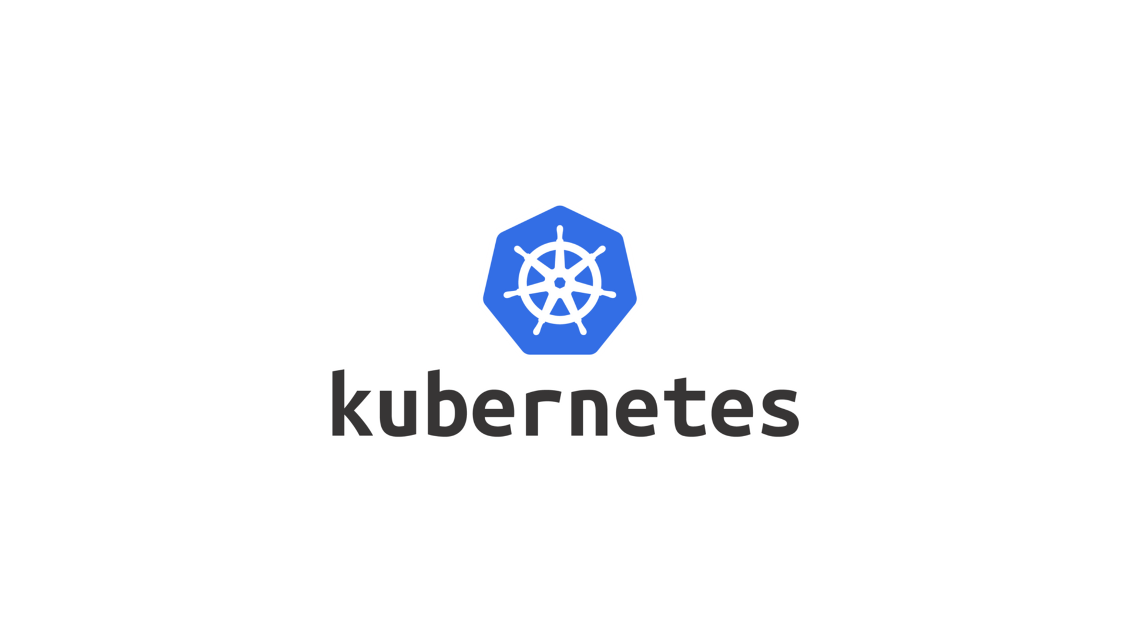

Slide 6

Hello World, Kubernetes !!
A German Word
It means , a “Pilot” or “Helmsman of a ship”
Kubernetes = k8s , [Eight Letters in between K and s]
Kubernetes was born in Google
Later donated to CNCF in 2014
Open source
Written in Go language
Orchestration Tools for running Containers
# CNCF- Cloud Native Computing Foundation
Notes:
Logs can be difficult to find
Access to server / device is often difficult for analyst
High expertise for accessing logs on different platforms necessary
Logs can be big and therefore difficult to copy
SSH access and grep on logs doesn’t scale or reach

Slide 7
Architecture of Kubernetes
Kubernetes
Master
Node-01
DOCKER
API Server
UI
POD-01
Control Manager
API
Containers
Containers
Scheduler
Node-02
DOCKER
CLI
etcd
POD-02
Containers
Containers

Slide 8
More about Kubernetes Architecture
API Server : Kube API Server interacts with API, Its a frontend of the kubernetes control plane
Scheduler: Scheduler watches the pods and assigns the pods to run on specific hosts
Control-Manager : Controller manager runs the controllers in background which runs different tasks in cluster
etcd: A simple distribute key value database to store kubernetes cluster data.Ex:job scheduling information, pods, state information and etc
Kubernetes
Master
API Server
UI
Control Manager
API
Scheduler
CLI
etcd

Slide 9
More about Kubernetes Architecture
WebUI (Dashboard):
Web-based Kubernetes user interface. You can use Dashboard to deploy containerized applications to a Kubernetes cluster, troubleshoot your containerized application, and manage the cluster itself along with its attendant resources
Kubectl:
Kubectl is a command line configuration tool (CLI) for Kubernetes used to interact with master node of kubernetes. Kubectl has a config file called kubeconfig, this file has the information about server and authentication information to access the API Server
Kubelet:
Kubelet is the primary node agent runs on each nodes and reads the container manifests which ensures that containers are running and healthy

Slide 10
More about Kubernetes Concepts
Nodes
Pods
Deployments
Services

Slide 11
Nodes in Kubernetes
API Server
Scheduler
Control Manager
etcd
Node-01
DOCKER
Node-02
DOCKER
POD-01
POD-02
Containers
Containers
Containers
Containers

Slide 12
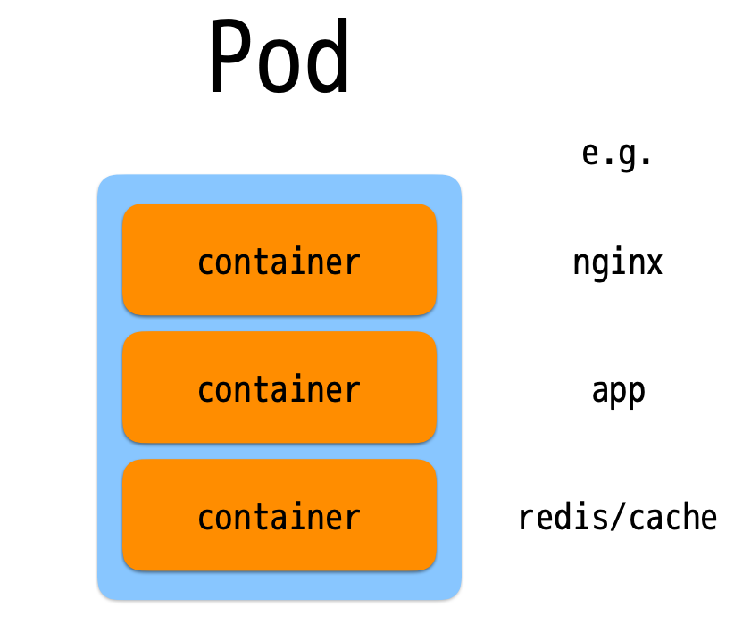
Pods in Kubernetes
It’s a logical collection of containers that belong to an application
A Pod is the smallest deployable unit
It can be created, scheduled, and managed
Each resource in Kubernetes is defined using a configuration file

Slide 13
Pods in Kubernetes
apiVersion: v1
kind: Pod
metadata:
name: hello-pod
spec:
containers:
- name: hello-container
image: ubuntu:trusty

Slide 14
Deployment in Kubernetes
replicas: 2
template: Pod
replicas: 2
template: Pod
replicas: 2
template: Pod
POD-01
POD-02
Containers
Containers
Containers
Containers

Slide 15
Deployment in Kubernetes
apiVersion: apps/v1
kind: Deployment
metadata:
name: deployment-example # Unique key of the Deployment instance
spec:
replicas: 3 # 3 Pods should exist at all times.
selector:
matchLabels:
app: nginx
template:
metadata:
labels:
app: nginx # Apply this label to pods and default the Deployment label selector to this value
spec:
containers:
- name: nginx # Run this image
image: nginx:1.14
Notes:
We must start with,
Kind: It specfies that, what are you going to achieve with this file (deployment, pod, service, secret, jobs, replication controller, replicaset).
apiVersion: It specifies the api version for the kind. "apps/v1beta1" is the apiVersion for "Deployment" kind.
metadata: Information about the kind specified. Here, we defined only "name" key and its value, so your service name will be created as "my-httpd-service"
spec- Actual specification starts from here with selector name, type of the service and ports to be exposed with name, port and target port.
replicas- Number of replicas will be created and distributed across the available worker nodes
template- Template to be used for entire pods. Templates are simply definitions of objects to be replicated
metadata- This metadata only for pods. It can be used to filter or identify by the name given within labels when you have lot of pods.
spec- This specification used for containers including the name of the container, name of the image, ports to be exposed, storage volumes and etc,
selector - We must specify the correct label name here what we have used while creating the deployment. else, it wont work properly.
type - Type of the service (ClusterIP, NodePort, LoadBalancer)
ports-Specify the name of the service port, port number and target port.

Slide 16
Services in Kubernetes
kind: Service
apiVersion: v1
metadata: # Unique key of the Service instance
name: service-example
spec:
ports: # Accept traffic sent to port 80
- name: http
port: 80
targetPort: 80
selector:
app: nginx
type: LoadBalancer
Notes:
We must start with,
Kind: It specfies that, what are you going to achieve with this file (deployment, pod, service, secret, jobs, replication controller, replicaset).
apiVersion: It specifies the api version for the kind. "apps/v1beta1" is the apiVersion for "Deployment" kind.
metadata: Information about the kind specified. Here, we defined only "name" key and its value, so your service name will be created as "my-httpd-service"
spec- Actual specification starts from here with selector name, type of the service and ports to be exposed with name, port and target port.
replicas- Number of replicas will be created and distributed across the available worker nodes
template- Template to be used for entire pods. Templates are simply definitions of objects to be replicated
metadata- This metadata only for pods. It can be used to filter or identify by the name given within labels when you have lot of pods.
spec- This specification used for containers including the name of the container, name of the image, ports to be exposed, storage volumes and etc,
selector - We must specify the correct label name here what we have used while creating the deployment. else, it wont work properly.
type - Type of the service (ClusterIP, NodePort, LoadBalancer)
ports-Specify the name of the service port, port number and target port.
apiVersion: v1
kind: Service
metadata:
name: ion-service
labels:
app: ion
spec:
selector:
app: ion
type: LoadBalancer
ports:
- port: 80
targetPort: 80
nodePort: 32180

Slide 17
Thank You

