Slide 1
04 – Azure SQL Database

Slide 2
Module Overview
Azure SQL Database Architecture
Importing and Exporting Data
Backup and Restore
Scaling Azure SQL Databases

Slide 3
Azure SQL Database Architecture

Slide 4
Azure SQL Server vs. “Regular” SQL Server
“Regular” SQL Server
Azure SQL Server
Windows Installation on a Physical or Virtual Computer
Azure SQL Server / TDS Endpoint
System Databases
Master
SQL Server Install – “Instance”
System Databases
User Databases
SQL Database Fabric / Management Services / etc.
Master
AdventureWorks
Model
Northwind
Windows
Windows
Windows
MSDB
Pubs
SQL
SQL
SQL
TempDB
…
AdvWrks
Northwind
Pubs

Slide 5
Azure SQL Database Tiers
Service Tier | Performance Level | Common App Pattern | Performance |  |  | Business Continuity
 |  |  | Max DB Size | Trans. Perf. Objective | DTUs | PITR | DR / GEO-Rep
Basic | Basic | Small DB, SQL opp | 2 GB | Reliability / Hr. | 5 | Past 7 Days | DB Copy + Manual Export
Standard | S1 / S2 | Wrkgp/cloud app, multiple concurrent operations | 250 GB | Reliability / Min. | 15/ 50 | Past 14 Days | DB Copy + Manual Export
Premium | P1 / P2 / P3 | Mission Critical, High volume, Many concurrent Users | 500 GB | Reliability / sec. | 100/ 200/ 800 | Past 35 Days | Active Geo-replication
The old “Web” and “Business” editions have been deprecated.
Database Throughput Unit (DTU): DTUs provide a way to describe the relative capacity of a performance level of Basic, Standard, and Premium databases. DTUs are based on a blended measure of CPU, memory, reads, and writes. As DTUs increase, the power offered by the performance level increases. For example, a performance level with 5 DTUs has five times more power than a performance level with 1 DTU.

Slide 6
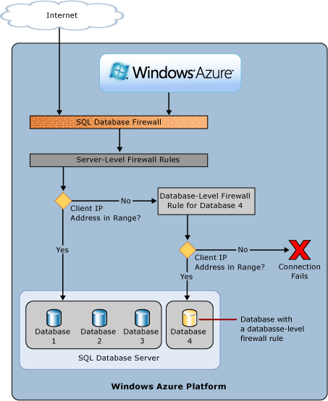
Azure SQL Server Security
Server Level
Server-Level Firewall Rules
Server Logins (SQL Auth Only)
Server Roles
Database Level
Database-Level Firewall Rules
Database Users
Database Roles

Slide 7
Creating an Azure SQL Database and Server

Slide 8
Importing and Exporting Data

Slide 9
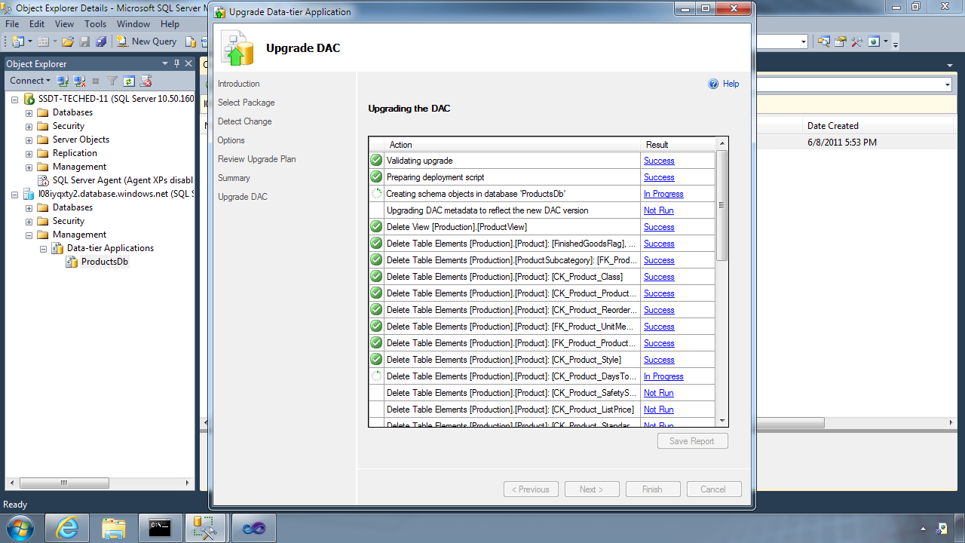
Importing and Exporting Data with BacPacs
Data-Tier Application Framework (DAC Fx)
Alternative to traditional script based approach
Dramatically simplifies deployment, migration and versioning of databases
Provides a single unit of deployment for schema (dacpac) or for schema + data (bacpac)
Supports automatic versioning of database schemas
Supports platform targeting for both SQL Server (2005 and above) and SQL Database
Build from scratch or extract from existing db
How To Get The Latest DAC Fx
With SQL Server Data Tools
With SQL Server 2012/2014 Management Studio
With SQL Database Import/Export Service
Via sqldacexamples.codeplex.com

Slide 10
Scripting the Schema & Data
USE SQL Server Management Studio’s Scripting Tasks
Script just the Schema
Script just the Data
Script the Schema and the Data
Choose Azure as the Target

Slide 11
Importing and Exporting Data

Slide 12
Backup and Restore Options

Slide 13
Azure SQL Database Business Continuity Options
 | Basic | Standard | Premium
Point-in-Time Restore | Last 7 Days | Last 14 Days | Last 35 Days
Geo-Restore | RTO < 24 Hours RPO < 24 Hours | RTO < 24 Hours RPO < 24 Hours | RTO < 24 Hours RPO < 24 Hours
Standard Geo-Replication | N/A | RTO < 2 Hours RPO < 30 Minutes | RTO < 2 Hours RPO < 30 Minutes
Active Geo-Replication | N/A | N/A | RTO < 1 Hour RPO < 5 Minutes
Can also use:
Database Export / Import
CREATE DATABASE AS COPY

Slide 14
Backup and Restore Options

Slide 15
Scaling Azure SQL Databases

Slide 16
SQL Database Federations – The Old Way
Federation – Based on some key
Federation – Based on some key
Federation – Based on some key
… Federation Members (Shards) … Each Shard is another SQL DB

