Slide 1


Checking Probabilistic Properties of Neural Networks via Symbolic Methods and Sampling
Ravi Mangal Aditya V. Nori Alessandro Orso

Slide 2
Testing and verification
Spec
Program
Verifier/Tester
Proof/
Counterexample

Slide 3
Testing and verification of neural networks
Spec
Neural Network
Verifier/Tester
Proof/
Counterexample

Slide 4
What are these specifications, anyway?
No functional correctness specifications
But,
Accuracy
Robustness
Fairness
Differential Privacy
…

Slide 5
What next?
Algorithms for testing and verification of neural networks
More study on specifications
Account for the fact that neural networks are “learned”

Slide 6
Two hypotheses
Specifications of neural network correctness are best expressed probabilistically
Verifying that these probabilistic specifications are met needs approaches that combine statistical and symbolic techniques
Notes:
-Push two thoughts out for discussion

Slide 7

What are probabilistic specifications?
Non-probabilistic robustness:
$$∀x,x′. ‖x−x′‖≤δ⟹f\left(x\right)≈f(x′)$$
Probabilistic robustness:
$$\underset{x,x^{′}\sim D}{Pr}\left(f\left(x\right)≈f(x′) ∣ \left\|x−x^{′}\right\|≤δ\right)≥1−ε$$

Slide 8
First hypothesis
Specifications of neural network correctness are best expressed probabilistically

Slide 9
Why probabilistic specifications?
Learning is an integral part of the neural network story
Account for learning in spec design
How are neural networks trained?
Why do neural networks generalize?

Slide 10
The black-box of learning
Spec
Data
Learner
Neural Network
Verifier/Tester
Proof/
Counterexample

Slide 11
How are neural networks trained?
Inherently relies on the differentiability of neural networks with respect to the parameter
Construct a loss function to capture the closeness of the neural network output to expected output
Minimize the loss function using gradient descent

Slide 12

Loss function
$$\sum_{i=0}^{n}{L\left(f_{θ}\left(x_{i}\right), y_{i}\right)+penalty}$$
Notes:
- Penalty needs to be differentiable – so non-differentiable constraints are not allowed
- SGD: Improved gradient computation efficiency but stochasticity/noise in the learning algorithm; possibility of picking local minima etc

Slide 13
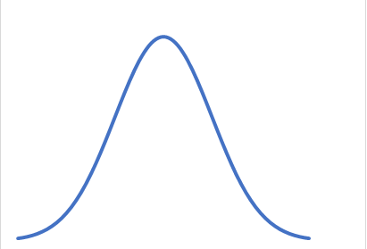
Why do neural networks generalize?
Natural Process
Neural Network
Input Variables
Output Variables
Generalization guarantees:$\underset{x\sim D}{Pr}{(f\left(x\right)≈y)≥1−ε}$

Slide 14
Second hypothesis
Verifying that probabilistic specifications are met needs approaches that combine statistical and symbolic techniques

Slide 15
Checking probabilistic specs - Statistically
Neural Network
Sample
Check spec +
Record results
Input Distribution
Notes:
- Use statistical theory to provide guarantees
- Too many samples

Slide 16
Checking probabilistic specs - Symbolically
Input distribution + Neural network = Probabilistic program
Symbolic methods for verifying probabilistic programs:
Probabilistic symbolic execution
Probabilistic abstract interpretation
Probabilistic model checking
…
Too expensive at the scale of neural networks!

Slide 17
A possible combined approach
Spec
Possible Spec Violating Regions
Neural Network
Static Analyzer
Neural Network
Sample
Check spec +
Record results
Input Distribution

Slide 18
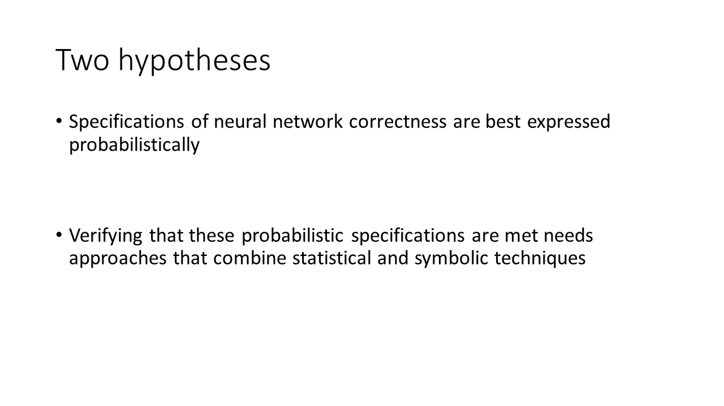
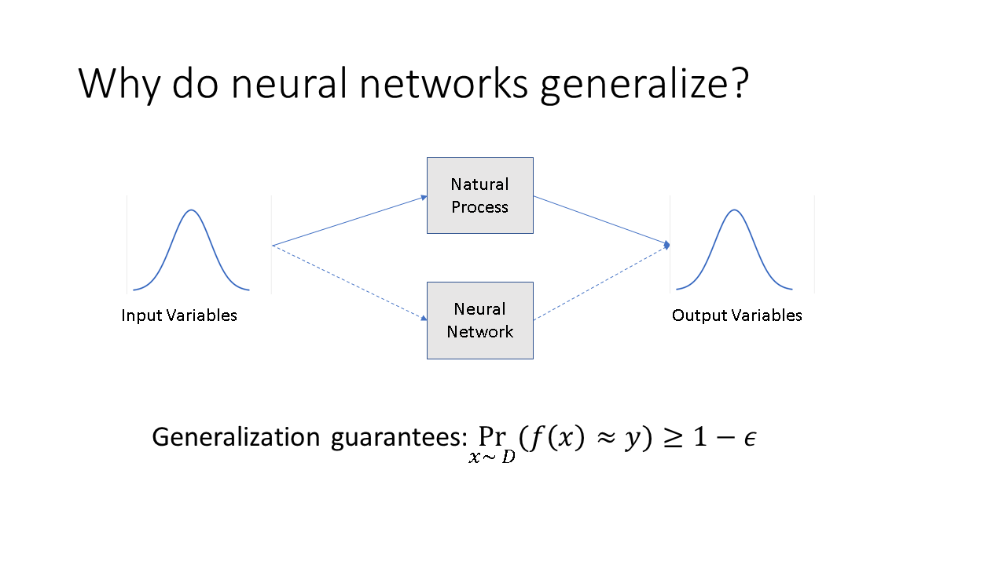
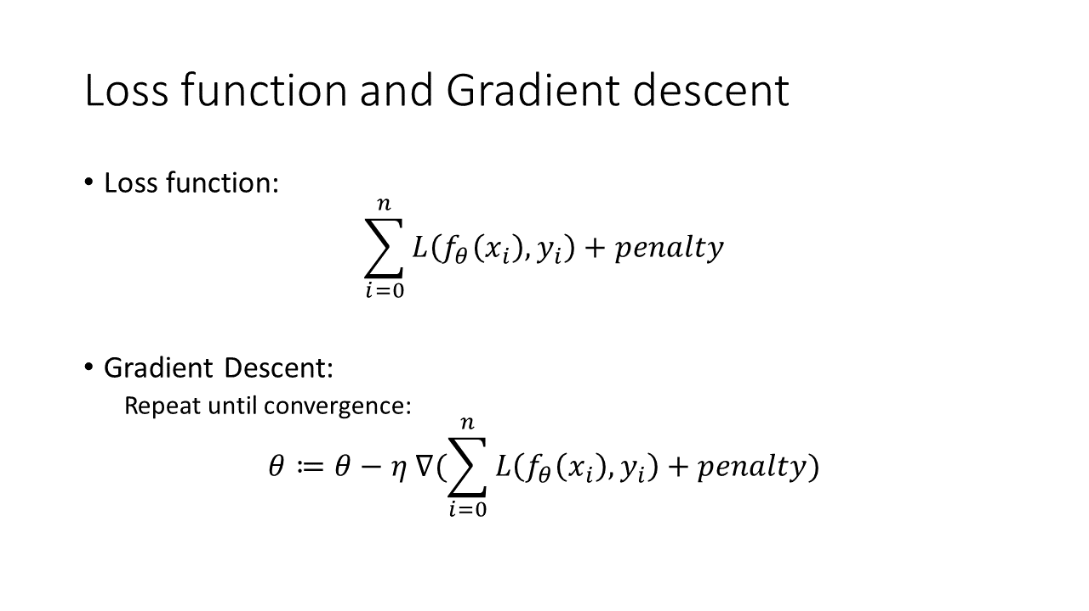
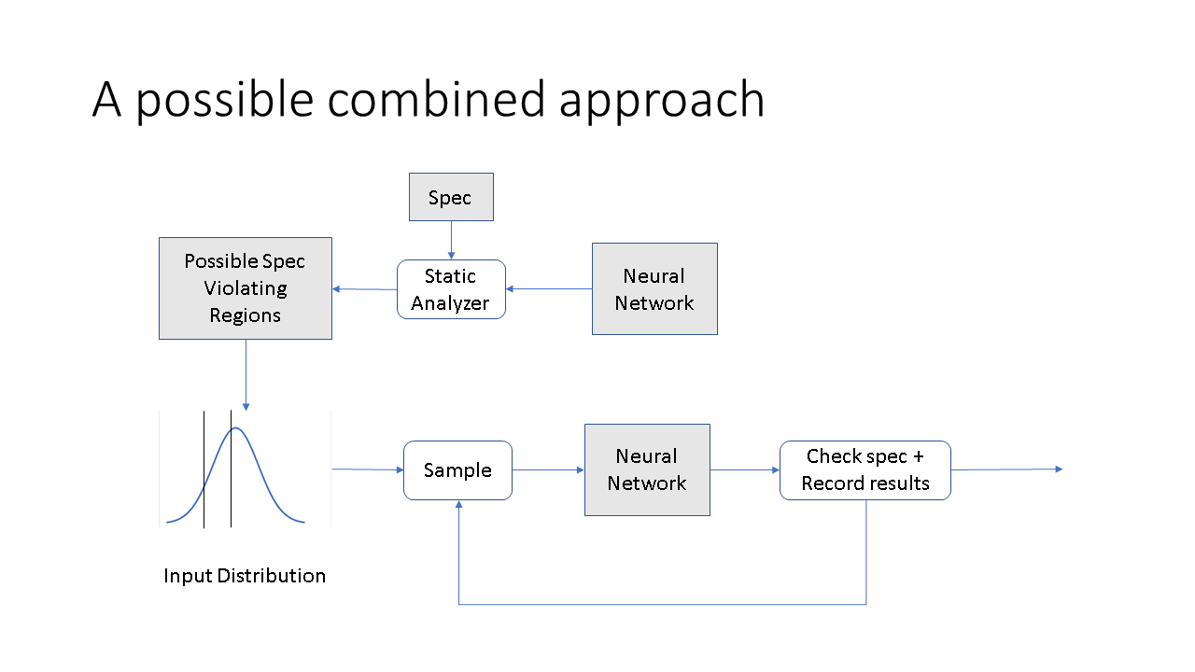
Summary

Slide 19
Extra Slides
The hammer in neural networks work is differentiability and gradient descent
The stochastic/iterative nature of gradient descent and employment of optimization theory means that difficult to enforce hard constraints during training
Therefore, such hard constraints are almost likely to be violated by trained networks
Better to express soft properties / probabilistic properties

Slide 20

Loss function and Gradient descent
Loss function:
$$\sum_{i=0}^{n}{L\left(f_{θ}\left(x_{i}\right), y_{i}\right)+penalty}$$
Gradient Descent:
Repeat until convergence:
$$θ≔θ−η ∇(\sum_{i=0}^{n}{L\left(f_{θ}\left(x_{i}\right), y_{i}\right)+penalty})$$
Notes:
- Penalty needs to be differentiable – so non-differentiable constraints are not allowed
- SGD: Improved gradient computation efficiency but stochasticity/noise in the learning algorithm; possibility of picking local minima etc

Slide 21
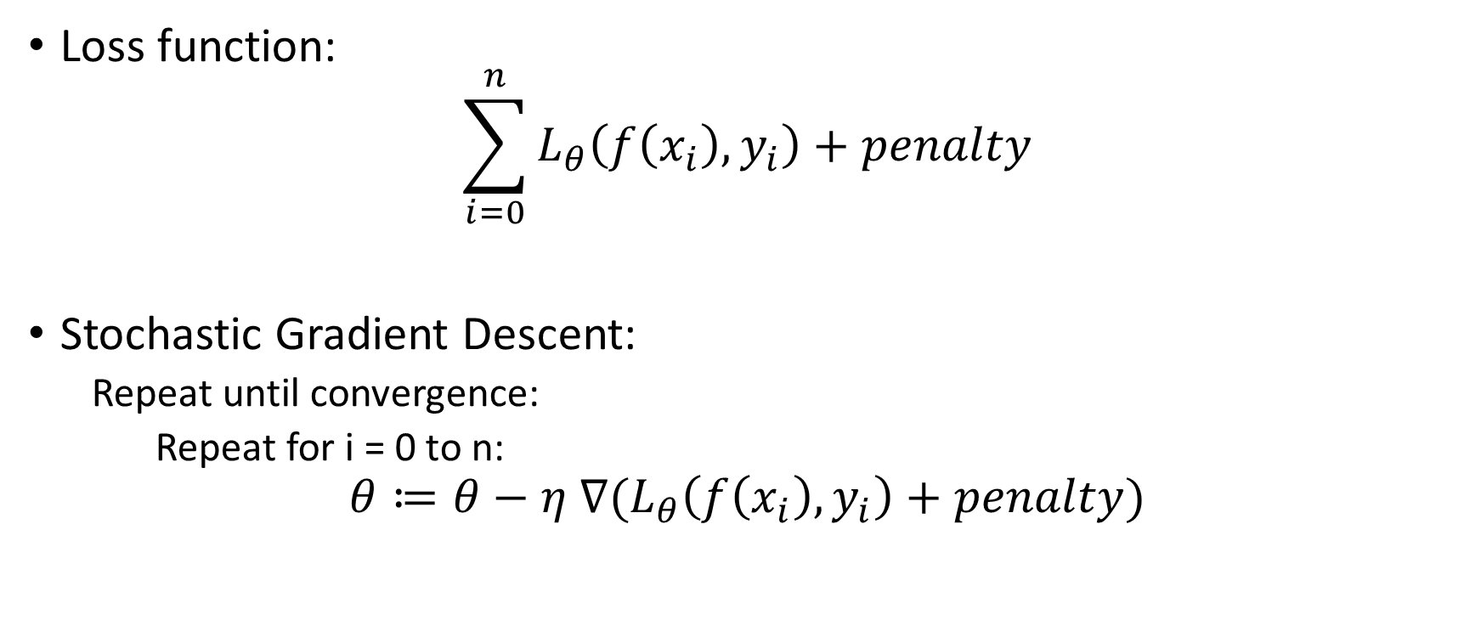
Loss function and Gradient descent
Loss function:
$$\sum_{i=0}^{n}{L_{θ}\left(f\left(x_{i}\right), y_{i}\right)+penalty}$$
Stochastic Gradient Descent:
Repeat until convergence:
Repeat for i = 0 to n:
$$θ≔θ−η ∇(L_{θ}\left(f\left(x_{i}\right), y_{i}\right)+penalty)$$
Notes:
- Penalty needs to be differentiable – so non-differentiable constraints are not allowed
- SGD: Improved gradient computation efficiency but stochasticity/noise in the learning algorithm; possibility of picking local minima etc

