Slide 1


Robustness of Neural Networks: A Probabilistic and Practical Perspective
Ravi Mangal Aditya V. Nori Alessandro Orso

Slide 2
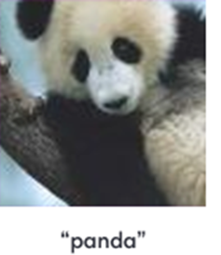
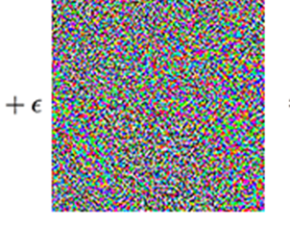
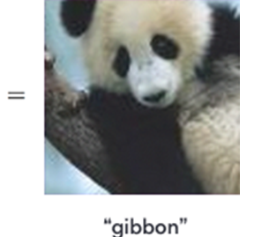
The Discovery of Adversarial Examples
Szegedy et al. (2013), Goodfellow et al. (2014) observe a curious phenomenon
Notes:
Mention robustness

Slide 3
What the heck is going on?
Why do neural networks exhibit such behavior?
How can we train neural networks to be robust?
How can we check if a trained neural network is robust?

Slide 4
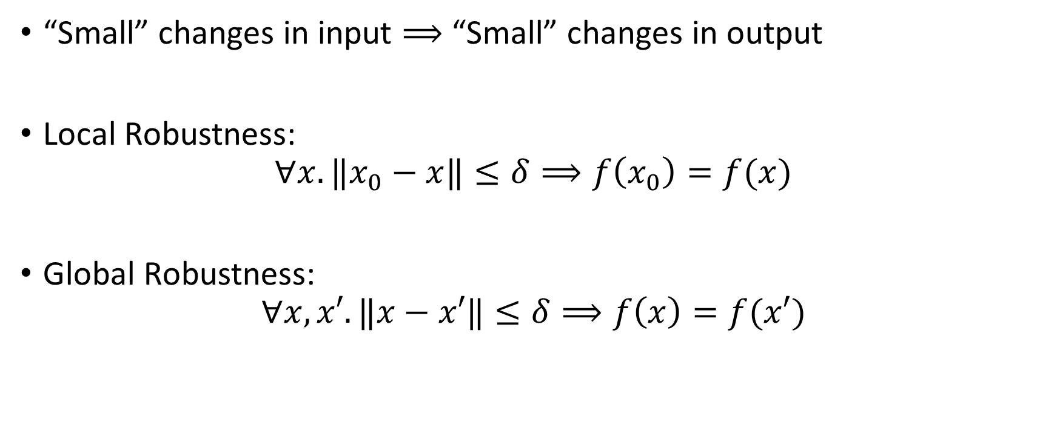
How to specify robustness?
“Small” changes in input $⟹$ “Small” changes in output
Local Robustness:
$$∀x. {‖x}_{0}−x‖≤δ⟹f\left(x_{0}\right)=f(x)$$
Global Robustness:
$$∀x,x′. ‖x−x′‖≤δ⟹f\left(x\right)=f(x′)$$

Slide 5
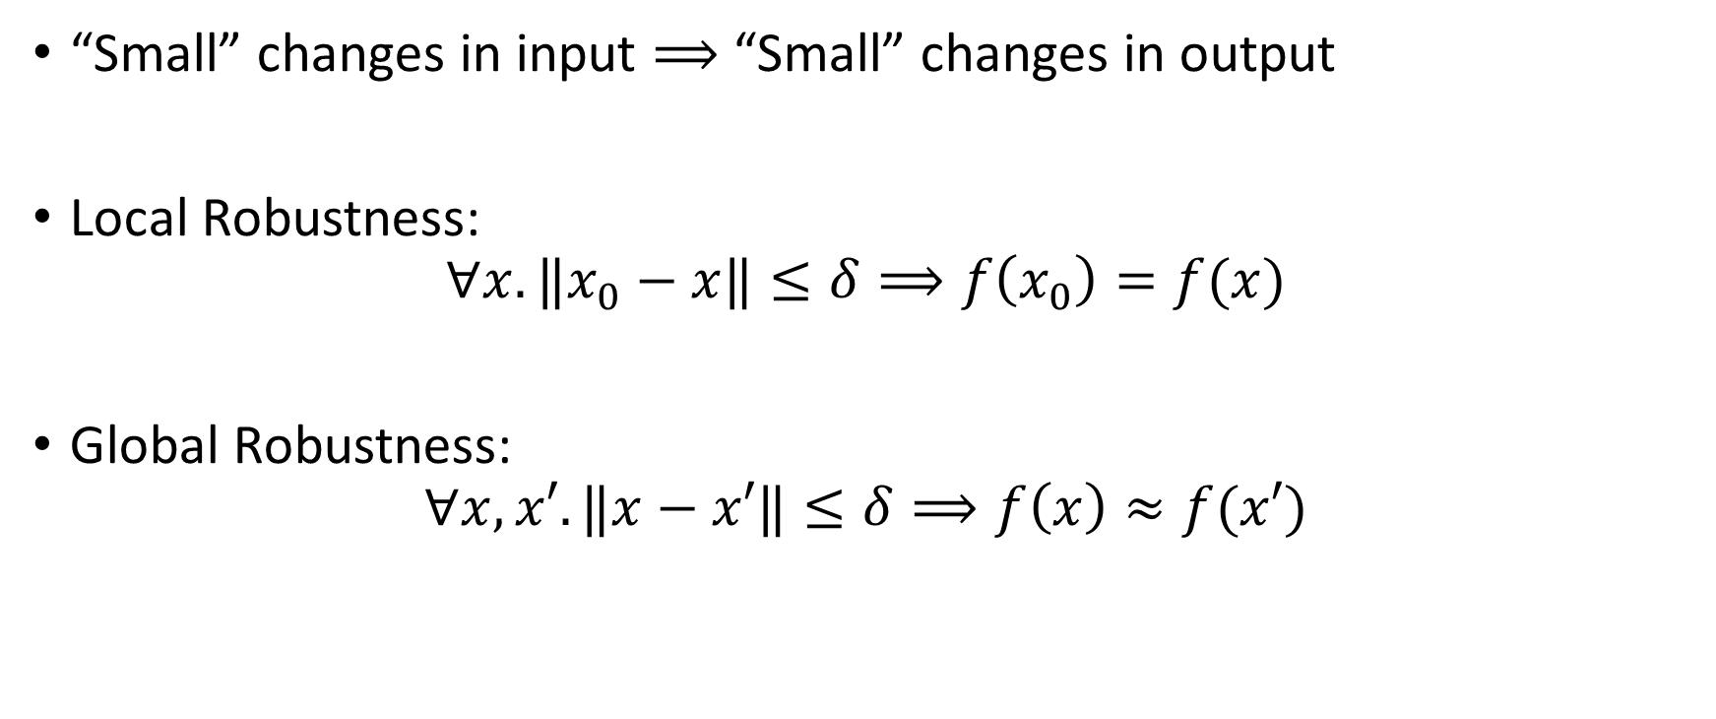
How to specify robustness?
“Small” changes in input $⟹$ “Small” changes in output
Local Robustness:
$$∀x. {‖x}_{0}−x‖≤δ⟹f\left(x_{0}\right)=f(x)$$
Global Robustness:
$$∀x,x′. ‖x−x′‖≤δ⟹f\left(x\right)≈f(x′)$$
Notes:
Both robustness notions motivated by security considerations. consider the worst-case scenarios. Defined over “ALL” inputs. Even a single example of violation is not acceptable. But SE experience suggests that its okay to relax

Slide 6
A Perspective Shift : From Adversarial to Non-Adversarial
Local and global robustness motivated by security considerations
Inputs generated by malicious entities
No adversarial examples tolerated
Our thesis: Non-adversarial setting is useful and understudied
Inputs generated by natural, non-malicious entities
Tolerance for rarely exhibit non-robust behavior

Slide 7
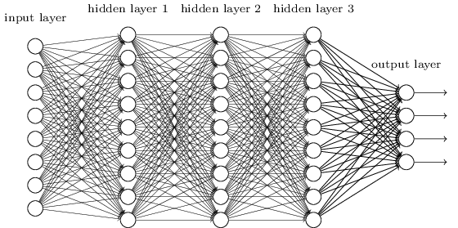
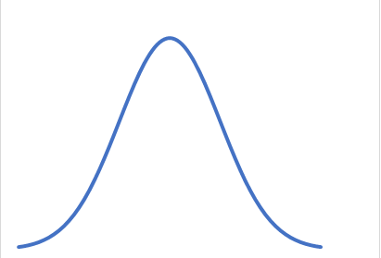
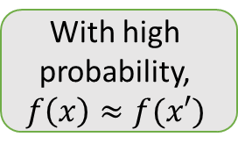
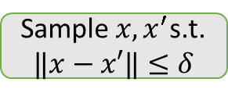
A Probabilistic View
*
With high probability,
$$f\left(x\right)≈f(x′)$$
Sample $x,x^{′}$s.t.
$$‖x−x′‖≤δ$$
*Michael A. Nielsen, "Neural Networks and Deep Learning", Determination Press, 2015

Slide 8

Non-Adversarial, Probabilistic Robustness
With high probability, “small” input changes $⟹$ “small” output changes
$$\underset{x,x^{′}\sim D}{Pr}\left(f\left(x\right)≈f(x′) ∣ \left\|x−x^{′}\right\|≤δ\right)≥1−ε$$

Slide 9

Non-Adversarial, Probabilistic Robustness
With high probability, “small” input changes $⟹$ “small” output changes
$$\underset{x,x^{′}\sim D}{Pr}\left(\left\|f\left(x\right)−f\left(x^{′}\right)\right\|≤k∗\left\|x−x^{′}\right\| ∣ \left\|x−x^{′}\right\|≤δ\right)≥1−ε$$

Slide 10
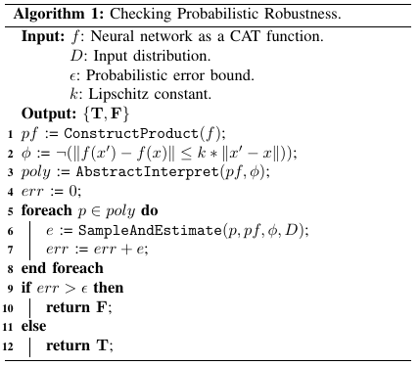
Sketch of an Algorithm
Combine statistical and symbolic techniques
Statistical – Sample inputs
Symbolic – Perform backwards abstract interpretation to find input regions to sample from

Slide 11
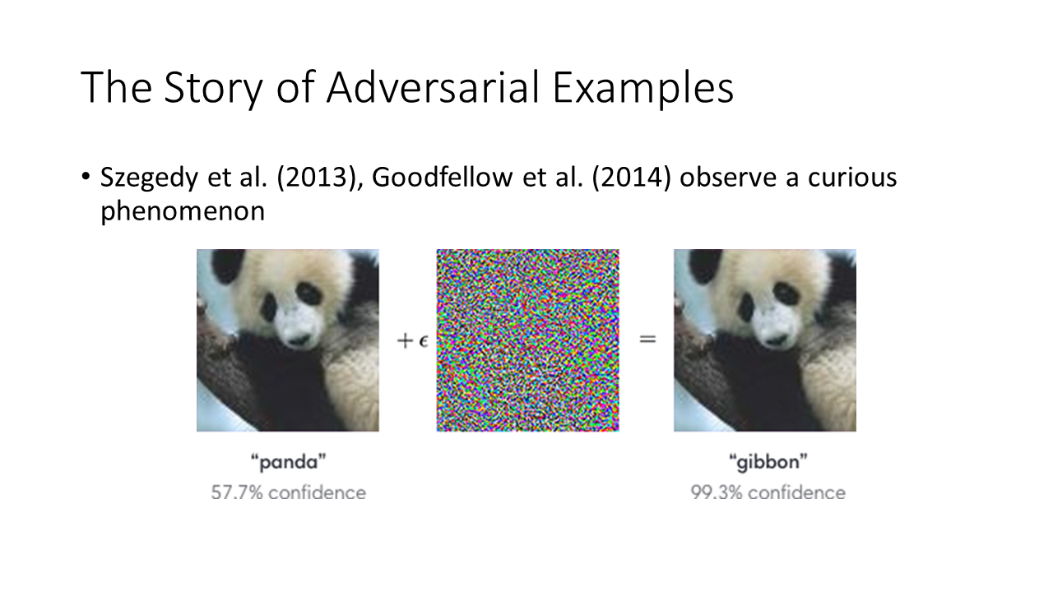
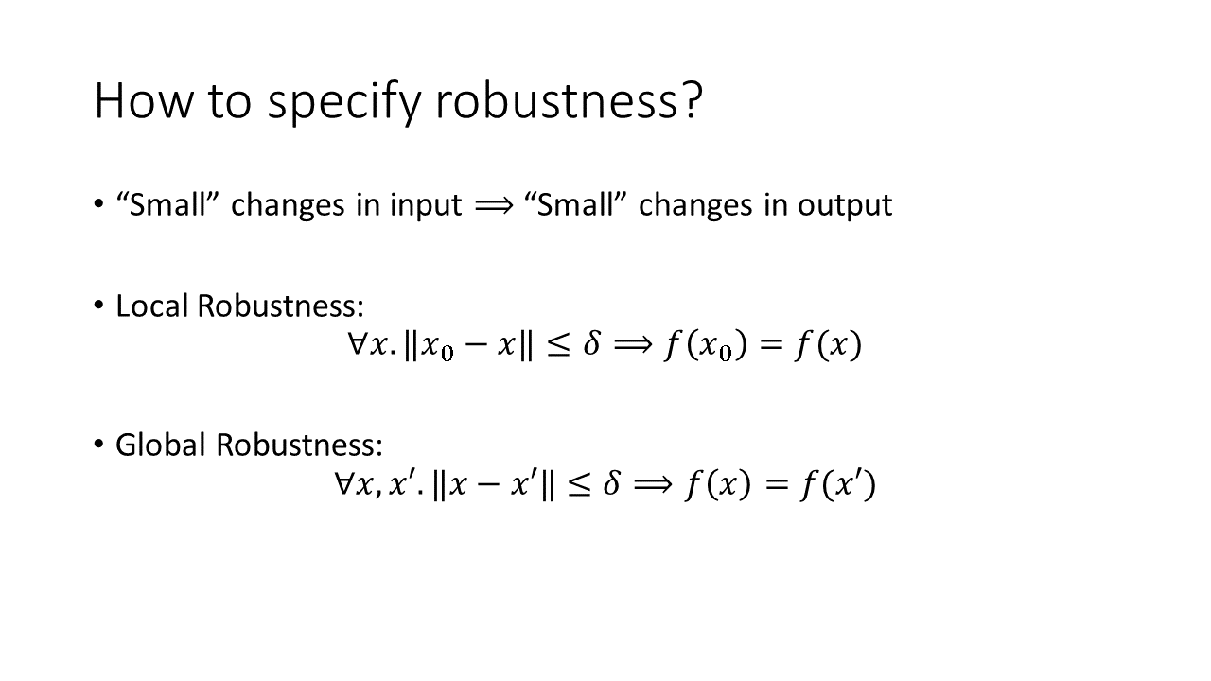
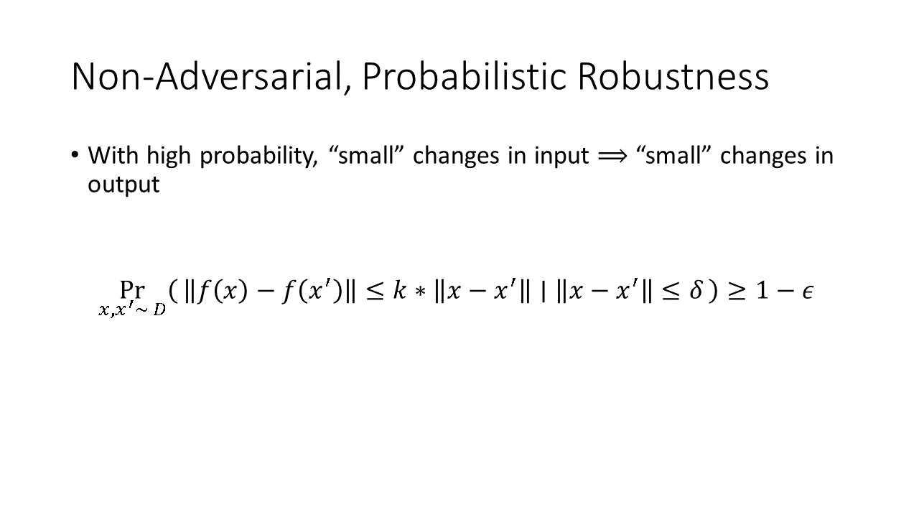
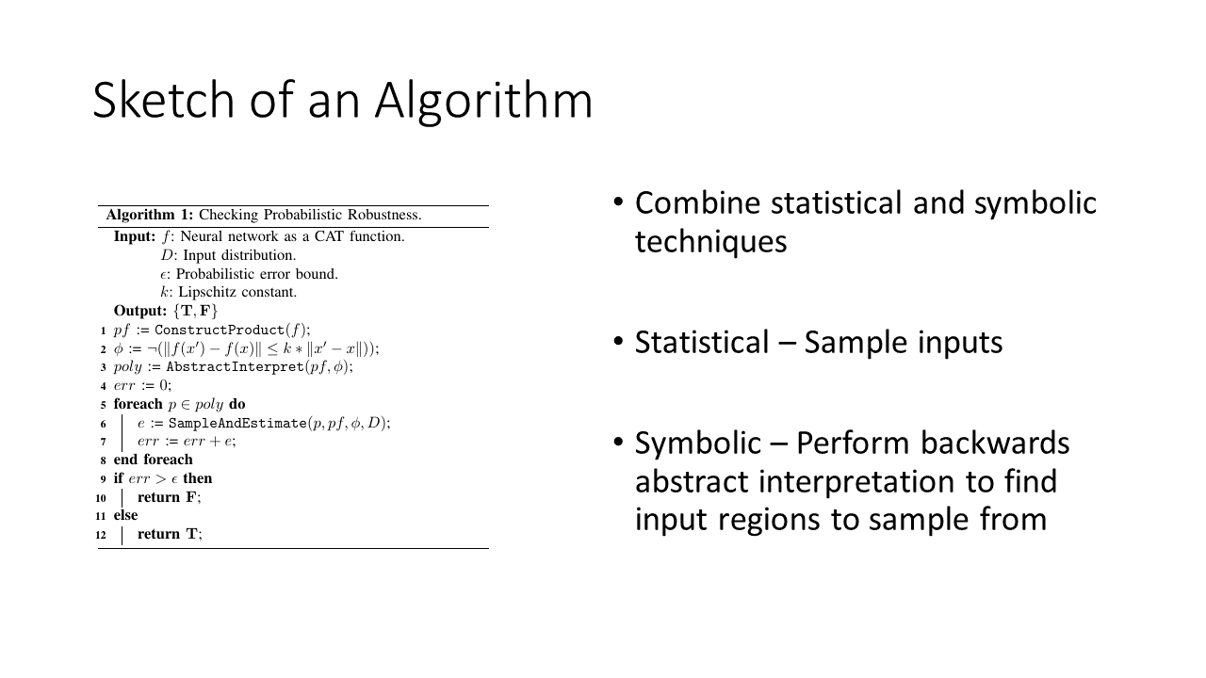
Summary

Slide 12
Extra: Sketch of an Algorithm
Backwards Abstract
Interpreter
Regions to sample from
*
Sampler
Estimate
Updater

