Slide 1
VOLT: A Lazy Grounding Framework for Solving Very Large MaxSAT Instances
Ravi Mangal, Xin Zhang, Mayur Naik
Georgia Tech
Aditya V. Nori
Microsoft Research

Slide 2
MaxSAT in Program Analysis
Program
Analysis
Engine
Program
Analysis
MaxSAT
Constraints
MaxSAT
Solver

Slide 3
MaxSAT in Program Analysis
Analysis
Engine
Program
Analysis Spec
MaxSAT
Solver
Analysis Result

Slide 4
Two MaxSAT Applications in Program Analysis
 | Find Suitable Abstraction to Prove Assertions | Adapt Program Analysis to User Feedback
Hard Clauses | Sound Inference Rules of Underlying Analysis
Soft Clauses | Relative Costs of Different Abstractions | Relative Confidences of Analysis Writer and User
 | Zhang, Mangal, Grigore, Naik, Yang. On Abstraction Refinement for Program Analyses Using Datalog. Programming Langauge Design and Implementation (PLDI) 2014 | Mangal, Zhang, Nori, Naik. A User-Guided Approach to Program Analysis. Foundations of Software Engineering (FSE), 2015

Slide 5
Challenge: Solving very large MaxSAT instances
 | Program size (KLOC) | Total number of clauses
 |  | Datarace Analysis | Pointer Analysis
antlr | 131 | 2.4 x 10²⁴ | 2.9 x 10²⁹
avrora | 193 | 1.8 x 10²⁶ | 1.8 x 10³¹
ftp | 130 | 3.7 x 10²³ | 1.7 x 10²⁸
hedc | 153 | 1.9 x 10²⁴ | 6.2 x 10²⁸
luindex | 190 | 1.6 x 10²⁵ | 1.2 x 10³⁰
lusearch | 198 | 1.7 x 10²⁵ | 1.2 x 10³⁰
weblech | 194 | 4.4 x 10²⁴ | 3.0 x 10²⁹
Notes:
Add analysis

Slide 6
VOLT: Lazy MaxSAT Solver Framework
Lazy, iterative framework that calls existing MaxSAT solvers in an outer loop
In each iteration, only a small, relevant subset of the entire MaxSAT instance is considered
Basic intuition: most clauses are trivially satisfied by assuming a false value for the variables
Many lazy approaches proposed by AI and PL communities

Slide 7
VOLT: Lazy MaxSAT Solver Framework
No
Yes

Slide 8
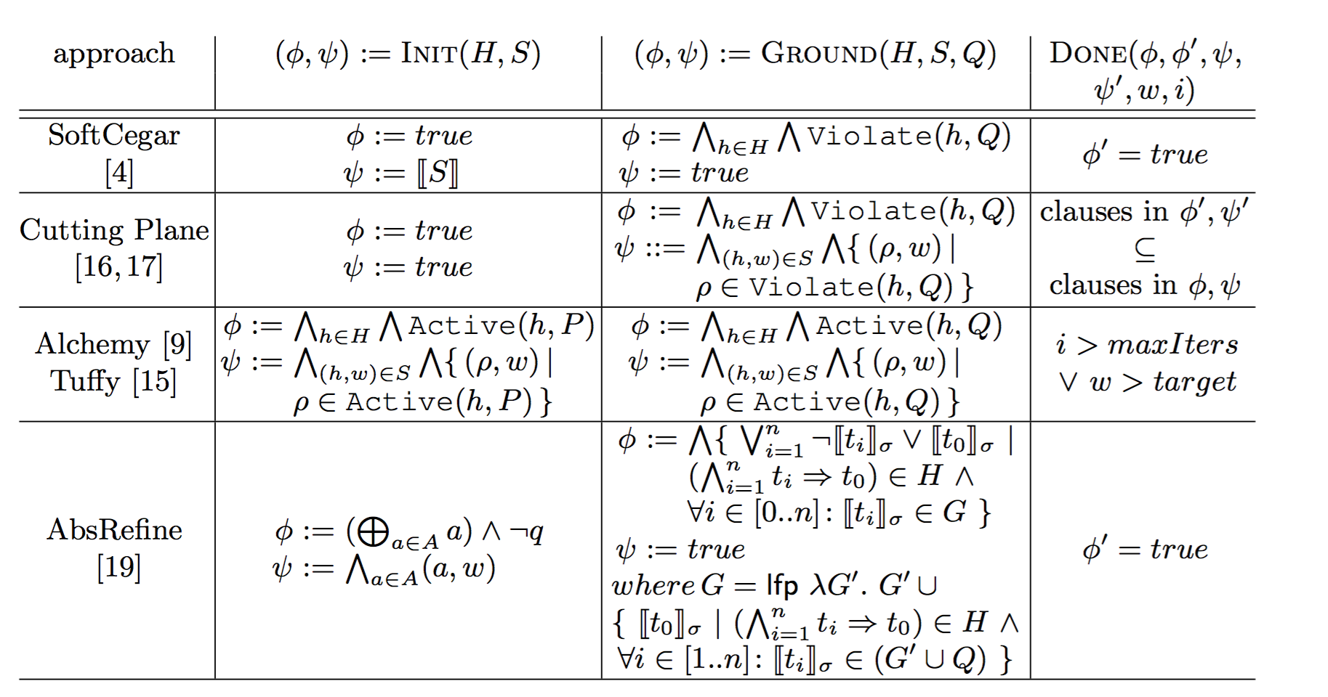
VOLT: Framework Instantiations
SoftCegar
CPI
Alchemy/Tuffy
AbsRefine

Slide 9
Example
v1 weight 100 ∧
v2 weight 100 ∧
¬ v4 weight 100 ∧
¬ v6 weight 100 ∧
¬ v1 ∨ v3 weight 5 ∧
¬ v2 ∨ v3 weight 5 ∧
¬ v3 ∨ v4 weight 5 ∧
¬ v3 ∨ v5 weight 5 ∧
¬ v5 ∨ v6 weight 5 ∧
...

Slide 10
Example: Iteration 1 of 6
v1 weight 100 ∧
v2 weight 100 ∧
¬ v4 weight 100 ∧
¬ v6 weight 100 ∧
¬ v1 ∨ v3 weight 5 ∧
¬ v2 ∨ v3 weight 5 ∧
¬ v3 ∨ v4 weight 5 ∧
¬ v3 ∨ v5 weight 5 ∧
¬ v5 ∨ v6 weight 5 ∧
...
Solution: empty

Slide 11
Example: Iteration 2 of 6
v1 weight 100 ∧
v2 weight 100 ∧
¬ v4 weight 100 ∧
¬ v6 weight 100 ∧
¬ v1 ∨ v3 weight 5 ∧
¬ v2 ∨ v3 weight 5 ∧
¬ v3 ∨ v4 weight 5 ∧
¬ v3 ∨ v5 weight 5 ∧
¬ v5 ∨ v6 weight 5 ∧
...
Solution: v1 = T, v2 = T

Slide 12
Example: Iteration 3 of 6
v1 weight 100 ∧
v2 weight 100 ∧
¬ v4 weight 100 ∧
¬ v6 weight 100 ∧
¬ v1 ∨ v3 weight 5 ∧
¬ v2 ∨ v3 weight 5 ∧
¬ v3 ∨ v4 weight 5 ∧
¬ v3 ∨ v5 weight 5 ∧
¬ v5 ∨ v6 weight 5 ∧
...
Solution: v1 = T, v2 = T, v3 = T

Slide 13
Example: Iteration 4 of 6
v1 weight 100 ∧
v2 weight 100 ∧
¬ v4 weight 100 ∧
¬ v6 weight 100 ∧
¬ v1 ∨ v3 weight 5 ∧
¬ v2 ∨ v3 weight 5 ∧
¬ v3 ∨ v4 weight 5 ∧
¬ v3 ∨ v5 weight 5 ∧
¬ v5 ∨ v6 weight 5 ∧
...
Solution: v1 = T, v2 = T, v3 = T, v4 = T, v5 = T

Slide 14
Example: Iteration 5 of 6
v1 weight 100 ∧
v2 weight 100 ∧
¬ v4 weight 100 ∧
¬ v6 weight 100 ∧
¬ v1 ∨ v3 weight 5 ∧
¬ v2 ∨ v3 weight 5 ∧
¬ v3 ∨ v4 weight 5 ∧
¬ v3 ∨ v5 weight 5 ∧
¬ v5 ∨ v6 weight 5 ∧
...
Solution: v1 = T, v2 = T, v3 = T, v4 = F, v5 = T, v6 = T

Slide 15
Example: Iteration 6 of 6
v1 weight 100 ∧
v2 weight 100 ∧
¬ v4 weight 100 ∧
¬ v6 weight 100 ∧
¬ v1 ∨ v3 weight 5 ∧
¬ v2 ∨ v3 weight 5 ∧
¬ v3 ∨ v4 weight 5 ∧
¬ v3 ∨ v5 weight 5 ∧
¬ v5 ∨ v6 weight 5 ∧
...
Solution: v1 = T, v2 = T, v3 = T, v4 = F, v5 = T, v6 = F

Slide 16
Evaluation Setup
4 real-world program analysis benchmarks
6 best performing and freely available solvers from MaxSAT 2014 competition
Linux server with 64GB RAM and 3.0GHz CPU
Timeout of 5 hours for MaxSAT solver in each iteration

Slide 17
Evaluation Results
 | solver | total time (min) | # iterations | avg solver time (secs) | # final clauses | # total clauses
antlr | CCLS2akms | - | 1 | - | 7.8M | 8.5 x 10³⁵
 | Eva500a | 124 | 15 | 64.8 | 10.4M
 | MaxHS | 117 | 14 | 71.2 | 10.1M
 | wmifumax | 109 | 14 | 44.4 | 10.3M
 | MSCG | - | 5 | 22.2 | 7.9M
 | WPM-2014-co | 115 | 14 | 40.3 | 10.3M
lusearch | CCLS2akms | - | 1 | - | 4.6M | 1 x 10³⁷
 | Eva500a | 127 | 14 | 78.6 | 14.7M
 | MaxHS | 144 | 14 | 123.1 | 19.1M
 | wmifumax | 119 | 15 | 51.2 | 10.2M
 | MSCG | - | 6 | 17 | 7.5M
 | WPM-2014-co | 196 | 14 | 332.7 | 16M

Slide 18
Empirical Results
 | solver | total time (min) | # iterations | avg solver time (secs) | # final clauses | # total clauses
avrora | CCLS2akms | - | 1 | - | 7M | 4 x 10³⁷
 | Eva500a | - | 4 | 80.2 | 17.6M
 | MaxHS | - | 13 | 136.7 | 15.5M
 | wmifumax | - | 13 | 115.1 | 9.1M
 | MSCG | - | 5 | 31.6 | 16.9M
 | WPM-2014-co | - | 12 | 2135.9 | 14.8M
xalan | CCLS2akms | - | 1 | - | 10M | 3.8 x 10³⁹
 | Eva500a | - | 5 | 96.6 | 19.2M
 | MaxHS | - | 18 | 571.6 | > 4290M
 | wmifumax | - | 14 | 78.7 | 42.9M
 | MSCG | - | 5 | 47.6 | 19.7M
 | WPM-2014-co | - | 12 | 505.7 | 44.3M

Slide 19
Conclusion
Program analyses are increasingly using MaxSAT solvers
MaxSAT instances generated by program analyses can be beyond the scope of the existing solvers
Lazy, iterative techniques are a promising approach
VOLT, a framework for expressing lazy techniques, can be used for future research in this area

