Slide 1
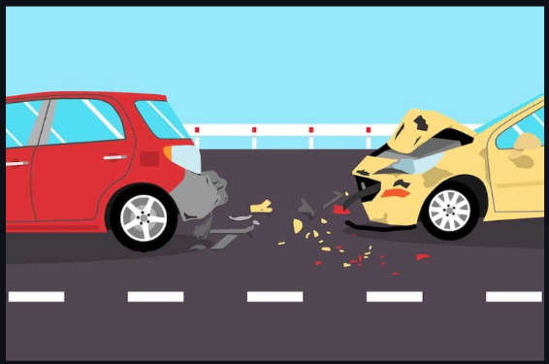

Cheelam, Guna Pranay Reddy: 11646048 Diddekunta, Siva Teja: 11655074 Pidamarthi, Bharath: 11657213 Ravi, Meghana :11716212 Swathi Sandela :11741222
Weather Impact on Accident severity

Slide 2
Introduction
Auto accidents are a public nuisance in highly populated cities such as New York. Snow, fog, rain, and ice are all contributory factors to the seriousness of an accident.
The weather contributes to the probability of an accident because of reduced visibility, road friction, and driver reaction time.
The impact of weather on motor vehicle accidents will be analyzed for New York City using the Motor Vehicle Collisions - Crashes data set.
The data set is used to predict the accident severity by location, weather conditions and by time of the day.
The study will also help traffic managers and municipal planners in their quest to make the roads much safer and reduce the number of accidents that relate to bad weather conditions

Slide 3

Research Questions
RQ1: How could the weather conditions impact the severity of accidents in a region?
H₀: Rain, snow, hail or storms and other severe weather conditions doesn’t impact the severity of accidents.
Hₐ: Rain, snow, hail or storms and other severe weather conditions increase the likelihood of severity of accidents.
Result: As per the analysis, during weather conditions like rain and snow have tied up with a high number of severe accidents. This confirms that bad weather is the direct cause for severe outcomes.

Slide 4
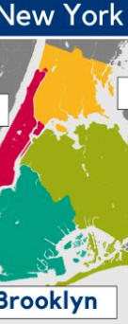
RQ2: Does the severity of accidents change significantly across boroughs?
H₀: The severity of accidents doesn’t change from one borough to the other relatively.
Hₐ: The severity of accidents changes from one borough to the other relatively, with some boroughs experiencing higher numbers of serious accidents and other boroughs comparatively less.
Result: Borough-wise distribution is showing the differences in patterns, and conclusions drawn out of it are that the areas with high traffic density may indeed have higher accident severity. For example, boroughs like Brooklyn might show higher counts, declaring further safety measures.

Slide 5
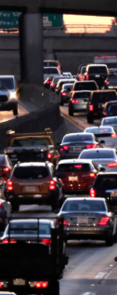
RQ3: Is there any direct relation between rush hours and the higher number of major accidents?
H₀: There is no relationship between peak hours and the frequency of major accidents.
Hₐ: Major accidents are more common during peak hours
Result: The accident time analysis in our data shows that during morning and evening hours, majorly during school and office hours, accident frequency is at peak level, which supports our hypothesis that traffic congestion is directly related to the number of major accidents.

Slide 6

RQ4: To what extent do the models Logistic Regression and Random Forests predict severe vs. non-severe accidents?
H₀: Logistic Regression and Random Forest models perform equally well in predicting severe accidents.
Hₐ: Random Forest performs better than Logistic Regression in predicting severe accidents due to class imbalance.
Result: Logistic Regression shows high accuracy of 72% for non-severe accidents but fails to identify severe ones due to imbalance. Random Forest, accuracy is 70%, and it better captured minority class patterns.

Slide 7
Literature Review
Properly estimating the severity of road accidents is essential regarding highway security as well as health.
For forecasting complex road conditions, considerable traffic, and changing weather, advanced models are helpful.
Using machine learning models with basic algorithms to deep learning, one may forecast the severity of accidents by analyzing driving behavior, road conditions, and weather (Celik & Sevli, 2022; Zheng et al., 2018).
Evaluated fourteen scholarly papers for the prediction of trends, issues, and potential advancement in accidents severity.

Slide 8
METHODS:
New York City accident data:
https://catalog.data.gov/dataset/motor-vehicle-collisions-crashes
Key Variables include:
Location Information
Time and Date
Contributing Factors
Crash Severity
Vehicle Information
No. of people Injured
No. of deaths

Slide 9
Data Pre-processing:
Imputed missing rows
Created a binary target variable, serious accident.
Defined a serious accident as one with either injuries or fatalities.
Converted crash_time to a datetime format to allow grouping by time ranges.
Removed entries that were labeled as "Unspecified“, ensuring only meaningful weather data is included.
Encoded categorical variables to prepare the data for machine learning models.
Removed columns that were unnecessary or columns which have unstructured data.

Slide 10
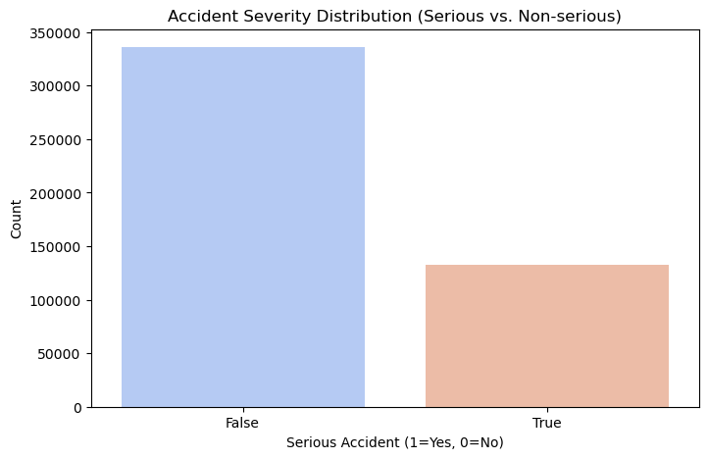
Exploratory Data Analysis (EDA):
Notes:
Above Graph shows the distribution of accident severity. It describes the number of serious accidents is less than the non-serious accidents and it indicates the most accidents do not result in serious injuries.

Slide 11
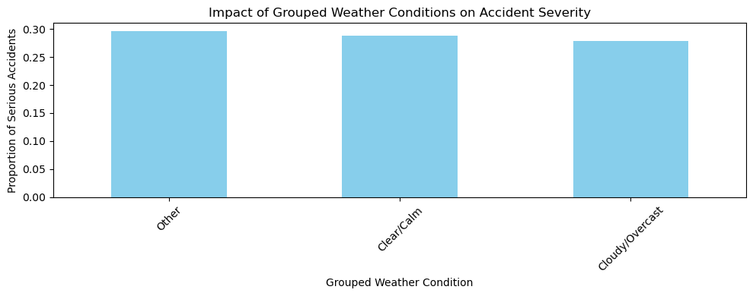
Notes:
As per the graph there no difference in variation in the proportion of serious accidents across the weather conditions in the map This implies that factors other than weather, such driving habits or road conditions, can be quite important in determining how serious accidents are in this dataset.

Slide 12
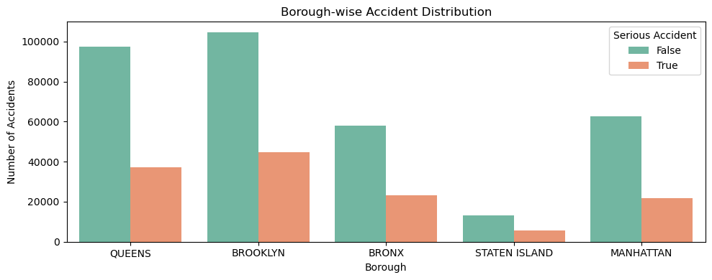
Notes:
The Above Graph clearly explains the accident frequency in each borough, broken down by severity. For the improvement of traffic safety there needs to be serious attention required to avoid the high number of serious accidents. Let’s say for example, most accidents happened in Brooklyn because of higher traffic density/ road conditions that affect the number of accidents rate. Variations among boroughs may indicate the necessity for specific interventions or tailored policies aimed at enhancing road safety.

Slide 13
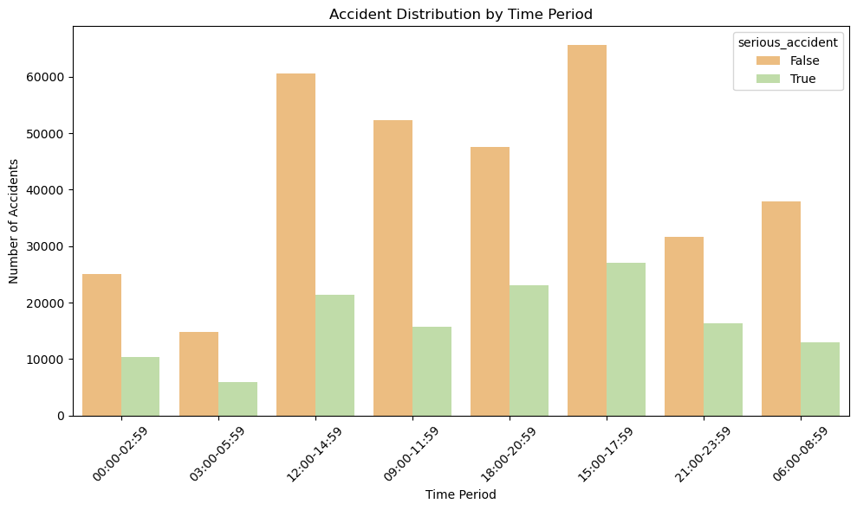
Notes:
This graph illustrates the frequency of accidents over time, highlighting accident hotspots. In peak hours (morning and evening) with huge accidents, it will give the idea that congestion and higher traffic volumes during these times. Illustrating severe and non-severe accidents over time can also help conclude whether those hours are more lead to serious accidents, which could suggest measures such as increased patrols or road safety campaigns during high-risk hours

Slide 14
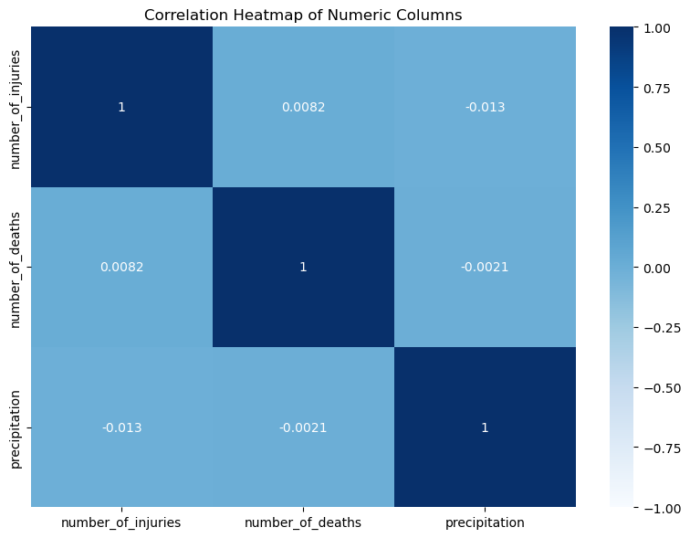
Notes:
Heat map showing the correlation between numerical variables: Number of injuries and number of deaths shows that there is a high positive correlation between these two and simulating more injuries likely to be occurred because of these accidents. This shows a relation between injury count and severity. In a linear way it shows that the precipitation does not directly influence accident severity, but it may indirectly affect the factors that influence the visibility of road slipperiness.

Slide 15
Model Selection:
1. Logistic Regression and
2. Random Forest model.
Why ?
Dependent variable is binary.
linearly separable data.
Feature importance score.
Time series Analysis

Slide 16
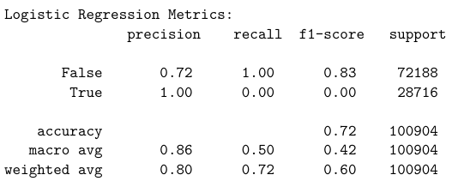
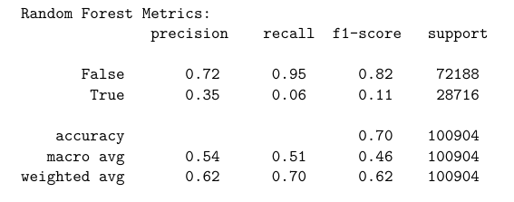
Results:
Logistic Regression:
Random Forest:

Slide 17
Interpretations:
Bad weather and bad road constructions increase severity in accidents.
Road constructions, steep angles, position of traffic signals majorly contribute to higher accident rates in specific regions.
Peak hour traffic, driver’s state of mind whether alcoholic or not, visually not impaired, intensity of fog, slippery conditions on the roads due to snow.
Logistic Regression model has outperformed in predictions of severity accidents considering the attributes like weather conditions, time, road construction, traffic signals, driver’s behavior.

Slide 18
Conclusion:
Important factors leading to major accidents in New York city.
Bad weather, road construction, steep angles and peak hours.
Limitations include a lack of real-time traffic data and limited details in weather conditions.
Future studies could incorporate additional variables, like real-time road monitoring data.
The findings provide a robust foundation for implementing safety measures in high-risk urban areas in New York.

Slide 19

Thank you

