Slide 1

Unbox yourself into Testing
- Ruchika Rawat
- Raman Kansal
Notes:
1

Slide 2
Web Application Architecture
from the eyes of a QA…
Notes:
2

Slide 3





Front End
API
Database
Notes:
every page has page class which contains all the methods and webelements of that class, cucumber less framework
3

Slide 4
UI based functional tests
API tests
and … ????
Notes:
4

Slide 5
Is it enough?

Slide 6
Do we really understand the system?

Slide 7
Let’s Unbox ourselves…

Slide 8









API
GATEWAY
Front end
Payment Gateway
Salesforce
Notes:
Dev ops testing – Featuring toggle automatic way to read features – migration data
Database testing

Slide 9
Now, What more comes to our mind…
Notes:
definition, photo, create feature file

Slide 10
API
GATEWAY
Front end
Payment Gateway
Salesforce
Notes:
UI based functional testing
Client Side Performance
Protractor Tests – javascript based

Slide 11
Various tools:
Mobile (Android/iOS) Testing:
Espresso, Calabash, Appium, MonkeyRunner etc
Client Side Performance Testing:
YSlow, Google Page Speed etc
API Testing:
SOAP UI or REST Assured API, Postman etc
Functional Testing:
Selenium or QTP etc
Server Side Performance Testing:
Jmeter or Gatling etc
Database Testing:
Verifying migrations/procedures etc
Security Testing:
ZAP, OWASP dependency checks, Fiddler etc

Slide 12
Is it enough?
Let’s unbox a bit more…

Slide 13
Testing other areas…

Slide 14
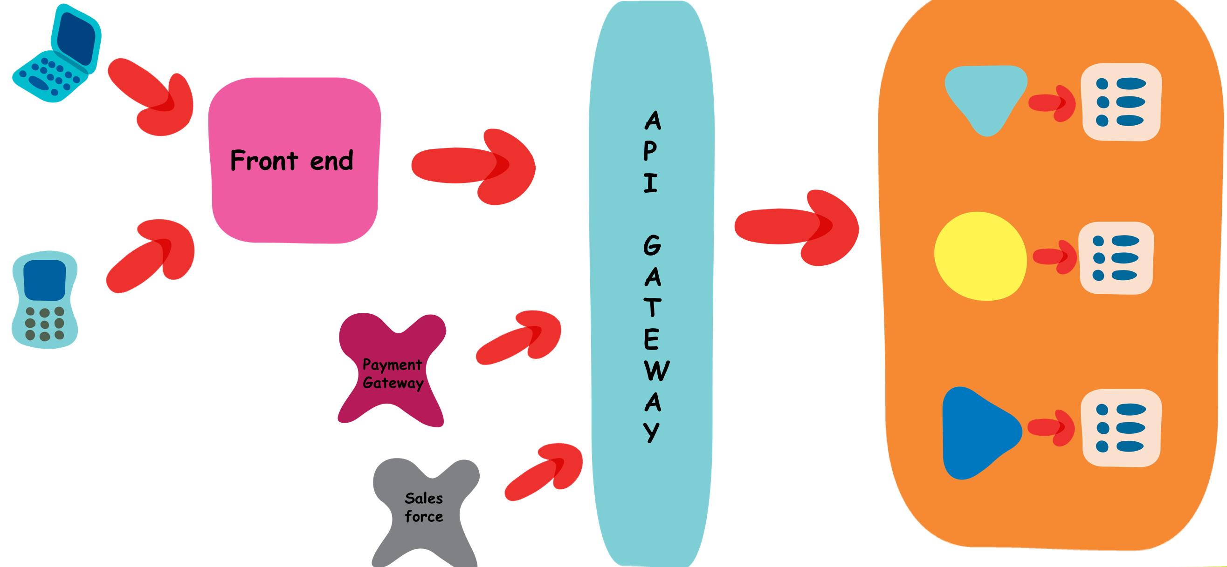
Deployment

Slide 15
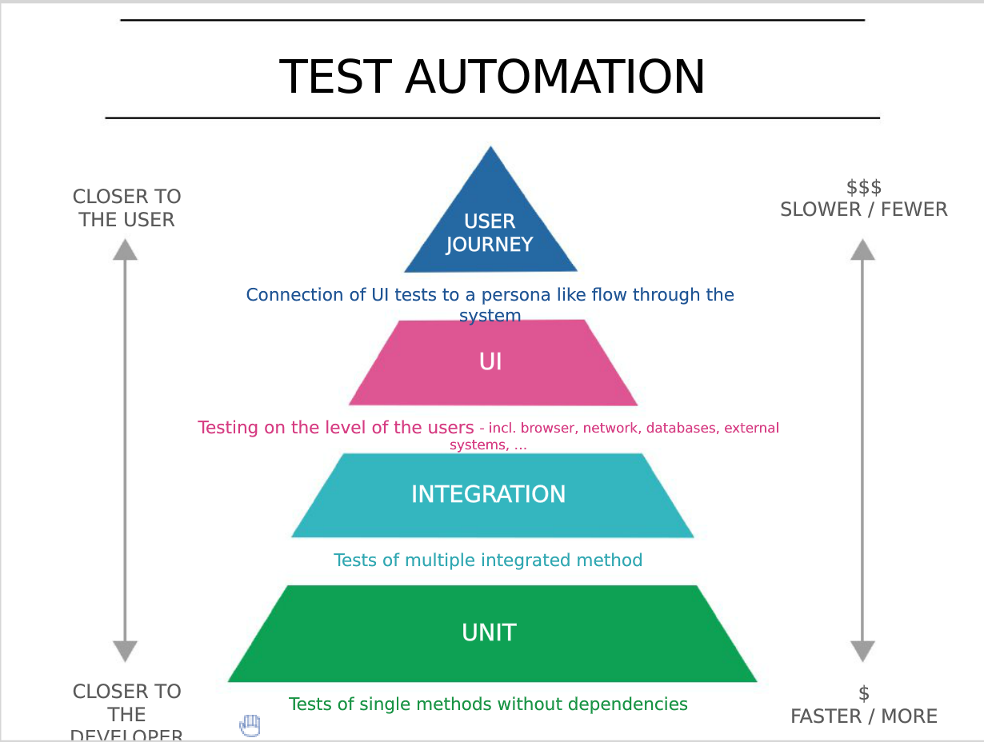
Test Pyramid

Slide 16

Questions

