Slide 1

Introduction to Gauge
Harmeet Singh
Vivek Mahajan

Slide 2

“Gauge is a lightweight open-source, cross-platform test automation tool from ThoughtWorks which provides the ability to author test cases in the business language”

Slide 3

Key Features
Open Source
Multi language support - Java, Ruby, C#, Javascript, python
    Multi IDE support - IntelliJ, Eclipse, Visual Studio
    Multiple platform support - Windows, Mac, Linux
    Simple markdown test syntax
    Supports parallel execution
    Excellent reports
    Supports Continuous Integration
    Supports multiple build tools
Notes:
every page has page class which contains all the methods and webelements of that class, cucumber less framework

Slide 4
Advanced Features
Data stores
Execution hooks
Table driven execution
Concepts

Slide 5


Slide 6
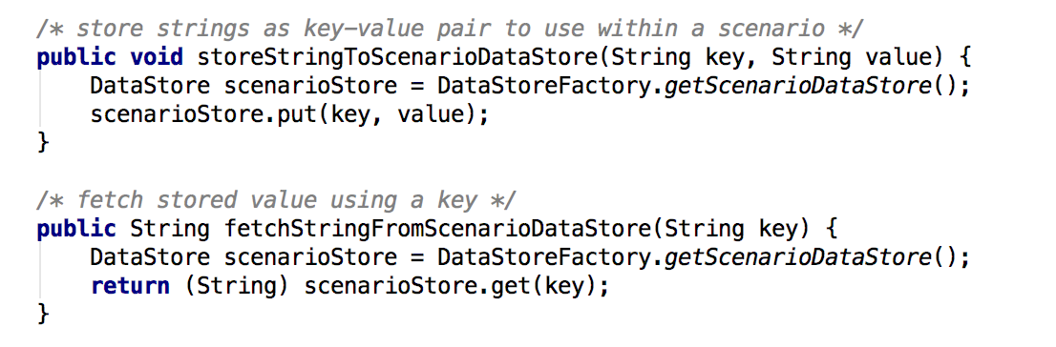
Data Stores
Share data amongst scenarios, specs and test suites

Slide 7
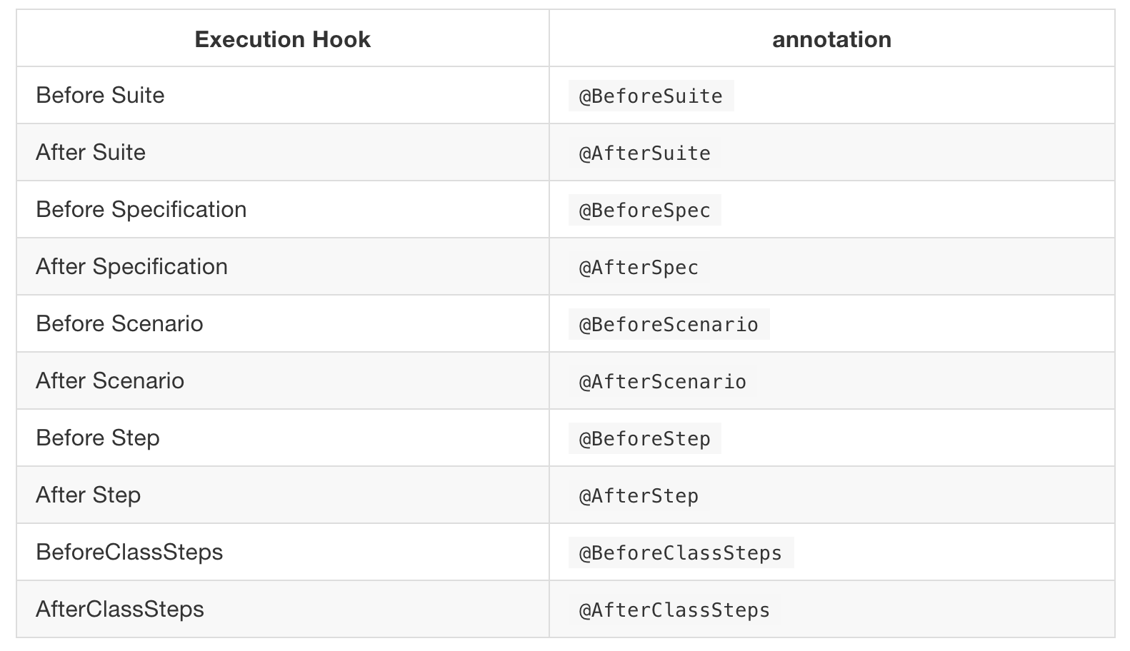
Execution Hooks

Slide 8

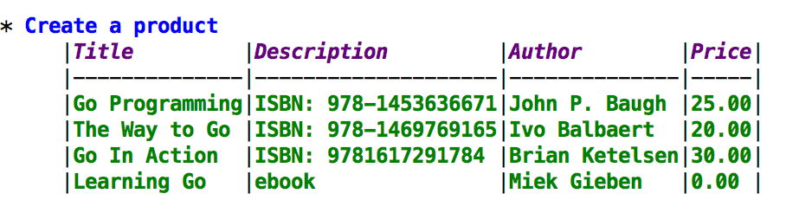

Table Driven Execution
Provide inline tables in specs
Specify a CSV directly in spec

Slide 9

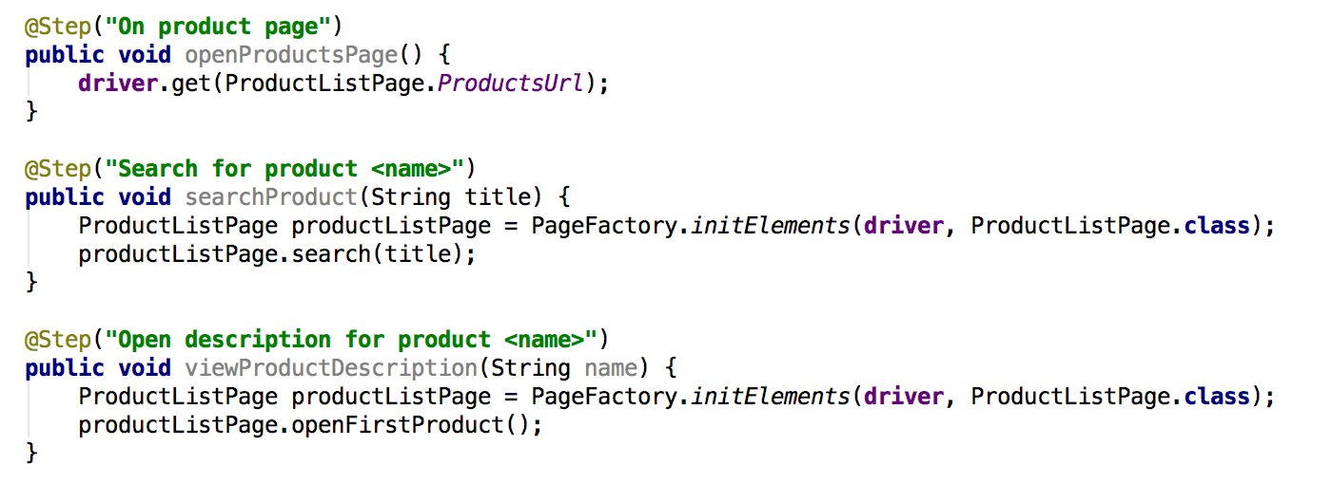

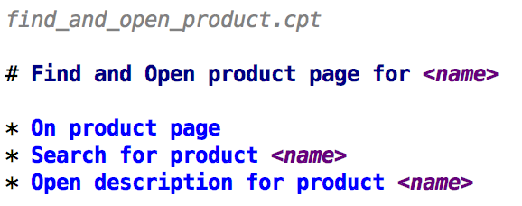
Concepts
Combine multiple steps into one - Reuse step definitions, abstract by business intent
Step implementation file
Concept file

Slide 10
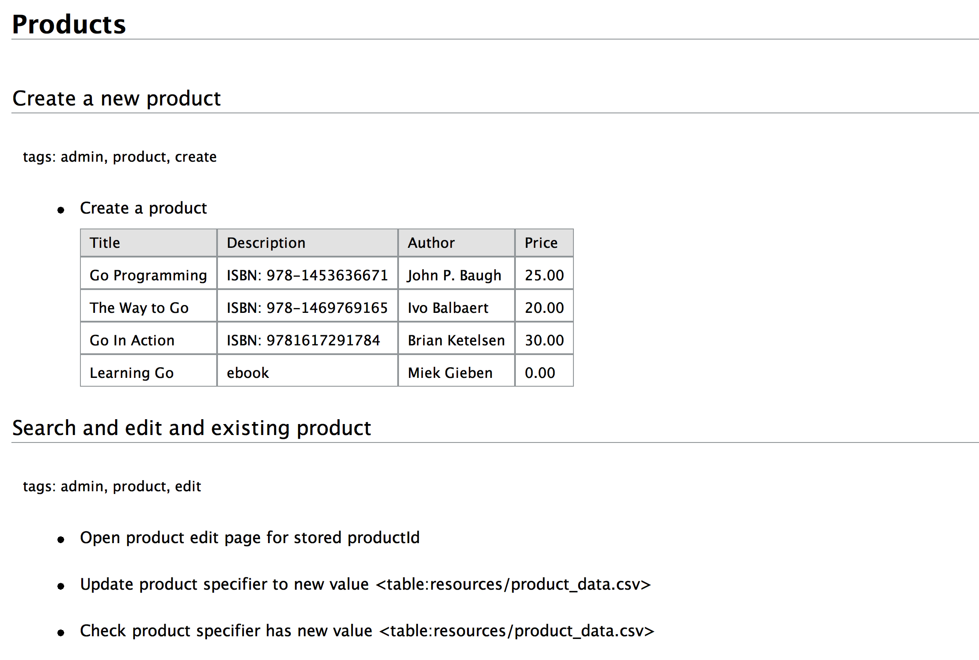
Test cases look like this to the business
Notes:
definition, photo, create feature file

Slide 11
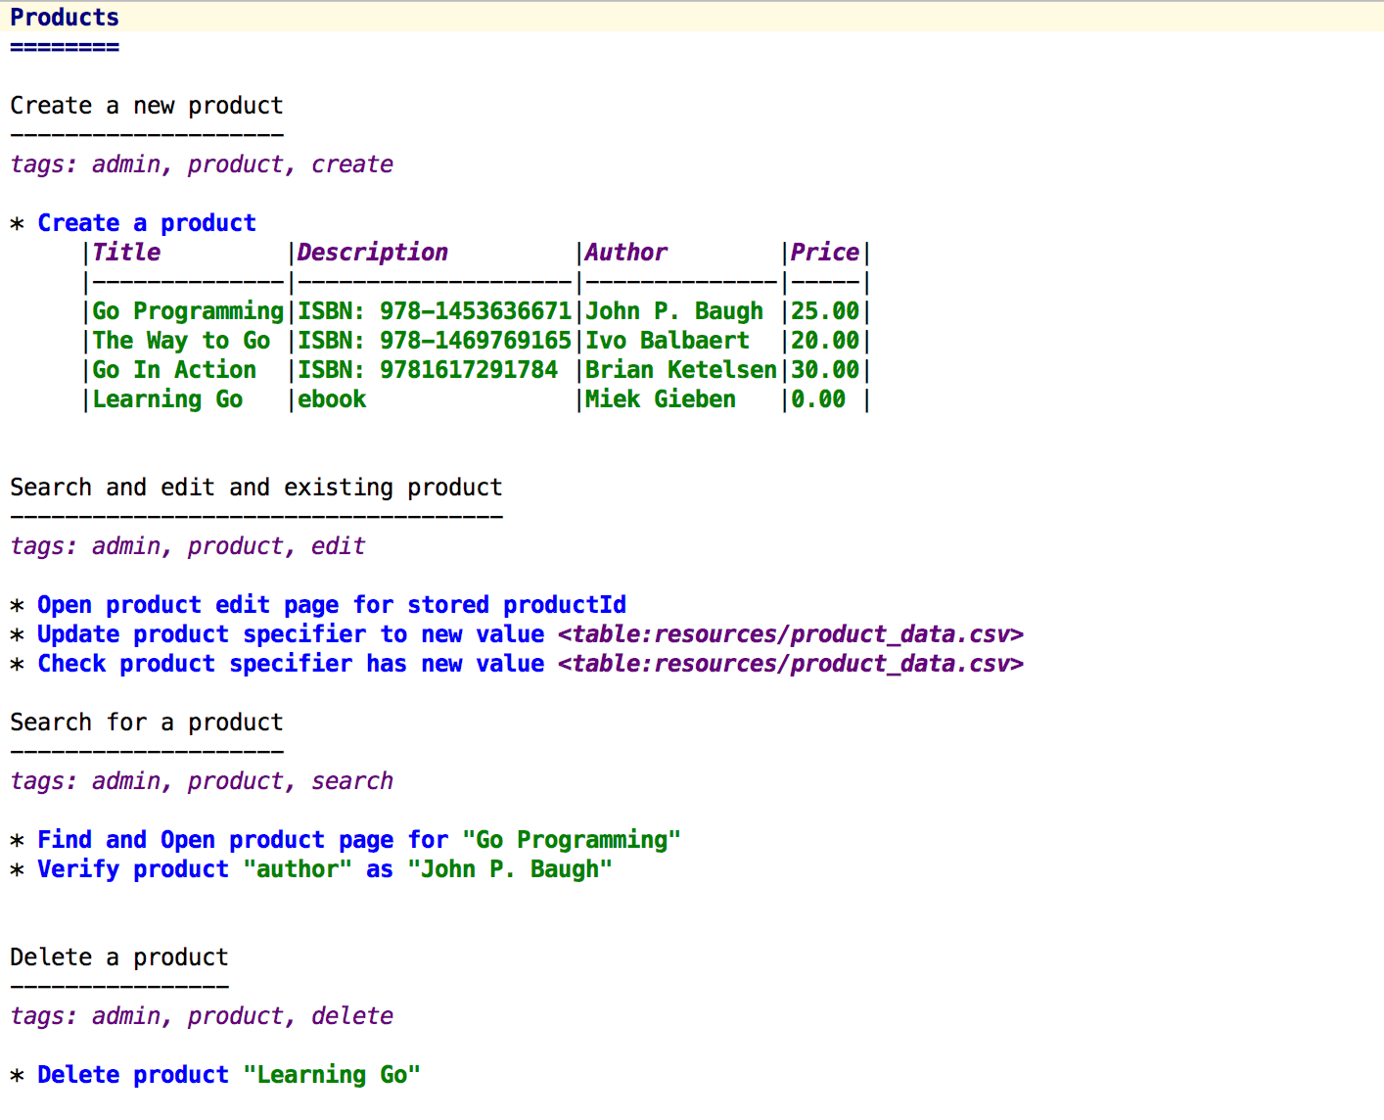
And like this to Devs & QAs

Slide 12
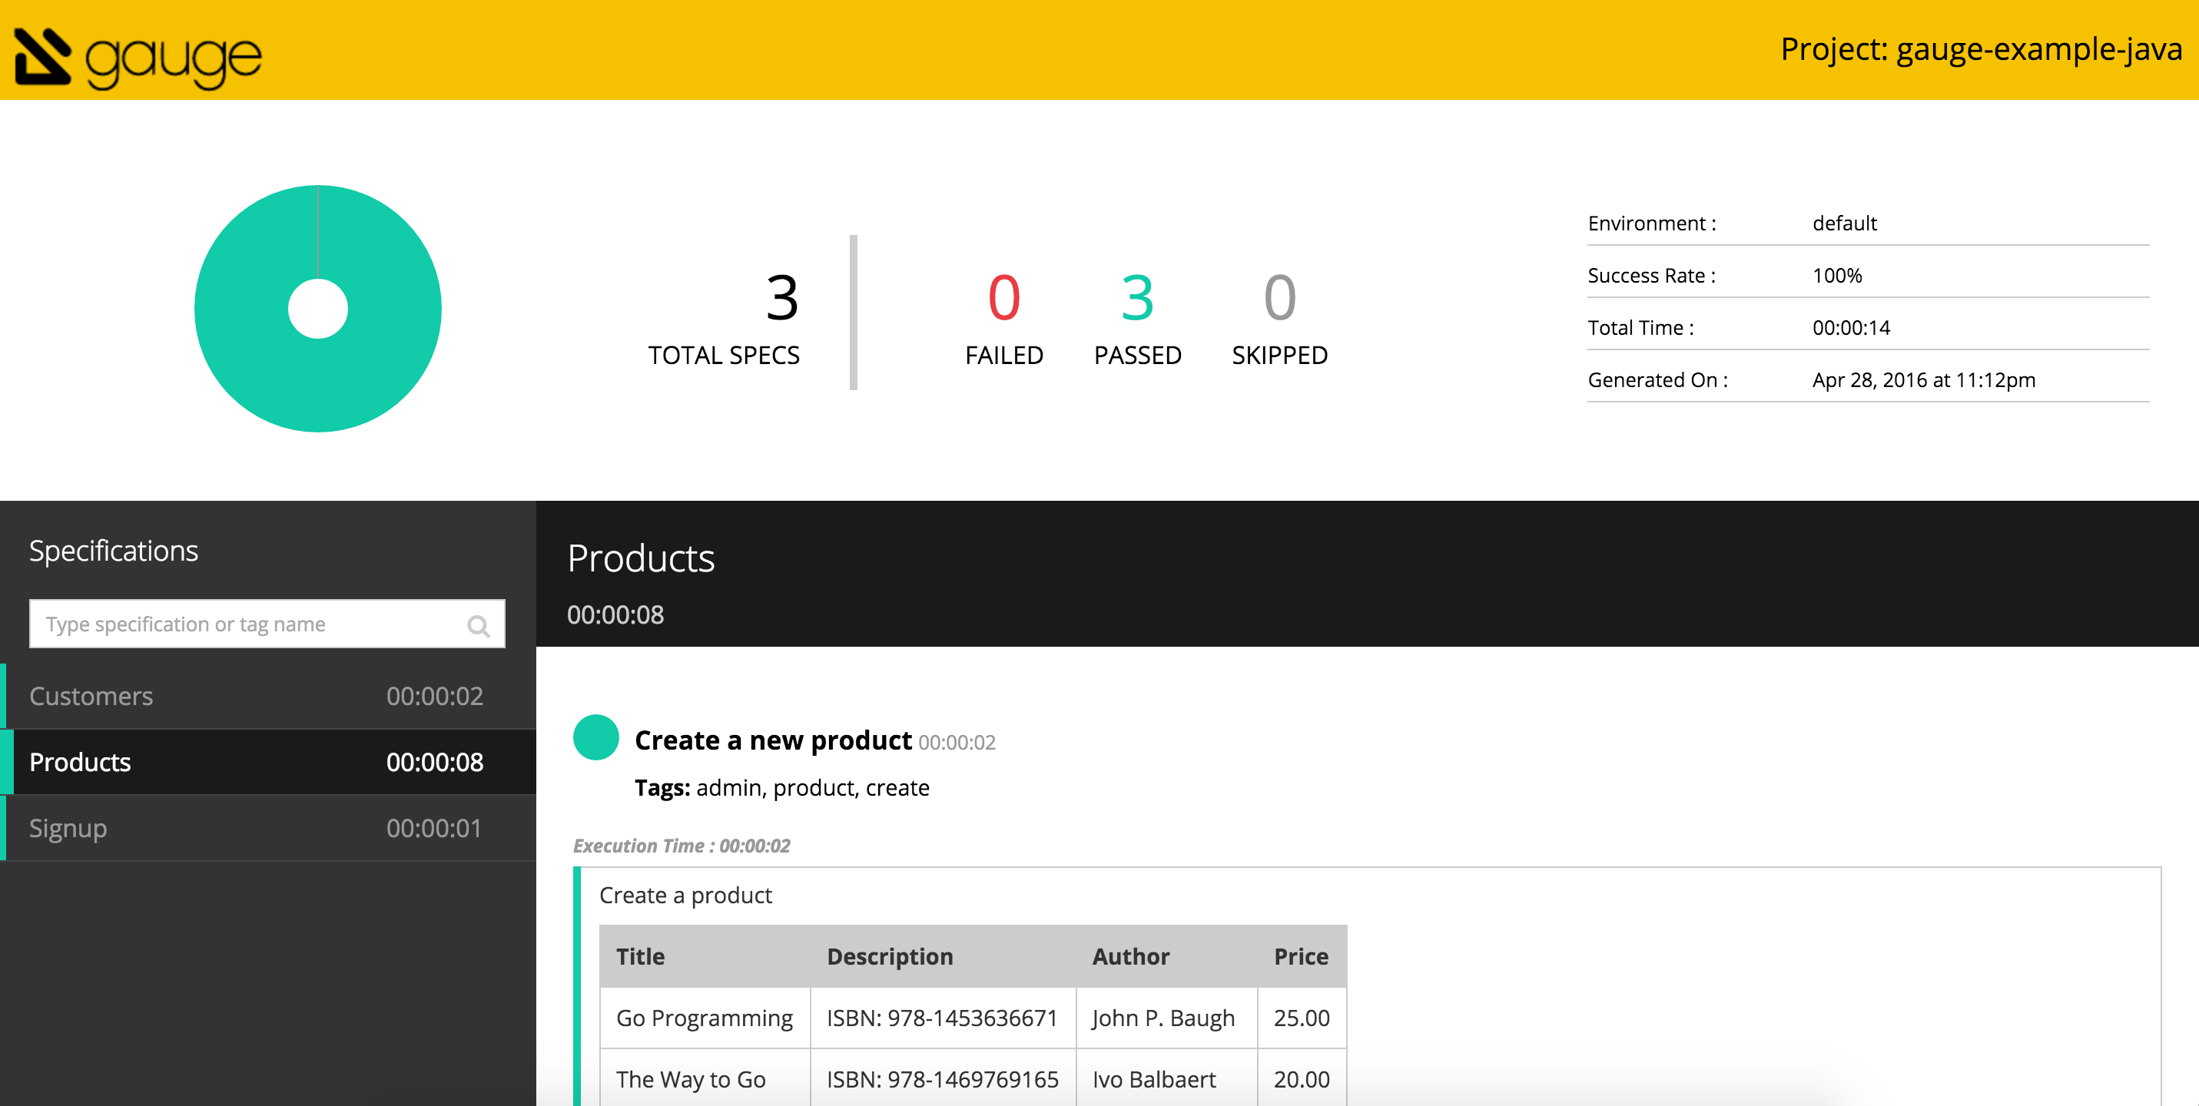
Reports

Slide 13
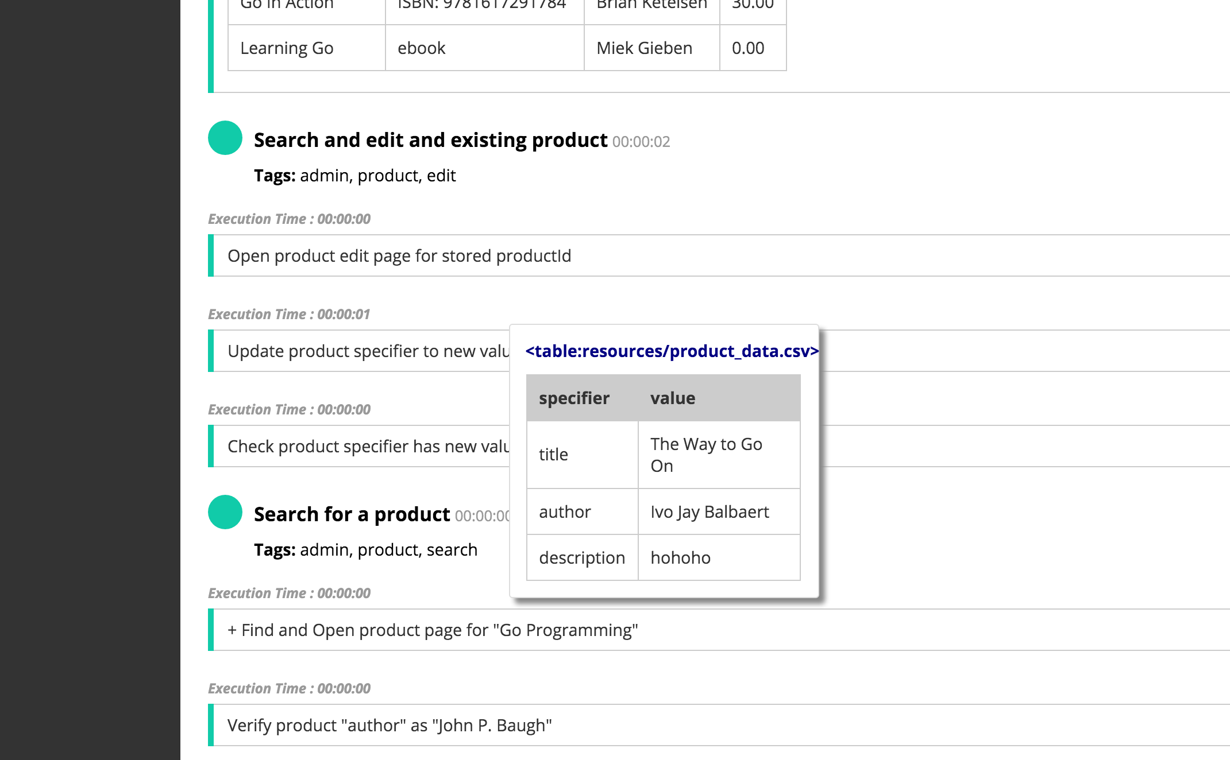
Reports

Slide 14
More About Gauge
getgauge@googlegroups.com
@getgauge
http://getgauge.io

Slide 15
Questions?

