Slide 1





App registrations in minutes, not days
Ask
ENTRA ID AUTOMATION
The team fills in a form in the Power App
Lock
The request is saved and locked
Approve
Manager, then the Entra ID team
Self-service Entra ID app registrations built on Power Apps, Power Automate and SharePoint
Create
A flow builds it in Entra ID through Graph
Stamp
Owner, appCatID and request ID as tags
Presenter name · Team · Date
Notes:
Open with the outcome: a team asks for an app registration in a form, two people approve, and a flow creates it in Entra ID in minutes. Everything runs on Microsoft 365 services we already license. See the speaker notes document for the full talk track.

Slide 2








What we'll cover
01
04
07
The problem today
How the solution works
Tags and ownership
02
05
08
Working with the M365 team
What it delivers
Future path
03
06
09
Options and why the Power stack
Benefits and savings
How we work together
Notes:
Nine short sections. The first half explains why and how; the second half covers the benefits, the ownership model, what comes next, and how we want to work with your team.

Slide 3




Today an app registration is a 10-day ticket
10 working days
1 person-day
Back-and-forth
No visibility
average time from request to a usable app registration
of Entra ID team effort for every request
requirements gathered over email and tickets, often several rounds
project teams can't see Entra ID, so mistakes and rework slip in
Result: projects wait, teams work around the process (one app reused for many purposes), and names, owners and settings differ every time.
Notes:
Walk the four cards left to right (one per click). Use real examples of a project that waited, an app reused for several purposes, or a misconfigured redirect URI. The last line is the consequence: delay plus inconsistency.

Slide 4



Built with the M365 team, on services we already license
Power Apps
Power Automate
SharePoint
The request form and tracker. Standard connectors only, so users need nothing beyond Microsoft 365.
Approvals in Outlook and Teams, and the flows that create everything in Entra ID through Microsoft Graph.
The request list (the audit trail), the catalog of apps and groups, and the settings. Item-level security.
What we needed from the M365 team
A Power Platform environment with Dataverse
used by Approvals and the solution import
Connectors allowed in the DLP policy
SharePoint, Approvals, Outlook, Office 365 Users, HTTP with Entra ID
One Power Automate Premium licence
for the flow account only, not for users
A SharePoint site
for the request, catalog and settings lists
Notes:
Stress that this is a partnership with the M365 team: we enable Power Apps, Power Automate and SharePoint capabilities that are already licensed, and keep the footprint small. Four concrete asks.

Slide 5

Three ways to build it: why we chose the Power stack
 | CI/CD pipelines Azure DevOps / GitHub | Function App + web portal Azure, custom code | Power Apps + Automate + SharePoint Microsoft 365, low-code
Familiar to M365 users | ●○○ | ●○○ | ●●●
Easy to extend flows | ●●○ | ●●● | ●●●
Keeps data in M365 | ●○○ | ●●○ | ●●●
Low maintenance (no servers) | ●●○ | ●○○ | ●●●
Approvals built in | ●●○ | ●○○ | ●●●
Running cost | ●●● | ●●○ | ●●●
Decision
Power Apps + Power Automate + SharePoint
People already know it, flows extend without developers, data stays in M365, nothing to host or patch, and approvals come built in.
Rating: ●●● strong · ●●○ partial · ●○○ weak
Notes:
Compare the three options against the six criteria. Pipelines and a Function App are both viable, but they need developer skills to extend, they keep data outside M365 or need custom storage, and approvals have to be built. Click to reveal the decision.

Slide 6


How it works: five steps from request to Entra ID
Ask
Lock
Manager approves
Entra team approves
Create
Requester fills in the Power App form
Request saved in SharePoint and locked
Outlook / Teams approval card
Second approval, self-approval blocked
Flow calls Microsoft Graph as the platform app
Result in minutes: app registration, Application ID URI and scopes, app roles with their groups, enterprise app, tags and notes. The requester sees every step in My requests and by email.
Editable: every box and arrow on this slide is a PowerPoint shape.
Notes:
One click per step. Emphasise that nothing happens in Entra ID until two people approve, and that the request is locked first so what is approved is exactly what gets built.

Slide 7








Requests and execution are kept apart
Request side
Approval gate
Execution side
Runs as the requester
Lock, then two approvals
Runs as the platform
Uses their own sign-in and standard licence
Request locked: requester can no longer edit
Flow account, separate from people
Can only create and read their own requests
Snapshot of exactly what is approved
App identity with a certificate, no secrets
Needs no Entra ID rights at all
Manager, then Entra ID team
Only identity with Graph write permissions
Guards the execution flow checks before it changes anything
Requester is the item's built-in Created By (can't be faked) · Last edit made by the flow account · Both decisions Approved · Owner tag names the requester or their group
Notes:
Explain the separation: people never get Entra ID rights; the only identity that can change Entra ID is the platform app, and only the execution flow uses it. A site owner editing the list by hand cannot trigger it.

Slide 8
Core flow: register an application in one request
Screenshot
Basics step
Screenshot
Expose an API step
Screenshot
App roles step
Screenshot
Enterprise app step
Screenshot
Review + submit step
1
Basics
2
Expose an API
3
App roles
4
Enterprise app
5
Review + submit
Name convention, appCatID, environment, optional owning group
Application ID URI, scopes, token claims
User / Admin roles, each held by a group
Assignment required, account types, tags
Summary, then manager and Entra approvals
Replace each frame with a screenshot of the matching wizard step (Insert > Pictures, then send the frame to back or delete it).
Notes:
Walk through the five wizard steps (one per click). Only Basics is required; the display name prefix is built from appCatID, environment and BoR short name and cannot be edited. Swap the frames for real screenshots before presenting.

Slide 9





What one request delivers
Standard name
Application ID URI
Scopes
App roles
APPCAT-ENV-BOR-name, prefix enforced
api://{appId} or custom
e.g. access_as_user for delegated access
User / Admin or custom roles
Role assignments
Enterprise app
Token claims & URIs
Tags & notes
Existing groups hold each role
Created for the app, assignment required
Optional claims, groups claim, redirect URIs
Owner, appCatID, request ID, audit
Notes:
Manually these are eight separate tasks in the Entra admin center, each a chance for a mistake. Here they come from one form, validated, and created in the right order with retries while Entra replicates.

Slide 10
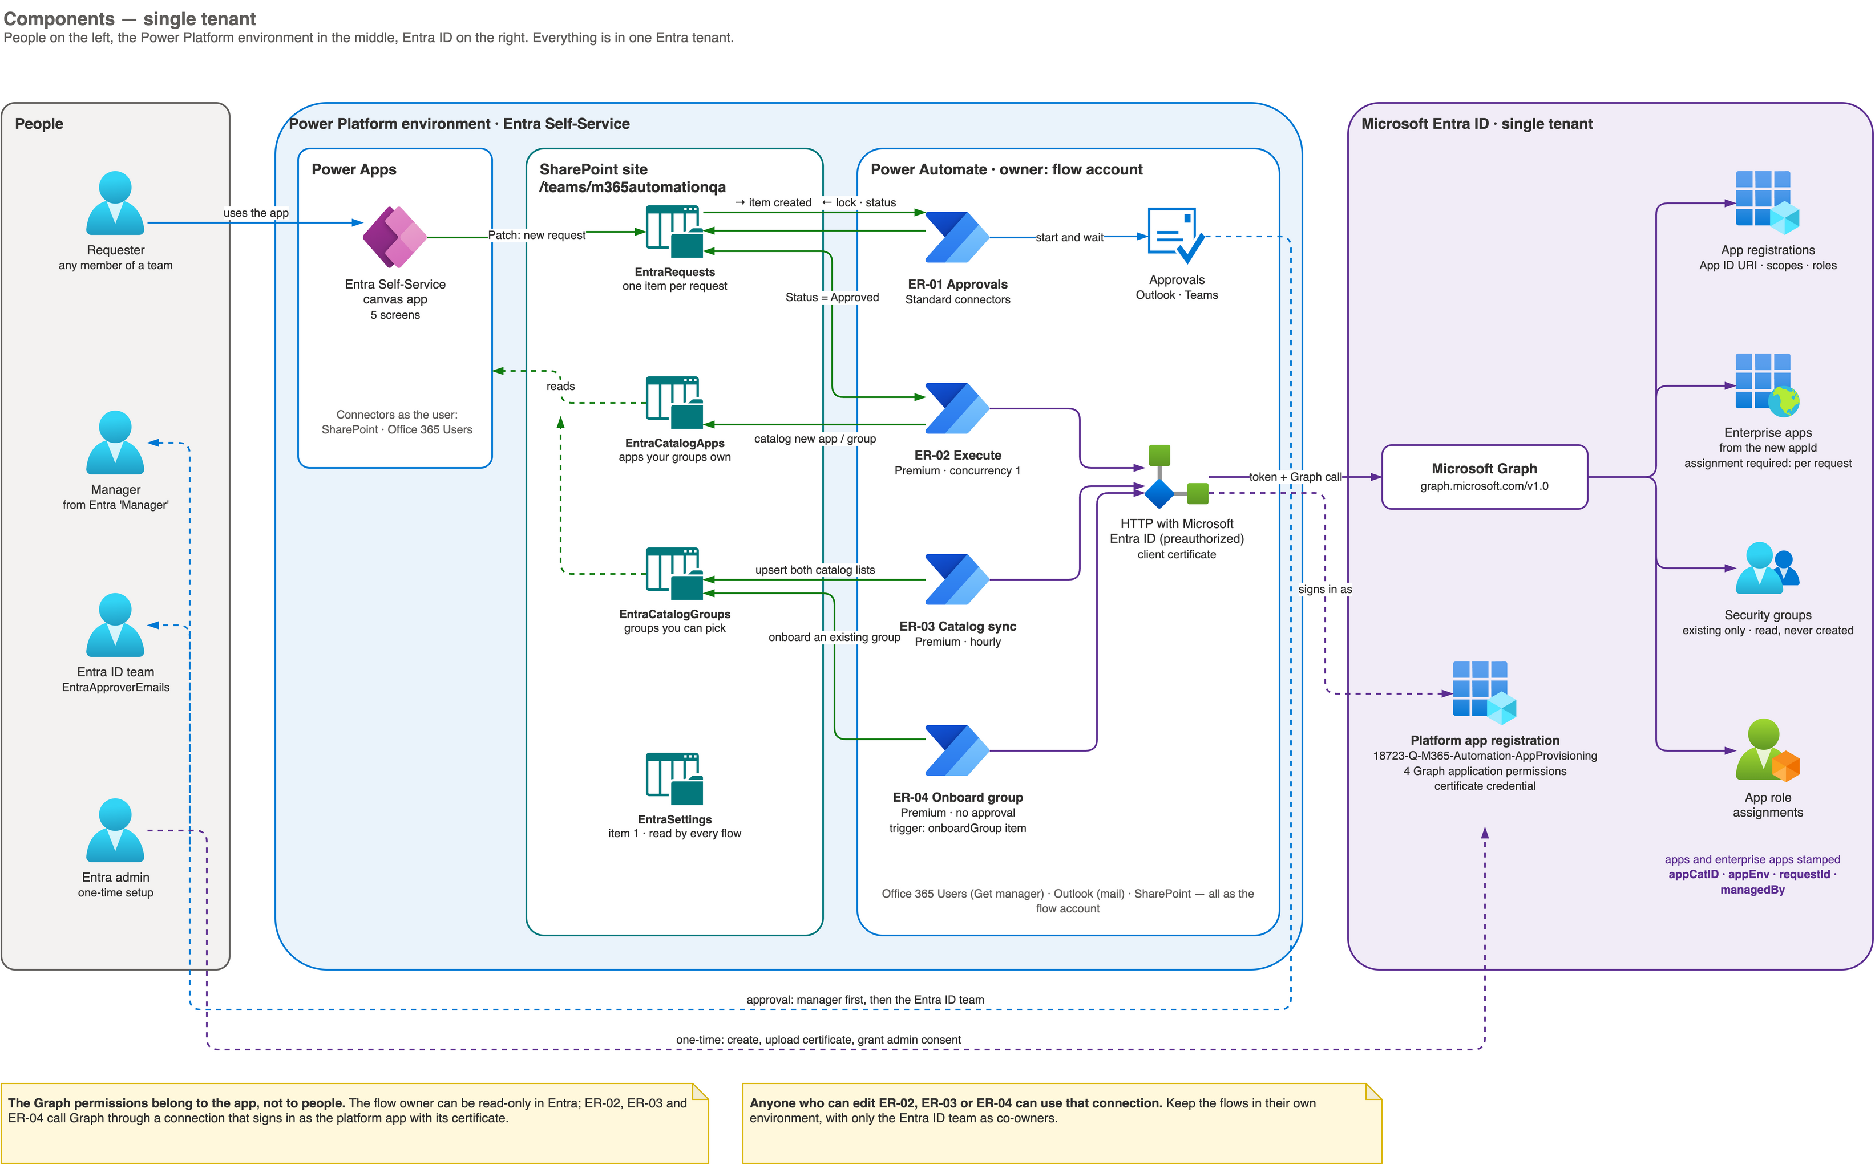
The complete picture
Notes:
People on the left, the Power Platform environment in the middle (app, SharePoint lists, flows), Entra ID on the right. Point out that only the platform app registration holds Graph permissions. Editable source: diagrams/entra-powerplatform.drawio, page 2.

Slide 11






Beyond new apps: the other flows
ER-01 Approvals
ER-02 Execute
Locks the request, manager then Entra ID team
Creates and changes apps through Graph, logs every step
ER-03 Catalog sync
ER-04 Add existing group
Hourly refresh of who can pick which apps and groups
Members make their group selectable, no approval
ER-05 Find app
ER-06 Owning group
Search by app ID; only the owner can continue
Hand an app from a person to a group
ER-07 Requeue
Change requests
Entra team re-runs approved requests
Expose an API, app roles, role assignments, enterprise app
Notes:
Three groups (one per click): the core pipeline (approvals, execution, catalog), the self-service helpers that need no approval (add group, find app, owning group), and operations (requeue, change requests).

Slide 12


From a 10-day ticket to a same-day request
Manual today
With self-service
Lead time
~10 working days
Same day: approval time plus minutes of flow time
Entra ID team effort
≥ 1 person-day per request
About 5 minutes to review and approve
Requirements
Back-and-forth over email and tickets
One validated form, captured once
Visibility
Project teams can't see Entra ID
My requests: status, approvals, step-by-step notes
Consistency
Every engineer builds it differently
Same names, tags and settings every time
Notes:
One row per click. Each row is a pain point from slide 3 and how the platform answers it.

Slide 13
What it saves
~9
working days
shorter lead time per request
~7.9 h
per request
Entra ID team effort saved
1
Premium licence
the only extra running cost
≈ 0.2 / 0.45 / 0.9 of a full-time person at 220 working days a year. Multiply person-days by your internal day rate for a money figure.
Notes:
The numbers use 8 hours manual effort vs about 5 minutes of review per request. Even at the lowest volume, one Premium licence costs a small fraction of the effort saved. Change requests (scopes, roles, assignments) add to this.

Slide 14





Ownership by tags, not by naming convention
Today
APP-1234-P-ORDERS-orders-api
App registration and enterprise app carry the same tags
Ownership is only implied by the app's name
No reliable link to the business application
Hard to find who to ask, or what to clean up
No record of who requested it, or when
appCatID:APP-1234
team:group\<group id>
business application
who may change it
appEnv:P
managedBy:entra-pp
environment
managed by the platform
requestId:REQ-2610-…
createdBy:alex@…
which request built it
who asked, and when
Ownership enforced
Full audit trail
Find and report
Chargeback-ready
Notes:
Contrast implied ownership (a name) with explicit tags the platform enforces. The team tag decides who can change the app (a person or a group); appCatID links it to the business application; the rest gives the audit trail and supports reporting and chargeback.

Slide 15



Future path
Phase 1
Phase 2
Phase 3
Phase 4
Complete the remaining flows
AppCatID on every identity
ServiceNow change, automatically
Easier approvals in Teams
Credentials (certificates, federated), decommission, periodic review
Every identity the automation manages carries its business owner
A normal change is raised after manager approval
Non-prod approvals posted to a Teams channel or chat
Order and timing to agree together; phase 3 design on the next slide.
Notes:
One phase per click. Phase 1 completes the identity lifecycle; phase 2 extends AppCatID ownership to every identity the automation manages; phase 3 connects ServiceNow; phase 4 makes non-production approvals one tap in Teams.

Slide 16
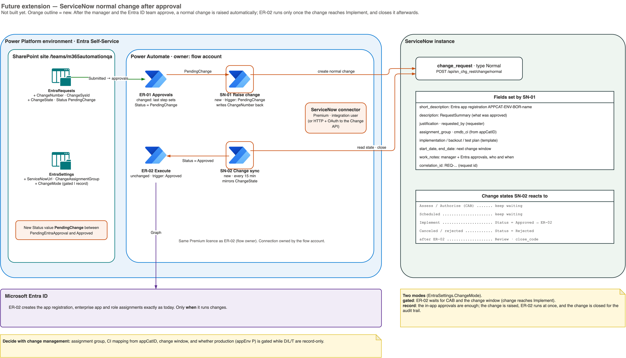
Phase 3 design: ServiceNow normal change after approval
Notes:
Not built yet. After both approvals the flow raises a normal change; in gated mode the app registration is created only when the change reaches Implement, then the change is closed with the result. A record-only mode suits non-production. Editable source: diagrams/entra-powerplatform-future.drawio.

Slide 17


What helps us deliver quickly
Knowledge
Willingness to help and collaborate
Your platform standards and naming conventions
How environments, DLP and licensing are set up
Who to ask when something is blocked
Quick answers on environment questions
Joint testing in QA before production
Shared ownership of the outcome
Notes:
Two things make the difference: knowledge of how your environment works, and the willingness to unblock us quickly. Ask for both explicitly.

Slide 18



Our working model: 51 : 49
We respect your knowledge
You know the platform best; we build on it, not around it.
We work the way your team works
51%
of the credit to the team we work with
Your processes, tools and change rules come first.
You unblock environment issues quickly
Fast help when we hit a licence, DLP or access blocker.
You get 51% of the credit
The delivery is presented as your team's success.
Notes:
The 51:49 model: we bring the build effort; your team brings knowledge and fast unblocking; in return your team takes the larger share of the credit. Reveal the four points one by one and end on the credit.

Slide 19
Questions
Thank you
Docs, diagrams and the importable solution: entra-powerplatform repository (docs/00-OVERVIEW.md)
Notes:
Invite questions. Have the appendix ready: request sequence, ER-02 flowchart, request lifecycle and the security model.

Slide 20
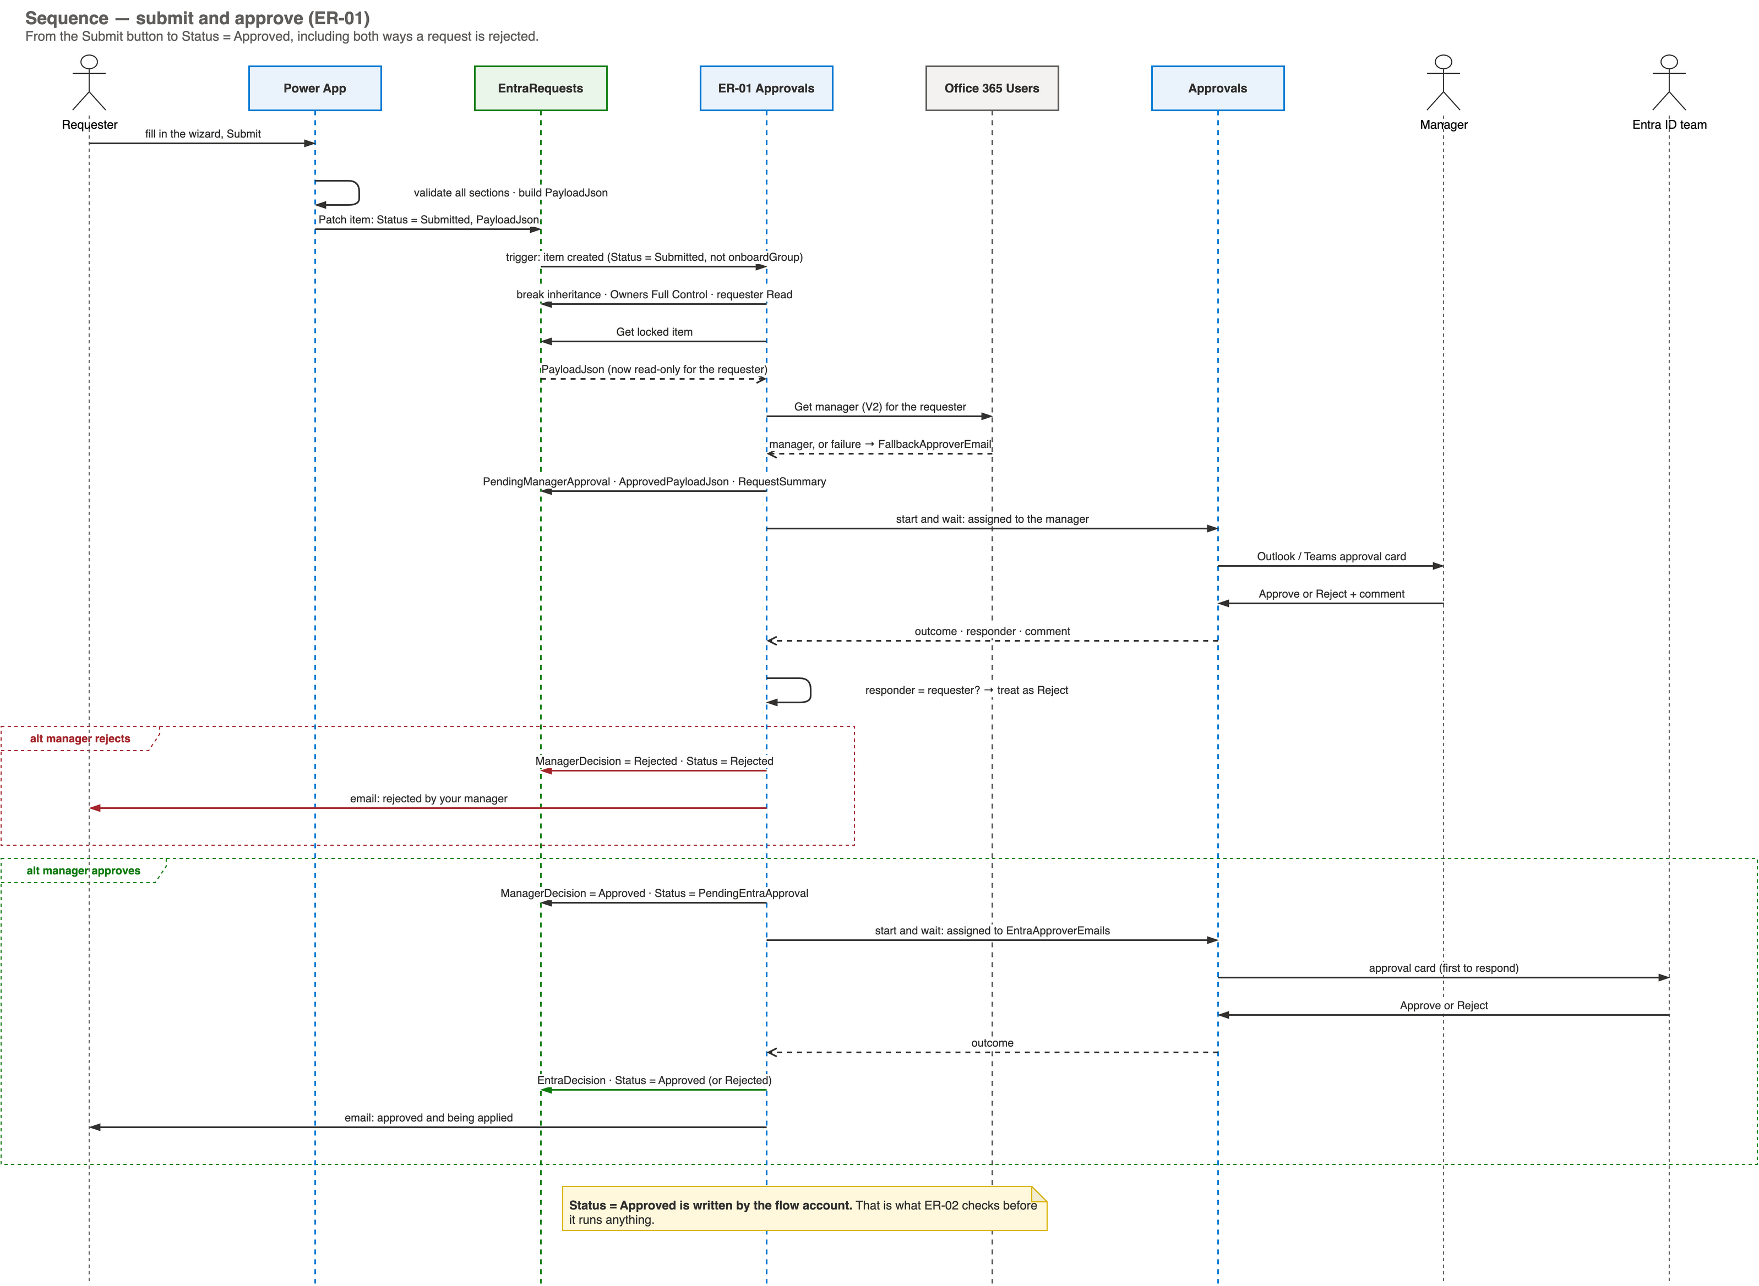
Appendix: submit and approve (ER-01)
Notes:
Editable source: diagrams/entra-powerplatform.drawio, page 4. Open it in draw.io (desktop, web or the VS Code extension), edit, and export again as PNG.

Slide 21
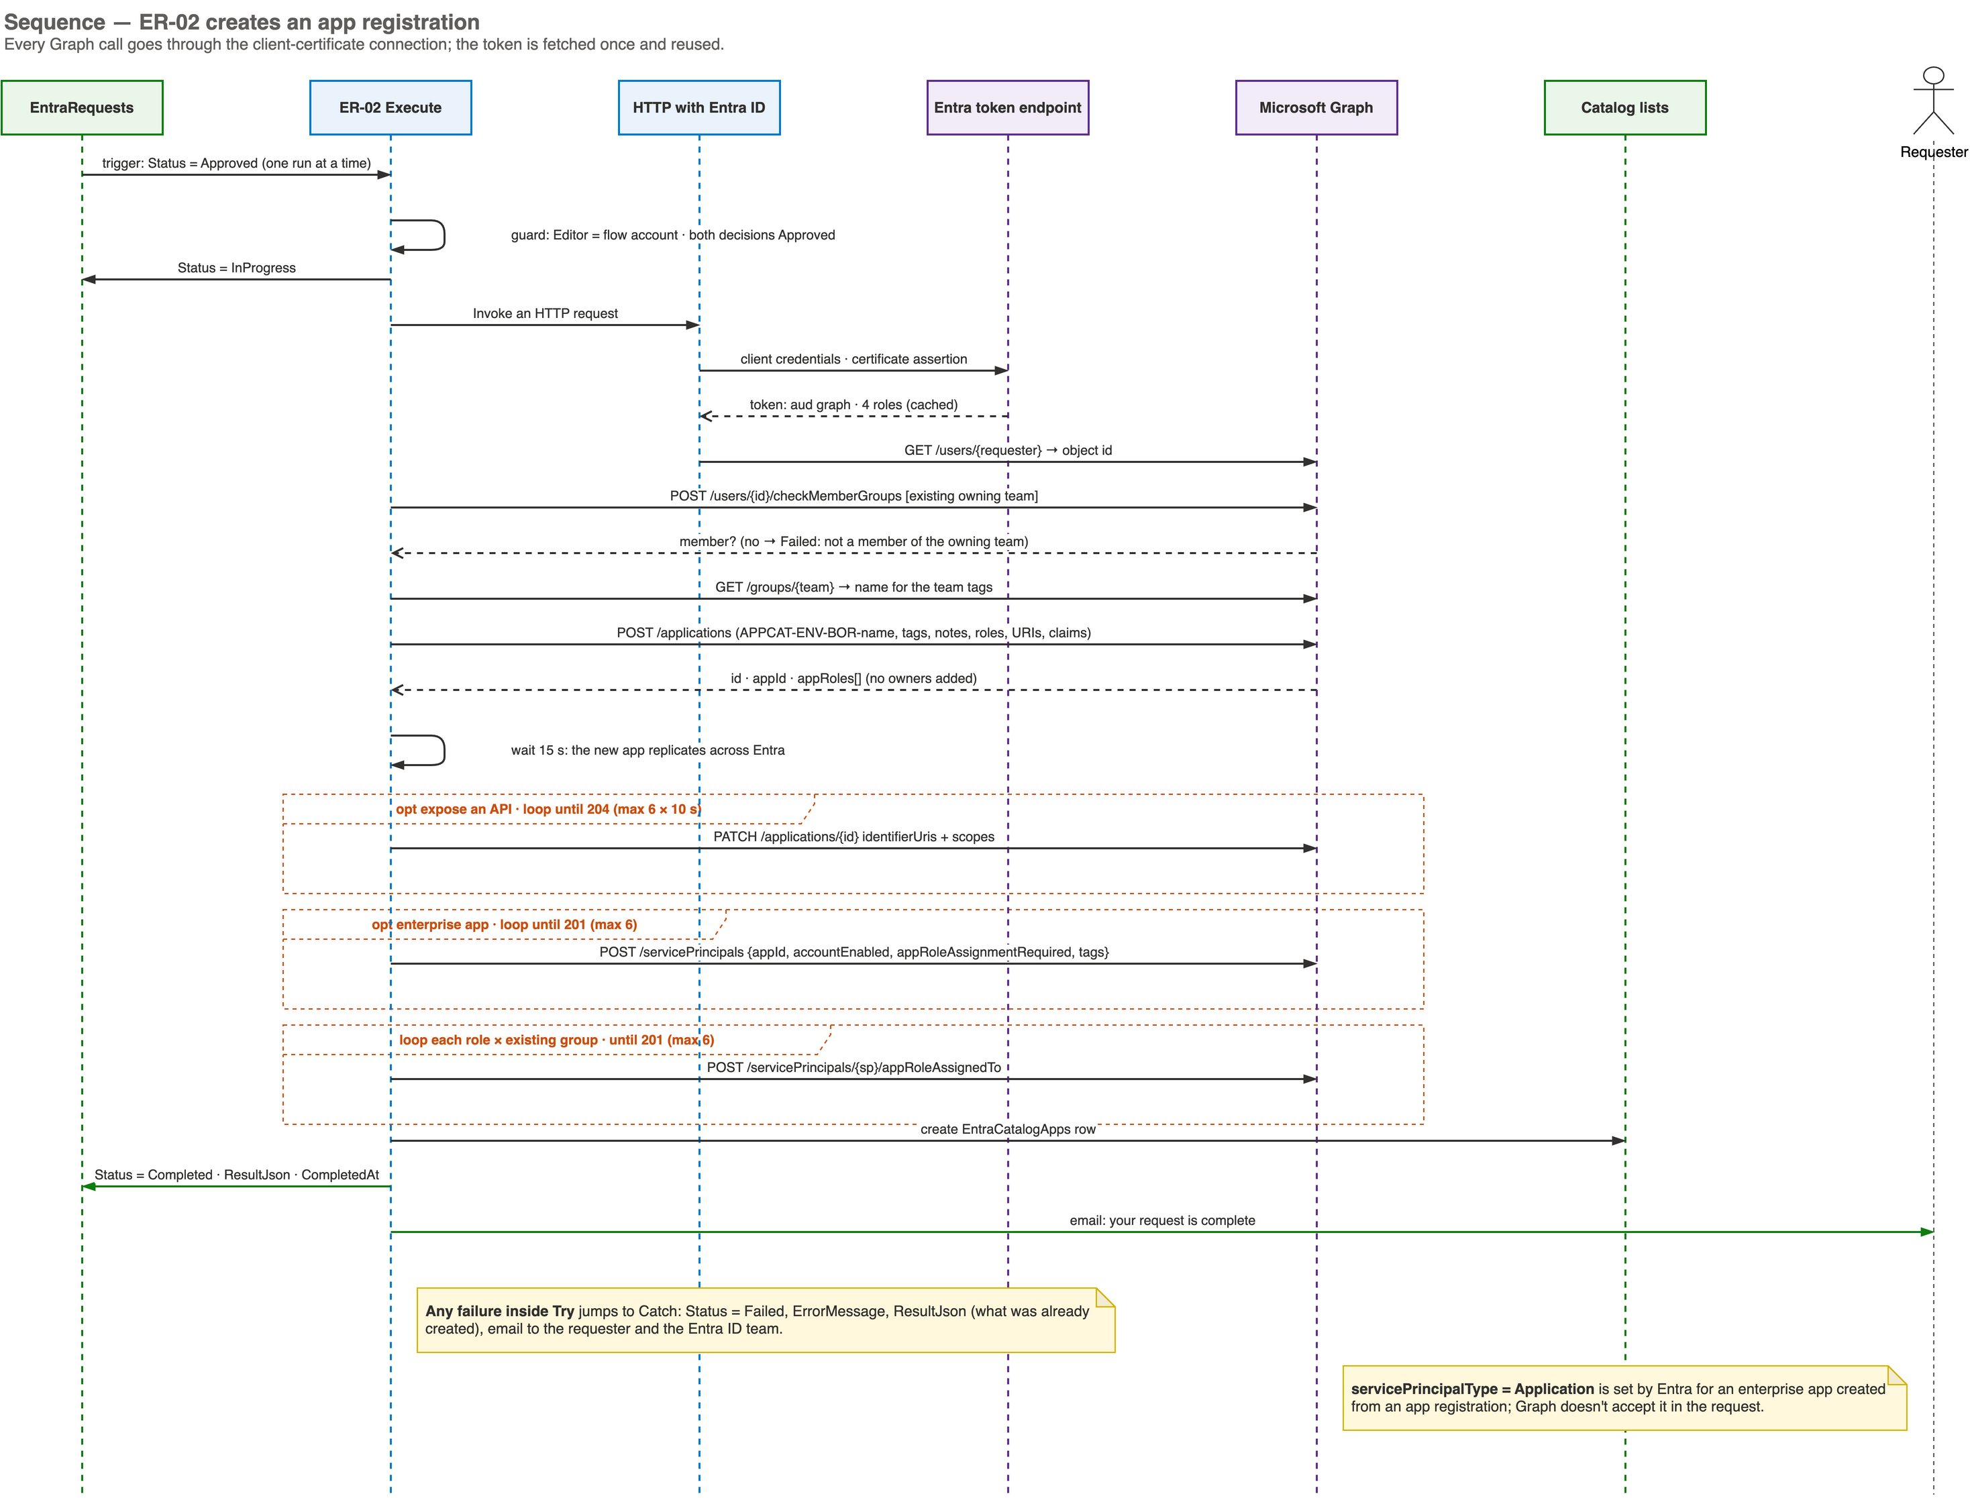
Appendix: creating an app registration (ER-02)
Notes:
Editable source: diagrams/entra-powerplatform.drawio, page 5. Open it in draw.io (desktop, web or the VS Code extension), edit, and export again as PNG.

Slide 22
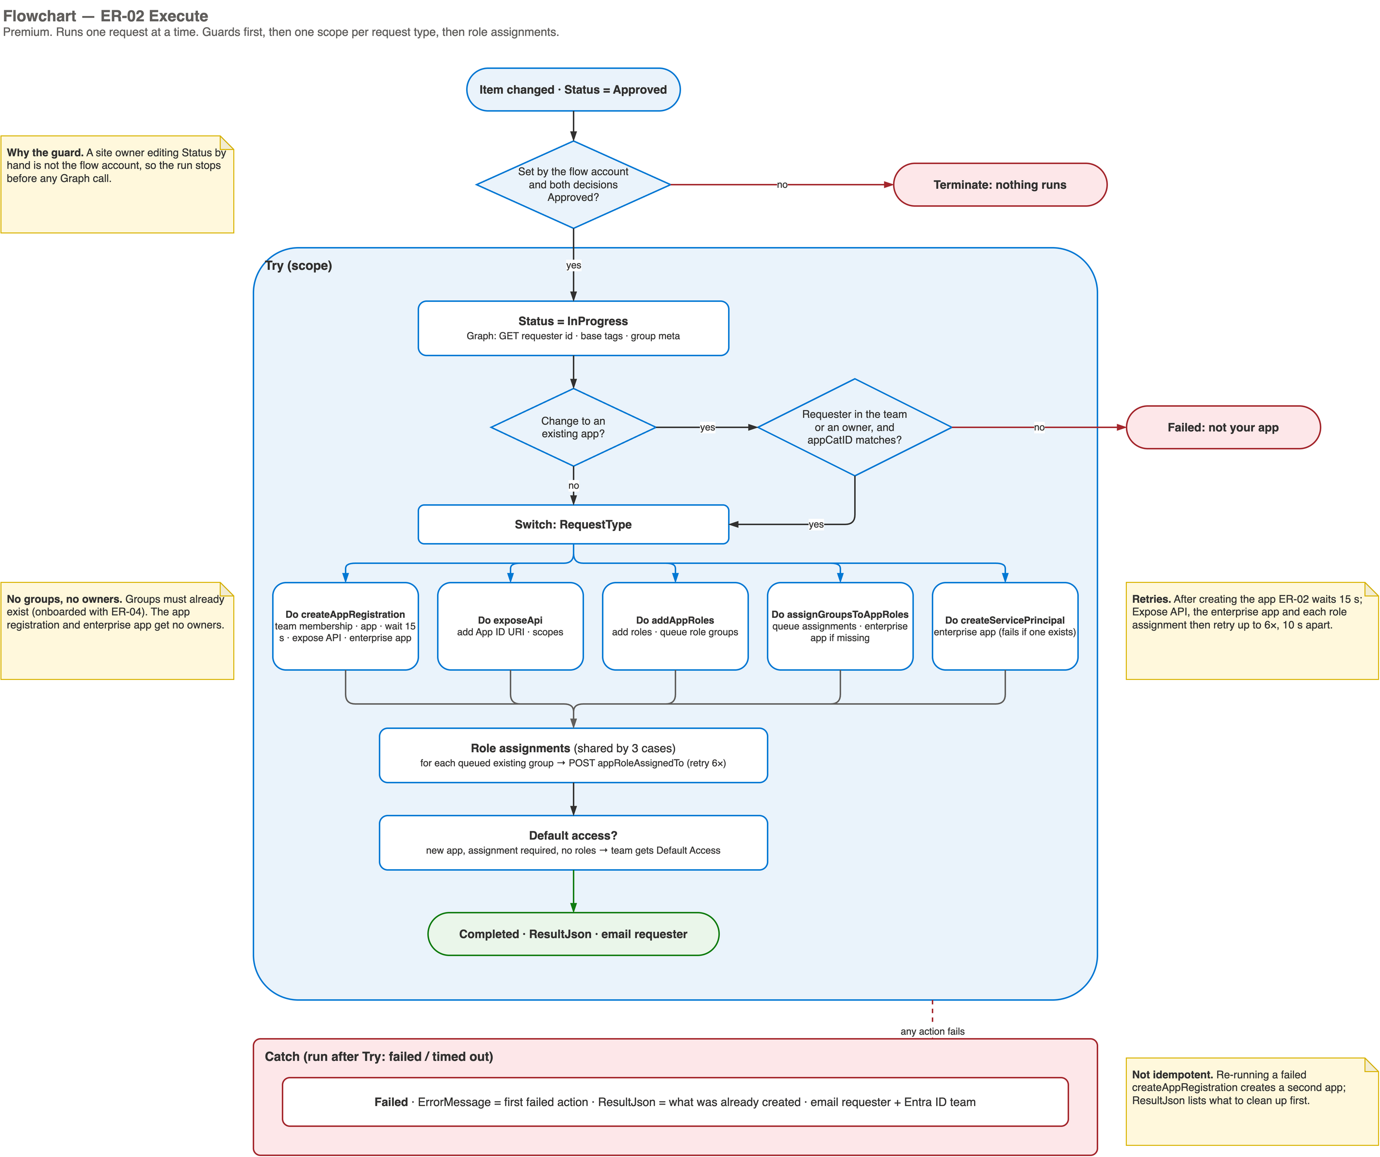
Appendix: ER-02 Execute flowchart
Notes:
Editable source: diagrams/entra-powerplatform.drawio, page 7. Open it in draw.io (desktop, web or the VS Code extension), edit, and export again as PNG.

Slide 23
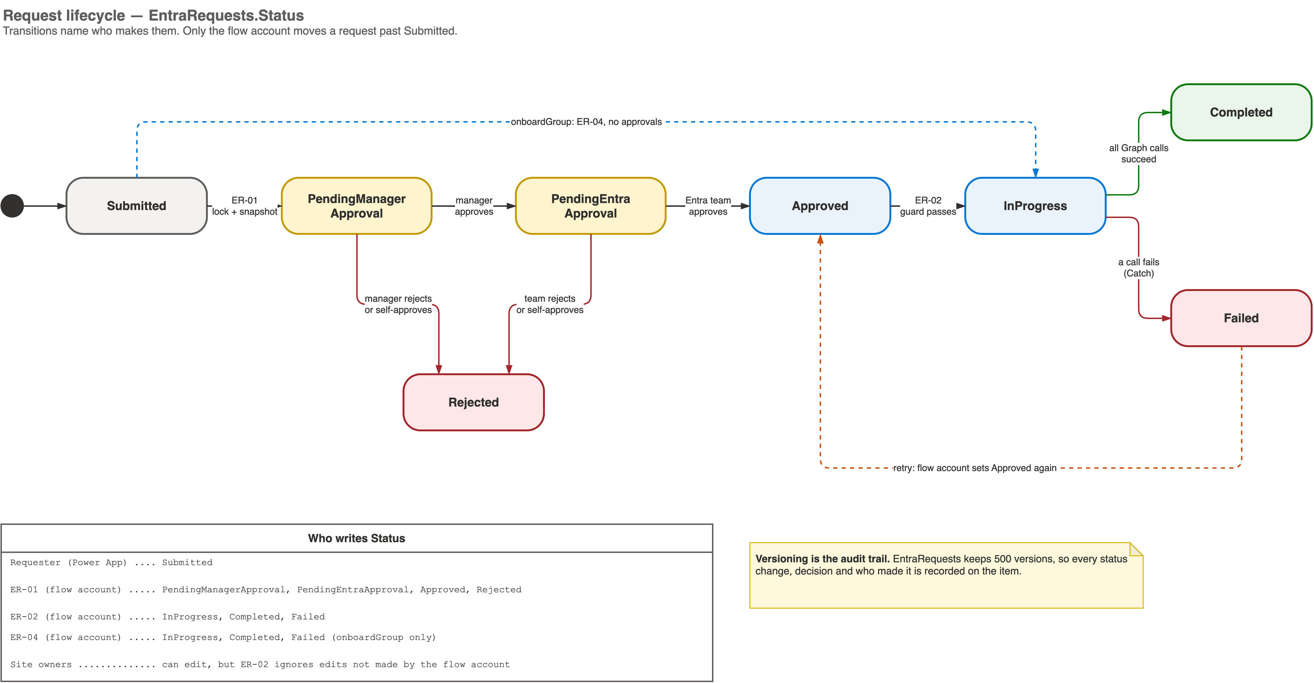
Appendix: request lifecycle
Notes:
Editable source: diagrams/entra-powerplatform.drawio, page 10. Open it in draw.io (desktop, web or the VS Code extension), edit, and export again as PNG.

Slide 24
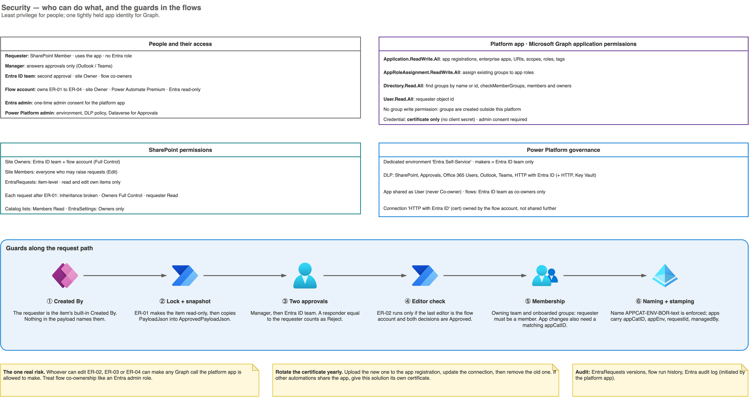
Appendix: security and permissions
Notes:
Editable source: diagrams/entra-powerplatform.drawio, page 12. Open it in draw.io (desktop, web or the VS Code extension), edit, and export again as PNG.

