Slide 1

JAYPEE UNIVERSITY OF ENGINEERING AND TECHNOLOGY,GUNA
MINOR PROJECT-1
18B19CI591

Slide 2
MENTORS AND PANEL MEMBERS
Supervised BY :
DR. MAHESH KUMAR
PROJECT NUMBER : 5
PROJECT BY :
RAVINDER SINGH (201B209)
RISHI RAJ SINGH (201B213)
UDAY TAMRAKAR (201B291)

Slide 3
Sales Forecasting

Slide 4
INDEX
S.NO. | TOPIC | PAGE NO.
1. | INTRODUCTION | 5
2. | PROBLEM STATEMENT | 6
3. | PURPOSE | 7
4. | DIFFERENT STAGES | 8-27
5. | HARDWARE-SOFTWARE REQUIRED | 28
6. | TIME FRAME | 29
7. | REFERENCES | 30

Slide 5
INTODUCTION
Sales forecasting is the process of estimating future revenue by predicting the amount of product or services a sales unit (which can be an individual salesperson, a sales team, or a company) will sell in the next week, month, quarter, or year.
Short Term
Medium Term
Long Term
Period of 3-6 Months
Period of 5-10 Years
Period of 6 months – 2 Years

Slide 6
Problem Statement
Sales forecasting is both a science and an art. Decision makers rely on these forecasts to plan for business expansion and to determine how to fuel the company’s growth.
For many small business like clothing shops ,grocery shops they many issues while purchasing their stocks because of inaccurate data of sales.
To overcome this problem we will be providing them small forecasting tools for them as they cant afford highly paid forecasting companies.

Slide 7
Purpose
By using this , we aim to improve the current sales trend for small business platforms. The benefits includes
Cost reduction.
Ease in buying products for future sales.
Reduction of human resources in purchasing and transporting goods.
Economic opportunity.
For effective control and evaluation.

Slide 8
Methodology
Gathering Data
Clean, Visualize Data
Choosing best forecasting model
Sales Forecast
Sales forecasting result evaluation

Slide 9
Gathering and Analysing Data
Gathering past sales data.
We need data to do data analysis.
We will work on CSV Data.
Extract the most relevant features into a pandas dataframe.

Slide 10
Code:-
import pandas as pd
df=pd.read_csv(“salesdata.csv")
df

Slide 11
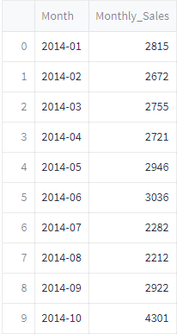
Outcome :

Slide 12
Visualize Data
Graphs help us quickly get a sense of the data.
We are visualizing the data via graphs using df.plot().
Plot the graph on the dataframe.

Slide 13
Code:-
import numpy as np
import pandas as pd
import matplotlib.pyplot as plt
%matplotlib inline
df.plot()

Slide 14
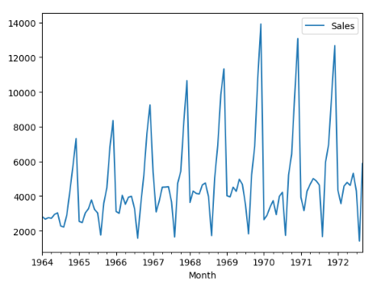
Outcome :

Slide 15
Various Model Developed for Forecasting Time Series Data
Simple Moving Average (SMA)
Exponential Smoothing (ES)
Autoregressive integration moving average (ARIMA)
Neural Network

Slide 16
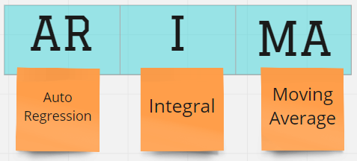
Choosing Best Forecasting Model
By using suitable statistical model we forecast the sales of product of organization efficiently.
The model we used is ARIMA (Autoregressive Integrated Moving Average) It is a model used in statistics to measure events that happen over a period of time .

Slide 17
ARIMA
An ARIMA model is a class of statistical models for analyzing and forecasting time series data. ARIMA stands for Auto-Regressive Integrated Moving Average.
The parameters of the ARIMA model are defined as follows:
p (the number of lag observations included in the model, also called the lag order)
d (the number of times that the raw observations are differenced, also called the degree of difference.)
q (The size of the moving average window, also called the order of moving average.)
Arima works on stationary data if data is not stationary then we have to apply differencing.

Slide 18
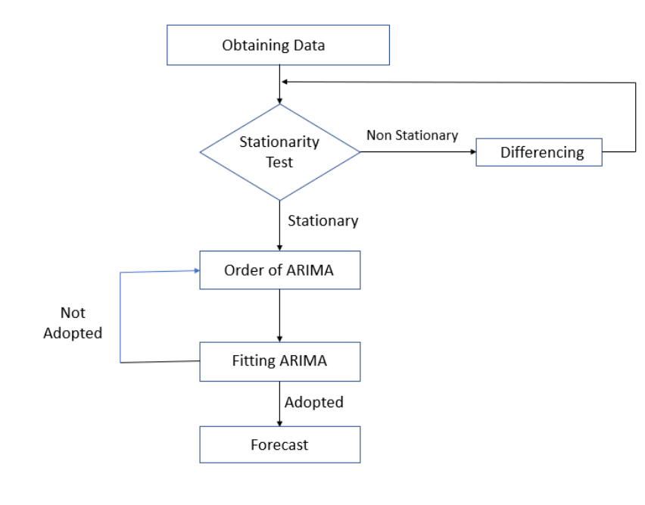
Flow Chart

Slide 19
Checking for Stationarity
To check whether the data is stationary or not we apply Augmented Dickey Fuller test.
The null hypothesis of the ADF test is that the time series is non-stationary. So, if the p-value of the test is less than the significance level (0.05) then you reject the null hypothesis and infer that the time series is indeed stationary.
def adfuller_test(sales):
result=adfuller(sales)
if result[1] <= 0.05:
print("Data is Stationary")
else:
print("Data is not stationary")
Adfuller_test(df[Monthly_Sales])

Slide 20
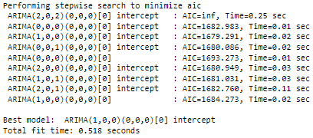
Finding Order Of Arima
To find the order of ARIMA we have used auto_arima function of pmdarima library.
from pmdarima import auto_arima
import warnings
warnings.filterwarnings("ignore")
order_item1=auto_arima(df[‘Monthly_Sales’])
Output:-

Slide 21
Working of ARIMA
An ARIMA model can be created using the statsmodels library as follows:
Define the model by calling ARIMA() and passing in the p, d, and q parameters.
The model is prepared on the training data by calling the fit() function.
Predictions can be made by calling the predict() function and specifying the index of the time or times to be predicted.

Slide 22
Code:-
import pandas as pd
import numpy as np
import matplotlib.pyplot as plt
%matplotlib inline
df=pd.read_csv('salesdata.csv’)
from statsmodels.tsa.stattools import adfuller
def adfuller_test(sales):
result=adfuller(sales)
labels = ['p-value','#Lags Used','Number of Observations]
for value,label in zip(result,labels):
print(label+' : '+str(value) )
if result[1] <= 0.05:
print("Data is Stationary")
else:
print("Data is not stationary")
adfuller_test(df['Sales’])
df['Seasonal First Difference']=df['Sales']-df['Sales'].shift(12)
from pmdarima import auto_arima

Slide 23
order_item1=auto_arima(df[‘Monthly_Sales’])
from statsmodels.tsa.arima.model import ARIMA
model=ARIMA(df['Sales'],order=(1,1,1))
model_fit=model.fit()
df['forecast']=model_fit.predict(start=2,end=103,dynamic=True)
df[['Sales','forecast']].plot(figsize=(12,8))
import statsmodels.api as sm
model=sm.tsa.statespace.SARIMAX(df['Sales'],order=(1, 1, 1),seasonal_order=(1,1,1,12))
results=model.fit()
df['forecast']=results.predict(start=90,end=103,dynamic=True)
df[['Sales','forecast']].plot(figsize=(12,8))
df['forecast']=results.predict(start=104,end=140,dynamic=True)
df[['Sales', 'forecast']].plot(figsize=(30, 8))

Slide 24
Outcome :
We will be able to forecast any product monthly sales with high accuracy.
Prediction of quantity of products that a costumers will buy.
Prediction of monthly sales.

Slide 25
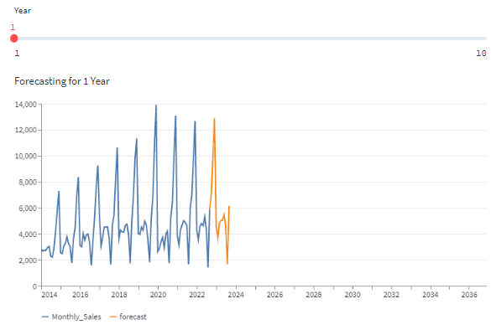
Outcome :

Slide 26
Web Implementation Using Streamlit
Streamlit is an open-source app framework in Python language. It helps us create web apps for data science and machine learning in a short time. It is compatible with major Python libraries such as scikit-learn, Keras, PyTorch, SymPy(latex), NumPy, pandas, Matplotlib etc.

Slide 27
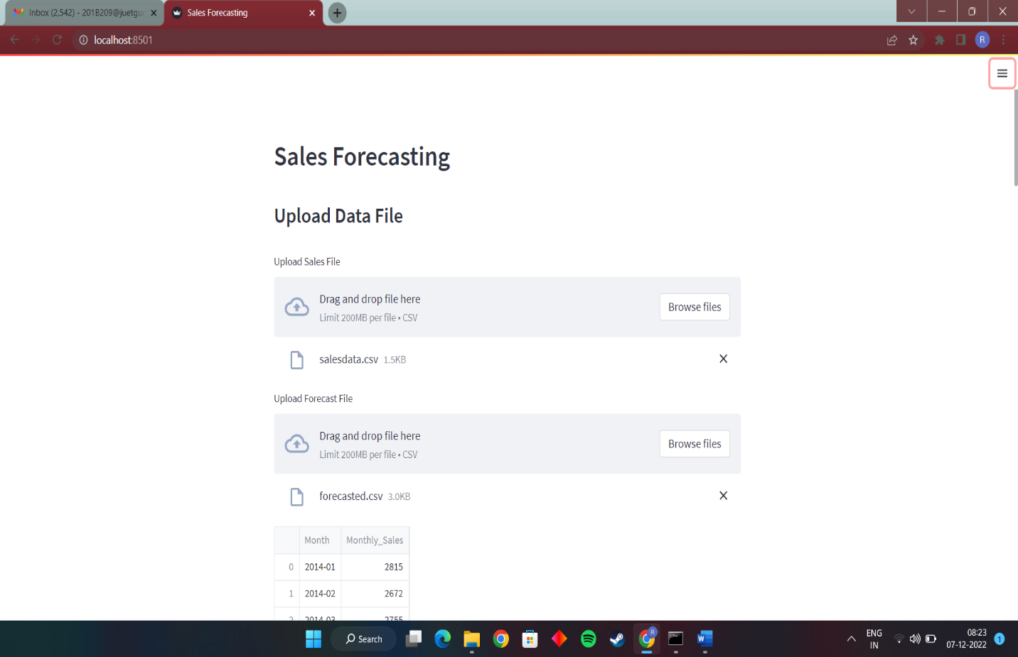

Slide 28
HARDWARE-SOFTWARE REQUIRED
SOFTWARE USED :
PYTHON
JUPYTER Notebook/GOOGLE Collab
Web Browser
HARDWARE USED :
CORE I5 PROCESSOR 10 GEN.
RAM SIZE = 8 GB.
MEMORY SIZE = 1 TB HDD

Slide 29
TIME FRAME :
TILL P1 :
RESEARCHED ABOUT THE PROJECT.
STUDIED AND PREPARED SLIDES.
TOOK REFERENCES FROM DIFFERENT WEBSITES.
TILL P2:
REMOVAL OF NULL AND NAN VALUES, FECTCHING AND VISUALISATION OF DATA,USING CHARTS.
TRAINING OF DATA ARIMA Model.
. TILL P3:-
1. Web Implementation of our project useing Steamlit framework.

Slide 30
REFERENCES
ARIMA Model – Complete Guide to Time Series Forecasting in Python LINK - https://www.machinelearningplus.com/time-series/arima-model-time-series-forecasting-python/
. Streamlit
LINK - https://streamlit.io/

Slide 31
THANK YOU

