Slide 1

CLOUD-BASED AI SOFTWARE
TESTING PLATFORM
Cloud Computing — Review 1
23MIC7176 — Tarun govardhan
23MIC7202 — sharan rao
23MIS7297 — J Ravindra
23MIS7257 — N Kartheek
23MIS7229 — Pardhasaradhi M
Guided by — [Dr. Shaik Kareemulla]
Cloud-Based AI Software Testing Platform | Review 1
1

Slide 2
PROBLEM STATEMENT
Writing software unit tests manually takes a lot of time, and developers frequently miss hidden bugs and edge cases.
KEY CHALLENGES IN SOFTWARE TESTING
• Manual Test Writing: Writing unit test cases by hand is slow, repetitive, and time-consuming.
• Missed Bugs & Edge Cases: Important scenarios like null inputs or empty values are easy to forget.
• Machine Differences: Code that works on one laptop can fail on another due to different software setups.
• Confusing Error Messages: Standard build tools show long error logs without explaining how to fix them.
• Computer Slowdowns: Running heavy test suites on personal laptops uses too much memory and CPU.
Cloud-Based AI Software Testing Platform | Review 1
2

Slide 3
INTRODUCTION
• Automated AI Platform: A web system that automatically creates and runs unit tests for Java projects.
• Powered by AI: Uses Artificial Intelligence to read code logic and write complete JUnit test cases.
• Safe Cloud Execution: Runs tests in isolated cloud containers so your computer stays fast and secure.
• Simple 4-Step Process: Upload project ZIP -> AI writes tests -> Cloud runs tests -> View results & bug fixes.
Cloud-Based AI Software Testing Platform | Review 1
3

Slide 4
OBJECTIVES
• 1. Automatic Test Writing — Use AI to generate unit tests for normal code and tricky edge cases.
• 2. Easy Project Upload — Allow users to drag and drop Java project ZIP files safely.
• 3. Isolated Cloud Running — Execute test suites in temporary cloud containers for consistent results.
• 4. Smart Error Explanations — Explain test failures in plain English and suggest automatic code fixes.
• 5. Live Progress Dashboard — Show real-time test progress, pass/fail totals, and execution logs.
• 6. Secure Cloud Storage — Keep project files, code versions, and test reports safe in cloud databases.
Cloud-Based AI Software Testing Platform | Review 1
4

Slide 5
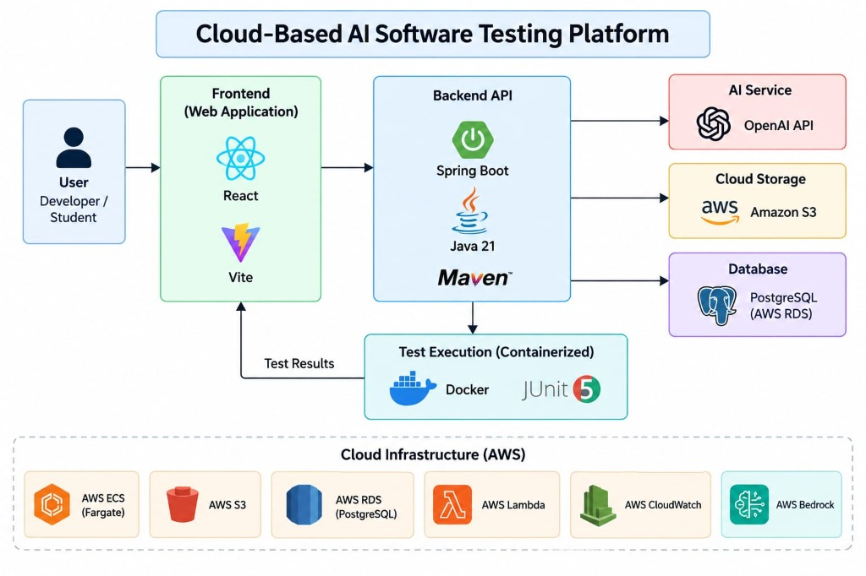
ARCHITECTURAL DIAGRAM
Cloud-Based AI Software Testing Platform | Review 1
5

Slide 6
LITERATURE REVIEW
KEY AREAS REVIEWED TODAY
• Traditional Testing Frameworks: Tools like JUnit automate running tests, but humans still write every test case manually.
• AI Code Generation: AI models can write test code, but standard tools don't execute tests in safe sandboxes.
• Container Sandboxes: Isolation tools keep test environments clean, but require complicated manual configuration.
• Cloud Storage & Services: Cloud platforms store files reliably, but lack automated error analysis and fix suggestions.
• Our Proposed Gap Solution: We combine AI test creation + Cloud container execution + Automated error fixes into one website.
Cloud-Based AI Software Testing Platform | Review 1
6

Slide 7
MODULES
MODULE 1: USER & PROJECT MANAGEMENT
• User login, developer accounts, and role permissions
• Project ZIP file upload with built-in security checks
• Interactive source code file tree viewer on screen
MODULE 2: AI TEST GENERATOR ENGINE
• Reads Java files, classes, methods, and functions
• Automatically writes test suites for normal logic and edge cases
• Formats generated code into ready-to-run Java test files
Cloud-Based AI Software Testing Platform | Review 1
7

Slide 8
MODULES
MODULE 3: CLOUD EXECUTION SANDBOX
• Starts a fresh, temporary cloud container for each project run
• Executes test builds automatically in isolation
• Prevents test runs from affecting developer laptops or servers
MODULE 4: ERROR FIXES & DIAGNOSTICS
• Captures build failures, compiler errors, and stack traces
• Explains the exact reason why a test failed in plain language
• Provides a one-click button to apply automatic code fixes
Cloud-Based AI Software Testing Platform | Review 1
8

Slide 9
MODULES
MODULE 5: LIVE DASHBOARD & ANALYTICS
• Streams real-time test execution logs directly to the web page
• Displays test pass/fail charts and project health metrics
• Shows side-by-side code diffs comparing broken vs fixed code
MODULE 6: CLOUD STORAGE & MONITORING
• Stores project archives and test reports securely in cloud storage
• Keeps historical logs of past test runs in a central database
• Monitors system speed, uptime, and user data security
Cloud-Based AI Software Testing Platform | Review 1
9

Slide 10
CURRENT STATUS
CURRENT STATUS — REVIEW 1 PROGRESS
• Finalized project topic, scope, and problem statement
• Identified system objectives and team responsibilities
• Designed complete cloud architecture and data workflow
• Mapped core project modules and feature requirements
• Selected technology stack (React, Spring Boot, AI & AWS Cloud)
• Next Focus: Build backend APIs, database tables, and AI test generation pipeline
Cloud-Based AI Software Testing Platform | Review 1
10

Slide 11
PLAN OF ACTION
PHASE 1 — FOUNDATION
• Set up cloud storage buckets and database tables
• Create user login and dashboard layout design
• Build initial ZIP file upload screens
PHASE 2 — CORE BACKEND & AI
• Build backend server APIs to handle project decompression
• Connect AI model to parse Java files and write unit tests
• Link web dashboard screens to backend services
Cloud-Based AI Software Testing Platform | Review 1
11

Slide 12
PLAN OF ACTION
PHASE 3 — SANDBOX & DIAGNOSTICS
• Build the cloud container test runner for clean execution
• Connect error log parser to AI diagnostic engine
• Enable automatic code fix suggestions on the dashboard
PHASE 4 — TESTING & DEPLOYMENT
• Test full workflow with real Java software projects
• Deploy backend and web portal to cloud servers for live access
• Add analytics dashboards and complete final documentation
Cloud-Based AI Software Testing Platform | Review 1
12

Slide 13
CONCLUSION
• Provides a complete, automated software testing platform for developers.
• Saves time by using AI to write unit tests automatically.
• Keeps code execution consistent by running tests in clean cloud containers.
• Helps developers fix bugs faster with automated error explanations and code fixes.
• Delivers a simple, user-friendly web portal for managing software quality.
Cloud-Based AI Software Testing Platform | Review 1
13

Slide 14
REFERENCES
• 1. JUnit 5 User Guide & Documentation — https://junit.org/junit5/docs/current/user-guide/
• 2. Spring Boot Framework Reference — https://docs.spring.io/spring-boot/
• 3. AWS Bedrock Foundation Models — https://docs.aws.amazon.com/bedrock/
• 4. AWS ECS Fargate User Guide — https://docs.aws.amazon.com/AmazonECS/
• 5. Docker Container Isolation Overview — https://docs.docker.com/get-started/overview/
• 6. S. Bareiß et al., 'Code Generation Tools in Software Testing: A Survey,' IEEE TSE, 2023.
Cloud-Based AI Software Testing Platform | Review 1
14

Slide 15
THANK YOU
Questions and discussion welcome.
Cloud-Based AI Software Testing Platform — Review 1
Department of Computer Science & Engineering | VIT-AP University
Cloud-Based AI Software Testing Platform | Review 1
15

