Slide 1

EDA on IPL by Ravindra Banwari

Slide 2
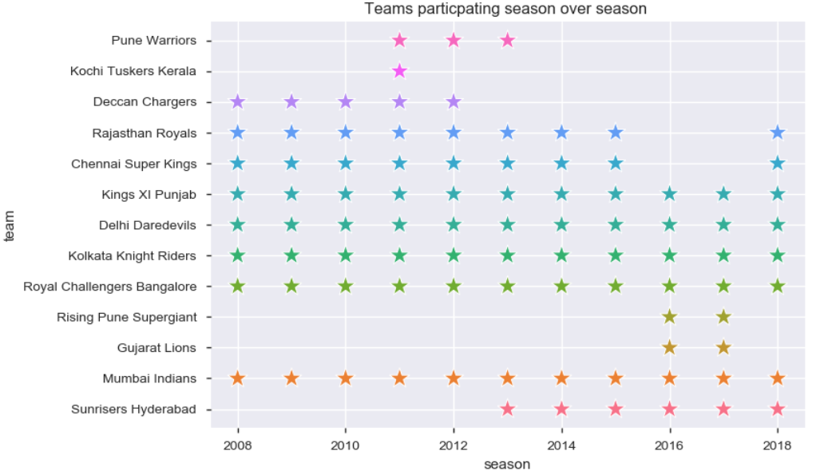
How many teams have been participating
We can see on average 8 teams are pretty constant in participating all the seasons

Slide 3
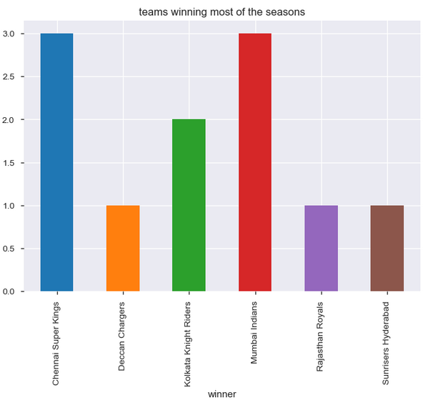
Which teams won most of the seasons
Chennai Super Kings and Mumbai Indians have won 3 seasons so far

Slide 4
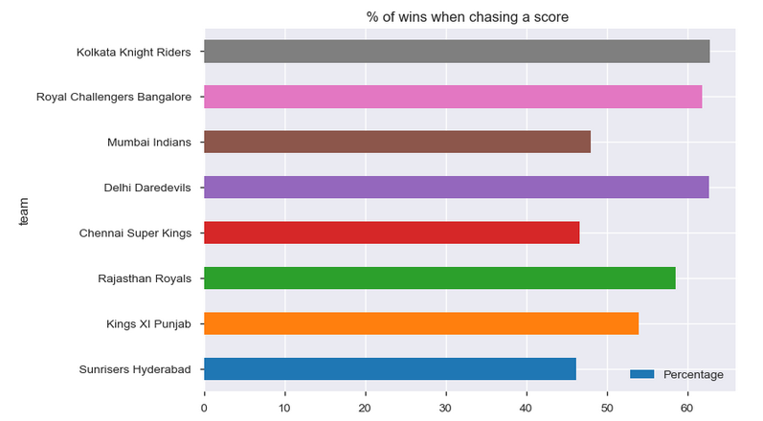
Percentage of winning match when chasing (match won above 20 only )
A slight positive correlation is seen in wining a match when chasing as more than half of the match ( ~ 60 % on average) wins are chasing win for top teams

Slide 5
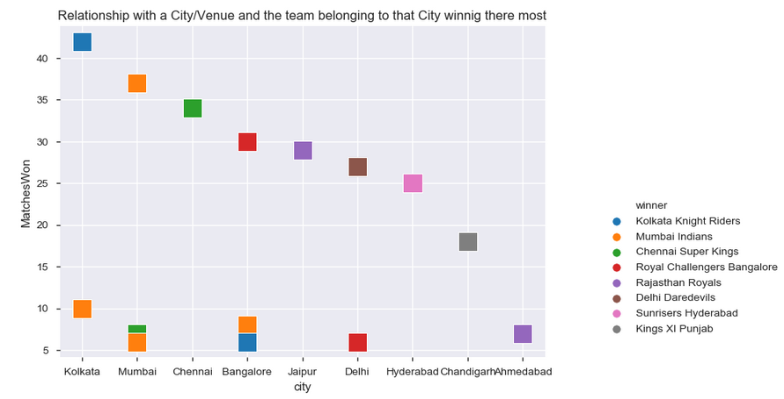
Is there any home advantage for winning a match?
There is very high correlation which indicate a team wont most of the match in its home group
KKR , MI ,CSK are ones above wining 30 + matches in their home ground .

Slide 6
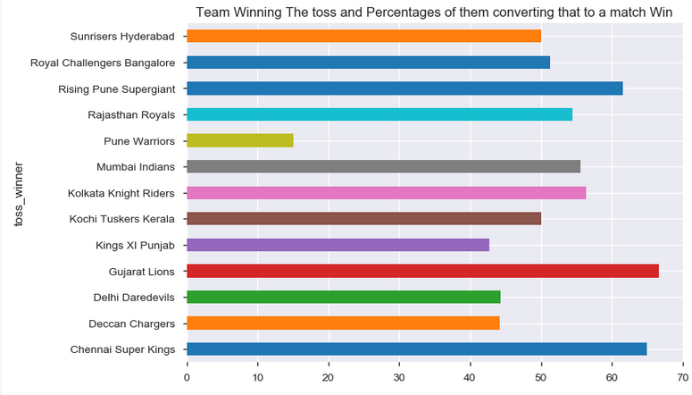
Is there any relation in wining a toss and winning the match
Toss Win actually did not help a team wining the match and there was around 50-50 chances for most of the teams.

Slide 7
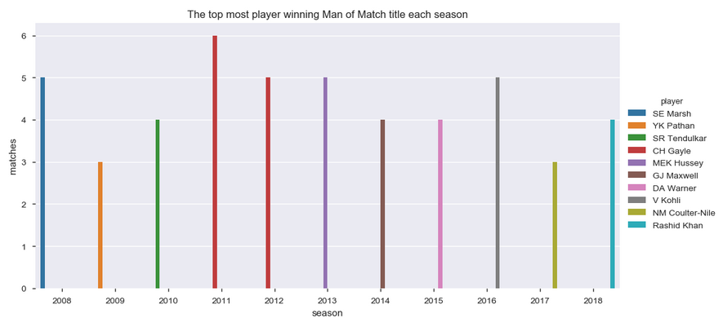
Players that won Man of Match award the most
CH Gayle wont 2 seasons most of the ‘Man of the Match Award’
V Kohli ,SE Marsh are ones next inline
This indicates mostly the batsmen are the man of the match

Slide 8
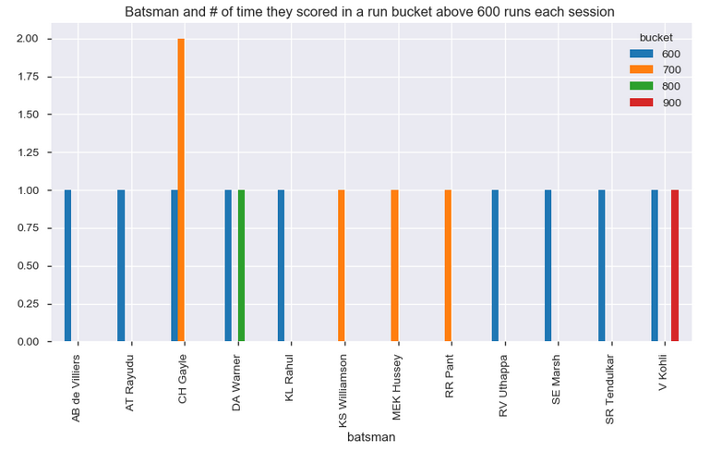
Best batsmen with total runs ( above 600 ) over all seasons
V Kohli is best in this category with 1 season above 900+ run and one season 600-700 .
CH Gayle and DA Warner are in line next .
This indicates mostly the batsmen are the man of the match

Slide 9
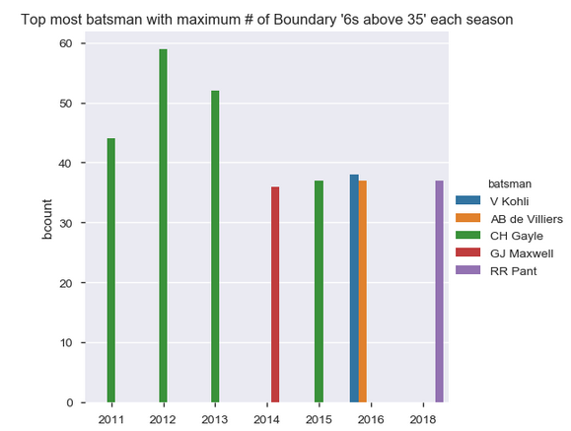
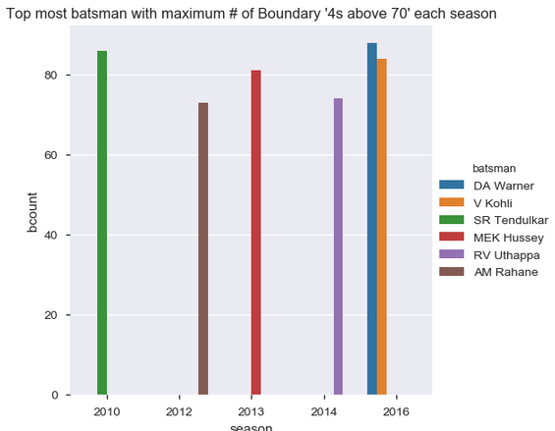
Best batsmen with # of boundaries
Sixes
Fours
CH Gayle is un- doubtably the best in this category for hitting 6’s
DA Warner and SR Tendulkar and V Kohli top most batman hitting 4’s
V Kohli is in both the categories ( but not CH Gayle ) indicating V Kohli’s consistency .

Slide 10
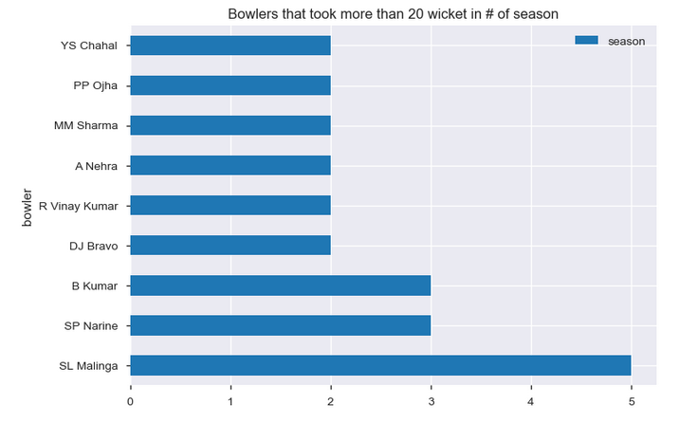
Best bowlers( taking above 20 wickets each season)
LS Malinga is the best in this category
B Kumar and SP Narine are next in line .

Slide 11
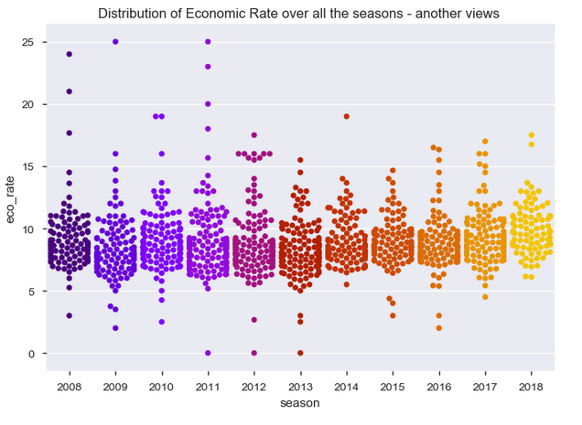
Economy Run Rate for bowlers over all seasons
The Economic Run Rate indicates all the bowlers conceded more run making it less bowler dominant game .

Slide 12
Conclusion :
A team playing at its home city has a home advantage and more chances to win the match there.
The Economic Run Rate and # of Man of the Match indicate Batsmen dominate the season not bowlers in this format of cricket .
CG Gayle and V Kohli have been the most consistent batsman over all the season.
SL Malinga has been the most consistent bowler
Winning a toss doesn’t really help in winning a match .
More than half of the wins are when chasing a score .

