Slide 1
Travel Agent Chatbot
A Comprehensive Approach to Building a Conversational Travel Agent
by:Ravindra Chabhadia

Slide 2
Problem Description
Travel planning is time-consuming and often requires personalized information.
Need for a chatbot that can handle both general travel queries and proprietary travel package information.
The challenge of accurately detecting the intent of user queries (general knowledge vs. proprietary information).

Slide 3
Data Source
General Knowledge Questions: Handled by OpenAI's GPT-4 model.
Proprietary Information: Stored in a SQLite database containing travel package details (e.g., origin, destination, price, and package details).

Slide 4
Technical Approach
Backend: Developed using FastAPI for handling API requests.
NLP Processing: Implemented using spaCy to extract key information from user queries.
Database: SQLite used for storing proprietary travel package data.
Frontend: Created using Streamlit to provide a user-friendly interface for interacting with the chatbot.

Slide 5
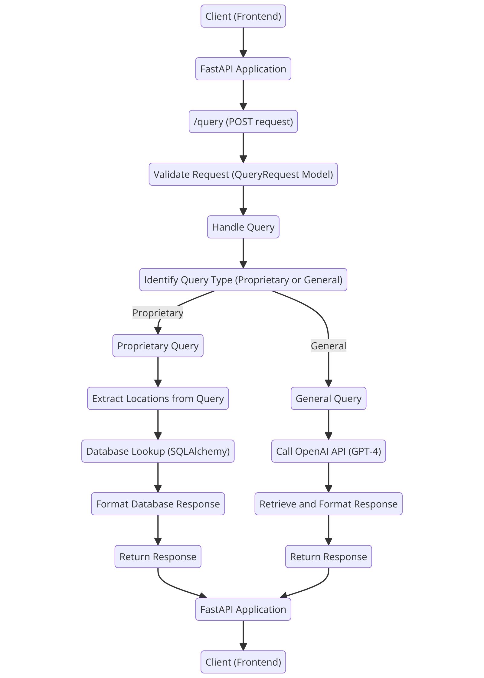
Implementation - Backend
FastAPI setup for handling HTTP requests.
Integration with OpenAI's GPT-4 for answering general knowledge questions.
Error handling and logging for robust API performance.

Slide 6
Implementation - NLP and Query Handling
Using spaCy to identify and extract geographical locations from user queries.
Custom logic to determine the type of query (general knowledge vs. proprietary information).
Case-insensitive database queries using SQLAlchemy's ilike function for accurate results.

Slide 7
Implementation - Frontend
Streamlit for creating an interactive web interface.
Input box for user queries and a button to submit queries.
Displaying responses from the backend, including general knowledge answers and specific travel package details.

Slide 8
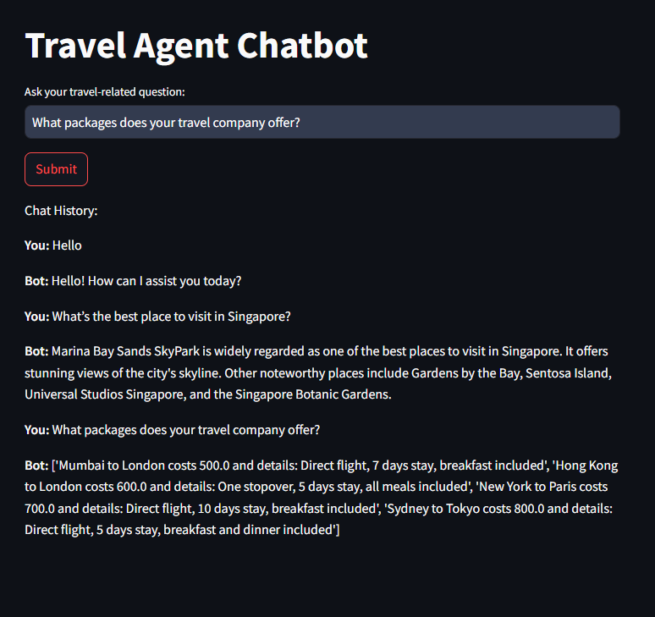
Results
Successful retrieval of general knowledge answers from OpenAI GPT-4.
Accurate extraction and retrieval of proprietary travel package information from the database.
User-friendly interface allowing seamless interaction with the chatbot.

Slide 9
Conclusion
Achieved a functional travel agent chatbot capable of handling diverse user queries.
Effective use of NLP for intent detection and information extraction.
Robust backend and intuitive frontend providing a comprehensive solution for travel planning.
Future enhancements could include more sophisticated NLP models and additional features like booking and payment integration.

