Slide 1
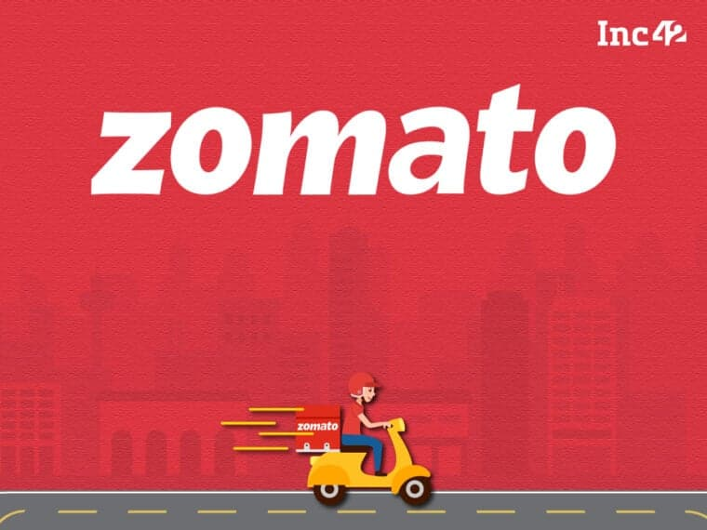
Ravindra Singh Negi ZOMATO DATA ANALYSIS

Slide 2
Problem Statement
As Zomato aims to expand its presence by opening new restaurants, it is crucial to identify the most strategic locations for investment. The challenge lies in selecting cities and countries with the optimal balance of demand, affordability, and low competition. By analyzing key metrics such as average cost for two, customer ratings, existing restaurant density, and dining trends, this study seeks to provide data-driven recommendations for Zomato's expansion strategy.
This analysis will help answer:
Which countries and cities have the least competition while maintaining strong demand?
What price range is most attractive to customers in different regions?
How do customer ratings and dining preferences influence success in new markets?

Slide 3
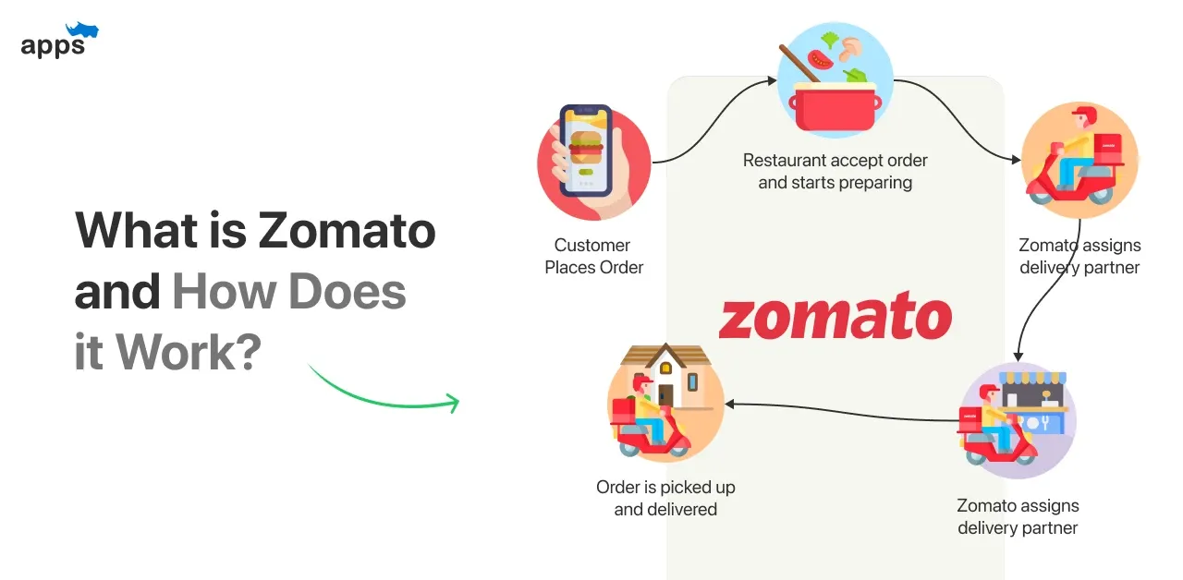
About Zomato
Zomato is a food delivery and restaurant discovery platform that helps users find restaurants, order food, and read reviews.

Slide 4

Zomato Data Key Insights
Total Number of Countries: 15
Total Number of Cities: 141
Total Number of Restaurants: 7,433
Total Number of Cuisines: 1,826
Data cleaning and preprocessing –
Firstly checked the duplicate rows in the data. There were no duplicate rows present in the data
Country name present in another table using the vlookup fetched the country name in main table.
Checked the null values in the data. Few null values present in the column latitude, longitude and cuisines column. There were no use of latitude and longitude column for my further process then I deleted both column. In cuisines column I used mode function to fill the null values.
In Average cost for two column the amounts were present in different currencies. I made a new column in which I changed the all amount in Indian INR.

Slide 5
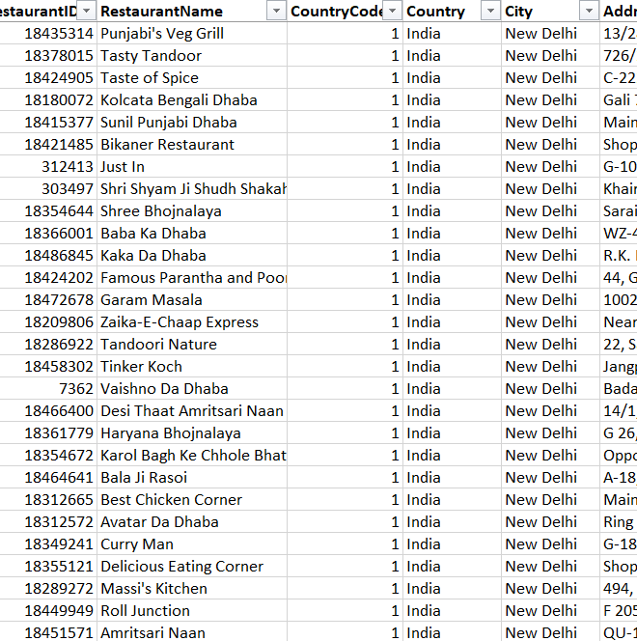
Analysis
In our analysis of the Zomato dataset, we encountered two tables, each containing essential information about restaurants. The dataset consists of 20 attributes, with 16 of them being categorical, such as cuisine types, restaurant names, and locations.
While exploring the data, we noticed that some values were missing in the cuisines column. To ensure data completeness, we addressed this issue by filling in the missing values using the mode (the most frequently occurring cuisine in the dataset). This approach helps maintain consistency while preserving the overall distribution of cuisines.
Additionally, one of the key enhancements we made involved filling in the country information in Table 1. Since Table 2 contained the country details linked to a unique identifier, we efficiently mapped the country names using the VLOOKUP function in Excel. By referencing the corresponding country codes in Table 2, we ensured that every entry in Table 1 had the correct country information, making our dataset more structured and ready for further analysis.
With these data cleaning and enrichment steps completed, the dataset is now more reliable, setting the stage for deeper insights into global restaurant trends, competition, and market opportunities.

Slide 6
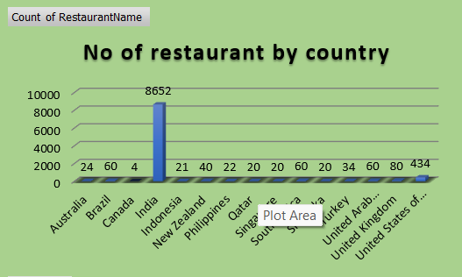
Australia: 24 restaurants
Brazil: 60 restaurants
Canada: 4 restaurants
India: 8652 restaurants
Indonesia: 21 restaurants
New Zealand: 40 restaurants
Philippines: 22 restaurants
Qatar: 20 restaurants
Singapore: 20 restaurants
South Africa: 60 restaurants
Sri Lanka: 20 restaurants
Turkey: 34 restaurants
United Arab Emirates: 60 restaurants
United Kingdom: 80 restaurants
United States of America: 434 restaurants
Country wise Number of Restaurant

Slide 7
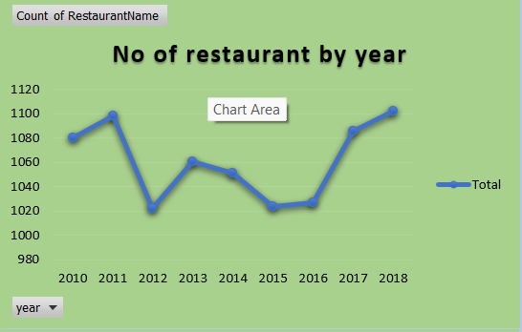
Over the years, the restaurant industry has seen consistent growth, with new establishments opening steadily each year. The data reveals a dynamic expansion pattern from 2010 to 2018, showcasing resilience and adaptability in the food business. The year 2018 recorded the highest number of new restaurant openings at 1,102, signaling a peak in the decade. Prior to this, 2011 also saw a strong surge with 1,098 restaurants. Notably, 2010 and 2017 followed closely behind with 1,080 and 1,086 openings, respectively. While there were minor fluctuations, the trend remained stable, with new openings averaging around 1,020–1,100 annually. The lowest recorded year was 2012, with 1,022 restaurants, but the industry quickly rebounded, maintaining a steady pace. This data underscores the robustness of the restaurant industry, highlighting consistent investment and expansion efforts despite economic shifts. The steady influx of new restaurants each year reflects ongoing demand, evolving culinary trends, and the ever-growing consumer appetite for dining experiences.
Year Wise Number of Restaurant

Slide 8
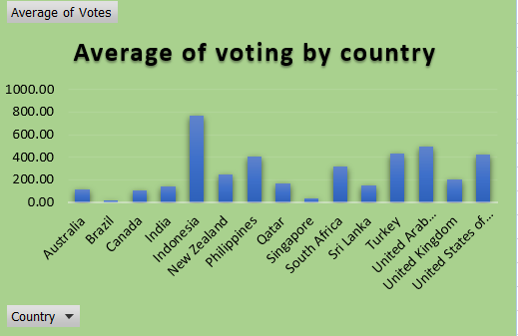
Country Wise Average Voting
India has 388 restaurants in the highest price range of 4, reflecting a strong premium dining market. The average number of votes per restaurant varies across countries, with Indonesia (772.10), UAE (493.52), Turkey (431.47), and the U.S. (428.22) leading in customer engagement. India also shows high interaction with 137.21 votes per restaurant. In contrast, Brazil (19.62) and Singapore (31.90) have the lowest engagement. High-vote regions indicate strong digital review culture, while low-vote markets may need strategies to boost online presence

Slide 9
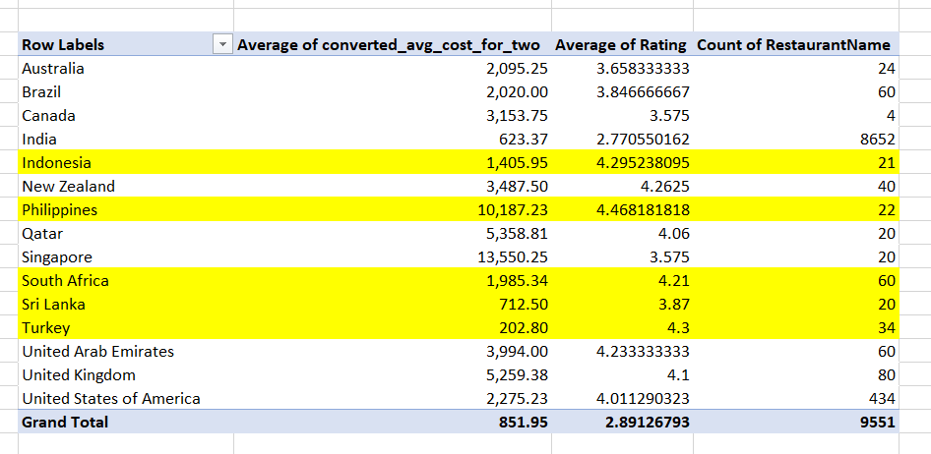
Countries For Opening New Restaurant

Slide 10
Indonesia:
Average Cost for Two: ₹1,405.95 — Moderate pricing.
Average Rating: 4.29 — High customer satisfaction.
Number of Restaurants: 21 — Indicates lesser competition with promising customer interest.
Philippines:
Average Cost for Two: ₹10,187.23 — Higher costs but excellent ratings (4.47), suggesting a market for premium dining experiences.
Number of Restaurants: 22 — Moderate competition, ideal for high-end restaurants.
South Africa:
Average Cost for Two: ₹1,985.34 — Balanced cost with strong ratings (4.21).
Number of Restaurants: 60 — Competitive yet manageable market with strong customer satisfaction.
Sri Lanka:
Average Cost for Two: ₹712.50 — Lowest average cost, providing an opportunity for budget-friendly restaurants.
Average Rating: 3.87 — Decent customer satisfaction, indicating growth potential.
Turkey:
Average Cost for Two: ₹202.80 — Extremely affordable dining costs, attracting budget-conscious customers.
Average Rating: 4.3 — Strong customer approval.
Number of Restaurants: 34 — Lower competition, indicating significant market entry potential.

Slide 11
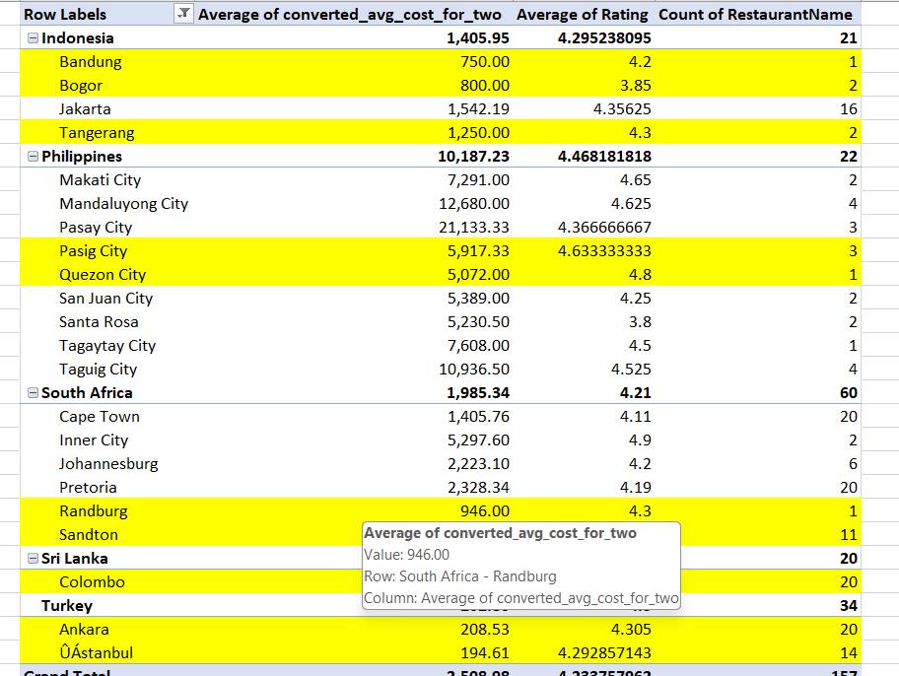
Indonesia Bandung (₹750, Rating: 4.2) – Affordable dining with strong customer feedback. Bogor (₹800, Rating: 3.85) – A budget-friendly market with room for growth. Tangerang (₹1,250, Rating: 4.3) – Balanced pricing with excellent customer satisfaction. Philippines Pasig City (₹5,917, Rating: 4.63) – A premium dining hub with remarkable reviews. Quezon City (₹5,072, Rating: 4.8) – Outstanding ratings suggest strong customer loyalty. South Africa Randburg (₹946, Rating: 4.3) – Affordable with impressive customer ratings. Sandton (₹1,778, Rating: 4.3) – Balanced pricing with high demand potential. Sri Lanka Colombo (₹712.50, Rating: 3.87) – Budget dining with emerging customer interest. Turkey Ankara (₹208.53, Rating: 4.3) – Extremely low dining costs with strong customer approval. Istanbul (₹194.61, Rating: 4.29) – Budget-friendly yet highly rated dining destination.
Cities For Opening New Restaurant From Recommended Countries

Slide 12
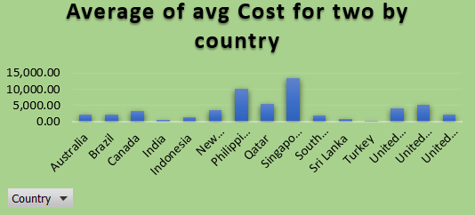
Key Countries for Expansion Turkey – ₹202.80 (Lowest Cost) With incredibly low dining costs, Turkey offers an ideal entry point for budget-friendly restaurants. This is a prime opportunity to tap into a price-conscious market with minimal investment. Sri Lanka – ₹712.50 With affordable dining expenses and emerging customer demand, Sri Lanka is perfect for launching mid-range restaurants that cater to locals and tourists alike. Indonesia – ₹1,405.95 Known for its rich food culture and growing dining scene, Indonesia offers a balanced mix of affordability and customer satisfaction, making it a stable investment choice. South Africa – ₹1,985.34 With slightly higher costs but a strong demand for dining experiences, South Africa is ideal for restaurants aiming to deliver quality meals at moderate prices. Philippines – ₹10,187.23 Despite higher costs, the Philippines presents an opportunity for premium dining experiences, catering to customers willing to pay more for quality food.
Country Wise Average Cost For Two

Slide 13
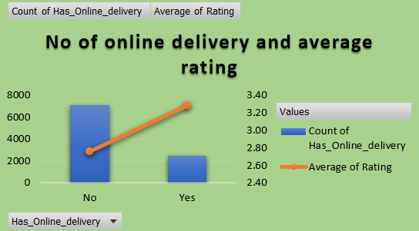
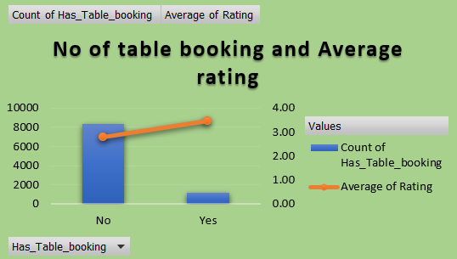
Our data reveals crucial insights about how online delivery and table booking influence customer satisfaction. 📊 Key Findings Online Delivery Impact: With Delivery: 3.29 average rating (higher satisfaction) Without Delivery: 2.75 average rating ✅ Conclusion: Restaurants offering delivery services receive higher ratings, indicating improved customer convenience and satisfaction. Table Booking Impact: With Table Booking: 3.48 average rating (significantly higher) Without Table Booking: 2.81 average rating ✅ Conclusion: Restaurants with table booking options achieve higher customer satisfaction, suggesting smoother dining experiences and better service quality. 🔍 Key Insights for Growth Strategy Online Delivery Boosts Satisfaction: Implementing a reliable delivery system can cater to customers seeking convenience, driving better ratings. Table Booking Elevates Experience: Enabling reservations enhances customer comfort, reduces waiting times, and attracts groups or special-event diners. Combined Strategy for Maximum Impact: Restaurants that provide both delivery and table booking are likely to see the highest customer satisfaction rates.
Online Delivery And Table Booking With Average Cost For Two

Slide 14
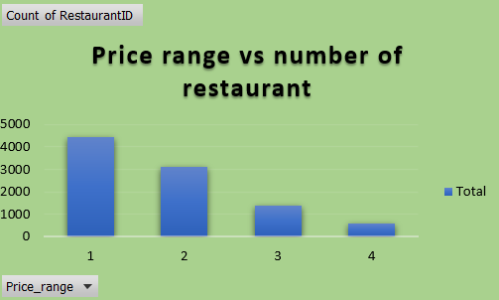
Price Range Analysis Price Range 1 (Lowest Price) – 4,444 restaurants ➔ Dominates the market, indicating strong demand for budget-friendly dining options. Price Range 2 (Moderate Pricing) – 3,113 restaurants ➔ Popular among customers seeking quality meals at reasonable prices. Price Range 3 (Premium Dining) – 1,408 restaurants ➔ A smaller yet significant segment catering to those willing to spend more for better quality and service. Price Range 4 (High-End Dining) – 586 restaurants ➔ The least competitive segment, presenting an opportunity for luxury dining concepts.
Number Of Restaurant By Price Range

Slide 15

Strategic Recommendations for Zomato Expansion
Target Markets for Expansion
Turkey and Sri Lanka: Ideal for budget-friendly restaurants due to low average costs and manageable competition.
Indonesia and South Africa: Balanced cost-to-rating ratios make them stable investment choices.
Philippines: Suitable for premium dining due to higher costs and excellent ratings.
City Selection for Expansion
Budget-Friendly Cities:
Ankara (Turkey) and Istanbul (Turkey) — Affordable dining with strong customer approval.
Colombo (Sri Lanka) — Emerging hotspot with decent ratings and low costs.
Premium Dining Cities:
Pasig City (Philippines) and Quezon City (Philippines) — Ideal for upscale restaurants with remarkable reviews.
Cuisine Recommendations
Focus on Bar Food, European, Asian, and Sushi to cater to diverse preferences.
Introduce Indonesian Sunda Cuisine in Indonesia for local authenticity.
Service Enhancements
Prioritize Online Delivery for broader customer reach and improved ratings.
Implement Table Booking to enhance dine-in experiences and increase satisfaction.
Pricing Strategy
Emphasize Budget-Friendly Dining in Turkey and Sri Lanka.
Introduce Premium Dining Concepts in key Philippine cities for upscale market penetration.
Competitive Strategy
Identify and monitor competitors in the selected countries and cities.
Focus on standout features like unique cuisines, improved customer service, and enhanced dining experiences.

Slide 16
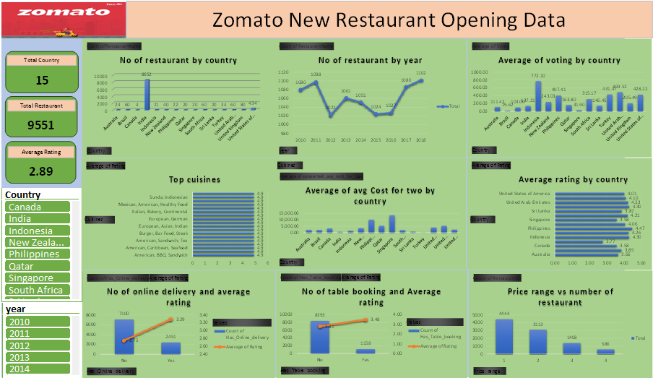
Dashboard

Slide 17

Conclusion Based on Zomato Data Analysis
Best Countries for Expansion:
Turkey and Sri Lanka offer ideal opportunities for budget-friendly restaurants with lower competition and affordable dining costs.
Indonesia and South Africa present stable investment options due to moderate costs and high customer ratings.
Philippines is well-suited for premium dining establishments with higher spending capacity and strong customer satisfaction.
City-Level Insights:
Cities like Ankara, Istanbul, and Colombo are promising low-cost entry points for budget dining.
Pasig City and Quezon City are prime locations for premium dining due to exceptional ratings.
Cuisine Recommendations:
Focus on popular cuisines such as Bar Food, Asian, and Sushi for mass appeal.
Introduce Indonesian Sunda Cuisine to attract local customers in Indonesia.
Service Recommendations:
Offering Online Delivery and Table Booking significantly improves customer satisfaction, making it essential for new restaurant openings.
Pricing Strategy:
Expanding in Turkey and Sri Lanka requires budget-focused strategies, while Philippines demands premium dining experiences.
Competitive Edge:
Monitoring competitors and enhancing customer experience with improved services, unique cuisine offerings, and strategic pricing will ensure successful market entry.
Final Note:
By strategically targeting countries with lesser competition, optimizing service offerings, and aligning cuisine choices with local preferences, Zomato can achieve successful expansion while meeting diverse customer demands.

