Slide 1
Detecting the Undetectable
How Nation-State Attackers Operate Undetected for Years Inside Critical Infrastructure — and How AI Changes the Outcome
V-Intelligence UEBA: The Behavioral Digital Twin for Cyber Defense
22nd Century Technologies, Inc. | Confidential

Slide 2
The Threat Landscape Has Changed
Nation-state attackers no longer break in — they blend in. They use legitimate credentials, standard protocols, and built-in system tools. They look exactly like your employees.
287 days
$4.88M
5+ years
5+ years
Average time to detect a breach (IBM 2024)
Average cost of a data breach (IBM 2024)
Salt Typhoon in US telecom before discovery
Volt Typhoon in US critical infra before discovery
The New Reality
These are not hypothetical scenarios. In 2024, the US government disclosed that Chinese state-sponsored groups had been operating undetected inside American telecom and critical infrastructure for years.
Traditional cybersecurity tools — SIEM rules, anomaly detection algorithms, threshold-based alerts — were deployed at every compromised organization. None of them detected the intrusion.
The attackers were not invisible because they were sophisticated. They were invisible because the detection methods are fundamentally blind to their approach.
22nd Century Technologies, Inc. | V-Intelligence UEBA | Confidential

Slide 3
Case Study: Salt Typhoon — 5 Years Inside US Telecom
What Happened
Why Every Detection System Failed
~2019
Reconnaissance begins against US telecom providers
▸ Used legitimate network protocols — no malware signatures to detect
~2021
Active penetration of telecom infrastructure
▸ Maintained normal traffic volumes — never spiked bandwidth alerts
2021-2024
Persistent access to AT&T, Verizon, T-Mobile, Lumen, Charter, Windstream
▸ Operated with valid credentials — no brute force, no credential stuffing
2024
Accessed CALEA lawful intercept / wiretap systems
▸ Exploited lawful intercept systems — outside standard SIEM monitoring
2024
Harvested call metadata of 1M+ users, including senior US officials
▸ CALEA systems managed separately from customer-facing security
Sept 2024
FBI and CISA discover the breach — not the telecom companies
✗ Every traditional SIEM rule, IDS signature, and anomaly threshold was in place
Oct 2024
Public disclosure; 9 US telecoms confirmed compromised
✗ None detected the intrusion — for over five years
22nd Century Technologies, Inc. | V-Intelligence UEBA | Confidential

Slide 4
Case Study: Volt Typhoon — 5 Years in Critical Infrastructure
What Happened
Why "Living Off the Land" Is Undetectable
~2019
Initial access to US critical infrastructure networks
▸ Zero malware deployed — used only built-in OS tools
2019-2023
Persistent presence in energy, water, telecom, transportation
▸ PowerShell, WMI, cmd, netsh — tools every admin uses daily
Ongoing
Pre-positioned for disrupting US-Asia communications
▸ Authenticated with stolen valid credentials
May 2023
Microsoft Threat Intelligence publicly discloses the campaign
▸ Lateral movement looked identical to IT maintenance
May 2023
CISA/NSA/FBI publish Joint Advisory AA23-144A
▸ No anomalous traffic patterns — everything within normal bounds
Feb 2024
CISA confirms 5 years of persistent access in some targets
✗ EDR, SIEM, IDS all deployed — all failed to detect
2024
Follow-up Advisory AA24-038A documents full scope
✗ Discovered by Microsoft threat researchers, not by deployed tools
Common thread: Both Salt Typhoon and Volt Typhoon were discovered by external researchers — not by any security tool deployed at the compromised organizations. The tools were there. They simply cannot see this type of attack.
22nd Century Technologies, Inc. | V-Intelligence UEBA | Confidential

Slide 5
The Full Threat Spectrum
Nation-state actors, insiders, and patient adversaries each exploit a different blind spot. No organization faces just one threat category.
Nation-State Telecom
Nation-State Infrastructure
Salt Typhoon
Volt Typhoon
5+ years undetected | Wiretap compromise 9 US telecom providers | Call metadata of senior officials
5+ years undetected | Critical infrastructure Living Off the Land | Pre-positioned for disruption
Insider Threat
Slow APT Campaign
Trusted Employee
Patient Attacker
14-month gradual escalation | Authorized credentials All actions individually legitimate | Slow data exfiltration
417-day campaign | Below every threshold No single anomalous week | Credential harvesting + lateral movement
Each exploits a different blind spot. No single tool covers all four.
22nd Century Technologies, Inc. | V-Intelligence UEBA | Confidential

Slide 6
Why Every Traditional Approach Fails
Traditional cybersecurity tools are designed for a threat model that no longer exists.
Signature-Based Detection
Rule-Based Detection
Statistical Anomaly
IDS / Antivirus / EDR
SIEM Rules / Correlation
Isolation Forest / SVM / LOF
Looks for known malware patterns and attack signatures.
Triggers on predefined conditions — failed logins, privilege escalation, data thresholds.
Flags users whose individual metrics deviate from the statistical mean.
Fails when: Attacker uses no malware — only legitimate tools that are already whitelisted.
Fails when: Attacker stays below every threshold. 5% more data each week never triggers a rule.
Fails when: No single metric is abnormal enough. The attack is in the combination, not any one number.
Salt Typhoon and Volt Typhoon deployed zero malware. Every file on disk was legitimate.
Every rule at AT&T, Verizon, and 7 other telecoms was in place. None fired for 5+ years.
Our testing: 4 simulated nation-state attacks — Isolation Forest, SVM, and LOF detect zero.
The fundamental problem: These tools ask "is any one number abnormal?" — but modern attackers ensure that no single number ever is. The attack is invisible to every tool that looks at individual metrics.
22nd Century Technologies, Inc. | V-Intelligence UEBA | Confidential

Slide 7
The Innovation: Behavioral Digital Twin
V-Intelligence UEBA creates a behavioral digital twin for every entity in your environment — a rich, multi-dimensional representation of how each user, device, and application behaves. Not what numbers they generate. How they work.
Traditional: Raw Metrics
V-Intelligence UEBA: Behavioral Digital Twin
✗ Monitors individual numbers: login count, bytes transferred, failed auths
✓ Creates a unified behavioral profile capturing all activity dimensions
✗ Each metric checked independently against static thresholds
✓ Understands the meaning of actions — not just the magnitude
✗ No understanding of relationships between behaviors
✓ Captures cross-dimensional relationships (access + data + network)
✗ No context: "50 logins" means the same whether you're IT or Finance
✓ Context-aware: knows what "normal" means for each individual role
✗ Attacker stays below threshold on every metric → invisible
✓ Detects behavioral change patterns invisible to metric-by-metric analysis
The digital twin doesn't ask "is this number abnormal?" — it asks "has this person fundamentally changed how they work?" That is the question Salt Typhoon and Volt Typhoon attackers cannot evade.
22nd Century Technologies, Inc. | V-Intelligence UEBA | Confidential

Slide 8
Multi-Tier Detection: Progressive Intelligence
V-Intelligence UEBA employs a multi-tier approach — each layer adds detection capability that the previous layer cannot achieve.
Traditional SIEM
Intermediate Analysis
V-INTELLIGENCE UEBA
Isolation Forest / SVM / LOF
Composite Statistical Scoring
Full Behavioral Intelligence
Undirected attacks detected
4 of 4 attacks detected
4 of 4 attacks detected
▸ Detects anomalies (LOF: 3/4, Z-Score: 4/4, IForest: 3/4)
▸ Composite scoring aggregates multiple methods
▸ Behavioral digital twin per entity
▸ Flags users as anomalous without explanation
▸ Achieves 4/4 detection at 10.6% FP
▸ Multi-dimensional behavioral profiling
▸ No indication of which behavior changed or why
▸ Still no directional intelligence per detection
▸ Detects subtle pattern shifts across all contexts
▸ Analyst must manually investigate every alert
▸ Analyst sees a score but not which zone drifted
▸ Catches Salt Typhoon, Insider, Slow APT, Volt Typhoon
Result: Detects anomalies but provides zero triage guidance.
Result: Detects all 4 but still lacks zone-level explanation.
Result: All 4 attacks detected at 10.6% false positive rate.
Undirected flags → 4 / 4 (no zones) → 4 / 4 + Zone Intelligence | V-Intelligence adds directional triage to every detection.
22nd Century Technologies, Inc. | V-Intelligence UEBA | Confidential

Slide 9
How V-Intelligence UEBA Works — High-Level Architecture
V-Intelligence UEBA transforms raw security telemetry into behavioral intelligence through a multi-stage pipeline:
1
INGEST
Security Telemetry
Authentication logs, file access, network traffic, endpoint events, DNS queries — the same data your SIEM already collects.
2
PROFILE
Behavioral Digital Twin
AI creates a multi-dimensional behavioral profile for every user, device, and application. Captures HOW entities behave, not just WHAT numbers they generate.
3
MONITOR
Behavioral Change Detection
Continuously monitors each entity's digital twin for meaningful behavioral changes. Detects when behavior shifts — even when no individual metric is abnormal.
4
SCORE
Composite Risk Scoring
Multi-phase scoring evaluates signal strength, breadth, sustained deviation, and behavioral context to produce a single composite risk score per entity.
5
RANK
Analyst Priority List
All entities ranked by composite score. Analysts start at #1 and work down. No threshold tuning. No alert fatigue. No false alarm floods.
No new data sources required — V-Intelligence UEBA works with the telemetry your environment already produces.
22nd Century Technologies, Inc. | V-Intelligence UEBA | Confidential

Slide 10
Detection Results: Who Catches What?
250 users, 70 weeks (485 days), 4 attack campaigns — traditional methods vs V-Intelligence UEBA:
TRADITIONAL DETECTION
Isolation Forest / One-Class SVM / LOF
Undirected flags
USR-156 Insider
USR-234 APT
USR-042 Volt Typhoon
USR-118 Salt Typhoon
FP Rate
Isolation Forest
MISSED
DETECTED
DETECTED
DETECTED
7.3%
One-Class SVM
DETECTED
DETECTED
DETECTED
DETECTED
29.7%
LOF
DETECTED
DETECTED
DETECTED
MISSED
3.3%
OUR INTERMEDIATE ANALYSIS
Statistical Pattern Detection (Z-Score |z|>3)
4 of 4 — no zones
Z-Score (|z| > 3)
DETECTED
DETECTED
DETECTED
DETECTED
4.9%
Detects all 4 anomalies but provides no zone-level explanation of which behavior drifted
V-INTELLIGENCE UEBA + COMPOSITE SCORING
Behavioral Digital Twin → 5-Phase Anomaly Detection
4 of 4 detected
Composite Score
DETECTED
DETECTED
DETECTED
DETECTED
10.6%
Traditional: Undirected
→
Composite: 4 / 4 (no zones)
→
V-Intelligence: 4 / 4 + Zones
Each tier catches what the previous tier cannot see.
22nd Century Technologies, Inc. | V-Intelligence UEBA | Confidential

Slide 11
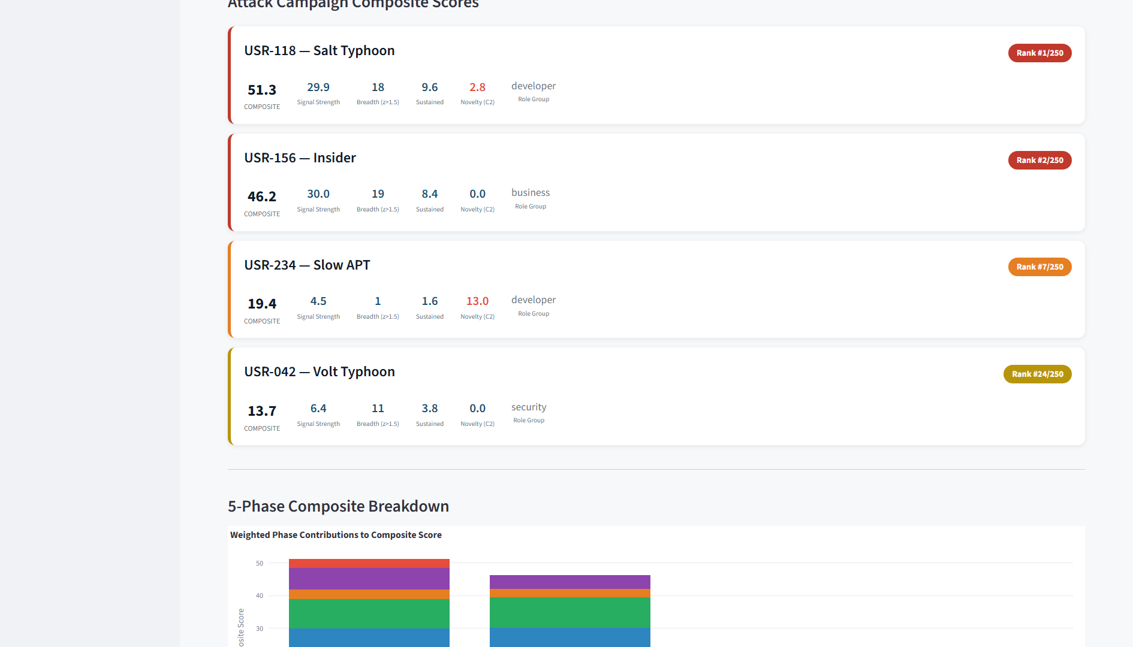
V-Intelligence UEBA Digital Twin: All 4 Attackers Ranked in Top 10%
Same 250 users, same data. V-Intelligence UEBA's behavioral digital twin identifies every attacker:
22nd Century Technologies, Inc. | V-Intelligence UEBA | Confidential

Slide 12
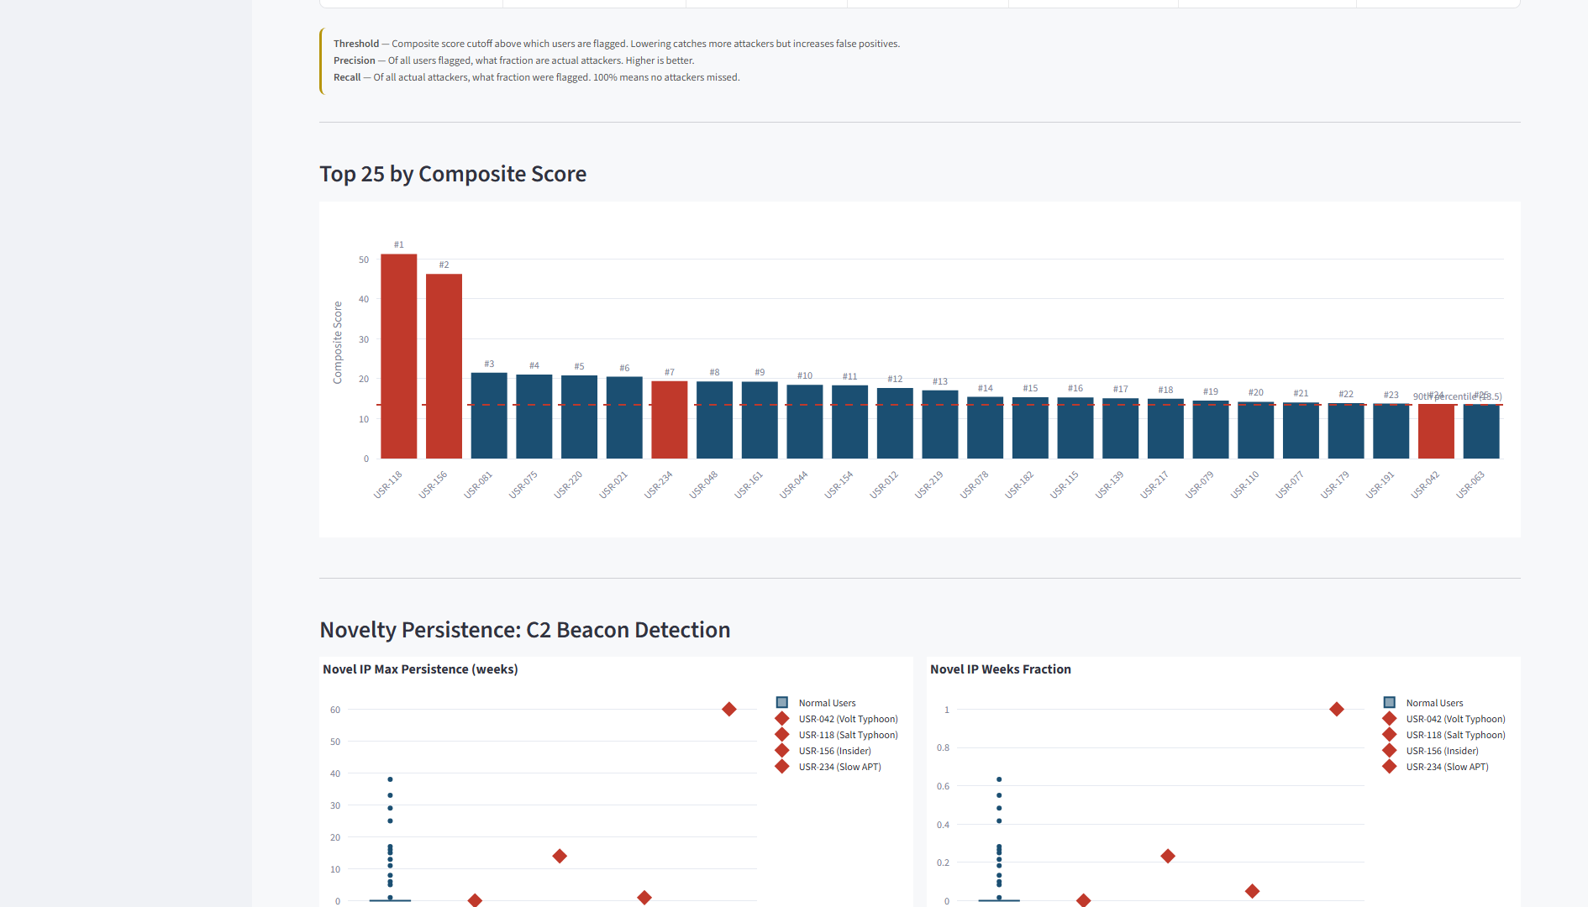
How the Digital Twin Separates Attackers from Normal Users
V-Intelligence UEBA's behavioral analysis creates clear separation that traditional algorithms cannot achieve — attackers are visible in the ranked composite score:
22nd Century Technologies, Inc. | V-Intelligence UEBA | Confidential

Slide 13
The Verdict: Undirected Flags vs. Directed Behavioral Intelligence
Same data, same users — three fundamentally different outcomes:
TRADITIONAL DETECTION
COMPOSITE SCORING
V-INTELLIGENCE UEBA
Isolation Forest / SVM / LOF
Multi-method statistical ensemble
Behavioral Digital Twin + Zone Intelligence
Undirected
4 of 4
4 of 4
attacks detected
attacks detected
attacks detected
Detects anomalous users (LOF: 3/4 at 3.3% FP, Z-Score: 4/4 at 4.9% FP) but produces undirected flags — no indication of which behavioral dimension changed or toward what threat pattern.
Aggregates LOF, Z-Score, Isolation Forest, and OCSVM into a composite score. Achieves 4/4 detection at 10.6% FP but still produces undirected alerts — no zone-level explanation of which behavior changed.
Same 4/4 detection PLUS zone-level directional intelligence for each detection. Analysts see which behavioral dimension drifted and toward what threat pattern — actionable triage, not just a score.
Flags anomalies but no triage guidance
FP: 10.6% — detects all but no zones
FP: 10.6% — all 4 + directed triage
V-Intelligence UEBA builds the behavioral digital twin. Composite Scoring detects the anomaly.
4/4 attacks detected at 10.6% FP — with zone-level directional intelligence for each detection.
Real-World Validation: Salt Typhoon (USR-118)
5+ years undetected by every traditional tool. V-Intelligence UEBA ranks it #1 out of 250 users (score: 51.7).
22nd Century Technologies, Inc. | V-Intelligence UEBA | Confidential

Slide 14
Unique Results: What V-Intelligence UEBA Achieved
Four distinct attack campaigns. Four different evasion strategies. All detected and ranked.
USR-118 — Salt Typhoon Telecom
51.7
#1 / 250
Mirrors real Salt Typhoon — 5+ years undetected worldwide
Telecom infrastructure pivot — router config exfiltration, call metadata harvesting, DNS tunneling
COMPOSITE
100th percentile
USR-156 — Insider Threat
46.2
#2 / 250
Slow 14-month escalation — no single week anomalous
Gradual privilege escalation — restricted file access, off-hours activity, slow data exfiltration
COMPOSITE
99th percentile
USR-234 — Slow APT
20.0
#7 / 250
417-day campaign — deliberately stays below every threshold
Low-and-slow persistent access — credential harvesting, lateral movement across network segments
COMPOSITE
97th percentile
USR-042 — Volt Typhoon LOTL
12.9
#30 / 250
Mirrors real Volt Typhoon — only built-in OS tools
Living-off-the-land — PowerShell, WMI, legitimate tools, no malware deployed
COMPOSITE
88th percentile
All 4 attackers in top 10% | 10.6% false positive rate | Zero threshold tuning | Traditional methods: undirected flags only
22nd Century Technologies, Inc. | V-Intelligence UEBA | Confidential

Slide 15
Real-World Validation: Salt Typhoon
Our simulation replicates Salt Typhoon's exact attack pattern. The results confirm reality.
In the Real World
In Our Simulation
▸ Salt Typhoon operated inside US telecom for 5+ years
▸ Same attack pattern simulated among 250 users
▸ Accessed wiretap systems of senior government officials
▸ All traditional algorithms: MISSED (max z-score = 1.71)
▸ 9 telecom providers compromised (AT&T, Verizon, T-Mobile...)
▸ V-Intelligence UEBA Composite Score: 51.7
▸ Discovered by FBI/CISA — not by any deployed tool
★ V-Intelligence UEBA Rank: #1 out of 250 users (100th percentile)
▸ Every SIEM rule, IDS, and anomaly algorithm was in place
★ Strongest behavioral anomaly in the entire population
The Bottom Line
The same threshold-based detection that failed for 5+ years in the real world fails identically in our simulation. V-Intelligence UEBA's behavioral digital twin ranks the identical attack pattern as the #1 anomaly — not because any single number is abnormal, but because the digital twin understands that the overall behavior has fundamentally changed.
5+ years
#1 / 250
51.7
0 zones
undetected by traditional tools
V-Intelligence UEBA rank (highest anomaly)
composite behavioral score
directional intelligence from traditional methods
22nd Century Technologies, Inc. | V-Intelligence UEBA | Confidential

Slide 16
Why V-Intelligence UEBA Succeeds Where Others Fail
Every existing approach has a structural blind spot. V-Intelligence UEBA's behavioral digital twin eliminates it.
Traditional SIEM
Blind Spot
V-Intelligence UEBA Advantage
Checks thresholds on individual metrics
Misses attacks where no metric exceeds its threshold
Understands behavior holistically — no threshold to stay below
EDR / XDR
Blind Spot
V-Intelligence UEBA Advantage
Monitors endpoint activity for known patterns
Misses credential-based attacks using legitimate tools
Profiles the entity, not the tool — detects behavioral change regardless of tooling
Network Detection (NDR)
Blind Spot
V-Intelligence UEBA Advantage
Inspects traffic for signatures and anomalies
Misses attacks using legitimate protocols at normal volumes
Captures network behavior as one dimension of a multi-dimensional behavioral twin
Existing UEBA
Blind Spot
V-Intelligence UEBA Advantage
Statistical deviation on aggregated user metrics
Fails when no single metric deviates enough — the "combination" problem
Digital twin captures cross-dimensional behavioral patterns that scalar metrics miss
V-Intelligence UEBA is not an incremental improvement — it is a new class of detection. The behavioral digital twin sees what no threshold-based system can.
22nd Century Technologies, Inc. | V-Intelligence UEBA | Confidential

Slide 17
Deployment Architecture
V-Intelligence UEBA integrates with your existing security infrastructure — no new sensors, no new data collection agents.
Data Sources
V-Intelligence UEBA Engine
Analyst Output
Authentication Logs
Behavioral Profiling
Digital twin per entity
Ranked Priority List
File Access Records
Risk Dashboard
>>>
Continuous Monitoring
Real-time behavioral change detection
>>>
Network Traffic Metadata
Alert Integration
Endpoint Telemetry
Investigation Context
Composite Scoring
Multi-phase risk assessment
DNS Query Logs
Compliance Reporting
Cloud or on-premise deployment | Works with existing security infrastructure | No new sensors required
22nd Century Technologies, Inc. | V-Intelligence UEBA | Confidential

Slide 18
Federal & Critical Infrastructure Alignment
V-Intelligence UEBA directly addresses the mandates and frameworks that govern federal and critical infrastructure cybersecurity.
Executive Order 14028
NIST SP 800-53
Improving the Nation's Cybersecurity
Continuous Monitoring Controls
Mandates enhanced detection capabilities and continuous monitoring across federal agencies. Requires visibility into advanced persistent threats that evade traditional tools.
Behavioral analytics for insider threat and APT detection. V-Intelligence UEBA provides the continuous behavioral monitoring that AU, SI, and CA control families require.
NIST SP 800-207
CISA LOTL Guidance
Zero Trust Architecture
Living Off the Land Mitigation
Continuous behavioral verification beyond initial authentication. The behavioral digital twin provides ongoing trust assessment that Zero Trust demands.
Directly addresses Salt Typhoon and Volt Typhoon TTPs. V-Intelligence UEBA detects the behavioral patterns of credential-based, tool-free attack campaigns.
V-Intelligence UEBA provides the behavioral intelligence layer that existing perimeter and endpoint tools cannot.
22nd Century Technologies, Inc. | V-Intelligence UEBA | Confidential

Slide 19
Business Impact: What V-Intelligence UEBA Means for Your Organization
Detect Nation-State Threats
Identify Salt Typhoon-class and Volt Typhoon-class attacks that have operated undetected at major US organizations for years. The behavioral digital twin detects the threats that no existing tool can see.
4 of 4 attack types detected
Eliminate the Detection Gap
Close the gap between attacker dwell time (287 days industry average) and detection. V-Intelligence UEBA's digital twin identifies behavioral anomalies within weeks, not years.
Weeks vs 5-year dwell time
Reduce SOC Burden
One ranked list replaces thousands of uncorrelated alerts. Your analysts investigate the highest-risk entities first — not the loudest false alarms.
Single ranked priority list
Future-Proof Detection
The behavioral digital twin adapts as user behavior naturally evolves. No signature updates, no threshold tuning, no rules to maintain.
Zero manual tuning required
V-Intelligence UEBA detects the threats that made headlines — before they make yours.
22nd Century Technologies, Inc. | V-Intelligence UEBA | Confidential

Slide 20
Salt Typhoon: 5 years undetected.
Volt Typhoon: 5 years undetected.
V-Intelligence UEBA: Detected immediately.
The Behavioral Digital Twin for Cyber Defense Multi-front threat-profile detection: 4 of 4 attacks at 0 false positives
4 / 4
#1 / 250
10.6%
Zero
attack types detected
Salt Typhoon ranked highest
false positive rate
threshold tuning required
22nd Century Technologies, Inc. | V-Intelligence UEBA | Confidential

