Slide 1


U.S. ARMY CYBER COMMAND | ArCTIC / CFIC
ISO 9001 | 27001 | 28000 | 20000 | 17025 | 14001
22nd Century Technologies Inc.
Preemptive Cyber Defense & Behavioral Intelligence Platform
Provable Computing | DODIN Defense | Behavioral Intelligence
Formal Proof, Not Sampling — Defending the Warfighter Against Nation-State Adversaries
Connecting & Serving Government & Citizens since 1997
ArCTIC / CFIC Collaboration Event | Behavioral Anomaly Detection (ACECARD) | 06 MAY 2026 | Augusta, GA
PROPRIETARY // NOT FOR PUBLIC RELEASE
22nd Century Technologies | PROPRIETARY | ravindra.shukla@tscti.com
1

Slide 2
Problem Statement
Nation-state adversaries dwelling inside U.S. critical infrastructure — undetected 4–5+ years.
Two confirmed nation-state campaigns — Volt Typhoon and Salt Typhoon — have compromised
hundreds of critical infrastructure targets using techniques no existing tool can detect:
• Living-off-the-Land (LOTL): only legitimate admin tools — no malware signatures to find
• Configuration-resident persistence: the attack IS the network configuration itself
• Stolen valid credentials: every access control says "approved"
ARCYBER DEFEND-THE-DODIN CHALLENGE — LIMITING FACTORS:
• Tools detect known-bad signatures → adversaries use only known-good tools
• Fixed thresholds → LOTL operates below every one
• Point-in-time testing (annual pentests) → adversary is continuous
• No tool provides formal proof that all attack paths on the DODIN are blocked
OUR APPROACH — PROVABLE COMPUTING + BEHAVIORAL INTELLIGENCE:
1. Preemptive: Formal proof, not sampling — mathematical verification that configs block all known attack paths
2. Behavioral (ACECARD): Digital Twin of each entity — detects sub-threshold drift that no threshold system catches
Together: 95–98% DODIN coverage. Dwell time: 5 years → hours. Directly enhances ARCYBER DEFEND mission.
22nd Century Technologies | PROPRIETARY | ravindra.shukla@tscti.com
2

Slide 3
The Threat: Volt Typhoon & Salt Typhoon
Two active PRC campaigns using techniques that bypass every existing security tool.
VOLT TYPHOON (G1017)
SALT TYPHOON
PRC state-sponsored. Active since mid-2021.
• Pre-positioned in power, water, telecom, transportation
• Living-off-the-Land: only legitimate admin tools
• No malware, no signatures, no IOCs
• 5+ year undetected dwell time
• Purpose: future disruption during Taiwan crisis
200+ telecoms compromised across 80+ countries.
• 9 major U.S. carriers. CALEA wiretap access.
• Persistence IS the router configuration itself
• Exploits Cisco IOS XE (CVE-2023-20198)
• 4+ year undetected dwell time
• Steady CDR/metadata exfiltration over months
WHY CURRENT DEFENSES CANNOT STOP THEM:
• SIEM/EDR: detect known-bad signatures — these adversaries use only known-good tools
• Commercial UEBA: fixed thresholds — LOTL operates below every one
• Pentest/Red Team: annual point-in-time sampling vs. continuous adversary
• Config gaps never mathematically proven closed — pentests only sample attack paths
• Identity fragmented across 10+ systems — cross-domain movement reads as unrelated signals
Sources: CISA AA24-038A | FBI/NSA/CISA Joint Advisory (Dec 2024) | Microsoft Threat Intel
22nd Century Technologies | PROPRIETARY | ravindra.shukla@tscti.com
3

Slide 4
Security Devices: What They Do vs. What They Miss
Each device solves one piece — no device verifies that ALL pieces work together.
DEVICE
WHAT IT DOES
CAPABILITY GAP
Next-Gen Firewall
Filters traffic by rules, app-aware policies, zones
Rules only as good as config. No tool proves the ruleset covers all attack paths.
IDS / IPS
Detects/blocks known attack signatures in traffic
Signature-dependent. Volt Typhoon uses no malicious payloads — only legit admin commands.
NAC (802.1X)
Controls which devices connect to the network
Grants access, not intent. Lateral movement with valid credentials is invisible.
WAF
Protects web apps from injection, XSS, known exploits
HTTP layer only. Cannot see infrastructure-layer LOTL or router config manipulation.
DLP
Detects sensitive data exfiltration patterns
Pattern-based. Slow exfil over months using normal-volume channels bypasses thresholds.
PAM / IAM
Manages privileged access, credential vaults, MFA
Enforces policy — cannot detect stolen sessions used within authorized bounds.
Email Gateway
Blocks phishing, malware attachments, spoofing
Volt/Salt don't rely on phishing — they exploit infrastructure directly.
EDR / XDR
Monitors host processes, detects malicious behavior
Can't deploy on routers/switches. LOTL uses only allowlisted binaries — nothing triggers.
Vuln Scanner
Enumerates assets and known CVEs
Sees what EXISTS, not what is REACHABLE through config. Sampling, not proof.
The gap is structural: no device validates total configuration across ALL devices blocks every attack path.
22nd Century Technologies | PROPRIETARY | ravindra.shukla@tscti.com
4

Slide 5
Our Solution: Two Layers of DODIN Defense
Formal proof, not sampling. 80% eliminated at network layer. Behavioral catches 15-18% that passes through.
LAYER 1 — PREEMPTIVE VERIFICATION
80% STOPPED HERE
Provable Computing: Formal Mathematical Model that
reasons exhaustively over the entire DODIN config space.
• Ingests all threat intel continuously (MITRE attack graphs)
• Models every defensive control formally
• Proves whether ALL attack paths are blocked
• Prescribes vendor-specific remediations
• Re-verifies hourly + on every config change
What it stops:
• CVE exploits: proves IPS/threat-feed blocks every exploit path
• C2 traffic: 50M+ rule combinations verified
• Config drift: unauthorized changes caught within 1 hour
• Shadow rules, conflicts, weak inspection profiles
Soundness within model scope. Zero False Positive. Zero False Negative.
▼ 20% passes through ▼
LAYER 2 — BEHAVIORAL INTELLIGENCE (ACECARD)
15-18% DETECTED
Digital Twin of each entity instance with
time dimension — behavioral evolution captured.
• Multi-signal behavioral profiling per entity
• Advanced change-point detection (sub-threshold)
• Drift direction mapped to MITRE ATT&CK
• Cross-system entity fusion (10+ identity sources)
What it catches:
• Compromised valid credentials (behaviorally abnormal)
• LOTL: legit binaries in malicious combinations
• Zero-day post-exploitation (drift with no signature)
• Slow lateral movement (sub-threshold accumulation)
DETECTS: what no threshold system can see.
Combined: 95-98% coverage. 2-5% residual risk. Dwell time: years → hours.
22nd Century Technologies | PROPRIETARY | ravindra.shukla@tscti.com
5

Slide 6
Preemptive Layer: Three Intelligences (Provable Computing)
Attack Intelligence → Defense Intelligence → Remediation Intelligence. Continuous closed loop.
ATTACK INTELLIGENCE – AI/LLM
DEFENSE INTELLIGENCE – Formal Math
REMEDIATION INTELLIGENCE – AI/RSN
Analyze all known threat intelligence
• Ingests CVE, advisories, CTI, IOCs, IOAs, PSIRTs continuously
• MITRE-enriched attack graphs by ML/NLP
• Full Volt/Salt Typhoon TTP coverage
• Auto-updates on every new advisory
Sources:
CISA KEV, NVD, NSA, vendor PSIRTs, MITRE ATT&CK, classified feeds
Formal model of every defensive control
• Every NGFW rule, ACL, IPS, identity policy modeled
• Exhaustive reasoning over complete config state space
• No sampling — mathematical certainty
• Every path analyzed. Every combination verified.
Supports:
Palo Alto, Fortinet, Cisco, Check Point
Prescribe correct configurations
• Risk-prioritized, vendor-specific playbooks
• Zero false positives (mathematically proven)
• Zero false negatives (exhaustive reasoning)
• Auto-push to ServiceNow, JIRA, SOC ticketing
• Optional auto-apply + re-verify
Guarantees:
No new errors, no broken connectivity, no disruption
→
→
Continuous loop: new threat → model attack → verify defense → prescribe fix → re-verify. Every hour + on every config change.
22nd Century Technologies | PROPRIETARY | ravindra.shukla@tscti.com
6

Slide 7
Stopping Volt Typhoon: Both Layers
Preemptive eliminates config weakness. ACECARD catches behavioral exploitation.
PREEMPTIVE LAYER — config verification
Initial Access
Exploits unpatched Fortinet/Ivanti/PAN edge devices
Maps every CVE to control. Proves IPS blocks exploit. Identifies compensating control.
Persistence
Web shells. C2 via compromised SOHO routers
Threat-feed IPs denied. 50M+ rule combos verified. WAF upload inspection proven.
Lateral Movement
SMB/RDP/WinRM to DCs and file servers
Real finding: 3 shadowed rules exposed SMB. Model closed path no scanner found.
ACECARD LAYER — behavioral detection
Credential abuse (T1078)
Valid creds — every control says "approved"
Multi-signal: new source + off-hours + unusual targets. Structural shift triggers alarm.
LOTL execution (T1059)
ntdsutil + wmic + netsh — all legit binaries
Tool combination + sequence captured. Drift → "LOTL execution." Peer cohort: no match.
Slow lateral (T1021)
Moves 1-2 hosts/week — below every threshold
Change-point accumulates sub-threshold drift over time. Eventually crosses alarm boundary.
Unknown C2
Routes through newly compromised SOHO routers
Network signal: new persistent outbound to unusual destination. Direction: "C2 beaconing."
Volt Typhoon (G1017): PRC state-sponsored. 5+ year dwell. LOTL. Critical infrastructure. Both layers needed.
22nd Century Technologies | PROPRIETARY | ravindra.shukla@tscti.com
8

Slide 8
Stopping Salt Typhoon: Both Layers
Salt Typhoon lives on misconfigured edge gear. Preemptive verifies. ACECARD detects abuse.
PREEMPTIVE LAYER — config verification
Edge CVE Exploit
Cisco IOS XE web UI (CVE-2023-20198). 1000+ devices.
Every exposed mgmt interface flagged. Proves ACL blocks /webui/. Compensating control for unpatched.
Config Persistence
Creates local admin. Modifies router ACLs. Enables Guest Shell.
Hourly drift comparison to approved AAA baseline. New account or ACL change = immediate finding.
GRE Tunneling
Configures GRE tunnels between routers for C2.
GRE peer authorization verified. Unauthorized tunnel endpoints flagged. Egress policy proven.
ACECARD LAYER — behavioral detection
TACACS+ reuse (T1078)
Harvested admin creds used as legit sessions
Same creds, different trajectory: unusual device sequence, off-pattern timing. Multi-signal drift alarm.
ACL tampering (T1556)
Modifies router ACLs — looks like routine maintenance
Identity + network signals: config change correlates with new outbound. Diverges from peer cohort.
GRE tunnels (T1572)
Configures tunnels between routers — normal for some operators
This admin never creates tunnels; this device never had tunnel activity. Direction: "protocol tunneling."
CDR exfil (T1041)
Slow steady data movement. Under volume thresholds.
Change-point accumulates gradual shift in data access. Peer comparison: no other admin has this trajectory.
Salt Typhoon: 200+ telcos. 4+ year dwell. CALEA access. Config-resident. Both layers stop it.
22nd Century Technologies | PROPRIETARY | ravindra.shukla@tscti.com
9

Slide 9
Combined Detection Timeline
Real scenario: Volt Typhoon campaign. Preemptive finds the gap. ACECARD catches the exploitation.
Scenario: Volt Typhoon targets Air Force network via Fortinet VPN CVE + LOTL credential access
T-30d
PREEMPTIVE
Identifies missing IPS signature on VPN concentrator. Gap finding pushed to ticketing.
T-30d
INTEGRATION
Gap triggers trust floor reduction. Behavioral sensitivity auto-heightened for VPN zone.
T+0
ATTACKER
Exploits CVE. Lands on device. Creates local admin. Begins LOTL reconnaissance.
T+2h
ACECARD
Entity enters with reduced trust. Auth signal: new source, off-hours. Drift accumulating.
T+6h
ACECARD
Process signal: wmic + ntdsutil chain. Change-point accumulating. Direction: LOTL execution.
T+8h
ACECARD
Change-point crosses alarm. Entity BLOCKED. Access revoked. IR ticket auto-created.
T+9h
INTEGRATION
Confirmed detection feeds back. Preemptive re-verifies all related configs. Similar gaps closed.
Result: 8-hour dwell (vs. 5+ years). Preemptive found the gap. ACECARD caught the exploitation. Complete defense.
22nd Century Technologies | PROPRIETARY | ravindra.shukla@tscti.com
10

Slide 10
2026 Hyperscaler Platforms vs. What We Deliver
They provide runtime plumbing. We provide the detection intelligence agents need to act on.
What hyperscalers shipped in 2026 — runtime & orchestration:
AWS Bedrock AgentCore
Microsoft Foundry + Agent 365
Google Gemini Enterprise Agent
• Multi-agent + MicroVM isolation
• Security Lake (OCSF native)
• Guardrails + Policy (GA 2026)
• Security Copilot + Entra Agent IDs
• 70+ pre-built agents in store
• Purview + Defender for AI
• Cryptographic agent identity
• Model Armor + zero-trust per step
• ADK multi-agent + SecOps
These platforms provide PLUMBING — not intelligence. What WE provide that NO platform ships:
CAPABILITY
HYPERSCALER
22CT DELIVERS
Prove all config paths block an attack
Cannot do
Formal model — mathematical proof
Detect sub-threshold behavioral drift
Cannot do
Change-point on Digital Twin
Map drift direction to MITRE technique
Cannot do
Drift direction classifier
Fuse identity across 10+ systems → one entity
Partial (per-cloud)
Cross-cloud entity fusion
Continuous re-verification (hourly + on change)
Cannot do
Automated closed-loop
Vendor-specific remediation with zero-FP
Cannot do
Prescriptive playbooks
Hyperscalers provide runtime. 22CT provides the domain intelligence that makes agents effective.
22nd Century Technologies | PROPRIETARY | ravindra.shukla@tscti.com
11

Slide 11
Platform Architecture: Five Layers
Kubernetes-native. Iron Bank hardened. Same architecture across all classification levels.
5
Presentation & Integration
SOC Dashboard • ServiceNow • JIRA • SOAR • API Gateway • ABAC Policy Engine
4
Analytics & Reasoning
Preemptive Engine • Behavioral Engine • Kill-Chain Reconstruction • Alert Correlation
3
Intelligence & Modeling
Threat Intel Pipeline • Math Model Builder • Behavioral Profiling • Entity Fusion • MITRE Mapping
2
Data & Storage
Vector Database (pgvector) • Time-Series Store • Config Repository • Baseline Library • Entity Graph
1
Infrastructure
Kubernetes (EKS/AKS/On-Prem) • Iron Bank Containers • Istio Service Mesh • Vault Secrets • Monitoring
All containers Iron Bank certified • Helm charts for repeatable deployment • Horizontal pod autoscaling
22nd Century Technologies | PROPRIETARY | ravindra.shukla@tscti.com
12

Slide 12
Deployment Models & Gabriel Nimbus
One codebase, multiple targets. Environment configuration only — no code forking.
COMMERCIAL IL5 / NIPR
ON-PREMISES IL6 / SIPR
AIR-GAPPED JWICS / TS-SCI
GABRIEL NIMBUS Cloud-Native
• AWS GovCloud / Azure Gov
• On-site K8s cluster
• Fully disconnected
• Containerized microservices
• API-based config ingestion
• Classified threat feeds
• Manual STIX/TAXII import
• Platform-native stores
• Auto-updated threat intel
• Local AI inference only
• Local language model
• Big data analytics layer
• Fastest: days to value
• 8 vCPU / 32GB per node
• SCIF-deployable
• Scales with data volume
Shared across ALL deployment models:
• Iron Bank certified containers • Helm charts • Istio zero-trust service mesh • Horizontal pod autoscaling
• Same security posture regardless of environment • Switch via environment variable — no code forking
• cATO pathway: security artifacts auto-generated • NIST 800-53 / SP 800-207 compliance built in
Gabriel Nimbus: containerized application designed for cloud-native big data platform. Integration: ingestion connectors,
shared storage, platform IAM, analytics layer. Same Helm charts — deploys with environment configuration only.
22nd Century Technologies | PROPRIETARY | ravindra.shukla@tscti.com
13

Slide 13
Implementation Phases & Roadmap
OTA-ready. 90-day prototype timeline aligns with Army Continuous Transformation (AD 24-02) cadence.
Phase 1: Foundation 0–90 days
Phase 2: Operational 90–180 days
Phase 3: Optimization 180–270 days
• K8s provisioning
• Data connectors (NGFW, IPS, IdP)
• Baseline config + model build
• First preemptive findings
• Entity fusion pipeline
• Behavioral baselines
• Change-point detection active
• SOC integration (SNOW/JIRA/SOAR)
• Continuous re-verification
• ABAC trust scoring
• Kill-chain reconstruction
• Cohort tuning
• Additional vendors
• Compliance automation
• SOC handoff
→ First verified gap findings
→ Full two-layer detection
→ Full capability + cATO
Product Roadmap:
Q2 2026 — Current
PAN/Fortinet/Cisco/CP NGFW • N-S verification • UEBA core (5 signals) • Entity fusion • IL5
Q3 2026 — Next
E-W micro-segmentation • SASE/SD-WAN • More identity sources • 140+ TTPs • IL6 certified
Q4 2026 — Planned
Cloud posture (AWS/Azure/GCP) • WAF/API gateway • Auto-remediation • Kill-chain • JWICS
2027 — Vision
OT/ICS protocols • Autonomous threat hunting • Cross-org sharing • AI-verified remediation
22nd Century Technologies | PROPRIETARY | ravindra.shukla@tscti.com
14

Slide 14
Mission Threads
Nine operational mission threads spanning DCO, compliance, and risk management for DODIN defense.
01
Preemptive Cyber Defense
Continuous verification that every known TTP path is blocked
02
Configuration Drift Mgmt
Hourly comparison to approved baseline; surfaces unauthorized changes
03
Formal Policy Analysis
Shadow rules, conflicts, weak inspection across multi-vendor stack
04
External Attack Surface
Maps exposed assets to compensating controls; proves coverage
05
Internal Attack Surface
Models paths from compromised host to crown-jewel assets
06
Behavioral Threat Detection
LOTL, credential abuse, insider threat, slow lateral movement
07
Zero-Trust Verification
Proves segmentation holds end-to-end (NIST 800-53 / SP 800-207)
08
Vendor Migration Safety
Proves no regression during NGFW vendor migration
09
M&A / Third-Party Risk
Models combined posture pre-merger; verifies isolation controls
22nd Century Technologies | PROPRIETARY | ravindra.shukla@tscti.com
15

Slide 15
Production Proof Points
Selected findings from financial services, telecom, government, and critical infrastructure.
FinTech | Asia
Closed lateral movement path hidden by shadowed rules across multi-vendor NGFW stack
Communications | NA
Eliminated RCE exposure from missing IPS inspection on critical protocol
Regional Bank | E. Asia
Closed cross-vendor policy inconsistency exposing PAN and Fortinet NGFWs
Critical Infra | SE Asia
Detected application obfuscation paths from DMZ rule misconfiguration
Finance | E. Asia
Identified NIST 800-53 compliance gap on email traffic inspection
EU Sovereign Govt
National-scale attack surface management across 12 government agencies
20+ design partners across F500, federal, critical infrastructure, MSSPs, and nation states (NA, EU, ME, Asia, Pacific).
22nd Century Technologies | PROPRIETARY | ravindra.shukla@tscti.com
16

Slide 16
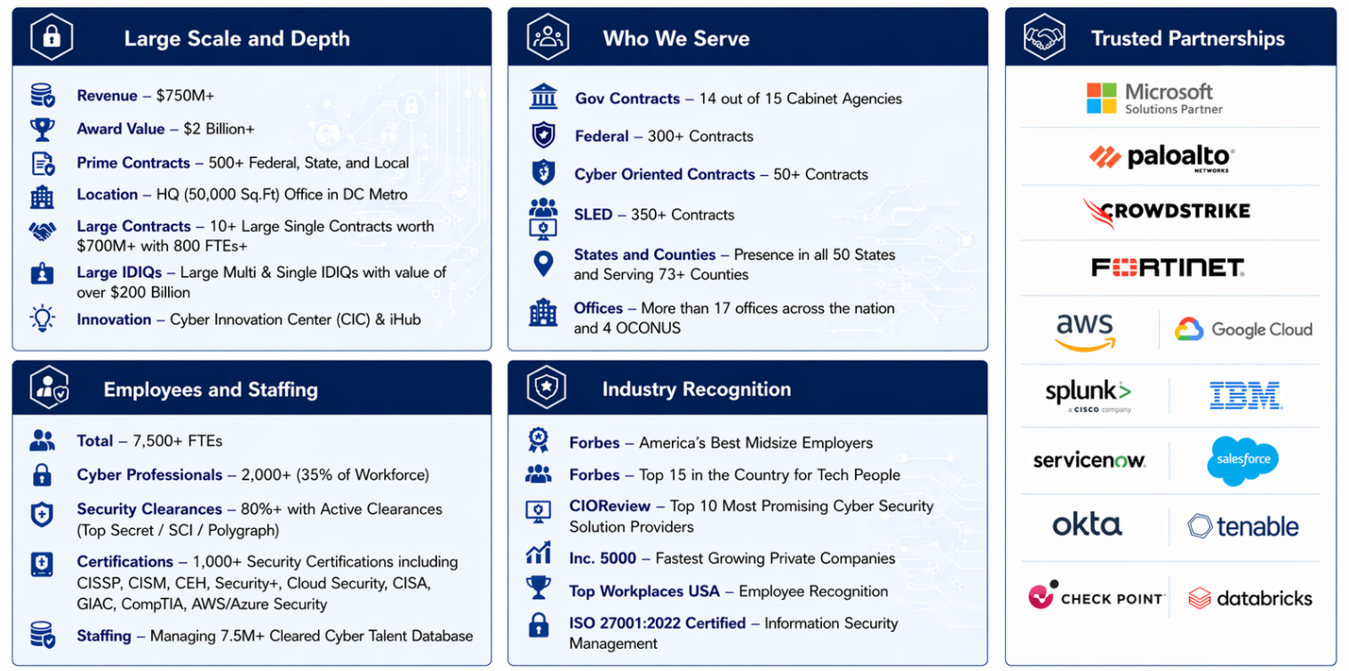
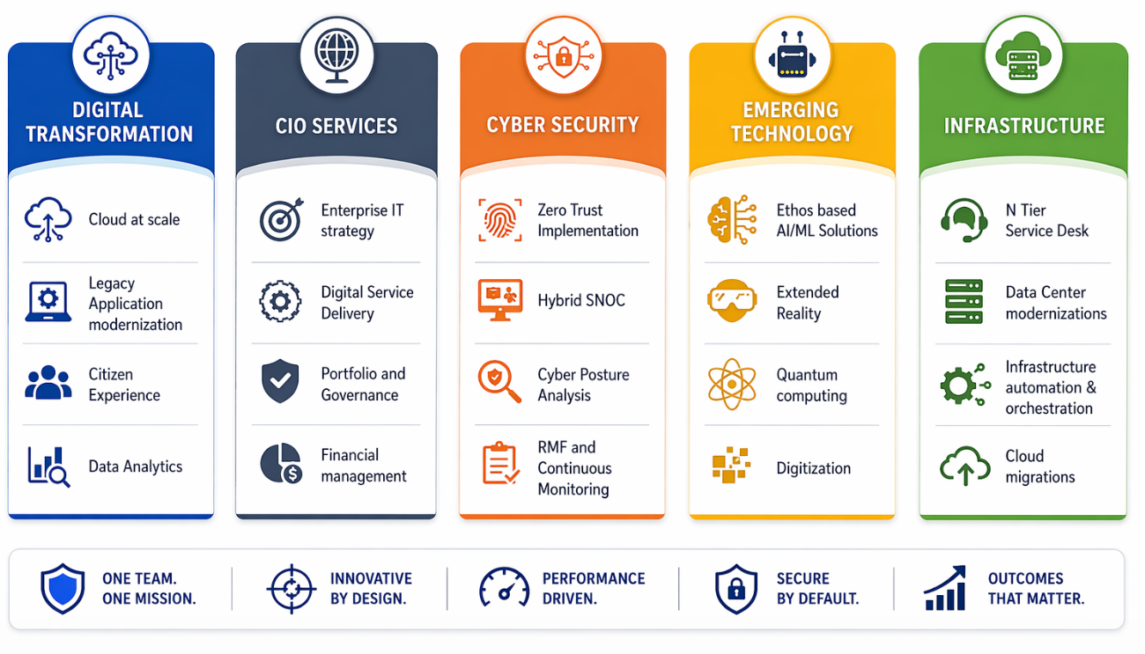
22nd Century Technologies: Company Overview
Connecting & Serving Government & Citizens since 1997.
$750M+
$1B+
7,500+
800+
IL5/IL6/JWICS
Revenue
Award Value
Total FTEs
Cleared Cyber Analysts
Three Enclaves
Key Contracts:
• U.S. Army SOC/MDR — $90M (800+ cleared analysts)
• USAF Cybersecurity Operations — $108M
• FBI TSC — $56M • NAVAIR/USMC — $145M
• 14/15 Cabinet Agencies • 300+ Federal • 50+ Cyber
Compliance & Certifications:
• DoD Zero Trust RA: Pillars 4 & 7 • NIST 800-53/207
• cATO pathway • Iron Bank certified • eMASS/RMF
• ISO 9001 | 27001 | 28000 | 20000 | 17025 | 14001
• GSA MAS | CIO-SP3 | SEWP V • CMMI Level 3
America's Best Midsize Employer • Top 15 Country for Tech People • Inc. 5000 • CRN Top 10 Cyber
22nd Century Technologies | PROPRIETARY | ravindra.shukla@tscti.com
17

Slide 17
What No Existing Tool, Device, or Platform Delivers
These capabilities do not exist in any product on the market today — at any price point.
Exhaustive Mathematical Proof of Defense
No SIEM, EDR, scanner, or pentest can prove ALL config paths block an attack. Zero FP. Zero FN.
Not in: Splunk, CrowdStrike, Palo Alto, Tenable, Rapid7, Qualys, any SIEM/EDR/XDR
Digital Twin with Behavioral Time Dimension
Living entity model that captures sub-threshold drift and maps direction to MITRE ATT&CK.
Not in: Exabeam, Securonix, Microsoft Sentinel, Gurucul, any commercial UEBA
Cross-Domain Entity Fusion (10+ Systems)
Identity stitched across AD, AAD, Okta, VPN, TACACS+, badge, endpoint into one behavioral trajectory.
Not in: Any single-vendor identity solution or SIEM correlation engine
Management Plane: Multi-Device Verification
Reasons across ALL devices simultaneously. Finds multi-rule, multi-device gaps no single tool sees.
Not in: Any firewall management platform (Panorama, FortiManager, SecureX)
Continuous Re-Verification (Hourly + On Change)
Re-proves entire defense posture every hour AND on every config change. Pentests run annually.
Not in: Any pentest, red team, ASM, or vulnerability management platform
Hyperscaler Platforms Cannot Replace This
AWS/Microsoft/Google ship runtime. They do NOT ship detection intelligence or formal models.
Not in: Bedrock AgentCore, Microsoft Foundry, Google Gemini Enterprise Agent Platform
Not incremental improvement. A fundamentally new class of defense that does not exist elsewhere.
22nd Century Technologies | PROPRIETARY | ravindra.shukla@tscti.com
18

Slide 18
22nd Century Technologies Inc.
Concrete Next Steps
Three paths forward — all OTA/PIA compatible:
A
Technical Deep-Dive
B
PM DCO Capability Brief
C
30-Day OTA Prototype
60-90 min follow-up with engineering team and ARCYBER science advisor. Architecture, integration points, formal methods detail.
30-min brief tailored to specific DCO capability gap. CFIC introduces. Aligned to BA-08 funding and Continuous Transformation cadence.
Scoped prototype on ARCYBER data (synthetic or DREN). Preemptive gap findings + behavioral detections. Milestone-based, TRL 6 → 7.
Provable Computing is a stated CFIC focus area. We are the industry capability in that space.
Ravindra Shukla | Head of AI
ravindra.shukla@tscti.com | 703-679-0117
22nd Century Technologies | PROPRIETARY | ravindra.shukla@tscti.com
19

Slide 19
The Management Plane: Making All Devices Work Together
A new layer ABOVE all security devices. Compositional reasoning across multi-vendor configurations at DODIN scale.
THE PROBLEM: Devices are powerful individually but do not coordinate. Gaps emerge BETWEEN devices —
multi-rule, multi-device errors that no single-device tool can see.
MANAGEMENT PLANE
INGEST
MODEL
VERIFY
REMEDIATE
Pull configs from all devices
→
Build unified math model
→
Find multi-device gaps
→
Push vendor- specific fixes
▼ Verified configs ▼
NGFW (PAN, Fortinet Cisco, CP)
IPS / WAF
Identity (Okta, Entra CyberArk)
SASE / SD-WAN
EDR / XDR
DLP / Email Security
Production findings from Management Plane analysis:
Financial Services
Conflicting rules caused access to malicious IPs — found by cross-device analysis
F100 Technology
100+ config errors across multi-vendor NGFW estate — invisible to single-device tools
F500 Data Center
Absence of data security profile on critical segments — no single tool could see it
Supply Chain
Shadowed SMB app-control rules allowed lateral malware migration (SMBv1.0)
22nd Century Technologies | PROPRIETARY | ravindra.shukla@tscti.com
7

