Slide 1
V-INTELLIGENCE UEBA
Behavioral Entity Intelligence for Cyber Defense
Catching the attacks that stay under the alarm: insiders, nation-state intrusions, and living-off-the-land campaigns.
Executive Overview | Business and Technical Briefing | June 2026

Slide 2
THE PROBLEM
The attacks that matter most never trip an alarm
▶ Volt Typhoon. A state-sponsored campaign lived inside US critical-infrastructure networks for at least five years, undetected by any victim tool.
▶ Salt Typhoon. A second campaign sat inside major US telecom carriers for months, called the worst telecom hack in the nation's history.
▶ Insiders. Roughly one breach in five comes from inside, with a median time to discovery beyond 200 days.
▶ The common thread. Valid credentials, legitimate tools, and gradual change over months. Every single action looks authorized.
Found by outsiders, not by victims
In both Typhoon campaigns the victims' SIEM, antivirus, and endpoint tools stayed green. The intrusions were discovered by outside intelligence agencies, years and months too late.
This is a structural gap
It is not a missed patch or a tuning error. The tools were asking "does this match something known to be bad?" and these attackers are built to answer no.
V-Intelligence UEBA | Behavioral Entity Intelligence Proof of concept on synthetic data 1

Slide 3
WHY TODAY'S TOOLS MISS THEM
Five blind spots in conventional monitoring
Look for the known
Signatures match only catalogued threats. Living-off-the-land attacks bring no malware to fingerprint.
Measure how much
Thresholds watch volume. An insider holds volume flat and shifts what they access instead.
Watch one entity alone
A covert channel calling home on a steady rhythm is invisible to a tool that only counts traffic.
Judge a single moment
Slow-and-low change is invisible in any one week and clear only across months.
Compare you to everyone
A developer judged against the whole company hides abuse that stands out only among developers.
The trap
Loosen the tools and they bury analysts in false alarms. Tighten them and they miss the real attack.
V-Intelligence UEBA | Behavioral Entity Intelligence Proof of concept on synthetic data 2

Slide 4
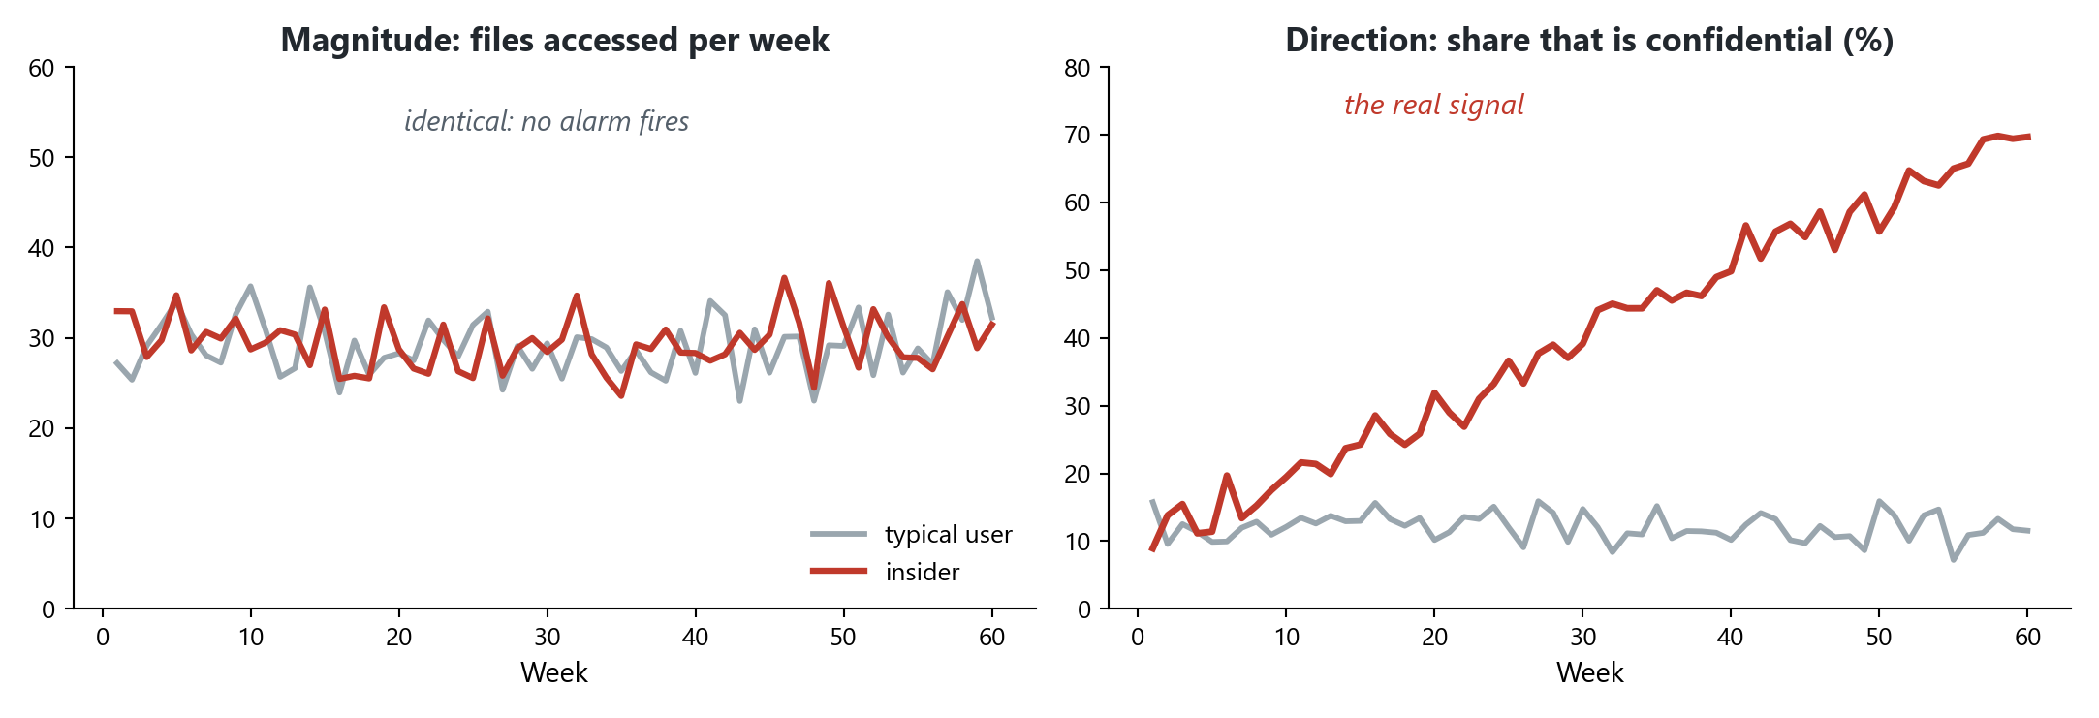
A DIFFERENT WAY TO SEE
Measure direction, not just magnitude
▶ Behavior, not events. Each entity is a profile that evolves week to week, like a medical chart.
▶ Direction, not size. We track which way behavior is trending, not just how big it is.
▶ Peers, not the crowd. Each entity is judged against its true role-group.
▶ Explanation attached. Each finding names what changed and the attacker technique it resembles.
The insider example: file volume never changes, so every magnitude-based tool stays silent. What changes is the direction, the share of confidential material, which is exactly what behavioral intelligence watches.
V-Intelligence UEBA | Behavioral Entity Intelligence Proof of concept on synthetic data 3

Slide 5
HOW IT WORKS
One pipeline, two complementary layers
Layer 1: Precision
named fingerprints, peer-relative, near-zero false alarms
Five log sources
sign-in, file, endpoint, network, DNS
Behavioral profile
per entity, five zones, updated weekly
Ranked, explained leads
with a MITRE ATT&CK technique, into your SOC
Layer 2: Discovery
drift and novelty, names the direction of change
Layer 1 catches what we can name and keeps false alarms low. Layer 2 is the safety net for novel attacks and explains the direction.
V-Intelligence UEBA | Behavioral Entity Intelligence Proof of concept on synthetic data 4

Slide 6
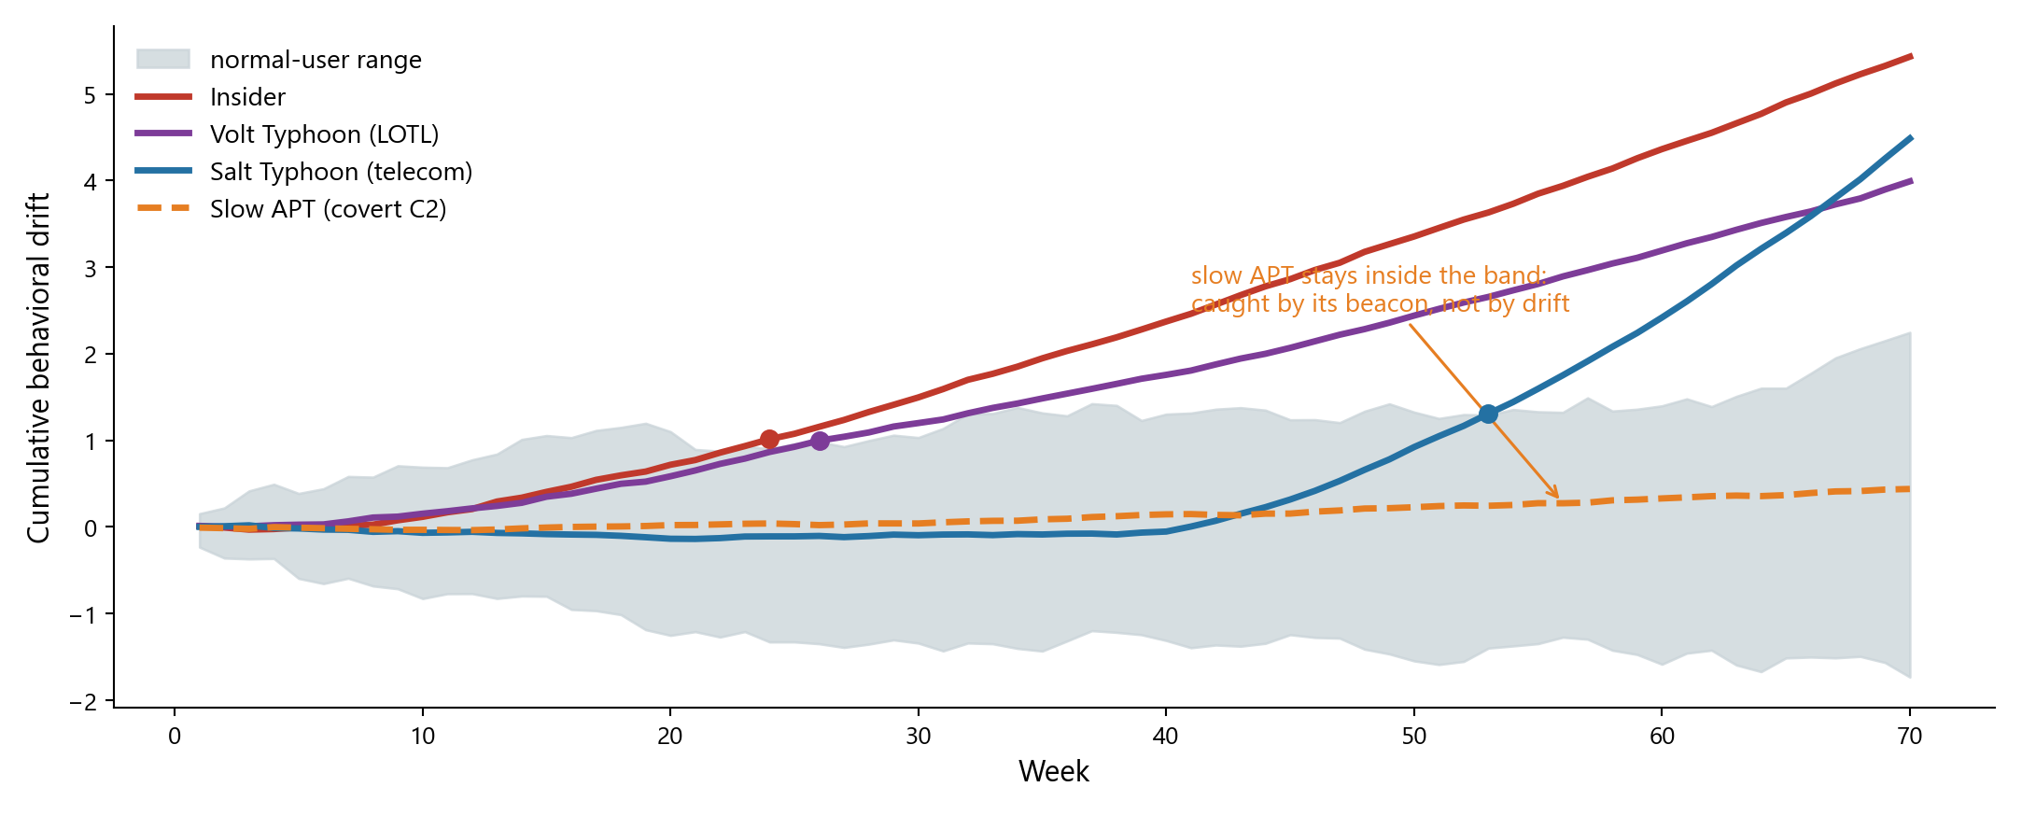
DRIFT IN ACTION
Behavioral drift pulls the attackers clear of normal
What drift measures
How far an entity has moved from its own normal, accumulated week over week, so a long run of small changes eventually shows.
No single net catches all
Three campaigns separate on drift at different times. The slow APT never does, and is caught by its beacon instead. Layers cover each other.
V-Intelligence UEBA | Behavioral Entity Intelligence Proof of concept on synthetic data 5

Slide 7
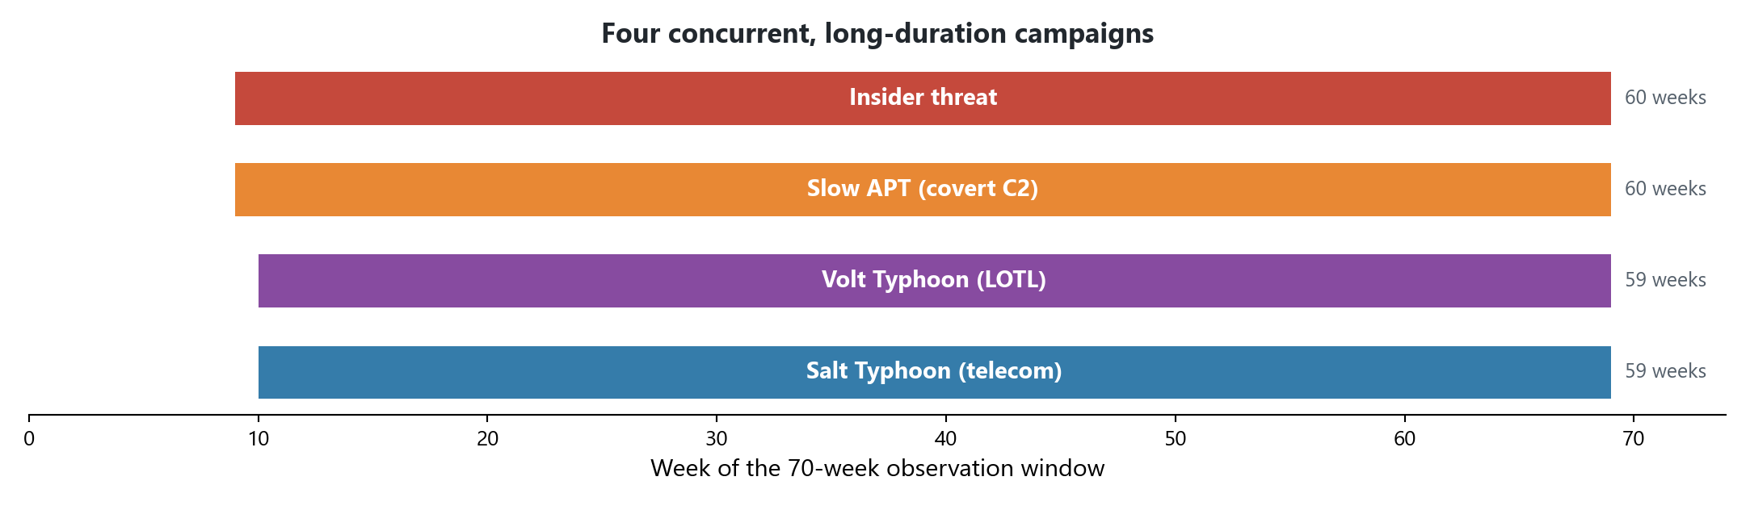
WHAT WE TESTED
Four long-running campaigns, modeled on real intrusions
Insider
drifts toward confidential files while volume stays flat
Slow APT
implant calls home every few hours in tiny packets
Volt Typhoon
critical-infrastructure pre-positioning with built-in tools
Salt Typhoon
telecom intrusion fanning out to map and intercept
V-Intelligence UEBA | Behavioral Entity Intelligence Proof of concept on synthetic data 6

Slide 8
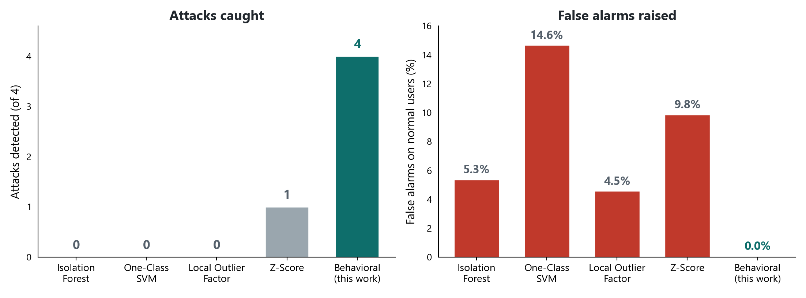
THE PROOF
All four caught, with no false alarms
4 of 4
campaigns detected
0%
false alarms
1 of 4
best conventional tool
250 users | 485 days (70 weeks) | about 14 million events | 5 log sources
V-Intelligence UEBA | Behavioral Entity Intelligence Proof of concept on synthetic data 7

Slide 9
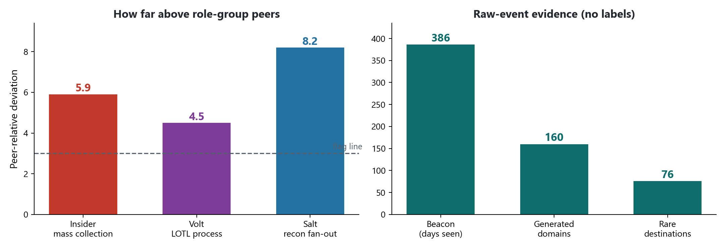
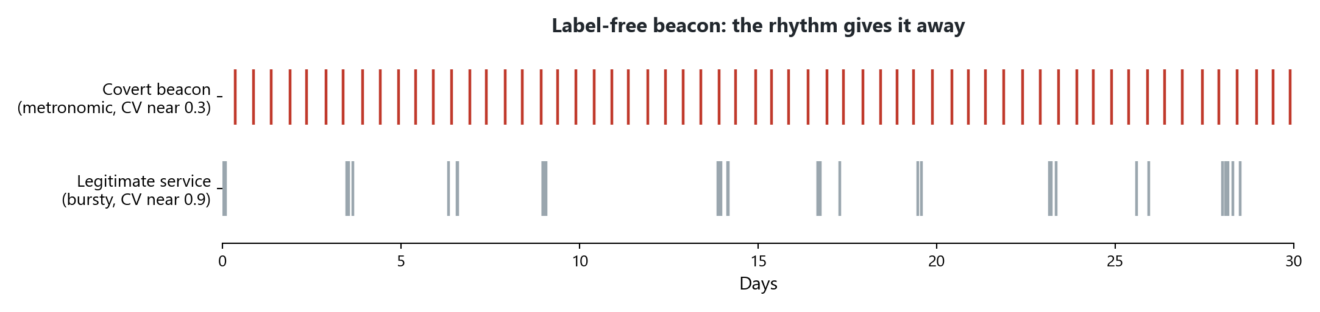
WHY THE DETECTIONS HOLD UP
Measurable evidence, not a black-box score
Every alert answers three questions
What changed? The specific behavior and zone. Compared to whom? The entity's true role-group peers. What does it resemble? A named attacker technique (MITRE ATT&CK). That is the difference between a score and a lead an analyst can act on.
V-Intelligence UEBA | Behavioral Entity Intelligence Proof of concept on synthetic data 8

Slide 10
WHAT WE PROVED, AND WHAT WE DID NOT
A direct read of the evidence
The data is simulated
Results come from a synthetic enterprise calibrated to public advisories. Every figure, including zero false alarms, must be re-measured on real telemetry.
Coverage has limits
The precision layer catches the patterns it is built to catch. The discovery layer is the net for novel attacks, and is noisier by design.
The bar was set in a lab
Thresholds here were tuned knowing the answers. In production they must be set blind and tuned to each environment.
None of this weakens the finding. The approach sees a class of attack today's tools demonstrably miss, with an explanation attached. That is the result worth validating.
V-Intelligence UEBA | Behavioral Entity Intelligence Proof of concept on synthetic data 9

Slide 11
THE PATH FORWARD
A low-risk pilot on your own data
▶ It adds, it does not replace. The behavioral layer runs alongside your existing stack, in advisory mode, with no automated blocking until results are validated.
▶ It uses data you already collect. Five standard log sources, no new sensors.
▶ It fits your workflow. Ranked, explained leads with a named technique, into your existing analyst process.
▶ It proves itself on your environment. Validated by replaying known-bad or historical incidents on your own telemetry.
The pilot question
Does the behavioral layer surface real, explained threats your current stack misses, at a false-alarm rate your team can live with?
Next step: scope a bounded pilot on a representative slice of live telemetry.
V-Intelligence UEBA | Behavioral Entity Intelligence Proof of concept on synthetic data 10

