Slide 1



Dr. Babasaheb Ambedkar Technological University, Lonere.
Project Guide
Prof. S. R. Hivre

Slide 2

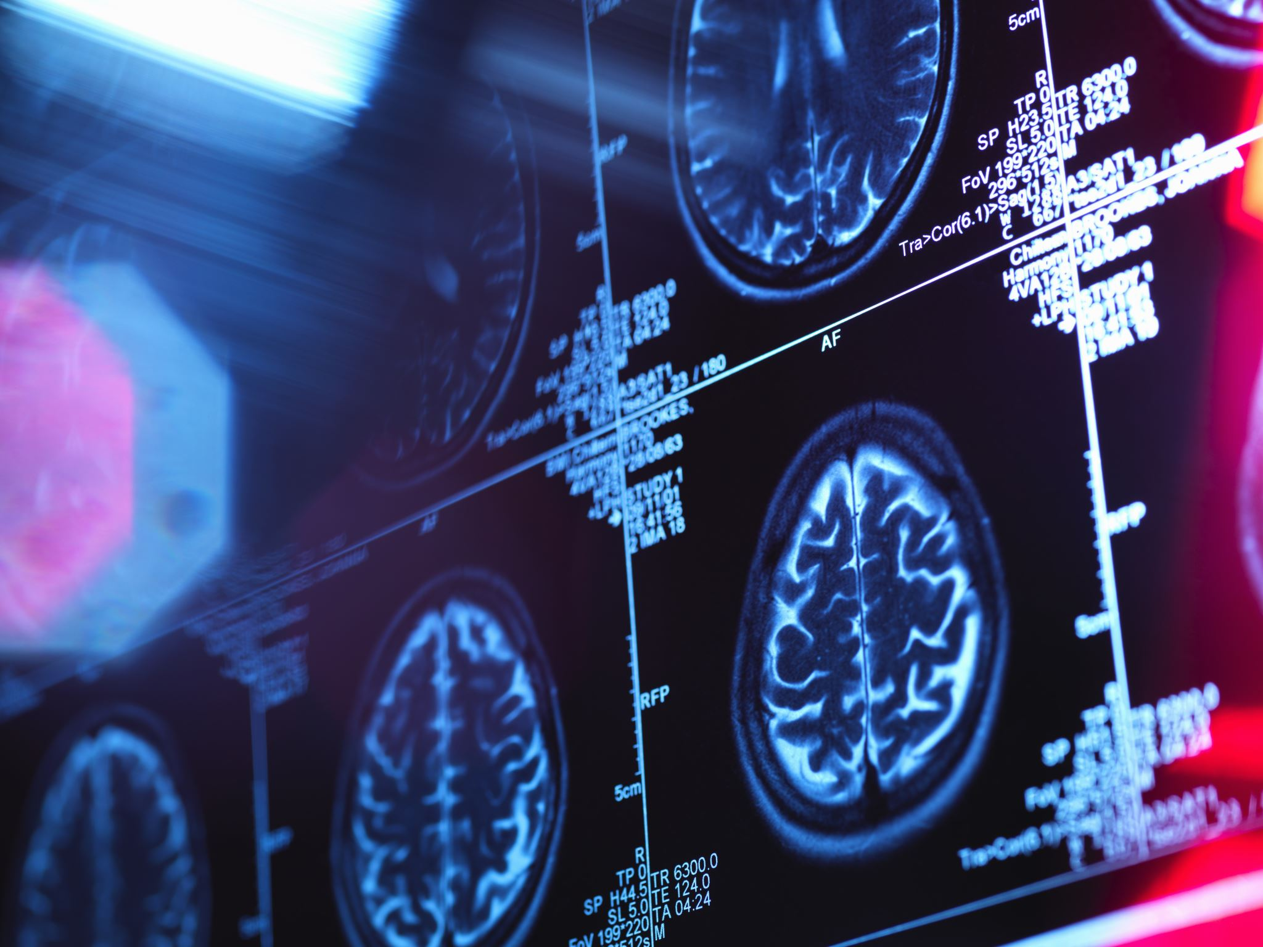

HUMAN STRESS DETECTION
Presented by :
Janavi Bangare (1930331246001)
Ravindra Yadav (1930331246041)
Rushikesh Waghule (1930331246045)
Suyash Shinde (1930331246007)

Slide 3

Agenda
Introduction
Problem Statement
Proposed System
Literature Survey
Hardware, Sensor, Algo.
Interfacing Arduino
System Requirement
Future work
Conclusion

Slide 4
Introduction
Stress is something that concerns our lives. There are many variables in our day-to-day life that are tension. Human environments, like worksite, home, or society, may somehow inflict stress on a person.
Due to stress, there may be other health issues like obesity, heart attack, diabetes, asthma etc.
Stress detector classifies a stressed individual from a normal one by acquiring his/her physiological signals through appropriate sensors such as Electrocardiogram (ECG), Galvanic Skin Response (GSR) etc., These signals are pre-processed to extract the desired features which depicts the stress level in working individuals.

Slide 5

Problem Statement
Stress has been a significant issue of the general public.
Near 82% Indians are experiencing of work, wellbeing and money related concerns.
The purpose of this project is to use extensive database to increase the performance of stress detection system to the extent that it can interpret user data history with a higher precision, so it can give adequate measures and advices to the user.

Slide 6
Proposed System
The proposed system is designed by collecting data from sensors. Using this dataset machine learning Decision tree classifier algorithm is applied using and the model is saved.
The first step is collecting the data from the data sources.
The second step is pre-processing the data in order to get a normalized dataset and then labelling the data rows.
In the third step, the result of the second step, the training, testing and optimization of dataset, is fed to the Machine Learning algorithm.
In next step, the result of all is get as output.

Slide 7


Literature Survey

Slide 8
Sr. No. | Year | Authors | Focus of the Paper | Key Points in Coverage | Technique Used | Parameter Analysed | Research Gaps
1. | 2022 | Tanya Nijhawan et al. | Natural Language Processing and Machine Learning over Social Interactions | Decision tree, Latent Dirichlet Algorithm, Logistic Regression | Sentiment and Emotion Analysis, Data Exploratory Analysis, PyLDAvis. | Emotion: Anger, Sadness, Fear, Joy, Tweets. | Combination of other Health Parameters Are Underlined in this paper.
2. | 2021 | Shruti Gedam, Et al. | Wearable Sensors, Mental Stress | Physiological Signals, Wearable Sensor, Feature Extraction. | Fuzzy Decision Algorithm, WEKA, Kubios, MATLAB. | High, Low and Ultra Low Frequency. HR-Max, HR-Min. | Best Sensors and Advanced Machine Learning Techniques can be used for Further Research

Slide 9
HARDWARE , sensors AND ALGORITHMS
HARDWARE
Arduino UNO
SD Card Module
Breadboard
Jumper wire
SENSORS
GSR Sensor
ALGORITHMS
Decision Tree Classifier

Slide 10
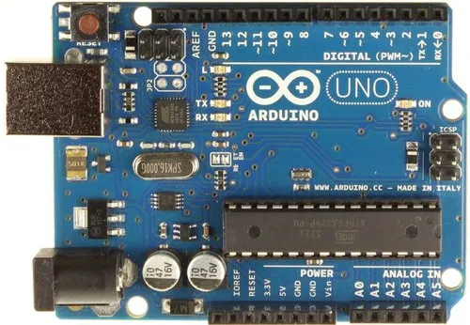
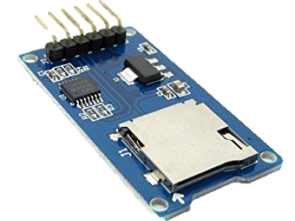
Arduino UNO & SD Card module
It was named as UNO to label the first release of Arduino Software. It was also the first USB board released by Arduino.
Arduino UNO is based on an ATmega328P microcontroller.

Slide 11
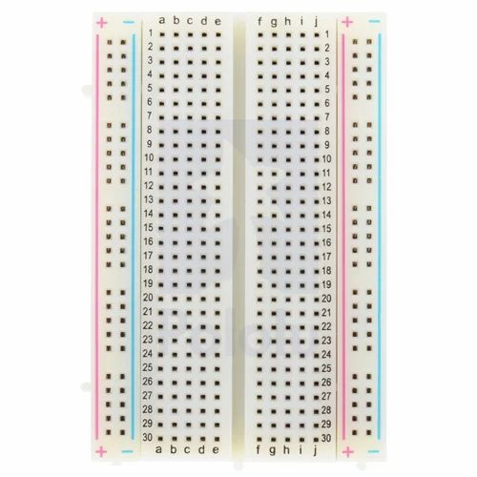
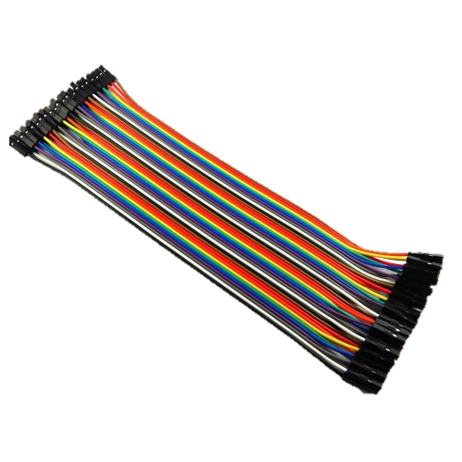
Breadboard & jumper wires
Breadboard
Jumper Wire

Slide 12
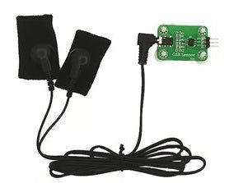
GSr Sensor
The Galvanic Skin Response (GSR), also named Electrodermal Activity (EDA) and Skin Conductance (SC).
is the measure of the continuous variations in the electrical characteristics of the skin, i.e., for instance the conductance, caused by the variation of the human body sweating.

Slide 13

decision Tree classifier
Decision Tree is a Supervised learning technique that can be used for both classification and Regression problems.
Mostly it is preferred for solving Classification problems.
It is a graphical representation for getting all the possible solutions to a decision based on conditions.

Slide 14
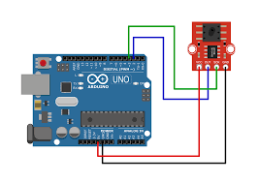
Interfacing Arduino-GSR

Slide 15
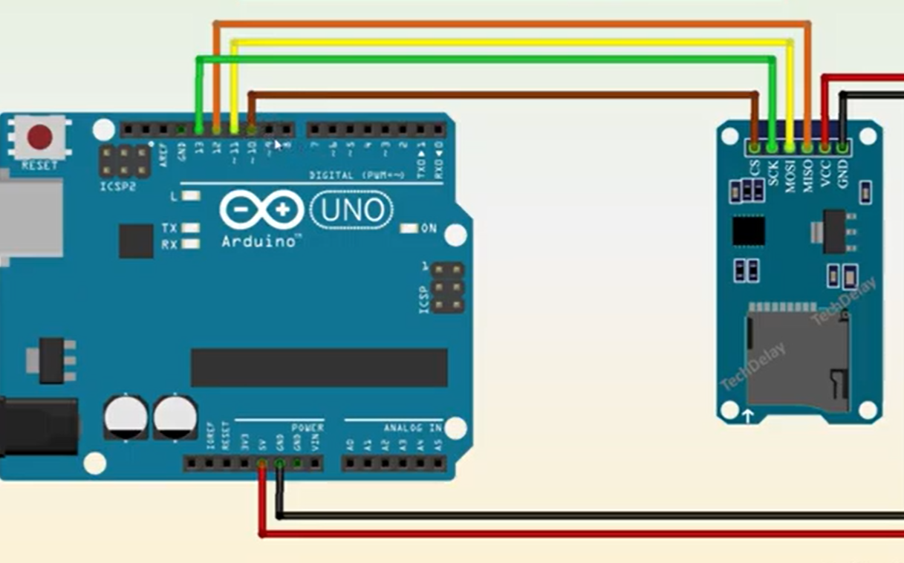
Interfacing Arduino-SDCM

Slide 16

System Requirement
Operating System :
Windows
Application Required :
Arduino IDE, Visual Studio Code
Programing Language :
Python
Hardware Used :
GSR Sensor , Arduino UNO ,SD card module

Slide 17
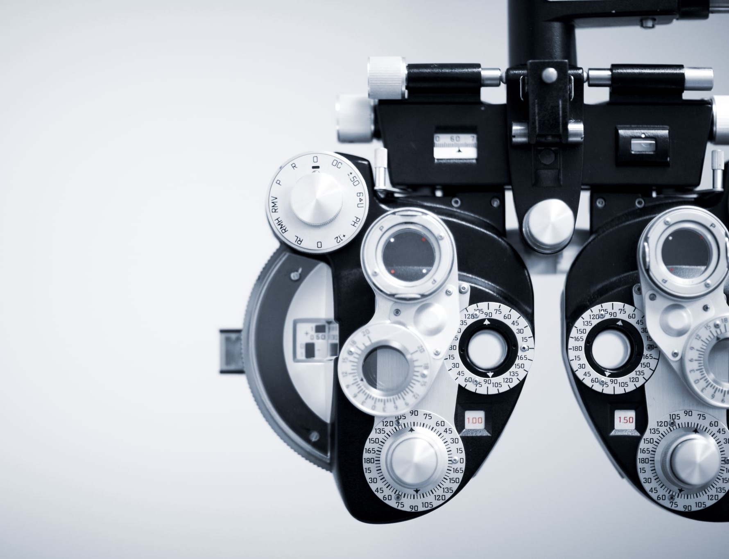
Future Work
For future work, it would be interesting to enhance this work into the development of a stress detection model by the addition of other physiological parameters, including an activity recognition system and application of machine learning techniques
Developing a user-friendly, flexible, and most importantly a sturdy multi-modal device comprising of sensors that can be used for consistent and reliable data collection.

Slide 18
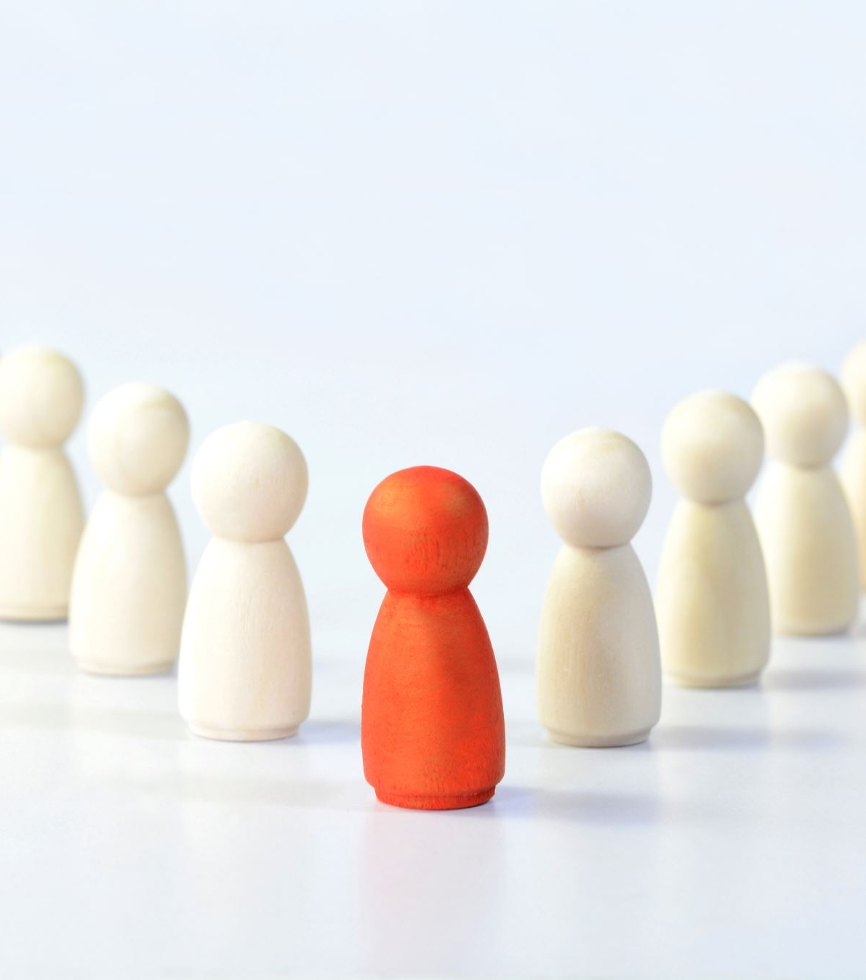
Conclusion
Physical activity acts as a de-stress agent on human stress. Therefore, by increasing the amount of physical activity in daily life, one can reduce his/her stress levels.
Sleep shortage and insomnia are common signs of stress. Our study shows the time in bed is a significant and positive indicator of stress. Changes in heart rate and an increase in BMI increase the stress levels of individuals.
The Galvanic Skin Response (GSR) device detects whether there has been an effort or a different situation from being relaxed with a success rate of 90.97%.

Slide 19

Thank You...

