Slide 1
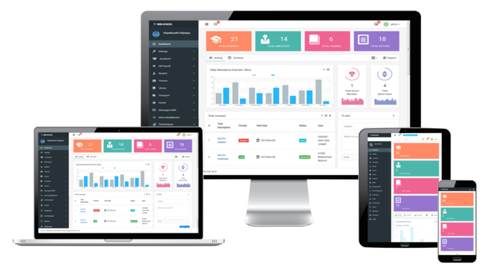
Department Course Page
For Undergraduate Students
Group 16 - Team members:
Dharmarathna N.S. E/18/077 Mihiranga G.D.R. E/18/224 Mudalige D.H. E/18/227

Slide 2

Ever faced difficulties when finding a detailed view of a course?

Slide 3

Problems With the Existing System
Lesser details
No ILOs
No lecturers details
No reference books
No grade distribution
Difficult to update
Not much flexible
Time consuming

Slide 4

Background and Motivation
cs.umd.edu
continuingstudies.stanford.edu

Slide 5

Objectives
To display courses publicly in a more detailed view to get a better idea about them
Provide statistics of the previous years
Teacher-student interactions

Slide 6
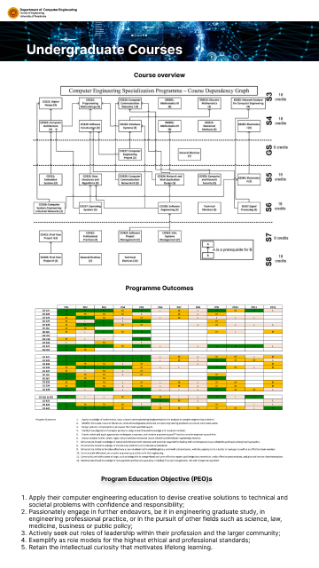
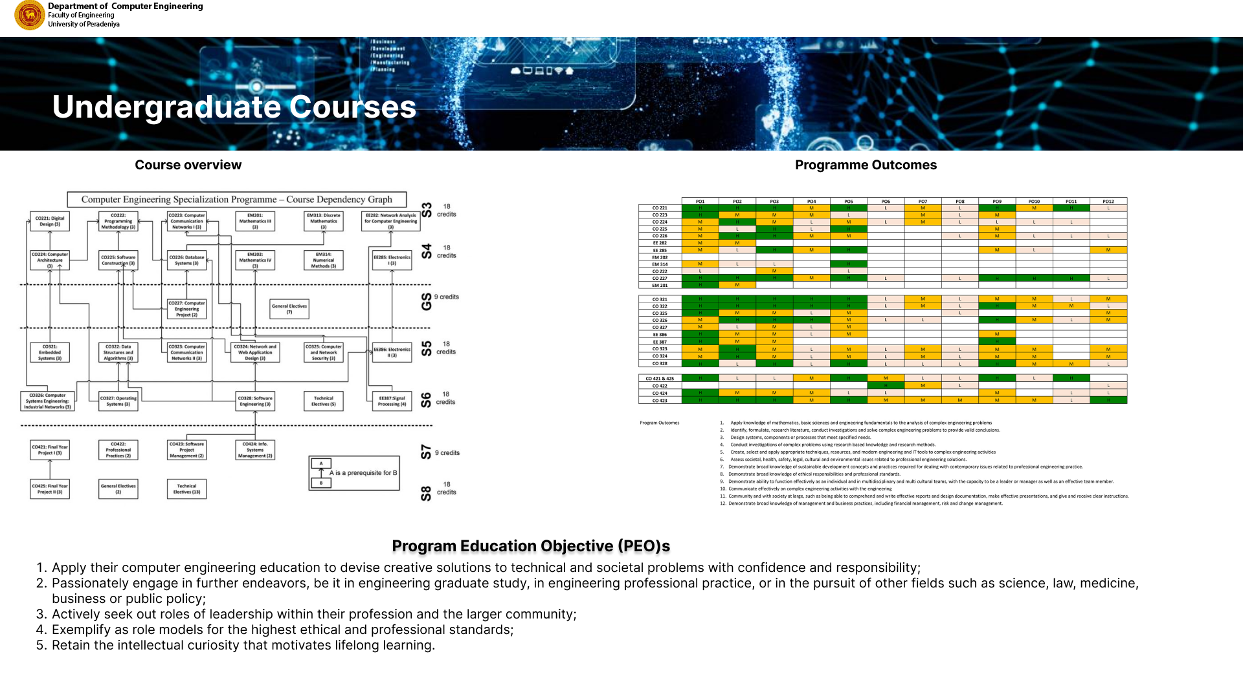
Proposed Solution
Is an interactive course page where course coordinators can integrate their course contents to it.

Slide 7
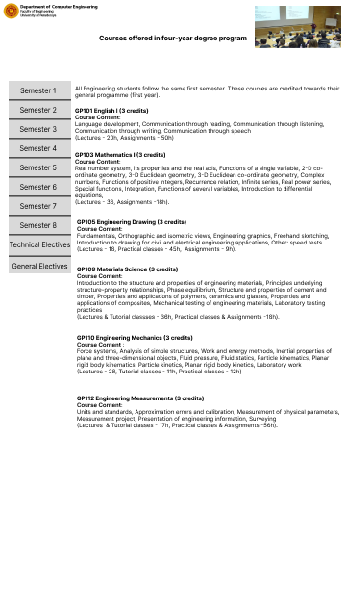
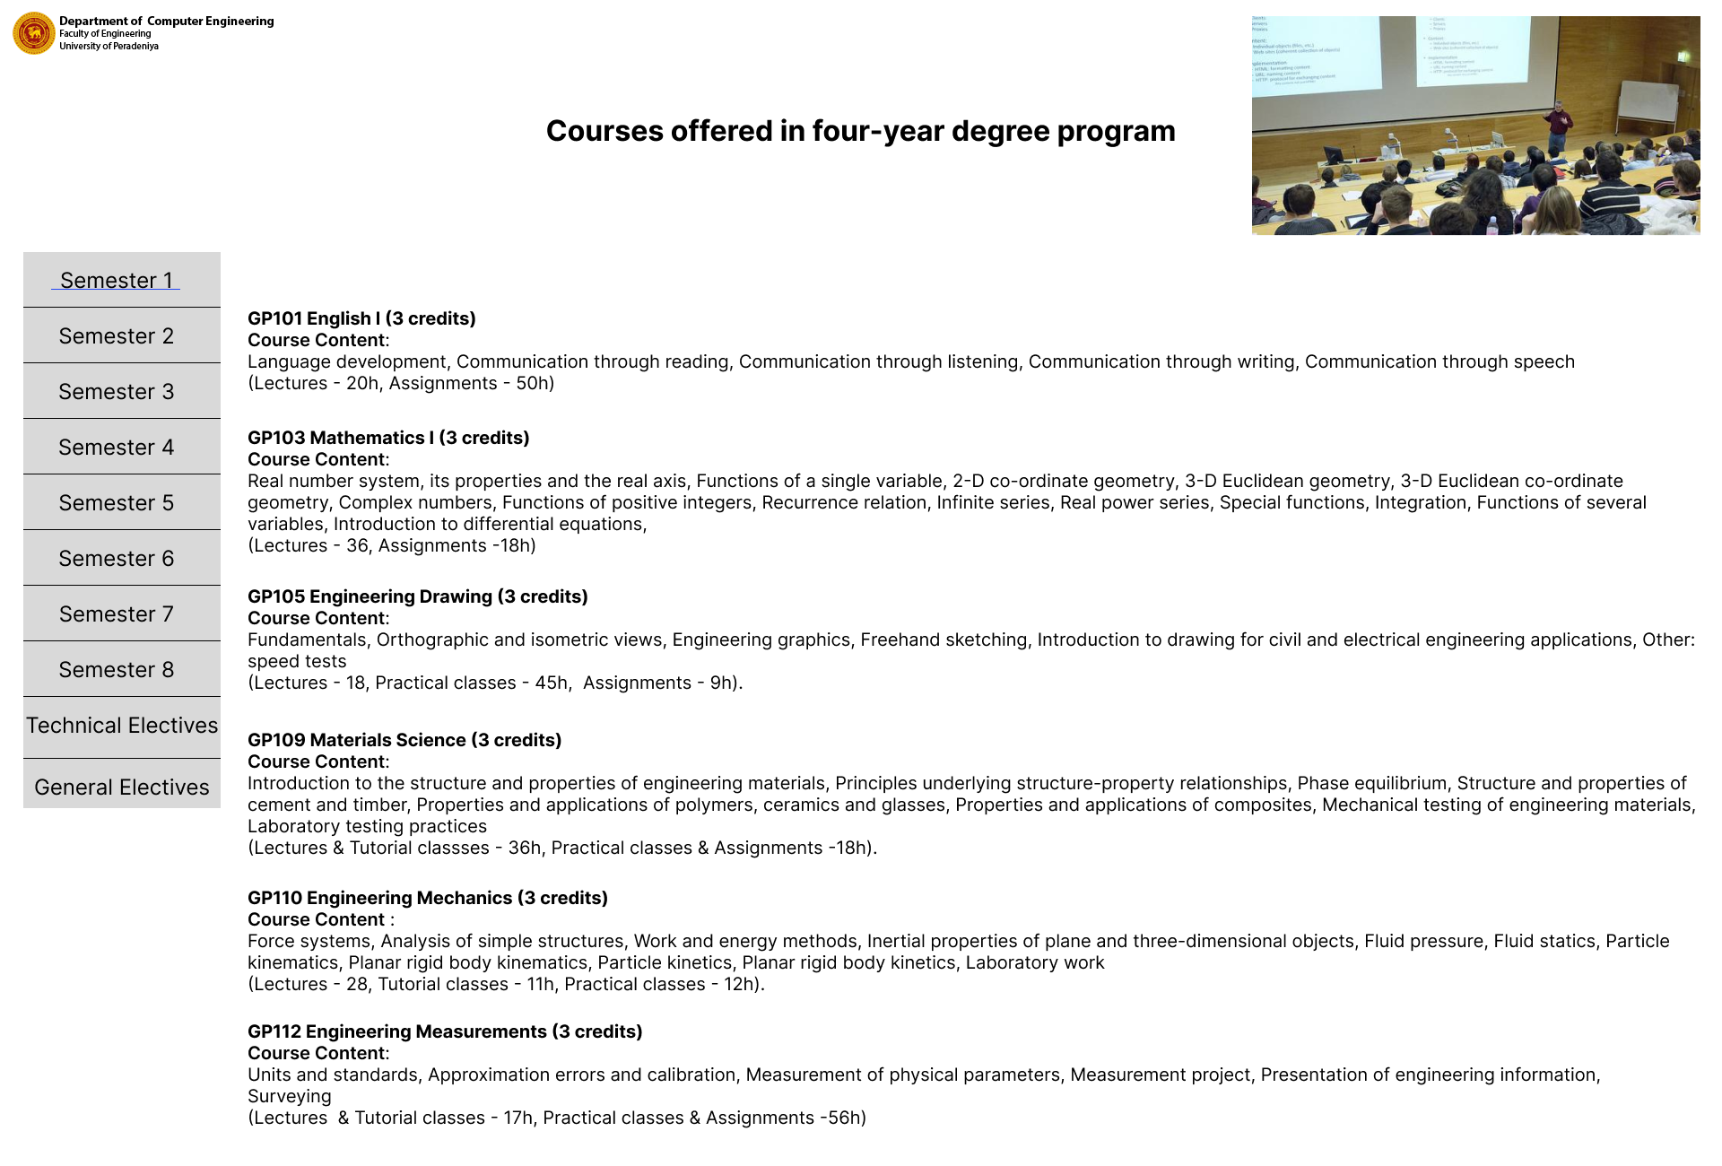

Slide 8

Advantages
Managing course details in public domain will be helpful for department to get accreditation from IESL
User-friendly system with simple interface for both students and lecturers
Easily accessible and maintainable
Less time consuming
Easy to update

Slide 9





Technology Stack
HTML
Jekyll
Java script
GitHub
Figma

Slide 10
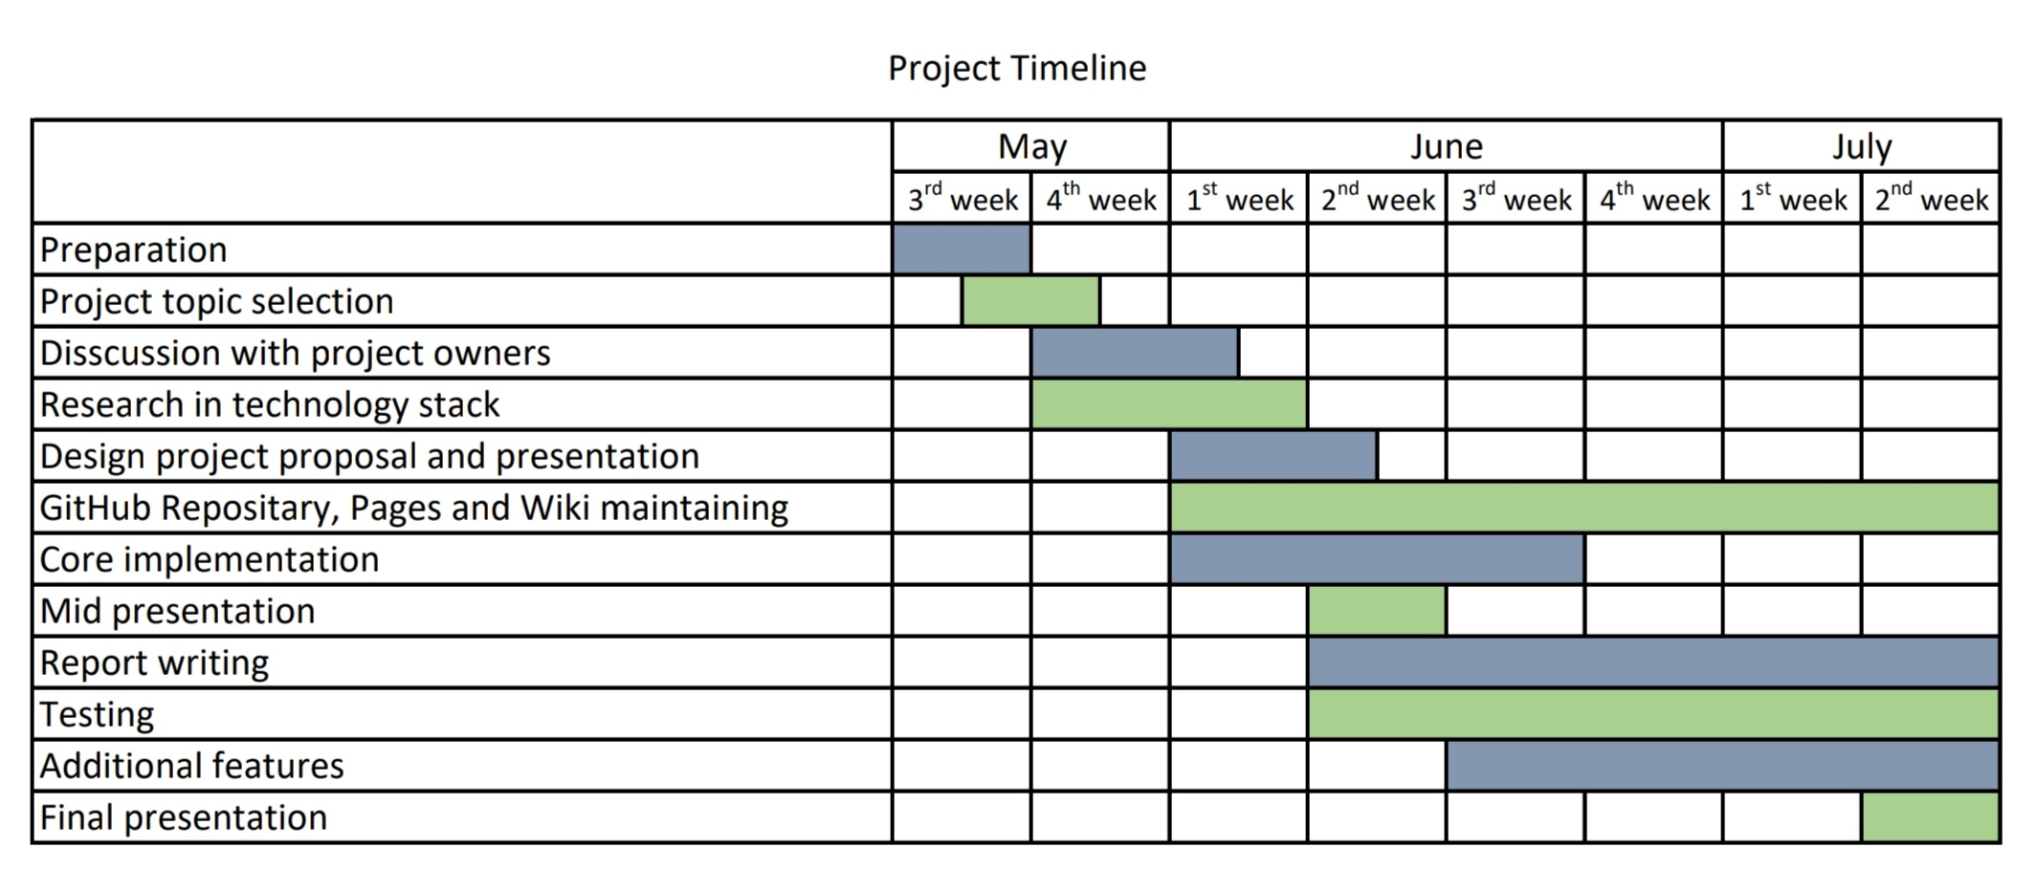
Timeline

Slide 11

Additional Features
Displaying marks distribution for grades over course contents
Detailed graphical representation of grade distribution for past years
Sorting and filtering courses

Slide 12

Team and process
Core implementation - E/18/227 Mudalige D.H.
UI Design - E/18/224 Mihiranga G.D.R.
Documentation - E/18/077 Dharmarathne N.S.
Although the tasks are separated as above, we works together as a team to make a better course page.

Slide 13
Documentation
Github Repository:
https://github.com/cepdnaclk/e18-co227-Department-Course-Page-Group-A
Github Pages:
https://cepdnaclk.github.io/e18-co227-Department-Course-Page-Group-A/
Github Wiki:
https://github.com/cepdnaclk/e18-co227-Department-Course-Page-Group-A/wiki

Slide 14

Q&A

Slide 15
Thank You!

