Slide 1
Automated 3D reconstruction
Frank Wang and Ravi Netravali

Slide 2
Problem
Reconstruct 3D object from two uncalibrated images
Traditional Approaches
  For each image, we need to do a camera calibration.
  Manually pick features points on images.

Slide 3
Our approach
Find intrinsic parameters of camera once instead of for every image
Automatic detection of feature points with sift
  Include corners as feature points for better reconstruction
Use intrinsic parameters and feature points to calculate fundamental and essential matrices
Use projective matrices to obtain 3d reconstruction

Slide 4
Finding intrinsic parameters
Zhang’s method
  Camera observes a planar pattern at multiple orientations
  Camera or pattern can be freely moved
  Given a model for the pattern and views from multiple orientations, we can provide a good approximation of the intrinsic parameters

Slide 5
Fundamental and essential matrix
Find matching 2d points from images with sift
  Need at least 8 pairs of matching points
Use RANSAC to only consider inliers and calculate fundamental matrix F.
Use fundamental matrix and intrinsic parameters to calculate essential matrix
  Can use essential matrix because camera is calibrated

Slide 6
Obtain 3D reconstruction
Extract extrinsic parameters
  Set one image as the world coordinates
  Then calculate rotation and translation of second image with respect to the first, using essential matrix.
We have the two image projective matrices, and using epipolar geometry to recover the 3d points.

Slide 7
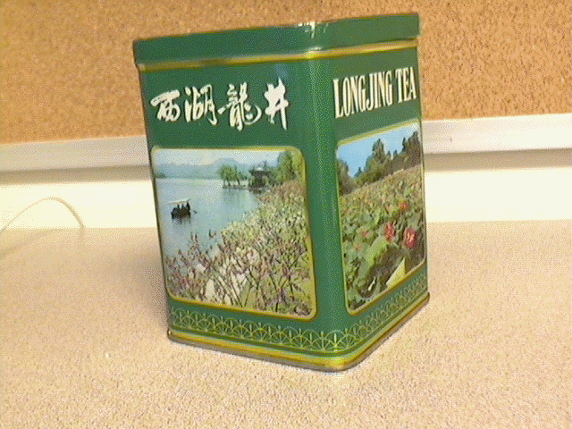
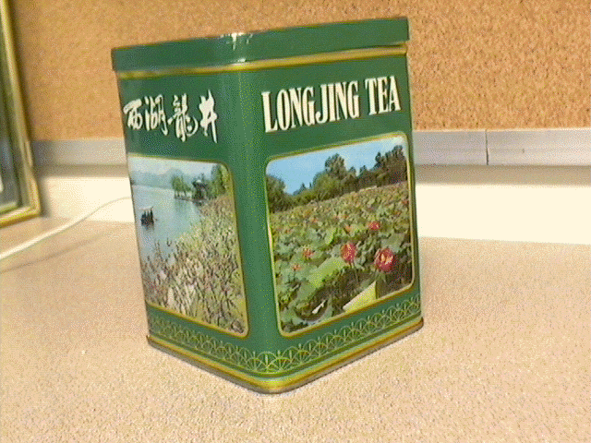
Original Images

Slide 8
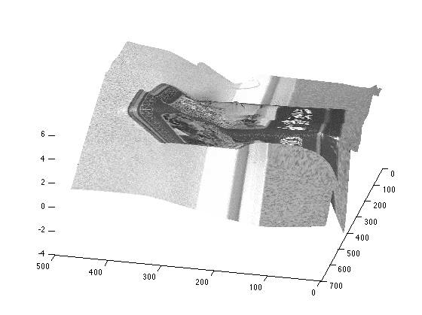
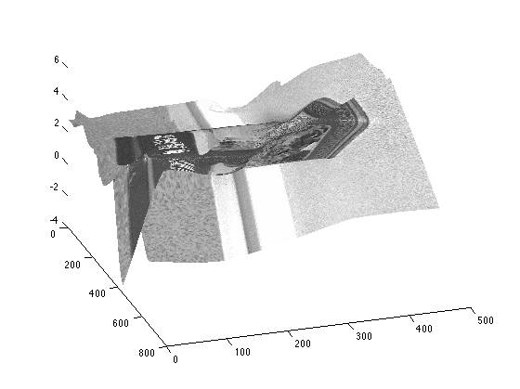
Reconstruction

Slide 9
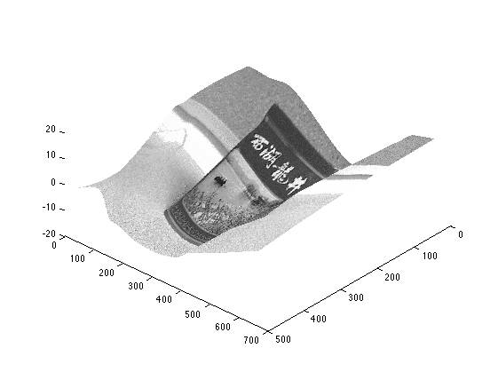
Reconstruction with corners

Slide 10
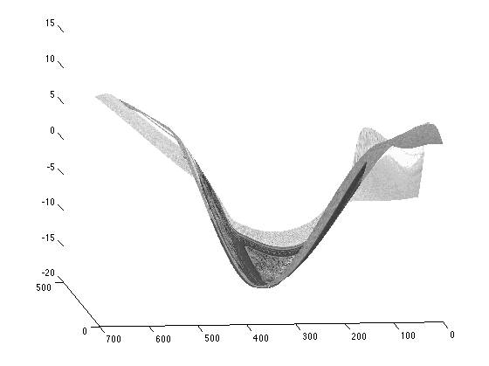

Slide 11
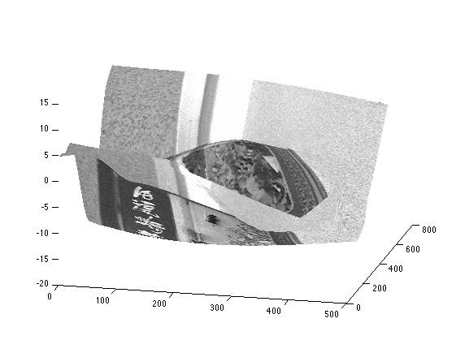

Slide 12
References
C. Harris, M. Stephens. A combined corner and edge detector. Proceedings of the 4th Alvey Vision Conference 1998. 147-151.
Z. Zhang. A flexible camera calibration by viewing a plane from unknown orientations. Proceedings of the 7th International Conference on Computer Vision. 1999. 666-673.
R. Hartley. A. Zisserman. Multiple view geometry in computer vision. Cambridge University Press, 2000.
D. Lowe. Distinctive Image Features from Scale-Invariant Interest Points. International Journal of Computer Vision 2004 60(2): 91-110.
K. Peng, X/ Chen, D. Zhou, and Y. Liu, "3D Reconstruction Based on SIFT and Harris Feature Points", Proceedings of the 2009 IEEE International Conference on Robotics and Biometrics December 19 -23, 2009, Guilin, China

