Slide 1
Embedded Systems Design
Assignment 01
Ravin Muthukumarane
Index No - 952
Link:
GitHub - ravinmuthukumarane/embedded_project

Slide 2
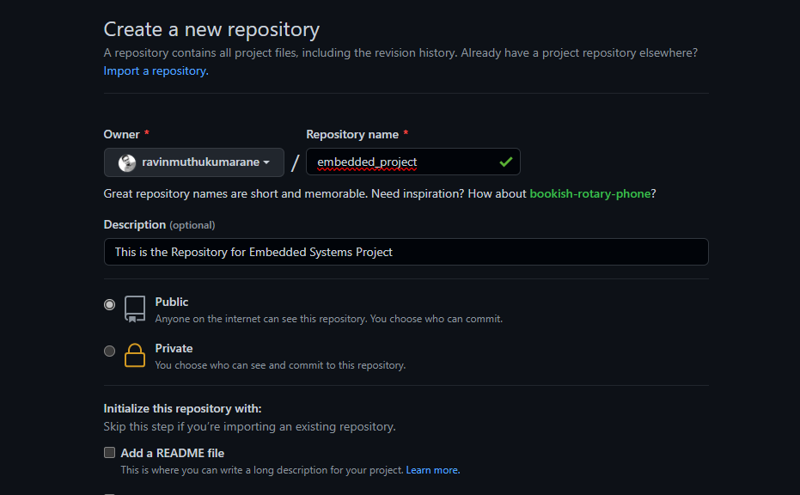
1. Creating a new Repository

Slide 3
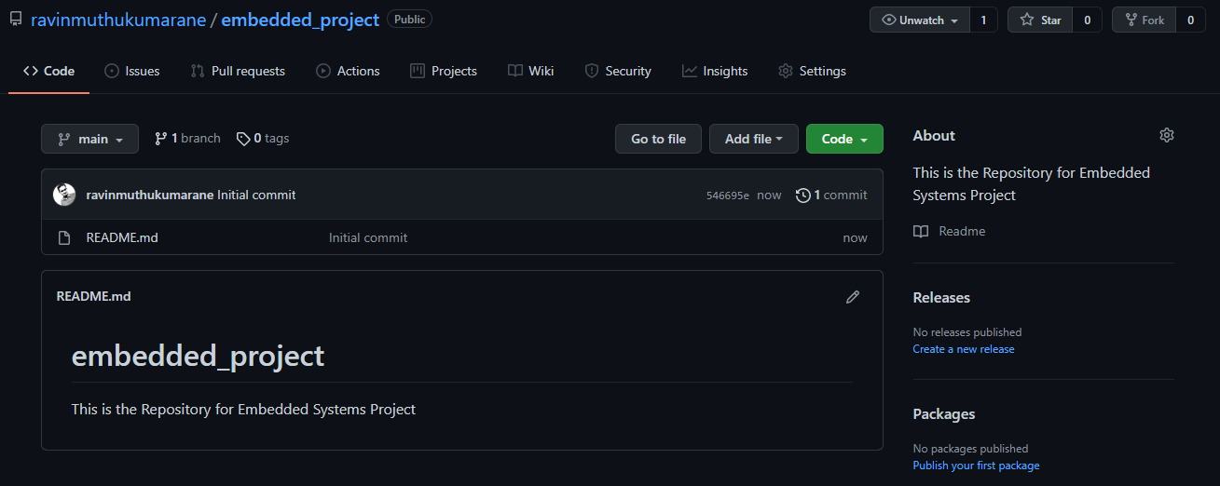
2. Dashboard of the created repository

Slide 4
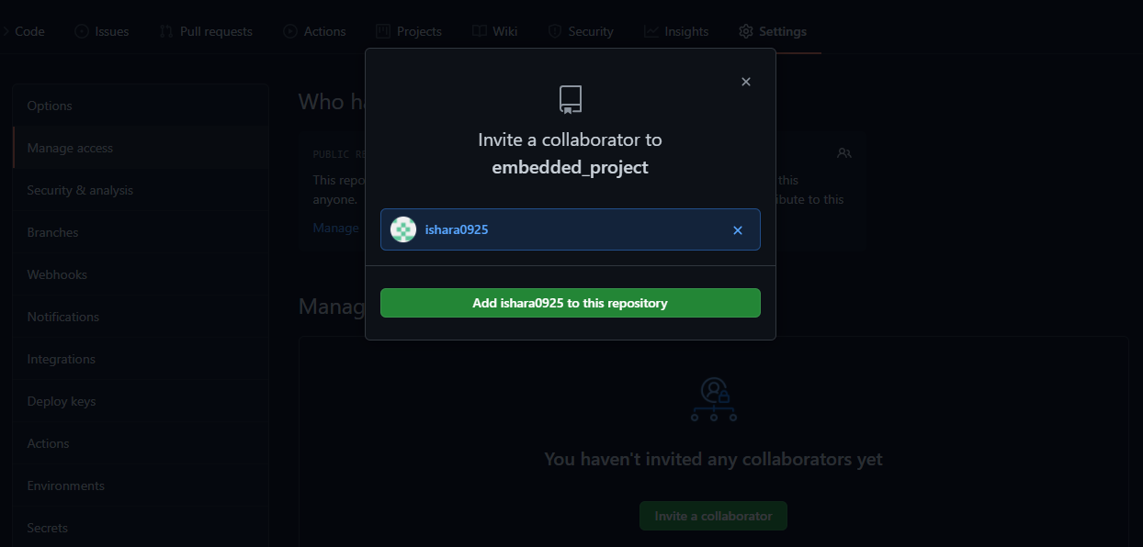
3. Add others to Collaborate

Slide 5
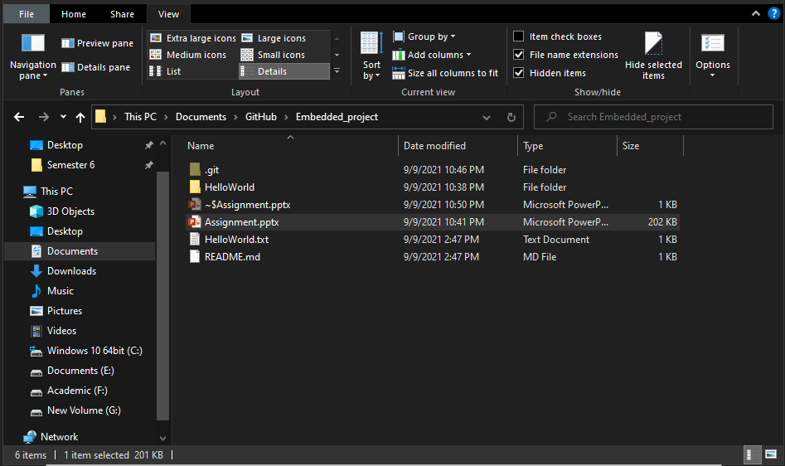
4. Project Folder

Slide 6
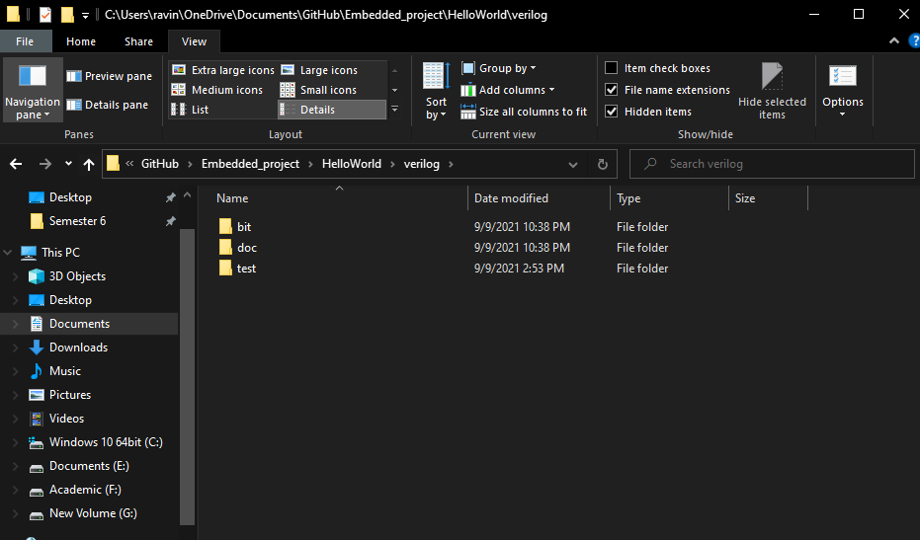
5. Folder Structure

Slide 7
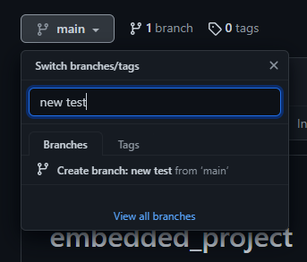
6. Committing a new branch

Slide 8
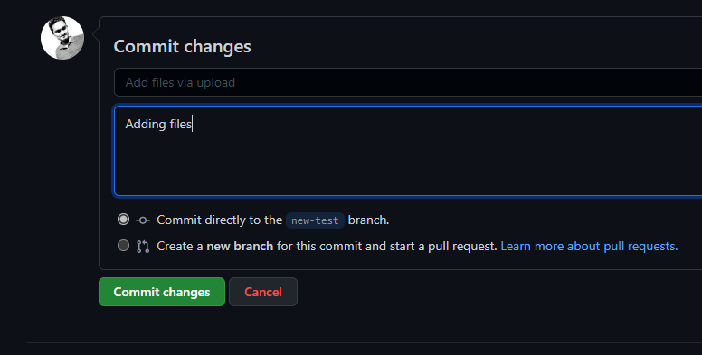
7. Committing Changes

Slide 9
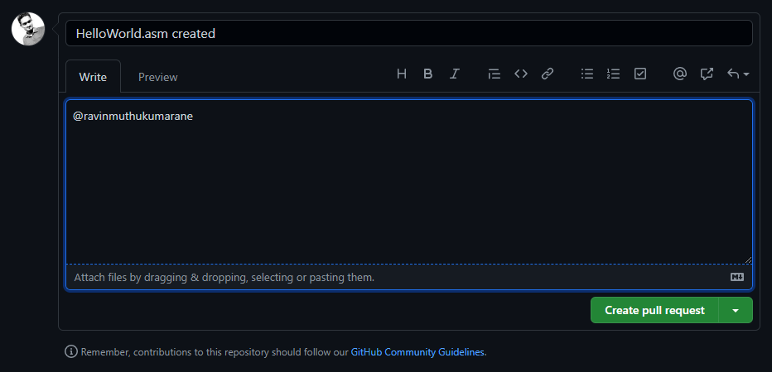
8. Creating a pull request

Slide 10
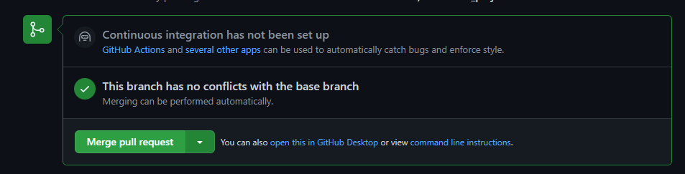
9. Merging the pull request

