Slide 1
INVESTMENT ASSIGNMENT SUBMISSION
Ravindra Kumar

Slide 2
Spark Fund Investment Case Study
Spark funds want to do investment in companies for that she wants to take effective decision
For this big decision analysis of global trend is required
Spark fund has two minor constraint:
It wants to invest between 5 to 15 million USD per round of investment
It wants to invest only in English-speaking countries because of the ease of communication with the companies it would invest in
Business objective:
The objective is to identify the best sectors, countries, and a suitable investment type for making investments.
Goals of data analysis:
Investment type analysis: Comparing the typical investment amounts so that Spark Funds can choose the type that is best suited for their strategy.
Country analysis: Identifying the countries which have been the most heavily invested in the past.
Sector analysis: Understanding the distribution of investments across the eight main sectors.

Slide 3
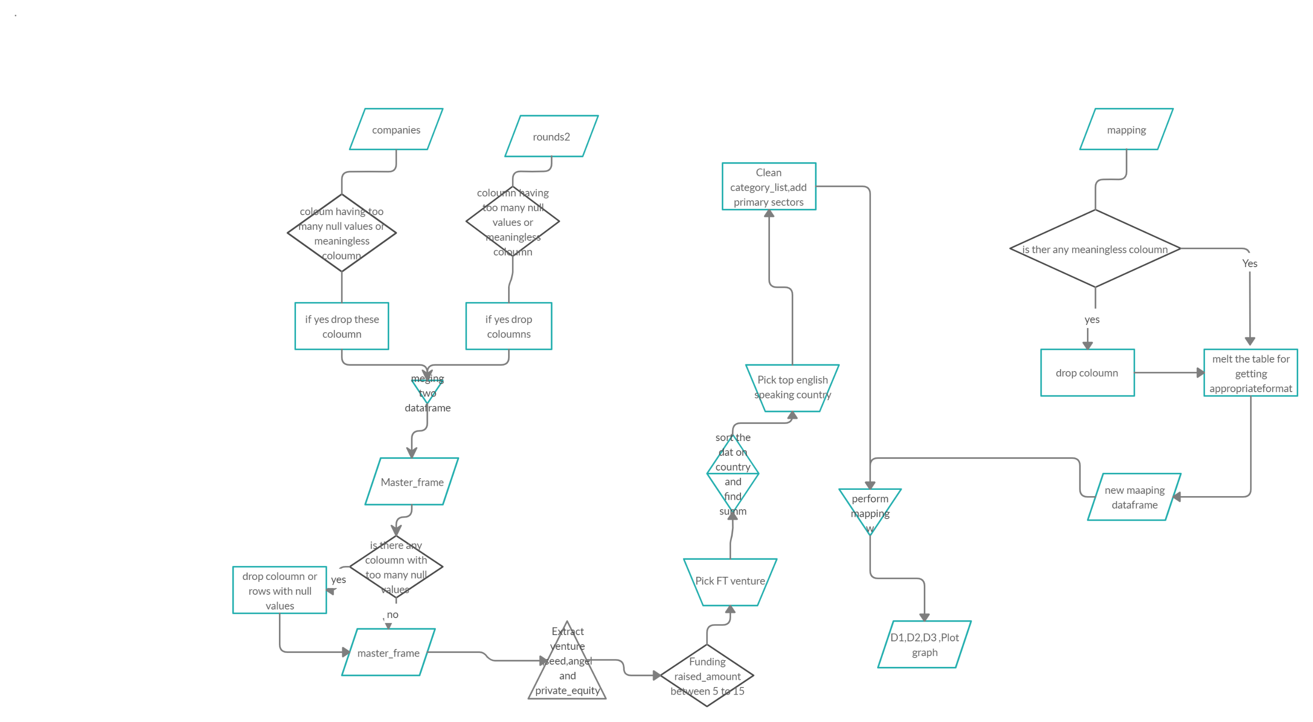
Problem solving methodology

Slide 4
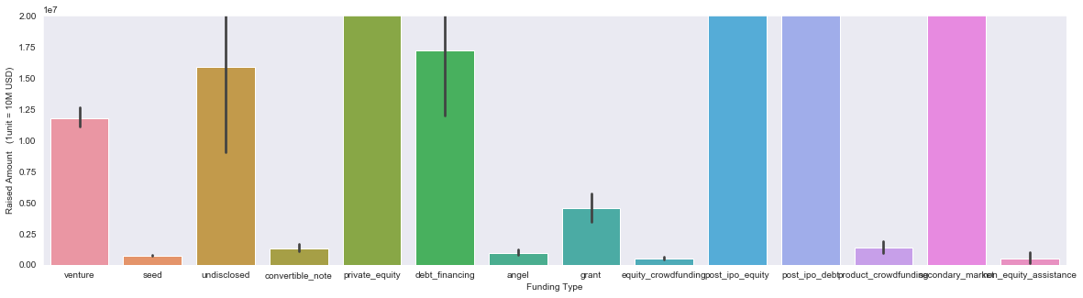
Investment Across all funding_round_types

Slide 5
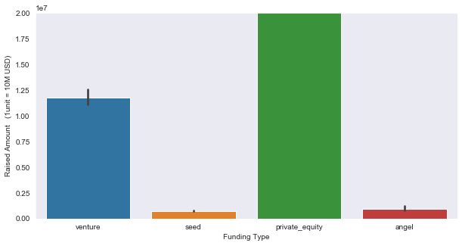
Investment Analysis for four main funding type

Slide 6
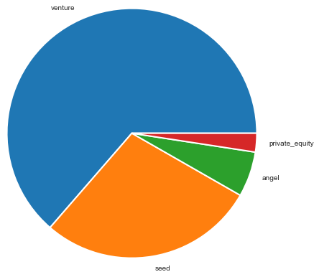
Pie chart analysis for fraction of number of investment

Slide 7
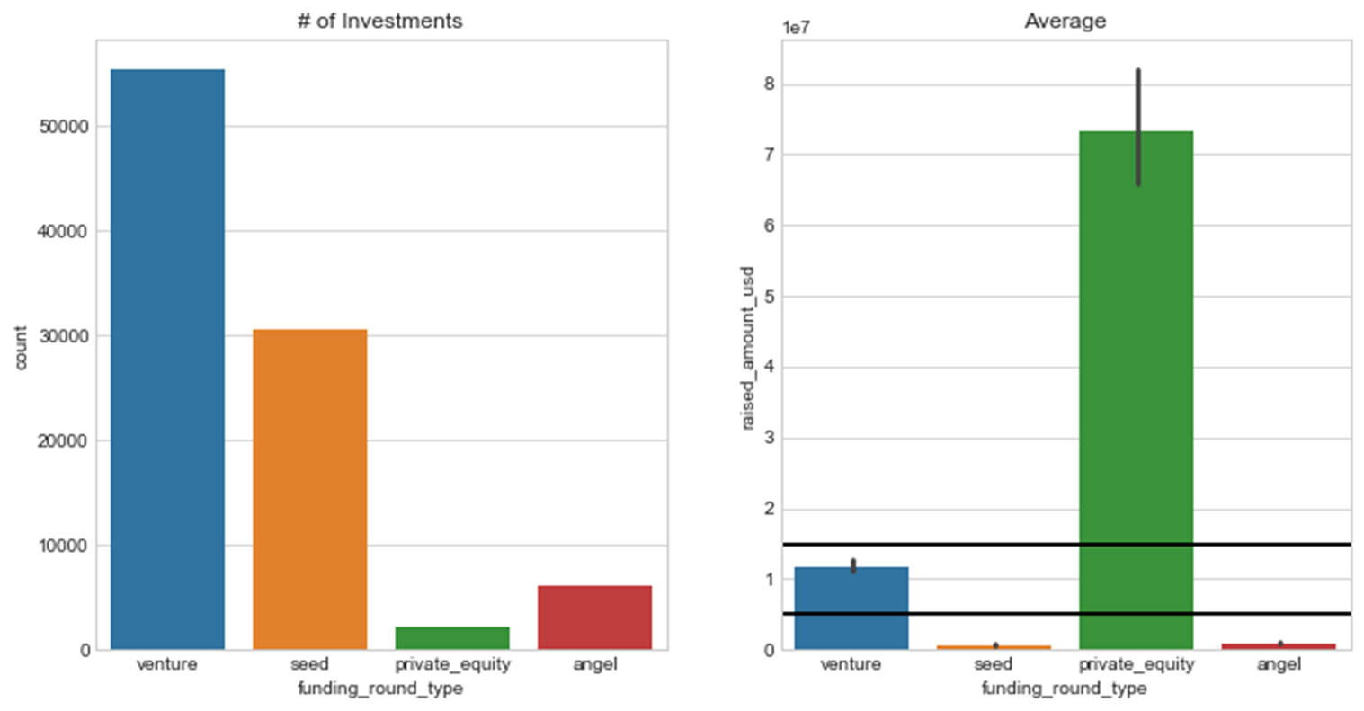
Average funding analysis

Slide 8
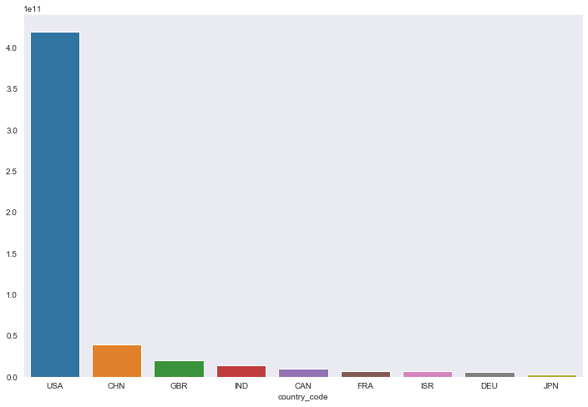
Top9 countries for best investment
Country_code | Raised_amount_usd
USA | 420068.029342
CHN | 39338.918773
GBR | 20072.813004
IND | 14261.508718
CAN | 9482.217668
FRA | 7226.851352
ISR | 6854.350477
DEU | 6306.921981
JPN | 3167.647127

Slide 9
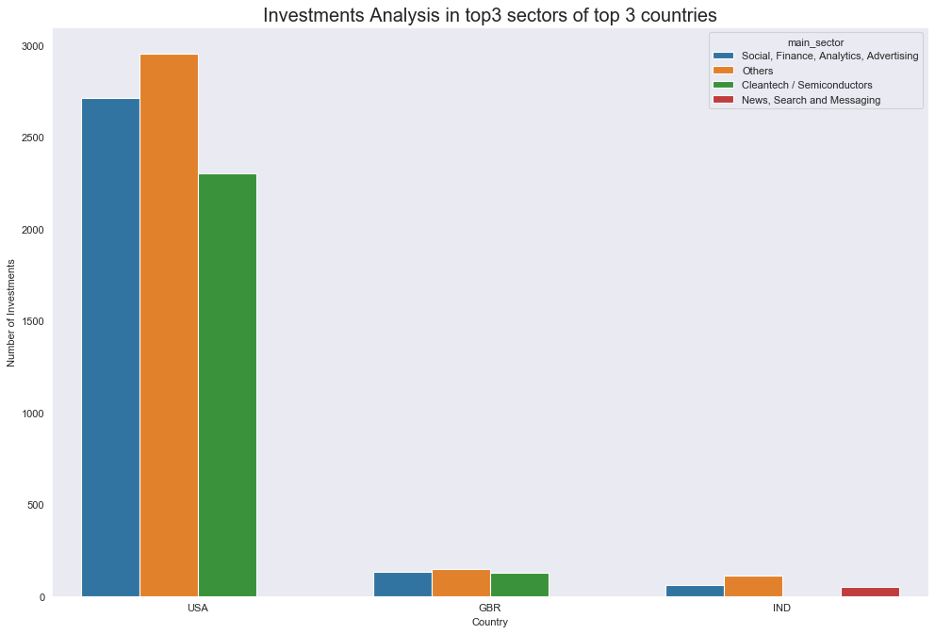
Investment analysis in top3 sector of top3 countries(English speaking Country)

Slide 10
Conclusion
Based on the all analysis spark fund can invest in these top countries and sectors and following companies:
Funding Type :venture
Country to invest | Investing Sector | Top companies
USA | Others | virtustream
 | Social, Finance, Analytics, Advertising | shotspotter
 | Cleantech / Semiconductors | biodesix
GBR | Others | electric-cloud
 | Social, Finance, Analytics, Advertising | celltick-technologies
 | Cleantech / Semiconductors | eusa-pharma
IND | Others | firstcry-com
 | Social, Finance, Analytics, Advertising | manthan-systems
 | News, Search and Messaging | gupshup-technology-india-pvt-ltd

