Slide 1
Unix II and Bedtools Bioinformatics Applications (PLPTH813)
Sanzhen Liu
2/28/2017

Slide 2
Outline
more Unix apps: sort, find, awk, sed, wget
data transfer
bedtools

Slide 3
sort - sort lines of text files
cat fruit.txt
orange 8
apple 6
peach 12
banana 5
sort fruit.txt
apple 6
banana 5
orange 8
peach 12
sort -k 2 fruit.txt
peach 12
banana 5
apple 6
orange 8
sort -k 2n fruit.txt
banana 5
apple 6
orange 8
peach 12
sort -k 2nr fruit.txt
peach 12
orange 8
apple 6
banana 5
sort -k 1,2 fruit.txt
apple 6
banana 5
orange 8
peach 12
http://www.theunixschool.com/2012/08/linux-sort-command-examples.html

Slide 4
find - search for files in a directory hierarchy
find [pathnames] [conditions]
# Finding files >10M
find . -size +10M
# Finding files <10M
find . -size -10M
# find a file
find -name "fruit.txt"
# find a file in the current directory
find -maxdepth 1 -name "fruit.txt"

Slide 5
find - II
# find files containing a specific word in its name
find -name "fruit*"
# find files whose name are not "fruit.txt"
find -not -name "fruit.txt"
# find files modified within 30 minutes
find . -mmin -30
# find files modified within 1 day
find . -mtime -1
# find files accessed within 1 hour.
find . -amin -60
http://www.folkstalk.com/2011/12/101-examples-of-using-find-command-in.html

Slide 6
awk - I
awk : a programming language designed for text processing and typically used as a data extraction and reporting tool.
cat fruit.txt
orange 8
apple 6
peach 12
banana 5
awk '{print $1}' fruit.txt # output first field
orange
apple
peach
banana

Slide 7
awk - II
awk 'BEGIN {start_action} {action} END {stop_action}' filename
# add up values in a column
awk 'BEGIN {sum=0} {sum=sum+$2} END {print sum}' fruit.txt
31
# print lines that satisfying certain conditions
awk '{if ($2 > 10) print }' fruit.txt
peach 12

Slide 8
awk - III:
# NF - Number of fileds variable:
awk '{print NF}' fruit.txt
2
2
2
2
# NR - number of records variable:
awk 'END {print NR}' fruit.txt
4
# length of strings
awk '{print length($1)}' fruit.txt
tolower(string)
toupper(string)

Slide 9
sed - a stream editor used for modifying files in unix
fruit.txt
orange 8
apple 6
peach 12
banana 5
sed 's/apple/strawberry/' fruit.txt
orange 8
strawberry 6
peach 12
banana 5
sed 's/apple/strawberry/g' fruit.txt
orange 8
strawberry 6
peach 12
banana 5

Slide 10
sed - II
fruit.txt
orange 8
apple 6
peach 12
banana 5
sed 's/apple/{&}/' fruit.txt
orange 8
{apple} 6
peach 12
banana 5
sed '/12/ s/peach/kiwi/' fruit.txt
orange 8
apple 6
kiwi 12
banana 5

Slide 11
wget
wget <url link to a file>
wget <a ftp link>
example:
wget http://129.130.89.83/tmp/public/sequence.cost.png

Slide 12
scp
scp user@hostname:directory/remotefile localfile
scp <eid>@beocat.cis.ksu.edu:<path/files> .

Slide 13

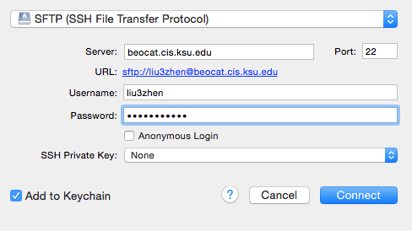
Cyberduck

Slide 14
Outline
more Unix apps: sort, find, awk, sed, wget
data transfer
bedtools

Slide 15
BED format
The first three required BED fields are:
chrom - the chromosome
chromStart - the starting position of the feature; The first base is numbered 0.
chromEnd - the ending position of the feature in the chromosome or scaffold.
The chromEnd base is not included in the display of the feature.
For example, the first 100 bases of a chromosome are defined as
chromStart=0, chromEnd=100, and span the bases numbered 0-99.
The additional optional BED fields are:
name - Defines the name of the BED line.
score - A score between 0 and 1000
strand - Defines the strand - either '+' or '-'.
…

Slide 16
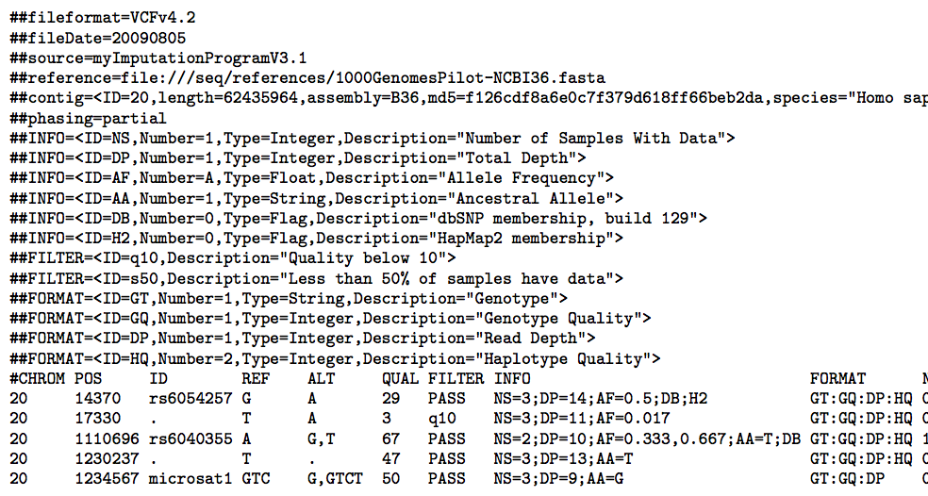
VCF format

Slide 17
coverage
bedtools coverage -abam $bam -b $bed
Bed input:
Interval_1 1 16452 10 -3.84
…
Output:
1 2 3 4
Interval_1 1 16452 10 -3.84 5432 16302 16451 0.9909
1. Read number
2. Coverage (bp)
3. Interval length
4. Coverage (%)

Slide 18
annotate and intersect
Input 1: #Chr chrStart chrEnd Len
10 10006596 10023047 16451
Input 2: #CHR POS REF ALT
10 64 C G
bedtools annotate -i Input1 -files Input2 -both
bedtools intersect -wo -a Input1 -b Input2
* -wo: write the original A and B entries plus the number of basepairs of overlap between the two features.

Slide 19
closest
# find the closest, non-overlapping gene for each interval where
# both experiments had a peak
# -io ignores overlapping intervals and returns only the closest,
# non-overlapping interval (in this case, genes)
bedtools closest -a both.bed -b genes.bed -io

Slide 20
slop & complement
# Step 1. Add 500 bp up and downstream of each probe
bedtools slop -i probes.bed -b 500
# Step 2. Get a BED file of all regions not covered by the probes (+500 bp up/down)
bedtools complement -i p.500bp.bed -g hg18.genome

Slide 21
window
#Report all genes that are within 10000 bp upstream or downstream of xxx.
bedtools window -a xxx.bed -b genes.bed -w 10000
# Report all genes that are within 10000 bp upstream or 5000 bp downstream of xxx.
bedtools window -a xxx.bed -b genes.bed -l 10000 -r 5000
#Report all SNPs that are within 5000 bp upstream or 1000 bp downstream of genes. Define upstream and downstream based on strand.
bedtools window -a genes.bed -b snps.bed -l 5000 -r 1000 -sw

Slide 22
merge
# Merge overlapping repetitive elements into a single entry.
bedtools merge -i example.bed
# Merge overlapping repetitive elements into a single entry, returning the number of entries merged.
bedtools merge -i example.bed -n
# Merge nearby (within 1000 bp) repetitive elements into a single entry.
bedtools merge -i example.bed -d 1000

Slide 23
Random
#Generate random sequences from the genome
bedtools random [options] –g <genome>
# typical options:
-l the length of the interval to generate
-n the number of intervals to generate
The genome file that is supplied takes the form:
<chromName><TAB><chromSize>
For example, Human (hg19):
chr1 249250621
chr2 243199373
...
chr18_gl000207_random 4262

Slide 24
flanking
head –n2 genes.bed
chr1 134212701 134230065 Nuak2 8 +
chr1 134212701 134230065 Nuak2 7 +
bedtools flank -i genes.bed -g ref.chromsizes -l 2000 -r 0 -s > prom.bed
This will give you the upstream regions based on strand as follows:
chr1 134210701 134212701 Nuak2 8 +
chr1 134210701 134212701 Nuak2 7 +
bedtools getfasta -fi ref.fa -bed prom.bed –fo prom.fa
-l The number of base pairs that a flank should start from orig. start coordinate.
-r The number of base pairs that a flank should end from orig. end coordinate
-s Define -l and -r based on strand.
e.g. if used, -l 500 for a negative-stranded feature,
it will start the flank 500 bp downstream. Default = false.
How To Use Bedtools To Extract Promoters?

