Slide 1
In-class project – DE Bioinformatics Applications (PLPTH813)
Sanzhen Liu
4/25/2017

Slide 2
RNA-Seq procedure
total RNA
mRNA
RNA to sequencing reads
1
DNA library
sequencing
reads
reads to read counts per gene
c
2
QC, alignment
read counts
read counts to significant genes
statistical test
3
q-values/FDR
significance

Slide 3


data information
SRR1238718
Makarevitch et al., 2015
Hirsch et al., 2016

Slide 4
Part I: Data downloading
Introduction of Sequence Read Archive (SRA) (2007)
Data download (SRA toolkit)
- fastq-dump

Slide 5
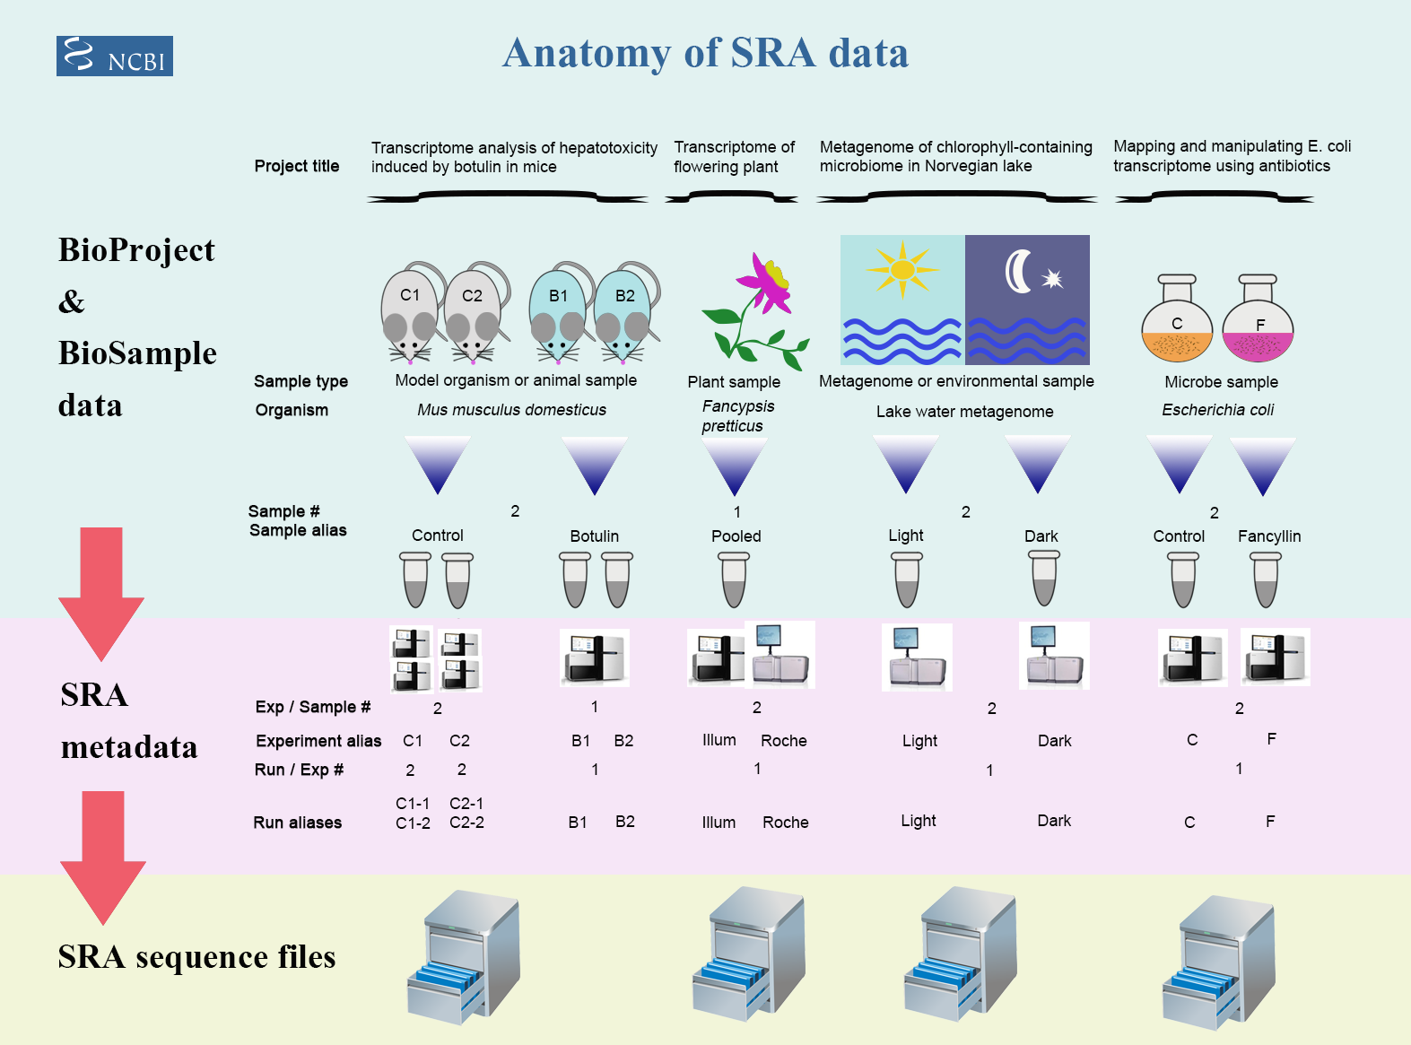
Framework of data submission

Slide 6
Metadata and sequence data
Study – a set of experiments with an overall goal
SRA Study accessions – SRP, DRP, or ERP
Experiment –laboratory operations on input material
SRA Experiment accessions – SRE, DRE, or ERE
Sample – An experiment targets one or more samples
SRA Sample accessions – SRS, DRS, or ERS
Run –the data gathered for a sample or sample bundle
SRA Run accessions – SRR, DRR, or ERR
Notes:
The SRA metadata describes the technical aspects of sequencing experiments: the sequencing libraries, preparation techniques and data files.

Slide 7
format conversion - fastq-dump in Beocat
fastq-dump [options] <accession>
#!/bin/bash
#$ -cwd
#$ -l mem=16G,h_rt=16:00:00
#$ -pe single 1
#$ -j y
/homes/liu3zhen/local/bin/fastq-dump \
--split-spot --split-3 \
--defline-seq '@$sn/$ri' \
--defline-qual '+' \
--gzip -A <accession>
a QSUB script
submit a job

Slide 8
Beocat pipeline to download SRA in batch - I
# step 1: Prepare data: dataset.txt
Order | ID | Genotype | Sample | Treatment | Citation
1 | SRR1238718 | B73 | norm1 | norm | Hirsch2015TPJ
2 | SRR1819617 | B73 | norm2 | norm | Hirsch2015TPJ
3 | SRR1819621 | B73 | norm3 | norm | Hirsch2015TPJ
4 | SRR1238717 | B73 | cold1 | cold | Hirsch2015TPJ
5 | SRR1819204 | B73 | cold2 | cold | Hirsch2015TPJ
6 | SRR1819205 | B73 | cold3 | cold | Hirsch2015TPJ
Makarevitch et al., 2015
Hirsch et al., 2016

Slide 9
General procedure
a QSUB script
submit a job
a script to generate and submit QSUB scripts
Organize the running script in a shell script
run the script to generate QSUB scripts
dataset.txt
perl srr.qsub.pl \
--mem 16 \
--time 16:00:00 \
--list dataset.txt \
--srrcol 2 \
--path /homes/liu3zhen/local/bin/
Order | ID | Genotype | Sample | Treatment | Citation
1 | SRR1238718 | B73 | norm1 | norm | Hirsch2015TPJ
2 | SRR1819617 | B73 | norm2 | norm | Hirsch2015TPJ
3 | SRR1819621 | B73 | norm3 | norm | Hirsch2015TPJ
4 | SRR1238717 | B73 | cold1 | cold | Hirsch2015TPJ
5 | SRR1819204 | B73 | cold2 | cold | Hirsch2015TPJ
6 | SRR1819205 | B73 | cold3 | cold | Hirsch2015TPJ
* path to the command: fastq-dump

Slide 10
Beocat pipeline to download SRA in batch - II
# step 2: Run "bash 1c-download.sh"
### must check
meta_file=dataset.txt
srr_col=2
rename_col=4
### might need to change
max_mem_size=16 ### requested memory
max_time=16:00:00 ### requested running time
fdpath=/homes/liu3zhen/local/bin/ ### fastq-dump path
srr_script_path=/homes/liu3zhen/local/pipelines/SRA/
rename_script=2c-rename.sh
### running
perl $srr_script_path/srr.qsub.pl --mem $max_mem_size \
--time $max_time --list $meta_file --srrcol $srr_col --path $fdpath
### create a script for renaming downloaded files
cut $meta_file -f $srr_col,$rename_col | grep "^[EDS]RR" | sed 's/^/rename /g' | sed 's/\t/ /g'| sed 's/$/ *gz/g' > $rename_script
Note: 1c-download.sh is copied from /homes/liu3zhen/local/pipelines/SRA

Slide 11
Beocat pipeline to download SRA in batch - III
# step 3: Run "2c-rename.sh" to change names (optional)
bash 2c-rename.sh

Slide 12
Part II. Trimming: generating qsub script
perl /homes/liu3zhen/local/pipelines/trimmomatic/trimmomatic.qsub.pl \
--mem 16 \
--time 12:00:00 \
--trim_shell "/homes/liu3zhen/local/pipelines/trimmomatic/trimmomatic.pe.sh" \
--trimmomatic "/homes/liu3zhen/local/jars/trimmomatic-0.36.jar" \
--adaptor_file "/homes/liu3zhen/local/pipelines/trimmomatic/trimmomatic_adaptDB/TruSeq3-PE.fa" \
--indir "../1-raw" \
--outdir "." \
--fq1feature "_1.fastq.gz" \
--fq2feature "_2.fastq.gz" \
--threads 4 \
--min_len 40

Slide 13
Part II. Trimming: qsub command
#!/bin/bash
#$ -cwd
#$ -l mem=16G,h_rt=12:00:00
#$ -pe single 4
#$ -j y
bash /homes/liu3zhen/local/pipelines/trimmomatic/trimmomatic.pe.sh \
/homes/liu3zhen/local/jars/trimmomatic-0.36.jar \
/homes/liu3zhen/local/pipelines/trimmomatic/trimmomatic_adaptDB/TruSeq3-PE.fa \
../1-raw \
. \
_1.fastq.gz \
_2.fastq.gz \
4 \
40 \
cold1_1.fastq.gz

Slide 14
RNA-Seq procedure
total RNA
mRNA
RNA to sequencing reads
1
DNA library
sequencing
reads
reads to read counts per gene
c
2
alignment
read counts
read counts to significant genes
statistical test
3
q-values/FDR
significance

Slide 15
Part IV. STAR: qsub script (one sample)
#!/bin/bash
#$ -cwd
#$ -l mem=48G,h_rt=12:00:00
#$ -pe single 1
#$ -j y
/homes/liu3zhen/local/bin/STAR --runThreadN 1 \
--genomeDir ../0-ref \
--readFilesIn ../2-trim/cold1.R1.pair.fq ../2-trim/cold1.R2.pair.fq \
--alignIntronMax 100000 \
--alignMatesGapMax 100000 \
--outFileNamePrefix cold1 \
--outSAMattrIHstart 0 \
--outSAMmultNmax 1 \
--outSAMstrandField intronMotif \
--outFilterIntronMotifs RemoveNoncanonicalUnannotated \
--outSAMtype BAM SortedByCoordinate \
--quantMode GeneCounts \
--outFilterMismatchNmax 2 \
--outFilterMismatchNoverLmax 0.05 \
--outFilterMatchNmin 40 \
--outSJfilterReads Unique \
--outFilterMultimapNmax 1 \
--outSAMmapqUnique 60 \
--outFilterMultimapScoreRange 2

Slide 16
Part III. STAR: Download and index the reference genome
wget ftp://ftp.ensemblgenomes.org/pub/release-35/plants/fasta/zea_mays/dna/Zea_mays.AGPv4.dna.toplevel.fa.gz
wget ftp://ftp.ensemblgenomes.org/pub/release-35/plants/gtf/zea_mays/Zea_mays.AGPv4.35.gtf.gz
gunzip *gz
qsub STAR.index.qsub
#!/bin/bash
#$ -cwd
#$ -l mem=3G,h_rt=12:00:00
#$ -pe single 1
#$ -j y #
/homes/liu3zhen/local/bin/STAR --runThreadN 4 \
--runMode genomeGenerate \
--genomeDir . \
--genomeFastaFiles Zea_mays.AGPv4.dna.toplevel.fa \
--sjdbGTFfile Zea_mays.AGPv4.35.gtf \
--sjdbOverhang 100

Slide 17
Part IV. STAR: generate qsub script and submit jobs
dbdir=../0-ref
perl /homes/liu3zhen/local/pipelines/STAR/STAR.qsub.pl \
--mem 48 --threads 1 --time 12:00:00 \
--star_cmd /homes/liu3zhen/local/bin/STAR \
--indir ../2-trim \
--dbdir $dbdir \
--fq1feature .R1.pair.fq \
--fq2feature .R2.pair.fq \
--alignIntronMax 100000 \
--alignMatesGapMax 100000 \
--outSAMattrIHstart 0 \
--outSAMmultNmax 1 \
--outSAMstrandField intronMotif \
--outFilterIntronMotifs RemoveNoncanonicalUnannotated \
--outSAMtype "BAM SortedByCoordinate" \
--quantMode GeneCounts \
--outFilterMismatchNmax 2 \
--outFilterMismatchNoverLmax 0.05 \
--outFilterMatchNmin 40 \
--outSJfilterReads Unique \
--outFilterMultimapNmax 1 \
--outSAMmapqUnique 60 \
--outFilterMultimapScoreRange 2

Slide 18
STAR output – cold1 sample
cold1Aligned.sortedByCoord.out.bam
cold1Log.final.out
cold1Log.out
cold1Log.progress.out
cold1ReadsPerGene.out.tab
cold1SJ.out.tab

Slide 19
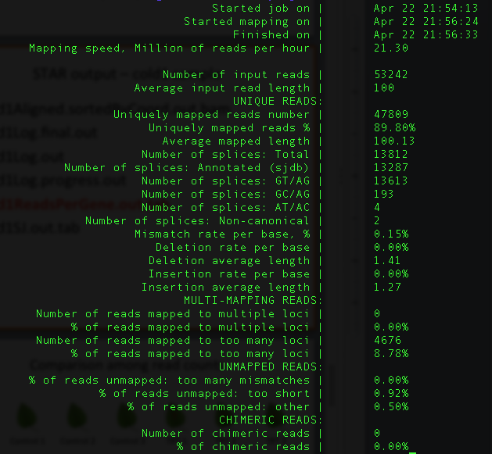
cold1Log.final.out

Slide 20
cold1ReadsPerGene.out.tab
N_unmapped | 5433 | 5433 | 5433
N_multimapping | 0 | 0 | 0
N_noFeature | 2927 | 25138 | 25275
N_ambiguous | 566 | 125 | 119
Zm00001d027230 | 3 | 1 | 2
Zm00001d027231 | 2 | 1 | 1
Zm00001d027232 | 0 | 0 | 0
Zm00001d027233 | 0 | 0 | 0
Zm00001d027234 | 0 | 0 | 0
Zm00001d027235 | 0 | 0 | 0
column 1: gene ID
column 2: counts for unstranded RNA-seq
column 3: counts for the 1st read strand aligned with RNA (htseq-count option -s yes)
column 4: counts for the 2nd read strand aligned with RNA (htseq-count option -s reverse)

Slide 21
RNA-Seq procedure
total RNA
mRNA
RNA to sequencing reads
1
DNA library
sequencing
reads
reads to read counts per gene
c
2
alignment
read counts
read counts to significant genes
statistical test
3
q-values/FDR
significance

Slide 22

Comparison among read counts
T
T
T
Control 1
Control 2
Control 3
TRT 1
TRT 2
TRT 3
Gene 1 | C1 | C2 | C3 | T1 | T2 | T3
…
Sum | N1 | N2 | N3 | N4 | N5 | N6
Sequence depth (total read number) influences read counts.
Can we generate some comparable numbers among samples?

Slide 23
Statistical test for differential expression
Statistical test to discover differential expression (DE)
Count data: Generalized Linear Model (GLM) to deal with count data
e.g., Poisson GLM could handle count data but overdispersion exits
Dispersion issue: Using negative binomial GLM to incorporate dispersion into the model
Small n problem: a few number of replication
Borrowing information across all the genes to estimate gene-specific variation
edgeR (Robinson and Smyth, 2007), DESeq (Anders and Huber, 2010), NBPSeq (Di et al., 2011), and QuasiSeq (Lund 2012)

Slide 24
Part V. DE: merge counting data
setwd("/homes/liu3zhen/teaching/BA17/in-class.project/DE/4-DE/")
library("DESeq2")
### Parameters - Subject to change
datapath <- "/homes/liu3zhen/teaching/BA17/in-class.project/DE/3-STAR/"
suffix <- "ReadsPerGene.out.tab"
count.files <- dir(path = datapath, pattern = suffix)
### merge all counts
allcounts <- NULL
for (cf in count.files) {
counts <- read.delim(paste0(datapath, "/", cf), header = F, stringsAsFactors = F, skip = 4)
base <- gsub(suffix, "", cf)
counts <- counts[, 1:2]
colnames(counts) <- c("Gene", base)
### merge data
if (is.null(allcounts)) {
allcounts <- counts
} else {
allcounts <- merge(allcounts, counts, by = "Gene")
}
}

Slide 25
Part VI. DE
### load modules
source("/homes/liu3zhen/local/share/LiuLabScripts/DESeq2.single.trt.R")
source("/homes/liu3zhen/local/share/LiuLabScripts/DE.summary.R")
### DE parameters
fdr.cutoff <- 0.05
# data reformat:
input <- allcounts[, 2:7]
rownames(input) <- allcounts[, 1]
# DE statistical analysis:
DE.out <- DESeq2.single.trt(input.matrix = input,
min.mean.reads = 5,
group1.col = 1:3,
group2.col = 4:6,
comparison = c("norm", "cold"),
geneID = rownames(input),
fdr = fdr.cutoff,
logpath = ".",
logfile = "cold-norm.log.md")
# merge DE with counts and output DE result:
DE.out <- data.frame(DE.out)
final.out <- merge(allcounts, DE.out, by.x = "Gene", by.y = "GeneID")
write.table(final.out, "cold-norm.DESeq2.txt", sep="\t", quote=F, row.names=F )

Slide 26
Part VI. DE summary
de.summary <- DE.summary(DE.path=".",
DE.files="cold-norm.DESeq2.txt",
qval.feature=".qval",
log2FC.feature=".log2FC",
fdr=fdr.cutoff,
out.path=".",
out.file="cold-norm.DESeq2.summary.txt")

Slide 27
your turn
Order | Runs | Samples | Tissue | Replicate
1 | SRR3466605 | RH1 | root hairs | rep1
2 | SRR3466606 | RH2 | root hairs | rep2
3 | SRR3466607 | RH3 | root hairs | rep3
4 | SRR3466608 | RH4 | root hairs | rep4
5 | SRR3466609 | root1 | root hair less roots | rep1
6 | SRR3466610 | root2 | root hair less roots | rep2
7 | SRR3466611 | root3 | root hair less roots | rep3
8 | SRR3466612 | root4 | root hair less roots | rep4
root hair (RH) vs. root without hair (root)

