Slide 1
Genome assembly Bioinformatics Applications (PLPTH813)
Sanzhen Liu
4/18/2017

Slide 2
Outline
Genome assembly: concept
Assembly algorithms: OLC/De Bruijn graph
Error correction (Kmer counts)
Assembly strategy to cope with the repeat problem
(mate-pair reads, long reads)
Assembly evaluation (N50, comparison to a reference genome)

Slide 3
Whole genome shotgun (WGS) sequencing
chromosome
sequencing
reads

Slide 4


Complexity of genome assembly
criticalmiami.com/
dreamstime.com
Algorithm Can Solve 10, 000 Piece Jigsaw in 24 Hours

Slide 5
Genome assembly
sequencing
reads
unitigs, superreads
contigs
scaffolds
NN..NN
complete assembly / pseudochomosome

Slide 6
Assembly algorithms
Overlap layout consensus (OLC)
all-to-all pair-wise read alignments
Construct graph based on overlaps
Trace paths for the assembly
De Bruijn graph
Determine k-mer from reads
Construct k-mer graph
Trace paths for the assembly

Slide 7
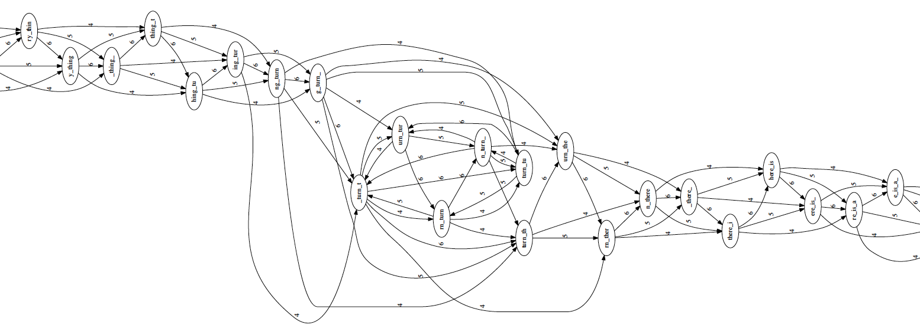
Overlap layout consensus (I)
Overlap graph
identifies all pairs of reads that overlap sufficiently well
organizes the overlapping information into a graph containing a node for every read and an edge between any pair of reads that overlap each other.
Overlap
Layout
Consensus
to_every_thing_turn_turn_turn_there_is_a_season
l = 4 (minimum overlap)
k = 7 (read length)
langmead-lab.org/teaching-materials

Slide 8
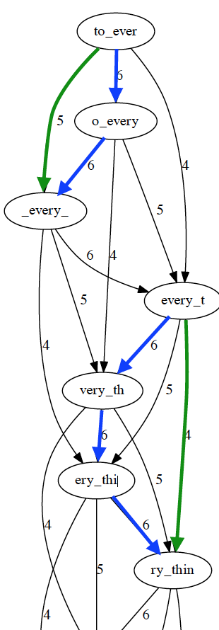
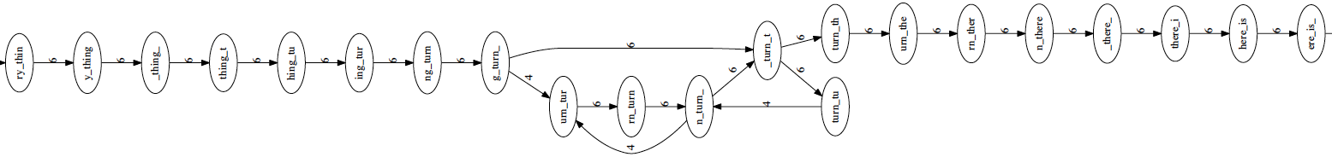
Overlap layout consensus (II)
Overlap
Layout
transitive edges: edges that skip one or more nodes
Consensus
Layout (string graph)
Simplifies the global overlap graph by removing redundant information (transitive edges)
Emit contigs corresponding to the non-branching stretches
langmead-lab.org/teaching-materials

Slide 9
Overlap layout consensus (III)
Overlap
Layout
Simplifies the global overlap graph by removing redundant information
Emits contigs corresponding to the non-branching paths
Layout
Consensus
contig 1
to_every_thing_turn_
unresolved repeat (gap)
contig 2
turn_there_is_a_season
to_every_thing_turn_turn_turn_there_is_a_season
langmead-lab.org/teaching-materials

Slide 10
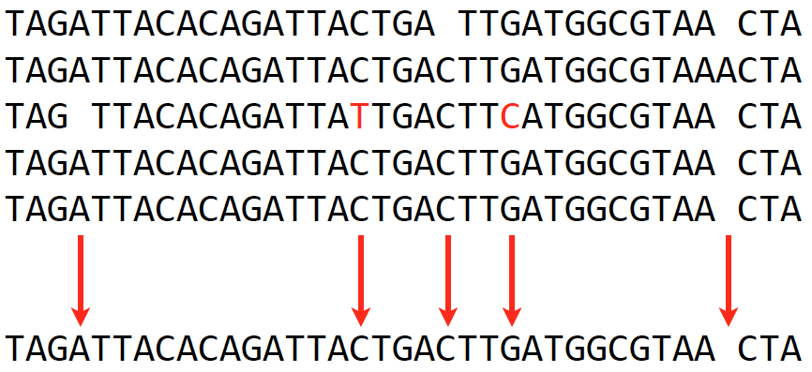
Overlap layout consensus (IV)
Overlap
Consensus
Extract consensus sequences (major votes) based on the alignment of reads that make up a contig
Layout
Consensus
langmead-lab.org/teaching-materials

Slide 11
OLC drawbacks
Identifying all-to-all overlaps is a slow procedure, especially when read number is millions or billions.
Overlap graph is big when read number is huge. One node per read, and in practice the number of edges grows superlinearly with the number of reads
The computational complexity limits its application

Slide 12
De Bruijn graph – k-mer
De Bruijn graph assemblers model the relationship between exact substrings of length k (k-mer) extracted from input reads.
(k=3)
reads
A T G G C G T
k-mer (k=3)
ATG
TGG
GGC
GCG
CGT
Compeau et al., 2011. Nature Biotechnology 29: 987-991.

Slide 13
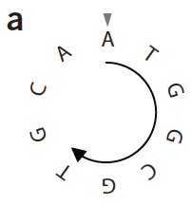
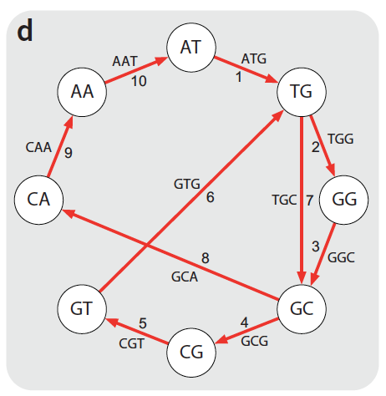
De Bruijn graph - assembly
De Bruijn graph assemblers model the relationship between exact substrings of length k (k-mer) extracted from input reads.
k-mer (k=3)
De Bruijn graph
C
ATG
TGG
GGC
GCG
CGT
GTG
TGC
GCA
CAA
AAT
genome
sequence
b
ATGGCGT
GGCGTCG
CTTGCAA
TGCAATG
CAATGGC
ATGGCGT
reads
edge
ATG
AT
TG
ATGGCGTGCAATG
Node
Compeau et al., 2011. Nature Biotechnology 29: 987-991.

Slide 14
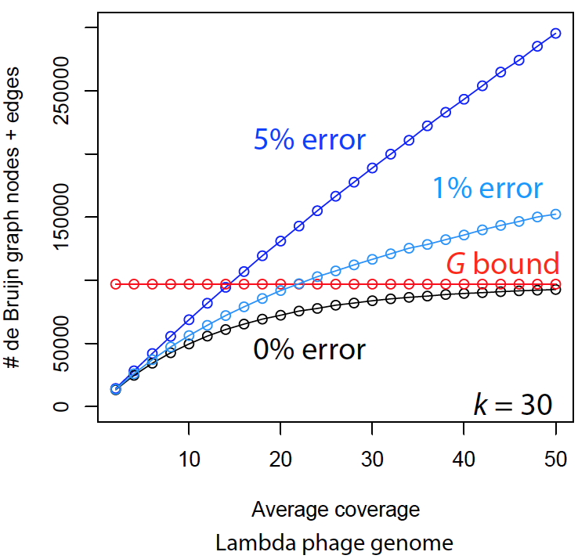
Sequencing errors complicate assemblies
The complexity of De Bruijn graph grows when reads contain errors.
Reads
TGCGTGA
TGCGTGA
TGCGTGA
TGGGTGA
k-mer count profile (k=5)
G: genome
TGCGT
GCGTG
CGTGA
TGGGT
GGGTG
GGTGA
langmead-lab.org/teaching-materials
Sequence error correction before graph construction is a critical step for De Bruijn graph assembly.

Slide 15
Error identification
Reads (depth = 10)
k-mer count profile (k=5)
TGCGTGATACG
TGCGTGATACG
TGGGTGATACG
TGCGTGATACG
TGCGTGATACG
TGCGTGATACG
TGCGTGATACG
TGCGTGATACG
TGCGTGATACG
TGCGTGATACG
TGGGT 1
GGGTG 1
GGTGA 1
TGCGT 9
GCGTG 9
CGTGA 9
GTGAT 10
TGATA 10
GATAC 10
ATACG 10
k-mer count profile indicates where errors are

Slide 16
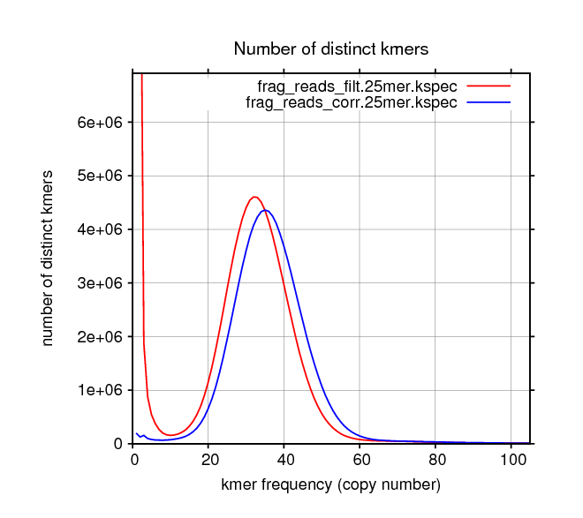
Error correction
uncorrected reads
corrected reads
Essentially, the error correction algorithm removes k-mers with a few copies and correct reads carrying these errors.
from Allpaths-LG

Slide 17
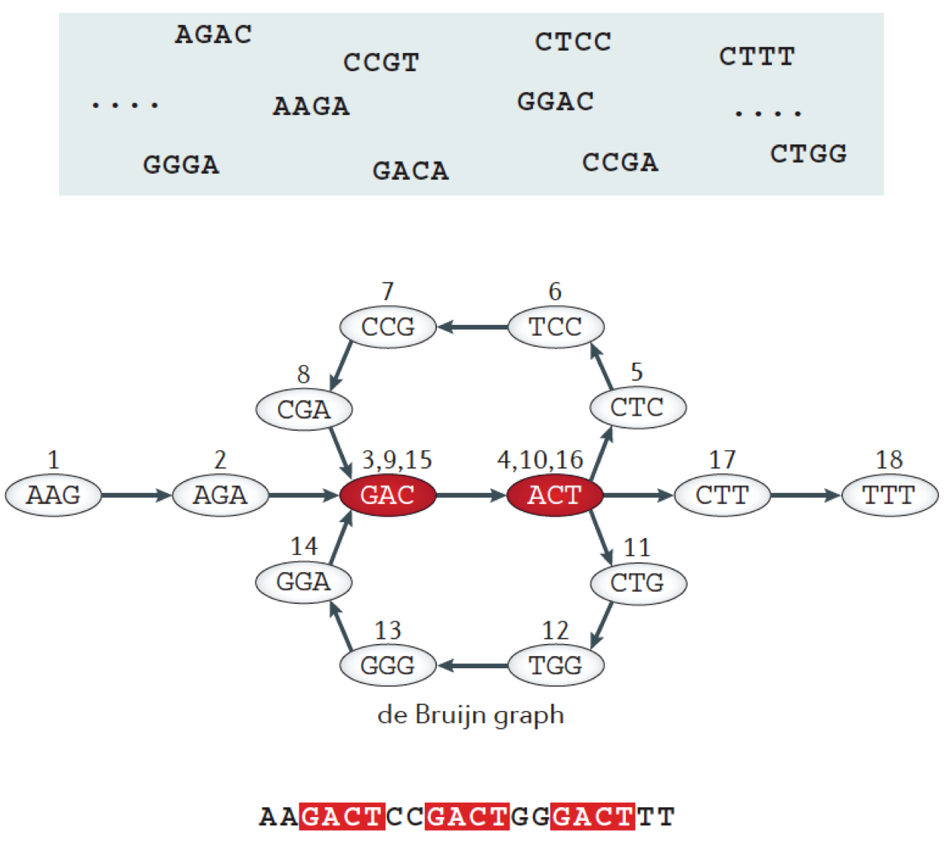
Repeats
Berger, B., et al., 2013 Nature Reviews Genetics 14: 333-346.

Slide 18
Unresolved repeats produce gaps
Long repeats, especially for those whose lengths are longer than read length, and high-copy repeats are challenging to resolve. If no other information can be used to assist in resolving repeats, gaps will be introduced.
Miller et al., 2010. Genomics 95: 315-327

Slide 19
Question
What strategies can be used to resolve repeats?

Slide 20
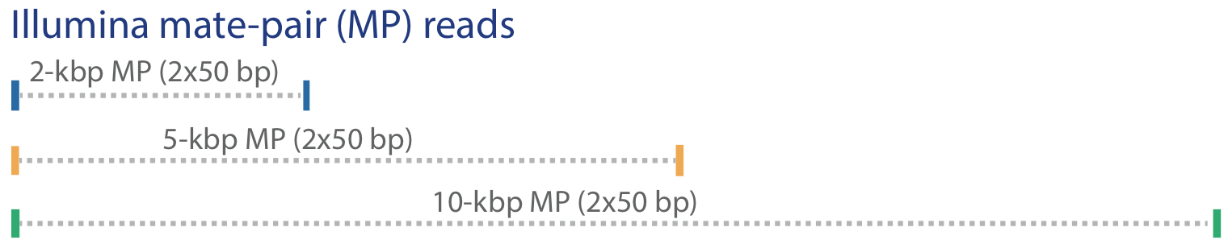
Strategies to resolve repeats
Mate-pair reads, long reads (e.g., PacBio), genetic map, physical map, and Hi-C data can resolve some repeats
Miller et al., 2010. Genomics 95: 315-327

Slide 21
Other assembly gaps
Low sequence coverage (depth)
Sequencing biases (e.g., regions recalcitrant to sequencing)
CGGATCTGCGTGATACGGAATAGCCTAGCA
GATCTGCGTGATACGGAAT
ATCTGCGTGATACGGAATA
TCTGCGTGATACGGAATAG
CTGCGTGATACGGAATAGC
TGCGTGATACGGAATAGCC
CGTGATACGGAATAGCCT
6 (coverage; depth)
Recalcitrant genomic regions:
extremely high GC or AT
complicated secondary structure
Preferred genome sequencing reads:
Long reads
High-quality reads
High sequencing depth (>30x)
No sequencing biases

Slide 22
Assembly statistics – N50
N50: A statistic used for assessing the contiguity of a genome assembly.
The contigs in an assembly are sorted by size and added, starting with the largest. The contig N50 is the size of the contig that makes the total greater than or equal to 50% of the total contig size.
OR: The contig N50 is the length of the smallest contig in the set that contains the fewest (largest) contigs whose combined length represents at least 50% of the assembly.

Slide 23
Assembly statistics – NG50
Problem of N50:
N50 values of the assemblies with significantly different total assembly space (lengths) are usually not comparable. Even if the same data set is used for the assembly.
50,000
30,000
10,000
50,000
40,000
30,000
20,000
10,000
NG50: The NG50 statistic is the same as N50 except that it is 50% of the known or estimated genome size. This allows for meaningful comparisons between different assemblies.

Slide 24
An example to determine N50 and NG50
Genome size: 5 Mbp
20 contigs
Accumulated (kbp) | % ASM | % genome
615 | 13% | 12%
1,130 | 25% | 23%
1,642 | 36% | 33%
2,092 | 46% | 42%
2,452 | 53% | 49%
2,808 | 61% | 56%
3,118 | 68% | 62%
3,319 | 72% | 66%
3,508 | 76% | 70%
3,694 | 80% | 74%
3,854 | 84% | 77%
4,004 | 87% | 80%
4,124 | 90% | 82%
4,226 | 92% | 85%
4,321 | 94% | 86%
4,407 | 96% | 88%
4,489 | 98% | 90%
4,543 | 99% | 91%
4,575 | 100% | 92%
4,596 | 100% | 92%
ctg_ID | ctg_size (kbp)
1 | 615
2 | 515
3 | 512
4 | 450
5 | 360
6 | 356
7 | 310
8 | 201
9 | 189
10 | 186
11 | 160
12 | 150
13 | 120
14 | 102
15 | 95
16 | 86
17 | 82
18 | 54
19 | 32
20 | 21
Total | 4,596
contig N50?
contig NG50?
360 kbp
356 kbp

Slide 25
Assembly evaluation – QUAST
QUAST: quality assessment tool for genome assemblies
No. of contigs: the total number of contigs in the assembly.
Largest contig: the length of the largest contig in the assembly.
Total length: total assembly length
Nxx (N50), NGxx (NG50)
Using a reference genome, No. of misassemblies, No. INDEL per 100 kbp, and No. of mismatches per 100 kbp are reported
NA50: splits contigs that contain "misassemblies" and "unaligned" sequences and uses the new contigs for N50 calculation (NA50)
Gurevich et al., 2013 Bioinformatics 29: 1072-1075.

Slide 26
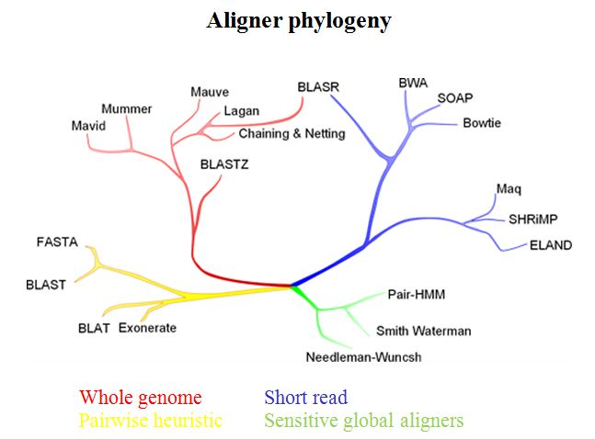
An alignment tool behind QUAST - Nucmer
Nucmer is a user-friendly alignment script of the MUMmer software package for DNA sequence alignment.
For instance, a very common use for Nucmer is to determine the position and orientation of a set of sequence contigs in relation to a reference genome sequence

Slide 27
Citations
Berger, B., J. Peng and M. Singh, 2013 Computational solutions for omics data. Nature Reviews Genetics 14: 333-346.
Compeau, P. E. C., P. A. Pevzner and G. Tesler, 2011 How to apply de Bruijn graphs to genome assembly. Nature Biotechnology 29: 987-991.
Nagarajan, N., and M. Pop, 2013 Sequence assembly demystified. Nature Reviews Genetics 14: 157-167.
Miller, J. R., S. Koren and G. Sutton, 2010 Assembly algorithms for next-generation sequencing data. Genomics 95: 315-327.
Gurevich, A., V. Saveliev, N. Vyahhi and G. Tesler, 2013 QUAST: quality assessment tool for genome assemblies. Bioinformatics 29: 1072-1075.

Slide 28
Lab
Genome assemblies using two assemblers:
SOAPdenovo
Discovar de novo
Assembly evaluation – QUAST
Nucmer – sequence comparison

