Slide 1
RNA-Seq (lab) Bioinformatics Applications (PLPTH813)
Sanzhen Liu
4/27/2017

Slide 2
Today's Lab
from reads to alignments (GSNAP)
from alignments to read counts (HTSeq)
Differential expression analysis (DESeq2)

Slide 3
Working directories
<course directory>
------ Lab12_RNA-Seq
-------------- aln
-------------- DE

Slide 4
Index the reference genome for GSNAP alignments
### index reference genome
/homes/liu3zhen/software/bin/gmap_build \
-D . -d ref ref.fas
skip to run

Slide 5
GSNAP to align SE reads to the reference genome
refpath=/homes/liu3zhen/teaching/BA17/Lab12_DE/gsnap
db=ref
fq=/homes/liu3zhen/teaching/BA17/Lab12_DE/fastq/se.fq
out=se
### alignment
/homes/liu3zhen/software/bin/gsnap \
-D $refpath -d $db \
-B 2 -N 1 -i 2 -n 3 -t 4 \
--format=sam $fq \
>$out.sam
### sorted, indexed BAM
samtools view -bS $out.sam -o $out.tmp.bam
samtools sort $out.tmp.bam –o $out.bam
samtools index $out.bam
rm $out.tmp.bam

Slide 6
GSNAP to align PE reads to the reference genome
refpath=/homes/liu3zhen/teaching/BA17/Lab12_DE/gsnap
db=ref
fq1=/homes/liu3zhen/teaching/BA17/Lab12_DE/fastq/sample.pe1.fq
fq2=/homes/liu3zhen/teaching/BA17/Lab12_DE/fastq/sample.pe2.fq
out=pe
### alignment
/homes/liu3zhen/software/bin/gsnap -D $refpath \
-d $db -B 2 -N 1 -i 2 -n 3 -t 4 \
--format=sam $fq1 $fq2 >$out.sam
### sorted, indexed BAM
samtools view -bS $out.sam -o $out.tmp.bam
##### note: sort by name for PE data, which is required for HTSeq
samtools sort -n $out.tmp.bam –o $out.sortbyname.bam
rm $out.tmp.bam

Slide 7
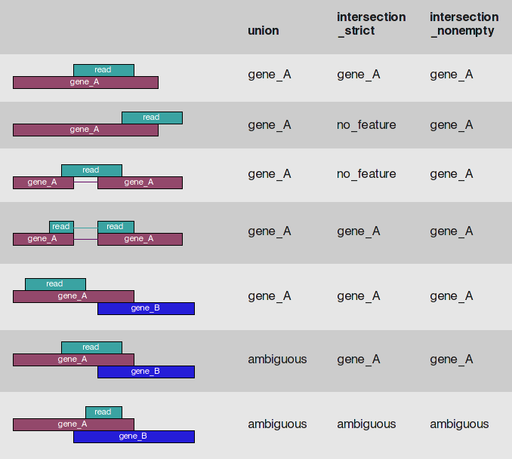
HTSeq to count reads for each gene
http://www-huber.embl.de/users/anders/HTSeq/doc/count.html

Slide 8
HTSeq Installation
pip2.7 install --user numpy
pip2.7 install --user PySam
cd ~
mkdir software
cd software
mkdir HTSeq
cd HTSeq
wget https://pypi.python.org/packages/source/H/HTSeq/HTSeq-0.6.1p1.tar.gz
tar -xf HTSeq-0.6.1p1.tar.gz
cd HTSeq-0.6.1p1
python2.7 setup.py install --user
export PATH=$PATH:~/software/HTSeq/HTSeq-0.6.1p1/build/scripts-2.7

Slide 9
HTSeq – Single-end reads
### gtf file:
gtf=/homes/liu3zhen/teaching/BA17/Lab12_DE/gtf/ZmB73_5b_FGS.standard.gtf
### BAM data
bam=/homes/liu3zhen/teaching/BA17/Lab12_DE/aln/se.bam
### counting
/homes/liu3zhen/software/bin/htseq-count \
--stranded=no --type=exon \
--format=bam --minaqual=30 \
--mode=union $bam $gtf > se.counts

Slide 10
HTSeq – Paired-end reads
### gtf file:
gtf=/homes/liu3zhen/teaching/BA17/Lab12_DE/gtf/ZmB73_5b_FGS.standard.gtf
### BAM data
bam=/homes/liu3zhen/teaching/BA17/Lab12_DE/aln/pe.bam
### counting
/homes/liu3zhen/software/bin/htseq-count \
--stranded=no --type=exon --order=pos \
--format=bam --minaqual=30 --mode=union \
$bam $gtf > pe.counts

Slide 11
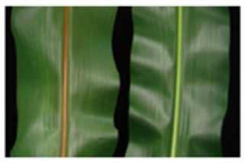
count data
counts:
/homes/liu3zhen/teaching/BA17/Lab12_DE/DE/bm2.txt
In total, four datasets: two mutants and two wild-types
mut
wt
Tang, HM, et al., 2014 The maize brown midrib2 (bm2) gene encodes a methylenetetrahydrofolate reductase that contributes to lignin accumulation. Plant J, 77: 380-392.

Slide 12
DESeq2 installation
### DESeq2
source("http://bioconductor.org/biocLite.R")
biocLite("DESeq2")
library("DESeq2")

Slide 13
Your Turn setup a working directory and read counting data "bm2.txt" to the variable "grc" datafile=/homes/liu3zhen/teaching/BA17/Lab12_DE/DE/bm2.txt

Slide 14
Set the working directory and import data
setwd(your working directory)
datafile=/homes/liu3zhen/teaching/BA17/Lab12_DE/DE/bm2.txt
grc <- read.delim(datafile)
head(grc)

Slide 15
data (read counts each gene)
> head(grc)
GeneID mut_1 wt_1 mut_2 wt_2
1 AC147602.5_FG004 6241 7181 3145 5364
2 AC148152.3_FG001 9 6 13 4
3 AC148152.3_FG005 45 62 52 37
4 AC148152.3_FG006 2 4 2 11
5 AC148152.3_FG008 803 1201 639 1036
6 AC148167.6_FG001 1394 1758 1192 1613

Slide 16
data organization
### count information
geneid <- grc$GeneID
in.data <- grc[, 2:5]
in.data <- as.matrix(in.data)
### sample names and grouping information (treatment)
sample.ids <- colnames(in.data)
sample.ids
treatment <- c("mut", "wt", "mut", "wt")
treatment
sample.info <- data.frame(row.names=sample.ids, trt=treatment)
sample.info

Slide 17
DESeq2
dds <- DESeqDataSetFromMatrix(countData=in.data,
colData=sample.info, formula(~trt))
dds <- DESeq(dds, "Wald")

Slide 18
Output
# DE:
res <- results(dds, cooksCutoff=F, independentFiltering=T)
res$GeneID <- geneid
res <- res[,c("GeneID","log2FoldChange", "pvalue", "padj")]

Slide 19
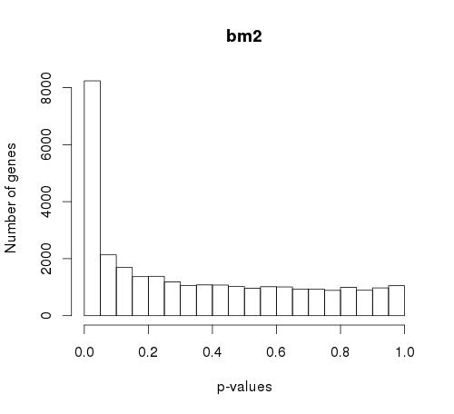
p-values
# p-value histogram
hist(res$pvalue, xlab = "p-values",
ylab = "Number of genes", main = "bm2")

Slide 20
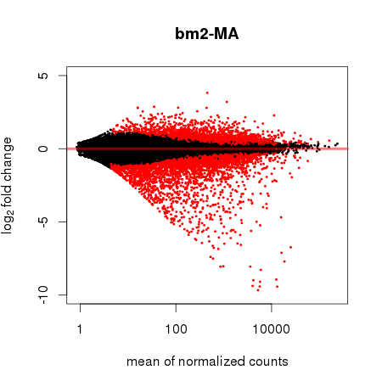
MA plot
plotMA(dds, alpha = 0.05,
main = "bm2-MA", ylim = c(-10, 5))

