Slide 1


Slide 2
R/qtl introduction
QTL analysis package R/qtl (Broman & Wu, 2014) is a very popular package for the linkage map construction of a simple Backcross (BC), Doubled Haploid (DH), intercrossed F2 (F2), 4-way crosses and advanced Recombinant Inbred Lines (RIL).
install.packages("qtl")

Slide 3
library(qtl)
data(mapthis)
summary(mapthis)
## F2 intercross
##
## No. individuals: 300
##
## No. phenotypes: 1
## Percent phenotyped: 100
##
## No. chromosomes: 1
## Autosomes: 1
##
## Total markers: 100
## No. markers: 100
## Percent genotyped: 95.4
## Genotypes (%): AA:26.2 AB:48.2 BB:25.6 not BB:0.0 not AA:0.0

Slide 4
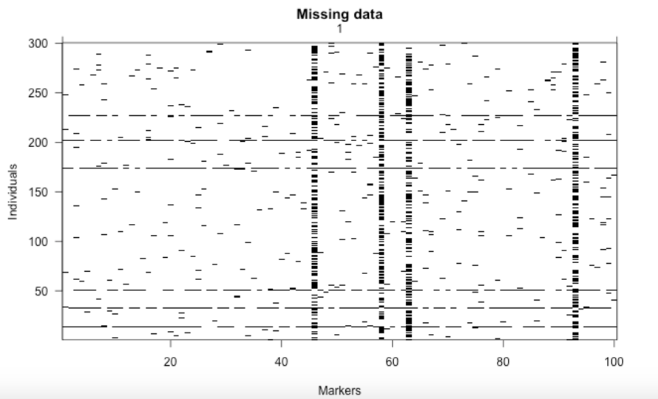
Omit individuals and markers with lots of missing data
plotMissing(mapthis, main="Missing data")

Slide 5
Omit individuals and markers with lots of missing data
par(mfrow=c(1,2), las=1)
plot(ntyped(mapthis), ylab="No. typed markers", main="No. genotypes by individual")
plot(ntyped(mapthis, "mar"), ylab="No. typed individuals",
main="No. genotypes by marker")

Slide 6
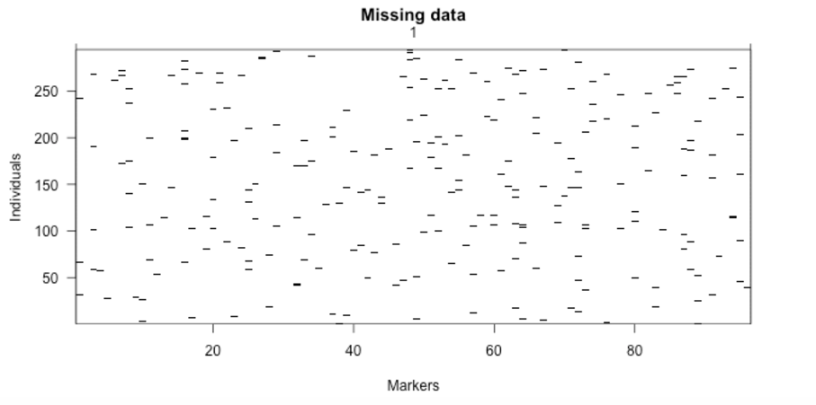
Drop individuals and markers with lots of missing data
mapthis <- subset(mapthis, ind=(ntyped(mapthis)>50))
nt.bymar <- ntyped(mapthis, "mar")
todrop <- names(nt.bymar[nt.bymar < 200])
mapthis <- drop.markers(mapthis, todrop)
plotMissing(mapthis, main="Missing data")

Slide 7
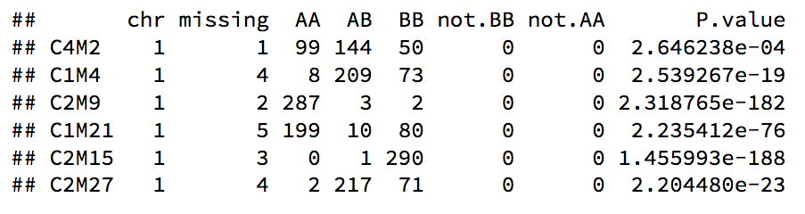
Look for markers with distorted segregation patterns
We expect the genotypes to appear with the frequencies 1:2:1. The function geno.table is used to inspect the segregation patterns.We will focus on those markers that show significant distortion at the 5% level, after a Bonferroni correction for the multiple tests.
gt <- geno.table(mapthis)
gt[gt$P.value < 0.05/totmar(mapthis),]
todrop <- rownames(gt[gt$P.value < 0.05/totmar(mapthis), ])
mapthis <- drop.markers(mapthis, todrop)

Slide 8
Study pairwise marker linkages; look for switched alleles
mapthis <- est.rf(mapthis)
## Warning in est.rf(mapthis): Alleles potentially switched at markers
## C3M16 C2M16 C1M2 C3M9 C2M14 C1M24 C1M1 C2M12 C1M36 C3M1 C2M25 C1M22

Slide 9
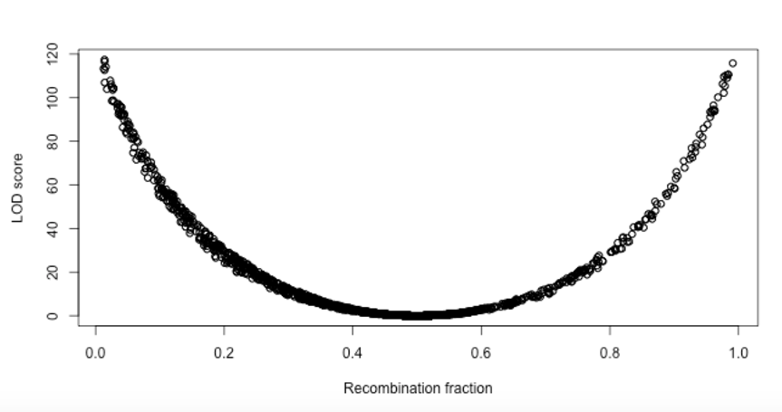
Plot of LOD scores versus estimated recombination fractions for all markers pairs
rf <- pull.rf(mapthis)
lod <- pull.rf(mapthis, what="lod")
plot(as.numeric(rf), as.numeric(lod), xlab="Recombination fraction", ylab="LOD score")

Slide 10
Look for switched alleles
One solution to this problem is to form initial linkage groups, ensuring that markers with rf > 1/2 are placed in different groups. If all goes well, each chromosome will come out as a pair of linkage groups: one containing markers with correct alleles and another containing markers with switched alleles.
mapthis <- formLinkageGroups(mapthis, max.rf=0.35, min.lod=6, reorgMarkers = T)

Slide 11
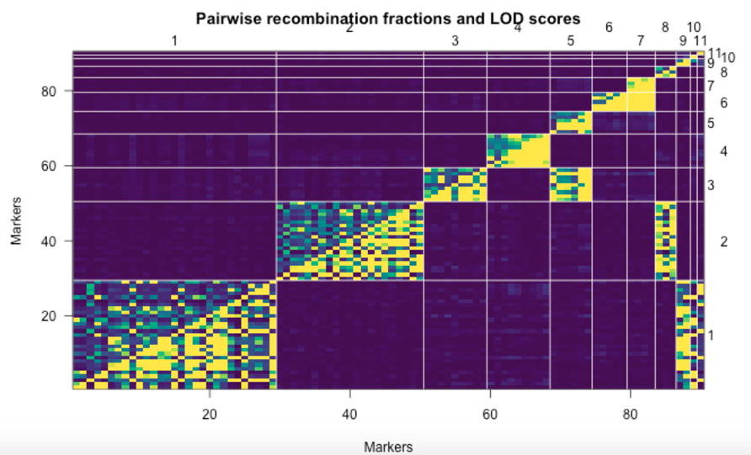
Plot of estimated recombinant fractions (Upper-left triangle) and LOD scores (lower-right triangle)
plotRF(mapthis, alternate.chrid=TRUE)

Slide 12
Switch alleles
toswitch <- markernames(mapthis, chr=c(5, 7:11))
mapthis <- switchAlleles(mapthis, toswitch)

Slide 13
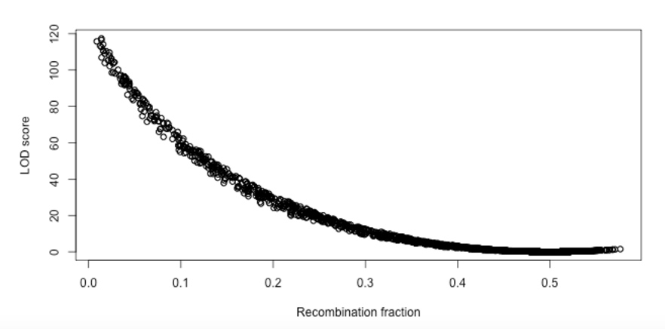
Revisit the plot of LOD scores versus recombinaion fractions
rf <- pull.rf(mapthis)
lod <- pull.rf(mapthis, what="lod")
plot(as.numeric(rf), as.numeric(lod), xlab="Recombination fraction", ylab="LOD score")

Slide 14
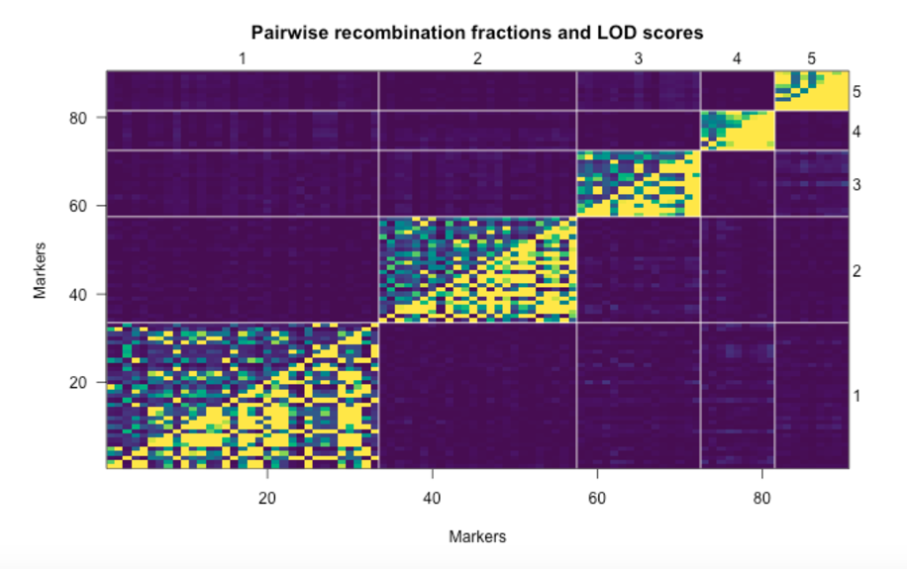
Form modifed linkage groups
mapthis <- formLinkageGroups(mapthis, max.rf=0.35, min.lod=6, reorgMarkers=TRUE)
plotRF(mapthis)

Slide 15
Order markers of each linkage group
mapthis <- orderMarkers(mapthis, use.ripple=TRUE, window = 7, chr=1)
mapthis <- orderMarkers(mapthis, use.ripple=TRUE, window = 7, chr=2)
mapthis <- orderMarkers(mapthis, use.ripple=TRUE, window = 7, chr=3)
mapthis <- orderMarkers(mapthis, use.ripple=TRUE, window = 7, chr=4)
mapthis <- orderMarkers(mapthis, use.ripple=TRUE, window = 7, chr=5)

Slide 16
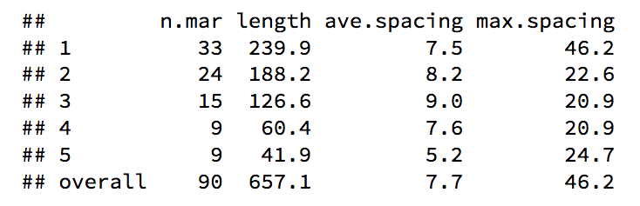
Summary
summaryMap(mapthis)

Slide 17
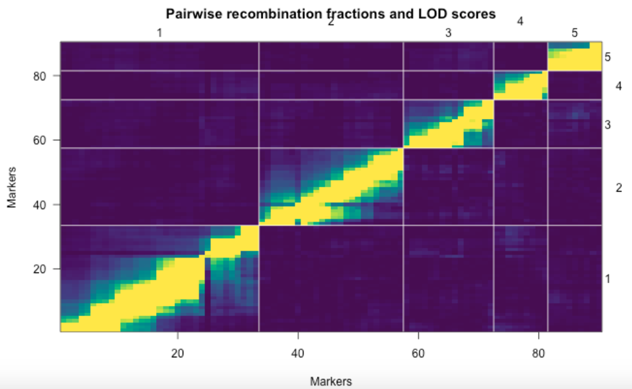
Plot of estimated recombinant fractions (Upper-left triangle) and LOD scores (lower-right triangle)
plotRF(mapthis, alternate.chrid=TRUE)

Slide 18
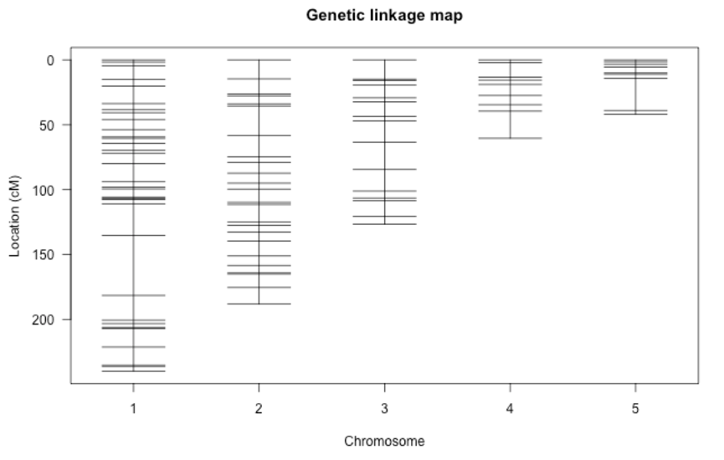
Plot genetic linkage map
plotMap(mapthis, main="Genetic linkage map")

